Slide 1
MATSATI.COM Teaching Ministry
Website: https://www.matsati.com YouTube Channel: https://www.youtube.com/user/MATSATI/
ישעיהו מה:א-ו / Isaiah 45:1-6
LIVE STREAM: 6:30 pm EST Thursday
New Telegram Channel: Messianic Ministries
https://t.me/MessianicMinistries
Focus: The Way of Life - Following Yeshua the Messiah with an emphasis on walking in His footsteps according to the Torah
A Community
for Learning
Discuss the Scriptures,
learn the languages,
and fellowship

Slide 2
Isaiah 45:1-6
ישעיהו מה:א-ו
The God of Israel is Able to Work through Anyone
and Any Circumstance
Isaiah / ישעיה
http://www.matsati.com

Slide 3
מבוא לישעיהו
Part 1
Isaiah / ישעיה
http://www.matsati.com

Slide 4
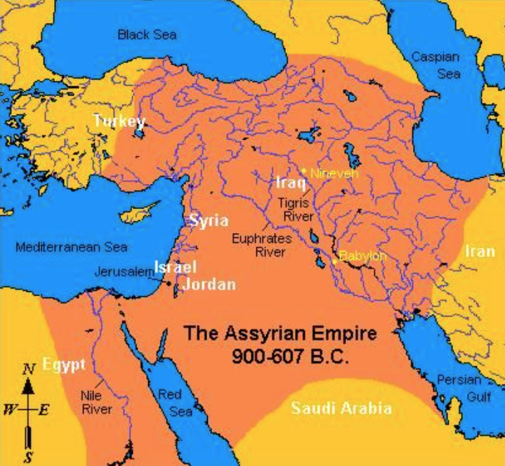
Cyrus's rule extended over a vast territory, including the regions of Persia, Media, Babylonia, Elam, and parts of Asia Minor, Egypt, and Central Asia.
Isaiah / ישעיה
http://www.matsati.com

Slide 5
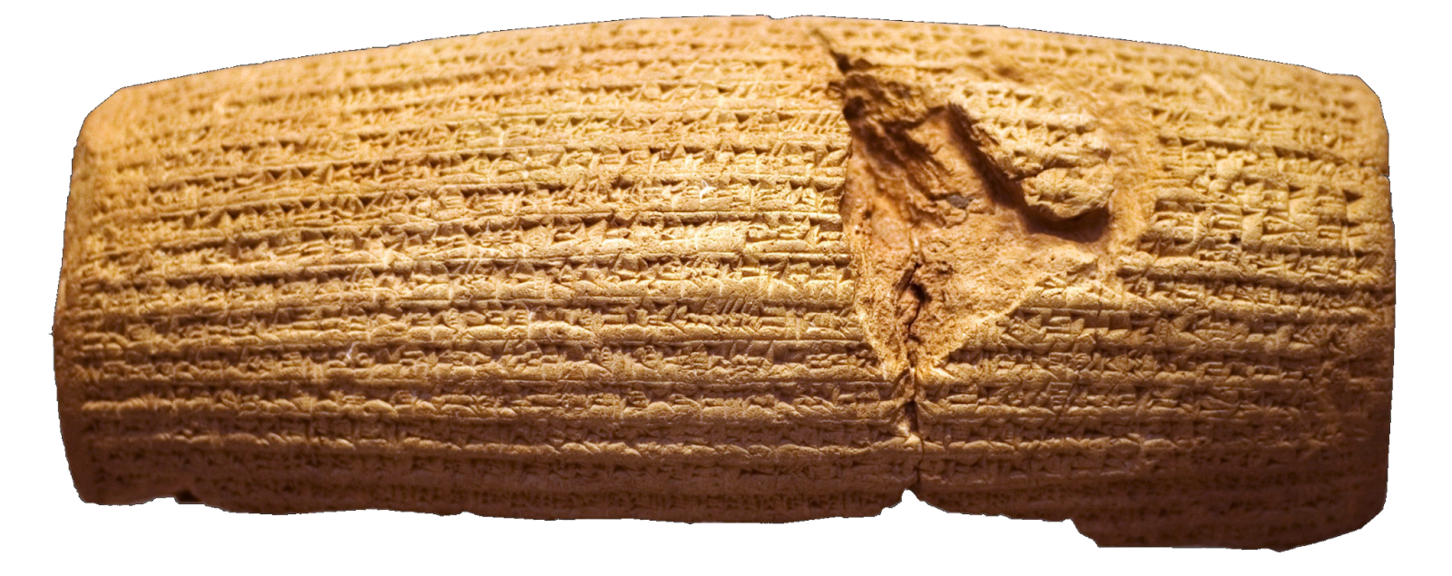
Cyrus Cylinder
Historical Evidence of Cyrus Conquering Babylon
Herodotus, "The Histories," Book 1: Herodotus, a Greek historian, provides an account of the events leading up to the conquest of Babylon by Cyrus the Great. He describes the Persian campaigns against the Medes and the capture of Babylon by the Persians.
Nabonidus Chronicle: This cuneiform tablet, also known as the Babylonian Chronicle, provides a contemporary account of the events surrounding the conquest of Babylon by Cyrus the Great. It records the capture of the city and the installation of Cyrus as the new ruler.
Cyrus Cylinder: This ancient artifact, discovered in 1879, contains an inscription by Cyrus the Great that describes his conquest of Babylon and his restoration of various temples and religious practices. It provides insight into Cyrus's motives and actions during this period.
Isaiah / ישעיה
http://www.matsati.com

Slide 6
ספר ישעיה
Part 2
Isaiah / ישעיה
http://www.matsati.com

Slide 7
﻿ספר ישעיה פרק מה
א כֹּה-אָמַר יְהֹוָה לִמְשִׁיחוֹ לְכוֹרֶשׁ אֲשֶׁר-הֶחֱזַקְתִּי בִימִינוֹ לְרַד-לְפָנָיו גּוֹיִם וּמָתְנֵי מְלָכִים אֲפַתֵּחַ לִפְתֹּחַ לְפָנָיו דְּלָתַיִם וּשְׁעָרִים לֹא יִסָּגֵרוּ: ב אֲנִי לְפָנֶיךָ אֵלֵךְ וַהֲדוּרִים אֲוַשֵּׁר [אֲיַשֵּׁר] דַּלְתוֹת נְחוּשָׁה אֲשַׁבֵּר וּבְרִיחֵי בַרְזֶל אֲגַדֵּעַ: ג וְנָתַתִּי לְךָ אוֹצְרוֹת חֹשֶׁךְ וּמַטְמֻנֵי מִסְתָּרִים לְמַעַן תֵּדַע כִּי אֲנִי יְהֹוָה הַקּוֹרֵא בְשִׁמְךָ אֱלֹהֵי יִשְֹרָאֵל: ד לְמַעַן עַבְדִּי יַעֲקֹב וְיִשְֹרָאֵל בְּחִירִי וָאֶקְרָא לְךָ בִּשְׁמֶךָ אֲכַנְּךָ וְלֹא יְדַעְתָּנִי: ה אֲנִי יְהֹוָה וְאֵין עוֹד זוּלָתִי אֵין אֱלֹהִים אֲאַזֶּרְךָ וְלֹא יְדַעְתָּנִי: ו לְמַעַן יֵדְעוּ מִמִּזְרַח-שֶׁמֶשׁ וּמִמַּעֲרָבָה כִּי-אֶפֶס בִּלְעָדָי אֲנִי יְהֹוָה וְאֵין עוֹד:
Isaiah / ישעיה
http://www.matsati.com

Slide 8
Matthew 12:18–21
12:18 Behold my servant, whom I have chosen; my beloved, in whom my soul is well pleased: I will put my spirit upon him, and he shall shew judgment to the Gentiles. 12:19 He shall not strive, nor cry; neither shall any man hear his voice in the streets. 12:20 A bruised reed shall he not break, and smoking flax shall he not quench, till he send forth judgment unto victory. 12:21 And in his name shall the Gentiles trust. (KJV ἰδοὺ ὁ παῖς μου ὃν ᾑρέτισα, ὁ ἀγαπητός μου εἰς ὃν εὐδόκησεν ἡ ψυχή μου θήσω τὸ πνεῦμά μου ἐπʼ αὐτόν, καὶ κρίσιν τοῖς ἔθνεσιν ἀπαγγελεῖ. οὐκ ἐρίσει οὐδὲ κραυγάσει, οὐδὲ ἀκούσει τις ἐν ταῖς πλατείαις τὴν φωνὴν αὐτοῦ. κάλαμον συντετριμμένον οὐ κατεάξει καὶ λίνον τυφόμενον οὐ σβέσει, ἕως ἂν ἐκβάλῃ εἰς νῖκος τὴν κρίσιν . καὶ τῷ ὀνόματι αὐτοῦ ἔθνη ἐλπιοῦσιν.)
Isaiah / ישעיה
http://www.matsati.com

Slide 9
ספר שמות פרק לג
א וַיְדַבֵּר יְהֹוָה אֶל-מֹשֶׁה לֵךְ עֲלֵה מִזֶּה אַתָּה וְהָעָם אֲשֶׁר הֶעֱלִיתָ מֵאֶרֶץ מִצְרָיִם אֶל-הָאָרֶץ אֲשֶׁר נִשְׁבַּעְתִּי לְאַבְרָהָם לְיִצְחָק וּלְיַעֲקֹב לֵאמֹר לְזַרְעֲךָ אֶתְּנֶנָּה: ב וְשָׁלַחְתִּי לְפָנֶיךָ מַלְאָךְ וְגֵרַשְׁתִּי אֶת-הַכְּנַעֲנִי הָאֱמֹרִי וְהַחִתִּי וְהַפְּרִזִּי הַחִוִּי וְהַיְבוּסִי:
Shemot / Exodus 33:1-2
33:1 And the LORD said unto Moses, Depart, and go up hence, thou and the people which thou hast brought up out of the land of Egypt, unto the land which I sware unto Abraham, to Isaac, and to Jacob, saying, Unto thy seed will I give it: 33:2 And I will send an angel before thee; and I will drive out the Canaanite, the Amorite, and the Hittite, and the Perizzite, the Hivite, and the Jebusite: (KJV)
Isaiah / ישעיה
http://www.matsati.com

Slide 10
Matthew 6:19–21
6:19 Lay not up for yourselves treasures upon earth, where moth and rust doth corrupt, and where thieves break through and steal: 6:20 But lay up for yourselves treasures in heaven, where neither moth nor rust doth corrupt, and where thieves do not break through nor steal: 6:21 For where your treasure is, there will your heart be also. (KJV Μὴ θησαυρίζετε ὑμῖν θησαυροὺς ἐπὶ τῆς γῆς, ὅπου σὴς καὶ βρῶσις ἀφανίζει καὶ ὅπου κλέπται διορύσσουσιν καὶ κλέπτουσιν· θησαυρίζετε δὲ ὑμῖν θησαυροὺς ἐν οὐρανῷ ὅπου οὔτε σὴς οὔτε βρῶσις ἀφανίζει καὶ ὅπου κλέπται οὐ διορύσσουσιν οὐδὲ κλέπτουσιν· ὅπου γάρ ἐστιν ὁ θησαυρός σου, ἐκεῖ ἔσται καὶ ἡ καρδία σου.)
Isaiah / ישעיה
http://www.matsati.com

Slide 11
Revelation 2:17
2:17 He that hath an ear, let him hear what the Spirit saith unto the churches; To him that overcometh will I give to eat of the hidden manna, and will give him a white stone, and in the stone a new name written, which no man knoweth saving he that receiveth it. (KJV Ὁ ἔχων οὖς ἀκουσάτω τί τὸ πνεῦμα λέγει ταῖς ἐκκλησίαις. Τῷ νικῶντι δώσω αὐτῷ τοῦ μάννα τοῦ κεκρυμμένου καὶ δώσω αὐτῷ ψῆφον λευκήν, καὶ ἐπὶ τὴν ψῆφον ὄνομα καινὸν γεγραμμένον ὃ οὐδεὶς οἶδεν εἰ μὴ ὁ λαμβάνων.)
Isaiah / ישעיה
http://www.matsati.com

Slide 12
ספר דברים פרק ו
ד שְׁמַע יִשְֹרָאֵל יְהוָֹה אֱלֹהֵינוּ יְהוָֹה | אֶחָד: ה וְאָהַבְתָּ אֵת יְהוָֹה אֱלֹהֶיךָ בְּכָל-לְבָבְךָ וּבְכָל-נַפְשְׁךָ וּבְכָל-מְאֹדֶךָ:
Devarim / Deuteronomy 6:4–5
6:4 Hear, O Israel: The LORD our God is one LORD: 6:5 And thou shalt love the LORD thy God with all thine heart, and with all thy soul, and with all thy might. (KJV)
Isaiah / ישעיה
http://www.matsati.com

Slide 13
Philippians 2:10–11
2:10 That at the name of Jesus every knee should bow, of things in heaven, and things in earth, and things under the earth; 2:11 And that every tongue should confess that Jesus Christ is Lord, to the glory of God the Father. (KJV ἵνα ἐν τῷ ὀνόματι Ἰησοῦ πᾶν γόνυ κάμψῃ ἐπουρανίων καὶ ἐπιγείων καὶ καταχθονίων καὶ πᾶσα γλῶσσα ἐξομολογήσηται ὅτι κύριος Ἰησοῦς Χριστὸς εἰς δόξαν θεοῦ πατρός.)
Isaiah / ישעיה
http://www.matsati.com

Slide 14
Rabbinic Literature
ספרות רבנית
Part 3
Isaiah / ישעיה
http://www.matsati.com

Slide 15
Targum Jonathan son of Uziel Isaiah 45:1-6
45:1 Thus saith the Lord to His anointed, to Cyrus, whom I hold firm by his right hand, to deliver the nations unto him; and I will loose the loins of the kings, to open the doors before him, and the gates shall not be shut. 45:2 My WORD shall go before thee, I will have a way in the plains; I will break in pieces the doors of brass, and cut in sunder the bars of iron. 45:3 And I will give thee the treasures of darkness, and hidden treasures, that thou mayest know, that I, the Lord, who called thee by thy name, am the God of Israel. 45:4 For Jacob my servant’s sake, and Israel my elect, yea, I have called thee by thy name; I have guided thee, though thou hast not known that thou shouldest fear me. 45:5 I am the Lord, and none else; there is no God beside me: I have supported thee, though thou hast not known that thou shouldest fear me: 45:6 That they may know from the rising of the sun, and from the west; I am the Lord, and there is none else: (TgJ)
Isaiah / ישעיה
http://www.matsati.com

Slide 16
ספר ישעיהו פרק מה ﻿א כֹּה-אָמַר יְהֹוָה לִמְשִׁיחוֹ לְכוֹרֶשׁ אֲשֶׁר-הֶחֱזַקְתִּי בִימִינוֹ לְרַד-לְפָנָיו גּוֹיִם וּמָתְנֵי מְלָכִים אֲפַתֵּחַ לִפְתֹּחַ לְפָנָיו דְּלָתַיִם וּשְׁעָרִים לֹא יִסָּגֵרוּ: | לוגוס א כִדנָן אְמַר יוי לִמשִיחֵיה לְכֹורַש דְאַתקֵיפִית בְיַמִינֵיה לְמִמסַר קֳדָמֹוהִי עַמְמִין וְחַרצֵי מַלכְוַן אְשָרֵי לְפַתָחָא קֳדָמֹוהִי דַשִין וְתַרעִין לָא יִתאַחְדוּן׃ | ספריה א כִּדְנַן אֲמַר יְיָ לִמְשִׁיחֵהּ לְכוֹרֶשׁ דְאַתְקְפֵית בִּימִינֵהּ לְמִמְסַר קֳדְמוֹהִי עַמְמִין וְחַרְצֵי מַלְכִין אַשְׁרֵי לְפַּתָּחָא קֳדָמוֹהִי דָשִׁין וְתַרְעִין לָא יִתְאַחָדוּן:
Isaiah / ישעיה
http://www.matsati.com

Slide 17
Talmud Bavli Megillah 12a:5
דָּרַשׁ רַב נַחְמָן בַּר רַב חִסְדָּא, מַאי דִּכְתִיב: ״כֹּה אָמַר ה׳ לִמְשִׁיחוֹ לְכוֹרֶשׁ אֲשֶׁר הֶחֱזַקְתִּי בִימִינוֹ״, וְכִי כּוֹרֶשׁ מָשִׁיחַ הָיָה? אֶלָּא אָמַר לֵיהּ הַקָּדוֹשׁ בָּרוּךְ הוּא לְמָשִׁיחַ: קוֹבֵל אֲנִי לְךָ עַל כּוֹרֶשׁ. אֲנִי אָמַרְתִּי: הוּא יִבְנֶה בֵּיתִי וִיקַבֵּץ גָּלִיּוֹתַי, וְהוּא אָמַר: ״מִי בָכֶם מִכׇּל עַמּוֹ וְיַעַל״.
Apropos its mention of Cyrus, the Gemara states that Rav Naḥman bar Rav Ḥisda interpreted homiletically a verse concerning Cyrus: What is the meaning of that which is written: “Thus says the Lord to His anointed, to Cyrus, whose right hand I have held” (Isaiah 45:1), which seemingly is referring to Cyrus as God’s anointed? Now was Cyrus God’s anointed one, i.e., the Messiah, that the verse should refer to him in this manner? Rather, the verse should be understood as God speaking to the Messiah with regard to Cyrus: The Holy One, Blessed be He, said to the Messiah: I am complaining to you about Cyrus, who is not acting in accordance with what he is intended to do. I had said: “He shall build My House and gather My exiles” (see Isaiah 45:13), but he did not carry this out. Rather, he said: “Whoever is among you of all His people…let him go up to Jerusalem” (Ezra 1:3). He gave permission to return to Israel, but he did no more than that.
Isaiah / ישעיה
http://www.matsati.com

Slide 18
ספר ישעיהו פרק מה ﻿ב אֲנִי לְפָנֶיךָ אֵלֵךְ וַהֲדוּרִים אֲוַשֵּׁר [אֲיַשֵּׁר] דַּלְתוֹת נְחוּשָׁה אֲשַׁבֵּר וּבְרִיחֵי בַרְזֶל אֲגַדֵּעַ: ג וְנָתַתִּי לְךָ אוֹצְרוֹת חֹשֶׁךְ וּמַטְמֻנֵי מִסְתָּרִים לְמַעַן תֵּדַע כִּי אֲנִי יְהֹוָה הַקּוֹרֵא בְשִׁמְךָ אֱלֹהֵי יִשְֹרָאֵל: ד לְמַעַן עַבְדִּי יַעֲקֹב וְיִשְֹרָאֵל בְּחִירִי וָאֶקְרָא לְךָ בִּשְׁמֶךָ אֲכַנְּךָ וְלֹא יְדַעְתָּנִי: ה אֲנִי יְהֹוָה וְאֵין עוֹד זוּלָתִי אֵין אֱלֹהִים אֲאַזֶּרְךָ וְלֹא יְדַעְתָּנִי: | לוגוס ב מֵימְרִי קֳדָמָך יְהָך וְשוּרַיָא אְכַבֵיש דַשִין דִנחָש אְתַבַר וְעָבְרִין דְבַרזַל אְקַצֵיץ׃ ג וְאַתֵין לָך אֹוצְרִין דַחְשֹוך וְסִימָן דְמִיטַמרָן בְדִיל דְתִידַע אְרֵי אְנָא יוי דְרַבִיתָך בִשמָך אְלָהָא דְיִשׂרָאֵל׃ ד בְדִיל עַבדִי יַעְקֹב וְיִשׂרָאֵל בְחִירִי וּקרֵית לָך בִשמָך אַתקֵינתָך וְלָא יְדַעתָא לְמִפלַח קֳדָמַי׃ ה אְנָא יוי וְלֵית עֹוד בָר מִנִי לֵית אְלָה סְעַדתָך וְלָא יְדַעתָא לְמִפלַח קֳדָמַי׃ | ספריה ב מֵימְרִי קֳדָמָךְ יְהָךְ וְשׁוּרַיָא אֲכַבֵּשׁ דָשִׁין דִנְחָשׁ אֱתַּבֵר וְעַבְרִין דְבַרְזֶל אֲקַצֵץ: ג וְאֶתֵּן לָךְ אוֹצְרִין דַחֲשׁוֹךְ וְסִימָן דְמִטַמְרָן בְּדִיל דְתֵידַע אֲרֵי אֲנָא יְיָ דְרַבֵּיתִי בִשְׁמָךְ אֱלָהָא דְיִשְׂרָאֵל: ד בְּדִיל עַבְדִי יַעֲקֹב וְיִשְׂרָאֵל בְּחִירִי וּקְרֵית לָךְ בִּשְׁמָךְ אַתְקֵינְתָּךְ וְלָא יְדַעְתָּא לְמִדְחַל קֳדָמַי: ה אֲנָא יְיָ וְלֵית עוֹד וּבַר מִנִי לֵית אֱלָהָא סְעַדְתִּיךְ וְלָא יָדַעְתָּא לְמִדְחַל קֳדָמַי:
Isaiah / ישעיה
http://www.matsati.com

Slide 19
Man and God, Chapter 1 the Knowledge of God 130
The peoples, with their idols, are in search of Elohim to save them. Y, they imagine, is too mighty and aloof to be concerned with them. They want little gods to serve their little needs and interests. But their El cannot save, for Y alone is the Elohim and there is none else beside him. Y is the only El and Savior. The time will come when all men will realize it and will seek their strength and salvation in Y alone. *Isa. 45:4–7.
Isaiah 46:4
46:4 Even to your old age I will be the same, And even to your graying years I will bear you! I have done it, and I will carry you; And I will bear you and I will deliver you. (NASB, וְעַד־זִקְנָה֙ אֲנִ֣י ה֔וּא וְעַד־שֵיבָ֖ה אֲנִ֣י אֶסְבֹּ֑ל אֲנִ֤י עָשִׂ֙יתִי֙ וַאֲנִ֣י אֶשָּׂ֔א וַאֲנִ֥י אֶסְבֹּ֖ל וַאֲמַלֵּֽט׃)
Isaiah / ישעיה
http://www.matsati.com

Slide 20
Isaiah 49:15
49:15 “Can a woman forget her nursing child And have no compassion on the son of her womb? Even these may forget, but I will not forget you. (NASB, הֲתִשְׁכַּ֤ח אִשָּׁה֙ עוּלָ֔הּ מֵרַחֵ֖ם בֶּן־בִּטְנָ֑הּ גַּם־אֵ֣לֶּה תִשְׁכַּ֔חְנָה וְאָנֹכִ֖י לֹ֥א אֶשְׁכָּחֵֽךְ׃)
ספר ישעיהו פרק מה ﻿ו לְמַעַן יֵדְעוּ מִמִּזְרַח-שֶׁמֶשׁ וּמִמַּעֲרָבָה כִּי-אֶפֶס בִּלְעָדָי אֲנִי יְהֹוָה וְאֵין עוֹד: | לוגוס ו בְדִיל דְיִדעוּן מִמַדנַח שִמשָא וּמִמַערְבֵיה אְרֵי לֵית בָר מִנִי אְנָא יוי וְלֵית עֹוד׃ | ספריה ו בְּדִיל דְיֵדְעוּן מִמַדְנַח שִׁמְשָׁא וּמִמַעַרְבָא אֲרֵי לֵית בַּר מִנִי אֲנָא יְיָ וְלֵית עוֹד:
Isaiah / ישעיה
http://www.matsati.com

Slide 21
Tanya, Part I; Likkutei Amarim 35:5
וְהִנֵּה, עִנְיַן הַשְׁרָאַת הַשְּׁכִינָה, הוּא גִּילּוּי אֱלֹהוּתוֹ יִתְבָּרֵךְ וְאוֹר אֵין־סוֹף בָּרוּךְ־הוּא בְּאֵיזֶה דָבָר, וְהַיְינוּ לוֹמַר, שֶׁאוֹתוֹ דָבָר נִכְלָל בְּאוֹר ה׳ וּבָטֵל לוֹ בִּמְצִיאוּת לְגַמְרֵי, שֶׁאָז הוּא שֶׁשּׁוֹרֶה וּמִתְגַּלֶּה בּוֹ ה׳ אֶחָד. אֲבָל כָּל מַה שֶּׁלֹּא בָטֵל אֵלָיו בִּמְצִיאוּת לְגַמְרֵי – אֵין אוֹר ה׳ שׁוֹרֶה וּמִתְגַּלֶּה בּוֹ. וְאַף צַדִּיק גָּמוּר שֶׁמִּתְדַּבֵּק בּוֹ בְּאַהֲבָה רַבָּה, הֲרֵי ״לֵית מַחֲשָׁבָה תְּפִיסָא בֵיהּ״ כְּלָל בֶּאֱמֶת, כִּי אֲמִיתַּת ״ה׳ אֱלֹהִים אֱמֶת״ – הוּא יִחוּדוֹ וְאַחְדוּתוֹ, שֶׁהוּא לְבַדּוֹ הוּא וְאֶפֶס בִּלְעָדוֹ מַמָּשׁ.
Now, the meaning of the “indwelling” of the Shechinah is the revelation of His G–dliness, blessed be He, and of the light of the En Sof, blessed is He, in any thing. That is to say that such thing merges into the light of G–d, and its reality is completely dissolved in Him; only then does the One G–d abide and manifest Himself in it. But any thing whose reality is not completely nullified in Him, the light of G–d does not abide nor manifest itself therein, even if one be a perfect tzaddik who cleaves to Him with abundant love, * Above, ch. 9. since no thought can truly apprehend Him at all. For the truth of “The L–rd is the true G–d” * Jeremiah 10:10. is His Unity and Oneness—that He is One Alone and there is no reality whatsoever apart from Him. * Isaiah 45:6.
Isaiah / ישעיה
http://www.matsati.com

