Slide 1
MATSATI.COM Teaching Ministry
Website: https://www.matsati.com YouTube Channel: https://www.youtube.com/user/MATSATI/
ישעיהו מד:ח-יד / Isaiah 44:8-14
LIVE STREAM: 6:30 pm EST Thursday
New Telegram Channel: Messianic Ministries
https://t.me/MessianicMinistries
Focus: The Way of Life - Following Yeshua the Messiah with an emphasis on walking in His footsteps according to the Torah
A Community
for Learning
Discuss the Scriptures,
learn the languages,
and fellowship

Slide 2
Isaiah 44:8-14
ישעיהו מד:ח-יד
God Reveals His Plan to Send the Servant Messiah
to Be a Witness to Israel and the Nations
Isaiah / ישעיה
http://www.matsati.com

Slide 3
מבוא לישעיהו
Part 1
Isaiah / ישעיה
http://www.matsati.com

Slide 4
Summary of Isaiah 42-44 (Major Points)
The introduction of the Servant King Messiah (Isaiah 42:1-4), and how God challenges the idol gods to predict the future (Isaiah 42:5-9) and the Lord God will lead the people out of captivity. (Isaiah 42:10-17)
The Lord God is Creator and Redeemer, and calls His people by name and makes them His own (Isaiah 43:1-7).
The Lord God is Savior (Isaiah 43:8-13) and will deliver His people similar to the way He did in Egypt (Isaiah 43:14-17).
Israel will be living witnesses for God’s power (Isaiah 43:10, 44:8)
The Lord God reaffirms His life and choosing of His people and promises to pour out His Spirit on His people (Isaiah 44:1-5).
God challenges anyone to prove His words false (Isaiah 44:6-8).
The Lord God reassures His people that He has swept away their sins and redeemed them (Isaiah 44:21-23).
His anointed one will subdue Babylon and set His people free (Isaiah 44:24-28).
Isaiah / ישעיה
http://www.matsati.com

Slide 5
ספר ירמיה פרק כט
יא כִּי אָנֹכִי יָדַעְתִּי אֶת-הַמַּחֲשָׁבֹת אֲשֶׁר אָנֹכִי חשֵׁב עֲלֵיכֶם נְאֻם-יְהֹוָה מַחְשְׁבוֹת שָׁלוֹם וְלֹא לְרָעָה לָתֵת לָכֶם אַחֲרִית וְתִקְוָה: יב וּקְרָאתֶם אֹתִי וַהֲלַכְתֶּם וְהִתְפַּלַּלְתֶּם אֵלָי וְשָׁמַעְתִּי אֲלֵיכֶם: יג וּבִקַּשְׁתֶּם אֹתִי וּמְצָאתֶם כִּי תִדְרְשֻׁנִי בְּכָל-לְבַבְכֶם: יד וְנִמְצֵאתִי לָכֶם נְאֻם-יְהֹוָה וְשַׁבְתִּי אֶת-שְׁביּתְכֶם [שְׁבוּתְכֶם] וְקִבַּצְתִּי אֶתְכֶם מִכָּל-הַגּוֹיִם וּמִכָּל-הַמְּקוֹמוֹת אֲשֶׁר הִדַּחְתִּי אֶתְכֶם שָׁם נְאֻם-יְהֹוָה וַהֲשִׁבֹתִי אֶתְכֶם אֶל-הַמָּקוֹם אֲשֶׁר-הִגְלֵיתִי אֶתְכֶם מִשָּׁם:
Isaiah / ישעיה
http://www.matsati.com

Slide 6
Talmud Bavli Sanhedrin 98a:11
ואמר רבי יוחנן אין בן דוד בא אלא בדור שכולו זכאי או כולו חייב בדור שכולו זכאי דכתיב (ישעיהו ס, כא) ועמך כולם צדיקים לעולם יירשו ארץ בדור שכולו חייב דכתיב (ישעיהו נט, טז) וירא כי אין איש וישתומם כי אין מפגיע וכתיב (ישעיהו מח, יא) למעני אעשה
And Rabbi Yoḥanan says: The son of David will come only in a generation that is entirely innocent, in which case they will be deserving of redemption, or in a generation that is entirely guilty, in which case there will be no alternative to redemption. He may come in a generation that is entirely innocent, as it is written: “And your people also shall be all righteous; they shall inherit the land forever” (Isaiah 60:21). He may come in a generation that is entirely guilty, as it is written: “And He saw that there was no man, and was astonished that there was no intercessor; therefore His arm brought salvation to Him, and His righteousness, it sustained Him” (Isaiah 59:16). And it is written: “For My own sake, for My own sake will I do it; for how should it be profaned? And My glory I will not give it to another” (Isaiah 48:11).
Isaiah / ישעיה
http://www.matsati.com

Slide 7
ספר ישעיה
Part 2
Isaiah / ישעיה
http://www.matsati.com

Slide 8
﻿ספר ישעיה פרק מד
﻿ח אַל-תִּפְחֲדוּ וְאַל-תִּרְהוּ הֲלֹא מֵאָז הִשְׁמַעְתִּיךָ וְהִגַּדְתִּי וְאַתֶּם עֵדָי הֲיֵשׁ אֱלוֹהַּ מִבַּלְעָדַי וְאֵין צוּר בַּל-יָדָעְתִּי: ט יֹצְרֵי-פֶסֶל כֻּלָּם תֹּהוּ וַחֲמוּדֵיהֶם בַּל-יוֹעִילוּ וְעֵדֵיהֶם הֵמָּה בַּל-יִרְאוּ וּבַל-יֵדְעוּ לְמַעַן יֵבֹשׁוּ: י מִי-יָצַר אֵל וּפֶסֶל נָסָךְ לְבִלְתִּי הוֹעִיל: יא הֵן כָּל-חֲבֵרָיו יֵבֹשׁוּ וְחָרָשִׁים הֵמָּה מֵאָדָם יִתְקַבְּצוּ כֻלָּם יַעֲמֹדוּ יִפְחֲדוּ יֵבֹשׁוּ יָחַד: יב חָרַשׁ בַּרְזֶל מַעֲצָד וּפָעַל בַּפֶּחָם וּבַמַּקָּבוֹת יִצְּרֵהוּ וַיִּפְעָלֵהוּ בִּזְרוֹעַ כֹּחוֹ גַּם-רָעֵב ואֵין כֹּחַ לֹא-שָׁתָה מַיִם וַיִּיעָף: יג חָרַשׁ עֵצִים נָטָה קָו יְתָאֲרֵהוּ בַשֶּׂרֶד יַעֲשֵֹהוּ בַּמַּקְצֻעוֹת וּבַמְּחוּגָה יְתָאֳרֵהוּ וַיַּעֲשֵֹהוּ כְּתַבְנִית אִישׁ כְּתִפְאֶרֶת אָדָם לָשֶׁבֶת בָּיִת: יד לִכְרָת-לוֹ אֲרָזִים וַיִּקַּח תִּרְזָה וְאַלּוֹן וַיְאַמֶּץ-לוֹ בַּעֲצֵי-יָעַר נָטַע אֹרֶן וְגֶשֶׁם יְגַדֵּל:
Isaiah / ישעיה
http://www.matsati.com

Slide 9
Revelation 22:11
22:11 Let the evildoer still do evil, and the filthy still be filthy, and the righteous still do right, and the holy still be holy.” (ESV, 11 ὁ ἀδικῶν ἀδικησάτω ἔτι ⸋καὶ ὁ ῥυπαρὸς ⸀ῥυπανθήτω ἔτι⸌,* καὶ ὁ δίκαιος δικαιοσύνην ποιησάτω ἔτι καὶ ὁ ἅγιος ἁγιασθήτω ἔτι.*)
Isaiah / ישעיה
http://www.matsati.com

Slide 10
חָרַשׁ בַּרְזֶל מַעֲצָד וּפָעַל בַּפֶּחָם וּבַמַּקָּבוֹת יִצְּרֵהוּ וַיִּפְעָלֵהוּ בִּזְרוֹעַ כֹּחוֹ גַּם-רָעֵב ואֵין כֹּחַ לֹא-שָׁתָה מַיִם וַיִּיעָף
מַקָּבָה (makavah) = "hammer"
יִצְּרֵהוּ (yitz'rehu) = "he shapes it" or "he forms it"
וַיִּפְעָלֵהוּ (va-yif'alehu) = "and he works it" or "and he makes it"
זְרוֹעַ (zro'a) = "arm, strength, or power"
כֹּחוֹ (kocho) = "his strength" or "his might"
כֹּחַ (koach) means "strength, might, or power"
לֹא-שָׁתָה (lo shatah) = "does not drink"
וַיִּיעָף (va-yi'af) = "and he is faint" or "and he grows weary"
Isaiah / ישעיה
http://www.matsati.com

Slide 11
Rabbinic Literature
ספרות רבנית
Part 3
Isaiah / ישעיה
http://www.matsati.com

Slide 12
Targum Jonathan son of Uziel Isaiah 44:8-14
44:8 Fear ye not, neither be afraid: have not I told thee from that time, and have declared it? ye also are my witnesses, that there is no God beside me, and there is none strong, except he to whom strength is given from me. 44:9 They that make images are all of them vanity, and worship what does not profit them; and they are witnesses against themselves, that they do not see, nor know, that they may be ashamed. 44:10 Whoever maketh a god or a molten image, it is for no purpose. 44:11 Behold, all their worshippers shall be ashamed, and the working artificers are workmen of the sons of men; let them all be gathered together, let them stand up; they shall fear and be confounded together. 44:12 The smith maketh an axe out of iron, and bloweth the coals in the fire, and maketh it firm with the hammer, and worketh it with the power of his strength; but when he that worketh it is hungry, and does not eat bread, he hath no strength; and if he is thirsty, and drinketh no water, he fainteth. 44:13 The carpenter stretcheth out the line, he applieth the plummet to it; he carveth it with a knife, and he dove-taileth it together, and he maketh it after the likeness of a man, according to the beauty of a woman, that it may remain in the house. 44:14 He heweth for himself cedars and taketh the scarlet oak, and the chestnut, and seasons them. He plants the ash amongst the trees of the forest, and the rain nourisheth it. (TgJ)
Isaiah / ישעיה
http://www.matsati.com

Slide 13
ספריה
ח לָא תִדַחֲלוּן וְלָא תִתַּבְּרוּן הֲלָא מִבְּכֵן בְסַרְתָּךְ וְחַוֵיתִי וְאַתּוּן סָהֲדִין קֳדָמַי הֲאִית אֱלָהָא בַּר מִנִי וְלֵית דְתַקִיף אֱלָהֵן דְמִן קֳדָמַי מִתְיְהַב לֵיהּ תְּקוֹף:
Isaiah / ישעיה
http://www.matsati.com

Slide 14
Rashi on Isaiah 44:8 Parts 1-5
ואל תרהו. אין לו דמיון ופתרונו לפי הענין כמו אל תחתו מלהודיע את שמי לבין העכו"ם:
and be not dismayed Heb. תִּרְהוּ. There is no similar word, and its interpretation according to its context is like תֵּחַתּוּ, be not dismayed from making My name known among the heathens (nations [K’li Paz and mss.]).
הלא מאז השמעתיך. מהר סיני והגדתי לכם שם שאין אלוהי מבלעדי:
let you hear from Mount Sinai, and I told you there that there is no God besides Me.
ואתם עדי. שפתחתי לכם שבעה רקיעים והראיתי אתכם שאין אחר ואתם עדי בדבר הזה שאין אלוה מבלעדי:
and you are My witnesses that I opened for you seven heavens and showed you that there is no other, and you are My witnesses to this thing that there is no God besides Me.
ואין צור בל ידעתי. ת"י ולית דתקיף אלהן דמן קדמי מתיהב ליה תקיף:
and there is no rock I did not know Jonathan renders: And there is no strong one unless he is given strength by Me.
בל ידעתי. לשון ואדעך בשם (שמות ל״ג:י״ז) ידע לכתך (דברים ב׳:ז׳) אני ידעתיך במדבר (הושע י״ג:ה׳):
I did not know Heb. יָדַעְתִּי. An expression similar to (Exodus 33:17) “And I knew you by name (וָאֵדָעֲךָ)”; ( Deut. 2:7) “He knew (יָדַע) your going”; (Hosea 13:5) “I knew you (יְדַעְתִּיךָ) in the desert.”
Isaiah / ישעיה
http://www.matsati.com

Slide 15
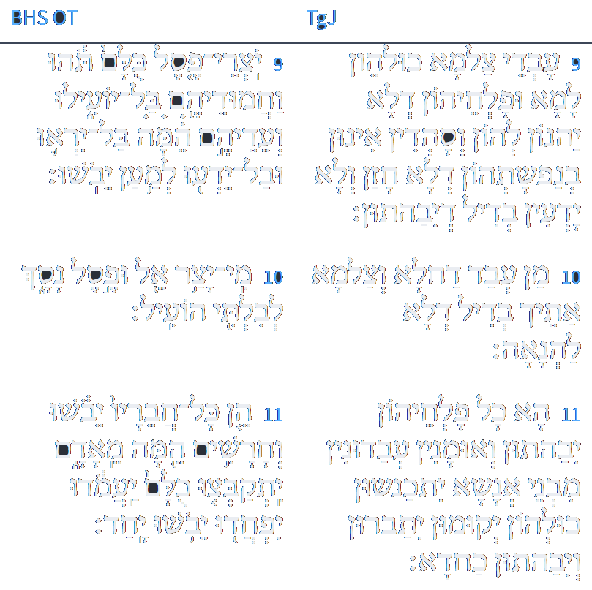
ספריה
ט עַבְדֵי צַלְמַיָא כּוּלְהוֹן לְמָא וּפָלְחֵיהוֹן דְלָא יַהֲנוּן לְהוֹן וְסָהֲדִין אִינוּן בְּנַפְשָׁתֵיהוֹן דְלָא חָזָן וְלָא יָדְעִין בְּדִין דְיִבַּהֲתוּן: י מַן עֲבַד דַחֲלָא וְצַלְמָא אַתִיךְ בְּדִיל דְלָא לַהֲנָאָה: יא הָא כָּל פָּלְחֵיהוֹן יִבָּהֲתוּן וְאוּמָנִין עוּבְדָנִין מִבְּנֵי אֱנָשָׁא יִתְכַּנְסוּן כּוּלְהוֹן יְקוּמוּן יִתַּבְּרוּן יִבַהֲתוּן כַּחֲדָא:
Isaiah / ישעיה
http://www.matsati.com

Slide 16
ספר שמות פרק כ
א וַיְדַבֵּר אֱלֹהִים אֵת כָּל-הַדְּבָרִים הָאֵלֶּה לֵאמֹר: ס ב אָנֹכִי יְהוָֹה אֱלֹהֶיךָ אֲשֶׁר הוֹצֵאתִיךָ מֵאֶרֶץ מִצְרַיִם מִבֵּית עֲבָדִים: ג לֹא-יִהְיֶה לְךָ אֱלֹהִים אֲחֵרִים עַל-פָּנָי: ד לֹא-תַעֲשֶֹה לְךָ פֶסֶל וְכָל-תְּמוּנָה אֲשֶׁר בַּשָּׁמַיִם מִמַּעַל וַאֲשֶׁר בָּאָרֶץ מִתָּחַת וַאֲשֶׁר בַּמַּיִם מִתַּחַת לָאָרֶץ: ה לֹא-תִשְׁתַּחֲוֶה לָהֶם וְלֹא תָעָבְדֵם כִּי אָנֹכִי יְהוָֹה אֱלֹהֶיךָ אֵל קַנָּא פֹּקֵד עֲוֹן אָבֹת עַל-בָּנִים עַל-שִׁלֵּשִׁים וְעַל-רִבֵּעִים לְשֹֹנְאָי:
Isaiah / ישעיה
http://www.matsati.com

Slide 17
Midrash Bereshit Rabbah 24:7
Rabbi Tanḥuma in the name of Rabbi Elazar, and Rabbi Menaḥem in the name of Rav said: Adam the first man learned all the crafts [in the world]. What is the source? “And craftsmen, they are me’adam” (Isaiah 44:11) – from Adam the first man. He learned even how to score a parchment, as it is stated: “This is the book” – it and its scoring.
“[This is the book of the descendants of Adam,] on the day that God created man” – this supports what Rabbi Elazar ben Azarya said: Three miracles occurred on that day: On that day they [Adam and Eve] were created, on that day they cohabited, and on that day they produced offspring.
Ben Azzai says: “This is the book of the descendants of Adam” – this verse represents the central tenet of the Torah. Rabbi Akiva says: “You shall love your neighbor as yourself” (Leviticus 19:18) – that verse represents the central tenet of the Torah, [as it teaches] that you should not say: Since I have been disparaged, let someone else be disparaged along with me; since I was cursed, let someone else be cursed along with me. Rabbi Tanḥuma said: If you do act like that, know who it is that you are disgracing: “in the likeness of God He made him” (Genesis 5:1).
Isaiah / ישעיה
http://www.matsati.com

Slide 18
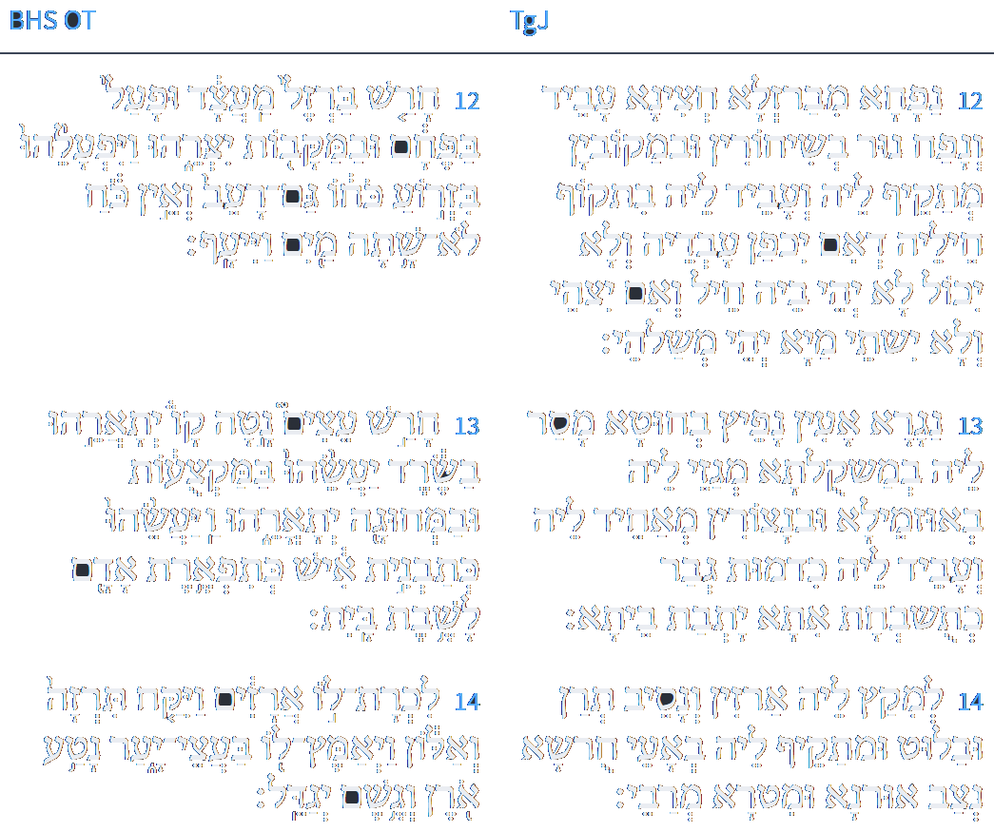
ספריה
יב נַפְחָא מִבַּרְזְלָא חֲצִינָא עָבֵיד וּנְפַח נוּר בְּשִׁיחוּרִין וּבְמַקוּבִין מַתְקֵיף לֵיהּ וְעָבִיד לֵיהּ בִּתְקוֹף חֵילֵהּ דְאִם יִכְפַּן עַבְדֵהּ וְלָא יֵיכוּל לָא יְהֵי בֵיהּ חֵיל וְאִם יִצְחֵי וְלָא יִשְׁתֵּי מַיָא יְהֵי מְשַׁלְהֵי: יג נַגָר אָעִין נָפֵיץ בְּחוּטָא מְסַר לֵיהּ בְּמַשְׁקוּלְתָּא מְגַזֵי לֵיהּ בְּאִזְמֵילַיָא וּבִנְצוּרִין מְאַחֵיד לֵיהּ וְעָבֵיד לֵיהּ כִּדְמוּת גְבַר כְּתוּשְׁבְּחַת אִתְּתָא לְמִיתַּב בְּבֵיתָא: יד לְמִקַץ לֵיהּ אַרְזִין וּנְסִיב תְּרֵז וּבְלוּט וּמַתְקֵיף לֵיהּ בַּאֲעֵי חוּרְשָׁא נְצַב אוּרְנָא וּמִטְרָא יְרַבֵּי:
Isaiah / ישעיה
http://www.matsati.com

Slide 19
Shenei Luchot HaBerit, Torah Shebikhtav, Bereshit, Torah Ohr 118
We had raised the question in the introduction to Parshat Bereshit, why the Talmud in Chagigah 2 did not quote the commandment of פרו ורבו in Genesis when it wanted to tell us about the severity of neglecting to fulfill the commandment of procreation, and chose the line from Isaiah about G–d not having created the universe in order for it to remain תהו, in an elementary state. We can now understand this when we consider that the message the Talmud wanted to convey was that someone who fails to heed that commandment is as if he arrested the whole process of creation and its purpose by allowing the universe to remain static, in the state of Tohu, its very beginning.
Isaiah / ישעיה
http://www.matsati.com

Slide 20
Rabbinic Sources that Support this Interpretation
In Midrash Rabbah on Bereshit / Genesis 1:1, the rabbis state that God created the world for the sake of Israel and the Torah, and that He consulted with the Torah before creating the world. This implies that God had a plan and a purpose for creation, and that the Torah is the blueprint and the guide for that plan and purpose.
In Midrash Rabbah on Bereshit / Genesis 1:28, the rabbis say that God blessed Adam and Eve and commanded them to be fruitful and multiply, and that this was the first commandment that God gave to humanity. This implies that procreation is the primary and essential commandment, and that it is the way to fulfill God's blessing and will in creation.
In Midrash Rabbah on Genesis 2:4, the rabbis say that God made two worlds, one upper and one lower, and that He placed Adam in the lower world to connect it with the upper world. This implies that the human being is a spiritual link to what is above. This parallels the concept that the man who obeys the commands is partnering with the divine. Mankind has the responsibility to do this through his actions and his obedience to God's commands.
Isaiah / ישעיה
http://www.matsati.com

