Slide 1
MATSATI.COM Teaching Ministry
Website: https://www.matsati.com YouTube Channel: https://www.youtube.com/user/MATSATI/
ישעיהו מד:טו-כא / Isaiah 44:15-21
LIVE STREAM: 6:30 pm EST Thursday
New Telegram Channel: Messianic Ministries
https://t.me/MessianicMinistries
Focus: The Way of Life - Following Yeshua the Messiah with an emphasis on walking in His footsteps according to the Torah
A Community
for Learning
Discuss the Scriptures,
learn the languages,
and fellowship

Slide 2
Isaiah 44:15-21
ישעיהו מד:טו-כא
Isaiah's Prophecy Holds the Key to Avoiding the
Practice of Worshiping Images or
Representations of gods
Isaiah / ישעיה
http://www.matsati.com

Slide 3
מבוא לישעיהו
Part 1
Isaiah / ישעיה
http://www.matsati.com

Slide 4
Names of the Ancient Canaanite gods
Elאֵל - The supreme god of the Canaanite pantheon, also known as the father of gods and men. El is also one of the names of the God of Israel in the Hebrew Bible, especially in the patriarchal narratives (Bereshit / Genesis 14:18-22, 21:33, 33:20).
Baalבַּעַל - The storm god and the son of El, also known as the lord of the land and the fertility god. Baal was often worshiped by the Israelites alongside or instead of the God of Israel, especially during the time of the judges and the kings (Judges 2:11-13, 1 Kings 18:18-40).
Asherahאֲשֵׁרָה - The consort of El and the mother goddess, also known as the lady of the sea and the queen of heaven. Asherah was also worshiped by some Israelites as the consort of the God of Israel, and her cult objects were set up in the temple and other places (1 Kings 15:13, 2 Kings 21:7, Jeremiah 44:17-19).
Anatעֲנַת - The sister and lover of Baal, also known as the virgin goddess and the goddess of war and love. Anat is mentioned in the Hebrew Bible as a foreign goddess whose worship was introduced by King Solomon. (1 Kings 11:5, 2 Kings 23:13)
Isaiah / ישעיה
http://www.matsati.com

Slide 5
God Condemns Idol Worship for Several Reasons
Idol worship is a violation of the first and second commandments, which prohibit having any other gods besides the LORD, and making any graven image or likeness of anything in heaven or earth to bow down to or serve (Shemot / Exodus 20:3-6).
Idol worship is an insult and a provocation to the LORD, who is a jealous God and will not share his glory with another or his praise with graven images (see Isaiah 42:8, 48:11).
Idol worship is a deception and a delusion, as idols are worthless and vain, and cannot speak, hear, see, or do anything. They are less than nothing and cause confusion, and those who trust in them are like them (see Isaiah 41:29, 44:9-10, Tehillim / Psalm 115:4-8).
Idol worship is a source of defilement and destruction, as idols pollute the land and the people with their abominations and abhorrent practices, such as child sacrifice, sexual immorality, and divination. They also bring the wrath and judgment of God upon the idolaters and their idols (see Vayikra / Leviticus 18:24-30, 26:30, Devarim / Deuteronomy 12:31, 2 Kings 23:24, Jeremiah 51:18).
Isaiah / ישעיה
http://www.matsati.com

Slide 6
Hebrew Words Used in the Bible Idolatry and Idols
אֱלֹהִים אֲחֵרִים elohim acherim - other gods (Exodus 20:3)
פֶּסֶל pesel - graven image (Exodus 20:4)
מַסֵּכָה massekah - molten image (Exodus 20:4)
גִּלּוּלִים gillulim - idols, literally dung pellets (Ezekiel 6:4)
תְּרָפִים teraphim - household idols (Genesis 31:19)
אֱלִיל elil - idol, literally worthless or of no account (Isaiah 2:8)
Isaiah / ישעיה
http://www.matsati.com

Slide 7
Prohibitions and Warnings Against Idolatry in the NT
In the first letter to the Corinthians, Paul urges the believers to flee from idolatry, as it is a participation in the table of demons and a provocation of the Lord’s jealousy (1 Corinthians 10:14-22).
In the letter to the Galatians, Paul lists idolatry among the works of the flesh, which are contrary to the fruit of the Spirit and prevent one from inheriting the kingdom of God (Galatians 5:19-21).
In the letter to the Colossians, Paul equates idolatry with greed, which is a form of covetousness and a rejection of the supremacy and sufficiency of the Messiah (Colossians 3:5).
In the first letter of John, John warns the believers to keep themselves from idols, as they are false gods that cannot give life or light, and to abide in the true God, who is eternal life and who has given us his Son (1 John 5:20-21).
In the book of Revelation, John describes the idolatry of the beast and the false prophet, who deceive the inhabitants of the earth and cause them to worship the image of the beast and receive its mark (Revelation 13:11-18). He also records the judgments of God upon the idolaters and their idols, and the exclusion of the idolaters from the holy city, the new Jerusalem (Revelation 9:20-21, 21:8, 22:15).
Isaiah / ישעיה
http://www.matsati.com

Slide 8
ספר ישעיה
Part 2
Isaiah / ישעיה
http://www.matsati.com

Slide 9
﻿ספר ישעיה פרק מד
﻿טו וְהָיָה לְאָדָם לְבָעֵר וַיִּקַּח מֵהֶם וַיָּחָם אַף-יַשִּׂיק וְאָפָה לָחֶם אַף-יִפְעַל-אֵל וַיִּשְׁתָּחוּ עָשָֹהוּ פֶסֶל וַיִּסְגָּד-לָמוֹ: טז חֶצְיוֹ שָֹרַף בְּמוֹ-אֵשׁ עַל-חֶצְיוֹ בָּשָֹר יֹאכֵל יִצְלֶה צָלִי וְיִשְֹבָּע אַף-יָחֹם וְיֹאמַר הֶאָח חַמּוֹתִי רָאִיתִי אוּר: יז וּשְׁאֵרִיתוֹ לְאֵל עָשָֹה לְפִסְלוֹ יִסְגָּוד [יִסְגָּד] -לוֹ וְיִשְׁתַּחוּ וְיִתְפַּלֵּל אֵלָיו וְיֹאמַר הַצִּילֵנִי כִּי אֵלִי אָתָּה: יח לֹא יָדְעוּ וְלֹא יָבִינוּ כִּי טַח מֵרְאוֹת עֵינֵיהֶם מֵהַשְֹכִּיל לִבֹּתָם: יט וְלֹא-יָשִׁיב אֶל-לִבּוֹ וְלֹא דַעַת וְלֹא-תְבוּנָה לֵאמֹר חֶצְיוֹ שָֹרַפְתִּי בְמוֹ-אֵשׁ וְאַף אָפִיתִי עַל-גֶּחָלָיו לֶחֶם אֶצְלֶה בָשָֹר וְאֹכֵל וְיִתְרוֹ לְתוֹעֵבָה אֶעֱשֶֹה לְבוּל עֵץ אֶסְגּוֹד: כ רֹעֶה אֵפֶר לֵב הוּתַל הִטָּהוּ וְלֹא-יַצִּיל אֶת-נַפְשׁוֹ וְלֹא יֹאמַר הֲלוֹא שֶׁקֶר בִּימִינִי: כא זְכָר-אֵלֶּה יַעֲקֹב וְיִשְֹרָאֵל כִּי עַבְדִּי-אָתָּה יְצַרְתִּיךָ עֶבֶד-לִי אַתָּה יִשְֹרָאֵל לֹא תִנָּשֵׁנִי:
Isaiah / ישעיה
http://www.matsati.com

Slide 10
Matthew 6:7–8
6:7 But when ye pray, use not vain repetitions, as the heathen do: for they think that they shall be heard for their much speaking. 6:8 Be not ye therefore like unto them: for your Father knoweth what things ye have need of, before ye ask him. (KJV 7 * Προσευχόμενοι δὲ μὴ βατταλογήσητε ὥσπερ οἱ ⸀ἐθνικοί,* δοκοῦσιν γὰρ ὅτι ἐν τῇ πολυλογίᾳ αὐτῶν εἰσακουσθήσονται.* 8 μὴ οὖν ὁμοιωθῆτε αὐτοῖς· οἶδεν γὰρ ⸂ὁ πατὴρ ὑμῶν⸃ ὧν χρείαν ἔχετε πρὸ τοῦ ὑμᾶς ⸄αἰτῆσαι αὐτόν⸅.)
Isaiah / ישעיה
http://www.matsati.com

Slide 11
Romans 1:21–23
1:21 Because that, when they knew God, they glorified him not as God, neither were thankful; but became vain in their imaginations, and their foolish heart was darkened. 1:22 Professing themselves to be wise, they became fools, 1:23 And changed the glory of the uncorruptible God into an image made like to corruptible man, and to birds, and fourfooted beasts, and creeping things. (KJV 21 διότι γνόντες τὸν θεὸν οὐχ ὡς θεὸν ἐδόξασαν ἢ ηὐχαρίστησαν, ἀλλʼ ἐματαιώθησαν ἐν τοῖς διαλογισμοῖς αὐτῶν καὶ ἐσκοτίσθη ἡ ἀσύνετος αὐτῶν καρδία*. 22 φάσκοντες εἶναι σοφοὶ ἐμωράνθησαν* 23 καὶ ⸀ἤλλαξαν τὴν δόξαν τοῦ ἀφθάρτου θεοῦ ἐν ὁμοιώματι εἰκόνος φθαρτοῦ ἀνθρώπου καὶ πετεινῶν καὶ τετραπόδων καὶ ἑρπετῶν*.)
Isaiah / ישעיה
http://www.matsati.com

Slide 12
2 Corinthians 4:4
4:4 In whom the god of this world hath blinded the minds of them which believe not, lest the light of the glorious gospel of Christ, who is the image of God, should shine unto them. (KJV 4 ἐν οἷς ὁ θεὸς τοῦ αἰῶνος τούτου ἐτύφλωσεν τὰ νοήματα τῶν ἀπίστων εἰς τὸ μὴ ⸀αὐγάσαι ⸆ τὸν φωτισμὸν τοῦ εὐαγγελίου τῆς δόξης τοῦ Χριστοῦ, ὅς ἐστιν εἰκὼν τοῦ θεοῦ*.)
Isaiah / ישעיה
http://www.matsati.com

Slide 13
1 Corinthians 8:4
8:4 As concerning therefore the eating of those things that are offered in sacrifice unto idols, we know that an idol is nothing in the world, and that there is none other God but one. (KJV 4 Περὶ τῆς βρώσεως οὖν τῶν εἰδωλοθύτων,* οἴδαμεν ὅτι οὐδὲν εἴδωλον ἐν κόσμῳ καὶ ὅτι οὐδεὶς θεὸς ⸆ εἰ μὴ εἷς.)
1 John 5:21
5:21 Little children, keep yourselves from idols. Amen. (KJV 21 Τεκνία,* φυλάξατε ♦⸀ἑαυτὰ ἀπὸ τῶν εἰδώλων. ⸆)
Isaiah / ישעיה
http://www.matsati.com

Slide 14
Isaiah 44:21
Isaiah / ישעיה
http://www.matsati.com

Slide 15
Rabbinic Literature
ספרות רבנית
Part 3
Isaiah / ישעיה
http://www.matsati.com

Slide 16
Targum Jonathan son of Uziel Isaiah 44:15-21
44:15 That it may serve a man to burn: and he taketh thereof, and warmeth himself; yea, he kindleth it, and baketh bread; yea, he maketh it a god, and worshippeth it; he formeth it an image, and prayeth to it. 44:16 He burneth half thereof in the fire; and by the other half he eateth flesh, he roasteth meat, and is satisfied; he also warmeth himself, and saith, Aha, I am warm, I have seen the fire. 44:17 And the remainder thereof he maketh a god; to the image he boweth down; he becometh servile to it, and prayeth to it, and saith, Deliver me; for thou art my god. 44:18 They know not, neither do they understand; for their eyes are closely shut up, so that they cannot see, and their heart, that they cannot understand. 44:19 And he does not consider in his heart, neither hath he knowledge or understanding to say, Half of it I have burned in the fire; yea, I have baked bread upon the coals thereof; I have roasted flesh and eaten it: and shall I make the remnant thereof a god? shall I bow myself down to the stock of a tree? 44:20 Behold his god, part of it is ashes; his undiscerning heart has caused him to err, so that he cannot deliver his soul, nor say, Is it not a lie which I have made with my right hand? 44:21 Remember these things, O Jacob and Israel; for thou art my servant: I have formed thee that thou shouldest serve me, that thou, O Israel, shouldest not forget my fear. (TgJ)
Isaiah / ישעיה
http://www.matsati.com

Slide 17
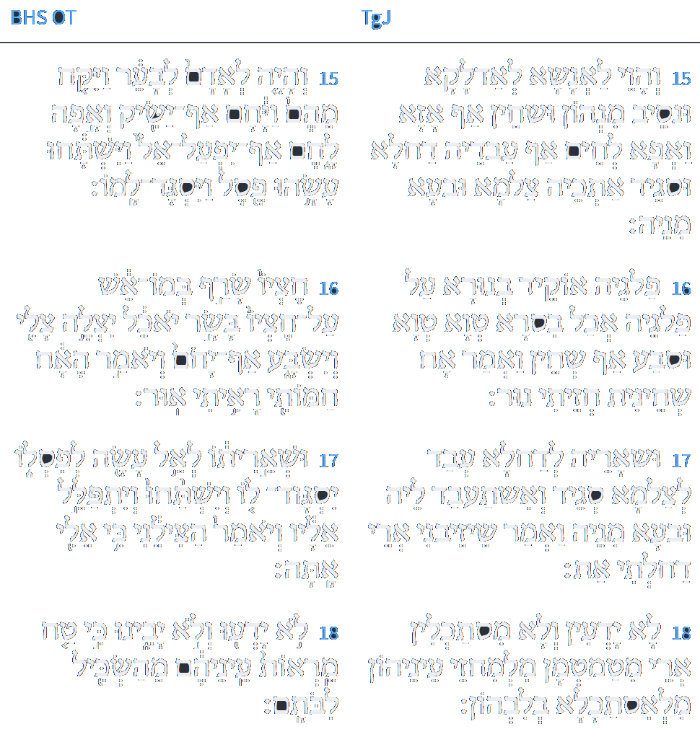
ספריה
טו וֶהֱוֵי לֶאֱנָשָׁא לְאַדְלָקָא וּנְסֵיב מִנְהוֹן וּשְׁחֵין אַף אֲזָא וְאָפָא לְחֵם אַף עָבְדֵהּ דַחֲלָא וּסְגֵיד אִתְּכֵהּ צַלְמָא וּבְעָא מִנֵהּ: טז פַּלְגֵהּ אוֹקִיד בְּנוּרָא עַל פַּלְגֵהּ בִּסְרָא אָכִיל טְוָא טָוִי וּסְבַע אַף שְׁחִין וַאֲמַר אָח שַׁחֵינִית חֲזֵיתִי נוּר: יז וּשְׁאָרֵהּ לְדַחֲלָא עָבַד לְצַלְמָא סְגִיד לֵיהּ וְאֶשְׁתַּעְבֵּד לֵיהּ וּבְעָא מִנֵהּ וַאֲמַר שֵׁיזְבָנִי אֲרֵי דְחַלְתִּי אָתְּ: יח לָא יָדְעוּן וְלָא מִסְתַּכְּלִין אֲרֵי מְטַמְטְמָן מִלְמֶחֱזֵי עֵינֵיהוֹן מִלְאִסְתַּכָּלָא בְּלִבְּהוֹן:
Isaiah / ישעיה
http://www.matsati.com

Slide 18
Duties of the Heart, Eighth Treatise on Examining the Soul 3:122
הה למבוכה הזאת כמה היא כוללת ולשכרות הזאת כמה היא חזקה כמו שאמר הכתוב (ישעיהו מ״ד:י״ח-י״ט) כי טח מראות עיניהם מהשכיל לבותם ואמר (שם כט) שכרו ולא יין וגו':
Alas to this confusion! How so universal it is! And to this drunkenness, how strong it is!, as the verse says: "for their eyes are shrouded, that they cannot see, and their hearts, that they cannot understand" (Yeshaya 44:18), and "ye that are drunken, but not with wine, that stagger, but not with strong drink" (Yeshaya 29:9).
Isaiah / ישעיה
http://www.matsati.com

Slide 19
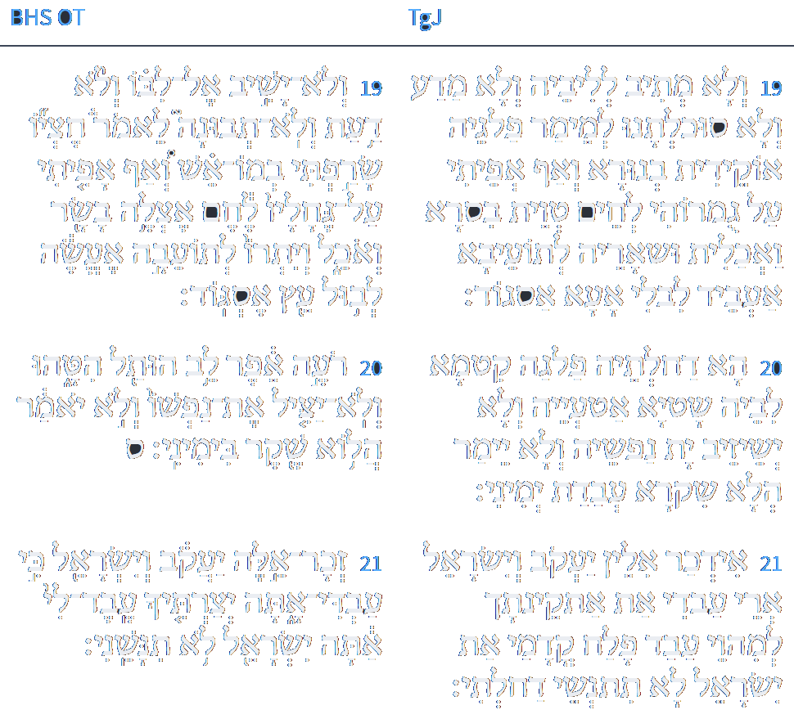
ספריה
ייט וְלָא מֵתִיב לְלִבֵּהּ וְלָא מַדַע וְלָא סוּכְלְתָנוּ לְמֵימַר פַּלְגֵהּ אוֹקֵידַת בְּנוּרָא וְאַף אֲפִיתִי עַל גוּמְרוֹהִי לְחֵם טְוֵית בִּסְרָא וַאֲכַלֵית וּשְׁאֵרֵהּ לְתוֹעֵבָא אַעְבֵּיד לְיִבְלֵי אָעָא אֶסְגוֹד: כ הָא דְחַלְתָּא פַלְגֵהּ קִטְמָא לִבֵּהּ שַׁטְיָא אַטְעֲיֵהּ וְלָא יְשֵׁיזֵיב יַת נַפְשֵׁהּ וְלָא יֵימַר הֲלָא שִׁקְרָא עֲבָדֵית בִּימִינִי: כא אִדְכַּר אִלֵין יַעֲקֹב וְיִשְׂרָאֵל אֲרֵי עַבְדִי אַתְּ אַתְקֵינְתָּךְ לְמֶהֱוֵי עֲבֵיד פְּלַח קֳדָמַי אַתְּ יִשְׂרָאֵל לָא תִתְנְשֵׁי דְחַלְתִּי:
Isaiah / ישעיה
http://www.matsati.com

Slide 20
Sefer HaYashar 2:48
Since it has been made clear that service to God must be with three things: with fear, with wisdom, and with love, we recognize that these three are given by one shepherd, and that is reason, for reason contains all three and other powers as well. For it is obvious that reason contains wisdom and love and the awareness that the rational person should in all things love the righteous path, lest he add to any of them more than is fitting or diminish more than is fitting. We learn from this that according to the perfection of the reason of man will his service to God become whole, and that what is lacking in the perfection of his service to God is lacking in the man’s reason and knowledge. If the service be perfect there is no doubt that the knowledge of their possessor is complete. For Scripture says with regard to sins and sinners (Jeremiah 10:14), “Every man is proved to be brutish, without knowledge,” and it says (Isaiah 44:18-19), “They know not, neither do they understand; for their eyes are bedaubed, that they cannot see, and their hearts, that they cannot understand. And none considereth in his heart, neither is there knowledge nor understanding.” The Prophet means that the service must be with the power of wisdom, as it is said (Psalms 111:10), “Fear of the Lord is the beginning of wisdom.” And this is a sign that the service of God, blessed be He, is the goal of reason and wisdom and that those who forsake God are fools. If someone were to say, “Behold you see the wicked, that even among them there are wise and intelligent men in every branch of wisdom. How can you say of them that they are fools or lacking in mental power?” Our answer would be: When a wise man is visited by misfortune and thereupon does a thing which he has never done before, but suddenly realizes that through this thing salvation will come to him, it is a sign of his previous folly.
Isaiah / ישעיה
http://www.matsati.com

Slide 21
Midrash Lekach Tov, Numbers 15:40:1
The verse: In order that you will remember and do them - to make remembering like action. Great is remembering, as it is stated (Malachi 3:22), "Remember the Torah of Moshe, My servant." And it states (Jeremiah 51:50), "remember the Lord from afar (all the corners of the world)." And it states (Isaiah 44:21), "Remember these things, Yaakov." And do all of My commandments - this teaches that remembering brings to action. And you shall be holy to your God - this is the holiness of tzitzit (fringes). It is saying that tzitzit adds holiness to the Jewish people. It is written three times: "and they shall make for themselves tzitzit; and they shall place on the tzitzit; and they shall be for (le) tzitzit." When you divide the [numerical count of the letter,] lamed (which is 30 and spells le) - ten for one, ten for one and ten for one - all of them become fully spelled. For they are all written tzitzat, without [a letter,] yod (the numerical count of which is ten). Rabbi Chanina ben Antigonos said, "What does it state about anyone who fulfills the commandment of tzitzit? 'In those days, ten people from nations of every tongue will take hold; they will take hold of every Jew by a corner of their cloak' (Zechariah 8:23) - this teaches that in the future, every Jew will be served by 2,800 servants.
Isaiah / ישעיה
http://www.matsati.com

