Slide 1
MATSATI.COM Teaching Ministry
Website: https://www.matsati.com YouTube Channel: https://www.youtube.com/user/MATSATI/
ישעיהו מד:א-ז / Isaiah 44:1-7
LIVE STREAM: 6:30 pm EST Thursday
New Telegram Channel: Messianic Ministries
https://t.me/MessianicMinistries
Focus: The Way of Life - Following Yeshua the Messiah with an emphasis on walking in His footsteps according to the Torah
A Community
for Learning
Discuss the Scriptures,
learn the languages,
and fellowship

Slide 2
Isaiah 44:1-7
ישעיהו מד:א-ז
What Does it Mean that The Lord God Will Make
a New Covenant and Write His Torah
on the Hearts of His People?
Isaiah / ישעיה
http://www.matsati.com

Slide 3
מבוא לישעיהו
Part 1
Isaiah / ישעיה
http://www.matsati.com

Slide 4
Bereshit / Genesis 15:6
15:6 And he believed in the LORD; and he counted it to him for righteousness. (KJV וְהֶאֱמִ֖ן בַּֽיהוָ֑ה וַיַּחְשְׁבֶ֥הָ לּ֖וֹ צְדָקָֽה׃)
Devarim / Deuteronomy 7:7–8
7:7 The LORD did not set his love upon you, nor choose you, because ye were more in number than any people; for ye were the fewest of all people: 7:8 But because the LORD loved you, and because he would keep the oath which he had sworn unto your fathers, hath the LORD brought you out with a mighty hand, and redeemed you out of the house of bondmen, from the hand of Pharaoh king of Egypt. (KJV לֹ֣א מֵֽרֻבְּכֶ֞ם מִכָּל־הָֽעַמִּ֗ים חָשַׁ֧ק יְהוָ֛ה בָּכֶ֖ם וַיִּבְחַ֣ר בָּכֶ֑ם כִּֽי־אַתֶּ֥ם הַמְעַ֖ט מִכָּל־הָעַמִּֽים׃ כִּי֩ מֵֽאַהֲבַ֨ת יְהוָ֜ה אֶתְכֶ֗ם וּמִשָּׁמְר֤וֹ אֶת־הַשְּׁבֻעָה֙ אֲשֶׁ֤ר נִשְׁבַּע֙ לַאֲבֹ֣תֵיכֶ֔ם הוֹצִ֧יא יְהוָ֛ה אֶתְכֶ֖ם בְּיָ֣ד חֲזָקָ֑ה וַֽיִּפְדְּךָ֙ מִבֵּ֣ית עֲבָדִ֔ים מִיַּ֖ד פַּרְעֹ֥ה מֶֽלֶךְ־מִצְרָֽיִם׃)
Isaiah / ישעיה
http://www.matsati.com

Slide 5
Tehillim / Psalm 40:6–8
40:6 Sacrifice and offering thou didst not desire; Mine ears hast thou opened: Burnt offering and sin offering hast thou not required. 40:7 Then said I, Lo, I come: In the volume of the book it is written of me, 40:8 I delight to do thy will, O my God: Yea, thy law is within my heart. (KJV זֶ֤בַח וּמִנְחָ֨ה׀ לֹֽא־חָפַ֗צְתָּ אָ֭זְנַיִם כָּרִ֣יתָ לִּ֑י עוֹלָ֥ה וַ֝חֲטָאָ֗ה לֹ֣א שָׁאָֽלְתָּ׃ אָ֣ז אָ֭מַרְתִּי הִנֵּה־בָ֑אתִי בִּמְגִלַּת־סֵ֝֗פֶר כָּת֥וּב עָלָֽי׃ לַֽעֲשֽׂוֹת־רְצוֹנְךָ֣ אֱלֹהַ֣י חָפָ֑צְתִּי וְ֝ת֥וֹרָתְךָ֗ בְּת֣וֹךְ מֵעָֽי׃)
Isaiah 53:5–6
53:5 But he was wounded for our transgressions, He was bruised for our iniquities: The chastisement of our peace was upon him; And with his stripes we are healed. 53:6 All we like sheep have gone astray; We have turned every one to his own way; And the LORD hath laid on him the iniquity of us all. (KJV וְהוּא֙ מְחֹלָ֣ל מִפְּשָׁעֵ֔נוּ מְדֻכָּ֖א מֵעֲוֺנֹתֵ֑ינוּ מוּסַ֤ר שְׁלוֹמֵ֙נוּ֙ עָלָ֔יו וּבַחֲבֻרָת֖וֹ נִרְפָּא־לָֽנוּ׃ כֻּלָּ֙נוּ֙ כַּצֹּ֣אן תָּעִ֔ינוּ אִ֥ישׁ לְדַרְכּ֖וֹ פָּנִ֑ינוּ וַֽיהוָה֙ הִפְגִּ֣יעַ בּ֔וֹ אֵ֖ת עֲוֺ֥ן כֻּלָּֽנוּ׃)
Isaiah / ישעיה
http://www.matsati.com

Slide 6
Jeremiah 31:31–34
31:31 Behold, the days come, saith the LORD, That I will make a new covenant With the house of Israel, and with the house of Judah: 31:32 Not according to the covenant that I made with their fathers In the day that I took them by the hand To bring them out of the land of Egypt; Which my covenant they brake, Although I was an husband unto them, saith the LORD: 31:33 But this shall be the covenant that I will make with the house of Israel; After those days, saith the LORD, I will put my law in their inward parts, And write it in their hearts; And will be their God, And they shall be my people. 31:34 And they shall teach no more every man his neighbour, and every man his brother, saying, Know the LORD: For they shall all know me, From the least of them unto the greatest of them, saith the LORD: For I will forgive their iniquity, And I will remember their sin no more. (KJV הִנֵּ֛ה יָמִ֥ים בָּאִ֖ים נְאֻם־יְהוָ֑ה וְכָרַתִּ֗י אֶת־בֵּ֧ית יִשְׂרָאֵ֛ל וְאֶת־בֵּ֥ית יְהוּדָ֖ה בְּרִ֥ית חֲדָשָֽׁה׃ לֹ֣א כַבְּרִ֗ית אֲשֶׁ֤ר כָּרַ֙תִּי֙ אֶת־אֲבוֹתָ֔ם בְּיוֹם֙ הֶחֱזִיקִ֣י בְיָדָ֔ם לְהוֹצִיאָ֖ם מֵאֶ֖רֶץ מִצְרָ֑יִם אֲשֶׁר־הֵ֜מָּה הֵפֵ֣רוּ אֶת־בְּרִיתִ֗י וְאָנֹכִ֛י בָּעַ֥לְתִּי בָ֖ם נְאֻם־יְהוָֽה׃ כִּ֣י זֹ֣את הַבְּרִ֡ית אֲשֶׁ֣ר אֶכְרֹת֩ אֶת־בֵּ֨ית יִשְׂרָאֵ֜ל אַחֲרֵ֨י הַיָּמִ֤ים הָהֵם֙ נְאֻם־יְהוָ֔ה נָתַ֤תִּי אֶת־תּֽוֹרָתִי֙ בְּקִרְבָּ֔ם וְעַל־לִבָּ֖ם אֶכְתֲּבֶ֑נָּה וְהָיִ֤יתִי לָהֶם֙ לֵֽאלֹהִ֔ים וְהֵ֖מָּה יִֽהְיוּ־לִ֥י לְעָֽם׃ וְלֹ֧א יְלַמְּד֣וּ ע֗וֹד אִ֣ישׁ אֶת־רֵעֵ֜הוּ וְאִ֤ישׁ אֶת־אָחִיו֙ לֵאמֹ֔ר דְּע֖וּ אֶת־יְהוָ֑ה כִּֽי־כוּלָּם֩ יֵדְע֨וּ אוֹתִ֜י לְמִקְטַנָּ֤ם וְעַד־גְּדוֹלָם֙ נְאֻם־יְהוָ֔ה כִּ֤י אֶסְלַח֙ לַֽעֲוֺנָ֔ם וּלְחַטָּאתָ֖ם לֹ֥א אֶזְכָּר־עֽוֹד׃)
Isaiah / ישעיה
http://www.matsati.com

Slide 7
Babylonian Talmud, Yoma 86a-b
R. Johanan said: Great is repentance, for it brings healing to the world … R. Johanan further said: Great is repentance, for it reaches up to the Throne of Glory … R. Johanan also said: Great is repentance, for it brings redemption nearer … R. Johanan said in the name of R. Simeon b. Yohai: Great is repentance, for on account of an individual who repents the whole world is forgiven.
Midrash Rabbah, Ecclesiastes 7:19
R. Eliezer the Great says: Whoever has the Torah but lacks the service of God and deeds of kindness is like one who holds a deed of purchase for a grave in his hand.
Mishnah, Yoma 8:9
R. Akiba said: Happy are ye, O Israel: before whom do ye cleanse yourselves, and who cleanses you? Your Father who is in heaven, as it is said, And I will sprinkle clean water upon you, and ye shall be clean. And it says, O hope of Israel, the Lord! Even as a fountain renders unclean things clean, so does the Holy One, blessed be He, render Israel clean.
Isaiah / ישעיה
http://www.matsati.com

Slide 8
Babylonian Talmud, Sanhedrin 98a
R. Joshua b. Levi met Elijah standing at the entrance of R. Simeon b. Yohai’s tomb. He asked him: Have I a portion in the world to come? He said, If this Master desires it. R. Joshua b. Levi said, I saw two, but heard the voice of a third. He then asked him, When will the Messiah come? — He said, Go and ask him himself. Where is he sitting? — At the entrance. And by what sign may I recognise him? — He is sitting among the poor lepers: all of them untie [them] all at once, and rebandage them together, whereas he unties and rebandages each separately, [before treating the next], thinking, should I be wanted, [it being time for my appearance as the Messiah] I must not be delayed [through having to bandage a number of sores]. So he went to him and greeted him, saying, Peace upon thee, Master and Teacher. Peace upon thee, O son of Levi, he replied. When wilt thou come Master? he asked. To-day, he answered. On his returning to Elijah, the latter enquired, What did he say to thee? — Peace Upon thee, O son of Levi, he answered. Thereupon he [Elijah] observed, He thereby assured thee and thy father of [a portion in] the world to come. He said, He spoke falsely to me, stating that he would come to-day, but has not. He [Elijah] answered him, This is what he said to thee, To-day, if ye will hear his voice.
Isaiah / ישעיה
http://www.matsati.com

Slide 9
Romans 3:23–24
3:23 For all have sinned, and come short of the glory of God; 3:24 Being justified freely by his grace through the redemption that is in Christ Jesus: (KJV 23 πάντες γὰρ ἥμαρτον καὶ ὑστεροῦνται τῆς δόξης τοῦ θεοῦ* 24 δικαιούμενοι δωρεὰν τῇ αὐτοῦ χάριτι διὰ τῆς ἀπολυτρώσεως τῆς ἐν Χριστῷ Ἰησοῦ·*)
Romans 6:23
6:23 For the wages of sin is death; but the gift of God is eternal life through Jesus Christ our Lord. (KJV 23 τὰ γὰρ ὀψώνια τῆς ἁμαρτίας θάνατος, τὸ δὲ χάρισμα τοῦ θεοῦ ζωὴ αἰώνιος ἐν Χριστῷ Ἰησοῦ τῷ κυρίῳ ἡμῶν*.)
Ephesians 2:8–9
2:8 For by grace are ye saved through faith; and that not of yourselves: it is the gift of God: 2:9 Not of works, lest any man should boast. (KJV 8 Τῇ γὰρ χάριτί ἐστε σεσῳσμένοι διὰ ⸆ πίστεως· καὶ τοῦτο οὐκ ἐξ ὑμῶν,* θεοῦ τὸ δῶρον· 9 οὐκ ἐξ ἔργων, ἵνα μή τις καυχήσηται.*)
Isaiah / ישעיה
http://www.matsati.com

Slide 10
John 3:16
3:16 For God so loved the world, that he gave his only begotten Son, that whosoever believeth in him should not perish, but have everlasting life. (KJV 16 οὕτως γὰρ ἠγάπησεν ὁ θεὸς τὸν κόσμον, ὥστε τὸν υἱὸν ⸆ τὸν μονογενῆ ἔδωκεν, ἵνα πᾶς ὁ πιστεύων εἰς αὐτὸν μὴ ἀπόληται ἀλλʼ ἔχῃ ζωὴν αἰώνιον.*)
John 3:36
3:36 He that believeth on the Son hath everlasting life: and he that believeth not the Son shall not see life; but the wrath of God abideth on him. (KJV *36 ὁ πιστεύων εἰς τὸν υἱὸν ἔχει ζωὴν αἰώνιον· ὁ °δὲ ἀπειθῶν τῷ υἱῷ οὐκ ὄψεται ζωήν, ἀλλʼ ἡ ὀργὴ τοῦ θεοῦ μένει ἐπʼ αὐτόν.*)
Isaiah / ישעיה
http://www.matsati.com

Slide 11
NT Parallels to Isaiah Chapter 44
Isaiah 44:22 states that the God of Israel has blotted out their transgressions like a cloud, and their sins like a mist. This is similar to Romans 3:24, which says that God justifies sinners freely by His grace.
Isaiah 44:3 states that God will pour water on the thirsty land, and floods on the dry ground. He will also pour His Spirit on their descendants, and His blessing on their offspring. This is similar to Romans 6:23 and John 3:16, which say that God gives the gift of eternal life and His Spirit to those who believe in Yeshua.
Isaiah 44:8 states that there is no other God besides the Lord, and no other Rock. He challenges Israel to not fear or be dismayed, but to trust in Him. This is similar to Ephesians 2:8-9, which says that salvation is by grace through faith, and not by works.
Isaiah 44:24-28 states that God is the Creator and the Redeemer of Israel, who has foretold and fulfilled His plans for them. He has raised up Cyrus, a Persian king, to be His instrument to deliver them from exile. This is similar to John 3:36, which says that God has sent His Son to be the Savior of the world, and that those who believe in Him have life, but those who reject Him have death.
Isaiah / ישעיה
http://www.matsati.com

Slide 12
ספר ישעיה
Part 2
Isaiah / ישעיה
http://www.matsati.com

Slide 13
﻿ספר ישעיה פרק מד
﻿א וְעַתָּה שְׁמַע יַעֲקֹב עַבְדִּי וְיִשְֹרָאֵל בָּחַרְתִּי בוֹ: ב כֹּה-אָמַר יְהֹוָה עֹשֶֹךָ וְיֹצֶרְךָ מִבֶּטֶן יַעְזְרֶךָּ אַל-תִּירָא עַבְדִּי יַעֲקֹב וִישֻׁרוּן בָּחַרְתִּי בוֹ: ג כִּי אֶצָּק-מַיִם עַל-צָמֵא וְנוֹזְלִים עַל-יַבָּשָׁה אֶצֹּק רוּחִי עַל-זַרְעֶךָ וּבִרְכָתִי עַל-צֶאֱצָאֶיךָ: ד וְצָמְחוּ בְּבֵין חָצִיר כַּעֲרָבִים עַל-יִבְלֵי-מָיִם: ה זֶה יֹאמַר לַיהֹוָה אָנִי וְזֶה יִקְרָא בְשֵׁם-יַעֲקֹב וְזֶה יִכְתֹּב יָדוֹ לַיהֹוָה וּבְשֵׁם יִשְֹרָאֵל יְכַנֶּה: ו כֹּה-אָמַר יְהֹוָה מֶלֶךְ-יִשְֹרָאֵל וְגֹאֲלוֹ יְהֹוָה צְבָאוֹת אֲנִי רִאשׁוֹן וַאֲנִי אַחֲרוֹן וּמִבַּלְעָדַי אֵין אֱלֹהִים: ז וּמִי-כָמוֹנִי יִקְרָא וְיַגִּידֶהָ וְיַעְרְכֶהָ לִי מִשּׂוּמִי עַם-עוֹלָם וְאֹתִיּוֹת וַאֲשֶׁר תָּבֹאנָה יַגִּידוּ לָמוֹ:
Isaiah / ישעיה
http://www.matsati.com

Slide 14
ספר בראשית פרק יב' ב-ג
ב וְאֶֽעֶשְׂךָ֙ לְגֹ֣וי גָּדֹ֔ול וַאֲבָ֣רֶכְךָ֔ וַאֲגַדְּלָ֖ה שְׁמֶ֑ךָ וֶהְיֵ֖ה בְּרָכָֽה׃ ג וַאֲבָֽרֲכָה֙ מְבָ֣רְכֶ֔יךָ וּמְקַלֶּלְךָ֖ אָאֹ֑ר וְנִבְרְכ֣וּ בְךָ֔ כֹּ֖ל מִשְׁפְּחֹ֥ת הָאֲדָמָֽה׃
ספר בראשית פרק טו' ה
ה וַיֹּוצֵ֨א אֹתֹ֜ו הַח֗וּצָה וַיֹּ֨אמֶר֙ הַבֶּט־נָ֣א הַשָּׁמַ֗יְמָה וּסְפֹר֙ הַכֹּ֣וכָבִ֔ים אִם־תּוּכַ֖ל לִסְפֹּ֣ר אֹתָ֑ם וַיֹּ֣אמֶר לֹ֔ו כֹּ֥ה יִהְיֶ֖ה זַרְעֶֽךָ׃
Isaiah / ישעיה
http://www.matsati.com

Slide 15
ספר בראשית פרק כב' יז-יח
יז כִּֽי־בָרֵ֣ךְ אֲבָרֶכְךָ֗ וְהַרְבָּ֨ה אַרְבֶּ֤ה אֶֽת־זַרְעֲךָ֙ כְּכֹוכְבֵ֣י הַשָּׁמַ֔יִם וְכַחֹ֕ול אֲשֶׁ֖ר עַל־שְׂפַ֣ת הַיָּ֑ם וְיִרַ֣שׁ זַרְעֲךָ֔ אֵ֖ת שַׁ֥עַר אֹיְבָֽיו׃ יח וְהִתְבָּרֲכ֣וּ בְזַרְעֲךָ֔ כֹּ֖ל גֹּויֵ֣י הָאָ֑רֶץ עֵ֕קֶב אֲשֶׁ֥ר שָׁמַ֖עְתָּ בְּקֹלִֽי׃
Isaiah / ישעיה
http://www.matsati.com

Slide 16
ספר ישעיהו פרק נג' י
י וַיהוָ֞ה חָפֵ֤ץ דַּכְּאֹו֙ הֶֽחֱלִ֔י אִם־תָּשִׂ֤ים אָשָׁם֙ נַפְשֹׁ֔ו יִרְאֶ֥ה זֶ֖רַע יַאֲרִ֣יךְ יָמִ֑ים וְחֵ֥פֶץ יְהוָ֖ה בְּיָדֹ֥ו יִצְלָֽח׃
Isaiah / ישעיה
http://www.matsati.com

Slide 17
יְהֹוָה מֶלֶךְ-יִשְֹרָאֵל וְגֹאֲלוֹ יְהֹוָה צְבָאוֹת
אֲנִי רִאשׁוֹן וַאֲנִי אַחֲרוֹן וּמִבַּלְעָדַי אֵין אֱלֹהִים
Isaiah / ישעיה
http://www.matsati.com

Slide 18
Rabbinic Literature
ספרות רבנית
Part 3
Isaiah / ישעיה
http://www.matsati.com

Slide 19
Targum Jonathan son of Uziel Isaiah 44:1-7
44:1 Yet now hear, O Jacob, my servant; and Israel, whom I have chosen: 44:2 Thus saith the Lord, thy Maker; and He that formed thee from the womb, He will help thee; Fear not, O Jacob, my servant, and thou, O Israel, whom I have chosen. 44:3 For as waters are discharged upon the thirsty land, and are set flowing upon the dry land, so will I give my Holy Spirit unto thy children, and my blessing unto thy children’s children. 44:4 The righteous shall grow, and tender and delicate as the flowers of the grass, as a tree that sends forth its roots by the streams of waters. 44:5 This one shall say, I am of them that fear the Lord, and another shall pray in the name of the God of Jacob; this one shall offer his oblation before the Lord, and draw near in the name of Israel. 44:6 Thus saith the King of Israel, and His Redeemer, the Lord of hosts; I am He who was from the beginning, yea, eternities of eternities are mine; and beside me there is no God. 44:7 Who like me shall proclaim this, shall declare it, and set it in order before me, from the time that I appointed the ancient people? and let them declare unto us the things that are coming, and shall come. (TgJ)
Isaiah / ישעיה
http://www.matsati.com

Slide 20
ספר ישעיהו פרק מד
לוגוס
ספריה
א וּכְעַן שְׁמַע יַעֲקֹב עַבְדִי וְיִשְׂרָאֵל דְאִתְרְעֵיתִי בֵיהּ:
Isaiah / ישעיה
http://www.matsati.com

Slide 21
Midrash Tanchuma, Beshalach 15:1
Thy right hand, O Lord (Exod. 15:6). This verse indicates that the Lord’s right hand is stretched out to receive repentant sinners. Though You set a time for the generation of the flood in which to do penance, as it is said: My spirit shall not abide in man forever (Gen. 6:3), You did not decree their destruction until they committed their most evil acts before You. Similarly, You set a time limit in which the men of the Tower of Babel were to repent, yet You did not decree their extinction until they performed their most wicked acts, as it is said: And now nothing will be withholden from them (ibid. 11:6). The expression and now is employed only to signify that they had an opportunity to repent, as is said: And now, Israel, what doth the Lord thy God require of thee? (Deut. 10:12); And now, O Israel, hearken unto the statutes (ibid. 4:1); And yet now hear, O Jacob (Isa. 44:1).
Isaiah / ישעיה
http://www.matsati.com

Slide 22
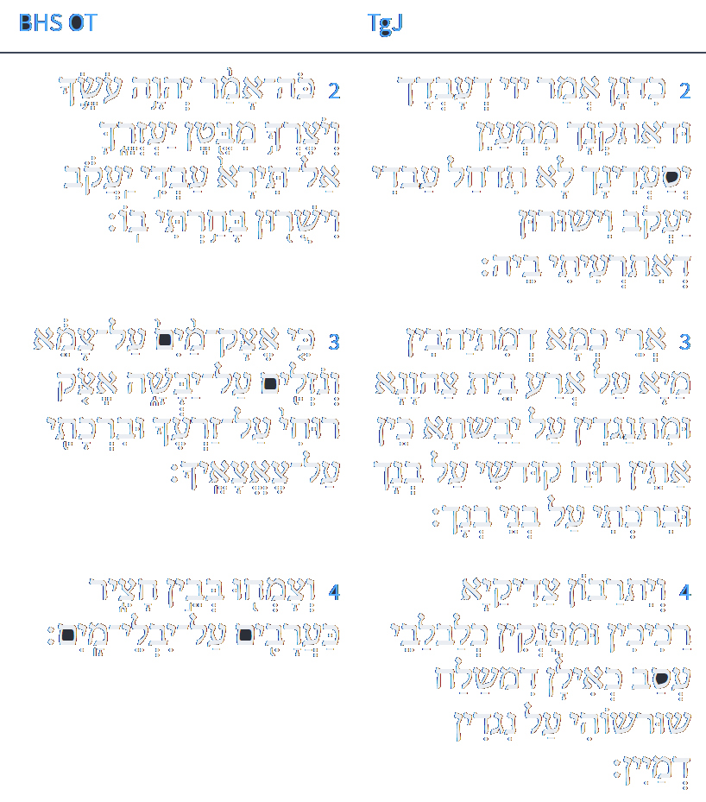
ספר ישעיהו פרק מד
לוגוס
ספריה
ב כִּדְנַן אֲמַר יְיָ דְעַבְדָךְ וּדְאַתְקְנָךְ מִמְעִין יְסַעְדִינָךְ לָא תִדְחַל עַבְדִי יַעֲקֹב וְיִשְׂרָאֵל דְאִתְרְעִיתִי בֵיהּ: ג אֲרֵי כְמָא דְמִתְיַהֲבִין מַיָא עַל אֲרַע בֵּית צַחֲוָנָא וּמִתְנַגְדִין עַל יַבֶּשְׁתָּא כֵּן אֶתֵּן רוּחַ קוּדְשִׁי עַל בְּנָךְ וּבִרְכָתִי עַל בְּנֵי בְנָךְ: ד וְיִתְרַבּוּן צַדִיקַיָא רַכִּיכִין וּמְפַנְקִין כְּלַבְלַבֵי עֲסַב כְּאִילָן דִמְשַׁלַח שָׁרְשׁוֹהִי עַל נַגְדִין דְמַיִין:
Isaiah / ישעיה
http://www.matsati.com

Slide 23
Rashi on Isaiah 44:4 Part 1
וצמחו בבין חציר. בתוך עמלק על ידי גרים שיתוספו עליהם, בין חציר הוא עמלק שנאמר עליו והיתה נוה תנים חציר לבנות יענה (לעיל ד):
And they shall sprout among the grass among Esau (mss. and K’li Paz). [The Jewish nation will grow] through the proselytes who will join them. [The expression,] “among the grass” refers to Esau, for it is stated concerning Edom (supra 34:13): “And it shall be the habitat of jackals, an abode (חָצִיר) for ostriches.” (Editions reading, “Amalek,” are erroneous cf. reference.)
Isaiah / ישעיה
http://www.matsati.com

Slide 24
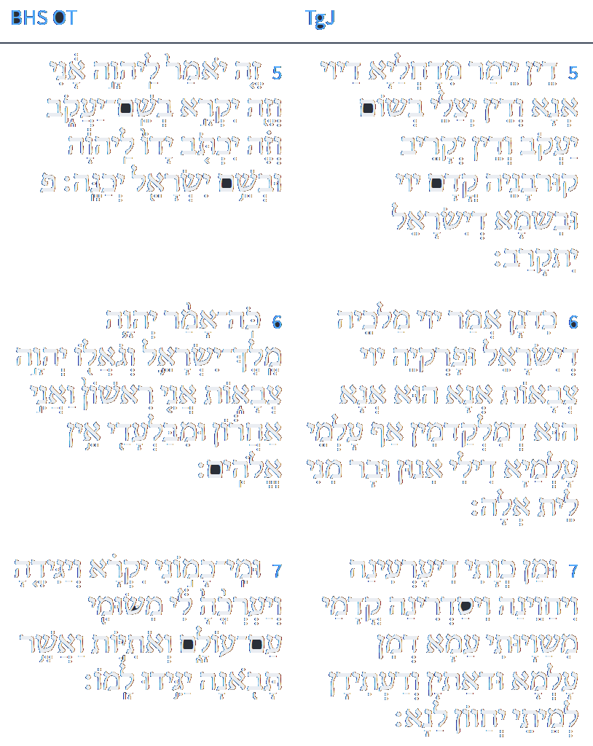
ספר ישעיהו פרק מד
לוגוס
ספריה
ה דֵין יֵימַר מִדָחֲלַיָא דַייָ אֲנָא וְדֵין יְצַלֵי בְשׁוּם יַעֲקֹב וְדֵין יְקָרֵיב קוּרְבָּנֵהּ קֳדָם יְיָ וּבִשְׁמָא דְיִשְׂרָאֵל יִתְקְרֵי: ו כִּדְנַן אֲמַר יְיָ מַלְכָּא דְיִשְׂרָאֵל וּפַרְקֵהּ יְיָ צְבָאוֹת אֲנָא הוּא דְמִלְקַדְמִין אַף עַלְמֵי עָלְמַיָא דִילִי אִינוּן וּבַר מִנִי לֵית אֱלֶהּ: ז וּמַן כְּוָתִי דִין עַרְעִינָהּ וִיחַוִינָהּ וִיסַדְרִינָהּ קֳדָמַי מִשַׁוָיוּתִי עַמָא דְמִן עַלְמָא וּדְאָתְיָן וְדַעֲתִידִין לְמֵיתֵי יְחַווּן לָנָא:
Isaiah / ישעיה
http://www.matsati.com

Slide 25
Shenei Luchot HaBerit, Torah Shebikhtav, Re'eh, Torah Ohr 1
“The commandments mentioned in this portion may be divided into three categories. They correspond to the three "pillars" that support the universe, i.e. תורה-עבודה-גמילות חסדים, Torah, service of the Lord and the dispensation of kind deeds. Torah is represented by commandments such as not to add or to deduct from them. In other words, we are ordered to preserve the שלימות, perfection, wholeness of the Torah. Philosophers have already said that it is part of the definition of perfection that one cannot add to it or detract from it. Perfection is indivisible. Torah is totally bound up with the great and Holy Name of G–d i.e. תורת ה' תמימה. I have elaborated on this in my treatise מסכת שבועות, section תורה אור. The Zohar, commenting on Exodus 3,15: זה שמי … זה זכרי, points out that the numerical value of י-ה+שמי=365, whereas the numerical value of ו-י+זכרי=248, together 613, i.e. the number of commandments in the Torah. G–d also describes Himself as אני ראשון ואני אחרון, " I am first and I am last," indicating total perfection.”
Isaiah / ישעיה
http://www.matsati.com

Slide 26
Akeidat Yitzchak 44:4:2
In considering that the purpose of observing Torah is to acquire the aforementioned level of partnership with the Divine, the question arises whether this is an exclusive objective, or whether one may have other more mundane benefits in mind which accrue to one in the process of fulfilling G-d’s commandments. If the former, the chances are that most people would not be able to take the long term view in order to live a life devoted to the performance of the mitzvot. The argument that mundane side benefits through the observance of mitzvot are not permissible, could be sustained by the following two considerations. 1) The more highly placed a worker or servant, the more lofty are the tasks that he is entrusted to perform. Man, as the most sophisticated creature on earth, would naturally only be concerned with the loftiest endeavors and objectives. 2) If we were to postulate that carrying out G-d’s will would have as its purpose merely human objectives, this would contradict the maxim that the objective is primary. If the prophet Isaiah 44,6, proclaims in the name of G-d "I am first and I am last," this clearly implies that the only considerations in all our endeavors must be centered around G-d and His purpose. Antignos, who has said in Avot,1 "do not be like the servant who serves the master for the sake of the reward," surely had this thought in mind. Also the saying of Ben Azzai "the reward for performing one mitzvah is another mitzvah, may be understood in a similar vein. In other words, performance of the commandments is an end in itself, not a means to an end. The Sifrey in Parshat Eykev says "a man might say to himself I'll perform the commandments in order to gain riches, or to acquire the title of Rabbi, or even in order to acquire a share in the hereafter; therefore the Torah says (Deut. 11,13) "in order to love the Lord your G-d." Your purpose in obeying should be to demonstrate your love for G-d. … [snip]
Isaiah / ישעיה
http://www.matsati.com

