Slide 1
MATSATI.COM Teaching Ministry
Website: https://www.matsati.com YouTube Channel: https://www.youtube.com/user/MATSATI/
ישעיהו מג:כב-כח / Isaiah 43:22-28
LIVE STREAM: 6:30 pm EST Thursday
New Telegram Channel: Messianic Ministries
https://t.me/MessianicMinistries
Focus: The Way of Life - Following Yeshua the Messiah with an emphasis on walking in His footsteps according to the Torah
A Community
for Learning
Discuss the Scriptures,
learn the languages,
and fellowship

Slide 2
Isaiah 43:22-28
ישעיהו מג:כב-כח
The Graciousness of God to Blot Out the Sins of Israel
according to ישעיהו מג:כב-כח / Isaiah 43:22-28
Isaiah / ישעיה
http://www.matsati.com

Slide 3
מבוא לישעיהו
Part 1
Isaiah / ישעיה
http://www.matsati.com

Slide 4
ספר ויקרא פרק ד
א וַיְדַבֵּר יְהוָֹה אֶל-מֹשֶׁה לֵּאמֹר: ב דַּבֵּר אֶל-בְּנֵי יִשְֹרָאֵל לֵאמֹר נֶפֶשׁ כִּי-תֶחֱטָא בִשְׁגָגָה מִכֹּל מִצְוֹת יְהֹוָה אֲשֶׁר לֹא תֵעָשֶֹינָה וְעָשָֹה מֵאַחַת מֵהֵנָּה: ג אִם הַכֹּהֵן הַמָּשִׁיחַ יֶחֱטָא לְאַשְׁמַת הָעָם וְהִקְרִיב עַל חַטָּאתוֹ אֲשֶׁר חָטָא פַּר בֶּן-בָּקָר תָּמִים לַיהוָֹה לְחַטָּאת: ד וְהֵבִיא אֶת-הַפָּר אֶל-פֶּתַח אֹהֶל מוֹעֵד לִפְנֵי יְהוָֹה וְסָמַךְ אֶת-יָדוֹ עַל-רֹאשׁ הַפָּר וְשָׁחַט אֶת-הַפָּר לִפְנֵי יְהוָֹה: ה וְלָקַח הַכֹּהֵן הַמָּשִׁיחַ מִדַּם הַפָּר וְהֵבִיא אֹתוֹ אֶל-אֹהֶל מוֹעֵד: ו וְטָבַל הַכֹּהֵן אֶת-אֶצְבָּעוֹ בַּדָּם וְהִזָּה מִן-הַדָּם שֶׁבַע פְּעָמִים לִפְנֵי יְהֹוָה אֶת-פְּנֵי פָּרֹכֶת הַקֹּדֶשׁ: ז וְנָתַן הַכֹּהֵן מִן-הַדָּם עַל-קַרְנוֹת מִזְבַּח קְטֹרֶת הַסַּמִּים לִפְנֵי יְהֹוָה אֲשֶׁר בְּאֹהֶל מוֹעֵד וְאֵת | כָּל-דַּם הַפָּר יִשְׁפֹּךְ אֶל-יְסוֹד מִזְבַּח הָעֹלָה אֲשֶׁר-פֶּתַח אֹהֶל מוֹעֵד:
Isaiah / ישעיה
http://www.matsati.com

Slide 5
ספר ישעיה
Part 2
Isaiah / ישעיה
http://www.matsati.com

Slide 6
﻿ספר ישעיה פרק מג
﻿כב וְלֹא-אֹתִי קָרָאתָ יַעֲקֹב כִּי-יָגַעְתָּ בִּי יִשְֹרָאֵל: כג לֹא-הֵבֵיאתָ לִּי שֵֹה עֹלֹתֶיךָ וּזְבָחֶיךָ לֹא כִבַּדְתָּנִי לֹא הֶעֱבַדְתִּיךָ בְּמִנְחָה וְלֹא הוֹגַעְתִּיךָ בִּלְבוֹנָה: כד לֹא-קָנִיתָ לִּי בַכֶּסֶף קָנֶה וְחֵלֶב זְבָחֶיךָ לֹא הִרְוִיתָנִי אַךְ הֶעֱבַדְתַּנִי בְּחַטֹּאותֶיךָ הוֹגַעְתַּנִי בַּעֲוֹנֹתֶיךָ: כה אָנֹכִי אָנֹכִי הוּא מֹחֶה פְשָׁעֶיךָ לְמַעֲנִי וְחַטֹּאתֶיךָ לֹא אֶזְכֹּר: כו הַזְכִּירֵנִי נִשָּׁפְטָה יָחַד סַפֵּר אַתָּה לְמַעַן תִּצְדָּק: כז אָבִיךָ הָרִאשׁוֹן חָטָא וּמְלִיצֶיךָ פָּשְׁעוּ בִי: כח וַאֲחַלֵּל שָֹרֵי קֹדֶשׁ וְאֶתְּנָה לַחֵרֶם יַעֲקֹב וְיִשְֹרָאֵל לְגִדּוּפִים:
Isaiah / ישעיה
http://www.matsati.com

Slide 7
ספר ישעיה פרק מג
כב וְלֹא-אֹתִי קָרָאתָ יַעֲקֹב כִּי-יָגַעְתָּ בִּי יִשְֹרָאֵל: כג לֹא-הֵבֵיאתָ לִּי שֵֹה עֹלֹתֶיךָ וּזְבָחֶיךָ לֹא כִבַּדְתָּנִי לֹא הֶעֱבַדְתִּיךָ בְּמִנְחָה וְלֹא הוֹגַעְתִּיךָ בִּלְבוֹנָה: כד לֹא-קָנִיתָ לִּי בַכֶּסֶף קָנֶה וְחֵלֶב זְבָחֶיךָ לֹא הִרְוִיתָנִי אַךְ הֶעֱבַדְתַּנִי בְּחַטֹּאותֶיךָ הוֹגַעְתַּנִי בַּעֲוֹנֹתֶיךָ:
Isaiah / ישעיה
http://www.matsati.com

Slide 8
ספר דברים פרק ל
יא כִּי הַמִּצְוָה הַזֹּאת אֲשֶׁר אָנֹכִי מְצַוְּךָ הַיּוֹם לֹא-נִפְלֵאת הִוא מִמְּךָ וְלֹא-רְחֹקָה הִוא: יב לֹא בַשָּׁמַיִם הִוא לֵאמֹר מִי יַעֲלֶה-לָּנוּ הַשָּׁמַיְמָה וְיִקָּחֶהָ לָּנוּ וְיַשְׁמִעֵנוּ אֹתָהּ וְנַעֲשֶֹנָּה: יג וְלֹא-מֵעֵבֶר לַיָּם הִוא לֵאמֹר מִי יַעֲבָר-לָנוּ אֶל-עֵבֶר הַיָּם וְיִקָּחֶהָ לָּנוּ וְיַשְׁמִעֵנוּ אֹתָהּ וְנַעֲשֶֹנָּה: יד כִּי-קָרוֹב אֵלֶיךָ הַדָּבָר מְאֹד בְּפִיךָ וּבִלְבָבְךָ לַעֲשֹתוֹ:
Isaiah / ישעיה
http://www.matsati.com

Slide 9
ספר שמות פרק לב
לב וְעַתָּה אִם-תִּשָּׂא חַטָּאתָם וְאִם-אַיִן מְחֵנִי נָא מִסִּפְרְךָ אֲשֶׁר כָּתָבְתָּ: לג וַיֹּאמֶר יְהֹוָה אֶל-מֹשֶׁה מִי אֲשֶׁר חָטָא-לִי אֶמְחֶנּוּ מִסִּפְרִי:
Shemot / Exodus 32:32–33
32:32 Yet now, if thou wilt forgive their sin—; and if not, blot me, I pray thee, out of thy book which thou hast written. 32:33 And the LORD said unto Moses, Whosoever hath sinned against me, him will I blot out of my book. (KJV)
Isaiah / ישעיה
http://www.matsati.com

Slide 10
Romans 5:12–21
5:12 Wherefore, as by one man sin entered into the world, and death by sin; and so death passed upon all men, for that all have sinned: 5:13 For until the law sin was in the world: but sin is not imputed when there is no law. 5:14 Nevertheless death reigned from Adam to Moses, even over them that had not sinned after the similitude of Adam’s transgression, who is the figure of him that was to come. 5:15 But not as the offence, so also is the free gift. For if through the offence of one many be dead, much more the grace of God, and the gift by grace, which is by one man, Jesus Christ, hath abounded unto many. 5:16 And not as it was by one that sinned, so is the gift: for the judgment was by one to condemnation, but the free gift is of many offences unto justification. 5:17 For if by one man’s offence death reigned by one; much more they which receive abundance of grace and of the gift of righteousness shall reign in life by one, Jesus Christ. 5:18 Therefore as by the offence of one judgment came upon all men to condemnation; even so by the righteousness of one the free gift came upon all men unto justification of life. 5:19 For as by one man’s disobedience many were made sinners, so by the obedience of one shall many be made righteous. 5:20 Moreover the law entered, that the offence might abound. But where sin abounded, grace did much more abound: 5:21 That as sin hath reigned unto death, even so might grace reign through righteousness unto eternal life by Jesus Christ our Lord. (KJV)
Isaiah / ישעיה
http://www.matsati.com

Slide 11
Rabbinic Literature
ספרות רבנית
Part 3
Isaiah / ישעיה
http://www.matsati.com

Slide 12
Targum Jonathan son of Uziel Isaiah 43:22-28
43:22 It hath been said by the prophets, that ye of the house of Jacob have not met together for my worship; but that ye were weary of the doctrine of my law, O Israel. 43:23 Thou hast not brought unto me the lambs of thy burnt offerings, and with thy holy sacrifices thou hast not honoured me. I have not caused thee to multiply offerings, neither did I burden thee with frankincense. 43:24 Thou hast not bought for me the aromatic reed with silver; with the fat of thy holy sacrifices thou hast not anointed mine altar; but thou hast multiplied thy sins before me; thou hast burdened me with thine iniquities. 43:25 I, even I, am He who forgiveth thy sins for the sake of my name, and thy sins shall not be remembered. 43:26 Speak now, we will plead together, declare thou for the purpose, that thou mayest justify thyself, if thou art able to do so. 43:27 Thy first father hath sinned, and thy teachers have rebelled against my WORD. 43:28 Therefore I have profaned the princes of the sanctuary, and I have delivered Jacob to the slaughter, and Israel to reproaches. (TgJ)
Isaiah / ישעיה
http://www.matsati.com

Slide 13
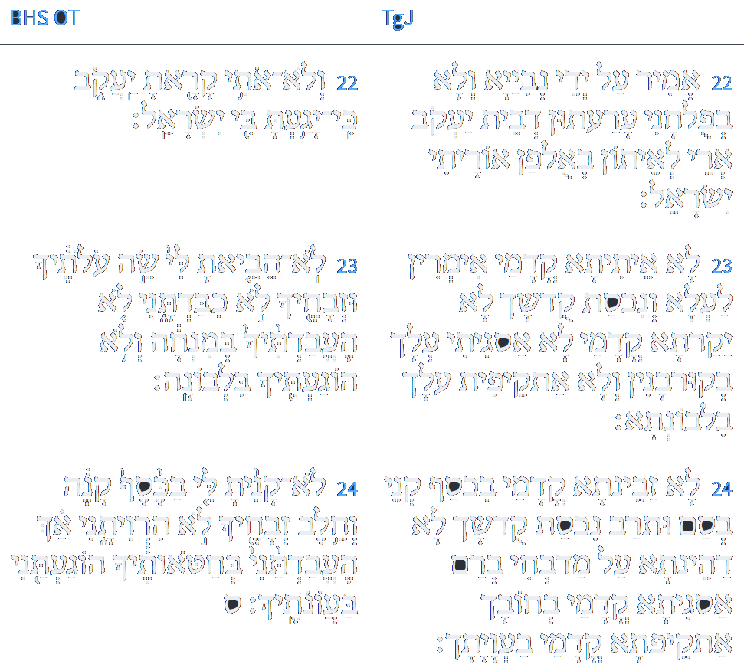
ספר ישעיה פרק מג
לוגוס
ספריה
כב אֱמִיר עַל יְדֵי נְבִיַיָא וְלָא בְּפּוּלְחָנִי עַרְעִיתוּן דְבֵית יַעֲקֹב אֲרֵי לָאֵיתוּן בְּאוּלְפַן אוֹרַיְתִי יִשְׂרָאֵל: כג לָא אַיְתֵיתָא קֳדָמַי אִמְרִין לְעָלְתָא וְנִכְסַת קוּדְשָׁךְ לָא יַקַרְתָּא קֳדָמַי לָא אַסְגֵיתִי עֲלָךְ בְּקוּרְבָּנִין וְלָא אַתְקְפֵית עֲלָךְ בִּלְבוֹנְתָּא: כד לָא זְבֵינְתָּא קֳדָמַי בִּכְסַף קָנִי בְּסָם וּתְרַב נִכְסַת קוּדְשָׁךְ לָא דְהֵינְתָּא עַל מַדְבְּחִי בְּרַם אַסְגֵיתָא קֳדָמַי בְּחוֹבָךְ אַתְקֵפְתָּא קֳדָמַי בַּעֲוָיָתָךְ:
Isaiah / ישעיה
http://www.matsati.com

Slide 14
Akeidat Yitzchak 57:1:3
Whenever the matter of animal sacrifices is discussed, there are some difficult questions that cannot be ignored. 1) Is it not unavoidable that sacrifices will be viewed as attempts to bribe G'd to forego the anger caused Him by the sinner who offers the sacrifice? 2) Does it not seem that the donor tries to placate G'd just as he would attempt to placate a mere mortal ruler, thereby insulting G'd, reducing His stature? 3) If, on the other hand, the offering is in the nature of a pennance, payment for trespass from which G'd receives no more benefit than from say the imposition of corporal punishment on the sinner, what good is it? 4) Is the purpose of the sacrifices perhaps merely to provide the priests with a livelihood, or simply the destruction of the animals that are being offered up? It is clearly erroneous to view the offerings as an attempt to restore the perfection or wholeness of G'd by means of a sacrifice that would complement something incomplete in Him. In Psalms 50, 11-13, "I will not accept bullocks from you, since all the animal kingdom is Mine; if I were hungry, would I have to call you? After all, the whole universe belongs to Me." Isaiah 43,24, states this even more succinctly. "You have not bought for Me fragrant reeds with money..nor have you tired yourself out on My behalf. You have not brought Me the lambs of your total offerings, not honoured Me with your meat offerings;..you have not bought Me with your money! I, I forgive you for MY sake!" Clearly, what the prophet stresses is that none of the things Israel did to placate G'd or bribe Him, has had the slightest impact on the well being of G'd Himself. G'd forgives for His own sake. He emphasizes that there is no other consideration, repeats His name when He proclaims that He dispenses forgiveness, in order to stress that there is no personal benefit involved. There is no aspect of G'd that can be enhanced by the gift of man. If there were a price tag on forgiveness, it would have to be set in motion through mutual action. Since however, there is no exchange of values for the forgiveness, it occurs only through "My righteousness." "I will not remember your sins," so as not to shame you.
Isaiah / ישעיה
http://www.matsati.com

Slide 15
Akeidat Yitzchak 57:1:3
However, "remind Me of them," you tell of them, so that you can become righteous. (Isaiah 43,26) It is evident that the prophet endeavours to squash the foolish notion of "our contribution" in the matter of sacrifices. It is noteworthy that the term avodah, service, is not used in the Torah concerning offerings that are brought on the altar in order to obtain forgiveness. When Moses did use that term when talking to Pharaoh, (Exodus 10,26) "we do not know what we will serve the Lord," he simply used terminology familiar to Pharaoh. It is the manner of pagans to employ the term avodah for their religious observances. (Deut. 13,7) "Let us go and serve other deities." We find a similar warning (Deut 12,30) "lest you inquire into their deities, saying," how do these nations serve their deities?" The Torah in that instance, continues "do not do thus, for the Lord your G'd etc.," meaning that worship of the G'd of Israel is not of that order. Positive proof that worship of our G'd is of a totally different calibre, is the fact that "they burn their own children in fire to their deities," something the G'd of Israel has described as an abomination. True worship of G'd consists of obeying His commandments, neither adding nor subtracting therefrom. (Deut. 13, 1.) When referring to that kind of worship, the Torah does not shrink from employing the term avodah as in Deut. 10, 12, or Exodus 23,25, and other places. In all matters of piety of the heart, performance of good deeds, the benefit that accrues to the practitioner is stressed. (Deut. 10, 13) "for your own good." "Serving" is for our benefit, not G'ds. It is significant that the rasha, wicked person quoted in Parshat Bo, describes the Passover ceremonial as an avodah, service, stressing "what is in it for you?" It is precisely this attitude to sacrificial service that needs to be debunked. Similarly, the second possible rationale suggested for the requirement of sacrifice, namely atonement, cannot be true. It is obvious that the object used for atonement would have to be in some value relationship to the subject against whom the sin had been committed. Since it is imposible to relate to the Creator in this fashion, the idea of sacrifice sufficing as an act of compensation is quite erroneous.
Isaiah / ישעיה
http://www.matsati.com

Slide 16
Akeidat Yitzchak 57:1:3
This is what the High Priest Eli (Samuel 1,2,23-24) tells his sons when he remonstrates with them. He had heard that they had acted improperly. "When man sins against man, the judge can mediate and determine fair compensation; but when man sins against G'd, who can determine the amount of compensation due to G'd?" How will one know that one had atoned adequately? Similarly, Michah 6,7, calls out: "Does the Lord want thousands of rams, tens of thousands rivers of oil?" The meaning is "could even the greatest amount of sacrificial animals compensate for the iniquity committed?" Obviously then, the idea of compensation is not the rationale for sacrificial rites. Regarding the third possibility mentioned, that the priests should be provided with a livelihood, the many offerings which are completely burned up, demonstrate that this could not have been the thought behind this legislation. Moreover, the idea that priests should be happy to consume the proceeds of man's sins, that their livelihood would improve in direct ratio to the number of sins committed by their brethren, could hardly be pleasing in the eyes of G'd. The fourth possibility mentioned, the wanton destruction of part of the animal kingdom is also difficult to accept as a possible motivation behind this legislation.
Isaiah / ישעיה
http://www.matsati.com

Slide 17
Names of the Idols, Nations, and Their gods
Baal: A Canaanite god of fertility, storms, and war. He was often depicted as a bull or a man with horns. He was worshiped in various places, such as Tyre, Sidon, Moab, and Israel. His consort was Asherah or Anat. Baal worship also included child sacrifice.
Asherah: A Canaanite goddess of fertility, motherhood, and trees. She was often depicted as a wooden pole or a tree. She was worshiped in various places, such as Tyre, Sidon, Moab, and Israel. Her consort was Baal or El.
Molech: A Canaanite or Ammonite god of fire and child sacrifice. He was often depicted as a bronze statue with a bull’s head and a human body. He was worshiped in various places, such as Ammon, Moab, and Israel. His worship involved burning children alive in his arms or mouth.
Chemosh: A Moabite god of war and national protection. He was often depicted as a stone or metal statue with a human or animal head. He was worshiped in Moab and sometimes in Israel. His worship involved offering human or animal sacrifices.
Dagon: A Philistine god of grain, agriculture, and fish. He was often depicted as a man with a fish tail or a fish head. He was worshiped in Philistia and sometimes in Israel. His worship involved offering grain or fish sacrifices.
Ashtoreth: A Phoenician or Canaanite goddess of love, fertility, and war. She was often depicted as a woman with horns, wings, or a star. She was worshiped in various places, such as Tyre, Sidon, and Israel. Her consort was Baal or Astarte.
Astarte: A Phoenician or Canaanite goddess of love, fertility, and war. She was often depicted as a woman with horns, wings, or a star. She was worshiped in various places, such as Tyre, Sidon, and Israel. Her consort was Baal or Ashtoreth.
Tammuz: A Mesopotamian god of vegetation, fertility, and death. He was often depicted as a young man with a shepherd’s crook or a branch. He was worshiped in various places, such as Babylon, Assyria, and Israel. His consort was Ishtar or Inanna.
Ishtar: A Mesopotamian goddess of love, fertility, and war. She was often depicted as a woman with wings, a lion, or a star. She was worshiped in various places, such as Babylon, Assyria, and Israel. Her consort was Tammuz or Dumuzi.
Inanna: A Sumerian goddess of love, fertility, and war. She was often depicted as a woman with wings, a lion, or a star. She was worshiped in various places, such as Sumer, Akkad, and Israel. Her consort was Dumuzi or Tammuz.
Dumuzi: A Sumerian god of vegetation, fertility, and death. He was often depicted as a young man with a shepherd’s crook or a branch. He was worshiped in various places, such as Sumer, Akkad, and Israel. His consort was Inanna or Ishtar.
Isaiah / ישעיה
http://www.matsati.com

Slide 18
ספר ישעיה פרק מג
לוגוס
ספריה
כה אֲנָא הוּא שָׁבֵיק לְחוֹבָךְ בְּדִיל שְׁמִי וְחֶטְאָךְ לָא יִדְכְּרוּן:
Isaiah / ישעיה
http://www.matsati.com

Slide 19
Rashi on Isaiah 43:25 Parts 1-2
אנכי אנכי. אני הוא שמחיתים מאז ואני מוחה אותם גם עתה:
I, yea I I am He Who erased them from time immemorial [lit. from then], and I erase them even now.
למעני. לא בזכותך ולא בצדקת אבותיך:
for My sake Neither in your merit nor in the merit of your forefathers.
Isaiah / ישעיה
http://www.matsati.com

Slide 20
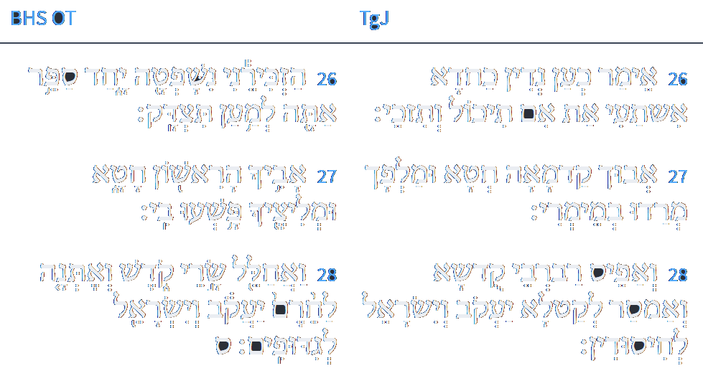
ספר ישעיה פרק מג
לוגוס
ספריה
כו אֱמַר כְּעַן נְדוֹן כַּחֲדָא אִשְׁתָּעֵי אַתְּ בְדִיל אִם תִּכּוּל וְתִזְכֵּי: כז אֲבוּךְ קַדְמָאָה חָטָא וּמַלְפָךְ מְרַדוּ בְמֵימְרִי: כח וְאַפֵּיס רַבְרְבֵי קוּדְשָׁא וְאֶמְסַר לְקַטָלָא יַעֲקֹב וְיִשְׂרָאֵל לְחִסוּדִין:
Isaiah / ישעיה
http://www.matsati.com

