Slide 1
MATSATI.COM Teaching Ministry
Website: https://www.matsati.com YouTube Channel: https://www.youtube.com/user/MATSATI/
ישעיהו מג:ח-יד / Isaiah 43:8-14
LIVE STREAM: 6:30 pm EST Thursday
New Telegram Channel: Messianic Ministries
https://t.me/MessianicMinistries
Focus: The Way of Life - Following Yeshua the Messiah with an emphasis on walking in His footsteps according to the Torah
A Community
for Learning
Discuss the Scriptures,
learn the languages,
and fellowship

Slide 2
Isaiah 43:8-14
ישעיהו מג:ח-יד
What is the Point of Being Called as Witnesses
of the Power of God in Our Lives?
Isaiah / ישעיה
http://www.matsati.com

Slide 3
מבוא לישעיהו
Part 1
Isaiah / ישעיה
http://www.matsati.com

Slide 4
Isaiah 43:14–21
43:14 Thus saith the LORD, your redeemer, the Holy One of Israel; For your sake I have sent to Babylon, And have brought down all their nobles, And the Chaldeans, whose cry is in the ships. 43:15 I am the LORD, your Holy One, The creator of Israel, your King. 43:16 Thus saith the LORD, which maketh a way in the sea, And a path in the mighty waters; 43:17 Which bringeth forth the chariot and horse, the army and the power; They shall lie down together, they shall not rise: They are extinct, they are quenched as tow. 43:18 Remember ye not the former things, Neither consider the things of old. 43:19 Behold, I will do a new thing; Now it shall spring forth; shall ye not know it? I will even make a way in the wilderness, And rivers in the desert. 43:20 The beast of the field shall honour me, The dragons and the owls: Because I give waters in the wilderness, And rivers in the desert, To give drink to my people, my chosen. 43:21 This people have I formed for myself; They shall shew forth my praise. (KJV כֹּֽה־אָמַ֧ר יְהוָ֛ה גֹּאַלְכֶ֖ם קְד֣וֹשׁ יִשְׂרָאֵ֑ל לְמַעַנְכֶ֞ם שִׁלַּ֣חְתִּי בָבֶ֗לָה וְהוֹרַדְתִּ֤י בָֽרִיחִים֙ כֻּלָּ֔ם וְכַשְׂדִּ֖ים בָּאֳנִיּ֥וֹת רִנָּתָֽם׃ אֲנִ֥י יְהוָ֖ה קְדֽוֹשְׁכֶ֑ם בּוֹרֵ֥א יִשְׂרָאֵ֖ל מַלְכְּכֶֽם׃ כֹּ֚ה אָמַ֣ר יְהוָ֔ה הַנּוֹתֵ֥ן בַּיָּ֖ם דָּ֑רֶךְ וּבְמַ֥יִם עַזִּ֖ים נְתִיבָֽה׃ הַמּוֹצִ֥יא רֶֽכֶב־וָס֖וּס חַ֣יִל וְעִזּ֑וּז יַחְדָּ֤ו יִשְׁכְּבוּ֙ בַּל־יָק֔וּמוּ דָּעֲכ֖וּ כַּפִּשְׁתָּ֥ה כָבֽוּ׃ אַֽל־תִּזְכְּר֖וּ רִֽאשֹׁנ֑וֹת וְקַדְמֹנִיּ֖וֹת אַל־תִּתְבֹּנָֽנוּ׃ הִנְנִ֨י עֹשֶׂ֤ה חֲדָשָׁה֙ עַתָּ֣ה תִצְמָ֔ח הֲל֖וֹא תֵֽדָע֑וּהָ אַ֣ף אָשִׂ֤ים בַּמִּדְבָּר֙ דֶּ֔רֶךְ בִּֽישִׁמ֖וֹן נְהָרֽוֹת׃ תְּכַבְּדֵ֙נִי֙ חַיַּ֣ת הַשָּׂדֶ֔ה תַּנִּ֖ים וּבְנ֣וֹת יַֽעֲנָ֑ה כִּֽי־נָתַ֨תִּי בַמִּדְבָּ֜ר מַ֗יִם נְהָרוֹת֙ בִּֽישִׁימֹ֔ן לְהַשְׁק֖וֹת עַמִּ֥י בְחִירִֽי׃ עַם־זוּ֙ יָצַ֣רְתִּי לִ֔י תְּהִלָּתִ֖י יְסַפֵּֽרוּ׃)
Isaiah / ישעיה
http://www.matsati.com

Slide 5
Isaiah 43:22–28
43:22 But thou hast not called upon me, O Jacob; But thou hast been weary of me, O Israel. 43:23 Thou hast not brought me the small cattle of thy burnt offerings; Neither hast thou honoured me with thy sacrifices. I have not caused thee to serve with an offering, Nor wearied thee with incense. 43:24 Thou hast bought me no sweet cane with money, Neither hast thou filled me with the fat of thy sacrifices: But thou hast made me to serve with thy sins, Thou hast wearied me with thine iniquities. 43:25 I, even I, am he that blotteth out thy transgressions for mine own sake, And will not remember thy sins. 43:26 Put me in remembrance: let us plead together: Declare thou, that thou mayest be justified. 43:27 Thy first father hath sinned, And thy teachers have transgressed against me. 43:28 Therefore I have profaned the princes of the sanctuary, And have given Jacob to the curse, And Israel to reproaches. (KJV וְלֹא־אֹתִ֥י קָרָ֖אתָ יַֽעֲקֹ֑ב כִּֽי־יָגַ֥עְתָּ בִּ֖י יִשְׂרָאֵֽל׃ לֹֽא־הֵבֵ֤יאתָ לִּי֙ שֵׂ֣ה עֹלֹתֶ֔יךָ וּזְבָחֶ֖יךָ לֹ֣א כִבַּדְתָּ֑נִי לֹ֤א הֶעֱבַדְתִּ֙יךָ֙ בְּמִנְחָ֔ה וְלֹ֥א הוֹגַעְתִּ֖יךָ בִּלְבוֹנָֽה׃ לֹא־קָנִ֨יתָ לִּ֤י בַכֶּ֙סֶף֙ קָנֶ֔ה וְחֵ֥לֶב זְבָחֶ֖יךָ לֹ֣א הִרְוִיתָ֑נִי אַ֗ךְ הֶעֱבַדְתַּ֙נִי֙ בְּחַטֹּאותֶ֔יךָ הוֹגַעְתַּ֖נִי בַּעֲוֺנֹתֶֽיךָ׃ אָנֹכִ֨י אָנֹכִ֥י ה֛וּא מֹחֶ֥ה פְשָׁעֶ֖יךָ לְמַעֲנִ֑י וְחַטֹּאתֶ֖יךָ לֹ֥א אֶזְכֹּֽר׃ הַזְכִּירֵ֕נִי נִשָּׁפְטָ֖ה יָ֑חַד סַפֵּ֥ר אַתָּ֖ה לְמַ֥עַן תִּצְדָּֽק׃ אָבִ֥יךָ הָרִאשׁ֖וֹן חָטָ֑א וּמְלִיצֶ֖יךָ פָּ֥שְׁעוּ בִֽי׃ וַאֲחַלֵּ֖ל שָׂ֣רֵי קֹ֑דֶשׁ וְאֶתְּנָ֤ה לַחֵ֙רֶם֙ יַעֲקֹ֔ב וְיִשְׂרָאֵ֖ל לְגִדּוּפִֽים׃)
Isaiah / ישעיה
http://www.matsati.com

Slide 6
Isaiah 44:1–5
44:1 Yet now hear, O Jacob my servant; And Israel, whom I have chosen: 44:2 Thus saith the LORD that made thee, And formed thee from the womb, which will help thee; Fear not, O Jacob, my servant; And thou, Jesurun, whom I have chosen. 44:3 For I will pour water upon him that is thirsty, And floods upon the dry ground: I will pour my spirit upon thy seed, And my blessing upon thine offspring: 44:4 And they shall spring up as among the grass, As willows by the water courses. 44:5 One shall say, I am the LORD’s; And another shall call himself by the name of Jacob; And another shall subscribe with his hand unto the LORD, And surname himself by the name of Israel. (KJV וְעַתָּ֥ה שְׁמַ֖ע יַעֲקֹ֣ב עַבְדִּ֑י וְיִשְׂרָאֵ֖ל בָּחַ֥רְתִּי בֽוֹ׃ כֹּה־אָמַ֨ר יְהוָ֥ה עֹשֶׂ֛ךָ וְיֹצֶרְךָ֥ מִבֶּ֖טֶן יַעְזְרֶ֑ךָּ אַל־תִּירָא֙ עַבְדִּ֣י יַֽעֲקֹ֔ב וִישֻׁר֖וּן בָּחַ֥רְתִּי בֽוֹ׃ כִּ֤י אֶצָּק־מַ֙יִם֙ עַל־צָמֵ֔א וְנֹזְלִ֖ים עַל־יַבָּשָׁ֑ה אֶצֹּ֤ק רוּחִי֙ עַל־זַרְעֶ֔ךָ וּבִרְכָתִ֖י עַל־צֶאֱצָאֶֽיךָ׃ וְצָמְח֖וּ בְּבֵ֣ין חָצִ֑יר כַּעֲרָבִ֖ים עַל־יִבְלֵי־מָֽיִם׃ זֶ֤ה יֹאמַר֙ לַֽיהוָ֣ה אָ֔נִי וְזֶ֖ה יִקְרָ֣א בְשֵֽׁם־יַעֲקֹ֑ב וְזֶ֗ה יִכְתֹּ֤ב יָדוֹ֙ לַֽיהוָ֔ה וּבְשֵׁ֥ם יִשְׂרָאֵ֖ל יְכַנֶּֽה׃)
Isaiah / ישעיה
http://www.matsati.com

Slide 7
ספר ישעיה
Part 2
Isaiah / ישעיה
http://www.matsati.com

Slide 8
﻿ספר ישעיה פרק מג
﻿ח הוֹצִיא עַם-עִוֵּר וְעֵינַיִם יֵשׁ וְחֵרְשִׁים וְאָזְנַיִם לָמוֹ: ט כָּל-הַגּוֹיִם נִקְבְּצוּ יַחְדָּו וְיֵאָסְפוּ לְאֻמִּים מִי בָהֶם יַגִּיד זֹאת וְרִאשֹׁנוֹת יַשְׁמִיעֻנוּ יִתְּנוּ עֵדֵיהֶם וְיִצְדָּקוּ וְיִשְׁמְעוּ וְיֹאמְרוּ אֱמֶת: י אַתֶּם עֵדַי נְאֻם-יְהֹוָה וְעַבְדִּי אֲשֶׁר בָּחָרְתִּי לְמַעַן תֵּדְעוּ וְתַאֲמִינוּ לִי וְתָבִינוּ כִּי-אֲנִי הוּא לְפָנַי לֹא-נוֹצַר אֵל וְאַחֲרַי לֹא יִהְיֶה: יא אָנֹכִי אָנֹכִי יְהֹוָה וְאֵין מִבַּלְעָדַי מוֹשִׁיעַ: יב אָנֹכִי הִגַּדְתִּי וְהוֹשַׁעְתִּי וְהִשְׁמַעְתִּי וְאֵין בָּכֶם זָר וְאַתֶּם עֵדַי נְאֻם-יְהֹוָה וַאֲנִי-אֵל: יג גַּם-מִיּוֹם אֲנִי הוּא וְאֵין מִיָּדִי מַצִּיל אֶפְעַל וּמִי יְשִׁיבֶנָּה: יד כֹּה-אָמַר יְהֹוָה גֹּאַלְכֶם קְדוֹשׁ יִשְֹרָאֵל לְמַעַנְכֶם שִׁלַּחְתִּי בָבֶלָה וְהוֹרַדְתִּי בָרִיחִים כֻּלָּם וְכַשְֹדִּים בָּאֳנִיּוֹת רִנָּתָם:
Isaiah / ישעיה
http://www.matsati.com

Slide 9
John 9:39
9:39 And Jesus said, For judgment I am come into this world, that they which see not might see; and that they which see might be made blind. (KJV Καὶ εἶπεν ὁ Ἰησοῦς· εἰς κρίμα ἐγὼ εἰς τὸν κόσμον τοῦτον ἦλθον, ἵνα οἱ μὴ βλέποντες βλέπωσιν καὶ οἱ βλέποντες τυφλοὶ γένωνται.)
Revelation 16:14
16:14 For they are the spirits of devils, working miracles, which go forth unto the kings of the earth and of the whole world, to gather them to the battle of that great day of God Almighty. (KJV εἰσὶν γὰρ πνεύματα δαιμονίων ποιοῦντα σημεῖα, ἃ ἐκπορεύεται ἐπὶ τοὺς βασιλεῖς τῆς οἰκουμένης ὅλης συναγαγεῖν αὐτοὺς εἰς τὸν πόλεμον τῆς ἡμέρας τῆς μεγάλης τοῦ θεοῦ τοῦ παντοκράτορος.)
Isaiah / ישעיה
http://www.matsati.com

Slide 10
Devarim / Deuteronomy 29:4
29:4 Yet the LORD hath not given you an heart to perceive, and eyes to see, and ears to hear, unto this day. (KJV וָאוֹלֵ֥ךְ אֶתְכֶ֛ם אַרְבָּעִ֥ים שָׁנָ֖ה בַּמִּדְבָּ֑ר לֹֽא־בָל֤וּ שַׂלְמֹֽתֵיכֶם֙ מֵעֲלֵיכֶ֔ם וְנַֽעַלְךָ֥ לֹֽא־בָלְתָ֖ה מֵעַ֥ל רַגְלֶֽךָ׃)
Jeremiah 5:21
5:21 Hear now this, O foolish people, and without understanding; which have eyes, and see not; which have ears, and hear not: (KJV שִׁמְעוּ־נָ֣א זֹ֔את עַ֥ם סָכָ֖ל וְאֵ֣ין לֵ֑ב עֵינַ֤יִם לָהֶם֙ וְלֹ֣א יִרְא֔וּ אָזְנַ֥יִם לָהֶ֖ם וְלֹ֥א יִשְׁמָֽעוּ׃)
Isaiah / ישעיה
http://www.matsati.com

Slide 11
John 8:24
8:24 I said therefore unto you, that ye shall die in your sins: for if ye believe not that I am he, ye shall die in your sins. (KJV)
כד לָכֵן אָמַרְתִּי לָכֶם שֶׁתָּמוּתוּ בַּחֲטָאֵיכֶם; שֶׁכֵּן אִם אֵינְכֶם מַאֲמִינִים כִּי אֲנִי הוּא, מוֹת תָּמוּתוּ בַּחֲטָאֵיכֶם.״
24 εἶπον °οὖν ὑμῖν ὅτι ἀποθανεῖσθε ἐν ταῖς ἁμαρτίαις ὑμῶν· ἐὰν γὰρ μὴ πιστεύσητε ⸆ ὅτι ἐγώ εἰμι
Isaiah / ישעיה
http://www.matsati.com

Slide 12
Isaiah 43:10
43:10 “Ye are my witnesses, saith the LORD, and my servant whom I have chosen: that ye may know and believe me, and understand that I am he: before me there was no God formed, neither shall there be after me.
Isaiah 43:10
אַתֶּ֤ם עֵדַי֙ נְאֻם־יְהוָ֔ה וְעַבְדִּ֖י אֲשֶׁ֣ר בָּחָ֑רְתִּי לְמַ֣עַן תֵּ֠דְעוּ וְתַאֲמִ֨ינוּ לִ֤י וְתָבִ֙ינוּ֙ כִּֽי־אֲנִ֣י ה֔וּא לְפָנַי֙ לֹא־נ֣וֹצַר אֵ֔ל וְאַחֲרַ֖י לֹ֥א יִהְיֶֽה׃
10 γένεσθέ μοι μάρτυρες, κἀγὼ μάρτυς, λέγει κύριος ὁ θεός, καὶ ὁ παῖς, ὃν ἐξελεξάμην, ἵνα γνῶτε καὶ πιστεύσητε καὶ συνῆτε ὅτι ἐγώ εἰμι, ἔμπροσθέν μου οὐκ ἐγένετο ἄλλος θεὸς καὶ μετʼ ἐμὲ οὐκ ἔσται,†
Isaiah / ישעיה
http://www.matsati.com

Slide 13
Rabbinic Literature
ספרות רבנית
Part 3
Isaiah / ישעיה
http://www.matsati.com

Slide 14
Targum Jonathan son of Uziel Isaiah 43:8-14
43:8 When I brought forth my people from Egypt, they were like the blind, although they had eyes; and like the deaf, although they had ears. 43:9 Let all the nations be gathered together, let the kingdoms be brought together: who among them can declare this, and give us the joyful tidings of old? let them bring forth their witnesses, that they may be justified; let them hear, and let them speak the truth. 43:10 Ye are my witnesses, saith the Lord, and my servant, the Messiah, in whom is my delight, in order that ye may know, and that ye may believe in me, and understand that I am He who was from the beginning; yea, ages after ages are mine, and beside me there is no god. 43:11 I, even I, am the Lord, and beside me there is no saviour. 43:12 I, I have declared unto Abraham your father what would come to pass; I, I redeemed you out of Egypt, as I swore to him between the pieces; and I, I have made you to hear the doctrine of my law from Sinai, and ye are still alive, when there was no strange god among you; yea, ye are my witnesses, saith the Lord, that I am God. 43:13 Yea, from eternity I am He; and there is none that can deliver out of my hand: I will do it, and who shall turn it back? 43:14 Thus saith the Lord, your Redeemer, the Holy One of Israel, Because of your sins I led you captive to Babylon; but I will prostrate all of them with their oars, yea, the Chaldeans in the ships of which they boast. (TgJ)
Isaiah / ישעיה
http://www.matsati.com

Slide 15
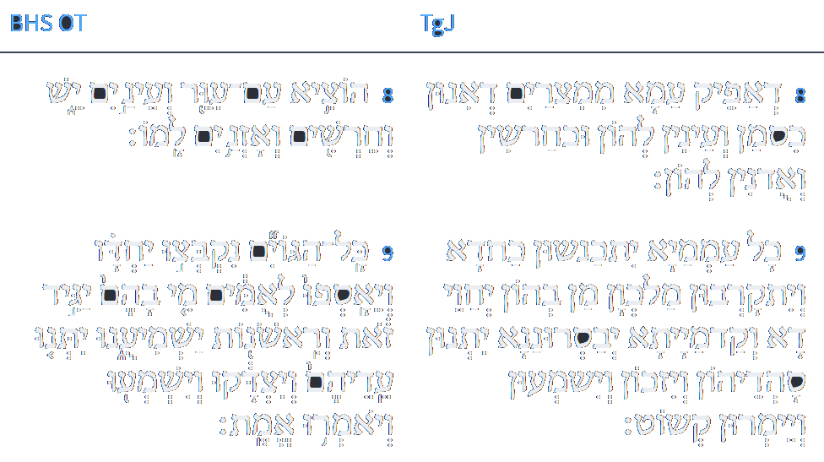
תנך
לוגוס
ספריה
ח דְאַפֵּיק עַמָא מִמִצְרַיִם דְאִינוּן כְּסָמִי וְעַיְנִין לְהוֹן וּכְחַרְשִׁין וְאוּדְנִין לְהוֹן: ט כָּל עַמְמַיָא יִתְכַּנְשׁוּן כַּחֲדָא וְיִתְקַרְבוּן מַלְכְּוָן מַן בְּהוֹן יְחַוֵי דָא וְקַדְמָיָתָא יְבַסְרוּנָנָא יִתְּנוּן סַהֲדֵיהוֹן וְיִזְכּוּן וְיִשְׁמְעוּן וְיֵימְרוּן קְשׁוֹט:
www.sefaria.org
Isaiah / ישעיה
http://www.matsati.com

Slide 16
Shenei Luchot HaBerit, Torah Shebikhtav, Vayakhel, Pekudei, Torah Ohr 87
We have a statement in Avodah Zarah 2 by Rabbi Chanina bar Pappa that in the future G–d personally will appear with a Torah scroll in His lap announcing that anyone who has studied and observed the Torah should come and get his reward. Thereupon the Gentiles would assemble in a disorderly fashion and claim their reward. G–d would tell them to appear in an orderly fashion, each nation separately headed by their scribes, etc. [Scriptural proof is provided for all this in the relevant passage in the Talmud. Ed.] The first nation laying claim to reward would be the Romans who would extol their contributions to civilisation, pointing out the public baths, highways, etc., they had built. They would claim to have done all this in order to enable Israel to devote itself to Torah study. G–d is described as rejecting the claim as foolish, telling them they had done all this for their own sakes. As an example, G–d cites the market-places as having served merely immoral purposes. G–d would ask them if there was none amongst them who could יגיד זאת, i.e. who had devoted himself to Torah (based on Isaiah 43,9 where the word זאת is understood to apply to Torah)? Upon hearing this the Romans would be deeply disappointed, etc." The whole paragraph in the Talmud seems very long-winded. The Talmud could simply have said: זאת=תורה, without listing all the Romans' so-called accomplishments, and G–d's describing them as the very reverse.
Isaiah / ישעיה
http://www.matsati.com

Slide 17
Revelation 20:11–15
20:11 And I saw a great white throne, and him that sat on it, from whose face the earth and the heaven fled away; and there was found no place for them. 20:12 And I saw the dead, small and great, stand before God; and the books were opened: and another book was opened, which is the book of life: and the dead were judged out of those things which were written in the books, according to their works. 20:13 And the sea gave up the dead which were in it; and death and hell delivered up the dead which were in them: and they were judged every man according to their works. 20:14 And death and hell were cast into the lake of fire. This is the second death. 20:15 And whosoever was not found written in the book of life was cast into the lake of fire. (KJV)
Isaiah / ישעיה
http://www.matsati.com

Slide 18
Talmud Bavli Avodah Zarah 4b:15
אמר רבי יהושע בן לוי כל מצות שישראל עושין בעולם הזה באות ומעידות אותם לעולם הבא שנאמר (ישעיהו מג, ט) יתנו עידיהם ויצדקו ישמעו ויאמרו אמת יתנו עידיהם ויצדקו אלו ישראל ישמעו ויאמרו אמת אלו עובדי כוכבים
Rabbi Yehoshua ben Levi says: All of the mitzvot that the Jews perform in this word will come and bear witness for them in the World-to-Come, as it is stated: “Let them bring their witnesses that they may be justified, and let them hear, and say: It is truth” (Isaiah 43:9). He explains: “Let them bring their witnesses that they may be justified”; these are referring to the Jews. “And let them hear, and say: It is truth”; these are referring to the nations of the world.
Isaiah / ישעיה
http://www.matsati.com

Slide 19
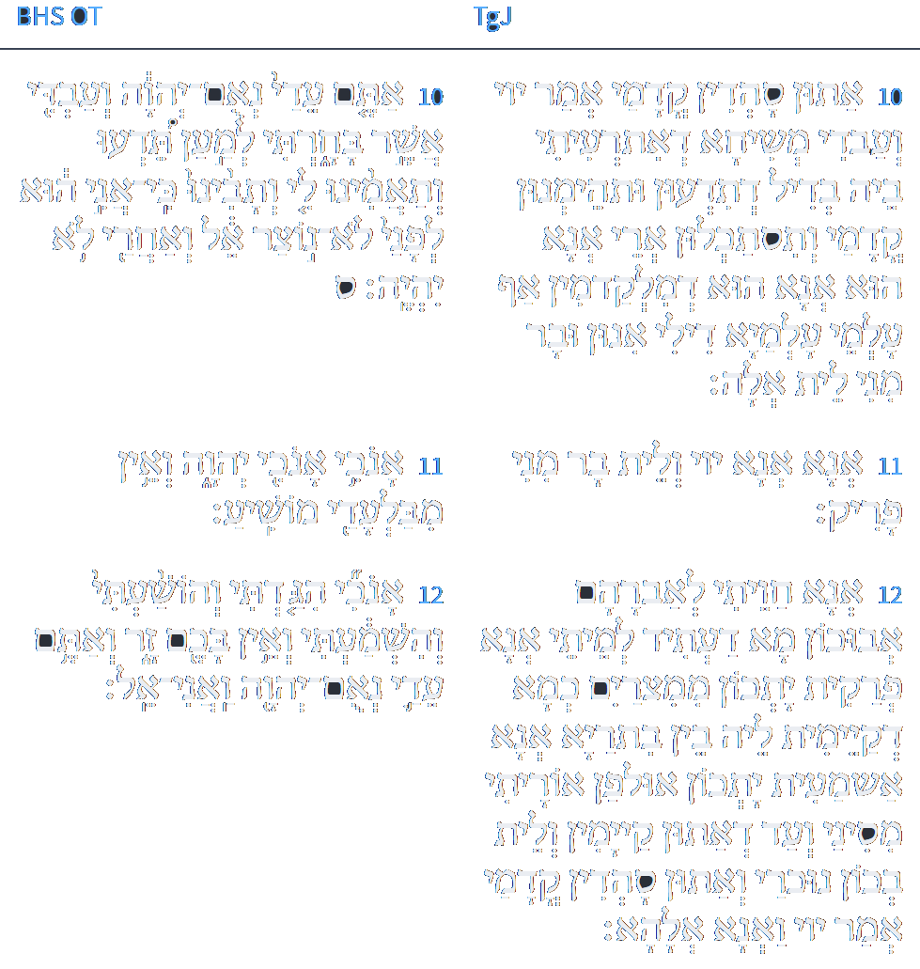
תנך
לוגוס
ספריה
י אַתּוּן סַהֲדִין קֳדָמַי אֲמַר יְיָ וְעַבְדִי מְשִׁיחָא דְאִתְרְעֵתִי בֵיהּ בְּדִיל דְתִידְעוּן וּתְהֵימְנוּן קֳדָמָי וְתִסְתַּכְּלוּן אֲרֵי אֲנָא הוּא דְמִלְקַדְמִין אַף עַלְמֵי עַלְמַיָא דִילִי אִינוּן וּבַר מִנִי לֵית אֱלָהּ:
יא אֲנָא אֲנָא יְיָ וְלֵית בַּר מִנִי פָּרִיק:
יב אֲנָא חֲוֵיתִי לְאַבְרָהָם אֲבוּכוֹן מָה דַעֲתִיד לְמֵיתָא אֲנָא פְּרָקִית יַתְכוֹן מִמִצְרָיִם כְּמָא דְקַיְמִית לֵיהּ בֵּין בִּתְרַיָא וַאֲנָא אַשְׁמְעֵית יַתְכוֹן אוּלְפַן אוֹרַיְתִי מִסִינַי וְעַד אַתּוּן קַיָמִין וְלֵית בְּכוֹן נוּכְרִי וְאַתּוּן סָהֲדִין קֳדָמַי אֲמַר יְיָ וַאֲנָא אֱלָהָא:
www.sefaria.org
Isaiah / ישעיה
http://www.matsati.com

Slide 20
Tanna Debei Eliyahu Rabbah 26:1
This is what God said to Israel: My children what do I seek from you? I seek no more than that you love one another, and honor one another, and that you have awe for one another
Isaiah / ישעיה
http://www.matsati.com

Slide 21
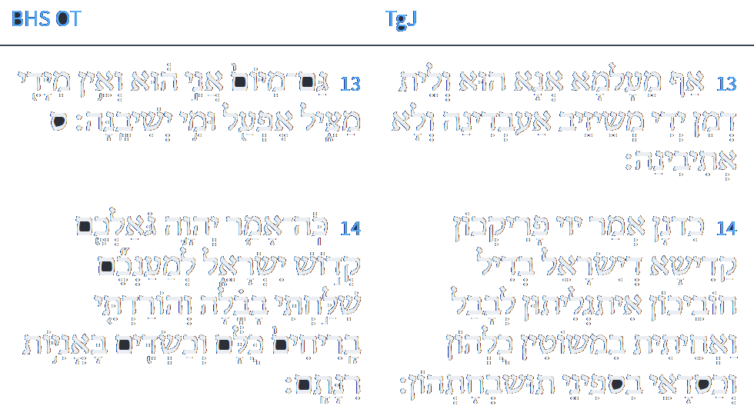
תנך
לוגוס
ספריה
יג אַף מַעַלְמָא אֲנָא הוּא וְלֵית דְמִן יְדִי מְשֵׁיזֵיב אַעַבְדִינָהּ וְלָא אֲתֵיבִינָהּ:
יד כִּדְנַן אֲמַר יְיָ פָרִיקְכוֹן קַדִישָׁא דְיִשְׂרָאֵל בְּדִיל חוֹבֵיכוֹן אַגְלֵיתִי יַתְכוֹן לְבָבֶל וְאַחֲתֵית בִּמְשׁוֹטִין כּוּלְהוֹן וְכַסְדָאֵי בִּסְפִינַי תּוּשְׁבַּחְתְּהוֹן:
www.sefaria.org
Isaiah / ישעיה
http://www.matsati.com

Slide 22
Kav HaYashar 94:1
It states, “Thus said Hashem, for your sake I have sent you into Babylon and I have sent them all down in boats” (Yeshayahu 43:14). [The Zohar comments (Parashas Shemos 2b), “‘I have sent you into Babylon’ — This alludes to the Holy One Blessed is He.”] This illustrates the great love of the Holy One Blessed is He for Israel, on account of which He shares in their afflictions and descends with them into exile. Similarly, regarding the descent into Egypt it is stated, “These are the names of the children of Israel who came to Egypt with [es] Yaakov” (Shemos 1:1). Wherever the word את appears it includes something not mentioned in the verse. In this case it includes the Shechinah, which went down with Yaakov into Egypt, in keeping with the verse, “I will descend with you into Egypt and I will bring you up” (Bereishis 46:4). Regarding the Babylonian exile, however, not only does it state, “For your sake I have sent you into Babylon,” but, “In all their afflictions He is afflicted” (Yeshayahu 63:9). The succeeding exiles were more difficult to bear than the Egyptian exile.
Isaiah / ישעיה
http://www.matsati.com

Slide 23
Shaarei Orah, First Gate, Tenth Sefirah 81
והיינו דאמרינן: חביבין ישראל, שבכל מקום שגלו שכינה עמהם. גלו למצרים שכינה עמהם, שנאמר: הנגלה נגליתי אל בית אביך בהיותם במצרים (שמואל, ב, כז), וכתיב: אנכי ארד עמך מצרימה (בראשית מו, ד) גלו לבבל שכינה עמהם, שנאמר: למענכם שלחתי בבלה (ישעיה מג, יד).
About this, our sages, of blessed memory, stated, “The Jewish people are beloved to the Holy One, blessed is He, and wherever they were exiled, the Indwelling Presence of HaShem-יהו״ה accompanied them. When they were exiled in Egypt, the Shechinah-שכינה was with them, as it states, ‘Did I not appear to the family of your ancestor when they were in Egypt, [enslaved] to the house of Pharaoh?’ Similarly, it is written, ‘I shall descend with You to Egypt.’ When they were exiled to Babylon, the Shechinah was with them. This is as stated, ‘Because of you I was sent to Babylon.’ When they were exiled to Elam, the Shechinah, was with them. This is as stated, ‘I will place My throne in Elam.’
Isaiah / ישעיה
http://www.matsati.com

Slide 24
Talmud Bavli Megillah 29a:4
תַּנְיָא, רַבִּי שִׁמְעוֹן בֶּן יוֹחַי אוֹמֵר: בּוֹא וּרְאֵה כַּמָּה חֲבִיבִין יִשְׂרָאֵל לִפְנֵי הַקָּדוֹשׁ בָּרוּךְ הוּא, שֶׁבְּכָל מָקוֹם שֶׁגָּלוּ — שְׁכִינָה עִמָּהֶן. גָּלוּ לְמִצְרַיִם — שְׁכִינָה עִמָּהֶן, שֶׁנֶּאֱמַר: ״הַנִּגְלֹה נִגְלֵיתִי לְבֵית אָבִיךָ בִּהְיוֹתָם בְּמִצְרַיִם וְגוֹ׳״. גָּלוּ לְבָבֶל — שְׁכִינָה עִמָּהֶן, שֶׁנֶּאֱמַר: ״לְמַעַנְכֶם שֻׁלַּחְתִּי בָבֶלָה״. וְאַף כְּשֶׁהֵן עֲתִידִין לִיגָּאֵל — שְׁכִינָה עִמָּהֶן, שֶׁנֶּאֱמַר: ״וְשָׁב ה׳ אֱלֹהֶיךָ אֶת שְׁבוּתְךָ״. ״וְהֵשִׁיב״ לֹא נֶאֱמַר, אֶלָּא ״וְשָׁב״. מְלַמֵּד שֶׁהַקָּדוֹשׁ בָּרוּךְ הוּא שָׁב עִמָּהֶן מִבֵּין הַגָּלִיּוֹת.
§ It is taught in a baraita: Rabbi Shimon ben Yoḥai says: Come and see how beloved the Jewish people are before the Holy One, Blessed be He. As every place they were exiled, the Divine Presence went with them. They were exiled to Egypt, and the Divine Presence went with them, as it is stated: “Did I reveal myself to the house of your father when they were in Egypt?” (I Samuel 2:27). They were exiled to Babylonia, and the Divine Presence went with them, as it is stated: “For your sake I have sent to Babylonia” (Isaiah 43:14). So too, when, in the future, they will be redeemed, the Divine Presence will be with them, as it is stated: “Then the Lord your God will return with your captivity” (Deuteronomy 30:3). It does not state: He will bring back, i.e., He will cause the Jewish people to return, but rather it says: “He will return,” which teaches that the Holy One, Blessed be He, will return together with them from among the various exiles.
Isaiah / ישעיה
http://www.matsati.com

Slide 25
The Three Major Concepts Illustrated in the Rabbinic Literature
God’s love for Israel
God’s sovereignty over history
The role of the Shechinah
Isaiah / ישעיה
http://www.matsati.com

