Slide 1
MATSATI.COM Teaching Ministry
Website: https://www.matsati.com YouTube Channel: https://www.youtube.com/user/MATSATI/
ישעיהו מג:טו-כא / Isaiah 43:15-21
LIVE STREAM: 6:30 pm EST Thursday
New Telegram Channel: Messianic Ministries
https://t.me/MessianicMinistries
Focus: The Way of Life - Following Yeshua the Messiah with an emphasis on walking in His footsteps according to the Torah
A Community
for Learning
Discuss the Scriptures,
learn the languages,
and fellowship

Slide 2
Isaiah 43:15-21
ישעיהו מג:טו-כא
How Does God Solve the Issue of Man
Giving into the Yetzer Hara?
Isaiah / ישעיה
http://www.matsati.com

Slide 3
מבוא לישעיהו
Part 1
Isaiah / ישעיה
http://www.matsati.com

Slide 4
Ephesians 2:8–9
2:8 For by grace are ye saved through faith; and that not of yourselves: it is the gift of God: 2:9 Not of works, lest any man should boast. (KJV Τῇ γὰρ χάριτί ἐστε σεσῳσμένοι διὰ πίστεως· καὶ τοῦτο οὐκ ἐξ ὑμῶν, θεοῦ τὸ δῶρον· οὐκ ἐξ ἔργων, ἵνα μή τις καυχήσηται.)
Romans 3:28
3:28 Therefore we conclude that a man is justified by faith without the deeds of the law. (KJV λογιζόμεθα γὰρ δικαιοῦσθαι πίστει ἄνθρωπον χωρὶς ἔργων νόμου.)
Titus 3:5
3:5 Not by works of righteousness which we have done, but according to his mercy he saved us, by the washing of regeneration, and renewing of the Holy Ghost; (KJV οὐκ ἐξ ἔργων τῶν ἐν δικαιοσύνῃ ἃ ἐποιήσαμεν ἡμεῖς ἀλλὰ κατὰ τὸ αὐτοῦ ἔλεος ἔσωσεν ἡμᾶς διὰ λουτροῦ παλιγγενεσίας καὶ ἀνακαινώσεως πνεύματος ἁγίου,)
Isaiah / ישעיה
http://www.matsati.com

Slide 5
2 Timothy 1:9
1:9 Who hath saved us, and called us with an holy calling, not according to our works, but according to his own purpose and grace, which was given us in Christ Jesus before the world began, (KJV τοῦ σώσαντος ἡμᾶς καὶ καλέσαντος κλήσει ἁγίᾳ, οὐ κατὰ τὰ ἔργα ἡμῶν ἀλλὰ κατὰ ἰδίαν πρόθεσιν καὶ χάριν, τὴν δοθεῖσαν ἡμῖν ἐν Χριστῷ Ἰησοῦ πρὸ χρόνων αἰωνίων,)
Galatians 2:16
2:16 Knowing that a man is not justified by the works of the law, but by the faith of Jesus Christ, even we have believed in Jesus Christ, that we might be justified by the faith of Christ, and not by the works of the law: for by the works of the law shall no flesh be justified. (KJV εἰδότες [δὲ] ὅτι οὐ δικαιοῦται ἄνθρωπος ἐξ ἔργων νόμου ἐὰν μὴ διὰ πίστεως Ἰησοῦ Χριστοῦ, καὶ ἡμεῖς εἰς Χριστὸν Ἰησοῦν ἐπιστεύσαμεν, ἵνα δικαιωθῶμεν ἐκ πίστεως Χριστοῦ καὶ οὐκ ἐξ ἔργων νόμου, ὅτι ἐξ ἔργων νόμου οὐ δικαιωθήσεται πᾶσα σάρξ.)
Isaiah / ישעיה
http://www.matsati.com

Slide 6
Mark 1:23–24
1:23 And there was in their synagogue a man with an unclean spirit; and he cried out, 1:24 Saying, Let us alone; what have we to do with thee, thou Jesus of Nazareth? art thou come to destroy us? I know thee who thou art, the Holy One of God. (KJV Καὶ εὐθὺς ἦν ἐν τῇ συναγωγῇ αὐτῶν ἄνθρωπος ἐν πνεύματι ἀκαθάρτῳ καὶ ἀνέκραξεν λέγων· τί ἡμῖν καὶ σοί, Ἰησοῦ Ναζαρηνέ; ἦλθες ἀπολέσαι ἡμᾶς; οἶδά σε τίς εἶ, ὁ ἅγιος τοῦ θεοῦ.)
Luke 4:33–34
4:33 And in the synagogue there was a man, which had a spirit of an unclean devil, and cried out with a loud voice, 4:34 Saying, Let us alone; what have we to do with thee, thou Jesus of Nazareth? art thou come to destroy us? I know thee who thou art; the Holy One of God. (KJV Καὶ ἐν τῇ συναγωγῇ ἦν ἄνθρωπος ἔχων πνεῦμα δαιμονίου ἀκαθάρτου καὶ ἀνέκραξεν φωνῇ μεγάλῃ· ἔα, τί ἡμῖν καὶ σοί, Ἰησοῦ Ναζαρηνέ; ἦλθες ἀπολέσαι ἡμᾶς; οἶδά σε τίς εἶ, ὁ ἅγιος τοῦ θεοῦ.)
Isaiah / ישעיה
http://www.matsati.com

Slide 7
John 6:69
6:69 And we believe and are sure that thou art that Christ, the Son of the living God. (KJV καὶ ἡμεῖς πεπιστεύκαμεν καὶ ἐγνώκαμεν ὅτι σὺ εἶ ὁ ἅγιος τοῦ θεοῦ.)
Acts 3:14
3:14 But ye denied the Holy One and the Just, and desired a murderer to be granted unto you; (KJV ὑμεῖς δὲ τὸν ἅγιον καὶ δίκαιον ἠρνήσασθε καὶ ᾐτήσασθε ἄνδρα φονέα χαρισθῆναι ὑμῖν,)
Isaiah / ישעיה
http://www.matsati.com

Slide 8
ספר ישעיה
Part 2
Isaiah / ישעיה
http://www.matsati.com

Slide 9
﻿ספר ישעיה פרק מג
﻿טו אֲנִי יְהֹוָה קְדוֹשְׁכֶם בּוֹרֵא יִשְֹרָאֵל מַלְכְּכֶם: טז כֹּה אָמַר יְהֹוָה הַנּוֹתֵן בַּיָּם דָּרֶךְ וּבְמַיִם עַזִּים נְתִיבָה: יז הַמּוֹצִיא רֶכֶב-וָסוּס חַיִל וְעִזּוּז יַחְדָּו יִשְׁכְּבוּ בַּל-יָקוּמוּ דָּעֲכוּ כַּפִּשְׁתָּה כָבוּ: יח אַל-תִּזְכְּרוּ רִאשֹׁנוֹת וְקַדְמֹנִיּוֹת אַל-תִּתְבֹּנָנוּ: יט הִנְנִי עֹשֶֹה חֲדָשָׁה עַתָּה תִצְמָח הֲלוֹא תֵּדָעוּהָ אַף אָשִֹים בַּמִּדְבָּר דֶּרֶךְ בִּישִׁמוֹן נְהָרוֹת: כ תְּכַבְּדֵנִי חַיַּת הַשָּׂדֶה תַּנִּים וּבְנוֹת יַעֲנָה כִּי-נָתַתִּי בַמִּדְבָּר מַיִם נְהָרוֹת בִּישִׁימֹן לְהַשְׁקוֹת עַמִּי בְחִירִי: כא עַם-זוּ יָצַרְתִּי לִי תְּהִלָּתִי יְסַפֵּרוּ:
Isaiah / ישעיה
http://www.matsati.com

Slide 10
אֲנִי יְהֹוָה קְדוֹשְׁכֶם בּוֹרֵא יִשְֹרָאֵל מַלְכְּכֶם
Isaiah / ישעיה
http://www.matsati.com

Slide 11
John 12:39–41
12:39 For this reason they could not believe, for Isaiah said again, 12:40 “HE HAS BLINDED THEIR EYES AND HE HARDENED THEIR HEART, SO THAT THEY WOULD NOT SEE WITH THEIR EYES AND PERCEIVE WITH THEIR HEART, AND BE CONVERTED AND I HEAL THEM.” 12:41 These things Isaiah said because he saw His glory, and he spoke of Him. (NASB διὰ τοῦτο οὐκ ἠδύναντο πιστεύειν, ὅτι πάλιν εἶπεν Ἠσαΐας· τετύφλωκεν αὐτῶν τοὺς ὀφθαλμοὺς καὶ ἐπώρωσεν αὐτῶν τὴν καρδίαν, ἵνα μὴ ἴδωσιν τοῖς ὀφθαλμοῖς καὶ νοήσωσιν τῇ καρδίᾳ καὶ στραφῶσιν, καὶ ἰάσομαι αὐτούς. ταῦτα εἶπεν Ἠσαΐας ὅτι εἶδεν τὴν δόξαν αὐτοῦ, καὶ ἐλάλησεν περὶ αὐτοῦ.)
Acts 3:14
3:14 “But you disowned the Holy and Righteous One and asked for a murderer to be granted to you, (NASB ὑμεῖς δὲ τὸν ἅγιον καὶ δίκαιον ἠρνήσασθε καὶ ᾐτήσασθε ἄνδρα φονέα χαρισθῆναι ὑμῖν,)
Isaiah / ישעיה
http://www.matsati.com

Slide 12
John 7:37–39
7:37 In the last day, that great day of the feast, Jesus stood and cried, saying, If any man thirst, let him come unto me, and drink. 7:38 He that believeth on me, as the scripture hath said, out of his belly shall flow rivers of living water. 7:39 (But this spake he of the Spirit, which they that believe on him should receive: for the Holy Ghost was not yet given; because that Jesus was not yet glorified.) (KJV Ἐν δὲ τῇ ἐσχάτῃ ἡμέρᾳ τῇ μεγάλῃ τῆς ἑορτῆς εἱστήκει ὁ Ἰησοῦς καὶ ἔκραξεν λέγων· ἐάν τις διψᾷ ἐρχέσθω πρός με καὶ πινέτω. ὁ πιστεύων εἰς ἐμέ, καθὼς εἶπεν ἡ γραφή, ποταμοὶ ἐκ τῆς κοιλίας αὐτοῦ ῥεύσουσιν ὕδατος ζῶντος. τοῦτο δὲ εἶπεν περὶ τοῦ πνεύματος ὃ ἔμελλον λαμβάνειν οἱ πιστεύσαντες εἰς αὐτόν· οὔπω γὰρ ἦν πνεῦμα, ὅτι Ἰησοῦς οὐδέπω ἐδοξάσθη.)
Isaiah / ישעיה
http://www.matsati.com

Slide 13
2 Corinthians 5:17
5:17 Therefore if any man be in Christ, he is a new creature: old things are passed away; behold, all things are become new. (KJV ὥστε εἴ τις ἐν Χριστῷ, καινὴ κτίσις· τὰ ἀρχαῖα παρῆλθεν, ἰδοὺ γέγονεν καινά.)
Revelation 21:27
21:27 And there shall in no wise enter into it any thing that defileth, neither whatsoever worketh abomination, or maketh a lie: but they which are written in the Lamb’s book of life. (KJV καὶ οὐ μὴ εἰσέλθῃ εἰς αὐτὴν πᾶν κοινὸν καὶ [ὁ] ποιῶν βδέλυγμα καὶ ψεῦδος εἰ μὴ οἱ γεγραμμένοι ἐν τῷ βιβλίῳ τῆς ζωῆς τοῦ ἀρνίου.)
Isaiah / ישעיה
http://www.matsati.com

Slide 14
Luke 1:74–75
1:74 That he would grant unto us, that we being delivered out of the hand of our enemies Might serve him without fear, 1:75 In holiness and righteousness before him, All the days of our life. (KJV ἀφόβως ἐκ χειρὸς ἐχθρῶν ῥυσθέντας λατρεύειν αὐτῷ ἐν ὁσιότητι καὶ δικαιοσύνῃ ἐνώπιον αὐτοῦ πάσαις ταῖς ἡμέραις ἡμῶν.)
Ephesians 1:4–6
1:4 According as he hath chosen us in him before the foundation of the world, that we should be holy and without blame before him in love: 1:5 Having predestinated us unto the adoption of children by Jesus Christ to himself, according to the good pleasure of his will, 1:6 To the praise of the glory of his grace, wherein he hath made us accepted in the beloved. (KJV καθὼς ἐξελέξατο ἡμᾶς ἐν αὐτῷ πρὸ καταβολῆς κόσμου εἶναι ἡμᾶς ἁγίους καὶ ἀμώμους κατενώπιον αὐτοῦ ἐν ἀγάπῃ, προορίσας ἡμᾶς εἰς υἱοθεσίαν διὰ Ἰησοῦ Χριστοῦ εἰς αὐτόν, κατὰ τὴν εὐδοκίαν τοῦ θελήματος αὐτοῦ, εἰς ἔπαινον δόξης τῆς χάριτος αὐτοῦ ἧς ἐχαρίτωσεν ἡμᾶς ἐν τῷ ἠγαπημένῳ.)
Isaiah / ישעיה
http://www.matsati.com

Slide 15
1 Peter 2:9
2:9 But ye are a chosen generation, a royal priesthood, an holy nation, a peculiar people; that ye should shew forth the praises of him who hath called you out of darkness into his marvellous light: (KJV ὑμεῖς δὲ γένος ἐκλεκτόν, βασίλειον ἱεράτευμα, ἔθνος ἅγιον, λαὸς εἰς περιποίησιν, ὅπως τὰς ἀρετὰς ἐξαγγείλητε τοῦ ἐκ σκότους ὑμᾶς καλέσαντος εἰς τὸ θαυμαστὸν αὐτοῦ φῶς·)
Isaiah / ישעיה
http://www.matsati.com

Slide 16
Rabbinic Literature
ספרות רבנית
Part 3
Isaiah / ישעיה
http://www.matsati.com

Slide 17
Targum Jonathan son of Uziel Isaiah 43:15-21
43:15 I am the Lord, your Holy One, the Creator of Israel, your King. 43:16 Thus saith the Lord, I am He who prepared a way in the sea, and a path in mighty waters. 43:17 I who brought out the chariots, and horses, and a great host, yea, much people; they were swallowed up together, they did not rise, they were extinguished, they are extinct like the glimmering wick is extinguished. 43:18 Remember not the former things, neither consider the things of old. 43:19 Behold, I make a new thing, and now it shall be revealed: and will ye not know it? I will even make a way in the wilderness, and rivers in the desert. 43:20 They shall honour me, when I make habitable provinces at the desert, and the places where the dragons and the daughters of the ostrich dwell; because I will give water in the wilderness, rivers in the desert, to give drink to the captives of my people, in whom I delight. 43:21 This people have I prepared for my service, they shall declare my praise. (TgJ)
Isaiah / ישעיה
http://www.matsati.com

Slide 18
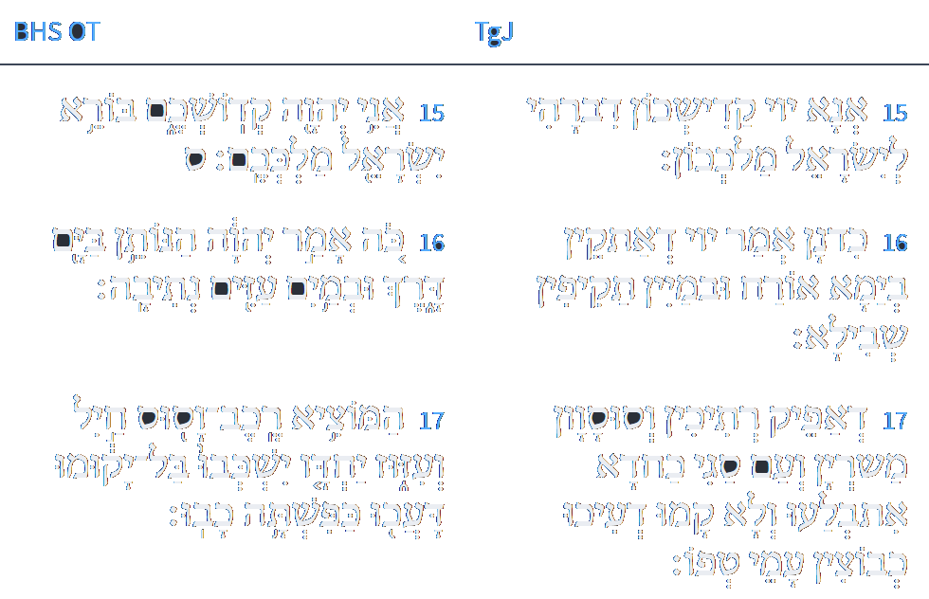
ספר ישעיהו פרק מג
LOGOS
ספריה
טו אֲנָא יְיָ קַדִישְׁכוֹן דִבְרָאֵי לְיִשְׂרָאֵל מַלְכְּכוֹן:טז כִּדְנַן אֲמַר יְיָ דְאַתְקֵין בְּיַמָא אוֹרְחָא וּבְמַיִין תַּקִיפִין שְׁבִילָא: יז דְאַפֵיק רְתִיכִין וְסוּסְוָן מַשִׁרְיָן וְעַם סַגִי כַּחֲדָא אִתְבְּלָעוּ וְלָא קָמוּ דְעִיכוּ כְּבוּצָא עַמִי טְפוֹ:
www.sefaria.org
Isaiah / ישעיה
http://www.matsati.com

Slide 19
Pesikta Rabbati 35:1
...Another explanation. “Sing and rejoice, O daughter of Zion… And many nations shall join the Lord…” (Zechariah 2:14-15) R’ Chanina bar Papa said: this verse is only speaking of that hour when the Holy One judges the nations of the world in the time to come. In that hour the Holy One will bring all of the converts who converted in this world and judge the nations before them. He will say to them: why did you abandon Me and worship idols that have no substance. They will say before Him: Master of the World! If we had come to Your door You would not have accepted us. He will reply to them” let the converts who converted from amongst you and testify upon you. Immediately the Holy One will bring all the converts and they will judge them, saying before them: why did you abandon Him and worship idols that have no substance? Wasn’t Yitro an idolatrous priest? Since he came to the door of the Holy One, He received him. And were we not idol worshippers? Since we came to the door of the Holy One, He received us. Immediately all of the wicked will be ashamed due to the repentance of the converts. Judgment will be passed and they will pass from the world, as it says “But with one thing they are brutish and foolish, the vanities for which they will be punished are but wood.” (Jeremiah 10:8) Therefore it says ‘Sing and rejoice.’
Isaiah / ישעיה
http://www.matsati.com

Slide 20
ספר ישעיהו פרק מג
LOGOS
ספריה
יח לָא תִדְכְּרוּן קַדְמָיָתָא וּדְמִן אַוְלָא לָא תִסְתַּכְּלוּן:
www.sefaria.org
Isaiah / ישעיה
http://www.matsati.com

Slide 21
Midrash Tehillim 149:2
Another thing, sing to God. (Isaiah 43:18) "Do not remember the former things" (ibid. 19) "Behold, I am doing a new thing" (ibid. 21) "This people I have formed for Myself" (ibid.) Thus said the Holy One, blessed be He: Just as I make these new things, so they said to Me to sing a new song. Therefore, it is said, "Sing to God a new song." And why did they see fit to say to sing with joy? Because they see and rejoice with Him, as it is said, "Let God rejoice in His works" (Psalms 104:31), and it is written, "Praise His holy name" (ibid. 105:3), and it is written, "Our soul waits for God" (ibid. 33:20). The Holy One, blessed be He, said: You see Me and rejoice and reveal yourselves, and I also see you and reveal Myself and rejoice, as it is said, "I will rejoice in Jerusalem and delight in My people" (Isaiah 65:19). Therefore it is said, "Let them praise His name with dancing" (Micah 7:15), "As in the days of your exodus from the land of Egypt" (ibid.), as it is said, "And all the women went out" (Exodus 15:20).
Isaiah / ישעיה
http://www.matsati.com

Slide 22
- - . mmon
ספר ישעיהו פרק מג
LOGOS
ספריה
יט הָא אֲנָא עָבִיד חַדְתָּא וּכְעַן תִּתְגְלֵי הֲלָא תֵידְעוּנָהּ אַף אַשַׁוֵי בְמַדְבְּרָא אוֹרַח בְּצַדְיוּתָא נַהַרְוָן:
www.sefaria.org
Isaiah / ישעיה
http://www.matsati.com

Slide 23
Talmud Bavli Berakhot 13a:1
לֹא שֶׁיֵּעָקֵר ״יַעֲקֹב״ מִמְּקוֹמוֹ, אֶלָּא ״יִשְׂרָאֵל״ עִיקָּר וְ״יַעֲקֹב״ טָפֵל לוֹ. וְכֵן הוּא אוֹמֵר ״אַל תִּזְכְּרוּ רִאשֹׁנוֹת וְקַדְמֹנִיּוֹת אַל תִּתְבֹּנָנוּ״: אַל תִּזְכְּרוּ רִאשֹׁנוֹת״ — זֶה שִׁעְבּוּד מַלְכֻיוֹת, ״וְקַדְמֹנִיּוֹת אַל תִּתְבֹּנָנוּ״ — זוֹ יְצִיאַת מִצְרַיִם.
not that the name Jacob will be entirely uprooted from its place, but that the name Israel will be the primary name to which the name Jacob will be secondary, as the Torah continues to refer to him as Jacob after this event. And it also says that the ultimate redemption will overshadow the previous redemption in the verse: “Do not remember the former events, and do not ponder things of old” (Isaiah 43:18), and the Gemara explains: “Do not remember the former events,” that is the subjugation to the kingdoms, and “do not ponder things of old,” that is the exodus from Egypt, which occurred before the subjugation to the nations.
Isaiah / ישעיה
http://www.matsati.com

Slide 24
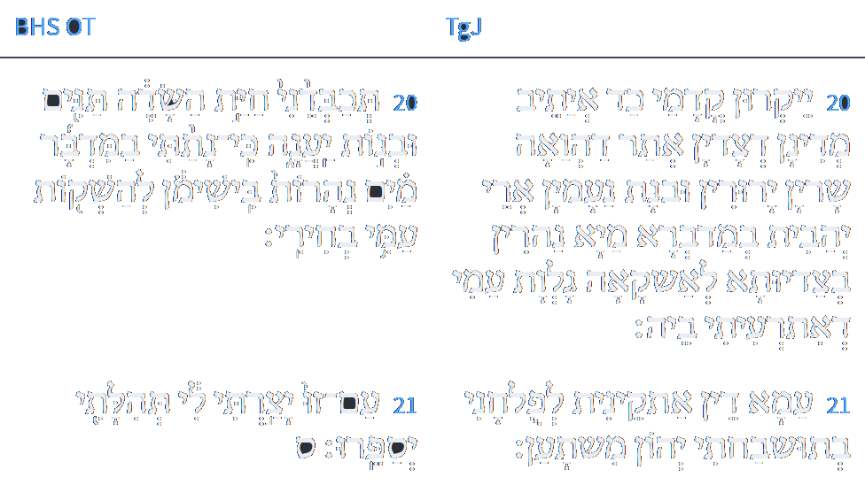
ספר ישעיהו פרק מג
LOGOS
ספריה
כ יְיַקְרוּן קֳדָמַי כַּד אַיְתֵב מְדִינָן דְצַדְיָן אֲתַר דַהֲוָאָה שָׁרְיָן יְרוּדִין וּבְנָת נַעֲמִין אֲרֵי יְהָבִית בְּמַדְבְּרָא מַיָא נַהֲרִין בְּצַדְיוּתָא לְאַשְׁקָאָה גַלְוַת עַמִי דְאִתְרְעֵיתִי בָהּ: כא עַמָא דֵין אַתְקְנֵית לְפוּלְחָנִי בְתוּשְׁבַּחְתִּי יְהוֹן מִשְׁתָּעָן:
www.sefaria.org
Isaiah / ישעיה
http://www.matsati.com

Slide 25
Orchot Tzadikim 28:12
Also consider that the Holy One, Blessed be He, has given permission to no people in the world to tell His praises other than Israel, as it is said, "The people which I have formed for Myself, that they might tell of My praise" (Is. 43:21). And it is written, "For thou art a holy people unto the Lord thy God" (Deut. 7:6). And it is written, "And the Lord hath avouched thee this day to be His own treasure" (Deut. 26:18). And it is written "To make thee high above all nations" (Deut. 26:19). And the Holy One, Blessed be He, did not give any creature the ability to know the Name, Blessed be He, save to Israel, as it is written, "Unto thee it was shown, that thou mightest know that the Lord, He is God; there is none else beside Him" (Deut. 4:35). And it is written, "And what great nation is there, that hath statutes, and ordinances so righteous as all this law, which I set before you this day" (Deut. 4:8). And it is written, "Thou shalt fear the Lord thy God; and Him shalt thou serve" (Deut. 6:13).
Isaiah / ישעיה
http://www.matsati.com

Slide 26
Midrash Tehillim 67:1
To conquer with melodies. May God have mercy on us and bless us. As it is written (Lamentations 3:22): "The Lord's mercies are not consumed." We know that the mercy of the Holy One, blessed be He, endures forever, and His mercies are not exhausted. His mercy towards us is such that even when the nations of the world say (Psalms 47:5): "Let us destroy them from being a nation," His mercies do not cease upon us. Therefore, it is said: "The Lord's mercies are not consumed," and even greater than this is that You renew us and establish us anew every morning, as it is written (Lamentations 3:23): "They are new every morning." From this we know that Your faithfulness is great to all the inhabitants of the world. And the matter of faith that You spoke with our forefathers, when we came to Babylon, the renewal that You made for us, made it little and it passed. And when Moses saw the kingdom of Greece that oppressed us, he began to pray that it should fall into the hand of the staff of Levi, and he began to say (Deuteronomy 33:11): "Bless, Lord, his strength." Therefore, we say "Bless" with a blessing that blesses Your children, and what blessing do we bless them with? "The Lord bless you and keep you" (Numbers 6:24). And also here, "May God have mercy on us and bless us." And if You do so (Psalms 67:16), You will make known Your strength among the nations, as it is said: "That Your way may be known upon earth, Your salvation among all nations." And the Holy One, blessed be He, does not save Israel through their own actions, but to make known His might and to declare His Name. And Asaph said thus (Psalms 76:2): "In Judah is God known; His name is great in Israel." And it is said (Psalms 77:15): "Thou hast with thine arm redeemed thy people, the sons of Jacob and Joseph." And He saved them for the sake of His Name, to make known His might, so that the nations may not say, "We have prevailed over them." Rather, they will acknowledge Him, as it is said: "Let the people praise Thee, O God; let all the people praise Thee" (Psalms 67:4). And thus it is said (Isaiah 35:1): "For as the earth bringeth forth her shoots." And it is said (Isaiah 43:21): "This people have I formed for Myself; they shall declare My praise."
Isaiah / ישעיה
http://www.matsati.com

