Slide 1
MATSATI.COM Teaching Ministry
Website: https://www.matsati.com YouTube Channel: https://www.youtube.com/user/MATSATI/
ישעיהו מג:א-ז / Isaiah 43:1-7
LIVE STREAM: 6:30 pm EST Thursday
New Telegram Channel: Messianic Ministries
https://t.me/MessianicMinistries
Focus: The Way of Life - Following Yeshua the Messiah with an emphasis on walking in His footsteps according to the Torah
A Community
for Learning
Discuss the Scriptures,
learn the languages,
and fellowship

Slide 2
Isaiah 43:1-7
ישעיהו מג:א-ז
The Problem isn't God's Ability to Save,
but the People's Willingness to Listen
Isaiah / ישעיה
http://www.matsati.com

Slide 3
מבוא לישעיהו
Part 1
Isaiah / ישעיה
http://www.matsati.com

Slide 4
Reasons Why God’s People Come Under Judgment
Disobedience to God’s covenant and commandments (Devarim / Deuteronomy 28:15-68, Vayikra / Leviticus 26:14-46).
Idolatry and worship of other gods (Judges 2:11-15, 2 Kings 17:7-23).
Unfaithfulness and corruption (Hosea 4:1-3, Jeremiah 5:1-9).
Injustice and oppression of the poor and the needy (Amos 2:6-8, Isaiah 1:21-23).
Pride and arrogance (Isaiah 2:12-17, Ezekiel 28:11-19).
Isaiah / ישעיה
http://www.matsati.com

Slide 5
ספר ישעיה
Part 2
Isaiah / ישעיה
http://www.matsati.com

Slide 6
﻿ספר ישעיה פרק מג
﻿א וְעַתָּה כֹּה-אָמַר יְהֹוָה בֹּרַאֲךָ יַעֲקֹב וְיֹצֶרְךָ יִשְֹרָאֵל אַל-תִּירָא כִּי גְאַלְתִּיךָ קָרָאתִי בְשִׁמְךָ לִי-אָתָּה: ב כִּי-תַעֲבֹר בַּמַּיִם אִתְּךָ-אָנִי וּבַנְּהָרוֹת לֹא יִשְׁטְפוּךָ כִּי-תֵלֵךְ בְּמוֹ-אֵשׁ לֹא תִכָּוֶה וְלֶהָבָה לֹא תִבְעַר-בָּךְ: ג כִּי אֲנִי יְהֹוָה אֱלֹהֶיךָ קְדוֹשׁ יִשְֹרָאֵל מוֹשִׁיעֶךָ נָתַתִּי כָפְרְךָ מִצְרַיִם כּוּשׁ וּסְבָא תַּחְתֶּיךָ: ד מֵאֲשֶׁר יָקַרְתָּ בְעֵינַי נִכְבַּדְתָּ וַאֲנִי אֲהַבְתִּיךָ וְאֶתֵּן אָדָם תַּחְתֶּיךָ וּלְאֻמִּים תַּחַת נַפְשֶׁךָ: ה אַל-תִּירָא כִּי-אִתְּךָ-אָנִי מִמִּזְרָח אָבִיא זַרְעֶךָ וּמִמַּעֲרָב אֲקַבְּצֶךָּ: ו אֹמַר לַצָּפוֹן תֵּנִי וּלְתֵימָן אַל-תִּכְלָאִי הָבִיאִי בָנַי מֵרָחוֹק וּבְנוֹתַי מִקְצֵה הָאָרֶץ: ז כֹּל הַנִּקְרָא בִשְׁמִי וְלִכְבוֹדִי בְּרָאתִיו יְצַרְתִּיו אַף-עֲשִֹיתִיו:
Isaiah / ישעיה
http://www.matsati.com

Slide 7
Matthew 3:16–17
3:16 And Jesus, when he was baptized, went up straightway out of the water: and, lo, the heavens were opened unto him, and he saw the Spirit of God descending like a dove, and lighting upon him: 3:17 And lo a voice from heaven, saying, This is my beloved Son, in whom I am well pleased. (KJV, βαπτισθεὶς δὲ ὁ Ἰησοῦς εὐθὺς ἀνέβη ἀπὸ τοῦ ὕδατος· καὶ ἰδοὺ ἠνεῴχθησαν [αὐτῷ] οἱ οὐρανοί, καὶ εἶδεν [τὸ] πνεῦμα [τοῦ] θεοῦ καταβαῖνον ὡσεὶ περιστερὰν [καὶ] ἐρχόμενον ἐπʼ αὐτόν· καὶ ἰδοὺ φωνὴ ἐκ τῶν οὐρανῶν λέγουσα· οὗτός ἐστιν ὁ υἱός μου ὁ ἀγαπητός, ἐν ᾧ εὐδόκησα.)
John 10:3–4
10:3 To him the porter openeth; and the sheep hear his voice: and he calleth his own sheep by name, and leadeth them out. 10:4 And when he putteth forth his own sheep, he goeth before them, and the sheep follow him: for they know his voice. (KJV, τούτῳ ὁ θυρωρὸς ἀνοίγει καὶ τὰ πρόβατα τῆς φωνῆς αὐτοῦ ἀκούει καὶ τὰ ἴδια πρόβατα φωνεῖ κατʼ ὄνομα καὶ ἐξάγει αὐτά. ὅταν τὰ ἴδια πάντα ἐκβάλῃ, ἔμπροσθεν αὐτῶν πορεύεται καὶ τὰ πρόβατα αὐτῷ ἀκολουθεῖ, ὅτι οἴδασιν τὴν φωνὴν αὐτοῦ·)
Isaiah / ישעיה
http://www.matsati.com

Slide 8
Romans 8:35–39
8:35 Who shall separate us from the love of Christ? shall tribulation, or distress, or persecution, or famine, or nakedness, or peril, or sword? 8:36 As it is written, For thy sake we are killed all the day long; we are accounted as sheep for the slaughter. 8:37 Nay, in all these things we are more than conquerors through him that loved us. 8:38 For I am persuaded, that neither death, nor life, nor angels, nor principalities, nor powers, nor things present, nor things to come, 8:39 Nor height, nor depth, nor any other creature, shall be able to separate us from the love of God, which is in Christ Jesus our Lord. (KJV, τίς ἡμᾶς χωρίσει ἀπὸ τῆς ἀγάπης τοῦ Χριστοῦ; θλῖψις ἢ στενοχωρία ἢ διωγμὸς ἢ λιμὸς ἢ γυμνότης ἢ κίνδυνος ἢ μάχαιρα; καθὼς γέγραπται ὅτι ἕνεκεν σοῦ θανατούμεθα ὅλην τὴν ἡμέραν, ἐλογίσθημεν ὡς πρόβατα σφαγῆς. ἀλλʼ ἐν τούτοις πᾶσιν ὑπερνικῶμεν διὰ τοῦ ἀγαπήσαντος ἡμᾶς. πέπεισμαι γὰρ ὅτι οὔτε θάνατος οὔτε ζωὴ οὔτε ἄγγελοι οὔτε ἀρχαὶ οὔτε ἐνεστῶτα οὔτε μέλλοντα οὔτε δυνάμεις οὔτε ὕψωμα οὔτε βάθος οὔτε τις κτίσις ἑτέρα δυνήσεται ἡμᾶς χωρίσαι ἀπὸ τῆς ἀγάπης τοῦ θεοῦ τῆς ἐν Χριστῷ Ἰησοῦ τῷ κυρίῳ ἡμῶν.)
Isaiah / ישעיה
http://www.matsati.com

Slide 9
Matthew 3:17
3:17 And lo a voice from heaven, saying, This is my beloved Son, in whom I am well pleased. (KJV καὶ ἰδοὺ φωνὴ ἐκ τῶν οὐρανῶν λέγουσα· οὗτός ἐστιν ὁ υἱός μου ὁ ἀγαπητός, ἐν ᾧ εὐδόκησα.)
Matthew 17:5
17:5 While he yet spake, behold, a bright cloud overshadowed them: and behold a voice out of the cloud, which said, This is my beloved Son, in whom I am well pleased; hear ye him. (KJV ἔτι αὐτοῦ λαλοῦντος ἰδοὺ νεφέλη φωτεινὴ ἐπεσκίασεν αὐτούς, καὶ ἰδοὺ φωνὴ ἐκ τῆς νεφέλης λέγουσα· οὗτός ἐστιν ὁ υἱός μου ὁ ἀγαπητός, ἐν ᾧ εὐδόκησα· ἀκούετε αὐτοῦ.)
Isaiah / ישעיה
http://www.matsati.com

Slide 10
Acts 8:26–40
8:26 And the angel of the Lord spake unto Philip, saying, Arise, and go toward the south unto the way that goeth down from Jerusalem unto Gaza, which is desert. 8:27 And he arose and went: and, behold, a man of Ethiopia, an eunuch of great authority under Candace queen of the Ethiopians, who had the charge of all her treasure, and had come to Jerusalem for to worship, 8:28 Was returning, and sitting in his chariot read Esaias the prophet. 8:29 Then the Spirit said unto Philip, Go near, and join thyself to this chariot. 8:30 And Philip ran thither to him, and heard him read the prophet Esaias, and said, Understandest thou what thou readest? 8:31 And he said, How can I, except some man should guide me? And he desired Philip that he would come up and sit with him. 8:32 The place of the scripture which he read was this, He was led as a sheep to the slaughter; and like a lamb dumb before his shearer, so opened he not his mouth: 8:33 In his humiliation his judgment was taken away: and who shall declare his generation? for his life is taken from the earth. 8:34 And the eunuch answered Philip, and said, I pray thee, of whom speaketh the prophet this? of himself, or of some other man? 8:35 Then Philip opened his mouth, and began at the same scripture, and preached unto him Jesus. 8:36 And as they went on their way, they came unto a certain water: and the eunuch said, See, here is water; what doth hinder me to be baptized? 8:37 And Philip said, If thou believest with all thine heart, thou mayest. And he answered and said, I believe that Jesus Christ is the Son of God. 8:38 And he commanded the chariot to stand still: and they went down both into the water, both Philip and the eunuch; and he baptized him. 8:39 And when they were come up out of the water, the Spirit of the Lord caught away Philip, that the eunuch saw him no more: and he went on his way rejoicing. 8:40 But Philip was found at Azotus: and passing through he preached in all the cities, till he came to Caesarea. (KJV)
Isaiah / ישעיה
http://www.matsati.com

Slide 11
Romans 9:25–26
9:25 As he saith also in Osee, I will call them my people, which were not my people; and her beloved, which was not beloved. 9:26 And it shall come to pass, that in the place where it was said unto them, Ye are not my people; there shall they be called the children of the living God. (KJV ὡς καὶ ἐν τῷ Ὡσηὲ λέγει· καλέσω τὸν οὐ λαόν μου λαόν μου καὶ τὴν οὐκ ἠγαπημένην ἠγαπημένην· καὶ ἔσται ἐν τῷ τόπῳ οὗ ἐρρέθη αὐτοῖς· οὐ λαός μου ὑμεῖς, ἐκεῖ κληθήσονται υἱοὶ θεοῦ ζῶντος.)
Mishley / Proverbs 21:18
21:18 The wicked shall be a ransom for the righteous, And the transgressor for the upright. (KJV כֹּ֣פֶר לַצַּדִּ֣יק רָשָׁ֑ע וְתַ֖חַת יְשָׁרִ֣ים בּוֹגֵֽד׃)
Isaiah / ישעיה
http://www.matsati.com

Slide 12
Matthew 24:31
24:31 And he shall send his angels with a great sound of a trumpet, and they shall gather together his elect from the four winds, from one end of heaven to the other. (KJV καὶ ἀποστελεῖ τοὺς ἀγγέλους αὐτοῦ μετὰ σάλπιγγος μεγάλης, καὶ ἐπισυνάξουσιν τοὺς ἐκλεκτοὺς αὐτοῦ ἐκ τῶν τεσσάρων ἀνέμων ἀπʼ ἄκρων οὐρανῶν ἕως [τῶν] ἄκρων αὐτῶν.)
Mark 13:27
13:27 And then shall he send his angels, and shall gather together his elect from the four winds, from the uttermost part of the earth to the uttermost part of heaven. (KJV καὶ τότε ἀποστελεῖ τοὺς ἀγγέλους καὶ ἐπισυνάξει τοὺς ἐκλεκτοὺς [αὐτοῦ] ἐκ τῶν τεσσάρων ἀνέμων ἀπʼ ἄκρου γῆς ἕως ἄκρου οὐρανοῦ.)
Isaiah / ישעיה
http://www.matsati.com

Slide 13
ספר דברים פרק ד
ד וְאַתֶּם הַדְּבֵקִים בַּיהוָֹה אֱלֹהֵיכֶם חַיִּים כֻּלְּכֶם הַיּוֹם: ה רְאֵה | לִמַּדְתִּי אֶתְכֶם חֻקִּים וּמִשְׁפָּטִים כַּאֲשֶׁר צִוַּנִי יְהוָֹה אֱלֹהָי לַעֲשֹוֹת כֵּן בְּקֶרֶב הָאָרֶץ אֲשֶׁר אַתֶּם בָּאִים שָׁמָּה לְרִשְׁתָּהּ: ו וּשְׁמַרְתֶּם וַעֲשִֹיתֶם כִּי הִוא חָכְמַתְכֶם וּבִינַתְכֶם לְעֵינֵי הָעַמִּים אֲשֶׁר יִשְׁמְעוּן אֵת כָּל-הַחֻקִּים הָאֵלֶּה וְאָמְרוּ רַק עַם-חָכָם וְנָבוֹן הַגּוֹי הַגָּדוֹל הַזֶּה: ז כִּי מִי-גוֹי גָּדוֹל אֲשֶׁר-לוֹ אֱלֹהִים קְרֹבִים אֵלָיו כַּיהוָֹה אֱלֹהֵינוּ בְּכָל-קָרְאֵנוּ אֵלָיו: ח וּמִי גּוֹי גָּדוֹל אֲשֶׁר-לוֹ חֻקִּים וּמִשְׁפָּטִים צַדִּיקִם כְּכֹל הַתּוֹרָה הַזֹּאת אֲשֶׁר אָנֹכִי נֹתֵן לִפְנֵיכֶם הַיּוֹם
Isaiah / ישעיה
http://www.matsati.com

Slide 14
Isaiah 11:11–12
11:11 And it shall come to pass in that day, That the Lord shall set his hand again the second time To recover the remnant of his people, Which shall be left, from Assyria, And from Egypt, and from Pathros, And from Cush, and from Elam, and from Shinar, And from Hamath, and from the islands of the sea. 11:12 And he shall set up an ensign for the nations, And shall assemble the outcasts of Israel, And gather together the dispersed of Judah From the four corners of the earth. (KJV וְהָיָ֣ה׀ בַּיּ֣וֹם הַה֗וּא יוֹסִ֨יף אֲדֹנָ֤י׀ שֵׁנִית֙ יָד֔וֹ לִקְנ֖וֹת אֶת־שְׁאָ֣ר עַמּ֑וֹ אֲשֶׁ֣ר יִשָּׁאֵר֩ מֵאַשּׁ֨וּר וּמִמִּצְרַ֜יִם וּמִפַּתְר֣וֹס וּמִכּ֗וּשׁ וּמֵעֵילָ֤ם וּמִשִּׁנְעָר֙ וּמֵ֣חֲמָ֔ת וּמֵאִיֵּ֖י הַיָּֽם׃ וְנָשָׂ֥א נֵס֙ לַגּוֹיִ֔ם וְאָסַ֖ף נִדְחֵ֣י יִשְׂרָאֵ֑ל וּנְפֻצ֤וֹת יְהוּדָה֙ יְקַבֵּ֔ץ מֵאַרְבַּ֖ע כַּנְפ֥וֹת הָאָֽרֶץ׃)
Isaiah 27:13
27:13 And it shall come to pass in that day, That the great trumpet shall be blown, And they shall come which were ready to perish in the land of Assyria, And the outcasts in the land of Egypt, And shall worship the LORD in the holy mount at Jerusalem. (KJV וְהָיָ֣ה׀ בַּיּ֣וֹם הַה֗וּא יִתָּקַע֮ בְּשׁוֹפָ֣ר גָּדוֹל֒ וּבָ֗אוּ הָאֹֽבְדִים֙ בְּאֶ֣רֶץ אַשּׁ֔וּר וְהַנִּדָּחִ֖ים בְּאֶ֣רֶץ מִצְרָ֑יִם וְהִשְׁתַּחֲו֧וּ לַיהוָ֛ה בְּהַ֥ר הַקֹּ֖דֶשׁ בִּירוּשָׁלִָֽם׃)
Isaiah / ישעיה
http://www.matsati.com

Slide 15
Isaiah 49:12
49:12 Behold, these shall come from far: And, lo, these from the north and from the west; And these from the land of Sinim. (KJV הִנֵּה־אֵ֕לֶּה מֵרָח֖וֹק יָבֹ֑אוּ וְהִֽנֵּה־אֵ֙לֶּה֙ מִצָּפ֣וֹן וּמִיָּ֔ם וְאֵ֖לֶּה מֵאֶ֥רֶץ סִינִֽים׃)
Isaiah 60:4
60:4 Lift up thine eyes round about, and see: All they gather themselves together, they come to thee: Thy sons shall come from far, And thy daughters shall be nursed at thy side. (KJV שְׂאִֽי־סָבִ֤יב עֵינַ֙יִךְ֙ וּרְאִ֔י כֻּלָּ֖ם נִקְבְּצ֣וּ בָֽאוּ־לָ֑ךְ בָּנַ֙יִךְ֙ מֵרָח֣וֹק יָבֹ֔אוּ וּבְנֹתַ֖יִךְ עַל־צַ֥ד תֵּאָמַֽנָה׃)
Isaiah / ישעיה
http://www.matsati.com

Slide 16
Devarim / Deuteronomy 30:3–6
30:3 That then the LORD thy God will turn thy captivity, and have compassion upon thee, and will return and gather thee from all the nations, whither the LORD thy God hath scattered thee. 30:4 If any of thine be driven out unto the outmost parts of heaven, from thence will the LORD thy God gather thee, and from thence will he fetch thee: 30:5 And the LORD thy God will bring thee into the land which thy fathers possessed, and thou shalt possess it; and he will do thee good, and multiply thee above thy fathers. 30:6 And the LORD thy God will circumcise thine heart, and the heart of thy seed, to love the LORD thy God with all thine heart, and with all thy soul, that thou mayest live. (KJV וְשָׁ֨ב יְהוָ֧ה אֱלֹהֶ֛יךָ אֶת־שְׁבוּתְךָ֖ וְרִחֲמֶ֑ךָ וְשָׁ֗ב וְקִבֶּצְךָ֙ מִכָּל־הָ֣עַמִּ֔ים אֲשֶׁ֧ר הֱפִֽיצְךָ֛ יְהוָ֥ה אֱלֹהֶ֖יךָ שָֽׁמָּה׃ אִם־יִהְיֶ֥ה נִֽדַּחֲךָ֖ בִּקְצֵ֣ה הַשָּׁמָ֑יִם מִשָּׁ֗ם יְקַבֶּצְךָ֙ יְהוָ֣ה אֱלֹהֶ֔יךָ וּמִשָּׁ֖ם יִקָּחֶֽךָ׃ וֶהֱבִֽיאֲךָ֞ יְהוָ֣ה אֱלֹהֶ֗יךָ אֶל־הָאָ֛רֶץ אֲשֶׁר־יָרְשׁ֥וּ אֲבֹתֶ֖יךָ וִֽירִשְׁתָּ֑הּ וְהֵיטִֽבְךָ֥ וְהִרְבְּךָ֖ מֵאֲבֹתֶֽיךָ׃ וּמָ֨ל יְהוָ֧ה אֱלֹהֶ֛יךָ אֶת־לְבָבְךָ֖ וְאֶת־לְבַ֣ב זַרְעֶ֑ךָ לְאַהֲבָ֞ה אֶת־יְהוָ֧ה אֱלֹהֶ֛יךָ בְּכָל־לְבָבְךָ֥ וּבְכָל־נַפְשְׁךָ֖ לְמַ֥עַן חַיֶּֽיךָ׃)
Isaiah / ישעיה
http://www.matsati.com

Slide 17
Rabbinic Literature
ספרות רבנית
Part 3
Isaiah / ישעיה
http://www.matsati.com

Slide 18
Targum Jonathan son of Uziel Isaiah 43:1-7
43:1 But now thus saith the Lord that created thee, O Jacob, and He that formed thee, O Israel, Fear not, for I have redeemed thee, I have called thee who art mine by thy name. 43:2 For at first when ye did pass the Red sea my WORD was your support. Pharaoh and the Egyptians, who were as many as the waters of the river, did not prevail against you. And again, when ye came amongst nations, who were as mighty as fire, they did not prevail against you; and kingdoms, which were strong as a flame, did not destroy you; 43:3 Because I am the Lord thy God, the Holy One of Israel, thy Saviour: I gave Egypt in exchange for thee, Ethiopia, and Seba, in thy stead. 43:4 Ever since I loved thee, thou wast precious; yea, I loved thee dearly, and I gave nations instead of thee, and kingdoms for thy soul. 43:5 Fear not, for my WORD shall be thy support; I will bring thy children from the east, I will bring together thy captivity from the west. 43:6 I will say to the north, Bring; and to the south, Keep not back: bring my sons from afar, and the captivity of my people from the ends of the earth. 43:7 All these things shall come to pass for the sake of your righteous fathers, upon whom my name was called, yea, for my glory I have created them. I will restore their captivity, yea, I will work wonders for them. (TgJ)
Isaiah / ישעיה
http://www.matsati.com

Slide 19
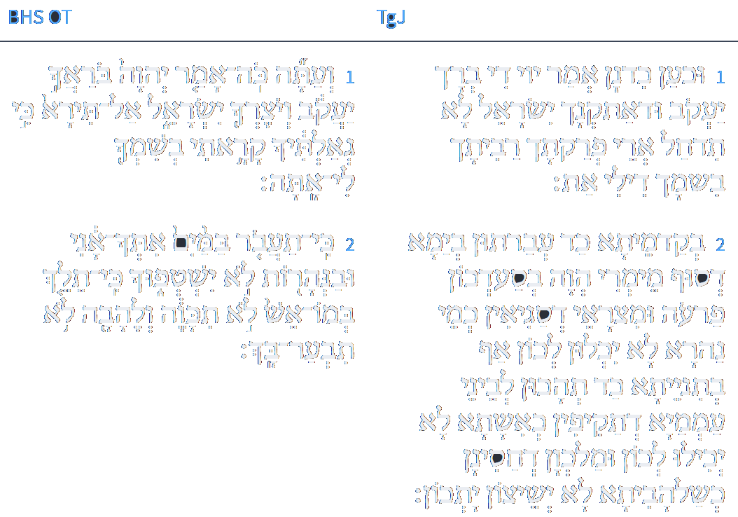
ספר ישעיה פרק מג
לוגוס
ספריה
א וּכְעַן כִּדְנַן אֲמַר יְיָ דִבְרָאָךְ יַעֲקֹב וּדְאַתְקְנָךְ יִשְׂרָאֵל לָא תִדְחַל אֲרֵי פְרִיקְתָּךְ רַבִּיתָךְ בִּשְׁמָךְ דִילִי אַתְּ: ב אֲרֵי בְקַדְמֵיתָא כַּד עֲבַרְתּוּן בְיַמָא דְסוּף מֵימְרִי הֲוָה בְּסַעְדְכוֹן פַּרְעֹה וּמִצְרָאֵי דְסַגִיאִין כְּמֵי נַהֲרָא לָא יְכִילוּ לְכוֹן וְאַף בְּתִנְיָנֵיתָא כַּד תַּהֲכוּן לְבֵינֵי עַמְמַיָא דְתַקִיפוּן כְּאֶשְׁתָּא לָא יִכְלוּן לְכוֹן וּמַלְכְּוָן דַחֲסִינָן כְּשַׁלְהוֹבִיתָא לָא יְשֵׁיצוּן יַתְכוֹן:
www.sefaria.org
Isaiah / ישעיה
http://www.matsati.com

Slide 20
Aggadat Bereshit 15:1
Chapter 15: Writings [1] "A Psalm of David. The LORD is my light and my salvation; whom shall I fear? The LORD is the strength of my life; of whom shall I be afraid?" (Psalm 27:1) "You shall not fear them, for it is the LORD your God who fights for you." (Deuteronomy 3:22) When Israel fears God, even the nations fear them, as David also said, "The LORD is my light and my salvation; whom shall I fear?" (Psalm 118:6) When I have God with me, I have nothing to fear. But when we abandon our fear of God, even the nations rebel against us, as it is said, "Israel has rejected what is good; an enemy will pursue him." (Hosea 8:3) What is good? "The LORD is good to all." (Psalm 145:9) When the nations fear God, everyone fears Israel, even the animals fear them. From whom did we learn this? From Daniel, who was thrown into a den of lions and was not harmed. As it is said, "My God sent His angel and shut the lions' mouths, so that they have not hurt me." (Daniel 6:23) Yet you say that only those with a soul can fear, but how do we know that even those without a soul can fear? We learn this from Abraham, to whom God said, "I am the LORD, who brought you out of Ur of the Chaldeans." (Genesis 15:7) Even fire feared Abraham, as did Hananiah, Mishael, and Azariah. Even water feared Israel, as it is said, "And the children of Israel went on dry ground through the midst of the sea." (Exodus 14:29) In the future, it will be the same, as it is said, "When you pass through the waters, I will be with you." (Isaiah 43:2) Therefore, "The LORD is my light and my salvation; whom shall I fear?" Even the nations seek to come under the protection of God's presence when Israel does His will. This is also found in David's writings and all the prophets, as in "David and six hundred men who were with him went to Achish the son of Maoch, king of Gath." (2 Samuel 15:18) And in Solomon's words, "And Solomon counted out seventy thousand men to bear burdens, and eighty thousand to quarry stone in the mountains, and three thousand six hundred to oversee them." (2 Chronicles 2:18) And in the days of Mordecai, many people in the land became Jews. (Esther 8:17) And Isaiah says, "Behold, they shall surely gather together, but not by Me." (Isaiah 54:15) What is "behold"? It is a Greek word meaning "one." The Lord says, "One man will be stronger than they are, because he is under My authority." From here on, whoever opposes Israel will not succeed.
Isaiah / ישעיה
http://www.matsati.com

Slide 21
ספר ישעיה פרק מג
לוגוס
ספריה
ג אֲרֵי אֲנָא יְיָ אֱלָהָךְ קַדִישָׁא דְיִשְׂרָאֵל פַּרְקָךְ יְהָבֵית חֲלִיפָךְ מִצְרָאֵי כּוּשׁ וּסְבָא תְּחוֹתָךְ:
www.sefaria.org
Isaiah / ישעיה
http://www.matsati.com

Slide 22
Rashi on Isaiah 43:3 Part 1
נתתי כפרך מצרים. והם היו לך לפדיון שבכוריהם מתו ואתה בני בכורי נצלת והייתם חייבים כליה כמו שנאמר (ביחזקאל כ׳:ח׳) ואומר לשפוך חמתי עליהם בארץ מצרים:
I have given Egypt as your ransom And they were your ransom, for their firstborn died, and you, My firstborn son, although you were deserving of destruction, as it is said in Ezekiel (20:8): “And I thought to pour out My fury upon them...in the land of Egypt.”
Isaiah / ישעיה
http://www.matsati.com

Slide 23
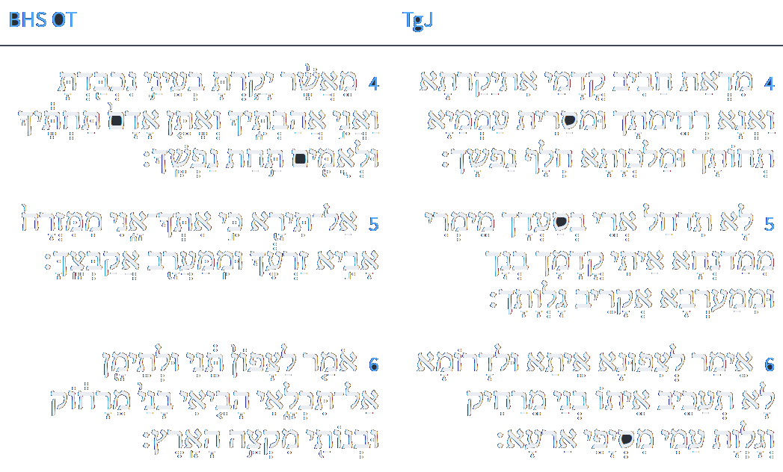
ספר ישעיה פרק מג
לוגוס
ספריה
ד מִדְאַתְּ חֲבִיב קֳדָמַי אִתְיְקַרְתָּא וַאֲנָא רְחִימְתָּךְ וּמְסַרֵית עַמְמַיָא תְּחוֹתָךְ וּמַלְכְּוָתָא חֲלַף נַפְשָׁךְ: ה לָא תִדְחַל אֲרֵי בְסַעְדָךְ מֵימְרִי מִמַדִינְחָא אַיְתִי בְנָךְ וּמִמַעֲרְבָא אֱקָרֵיב גַלְוָתָךְ: ו אֲמַר לְצִפוּנָא אַיְתָא וּלְדָרוֹמָא לָא תְעַכֵּב אַיְתוּ בָנַי מֵרָחִיק וְגַלְוַת עַמִי מִסְיָפֵי אַרְעָא:
www.sefaria.org
Isaiah / ישעיה
http://www.matsati.com

Slide 24
Likutei Moharan 35:1:3
לָכֵן צָרִיךְ כָּל אֶחָד לִשְׁמֹר אֶת שִׂכְלוֹ מִשִּׂכְלִיּוֹת חִיצוֹנִיּוֹת, הַמְכֻנָּה בְּשֵׁם בַּת פַּרְעֹה. כִּי עִקַּר הַחָכְמָה לִקְנוֹת שְׁלֵמוּת, אֵינָם רַק חָכְמוֹת אֱלֹקוּת, וּשְׁאָר הַחָכְמוֹת הֵם רַק חָכְמוֹת בְּטֵלוֹת, וְאֵינָם חָכְמוֹת כְּלָל.
As a result, every person has to guard his intellect from extraneous concepts, which are known as “Pharaoh’s daughter.” For the main wisdom by means of which one acquires wholeness is only the wisdom of Godliness. The other wisdoms are negations of wisdom. They are not wisdom at all. {“Bring My sons from afar, and My daughters from the ends of the earth” (Isaiah 43:6).}
Talmud Bavli Menachot 110a:3
(ישעיהו מג, ו) הביאי בני מרחוק ובנותי מקצה הארץ הביאי בני מרחוק אמר רב הונא אלו גליות של בבל שדעתן מיושבת עליהן כבנים ובנותי מקצה הארץ אלו גליות של שאר ארצות שאין דעתן מיושבת עליהן כבנות
§ After mentioning the Jewish community in Egypt, the Gemara discusses Jewish communities in other locations. The verse states: “Fear not, for I am with you; I will bring your seed from the east and gather you from the west; I will say to the north: Give up, and to the south: Keep not back, bring My sons from far, and My daughters from the end of the earth” (Isaiah 43:5–6). What is the meaning of “bring My sons from far”? Rav Huna says: These are the exiles of Babylonia, whose minds are calm, like sons, and who can therefore focus properly on Torah study and mitzvot. What is the meaning of “and My daughters from the end of the earth”? These are the exiles of other countries, whose minds are unsettled, like daughters.
Isaiah / ישעיה
http://www.matsati.com

Slide 25
ספר ישעיה פרק מג
לוגוס
ספריה
ז כָּל דָא בְּדִיל אֲבָהַתְכוֹן צַדִיקַיָא דְאִתְקְרֵי שְׁמִי עֲלֵיהוֹן וְלִיקָרִי בְרֵיתִינוּן אַתְקְנִית גַלְוַתְהוֹן אַף עֲבָדֵית לְהוֹן נִסִין:
www.sefaria.org
Isaiah / ישעיה
http://www.matsati.com

Slide 26
Guide for the Perplexed, Part 3 13:7
I consider therefore the following opinion as most correct according to the teaching of the Bible, and best in accordance with the results of philosophy; namely, that the Universe does not exist for man’s sake, but that each being exists for its own sake, and not because of some other thing. Thus we believe in the Creation, and yet need not inquire what purpose is served by each species of the existing things, because we assume that God created all parts of the Universe by His will; some for their own sake, and some for the sake of other beings, that include their own purpose in themselves. In the same manner as it was the will of God that man should exist, so it was His will that the heavens with their stars should exist, that there should be angels, and each of these beings is itself the purpose of its own existence. When anything can only exist provided some other thing has previously existed, God has caused the latter to precede it; as, e.g., sensation precedes comprehension. We meet also with this view in Scripture “The Lord hath made everything (la-ma‘anehu) for its purpose (Prov. 16:4). It is possible that the pronoun in la-maanehu refers to the object; but it can also be considered as agreeing with the subject; in which case the meaning of the word is, for the sake of Himself, or His will which is identical with His self [or essence], as has been shown in this treatise. We have also pointed out that His essence is also called His glory. The words, “The Lord hath made everything for Himself, “express therefore the same idea as the following verse, “Everything that is called by my name: I have created it for my glory, I have formed it; yea, I have made it” (Isa. 43:7); that is to say, everything that is described as My work has been made by Me for the sake of My will and for no other purpose. The words, “I have formed it,” “I have made it,” express exactly what I pointed out to you, that there are things whose existence is only possible after certain other things have come into existence. To these reference is made in the text, as if to say, I have formed the first thing which must have preceded the other things, e.g., matter has been formed before the production of material beings; I have then made out of that previous creation, or after it, what I intended to produce, and there was nothing but My will.
Isaiah / ישעיה
http://www.matsati.com

