Slide 1
MATSATI.COM Teaching Ministry
Website: https://www.matsati.com YouTube Channel: https://www.youtube.com/user/MATSATI/
ישעיהו מב:ז-יב / Isaiah 42:7-12
LIVE STREAM: 6:30 pm EST Wednesday
New Telegram Channel: Messianic Ministries
https://t.me/MessianicMinistries
Focus: The Way of Life - Following Yeshua the Messiah with an emphasis on walking in His footsteps according to the Torah
A Community
for Learning
Discuss the Scriptures,
learn the languages,
and fellowship

Slide 2
Isaiah 42:7-12
ישעיהו מב:ז-יב
Being Called by God What is Expected of Us?
Isaiah / ישעיה
http://www.matsati.com

Slide 3
מבוא לישעיהו
Part 1
Isaiah / ישעיה
http://www.matsati.com

Slide 4
Examples of People Who were Called by God in the Hebrew Bible
Abraham, who was called by God to leave his country and go to the land that God would show him, and to become the father of a great nation that would bless all the families of the earth (Bereshit / Genesis 12:1-3).
Moshe, who was called by God to lead the Israelites out of slavery in Egypt and to bring them to the promised land, and to mediate the covenant between God and his people (Shemot / Exodus 3:1-22).
Samuel, who was called by God to be a prophet, judge, and leader of Israel, and to anoint the first two kings of Israel, Saul and David (1 Samuel 3:1-21).
Isaiah, who was called by God to be a prophet to the nations, and to proclaim God's judgment and salvation, especially through the figure of the suffering servant, who would bear the sins of the people and bring light to the world (Isaiah 6:1-13, 42:1-9, 53:1-12).
Isaiah / ישעיה
http://www.matsati.com

Slide 5
Examples of People Who were Called by God in the Hebrew Bible
Jeremiah, who was called by God to be a prophet to the nation, and to warn them of the coming destruction and exile, and to promise them a new covenant and a restoration (Jeremiah 1:4-19, 31:31-34).
Ezekiel, who was called by God to be a prophet to the exiles in Babylon, and to show them the glory and sovereignty of God, and to assure them of a future restoration and renewal (Ezekiel 1:1-3, 37:1-14).
Jonah, who was called by God to preach to the Ninevites, the enemies of Israel, and to call them to repentance and mercy (Jonah 1:1-2, 3:1-10).
Esther, who was called by God to use her position as the queen of Persia to save her people from a plot of genocide (Esther 4:13-17).
Isaiah / ישעיה
http://www.matsati.com

Slide 6
ספר ישעיה
Part 2
Isaiah / ישעיה
http://www.matsati.com

Slide 7
﻿ספר ישעיה פרק מב
﻿ז לִפְקֹחַ עֵינַיִם עִוְרוֹת לְהוֹצִיא מִמַּסְגֵּר אַסִּיר מִבֵּית כֶּלֶא ישְׁבֵי חשֶׁךְ: ח אֲנִי יְהֹוָה הוּא שְׁמִי וּכְבוֹדִי לְאַחֵר לֹא-אֶתֵּן וּתְהִלָּתִי לַפְּסִילִים: ט הָרִאשֹׁנוֹת הִנֵּה-בָאוּ וַחֲדָשׁוֹת אֲנִי מַגִּיד בְּטֶרֶם תִּצְמַחְנָה אַשְׁמִיע אֶתְכֶם: י שִֹירוּ לַיהֹוָה שִׁיר חָדָשׁ תְּהִלָּתוֹ מִקְצֵה הָאָרֶץ יוֹרְדֵי הַיָּם וּמְלֹאוֹ אִיִּים וְיֹשְׁבֵיהֶם: יא יִשְֹאוּ מִדְבָּר וְעָרָיו חֲצֵרִים תֵּשֵׁב קֵדָר יָרֹנּוּ ישְׁבֵי סֶלַע מֵרֹאשׁ הָרִים יִצְוָחוּ: יב יָשִֹימוּ לַיהֹוָה כָּבוֹד וּתְהִלָּתוֹ בָּאִיִּים יַגִּידוּ:
Isaiah / ישעיה
http://www.matsati.com

Slide 8
Survey of California Policies that Affect Prisoners and Misdemeanor Crimes
In 2011, the U.S. Supreme Court ordered California to reduce its prison population by 33,000 inmates, citing overcrowding and inadequate health care as violations of the Eighth Amendment's prohibition of cruel and unusual punishment. ¹
In response, California passed a law (AB 109) that shifted the responsibility of supervising certain nonviolent, nonserious, and nonsexual offenders from the state to the counties. This law also allowed some offenders to serve their sentences in county jails instead of state prisons. ¹
In 2014, California voters approved Proposition 47, which reduced certain drug possession and property crimes from felonies to misdemeanors, and allowed offenders to petition for resentencing or reclassification of their convictions. This law also required the state to spend the savings from reduced incarceration on mental health, substance abuse, education, and victim services. ²
In 2016, California voters approved Proposition 57, which increased parole and good behavior opportunities for felons convicted of nonviolent crimes, and gave them more credit for completing rehabilitation programs. This law also allowed judges, not prosecutors, to decide whether to try certain juveniles as adults in court. ²
In 2020, California voters rejected Proposition 20, which would have reversed some of the changes made by Propositions 47 and 57, and added more crimes to the list of violent felonies that are ineligible for early parole. This proposition also would have required DNA collection for certain misdemeanors, and increased penalties for repeat offenders of certain theft and fraud crimes. ³
In 2021, California Governor Gavin Newsom announced a plan to close two state prisons, one in Tracy and one in Susanville, as part of his budget proposal. He cited the declining prison population, the high cost of incarceration, and the need to invest in rehabilitation and reentry programs as the reasons for his decision.
Isaiah / ישעיה
http://www.matsati.com

Slide 9
ספר שמות פרק ג
יד וַיֹּאמֶר אֱלֹהִים אֶל-מֹשֶׁה אֶהְיֶה אֲשֶׁר אֶהְיֶה וַיֹּאמֶר כֹּה תֹאמַר לִבְנֵי יִשְֹרָאֵל אֶהְיֶה שְׁלָחַנִי אֲלֵיכֶם: טו וַיֹּאמֶר עוֹד אֱלֹהִים אֶל-מֹשֶׁה כֹּה תֹאמַר אֶל-בְּנֵי יִשְֹרָאֵל יְהֹוָה אֱלֹהֵי אֲבֹתֵיכֶם אֱלֹהֵי אַבְרָהָם אֱלֹהֵי יִצְחָק וֵאלֹהֵי יַעֲקֹב שְׁלָחַנִי אֲלֵיכֶם זֶה-שְּׁמִי לְעֹלָם וְזֶה זִכְרִי לְדֹר דֹּר:
Shemot / Exodus 3:14–15
3:14 And God said unto Moses, I AM THAT I AM: and he said, Thus shalt thou say unto the children of Israel, I AM hath sent me unto you. 3:15 And God said moreover unto Moses, Thus shalt thou say unto the children of Israel, The LORD God of your fathers, the God of Abraham, the God of Isaac, and the God of Jacob, hath sent me unto you: this is my name for ever, and this is my memorial unto all generations. (KJV)
Isaiah / ישעיה
http://www.matsati.com

Slide 10
Tehillim / Psalm 96:1–13
96:1 O sing unto the LORD a new song: Sing unto the LORD, all the earth. 96:2 Sing unto the LORD, bless his name; Shew forth his salvation from day to day. 96:3 Declare his glory among the heathen, His wonders among all people. 96:4 For the LORD is great, and greatly to be praised: He is to be feared above all gods. 96:5 For all the gods of the nations are idols: But the LORD made the heavens. 96:6 Honour and majesty are before him: Strength and beauty are in his sanctuary. 96:7 Give unto the LORD, O ye kindreds of the people, Give unto the LORD glory and strength. 96:8 Give unto the LORD the glory due unto his name: Bring an offering, and come into his courts. 96:9 O worship the LORD in the beauty of holiness: Fear before him, all the earth. 96:10 Say among the heathen that the LORD reigneth: The world also shall be established that it shall not be moved: He shall judge the people righteously. 96:11 Let the heavens rejoice, and let the earth be glad; Let the sea roar, and the fulness thereof. 96:12 Let the field be joyful, and all that is therein: Then shall all the trees of the wood rejoice 96:13 Before the LORD: for he cometh, For he cometh to judge the earth: He shall judge the world with righteousness, And the people with his truth. (KJV)
Isaiah / ישעיה
http://www.matsati.com

Slide 11
Revelation 5:9–14
5:9 And they sung a new song, saying, Thou art worthy to take the book, and to open the seals thereof: for thou wast slain, and hast redeemed us to God by thy blood out of every kindred, and tongue, and people, and nation; 5:10 And hast made us unto our God kings and priests: and we shall reign on the earth. 5:11 And I beheld, and I heard the voice of many angels round about the throne and the beasts and the elders: and the number of them was ten thousand times ten thousand, and thousands of thousands; 5:12 Saying with a loud voice, Worthy is the Lamb that was slain to receive power, and riches, and wisdom, and strength, and honour, and glory, and blessing. 5:13 And every creature which is in heaven, and on the earth, and under the earth, and such as are in the sea, and all that are in them, heard I saying, Blessing, and honour, and glory, and power, be unto him that sitteth upon the throne, and unto the Lamb for ever and ever. 5:14 And the four beasts said, Amen. And the four and twenty elders fell down and worshipped him that liveth for ever and ever. (KJV)
Isaiah / ישעיה
http://www.matsati.com

Slide 12
Revelation 14:1–5
14:1 And I looked, and, lo, a Lamb stood on the mount Sion, and with him an hundred forty and four thousand, having his Father’s name written in their foreheads. 14:2 And I heard a voice from heaven, as the voice of many waters, and as the voice of a great thunder: and I heard the voice of harpers harping with their harps: 14:3 And they sung as it were a new song before the throne, and before the four beasts, and the elders: and no man could learn that song but the hundred and forty and four thousand, which were redeemed from the earth. 14:4 These are they which were not defiled with women; for they are virgins. These are they which follow the Lamb whithersoever he goeth. These were redeemed from among men, being the firstfruits unto God and to the Lamb. 14:5 And in their mouth was found no guile: for they are without fault before the throne of God. (KJV)
Isaiah / ישעיה
http://www.matsati.com

Slide 13
Rabbinic Literature
ספרות רבנית
Part 3
Isaiah / ישעיה
http://www.matsati.com

Slide 14
Targum Jonathan Son of Uziel on Isaiah 42:7-12
42:7 To open the eyes of the house of Israel, who are blind to the law, to bring back their captivity from among the nations, where they are like prisoners, and to redeem them from the servitude of the kingdoms being shut up as those that are bound in darkness. 42:8 I am the Lord: that is my name: and my glory in which I am revealed to you I will not give to another people; nor my praise to the worshippers of images. 42:9 Behold, the former things are come to pass, and new things do I declare: I apprize you of them before they come to pass. 42:10 Sing unto the Lord a new song, proclaim His praise from the ends of the earth, ye that go down to the sea, and its fulness; the isles, and the inhabitants thereof. 42:11 Let the wilderness praise Him, and the cities that are in it, the villages which inhabit the wilderness of the Arabians; let the dead praise Him, when they go forth from their long abodes; from the tops of the mountains let them lift up their voice. 42:12 Let them ascribe glory unto the Lord, and declare His praise in the islands. (TgJ)
Isaiah / ישעיה
http://www.matsati.com

Slide 15
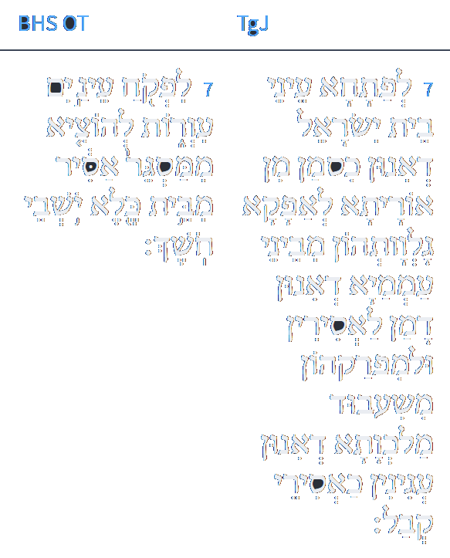
www.sefaria.org
ז לְפַתָּחָא עֵינֵי בֵּית יִשְׂרָאֵל דְאִינוּן כְּסָמָן מִן אוֹרַיְתָא לְאַפָקָא נַלְוַתְהוֹן מִבֵּינֵי עַמְמַיָא דְאִינוּן דָמָן לַאֲסִירִין וּלְמִפְרַקְהוֹן מִשִׁעְבּוּד מַלְכְּוָתָא דְאִינוּן עֲנִינִין כַּאֲסִירֵי קְבָל:
Isaiah / ישעיה
http://www.matsati.com

Slide 16
Likutei Moharan, Introduction 5
כי אך לזה היתה כונתו הקדושה. לעורר ישנים ולהקיץ נרדמים. להישיר לבות בני אדם אחינו בני-ישראל אליו יתברך. לאמר לאסורים צאו לאשר בחשך הגלו. לפקח עינים עורות. ולהוציא אסירים בכושרות. להוציא ממסגר אסיר מבית כלא יושבי חשך. האסורים בתאוותיהן. והלכודים בהבליהם. והנדחים בעוונותיהם. להטות לבבם אליו יתברך להשיבם אל ה' באמת בדרך הישר והנכון לפניהם. בדרך אשר דרכו בו אבותינו מעולם:
For this alone was the Rebbe’s holy intention: “to rouse the sleeping and waken the slumbering” (Shabbat Liturgy); to make straight the hearts of men, our Jewish brethren, with God’ “to tell the imprisoned, ‘Go free,’ to those residing in darkness, ‘Come out’” (Isaiah 49:9); “to give sight to eyes that are blind” (ibid. 42:7); ‘to redeem those bound in fetters’ (cf. Psalms 68:7), to “release the shackled from confinement, those who sit in darkness from [their] prison” (Isaiah 42:7)—those bound to their passions, trapped in their folly, cast out by their sins. [His desire was] to turn their hearts to the Holy One, to return them to God in truth, along the straight and true path, the path which our forefathers have followed from yore.
Isaiah / ישעיה
http://www.matsati.com

Slide 17
Rashi on Isaiah 42:7 Parts 1-2
לפקוח עינים עורות. שאינ' רואין את גבורתו לתת לב לשוב אלי:
To open blind eyes who do not see My might, to take heart to return to Me.
להוציא ממסגר אסיר. וע"י שיתפקחו עיניהם יצאו אסירים ממסגר ד"א לבשרם על גלות בבל העתיד' לבא עליהן שסופן לצאת ממנה:
to bring prisoners out of a dungeon And because their eyes will be opened, the prisoners will come out of the dungeon. Another explanation: To inform them of the exile destined to befall them, out of which they will eventually come.
Isaiah / ישעיה
http://www.matsati.com

Slide 18
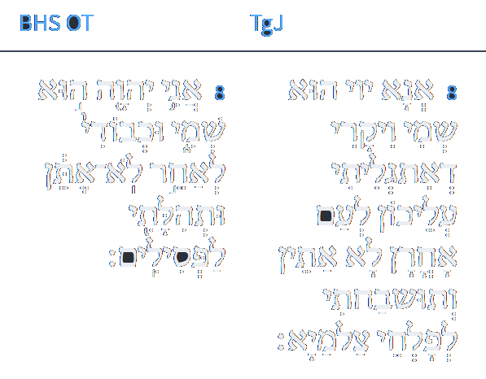
www.sefaria.org
ח אֲנָא יְיָ הוּא שְׁמִי וִיקָרִי דְאִתְגְלֵיתִי עֲלֵיכוֹן לְעַם אוֹחֲרָן לָא אֶתֵּן וְתוּשְׁבַּחְתִּי לְפַלְחֵי צַלְמַיָא:
Isaiah / ישעיה
http://www.matsati.com

Slide 19
Pesikta DeRav Kahanna 7:2
2. R. Acha explicated the following verse: I am YHWH, that is My name; and My glory will I not give to another, neither My praise to graven images. (Is 42:8) I am YHWH, that is My name. R. Acha stated: The Kadosh Baruch Hu said “I am YHWH, that is My name; it is the name that the first man called me. It is the name by which I made a stipulation with Myself. It is the name by which I made a stipulation with the ministering angels. My glory will I not give to another.” R. Menahama said in the name of R. Avin, “These [others] are the demons.” R. Nechemiah said in the name of R. Mina, “No one can distinguish between the drop of a firstborn and one that is not of a firstborn, except for the Kadosh Baruch Hu. For me, [when I pondered how I might know this,] it was wearisome in mine eyes. Because no one can stand on the [moment of] midnight except for the Kadosh Baruch Hu, therefore [it is said], “And it came to pass at midnight.”
Isaiah / ישעיה
http://www.matsati.com

Slide 20
www.sefaria.org
ט קַדְמָיָתָא הָא אֲתָאָה וְחַדְתָּן אֲנָא מְחַוֵי עַד לָא אַתְיַן אֶבְסַר יַתְכוֹן: י שַׁבָּחוּ קֳדָם יְיָ תּוּשְׁבַּחְתָּא חַדְתָּא אֱמָרוּ תּוּשְׁבַּחְתֵּהּ מִסְיָפֵי אַרְעָא נַחֲתֵי יַמָא וּמְלָאָהּ נַגְוָן וְיָתְבֵיהוֹן:
Isaiah / ישעיה
http://www.matsati.com

Slide 21
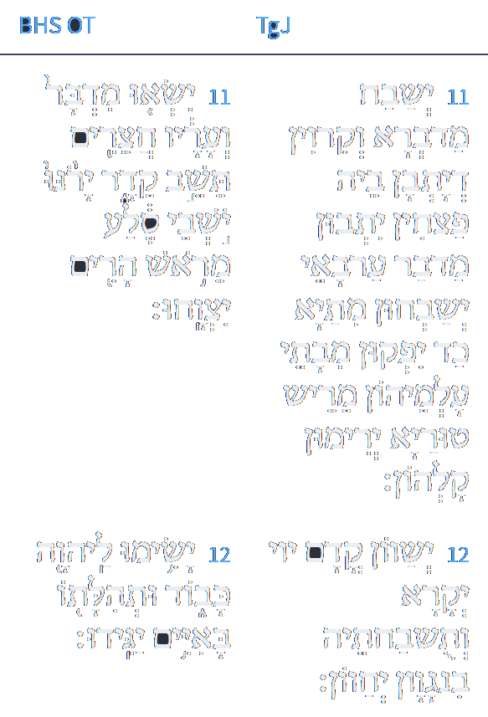
www.sefaria.org
יא יְשַׁבַּח מַדְבְּרָא וְקִרְוִין דְיַתְבִין בֵּיהּ פְּצִיחִין יָתְבִין מִדְבַּר עַרְבָאִי יְשַׁבְּחוּן מֵיתַיָא כַּד יִפְקוּן מִבָּתֵּי עַלְמֵיהוֹן מְרֵישֵׁי טוּרַיָא יְרִימוּן קָלְהוֹן: יב יְשַׁווּן קֳדָם יְיָ יְקָרָא וְתוּשְׁבַּחְתֵּהּ בְּנַגְוָן יְחַווּן:
Isaiah / ישעיה
http://www.matsati.com

Slide 22
Rashi on Isaiah 42:11 Parts 1-4
ישאו מדבר. קול בשיר:
The desert and its cities shall raise [their voice] their voice in song.
חצרים תשב קדר. (מוסב על ישאו) מדבר קדר שהם דרים עתה באוהלים ישאו קול וירונו (כמו והחצרים אשר תשב קדר), במדבר קדר שהם דרים עתה באהליהם יהיו ערים וחצרים קבועים:
Kedar shall be inhabited with villages (Connected to “The desert...shall raise.” The desert of Kedar, where they now dwell in tents, shall raise their voice and sing. It is like: And the villages with which Kedar is settled.) The desert of Kedar, where they now dwell in tents, will be permanent cities and villages.
יושבי סלע. המתים שיחיו כן ת"י:
rock dwellers The dead who will be resurrected. So did Jonathan render this.
מראש הרים יצווחו. מריש טוריא ירימון קליהון:
from the mountain peaks they shall shout From the mountain peaks they shall raise their voices [from Jonathan].
Isaiah / ישעיה
http://www.matsati.com

