Slide 1
MATSATI.COM Teaching Ministry
Website: https://www.matsati.com YouTube Channel: https://www.youtube.com/user/MATSATI/
ישעיהו מב:יג-יח / Isaiah 42:13-18
LIVE STREAM: 6:30 pm EST Thursday
New Telegram Channel: Messianic Ministries
https://t.me/MessianicMinistries
Focus: The Way of Life - Following Yeshua the Messiah with an emphasis on walking in His footsteps according to the Torah
A Community
for Learning
Discuss the Scriptures,
learn the languages,
and fellowship

Slide 2
Isaiah 42:13-18
ישעיהו מב:יג-יח
Why the Servant Spoken of in Isaiah 42 is an Individual
and Not a Group of People
Isaiah / ישעיה
http://www.matsati.com

Slide 3
מבוא לישעיהו
Part 1
Isaiah / ישעיה
http://www.matsati.com

Slide 4
ספר ישעיה פרק מב
ו אֲנִ֧י יְהוָ֛ה קְרָאתִ֥יךָֽ בְצֶ֖דֶק וְאַחְזֵ֣ק בְּיָדֶ֑ךָ וְאֶצָּרְךָ֗ וְאֶתֶּנְךָ֛ לִבְרִ֥ית עָ֖ם לְא֥וֹר גּוֹיִֽם׃
Isaiah 42:6
42:6 I the LORD have called thee in righteousness, And will hold thine hand, and will keep thee, And give thee for a covenant of the people, for a light of the Gentiles; (KJV)
Isaiah / ישעיה
http://www.matsati.com

Slide 5
Isaiah 49:6
49:6 And he said, It is a light thing that thou shouldest be my servant To raise up the tribes of Jacob, And to restore the preserved of Israel: I will also give thee for a light to the Gentiles, That thou mayest be my salvation unto the end of the earth. (KJV וַיֹּ֗אמֶר נָקֵ֨ל מִֽהְיוֹתְךָ֥ לִי֙ עֶ֔בֶד לְהָקִים֙ אֶת־שִׁבְטֵ֣י יַעֲקֹ֔ב וּנְצִירֵי יִשְׂרָאֵ֖ל לְהָשִׁ֑יב וּנְתַתִּ֙יךָ֙ לְא֣וֹר גּוֹיִ֔ם לִֽהְי֥וֹת יְשׁוּעָתִ֖י עַד־קְצֵ֥ה הָאָֽרֶץ׃)
Isaiah / ישעיה
http://www.matsati.com

Slide 6
ספר ישעיה
Part 2
Isaiah / ישעיה
http://www.matsati.com

Slide 7
﻿ספר ישעיה פרק מב
﻿יג יְהֹוָה כַּגִּבּוֹר יֵצֵא כְּאִישׁ מִלְחָמוֹת יָעִיר קִנְאָה יָרִיעַ אַף-יַצְרִיחַ עַל-אֹיְבָיו יִתְגַּבָּר: יד הֶחֱשֵׁיתִי מֵעוֹלָם אַחֲרִישׁ אֶתְאַפָּק כַּיּוֹלֵדָה אֶפְעֶה אֶשֹּׁם וְאֶשְׁאַף יָחַד: טו אַחֲרִיב הָרִים וּגְבָעוֹת וְכָל-עֶשְֹבָּם אוֹבִישׁ וְשַֹמְתִּי נְהָרוֹת לָאִיִּים וַאֲגַמִּים אוֹבִישׁ: טז וְהוֹלַכְתִּי עִוְרִים בְּדֶרֶךְ לֹא יָדָעוּ בִּנְתִיבוֹת לֹא-יָדְעוּ אַדְרִיכֵם אָשִֹים מַחְשָׁךְ לִפְנֵיהֶם לָאוֹר וּמַעֲקַשִּׁים לְמִישׁוֹר אֵלֶּה הַדְּבָרִים עֲשִֹיתִם וְלֹא עֲזַבְתִּים: יז נָסֹגוּ אָחוֹר יֵבֹשׁוּ בֹשֶׁת הַבֹּטְחִים בַּפָּסֶל הָאֹמְרִים לְמַסֵּכָה אַתֶּם אֱלֹהֵינוּ: יח הַחֵרְשִׁים שְׁמָעוּ וְהַעִוְרִים הַבִּיטוּ לִרְאוֹת:
Isaiah / ישעיה
http://www.matsati.com

Slide 8
ספר שמות פרק טו
ב עָזִּי וְזִמְרָת יָהּ וַיְהִי-לִי לִישׁוּעָה זֶה אֵלִי וְאַנְוֵהוּ אֱלֹהֵי אָבִי וַאֲרֹמְמֶנְהוּ: ג יְהוָֹה אִישׁ מִלְחָמָה יְהוָֹה שְׁמוֹ:
Shemot / Exodus 15:2–3
15:2 The LORD is my strength and song, And he is become my salvation: He is my God, and I will prepare him an habitation; My father’s God, and I will exalt him. 15:3 The LORD is a man of war: the LORD is his name. (KJV)
Isaiah / ישעיה
http://www.matsati.com

Slide 9
Revelation 7:14–17
7:14 And I said unto him, Sir, thou knowest. And he said to me, These are they which came out of great tribulation, and have washed their robes, and made them white in the blood of the Lamb. 7:15 Therefore are they before the throne of God, and serve him day and night in his temple: and he that sitteth on the throne shall dwell among them. 7:16 They shall hunger no more, neither thirst any more; neither shall the sun light on them, nor any heat. 7:17 For the Lamb which is in the midst of the throne shall feed them, and shall lead them unto living fountains of waters: and God shall wipe away all tears from their eyes. (KJV)
Isaiah / ישעיה
http://www.matsati.com

Slide 10
Rabbinic Literature
ספרות רבנית
Part 3
Isaiah / ישעיה
http://www.matsati.com

Slide 11
Targum Jonathan son of Uziel Isaiah 42:13-18
42:13 The Lord shall be seen to do mighty things: He shall reveal Himself in anger to do a mighty work by the word of His wrath; He shall reveal Himself to His enemies by His might in an earthquake. 14 I have given them prolongation for a long time, if they would but return to my law; but they did not return. My judgment shall be revealed upon them, as pains on a woman in travail; they shall be destroyed, and come to an end together. 15 I will make waste mountains and hills, and dry up all their herbs; and I will make the rivers islands, and I will dry up the pools. 16 And I will lead the house of Israel, who are like the blind, in a way which they knew not, in paths they have not learned I will lead them; I will make darkness light before them, and the rugged place a plain. These things will I do for them, and will not forsake them. 17 They shall be turned back, they shall be ashamed, that worship images, that say to the molten images, Ye are our gods. 18 Ye wicked, (who are like the deaf,) have ye no ears? hear ye! and ye sinners, (who are like the blind,) have ye no eyes? (TgJ)
Isaiah / ישעיה
http://www.matsati.com

Slide 12
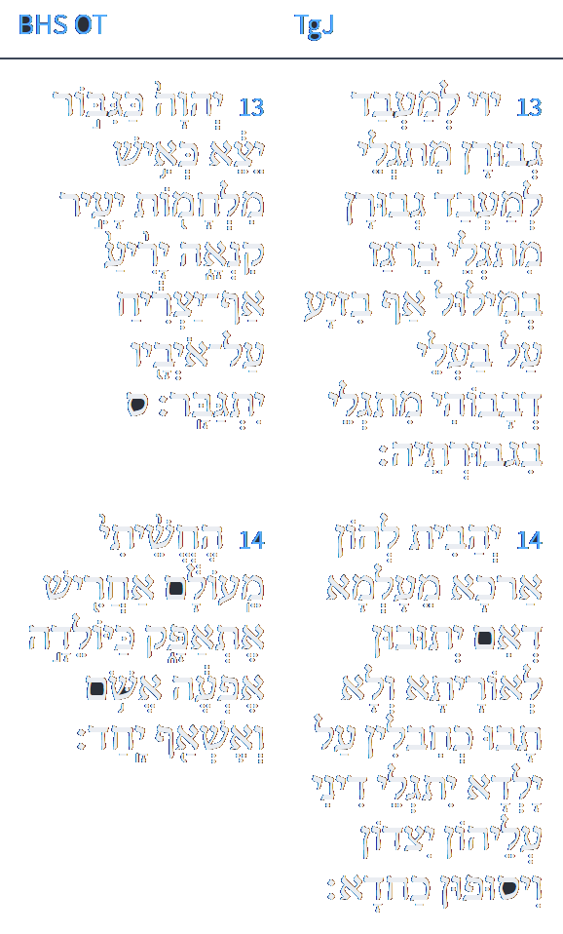
LOGOS
Targum Jonathan – Isaiah 42:13-14
יג יְיָ לְמֶעְבַּד גְבוּרָן אִתְגְלֵי לְמֶעְבַּד גְבוּרָא מִתְגְלֵי בִּרְגַז בְּמִלוּל אַף בְּזִיעַ עַל בַּעֲלֵי דְבָבוֹהִי מִתְגְלֵי בִּגְבוּרְתֵּהּ:
יד יְהָבִית לְהוֹן אַרְכָּא מֵעַלְמָא דְאִם יְתוּבוּן לְאוֹרַיְתָא וְלָא תָבוּ כְּחַבְלִין עַל יְלִידְתָּא יִתְגְלֵי דִינִי עֲלֵיהוֹן יִצְדוּן וִיסוּפוּן כַּחֲדָא:
www.sefaria.org
Isaiah / ישעיה
http://www.matsati.com

Slide 13
Questions that Draw Out the Meaning of these Verses
How does the identification of the servant as the Messiah affect our understanding of his role and mission?
How does the emphasis on God's word affect our view of His power and authority?
How does the change of the term for labor affect our view of God's justice and mercy?
How does the addition of the condition for repentance affect our view of God's grace and sovereignty?
Isaiah / ישעיה
http://www.matsati.com

Slide 14
Shenei Luchot HaBerit, Torah Shebikhtav, Shemot, Introduction 14
There is an interesting Midrash on Psalms 2,2, יתיצבו מלכי ארץ, "The kings of the earth will take their stand, and regents will intrigue together against G–d and His anointed." Rabbi Berechyah quotes Rabbi Levi as saying that the wicked are cursed, since they conspire against Israel. Each one claims to outdo the other in his devious plot. Esau describes Cain as having been foolish, since he killed Abel during Adam's lifetime, enabling Adam to replace Abel with other children. He, Esau was going to wait to kill Jacob until after his father had died and Jacob could no longer be replaced by Isaac siring any other children (Genesis 27,41). Pharaoh considered Esau as having been foolish, since he had overlooked the fact that while he waited, Jacob himself had a chance to sire many children, thus ensuring survival of the Jewish nation. He, Pharaoh, would not go about in in this way, but he would kill the Jewish males as soon as they emerged from their mother's womb (Exodus 1,22). Haman, on the other hand, considered that even Pharaoh had been foolish, since the latter had not realized that when the Jewish girls would marry they would multiply, the children being considered Jewish in Jewish law. Hence he decreed death for all Jews (Esther 3,13). In the future Gog and Magog will consider all former enemies of the Jews as having been fools for having ignored the fact that the Jews have a Patron in Heaven who may come to their rescue. Hence Gog and Magog plan to first contend with said Patron of the Jews, i.e. G–d, and only afterwards to attack Israel itself. This is why the verse in Psalms we quoted, reads "against G–d and His Messiah." G–d is reported as smiling, saying to Gog and Magog that their undertaking is both foolish and arrogant, since they have no idea how heavily outnumbered they will be when G–d employs His lightning, etc. After all, it is written (Isaiah 42,13): "G–d will go forth like a warrior, like a fighter. He will awaken His jealousy like a man of war." It also says (Zachariah 14,9) that "G–d will be king over the entire universe" (after having battled Gog and Magog).
Isaiah / ישעיה
http://www.matsati.com

Slide 15
Midrash Tehillim 2:4
"On Hashem and His Messiah. It is compared to a mighty warrior who was in a country, and when conscripts came to that country, they were afraid of that warrior and said, 'What shall we do? Let us kill that warrior, and then we will unite with the country.' So it is with them. Rabbi Berachiah said in the name of Rabbi Levi, 'Cursed are the wicked who maintain a council against Israel, and each one says, "My counsel is better than yours." Esau was foolish; Cain killed Abel while their father was still alive, not knowing that his father would procreate and increase. I do not do that, but rather as it is written, "Let my father's days be prolonged." Pharaoh was foolish; Esau said so, not knowing that his brothers married women and those women multiplied. I do not do that, but rather until the verdict of Kikin under the pillows of their mothers I plead for them, as it is written, "Every male who is born, you shall cast into the river." Haman the wicked said, 'Pharaoh was foolish who said so, not knowing that the girls marry men and those men procreate and increase.' I do not do that, but rather as it is written, "To destroy, to kill, and to cause to perish." Gog and Magog are destined to say the same, that the fools were the first to plot against Israel and did not know that they had a patron in heaven. I do not do that, but first I unite with my patron, and then I return to Israel. This is what is written, "On Hashem and His Messiah." And the Holy One, blessed be He, says to them, 'Gog and Magog, how many troops do I have before me, and how many lightning bolts, thunders, and flames? I will go with you to war,' as it is said, 'Hashem will go forth as a mighty man, he shall stir up jealousy like a man of war: he shall cry, yea, roar; he shall prevail against his enemies' (Isaiah 42:13). What is written there? "And Hashem shall be king over all the earth."' (Zechariah 14:9)"
Isaiah / ישעיה
http://www.matsati.com

Slide 16
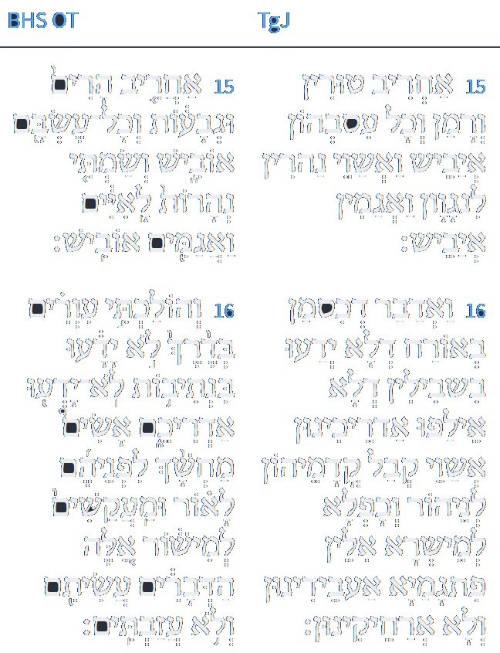
LOGOS
Targum Jonathan – Isaiah 42:15-16
טו אַחֲרִיב טוּרִין וְרָמָן וְכָל עִסְבֵּיהוֹן אֲיַבֵּשׁ וַאֲשַׁוֵי נַהֲרִין לְנַגְוָן וַאֲגַמִין אֲיַבֵּשׁ:
טז וָאֱדַבֵּר לְבֵית יִשְׂרָאֵל דְדָמִין כְּסָמָן בְּאוֹרַח דְלָא יְדָעוּ בִּשְׁבִילִין דְלָא אֲלִיפוּ אַדַרְכִינוּן אֲשַׁוֵי קְבַל קֳדָמֵיהוֹן לִנְהוֹר וְכַפְלָא לְמֵישְׁרָא אִלֵין פִּתְגָמַיָא אַעְבְדִינוּן וְלָא אַרְחִיקִינוּן:
www.sefaria.org
Isaiah / ישעיה
http://www.matsati.com

Slide 17
Midrash Tanchuma Buber, Devarim 1:1
(Deut. 1:1:) THESE ARE THE WORDS (elleh hadevarim). May the name <of the Holy One> be blessed and may his memory be exalted. All the miracles that he did for Israel in the wilderness, he is likewise going to do in Zion. It is written concerning the wilderness (ibid.): THESE ARE THE WORDS; and it is written concerning Zion (in Is. 42:16): I WILL TURN DARKNESS BEFORE THEM INTO LIGHT AND ROUGH PLACES INTO LEVEL GROUND. THESE THINGS (elleh hadevarim) [I WILL DO, AND I WILL NOT FORSAKE THEM]. It is written concerning the wilderness (in Exod. 20:15): NOW ALL THE PEOPLE SAW THE THUNDERINGS (qol in the plural); and it is written concerning Zion (in Jer. 7:34): <AND I WILL PUT AN END … > TO THE SOUND (qol) OF JOY AND THE SOUND (qol) OF GLADNESS, THE VOICE (qol) OF THE BRIDEGROOM <AND THE VOICE (qol) OF THE BRIDE>. It is written concerning the wilderness (in Ps. 68:9): THE EARTH QUAKED; and it is written concerning Zion (in Hag. 2:6): I WILL CAUSE THE HEAVENS AND THE EARTH TO QUAKE. It is written concerning the wilderness (in Exod. 13:21): AND THE LORD WENT BEFORE THEM BY DAY; and it is written concerning Zion (in Is. 52:12): FOR THE LORD SHALL GO BEFORE YOU. It is written concerning the wilderness (in Deut. 30:9): FOR THE LORD SHALL BE GLAD OVER YOU AGAIN; and it is written concerning Zion (in Is. 65:19): I WILL ALSO REJOICE IN JERUSALEM AND BE GLAD IN MY PEOPLE. [<Also> (according to Is. 35:1): THE WILDERNESS AND THE ARID LAND SHALL BE GLAD.] What did Isaiah see to say this? It is simply that, when Israel transgressed the Torah, Hosea arose and said (in Hos. 2:5): I WILL MAKE HER LIKE A WILDERNESS [AND RENDER HER LIKE AN ARID LAND]. For that reason Isaiah has said (in Is. 35:1): THE WILDERNESS <AND THE ARID LAND> SHALL BE GLAD. Now all the consolations of which Isaiah spoke are double, because (according to Is. 40:2:) SHE (i.e., Jerusalem) HAS RECEIVED FROM THE HAND OF THE LORD DOUBLE FOR ALL HER SINS. So for that reason Isaiah has comforted her doubly (in vs. 1) COMFORT, O COMFORT <MY PEOPLE, SAYS YOUR GOD>. <Similarly> (in Is. 51:12): I, I <AM THE ONE WHO COMFORTS YOU>. <Also> (in Is. 51:9): AWAKE, AWAKE, <PUT ON STRENGTH, O ARM OF THE LORD>! <Also> (in Is. 51:17): ROUSE YOURSELF, ROUSE YOURSELF! <ARISE, O JERUSALEM … !> <Also> (in Is. 61:10): I WILL BE GLAD WITH REJOICING <IN THE LORD>. <Also> (in Is. 35:1–2) <THE WILDERNESS AND THE ARID LAND SHALL BE GLAD …;> IT SHALL BLOSSOM WITH BLOSSOMS.
Isaiah / ישעיה
http://www.matsati.com

Slide 18
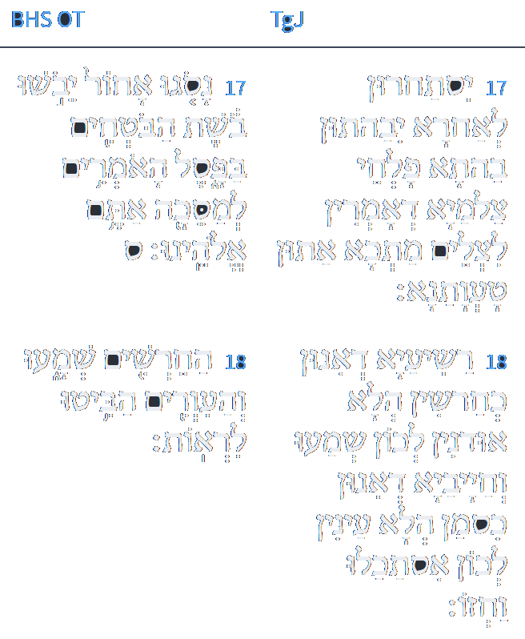
LOGOS
Targum Jonathan – Isaiah 42:17-18
יז יִסְתַּחֲרוּן לַאֲחוֹרָא יִבַּהֲתוּן בַּהֲתָא פַלְחֵי צַלְמַיָא דְאָמְרִין לִצְלַם מַתְּכָא אַתּוּן טַעֲוָתָנָא:
יח רַשִׁיעַיָא דְאִינוּן כְּחֵרְשִׁין הֲלָא אוּדְנִין לְכוֹן שְׁמָעוּ וְחַיָבַיָא דְאִינוּן כְּסָמָן הֲלָא עַיְנִין לְכוֹן אִסְתַּכָּלוּ וַחֲזוֹ:
www.sefaria.org
Isaiah / ישעיה
http://www.matsati.com

Slide 19
Aggadat Bereshit 70:2
Alternative explanation: "An ear that hears and an eye that sees." Rabbi Ashi said in the name of Rabbi Chelkiah: "Because in this world, Israel sinned and became deaf to the Torah and blind to the Divine Presence, as it says, 'Their ear is uncircumcised, and they cannot listen; behold, the word of the Lord is to them an object of scorn; they take no pleasure in it' (Jeremiah 6:10). Therefore, they were prevented from learning Torah, and their eyes were sealed from seeing the Divine Presence. Similarly, Isaiah cries out, 'Hear, you deaf, and look, you blind, that you may see!' (Isaiah 42:18). And they say to Him, 'We grope, like blind men along a wall; Like those without eyes we grope. We stumble at noon, as if in darkness; Among the sturdy, we are like the dead.' (Isaiah 59:10). And they do not hear, as it says, "And I [(Israel)] was like a deaf man, not hearing [their taunts]; and as a mute, not opening his mouth." (Psalm 38:14). What does the Holy One, blessed be He, do? In the future, He will first revive them and then open their eyes and ears, as it says, 'Then the eyes of the blind shall be opened, and the ears of the deaf unstopped' (Isaiah 35:5). And they will hear the words of God, as it says, 'And your ears shall hear a word behind you, saying, "This is the way, walk in it," when you turn to the right or when you turn to the left' (Isaiah 30:21), and they will see how He teaches, as it says, 'And your Teacher will not hide himself anymore, but your eyes shall see your Teacher' (Isaiah 30:20). At that time, the verse will be fulfilled, 'An ear that hears and an eye that sees' (Proverbs 20:12). Neither an angel nor a seraph does this, but the Lord does both." [edit. How LORD guides you? The Ruach haKodesh guides you (Megillah 14a:13)]
Isaiah / ישעיה
http://www.matsati.com

