Slide 1
MATSATI.COM Teaching Ministry
Website: https://www.matsati.com YouTube Channel: https://www.youtube.com/user/MATSATI/
ישעיהו מא:כה-כט / Isaiah 41:25-29
LIVE STREAM: 6:30 pm EST Thursday
New Telegram Channel: Messianic Ministries
https://t.me/MessianicMinistries
Focus: The Way of Life - Following Yeshua the Messiah with an emphasis on walking in His footsteps according to the Torah
A Community
for Learning
Discuss the Scriptures,
learn the languages,
and fellowship

Slide 2
Isaiah 41:25-29
ישעיהו מא:כה-כט
Why Some People Have a
Pagan Understanding of Scripture?
Isaiah / ישעיה
http://www.matsati.com

Slide 3
מבוא לישעיהו
Part 1
Isaiah / ישעיה
http://www.matsati.com

Slide 4
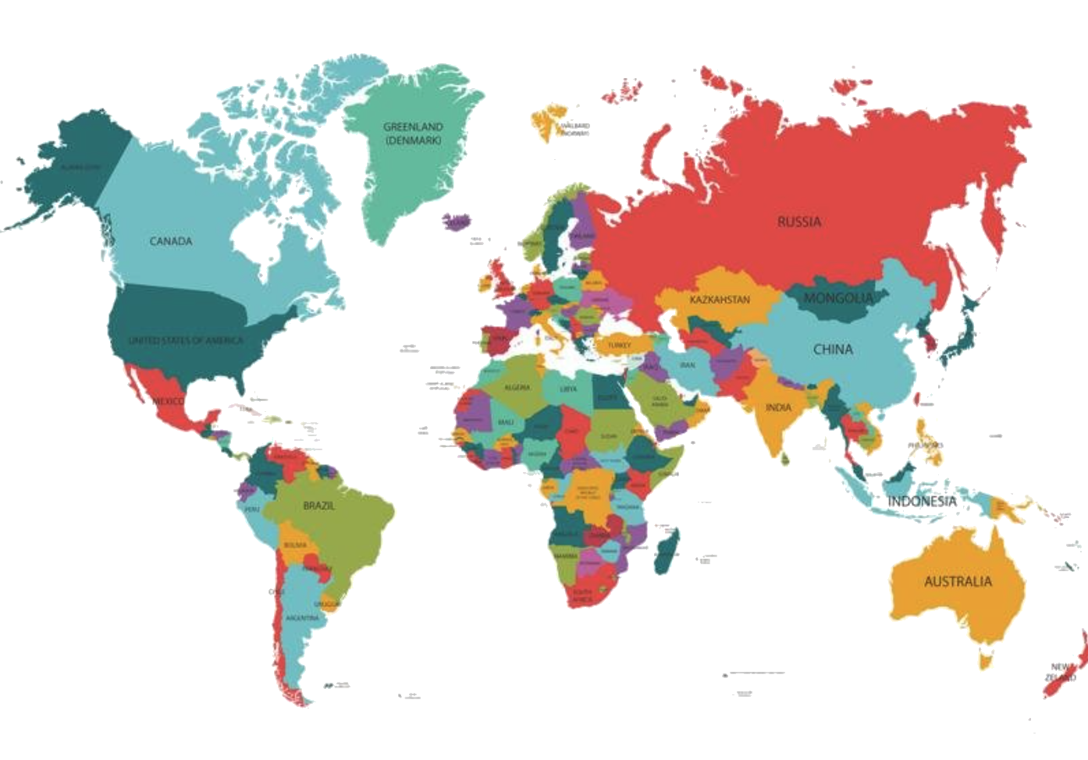
Isaiah / ישעיה
http://www.matsati.com

Slide 5
How does Sin Bind Us Up?
Sin separates us from God, who is holy and righteous. Sin is anything that goes against God’s will and character, and it creates a barrier between us and him. Isaiah 59:2 says, “But your iniquities have separated you from your God; your sins have hidden his face from you, so that he will not hear.”
Sin enslaves us to its power and influence. Sin is not just an action, but a condition of our hearts. Romans 6:16 says, “Don’t you know that when you offer yourselves to someone as obedient slaves, you are slaves of the one you obey—whether you are slaves to sin, which leads to death, or to obedience, which leads to righteousness?”
Sin blinds us to the truth and reality of God. Sin deceives us and makes us think that we can live without God or that we know better than him. Sin also hardens our hearts and makes us resistant to his grace and correction. 2 Corinthians 4:4 says, “The god of this age has blinded the minds of unbelievers, so that they cannot see the light of the gospel that displays the glory of Christ, who is the image of God.”
Sin wounds us and causes pain and suffering. Sin affects not only our relationship with God, but also with ourselves and others. Sin brings guilt, shame, fear, anger, bitterness, resentment, and other negative emotions that harm us emotionally. Sin also leads to physical, mental, and spiritual consequences that can be devastating. Romans 6:23 says, “For the wages of sin is death, but the gift of God is eternal life in Christ Jesus our Lord.”
Isaiah / ישעיה
http://www.matsati.com

Slide 6
What kind of God is he who knows what has not happened Yet?
What kind of God is he who can explain the first principles of existence?
Isaiah / ישעיה
http://www.matsati.com

Slide 7
ספר ישעיה
Part 2
Isaiah / ישעיה
http://www.matsati.com

Slide 8
﻿ספר ישעיה פרק מא
כה הַעִירוֹתִי מִצָּפוֹן וַיַּאת מִמִּזְרַח-שֶׁמֶשׁ יִקְרָא בִשְׁמִי וְיָבֹא סְגָנִים כְּמוֹ-חֹמֶר וּכְמוֹ יוֹצֵר יִרְמָס-טִיט: כו מִי-הִגִּיד מֵרֹאשׁ וְנֵדָעָה וּמִלְּפָנִים וְנֹאמַר צַדִּיק אַף אֵין-מַגִּיד אַף אֵין מַשְׁמִיעַ אַף אֵין-שֹׁמֵעַ אִמְרֵיכֶם: כז רִאשׁוֹן לְצִיּוֹן הִנֵּה הִנָּם וְלִירוּשָׁלַם מְבַשֵּׂר אֶתֵּן: כח וְאֵרֶא וְאֵין אִישׁ וּמֵאֵלֶּה וְאֵין יוֹעֵץ וְאֶשְׁאָלֵם וְיָשִׁיבוּ דָבָר: כט הֵן כֻּלָּם אָוֶן אֶפֶס מַעֲשֵֹיהֶם רוּחַ וָתֹהוּ נִסְכֵּיהֶם
Isaiah / ישעיה
http://www.matsati.com

Slide 9
Ezra 1:1–4
1:1 NOW in the first year of Cyrus king of Persia, that the word of the LORD by the mouth of Jeremiah might be fulfilled, the LORD stirred up the spirit of Cyrus king of Persia, that he made a proclamation throughout all his kingdom, and put it also in writing, saying, 1:2 Thus saith Cyrus king of Persia, The LORD God of heaven hath given me all the kingdoms of the earth; and he hath charged me to build him an house at Jerusalem, which is in Judah. 1:3 Who is there among you of all his people? his God be with him, and let him go up to Jerusalem, which is in Judah, and build the house of the LORD God of Israel, (he is the God,) which is in Jerusalem. 1:4 And whosoever remaineth in any place where he sojourneth, let the men of his place help him with silver, and with gold, and with goods, and with beasts, beside the freewill offering for the house of God that is in Jerusalem. (KJV)
Isaiah / ישעיה
http://www.matsati.com

Slide 10
Parallels or Similarities in the Messianic Figures
Being chosen and empowered by God to accomplish his purpose (Isaiah 41:2, 42:1).
Being called by God's name and acting as his representatives (Isaiah 41:25, 49:3).
Being victorious over their enemies and bringing salvation to God's people (Isaiah 41:2-3, 52:13-53:12).
Isaiah / ישעיה
http://www.matsati.com

Slide 11
Differences between the Messiah Sent of God and Cyrus
Cyrus is a human king who rules by military force and political power (Isaiah 41:2-3, 45:1-4).
Cyrus is a Gentile who does not know God personally (Isaiah 45:4-5).
Cyrus is a temporal deliverer who frees the Jews from physical captivity (Isaiah 45:13).
Yeshua is the divine Son of God who rules by grace and truth (Isaiah 9:6-7, 42:1-4, John 1:1-14).
Yeshua is a Jew who reveals God to the world (Isaiah 49:6; John 1:18).
Yeshua is called an eternal redeemer who frees the people from spiritual bondage (Isaiah 53:4-6, John 8:36).
Isaiah / ישעיה
http://www.matsati.com

Slide 12
Mark 1:1–3
1:1 THE beginning of the gospel of Jesus Christ, the Son of God; 1:2 As it is written in the prophets, Behold, I send my messenger before thy face, which shall prepare thy way before thee. 1:3 The voice of one crying in the wilderness, Prepare ye the way of the Lord, make his paths straight. (KJV Ἀρχὴ τοῦ εὐαγγελίου Ἰησοῦ Χριστοῦ [υἱοῦ θεοῦ]. Καθὼς γέγραπται ἐν τῷ Ἠσαΐᾳ τῷ προφήτῃ· ἰδοὺ ἀποστέλλω τὸν ἄγγελόν μου πρὸ προσώπου σου, ὃς κατασκευάσει τὴν ὁδόν σου· φωνὴ βοῶντος ἐν τῇ ἐρήμῳ· ἑτοιμάσατε τὴν ὁδὸν κυρίου, εὐθείας ποιεῖτε τὰς τρίβους αὐτοῦ,)
Isaiah 40:3
40:3 The voice of him that crieth in the wilderness, Prepare ye the way of the LORD, Make straight in the desert a highway for our God. (KJV קָל דְמַכלֵי בְמַדבְרָא פַנֹו אֹורחָא קֳדָם עַמָא דַיוי כְבִישוּ בְמֵישְרָא כִבשִין קֳדָם כְנִשתָא דַאְלָהַנָא׃)
Isaiah 41:27
41:27 The first shall say to Zion, Behold, behold them: And I will give to Jerusalem one that bringeth good tidings. (KJV פִתגָמֵי נַחָמָתָא דְאִתנַבִיוּ נְבִיַיָא מִלְקַדמִין עַל צִיֹון הָא אְתֹו וְלִירוּשלַם מְבַסַר אַתֵן׃)
Isaiah / ישעיה
http://www.matsati.com

Slide 13
Isaiah 41:27
Isaiah / ישעיה
http://www.matsati.com

Slide 14
Rabbinic Literature
ספרות רבנית
Part 3
Isaiah / ישעיה
http://www.matsati.com

Slide 15
Targum Jonathan son of Uziel Isaiah 41:25-29
41:25 I will certainly bring a king who is mightier than the north wind, and he shall go forth as the going forth of the sun in might from the east: I will strengthen him by my name, and he shall come, and tread the rulers of the nations under foot, as those who tread the dust under foot, as the potter who prepares the clay. 41:26 Who hath declared this from the beginning that we should know it? and beforetime, that we may say, It is true? Yea, there was none that foretold it; yea, none that declared it; yea, none that heard your words. 41:27 The words of consolation which the prophets prophesied from of old concerning Zion, behold, they shall come to pass! and unto Jerusalem I will give one that bringeth good tidings. 41:28 And it was made known to me, that there was no man whose works were good, and of these there was none who would take counsel, that I should ask them, and they would answer a word. 41:29 Behold, all of them are nothing, and their work less than nothing: their thoughts are plunder and destruction. (TgJ)
Isaiah / ישעיה
http://www.matsati.com

Slide 16
Rashi on Isaiah 41:25 Part 1-3
העירותי מצפון ויאת. אני מגיד העתידות הנני מעיר לבנות חרבות ירושלם את כורש מצפון ויאת את בבל להחריבה:
I have aroused from the north and he came I tell the future events. Behold I arouse Cyrus from the north to build the ruins of Jerusalem, and he came upon Babylon to destroy it.
ממזרח שמש, יקרא בשמי. כל ממלכות הארץ נתן לי ה' אלהי השמים (עזרא א׳:ב׳) ונראה שארץ פרס במזרחית צפונית היא לארץ ישראל, ד"א העירותי מצפון את נבוכדנצר להחריב את עירי ויאת, וכורש העירותי ממזרח שיקרא בשמי לבנות את עירי שמלכות פרס ממזרח ארץ ישראל היא שנא' ראיתי את האיל וגו' וי"ת אייתיתי בגלאי מלך דתקוף מרוח צפונא וייתי כמפק שמשא בגבורתיה ממדינתא אגבריני' בשמי:
from the rising of the sun he shall call in My name (Ezra 1:2) “All the kingdoms of the earth has the Lord God of the heavens given me.” And it appears that Persia is northeast of Eretz Israel. Another explanation is: I aroused Nebuchadnezzar from the north to destroy My city, and he came, and I aroused Cyrus from the east, that he call in My name to build My city, for the kingdom of Persia is east of Eretz Israel, as it is stated (Dan. 8:4): “I saw the ram butting etc.” [This verse in Daniel proves it. “I saw the ram butting to the west and to the north and to the south.” We deduce that he came from the east.] Jonathan paraphrases: I brought speedily a king, strong as the north wind, and he will come as the sun comes out with its might from the east; I will strengthen him with My name.
ויבא סגנים. ויבא על מלך בבל ועל שריו כאשר בא לרמוס על חומר וכמו יוצר חרשים ירמוס טיט לכלי חרס כן ירמוס הוא סגנים:
and he shall come [upon] princes And he shall come upon the king of Babylon and upon his princes as he would come to trample upon mire, and as a potter tramples clay for earthenware vessels, so will he trample the princes.
Isaiah / ישעיה
http://www.matsati.com

Slide 17
Rashi on Isaiah 41:26 Parts 1-3
מי. מנביאי הבעל הגיד כמוני דבר העתיד לבוא, ומי מלפנים הגידה ולכשתבא נאמר שהיא צדיק שנבואתו צדק:
Who of the prophets of Baal told, like me, a thing destined to come, and who told it from before, that when it comes we will say that he is just, that his prophecy is just?
אף אין מגיד. אבל אין בכם שיגיד עתידות ותתקיים:
Not one told But there is none among you who will foretell the future and that it will come true.
אף אין שומע אמריכם. שיעיד בבא עתידה פלוני נביא הבעל נבא אותה מלפנים:
not one hears your statements Who will testify when the future comes, that so and so the prophet of the Baal prophesied this from before.
Isaiah / ישעיה
http://www.matsati.com

Slide 18
Brief Summary on the History of Midrash Rabbah
Midrash Bereshit Rabbah: This is the oldest and most important of the midrashim to the Torah. It covers most of the book of Genesis, except for some genealogical and narrative passages, with verse-by-verse and often word-by-word commentary. It contains many simple explanations, haggadic stories, philosophical discussions, and ethical teachings. It is written in Hebrew mixed with Aramaic and some Greek words. It is traditionally attributed to Rabbi Hoshaiah, who lived in Israel in the third century CE, but it also incorporates material from earlier and later sources. It was probably edited and completed in the fifth century CE. (www.sefaria.org)
Midrash Shemot Rabbah: This is a midrash on the book of Exodus, consisting of two distinct parts compiled in different eras. The first part provides verse-by-verse interpretations of the first ten chapters of Exodus, while the second part offers drashot connected to chapters 12-40. The first part is similar in style and content to Midrash Bereshit Rabbah, while the second part is more homiletic and thematic. The midrash is written mostly in Hebrew, with some Aramaic and Greek words. It is not clear who the author or editor of the midrash was, but it is generally dated between the seventh and the twelfth centuries CE, based on the references to other works and historical events it contains. (www.sefaria.org)
Midrash Vayikra Rabbah: This is a midrash on the book of Leviticus, containing sermons based on the opening verses of the book's sections. It consists largely of materials from older works, such as Midrash Bereshit Rabbah, Pesikta de-Rav Kahana, and the Jerusalem and Babylonian Talmuds. It is written in Hebrew, with some Aramaic and Greek words. It is not known who the author or editor of the midrash was, but it is usually dated to the middle of the seventh century CE, based on the linguistic and literary features it exhibits. (www.sefaria.org)
Isaiah / ישעיה
http://www.matsati.com

Slide 19
Bereshit Rabbah 63:8 links the verse in Isaiah to the verse in Genesis 25:25, which says: "The first one emerged red, like a hairy mantle all over; so they named him Esau." The midrash says that Esau is called the first one, and he is a murderer and a wicked person. The midrash then says that the Holy One, blessed be He, will come, who is also called the first one, as it says in Isaiah 44:6: "I am the first and I am the last." The Holy One will rebuild the Temple, which is also called the first one, as it says in Jeremiah 17:12: "A throne of glory, exalted from the first, is the place of our sanctuary." The Holy One will take vengeance from Esau, who is also called the first one, and will bring the Messiah, who is also called the first one, as it says in Isaiah 41:27: "I am the first to say to Zion, 'Behold, behold them.'" The midrash concludes that the Holy One, the Temple, Esau, and the Messiah are all called the first one, and they will all meet in the first month, which is Nisan, when the Exodus from Egypt took place. The midrash implies that the King Messiah will be a descendant of Jacob, who will defeat Esau and his evil empire, and will restore the glory of God and His sanctuary in Jerusalem.
Isaiah / ישעיה
http://www.matsati.com

Slide 20
Shemot Rabbah 15:1 links the verse in Isaiah to the verse in Exodus 12:2, which states: "This month shall mark for you the beginning of the months; it shall be the first of the months of the year for you." The midrash says that this verse refers to the month of Nisan, when God redeemed Israel from Egypt and gave them the Torah. Note how the King Messiah is connected to the power of God, miracles, and deliverance. The midrash says that God established a condition with the act of Creation, and said to the heavens and the earth: "If Israel accepts the Torah on the sixth day of Sivan, you will exist; and if they do not accept it, I will return you to the primordial state of chaos and disorder." The midrash then quotes several verses from the Song of Songs, chapter 2, to describe how God wooed Israel and brought them out of Egypt, where they were surrounded by idolatry and impurity. The midrash says that God heard the voice of Israel singing the Song of the Sea, and said: "The time of singing has come," meaning the time for the Levites to sing praises to God. The midrash then says that God said: "And the voice of the turtledove is heard in our land," meaning the voice of Israel, who sacrificed a turtledove in the merit of Abraham, who also sacrificed a turtledove. The midrash then says that God said: "Arise, my love, my fair one, and come away," meaning that God invited Israel to receive the Torah at Mount Sinai. The midrash concludes that God said to Israel: "You have no other month greater than this," meaning that Nisan is the most important month, because it is the month of redemption and revelation. The midrash implies that the King Messiah will be a teacher of Torah, who will lead Israel to a new covenant with God, and will bring peace and harmony to the world.
Isaiah / ישעיה
http://www.matsati.com

Slide 21
Vayikra Rabbah 30:16 links the verse in Isaiah to the verse in Leviticus 25:10, which says: "And you shall hallow the fiftieth year. You shall proclaim release throughout the land for all its inhabitants. It shall be a jubilee for you: each of you shall return to his holding and each of you shall return to his family." The midrash says that this verse refers to the jubilee year, when slaves are freed, debts are canceled, and lands are returned to their original owners. The midrash then says that God will bring the King Messiah in the jubilee year, and he will proclaim freedom to Israel and the nations. Note again how the Midrash connects the King Messiah to being set free from bondage and debt, restoration of assets (land), and redemption. The midrash then quotes several verses from Isaiah, chapter 61, to describe how the King Messiah will announce good tidings to the poor, bind up the brokenhearted, proclaim liberty to the captives, comfort all who mourn, and bestow on them a crown of beauty instead of ashes. The midrash then says that the King Messiah will be called by seven names: Yinnon, Tzemach, Menachem, David, Shiloh, Elijah, and the Anointed One. This is because of the connection to mashiach the anointed one of God, and being called into the service of God in the lives of each of these men. The midrash concludes that the King Messiah will be a descendant of David, who will restore the kingdom of Israel and bring justice and righteousness to the world.
Isaiah / ישעיה
http://www.matsati.com

Slide 22
Rashi on Isaiah 41:29 Parts 1-2
הן כולם און. יש לכם לדעת שכל נביאי מכחישי תורה און ואפס כל מעשיהם נסכיהם.
Behold them all,...naught You should know that, as for the prophets of those who deny the Torah ([mss.:] pagan prophets;) ([other mss.:] prophets of Baal), all their deeds are naught and of no substance.
דמות מסכותם. כמו הפסל נסך חרש וי"ת בענין אחר. ראשון לציון וגו'. פתגמי נחמתא דאתנביאו נבייא מלקדמין על ציון הא אתו ולפי התרגום כל העניין מדבר ממלך המשיח ובגאולה אחרונה אבל אני רואה נבואה שנתנבא ישעיה על כורש כולם בל' הסיגנון של פרשה זו אני ה' העירותיהו בצדק קורא ממזרח עיט האותיות שאלוני מגיד מראשית אחרית כולה נוטה אחר ענין פרשה זו:
their molten images Heb. נִסְכֵּיהֶם. Comp. (supra 40:19) “The graven image the craftsman melted (נָסַךְ).” Jonathan renders this section differently: The first one to Zion etc. The words of consolation that the prophets prophesied concerning Zion, from before, behold they have come. And according to the Targum, the entire section speaks of the King Messiah and of the last redemption, but I see that the prophecy that Isaiah prophesied concerning Cyrus is all in the same language as this section. Comp. (infra 45:13) “I aroused him with righteousness”; (Infra 46:11) “Calling from the east a bird of prey”; (infra 45:11) “The signs ask Me;” (infra 46:10) “Who tells from the beginning the end.” All of this resembles the topic of this section.
Isaiah / ישעיה
http://www.matsati.com

