Slide 1
MATSATI.COM Teaching Ministry
Website: https://www.matsati.com YouTube Channel: https://www.youtube.com/user/MATSATI/
ישעיהו מא:יג-יח / Isaiah 41:13-18
LIVE STREAM: 6:30 pm EST Thursday
New Telegram Channel: 518Ministries
https://t.me/five18Ministries
Focus: The Way of Life - Following Yeshua the Messiah with an emphasis on walking in His footsteps according to the Torah
A Community
for Learning
Discuss the Scriptures,
learn the languages,
and fellowship

Slide 2
Isaiah 41:13-18
ישעיהו מא:יג-יח
What Does It Mean
"The Angel of the Lord Will Go Before You?"
Isaiah / ישעיה
http://www.matsati.com

Slide 3
מבוא לישעיהו
Part 1
Isaiah / ישעיה
http://www.matsati.com

Slide 4
The Hebrew text of Isaiah 41:15:
טו הִנֵּה שַֹמְתִּיךְ לְמוֹרַג חָרוּץ חָדָשׁ בַּעַל פִּיפִיּוֹת תָּדוּשׁ הָרִים וְתָדֹק וּגְבָעוֹת כַּמֹּץ תָּשִֹים:
41:15 Behold, I will make thee a new sharp threshing instrument having teeth: thou shalt thresh the mountains, and beat them small, and shalt make the hills as chaff. (KJV)
The Targum translation of Isaiah 41:15:
טו הָא שַוִיתְכֹון לְמֹורַג תַקִיף חְדַת מְלֵי סַמפֵיריָן תְקַטֵיל בְעַמְמַיָא וּתשֵיצֵי וּמַלכְוָותָא כְמֹוצָא תְשַוֵי׃
41:15 Behold, I will make you a mighty threshing-instrument full of sharp edges: thou shalt slay the nations, thou shalt consume the kingdoms, thou shalt make them like chaff.
Isaiah / ישעיה
http://www.matsati.com

Slide 5
ספר ישעיה
Part 2
Isaiah / ישעיה
http://www.matsati.com

Slide 6
﻿ספר ישעיה פרק מא
יג כִּי אֲנִי יְהֹוָה אֱלֹהֶיךָ מַחֲזִיק יְמִינֶךָ הָאֹמֵר לְךָ אַל-תִּירָא אֲנִי עֲזַרְתִּיךָ: יד אַל-תִּירְאִי תּוֹלַעַת יַעֲקֹב מְתֵי יִשְֹרָאֵל אֲנִי עֲזַרְתִּיךְ נְאֻם-יְהֹוָה וְגֹאֲלֵךְ קְדוֹשׁ יִשְֹרָאֵל: טו הִנֵּה שַֹמְתִּיךְ לְמוֹרַג חָרוּץ חָדָשׁ בַּעַל פִּיפִיּוֹת תָּדוּשׁ הָרִים וְתָדֹק וּגְבָעוֹת כַּמֹּץ תָּשִֹים: טז תִּזְרֵם וְרוּחַ תִּשָּׂאֵם וּסְעָרָה תָּפִיץ אוֹתָם וְאַתָּה תָּגִיל בַּיהֹוָה בִּקְדוֹשׁ יִשְֹרָאֵל תִּתְהַלָּל: יז הָעֲנִיִּים וְהָאֶבְיוֹנִים מְבַקְשִׁים מַיִם וָאַיִן לְשׁוֹנָם בַּצָּמָא נָשָׁתָּה אֲנִי יְהֹוָה אֶעֱנֵם אֱלֹהֵי יִשְֹרָאֵל לֹא אֶעֶזְבֵם: יח אֶפְתַּח עַל-שְׁפָיִים נְהָרוֹת וּבְתוֹךְ בְּקָעוֹת מַעְיָנוֹת אָשִֹים מִדְבָּר לַאֲגַם-מַיִם וְאֶרֶץ צִיָּה לְמוֹצָאֵי מָיִם:
Isaiah / ישעיה
http://www.matsati.com

Slide 7
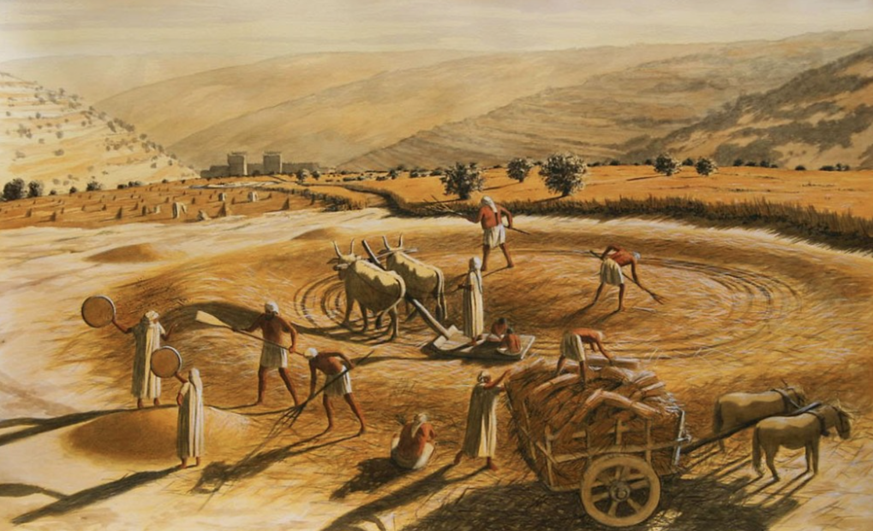
Ancient Threshing Instruments
The bottom was covered with lithic flakes or razor-like metal blades. It was pulled by horses or oxen over the grain that was spread on the threshing floor. (ii) A tribulum, this was a type of threshing board that had sharp stones or iron spikes embedded in the underside. It was also dragged by animals over the grain. (iii) The plostellum punicum or threshing wheel. This was a wooden cart with iron wheels that had sharp teeth or knives attached to them. It was driven by a person over the grain to cut the straw and separate the kernels. (iv) Carthaginian wagon, this was another form of threshing wheel that had two large wooden discs with iron spikes on the rims. It was also pulled by animals over the grain. We note the biblical description of this device according to the Torah in Devarim / Deuteronomy 25:4 and by Isaiah according to Isaiah 28:27.
There were different types of threshing sledges used in the Middle East: (i) the threshing board which was a thick board, made with a variety of slats, with a shape between rectangular and trapezoidal, with the frontal part somewhat narrower and curved upward.
Isaiah / ישעיה
http://www.matsati.com

Slide 8
Devarim / Deuteronomy 25:4
25:4 Thou shalt not muzzle the ox when he treadeth out the corn. (KJV לֹא־תַחְסֹ֥ם שׁ֖וֹר בְּדִישֽׁוֹ׃.)
Isaiah 28:27
28:27 For the fitches are not threshed with a threshing instrument, Neither is a cart wheel turned about upon the cummin; But the fitches are beaten out with a staff, And the cummin with a rod. (KJV כִּ֣י לֹ֤א בֶֽחָרוּץ֙ י֣וּדַשׁ קֶ֔צַח וְאוֹפַ֣ן עֲגָלָ֔ה עַל־כַּמֹּ֖ן יוּסָּ֑ב כִּ֧י בַמַּטֶּ֛ה יֵחָ֥בֶט קֶ֖צַח וְכַמֹּ֥ן בַּשָּֽׁבֶט׃.)
Isaiah / ישעיה
http://www.matsati.com

Slide 9
Isaiah 40:4
40:4 Every valley shall be exalted, And every mountain and hill shall be made low: And the crooked shall be made straight, And the rough places plain: (KJV כָּל־גֶּיא֙ יִנָּשֵׂ֔א וְכָל־הַ֥ר וְגִבְעָ֖ה יִשְׁפָּ֑לוּ וְהָיָ֤ה הֶֽעָקֹב֙ לְמִישׁ֔וֹר וְהָרְכָסִ֖ים לְבִקְעָֽה׃.)
Isaiah / ישעיה
http://www.matsati.com

Slide 10
The Meaning and Application of Isaiah 41:17-18 for Our Lives
God’s compassion for the needy: Isaiah 41:17-18 describes the situation of the poor and needy who are searching for water and are thirsty. God promises to answer them and not forsake them. He will provide them with water in the desert and make rivers flow on barren heights. This shows God’s compassion and care for the oppressed and suffering people, who depend on Him for their survival.
God’s power over nature: The verses also demonstrate God’s power over nature, as He can create water sources in the most unlikely places. He can turn the desert into pools of water and the parched ground into springs. This shows God’s ability to do miracles and to provide for His people in times of need.
God’s fulfillment of His promises: The verses also point to God’s fulfillment of His promises to His people, especially in relation to the restoration of Israel after the exile. God will bring them back to their land and bless them with abundance and prosperity. He will also make them a light to the nations and a witness to His glory which is a Torah based principle.
God’s invitation to trust Him: The verses also invite us to trust God and His word, as He is faithful and true. He is the only God who can save us and deliver us from our troubles. He is the first and the last, and there is no one like Him. He calls us to remember His deeds and His plans, and to rely on His grace and mercy.
Isaiah / ישעיה
http://www.matsati.com

Slide 11
Thirst and Lack of Water a Spiritual Deficit
Tehillim / Psalm 42:1-2, the psalmist expresses his longing for God as a deer pants for water. He says: “As the deer pants for streams of water, so my soul pants for you, my God. My soul thirsts for God, for the living God. When can I go and meet with God?” This shows that the psalmist feels a spiritual dryness and emptiness without God’s presence and fellowship.
Jeremiah 2:13, God rebukes Israel for forsaking Him, the fountain of living water, and digging their own broken cisterns that cannot hold water. He says: “My people have committed two sins: They have forsaken me, the spring of living water, and have dug their own cisterns, broken cisterns that cannot hold water.” This shows that Israel has turned away from God, the source of life and blessing, and has relied on their own idols and alliances, which are futile and worthless.
Isaiah / ישעיה
http://www.matsati.com

Slide 12
Thirst and Lack of Water a Spiritual Deficit
John 4:13-14, Yeshua offers the Samaritan woman at the well the living water that can quench her thirst forever. He says: “Everyone who drinks this water will be thirsty again, but whoever drinks the water I give them will never thirst. Indeed, the water I give them will become in them a spring of water welling up to eternal life.” This shows that Jesus is the fulfillment of God’s promise to provide water for the thirsty. He is the Messiah who can give the Holy Spirit and eternal life to those who believe in Him.
Revelation 22:17, the Spirit and the bride invite everyone who is thirsty to come and take the free gift of the water of life. They say: “The Spirit and the bride say, ‘Come!’ And let the one who hears say, ‘Come!’ Let the one who is thirsty come; and let the one who wishes take the free gift of the water of life.” This shows that God’s invitation to quench our spiritual thirst is open and gracious. He offers us His salvation and His presence through His Son and His Spirit.
Isaiah / ישעיה
http://www.matsati.com

Slide 13
Rabbinic Literature
ספרות רבנית
Part 3
Isaiah / ישעיה
http://www.matsati.com

Slide 14
Targum Jonathan son of Uziel Isaiah 41:13-18
41:13 For I am the Lord thy God, that will hold thee fast by thy right hand; who saith unto thee, Fear not, my WORD shall be thy help. 41:14 Fear ye not, ye tribes of the house of Jacob, ye seed of Israel, my WORD shall be your help, saith the Lord, and your Redeemer, the Holy One of Israel. 41:15 Behold, I will make you a mighty threshing-instrument full of sharp edges: thou shalt slay the nations, thou shalt consume the kingdoms, thou shalt make them like chaff. 41:16 Thou shalt fan them, and the wind shall carry them away, and my WORD shall scatter them as the whirlwind scattereth the chaff; but as for thee, thou shalt rejoice in the WORD of the Lord, thou shalt glory in the Holy One of Israel. 41:17 The poor and the needy long after instruction, as the thirsty after water, but do not find it; their spirit faints in affliction. I, the Lord, will hear their prayer; I, the God of Israel, will not cast them off. 41:18 I will gather their captives from the midst of the nations, and I will lead them in the right path; and I will open for them rivers in torrentbeds, and fountains in the midst of the valleys: I will make the desert pools of water, and the land that is a thirsty place springs of water. (TgJ)
Isaiah / ישעיה
http://www.matsati.com

Slide 15
Midrash Tanchuma, Beshalach 9:2
Furthermore it says: Fear not, thou worm Jacob (Isa. 41:14). Why is Israel compared to a worm? To teach us that just as a worm has only a soft and tender mouth with which to strike at a hard cedar tree, so Israel has only its prayers. Idolaters are likened to a cedar, as Scripture states: Behold, the Assyrian was a cedar in Lebanon (Exod. 31:3). And yea, the Lord breaketh in pieces the cedars in Lebanon (Ps. 29:5). Whenever their enemies overpowered them, the Israelites would become penitent and would plead and pray. Hence it says: I have given to thee one portion above thy brethren which I took out of the hand of the Amorites, with my sword and with my bow (Gen 48:29). Did he actually seize it with his sword and his bow? Has it not already been said: For I trust not in my bow, neither can my sword save me (Ps. 44:7)? This implies that my sword refers to prayer and my bow to beseeching. Scripture says: And this for Judah, and he said: “Hear Lord, the voice of Judah,” etc. (Deut. 33:7). Similarly, David said: Thou comest to me with a sword, and with a spear, and with a javelin; but I come to thee in the name of the Lord of hosts, the God of the armies of Israel, whom thou hast taunted (I Sam. 17:45). It says also: Some trust in chariots, and some in horses, but we will make mention of the name of the Lord his God (Ps. 20:8), and it is said: There is none beside Thee to help, between the mighty and him that hath no strength; help us, O Lord our God; for we rely on Thee, and in Thy name are we come against this multitude. Thou art the Lord our God; let not man prevail against thee (II Chron. 14:10). Concerning Moses it states: And Moses sent messengers from Kadesh unto the king of Edom … how our fathers went down into Egypt, and when we cried unto the Lord, He heard our voice (Num. 20:14–15). He said to them: Ye exalt yourselves because of your fathers’ legacy to you, but the voice is the voice of Jacob, and the hands are the hands of Esau (Gen. 27:40). Thus the verse The children of Israel cried out unto the Lord indicates that they followed the practices of their fathers. After they cried out to Him, the Holy One, blessed be He, revealed Himself to them, as it is said: But from thence ye will seek the Lord thy God; and thou shall find him (Deut. 4:29).
Isaiah / ישעיה
http://www.matsati.com

Slide 16
To call someone a killjoy when referring to the commands of God means to have a negative or critical attitude towards God’s Torah (laws) and to discourage others from following them.
A person who calls others a killjoy may think that God’s commands are too strict, too boring, or too irrelevant for today’s world.
A person who calls others a killjoy may also mock, judge, or persecute those who try to obey God and please him.
The actually Bible teaches that God’s commands are not meant to be a burden or a hindrance, but a blessing and a guide for our lives.
Isaiah / ישעיה
http://www.matsati.com

Slide 17
Mei HaShiloach, Volume I, Genesis, Lech Lecha 1
“And God said to Avram, get yourself from your country ….” (Bereshit, 12:1) It is written (Yesahya, 44:3), “When I will pour water on the thirsty, and drip moisture on the dry lands, thus I will pour My Spirit ….” Avraham Avinu began to investigate and seek after the own source of his life, for he realized that it is inconceivable that all the lusts of this world could be called true life, for all worldly desires and lusts only serve to remove the numerous anxieties and obstacles we face. Then once all anxieties are negated, what will be the true core of life upon which the world was created? Concerning this God said to him, “Lech L’cha,” move yourself forward, meaning to yourself, to your true source, for truly all the matters of this world cannot be termed “life,” and the main point of life you shall find in yourself. “You will rejoice in God, in the holy One of Israel you will glory” (Yesahya, 41:16), this is the life.
Isaiah / ישעיה
http://www.matsati.com

Slide 18
Bereshit Rabbah 83:5
with one another. This one said: ‘The field was sown for my sake,’ and that one said: ‘The field was sown for my sake.’ The wheat said: ‘Wait until you come to the threshing floor, and we will know for what the field was sown.’ They came to the threshing floor and the landowner went out to winnow it. The chaff was carried away with the wind, he took the stubble and cast it to the ground, he took the straw and burned it, he took the wheat and made it into a grain pile. Anyone who saw it kissed it, just as it says: “Kiss the grain lest He be angry” (Psalms 2:12). So it is with the nations of the world; these say: ‘We are primary and the world was created for our sake’ and those say: ‘The world was created for our sake.’ Israel says to them: ‘Wait until the day arrives when we will know for whose sake the world was created.’ That is what is written: “For, behold, the day is coming, burning like a furnace, [and all the wicked and all the evildoers will be straw]” (Malachi 3:19). And in their regard it is written: “You will winnow them and the wind will carry them and the storm will scatter them” (Isaiah 41:16). But Israel: “But you will rejoice in the Lord, you will be glorified in the Holy One of Israel” (Isaiah 41:16).
Isaiah / ישעיה
http://www.matsati.com

