Slide 1
MATSATI.COM Teaching Ministry
Website: https://www.matsati.com YouTube Channel: https://www.youtube.com/user/MATSATI/
ישעיהו מ:יט-כד / Isaiah 40:19-24
LIVE STREAM: 6:30 pm EST Thursday
New Telegram Channel: 518Ministries
https://t.me/five18Ministries
Focus: The Way of Life - Following Yeshua the Messiah with an emphasis on walking in His footsteps according to the Torah
A Community
for Learning
Discuss the Scriptures,
learn the languages,
and fellowship

Slide 2
Isaiah 40:19-24
ישעיהו מ:יט-כד
Is the Earth Round or Flat?
Isaiah has Something to Say About That!
Isaiah / ישעיה
http://www.matsati.com

Slide 3
מבוא לישעיהו
Part 1
Isaiah / ישעיה
http://www.matsati.com

Slide 4
Isaiah / ישעיה
http://www.matsati.com

Slide 5
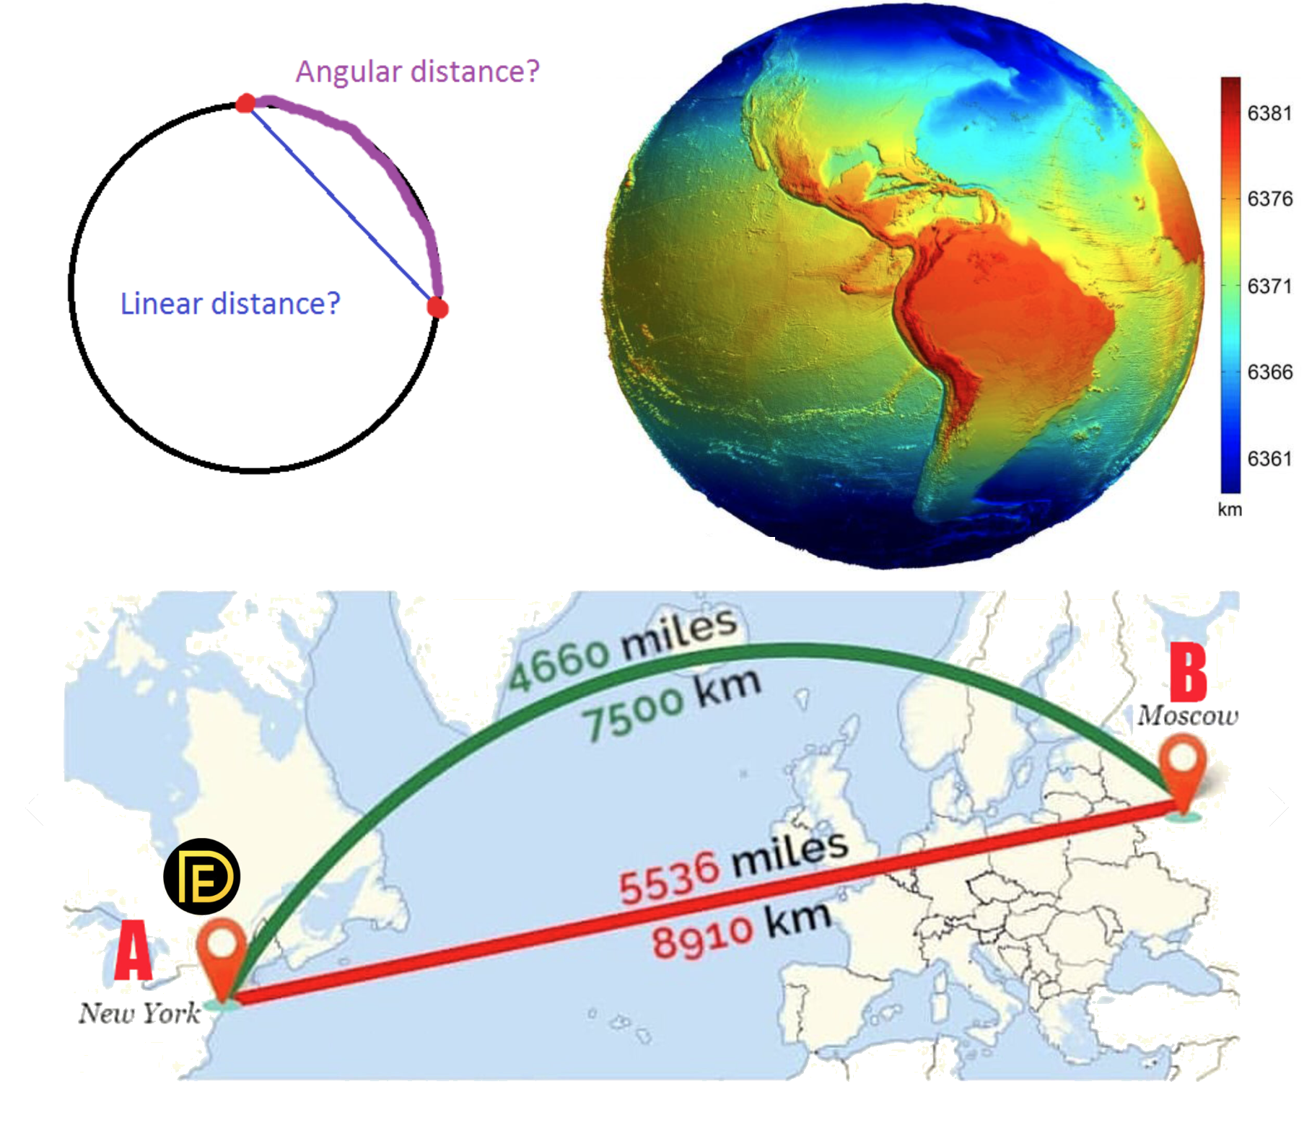
Isaiah / ישעיה
http://www.matsati.com

Slide 6
Scripture that Speak of God's Transcendence
Tehillim / Psalm 97:9: "For you, O Lord, are most high over all the earth; you are exalted far above all gods." (כִּֽי־אַתָּ֤ה יְהוָ֗ה עֶלְיֹ֥ון עַל־כָּל־הָאָ֑רֶץ מְאֹ֥ד נַ֝עֲלֵ֗יתָ עַל־כָּל־אֱלֹהִֽים׃)
1 Kings 8:27: "But will God indeed dwell on the earth? Behold, heaven and the highest heaven cannot contain you, how much less this house which I have built!" (כִּ֚י הַֽאֻמְנָ֔ם יֵשֵׁ֥ב אֱלֹהִ֖ים עַל־הָאָ֑רֶץ הִ֠נֵּה הַשָּׁמַ֜יִם וּשְׁמֵ֤י הַשָּׁמַ֨יִם֙ לֹ֣א יְכַלְכְּל֔וּךָ אַ֕ף כִּֽי־הַבַּ֥יִת הַזֶּ֖ה אֲשֶׁ֥ר בָּנִֽיתִי׃)
Isaiah 40:22: "It is he who sits above the circle of the earth, and its inhabitants are like grasshoppers; who stretches out the heavens like a curtain, and spreads them out like a tent to dwell in." (הַיֹּשֵׁב֙ עַל־ח֣וּג הָאָ֔רֶץ וְיֹשְׁבֶ֖יהָ כַּחֲגָבִ֑ים הַנֹּוטֶ֤ה כַדֹּק֙ שָׁמַ֔יִם וַיִּמְתָּחֵ֥ם כָּאֹ֖הֶל לָשָֽׁבֶת׃)
Jeremiah 23:24: "Can anyone hide in secret places so that I cannot see him?" declares the Lord. "Do I not fill heaven and earth?" declares the Lord." (אִם־יִסָּתֵ֨ר אִ֧ישׁ בַּמִּסְתָּרִ֛ים וַאֲנִ֥י לֹֽא־אֶרְאֶ֖נּוּ נְאֻם־יְהוָ֑ה הֲלֹ֨וא אֶת־הַשָּׁמַ֧יִם וְאֶת־הָאָ֛רֶץ אֲנִ֥י מָלֵ֖א נְאֻם־יְהוָֽה׃)
Acts 17:24: "The God who made the world and everything in it, being Lord of heaven and earth, does not live in temples made by human hands." (24 ὁ θεὸς ὁ ποιήσας τὸν κόσμον καὶ πάντα τὰ ἐν αὐτῷ, οὗτος οὐρανοῦ καὶ γῆς ὑπάρχων κύριος οὐκ ἐν χειροποιήτοις ναοῖς κατοικεῖ)
Isaiah / ישעיה
http://www.matsati.com

Slide 7
ספר שמות פרק כ
א וַיְדַבֵּר אֱלֹהִים אֵת כָּל-הַדְּבָרִים הָאֵלֶּה לֵאמֹר: ס ב אָנֹכִי יְהוָֹה אֱלֹהֶיךָ אֲשֶׁר הוֹצֵאתִיךָ מֵאֶרֶץ מִצְרַיִם מִבֵּית עֲבָדִים: ג לֹא-יִהְיֶה לְךָ אֱלֹהִים אֲחֵרִים עַל-פָּנָי: ד לֹא-תַעֲשֶֹה לְךָ פֶסֶל וְכָל-תְּמוּנָה אֲשֶׁר בַּשָּׁמַיִם מִמַּעַל וַאֲשֶׁר בָּאָרֶץ מִתָּחַת וַאֲשֶׁר בַּמַּיִם מִתַּחַת לָאָרֶץ: ה לֹא-תִשְׁתַּחֲוֶה לָהֶם וְלֹא תָעָבְדֵם כִּי אָנֹכִי יְהוָֹה אֱלֹהֶיךָ אֵל קַנָּא פֹּקֵד עֲוֹן אָבֹת עַל-בָּנִים עַל-שִׁלֵּשִׁים וְעַל-רִבֵּעִים לְשֹֹנְאָי: ו וְעֹשֶֹה חֶסֶד לַאֲלָפִים לְאֹהֲבַי וּלְשֹׁמְרֵי מִצְוֹתָי:
Isaiah / ישעיה
http://www.matsati.com

Slide 8
ספר ישעיה
Part 2
Isaiah / ישעיה
http://www.matsati.com

Slide 9
﻿ספר ישעיה פרק מ
יט הַפֶּסֶל נָסַךְ חָרָשׁ וְצֹרֵף בַּזָּהָב יְרַקְּעֶנּוּ וּרְתֻקוֹת כֶּסֶף צוֹרֵף: כ הַמְסֻכָּן תְּרוּמָה עֵץ לֹא-יִרְקַב יִבְחָר חָרָשׁ חָכָם יְבַקֶּשׁ-לוֹ לְהָכִין פֶּסֶל לֹא יִמּוֹט: כא הֲלוֹא תֵדְעוּ הֲלוֹא תִשְׁמָעוּ הֲלוֹא הֻגַּד מֵרֹאשׁ לָכֶם הֲלוֹא הֲבִינֹתֶם מוֹסְדוֹת הָאָרֶץ: כב הַיּשֵׁב עַל-חוּג הָאָרֶץ וְיֹשְׁבֶיהָ כַּחֲגָבִים הַנּוֹטֶה כַדֹּק שָׁמַיִם וַיִּמְתָּחֵם כָּאֹהֶל לָשָׁבֶת: כג הַנּוֹתֵן רוֹזְנִים לְאָיִן שֹׁפְטֵי אֶרֶץ כַּתֹּהוּ עָשָֹה: כד אַף בַּל-נִטָּעוּ אַף בַּל-זֹרָעוּ אַף בַּל-שֹׁרֵשׁ בָּאָרֶץ גִּזְעָם וְגַם-נָשַׁף בָּהֶם וַיִּבָשׁוּ וּסְעָרָה כַּקַּשׁ תִּשָּׂאֵם:
Isaiah / ישעיה
http://www.matsati.com

Slide 10
References where Idolatry is Forbidden
Shemot / Exodus 20:3-6: The first and second commandments prohibit having any other gods besides the Lord and making or worshiping any idols.
Devarim / Deuteronomy 5:7-10: A repetition of the first and second commandments with a warning that idolaters will be punished for generations, but those who love God will be shown mercy.
Isaiah 44:9-20: A sarcastic description of how foolish it is to make and worship idols from wood and metal, while ignoring the true God who made everything.
Jeremiah 10:1-16: A contrast between the living God who created the heavens and the earth and the worthless idols that are made by human hands and cannot speak, move, or do anything.
1 Corinthians 10:14-22: A warning to Believers not to participate in idolatry or eat food sacrificed to idols, because it is incompatible with the worship of the Lord God and provokes God to jealousy.
1 John 5:21: A final exhortation to Christians to keep themselves from idols and remain faithful to God.
Isaiah / ישעיה
http://www.matsati.com

Slide 11
יט הַפֶּסֶל נָסַךְ חָרָשׁ וְצֹרֵף בַּזָּהָב יְרַקְּעֶנּוּ וּרְתֻקוֹת כֶּסֶף צוֹרֵף: כ הַמְסֻכָּן תְּרוּמָה עֵץ לֹא-יִרְקַב יִבְחָר חָרָשׁ חָכָם יְבַקֶּשׁ-לוֹ לְהָכִין פֶּסֶל לֹא יִמּוֹט:
Isaiah / ישעיה
http://www.matsati.com

Slide 12
Hebrews 1:10–12
1:10 And, Thou, Lord, in the beginning hast laid the foundation of the earth; and the heavens are the works of thine hands: 1:11 They shall perish; but thou remainest; and they all shall wax old as doth a garment; 1:12 And as a vesture shalt thou fold them up, and they shall be changed: but thou art the same, and thy years shall not fail. (KJV καί· σὺ κατʼ ἀρχάς, κύριε, τὴν γῆν ἐθεμελίωσας, καὶ ἔργα τῶν χειρῶν σού εἰσιν οἱ οὐρανοί· αὐτοὶ ἀπολοῦνται, σὺ δὲ διαμένεις, καὶ πάντες ὡς ἱμάτιον παλαιωθήσονται, καὶ ὡσεὶ περιβόλαιον ἑλίξεις αὐτούς, ὡς ἱμάτιον καὶ ἀλλαγήσονται· σὺ δὲ ὁ αὐτὸς εἶ καὶ τὰ ἔτη σου οὐκ ἐκλείψουσιν.)
Isaiah / ישעיה
http://www.matsati.com

Slide 13
Tehillim / Psalm 102:25–27
102:25 Of old hast thou laid the foundation of the earth: And the heavens are the work of thy hands. 102:26 They shall perish, but thou shalt endure: Yea, all of them shall wax old like a garment; As a vesture shalt thou change them, and they shall be changed: 102:27 But thou art the same, And thy years shall have no end. (KJV לְ֭פָנִים הָאָ֣רֶץ יָסַ֑דְתָּ וּֽמַעֲשֵׂ֖ה יָדֶ֣יךָ שָׁמָֽיִם׃ הֵ֤מָּה׀ יֹאבֵדוּ֮ וְאַתָּ֪ה תַ֫עֲמֹ֥ד וְ֭כֻלָּם כַּבֶּ֣גֶד יִבְל֑וּ כַּלְּב֖וּשׁ תַּחֲלִיפֵ֣ם וְֽיַחֲלֹֽפוּ׃)
Isaiah / ישעיה
http://www.matsati.com

Slide 14
Reasons People Remain Skeptical about a Spherical Earth
They are skeptical of the authorities and institutions that provide the evidence, such as NASA, governments, scientists, etc. They may think that these sources are lying or hiding something from the public for their own agendas.
They are influenced by their social and cultural environment, such as their friends, family, online communities, religious beliefs, etc. They may find comfort and support in belonging to a group that shares their worldview.
They are motivated by their psychological needs, such as curiosity, wonder, empowerment, etc. They may enjoy exploring alternative explanations and challenging the mainstream views. Some people feel empowered by this belief thinking they have some special insight that nobody else does.
They are biased by their subjective experience, such as their perception, intuition, common sense, etc. They may trust what they see and feel more than what they learn from abstract and complex sources. For example the earth is so massive, that the tangent line appears to be mostly flat at any given point on the surface of the earth.
Isaiah / ישעיה
http://www.matsati.com

Slide 15
The Theme of God’s Sovereignty and Judgment over the Nations
1 Corinthians 1:26-29, here Paul reminds the Corinthians that God chose the foolish, weak, lowly, and despised things of the world to shame the wise, strong, noble, and proud. This may echo the idea of Isaiah 40:23-24 that God brings princes to naught and reduces the rulers of this world to nothing.
James 1:9-11, here James contrasts the lowly brother who boasts in his exaltation and the rich man who boasts in his humiliation. He says that the rich man will fade away like a flower of the field, which is similar to the imagery of Isaiah 40:23-24 that the rulers of this world wither and are swept away like chaff.
Revelation 18:1-3, here John sees a vision of the fall of Babylon, the great city that ruled over the kings of the earth. He hears a voice from heaven saying that Babylon has become a dwelling place of demons and a haunt of every unclean spirit. This may reflect the prophecy of Isaiah 40:23-24 that God will judge the great people of the world and bring them all to nothing.
Isaiah / ישעיה
http://www.matsati.com

Slide 16
Rabbinic Literature
ספרות רבנית
Part 3
Isaiah / ישעיה
http://www.matsati.com

Slide 17
Targum Jonathan son of Uziel Isaiah 40:19-24
40:19 Behold, the artificer maketh an image, and the goldsmith overlayeth it with gold, and with silver chains the silversmith fasteneth it. 40:20 He cuts a wild ash of the forest, which rottenness will seize; he procures a skilful artist to fix the image, that it be not moved. 40:21 Have ye not known? have ye not heard? hath not the work in the creation been declared unto you in its order from the beginning? Have ye not understood that ye ought to fear Him, who hath created the foundations of the earth? 40:22 Who maketh the Shekinah of His glory to dwell in exalted strength, and all the inhabitants of the earth are in His estimation as locusts; He that stretched out the heavens as a little thing, and spreadeth them out as the tent of the glory of the house of the Shekinah. 40:23 Who gives princes over to weakness; the judges of the earth He bringeth to naught. 40:24 Although they multiply, although they increase, although their children become great in the earth, yet, nevertheless, He will send His wrath among them, and they shall be confounded: and His WORD shall scatter them, as the whirlwind the chaff. (TgJ)
Isaiah / ישעיה
http://www.matsati.com

Slide 18
Isaiah 40:20
הַמְסֻכָּן תְּרוּמָה עֵץ לֹא-יִרְקַב יִבְחָר חָרָשׁ חָכָם יְבַקֶּשׁ-לוֹ לְהָכִין פֶּסֶל לֹא יִמּוֹט
“He that is so impoverished that he hath no oblation chooseth a tree that will not rot; he seeketh unto him a cunning workman to prepare a graven image, that shall not be moved.”
Isaiah / ישעיה
http://www.matsati.com

Slide 19
Rashi on Isaiah 40:20 Parts 1-3
המסכן תרומה. או אם בא לעשותו של עץ המלומד להבחין בין עץ המתקיים לשאר עצים שלא ירקב מהר יבחר:
He who is accustomed to select הַמְסֻכָּן תְּרוּמָה. Or, if he comes to make it of wood, one who is accustomed to discern between a durable tree and other trees, chooses a tree that does not decay quickly.
המסכן. המלומד כמו (במדבר כ״ב:ל׳) ההסכן הסכנתי:
He who is accustomed Heb. הַמְסֻכָּן. Comp. (Num. 22:30) “Have I been accustomed (הַהַסְכֵּן הִסְכַּנְתִּי)?”
תרומה. הפרשה ברירת העצים:
to select Heb. תְּרוּמָה, separation, selection of the trees.
Isaiah / ישעיה
http://www.matsati.com

Slide 20
Duties of the Heart, Second Treatise on Examination 2:4
From Scripture: The same can be demonstrated from Scriptures, as it is said, "Lift up your eyes on high and behold, who created these?" (Yeshaya 40:26). And again "When I behold Your heavens, the work of Your fingers, the moon and the stars, which You have established" (Tehilim 8:4). Scripture also said "Have you not known? have you not heard? has it not been told you from the beginning? [have you not understood from the foundations of the earth?]" (Yeshaya 40:21) Further "Hear O deaf, look O blind, that you may see" (Yeshaya 42:18); "Better to go to the house of mourning than to go to the house of feasting, since that is the end of all men, and the living will take it to his heart" (Koheles 7:2); "The wise man, his eyes are in his head; but the fool walks in darkness" (Koheles 2:14). "But the path of the righteous is as the light of dawn that shines more till the day is perfect. The way of the wicked is as darkness; they know not at what they stumble" (Mishlei 4:18-19).
Isaiah / ישעיה
http://www.matsati.com

Slide 21
Midrash Tehillim 19:4
Another thing, the heavens declare the glory of God. Rabbi Yaakov bar Zavdi said that this refers to what is stated in Psalms 116:12: "What shall I render unto the LORD for all His benefits toward me?" Rabbi Shmuel bar Nachman said that four psalms should be recited, all of them in Psalm 145. Another thing, the heavens declare the glory of God. It is like a hero who enters a country and his strength is unknown. One wise man said, "I know that he is strong because he shakes the dust off his shoes." Similarly, we learn of the strength of the Holy One, blessed be He, from the heavens. Rabbi Yitzchak said that this is because it is written (Jeremiah 23:24), "Do I not fill heaven and earth?" Can it be that His glory fills the upper and lower worlds? But it has already been said (Psalms 8:4), "When I consider Your heavens, the work of Your fingers." They only contain the space of the Holy One, blessed be He's finger. This is like a king who hangs a veil over the entrance to his palace. The king says, "Let anyone who is wise come and tell me what is behind the veil. Let anyone who is rich make a similar one, and let anyone who is strong touch it." So too, the Holy One, blessed be He, spreads out the heavens like a curtain, but He said, "Let anyone who is wise tell me what it is, and let anyone who is strong touch it." Rabbi Pinchas said, "When the heavens pour down and the earth grows, the creatures praise the Holy One, blessed be He." Therefore, the heavens declare the glory of God, and His handiwork proclaims His handiwork. When Israel sins, what is written (Job 20:27), "The heavens shall reveal his iniquity." When they are righteous, what is written (Deuteronomy 28:12), "The Lord shall open unto thee His good treasure."
Isaiah / ישעיה
http://www.matsati.com

