Slide 1
MATSATI.COM Teaching Ministry
Website: https://www.matsati.com YouTube Channel: https://www.youtube.com/user/MATSATI/
ישעיהו מ:א-ו / Isaiah 40:1-6
LIVE STREAM: 6:30 pm EST Thursday
New Telegram Channel: 518Ministries
https://t.me/five18Ministries
Focus: The Way of Life - Following Yeshua the Messiah with an emphasis on walking in His footsteps according to the Torah
A Community
for Learning
Discuss the Scriptures,
learn the languages,
and fellowship

Slide 2
Isaiah 40:1-6
ישעיהו מ:א-ו
AntiMissionary Questions about Believing in Yeshua
as the Messiah of God
Isaiah / ישעיה
http://www.matsati.com
Notes:
אַבָּא שֶׁבְּשָׁמַיִם אָנוּ מוֹדִים לְךָ עַל כָּל הַבְּרָכוֹת שֶׁלָּךְ, עָזְרוּ לָנוּ לָקַחַת אֶת כִּתְבֵי הַקֹּדֶשׁ וּלְיַשֵּׂם אֶת הָאֲמִתּוּת הַלְּלוּ בַּחַיֵּינוּ. בַּשֵּׁם ישוע אָנוּ מִתְפַּלְּלִים, אָמָּן.

Slide 3
מבוא לישעיהו
Part 1
Isaiah / ישעיה
http://www.matsati.com

Slide 4
Modern scholarship states that the book of Isaiah is divided into three major sections:
Chapters 1-39: This section is traditionally attributed to Isaiah of Jerusalem, who lived in the 8th century B.C. It contains prophecies about the judgment of Judah and Israel for their sins, as well as prophecies about the future restoration of the people.
Chapters 40-55: This section is known as "Second Isaiah" or "Deutero-Isaiah." It is thought to have been written by a different author in the 6th century B.C., during the Babylonian exile. It contains prophecies of comfort and hope for the exiles, as well as prophecies about the coming of a messianic figure.
Chapters 56-66: This section is known as "Third Isaiah" or "Trito-Isaiah." It is thought to have been written by a different author in the 5th century B.C., after the exile. It contains prophecies about the restoration of Jerusalem and the establishment of a new Davidic kingdom.
Isaiah / ישעיה
http://www.matsati.com

Slide 5
AntiMissionary Questions and Claims
“Do you really believe that a person has to believe in Yeshua before understanding how the scriptures speak about him?”
and
“Are you saying that I cannot understand the scriptures properly until I first place my faith in Yeshua?”
Isaiah / ישעיה
http://www.matsati.com

Slide 6
Luke 24:36–49
24:36 And as they thus spake, Jesus himself stood in the midst of them, and saith unto them, Peace be unto you. 24:37 But they were terrified and affrighted, and supposed that they had seen a spirit. 24:38 And he said unto them, Why are ye troubled? and why do thoughts arise in your hearts? 24:39 Behold my hands and my feet, that it is I myself: handle me, and see; for a spirit hath not flesh and bones, as ye see me have. 24:40 And when he had thus spoken, he shewed them his hands and his feet. 24:41 And while they yet believed not for joy, and wondered, he said unto them, Have ye here any meat? 24:42 And they gave him a piece of a broiled fish, and of an honeycomb. 24:43 And he took it, and did eat before them. 24:44 And he said unto them, These are the words which I spake unto you, while I was yet with you, that all things must be fulfilled, which were written in the law of Moses, and in the prophets, and in the psalms, concerning me. 24:45 Then opened he their understanding, that they might understand the scriptures, 24:46 And said unto them, Thus it is written, and thus it behoved Christ to suffer, and to rise from the dead the third day: 24:47 And that repentance and remission of sins should be preached in his name among all nations, beginning at Jerusalem. 24:48 And ye are witnesses of these things. 24:49 And, behold, I send the promise of my Father upon you: but tarry ye in the city of Jerusalem, until ye be endued with power from on high. (KJV)
Isaiah / ישעיה
http://www.matsati.com

Slide 7
ספר ישעיה
Part 2
Isaiah / ישעיה
http://www.matsati.com

Slide 8
﻿ספר ישעיה פרק מ
﻿א נַחֲמוּ נַחֲמוּ עַמִּי יֹאמַר אֱלֹהֵיכֶם: ב דַּבְּרוּ עַל-לֵב יְרוּשָׁלַם וְקִרְאוּ אֵלֶיהָ כִּי מָלְאָה צְבָאָהּ כִּי נִרְצָה עֲוֹנָהּ כִּי לָקְחָה מִיַּד יְהֹוָה כִּפְלַיִם בְּכָל-חַטֹּאתֶיהָ: ג קוֹל קוֹרֵא בַּמִּדְבָּר פַּנּוּ דֶּרֶךְ יְהֹוָה יַשְּׁרוּ בָּעֲרָבָה מְסִלָּה לֵאלֹהֵינוּ: ד כָּל-גֶּיא יִנָּשֵֹא וְכָל-הַר וְגִבְעָה יִשְׁפָּלוּ וְהָיָה הֶעָקֹב לְמִישׁוֹר וְהָרְכָסִים לְבִקְעָה: ה וְנִגְלָה כְּבוֹד יְהֹוָה וְרָאוּ כָל-בָּשָֹר יַחְדָּו כִּי פִּי יְהֹוָה דִּבֵּר: ו קוֹל אֹמֵר קְרָא וְאָמַר מָה אֶקְרָא כָּל-הַבָּשָֹר חָצִיר וְכָל-חַסְדּוֹ כְּצִיץ הַשָּׂדֶה:
Isaiah / ישעיה
http://www.matsati.com

Slide 9
Isaiah 40:1-2
Isaiah / ישעיה
http://www.matsati.com

Slide 10
ספר שמות פרק ו
﻿ז וְלָקַחְתִּי אֶתְכֶם לִי לְעָם וְהָיִיתִי לָכֶם לֵאלֹהִים וִידַעְתֶּם כִּי אֲנִי יְהוָֹה אֱלֹהֵיכֶם הַמּוֹצִיא אֶתְכֶם מִתַּחַת סִבְלוֹת מִצְרָיִם:
﻿ספר שמות פרק יט
ה וְעַתָּה אִם-שָׁמוֹעַ תִּשְׁמְעוּ בְּקֹלִי וּשְׁמַרְתֶּם אֶת-בְּרִיתִי וִהְיִיתֶם לִי סְגֻלָּה מִכָּל-הָעַמִּים כִּי-לִי כָּל-הָאָרֶץ:
﻿ספר ויקרא פרק כו
יב וְהִתְהַלַּכְתִּי בְּתוֹכֲכֶם וְהָיִיתִי לָכֶם לֵאלֹהִים וְאַתֶּם תִּהְיוּ-לִי לְעָם:
﻿ספר דברים פרק כו
יז אֶת-יְהוָֹה הֶאֱמַרְתָּ הַיּוֹם לִהְיוֹת לְךָ לֵאלֹהִים וְלָלֶכֶת בִּדְרָכָיו וְלִשְׁמֹר חֻקָּיו וּמִצְוֹתָיו וּמִשְׁפָּטָיו וְלִשְׁמֹעַ בְּקֹלוֹ: יח וַיהֹוָה הֶאֱמִירְךָ הַיּוֹם לִהְיוֹת לוֹ לְעַם סְגֻלָּה כַּאֲשֶׁר דִּבֶּר-לָךְ וְלִשְׁמֹר כָּל-מִצְוֹתָיו:
Isaiah / ישעיה
http://www.matsati.com

Slide 11
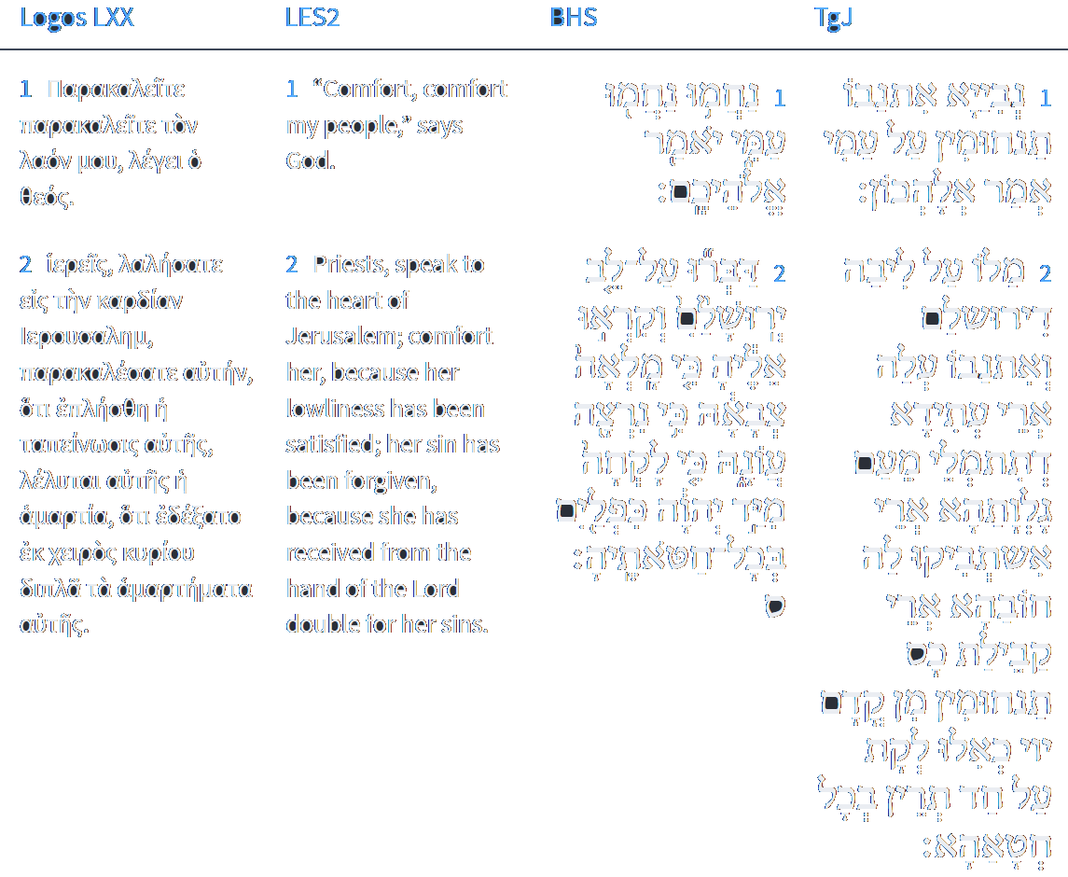
Isaiah 40:1-2
Isaiah / ישעיה
http://www.matsati.com

Slide 12
Hebrews 4:1-11
4:1 Let us therefore fear, lest, a promise being left us of entering into his rest, any of you should seem to come short of it. 4:2 For unto us was the gospel preached, as well as unto them: but the word preached did not profit them, not being mixed with faith in them that heard it. 4:3 For we which have believed do enter into rest, as he said, As I have sworn in my wrath, if they shall enter into my rest: although the works were finished from the foundation of the world. 4:4 For he spake in a certain place of the seventh day on this wise, And God did rest the seventh day from all his works. 4:5 And in this place again, If they shall enter into my rest. 4:6 Seeing therefore it remaineth that some must enter therein, and they to whom it was first preached entered not in because of unbelief: 4:7 Again, he limiteth a certain day, saying in David, To day, after so long a time; as it is said, To day if ye will hear his voice, harden not your hearts. 4:8 For if Jesus had given them rest, then would he not afterward have spoken of another day. 4:9 There remaineth therefore a rest to the people of God. 4:10 For he that is entered into his rest, he also hath ceased from his own works, as God did from his. 4:11 Let us labour therefore to enter into that rest, lest any man fall after the same example of unbelief. (KJV)
Isaiah / ישעיה
http://www.matsati.com

Slide 13
Aggadat Bereshit 68:1
Chapter (67) 68: Prophets [1] "In the second year of King Darius, the word of the Lord came through the prophet Haggai" (Haggai 1:1). Like the scriptures say: "A voice of one calling: “In the wilderness prepare the way for the Lord; make straight in the desert a highway for our God. Every valley shall be raised up, every mountain and hill made low; the rough ground shall become level,the rugged places a plain. And the glory of the Lord will be revealed, and all people will see it together. For the mouth of the Lord has spoken.” (Isaiah 40:3-5) [also look: Eikhah Rabbah 1:23]. "A voice calls out [in the wilderness]" [edit: ] . Rabbi Levi said: "Why is it called 'in the wilderness'? Rather, it is in accordance with the practice of the world. Just as someone who lost a valuable object does not search for it in the place where it was lost, but rather in a public place where many people pass through, so too the Holy One, blessed be He, caused Israel to be lost in the wilderness, as it is said, 'In this wilderness they shall be consumed, and there they shall die' (Numbers 14:35), and there He goes and seeks them. A voice calls out in the wilderness, 'Prepare the way.' What should we prepare? He said to them, 'Remove the obstacles from among you.' As Laban said to Eliezer, 'Do not be delayed by me, now that the Lord has granted success to your journey. Let me see you off and send you on your way to my master' (Genesis 24:56). Laban had already uprooted [Rebecca] from here [Haran] for Eliezer's sake, as it is said, 'And I have set my face towards the Lord' (Genesis 24:27). And what about the place for the camels? He said to him, 'Rebecca does not steal in this place. And I have set my face towards the Lord.' And who will steal [the idols]? Rachel, who is destined to stand up [to Laban], will steal them and put them among the camels, as it is said, 'And Rachel took the teraphim * [*תְּרָפִים m.n. pl. a kind of household idols. Of uncertain origin. According to Neubauer and others, related to רֽפָאִים ᴵ (= shades, ghosts ).], and put them in the camel's saddle' (Genesis 31:34). Alternatively, 'And I have set my face towards the Lord' is a reference to the statue of Manasseh. And when was it [that it was hidden]? When Nebuchadnezzar went out to destroy it, as it is compared to a camel, as it is said, 'The burden upon beasts of burden' (Isaiah 21:7). The burden upon beasts of burden is the Messiah, and the burden upon a camel is Nebuchadnezzar.
Isaiah / ישעיה
http://www.matsati.com

Slide 14
Aggadat Bereshit 68:1, cont…
On the day that Nebuchadnezzar destroyed the Temple, the Messiah was born, as it is said, 'And Lebanon shall fall by a mighty one' (Isaiah 10:34), and 'a shoot shall grow out of the stock of Jesse' (Isaiah 11:1). Therefore, 'Prepare the way of the Lord, make straight in the wilderness a highway for our God' (Isaiah 40:3), straighten yourselves like those whom I straightened out in the wilderness who were crooked, 'and let every valley be exalted, and every mountain and hill be made low' (Isaiah 40:4), so that you will no longer be afraid of sin, as it is said, 'Look at your way in the valley' (Jeremiah 2:23)." Alternative interpretation: "All valleys will be exalted. I will carry Moshe, who was buried in a valley, as it is written 'And He buried him in the valley' (Deuteronomy 34:6). This can be compared to a wise man who entrusted his son to a scribe to learn Torah laws and teachings. When they came to appoint him as a wise man, he said, 'I swear that my son has not yet been appointed a wise man until his teacher comes and sanctifies him.' Similarly, Hashem entrusted Israel to Moshe and taught them everything, as it is written, 'See, I have taught you statutes and laws' (Deuteronomy 4:5). And the Messiah will come to redeem them, and Hashem says to him, 'I swear that my children will not be redeemed until Moshe Rabbeinu comes,' as it is written, 'I saw his beginning and ending' (Isaiah 41:4). Why do I carry him? 'Every valley shall be raised up, every mountain and hill shall be made low' (Isaiah 40:4). These are the kingdoms, as it is written, 'And I looked up and saw four chariots coming out from between two mountains' (Zechariah 6:1). And 'The crooked shall be made straight and the rough places smooth' (Isaiah 40:4). This refers to the evil inclination, as it is written, 'The heart is deceitful above all things' (Jeremiah 17:9). And 'The riders shall come down to the plain' (Isaiah 40:4). These are wicked people, as David says, 'You will hide them in the shelter of Your presence from the intrigues of men' (Psalms 31:21). Afterwards, 'And the glory of Hashem shall be revealed' (Isaiah 40:5), because in this world the prophets prophesy indirectly, saying, 'I saw Hashem standing by the altar' (Amos 9:1). Ezekiel says, 'The word of Hashem came to me and I saw visions by the river Kevar' (Ezekiel 1:1). Amos says, 'Behold, Hashem stood upon a wall with a plumb line' (Amos 7:7). "And the prophet Haggai prophesied about the Jews who were in Judah and Jerusalem" (Ezra 5:1), but in the future, everyone will see it, as it is said, "And the glory of the Lord will be revealed, and all flesh will see it together, for the mouth of the Lord has spoken" (Isaiah 40:5).
Isaiah / ישעיה
http://www.matsati.com

Slide 15
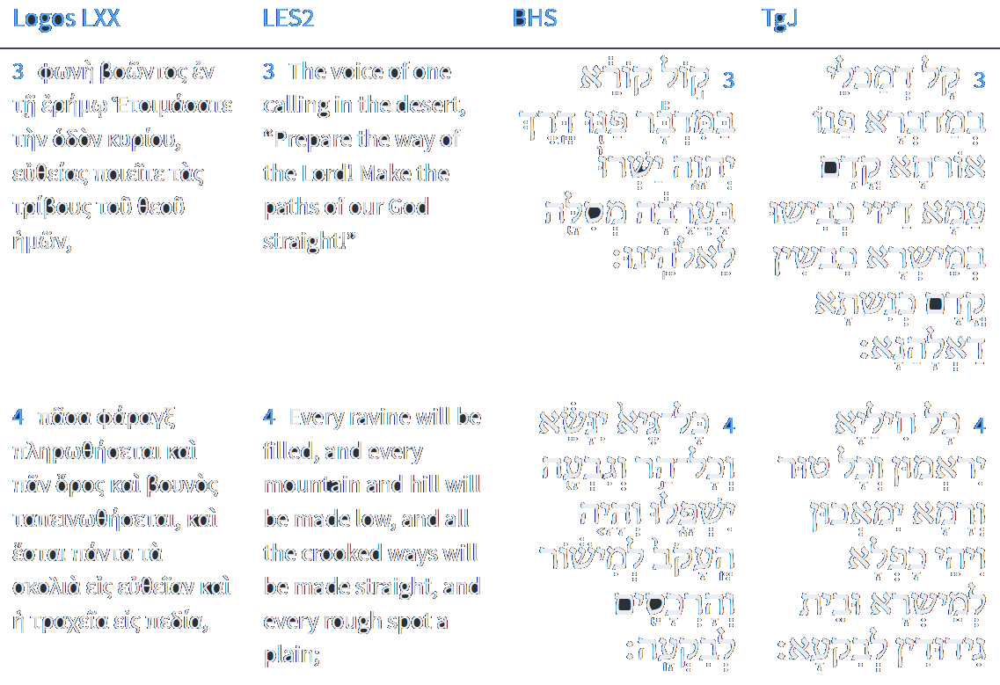
Isaiah 40:3-4
Isaiah / ישעיה
http://www.matsati.com

Slide 16
The wordכְּבוֹד occurs 38 times spelled in this way in the book of Isaiah.
Isaiah / ישעיה
http://www.matsati.com

Slide 17
The wordכְּבוֹד occurs 38 times spelled in this way in the book of Isaiah.
Isaiah / ישעיה
http://www.matsati.com

Slide 18
Rabbinic Literature
ספרות רבנית
Part 3
Isaiah / ישעיה
http://www.matsati.com

Slide 19
Targum Jonathan son of Uziel Isaiah 40:1-6
40:1 O ye prophets, prophesy comforts to my people, saith your God. 40:2 Speak ye comfortably, to Jerusalem, and prophesy concerning her, that she shall be filled with the people of the captivity, because her sins are forgiven, for she hath received the cup of consolations from the Lord, as if she had been smitten twice for all her sins. 40:3 A voice of one crying in the wilderness, Prepare ye the way before the people of the Lord; cast up a highway in the plain before the congregation of our God. 40:4 All the valleys shall be exalted, and every mountain and hill shall be made low, and the rugged way shall be a level, and the hilly ground a valley. 40:5 And the glory of the Lord shall be revealed, and all the sons of flesh shall see together, that by the WORD of the Lord it has been decreed thus. 40:6 The voice of one crying, Prophesy! He answered and said, What shall I prophesy? All the wicked are as grass, and all their strength as chaff of the field. (TgJ)
Isaiah / ישעיה
http://www.matsati.com

Slide 20
Midrash Tehillim 4:9
ודעו כי הפלה ה' חסיד. כבר בשרני על ידי ישעיה (ישעיה מ א) נחמו נחמו עמי. וכד אתי ההיא שעתא ישמע בקראי אליו:
"And know that the Lord has set apart the godly for Himself; the Lord hears when I call to Him." (Psalms 4:3) "And you shall know that I am the Lord, when I bring you into the land of Israel, the country which I lifted up My hand in an oath to give to your fathers." (Ezekiel 20:42) "Comfort, comfort My people, says your God." (Isaiah 40:1) "And it shall come to pass at that time that I will hear," says the Lord; "I will hear the heavens, and they shall hear the earth." (Hosea 2:23)
Isaiah / ישעיה
http://www.matsati.com

Slide 21
The Importance of Godliness According to the Tanakh
Tehillim / Psalms 25:21, May integrity and godliness protect me, for I rely on you.
Isaiah 51:1, Listen to me, you who pursue godliness, who seek the Lord! Look at the rock from which you were chiseled, at the quarry from which you were dug.
Isaiah 59:14, Justice is driven back, godliness stands far off. Indeed, honesty stumbles in the city square and morality is not even able to enter.
Ezekiel 33:18, When a righteous man turns from his godliness and commits iniquity, he will die for it.
Isaiah / ישעיה
http://www.matsati.com

Slide 22
The Importance of Godliness According to the NT
1 Timothy 4:8, For bodily exercise profiteth little: but godliness is profitable unto all things, having promise of the life that now is, and of which is to come.
2 Peter 1:3, His divine power has granted to us all things that pertain to live and godliness, through the knowledge of him who called us to his own glory and excellence.
Titus 2:12, Training us to renounce ungodliness and worldly passions, and to live self-controlled, upright, and godly lives in the present age.
2 Timothy 3:12, Yea, and all that will live godly in Christ Jesus shall suffer persecution.
1 Timothy 6:6, But godliness with contentment is great gain.
Isaiah / ישעיה
http://www.matsati.com

Slide 23
Aggadat Bereshit 68:1
Chapter (67) 68: Prophets [1] "In the second year of King Darius, the word of the Lord came through the prophet Haggai" (Haggai 1:1). Like the scriptures say: "A voice of one calling: “In the wilderness prepare the way for the Lord; make straight in the desert a highway for our God. Every valley shall be raised up, every mountain and hill made low; the rough ground shall become level,the rugged places a plain. And the glory of the Lord will be revealed, and all people will see it together. For the mouth of the Lord has spoken.” (Isaiah 40:3-5) [also look: Eikhah Rabbah 1:23]. "A voice calls out [in the wilderness]" [edit: ] . Rabbi Levi said: "Why is it called 'in the wilderness'? Rather, it is in accordance with the practice of the world. Just as someone who lost a valuable object does not search for it in the place where it was lost, but rather in a public place where many people pass through, so too the Holy One, blessed be He, caused Israel to be lost in the wilderness, as it is said, 'In this wilderness they shall be consumed, and there they shall die' (Numbers 14:35), and there He goes and seeks them. A voice calls out in the wilderness, 'Prepare the way.' What should we prepare? He said to them, 'Remove the obstacles from among you.' As Laban said to Eliezer, 'Do not be delayed by me, now that the Lord has granted success to your journey. Let me see you off and send you on your way to my master' (Genesis 24:56). Laban had already uprooted [Rebecca] from here [Haran] for Eliezer's sake, as it is said, 'And I have set my face towards the Lord' (Genesis 24:27). And what about the place for the camels? He said to him, 'Rebecca does not steal in this place. And I have set my face towards the Lord.' And who will steal [the idols]? Rachel, who is destined to stand up [to Laban], will steal them and put them among the camels, as it is said, 'And Rachel took the teraphim * [*תְּרָפִים m.n. pl. a kind of household idols. Of uncertain origin. According to Neubauer and others, related to רֽפָאִים ᴵ (= shades, ghosts ).], and put them in the camel's saddle' (Genesis 31:34). Alternatively, 'And I have set my face towards the Lord' is a reference to the statue of Manasseh. And when was it [that it was hidden]? When Nebuchadnezzar went out to destroy it, as it is compared to a camel, as it is said, 'The burden upon beasts of burden' (Isaiah 21:7). The burden upon beasts of burden is the Messiah, and the burden upon a camel is Nebuchadnezzar.
Isaiah / ישעיה
http://www.matsati.com

Slide 24
Aggadat Bereshit 68:1, cont…
On the day that Nebuchadnezzar destroyed the Temple, the Messiah was born, as it is said, 'And Lebanon shall fall by a mighty one' (Isaiah 10:34), and 'a shoot shall grow out of the stock of Jesse' (Isaiah 11:1). Therefore, 'Prepare the way of the Lord, make straight in the wilderness a highway for our God' (Isaiah 40:3), straighten yourselves like those whom I straightened out in the wilderness who were crooked, 'and let every valley be exalted, and every mountain and hill be made low' (Isaiah 40:4), so that you will no longer be afraid of sin, as it is said, 'Look at your way in the valley' (Jeremiah 2:23)." Alternative interpretation: "All valleys will be exalted. I will carry Moshe, who was buried in a valley, as it is written 'And He buried him in the valley' (Deuteronomy 34:6). This can be compared to a wise man who entrusted his son to a scribe to learn Torah laws and teachings. When they came to appoint him as a wise man, he said, 'I swear that my son has not yet been appointed a wise man until his teacher comes and sanctifies him.' Similarly, Hashem entrusted Israel to Moshe and taught them everything, as it is written, 'See, I have taught you statutes and laws' (Deuteronomy 4:5). And the Messiah will come to redeem them, and Hashem says to him, 'I swear that my children will not be redeemed until Moshe Rabbeinu comes,' as it is written, 'I saw his beginning and ending' (Isaiah 41:4). Why do I carry him? 'Every valley shall be raised up, every mountain and hill shall be made low' (Isaiah 40:4). These are the kingdoms, as it is written, 'And I looked up and saw four chariots coming out from between two mountains' (Zechariah 6:1). And 'The crooked shall be made straight and the rough places smooth' (Isaiah 40:4). This refers to the evil inclination, as it is written, 'The heart is deceitful above all things' (Jeremiah 17:9). And 'The riders shall come down to the plain' (Isaiah 40:4). These are wicked people, as David says, 'You will hide them in the shelter of Your presence from the intrigues of men' (Psalms 31:21). Afterwards, 'And the glory of Hashem shall be revealed' (Isaiah 40:5), because in this world the prophets prophesy indirectly, saying, 'I saw Hashem standing by the altar' (Amos 9:1). Ezekiel says, 'The word of Hashem came to me and I saw visions by the river Kevar' (Ezekiel 1:1). Amos says, 'Behold, Hashem stood upon a wall with a plumb line' (Amos 7:7). "And the prophet Haggai prophesied about the Jews who were in Judah and Jerusalem" (Ezra 5:1), but in the future, everyone will see it, as it is said, "And the glory of the Lord will be revealed, and all flesh will see it together, for the mouth of the Lord has spoken" (Isaiah 40:5).
Isaiah / ישעיה
http://www.matsati.com

Slide 25
What Aggadat Bereshit States about the Messiah
He will be a "shoot" from the "stock of Jesse," which is a reference to the Davidic dynasty (Isaiah 11:1).
He will be "a mighty one" who will defeat Israel's enemies (Isaiah 10:34).
He will be "a light to the nations" who will bring peace and justice to the world (Isaiah 42:6).
He will be "a bruised reed" who will suffer for the sins of the people (Isaiah 53:5).
He will be "a high priest forever" who will bring the people of Israel back to God (Hebrews 7:17).
Isaiah / ישעיה
http://www.matsati.com

Slide 26
Kol HaTor 1:18
[g]. Tsofnat Paneach. At the beginning of the redemption when “it is the time to favor her” [Ps. 102:14], which will occur through Mashiach of the beginning of the Redemption, then hints in the Torah and in the works of our Sages of blessed memory will begin to be revealed. Thereby, people will begin to understand the ways of the beginning of the Redemption and the footsteps of the Mashiach hinted at in the words, “designated deeds, times and emissaries, ” as is written: “the buds were seen on the land, the songbird’s time has arrived, and the voice of the turtle-dove is heard in our land” [Song 2:12]. Also, according to the command, “make straight in the desert a highway for our God” [Isa. 40:3]. As explained below in chapters 3 and 4, the Gaon came down from Heaven in order to reveal the hints of the Torah regarding the footsteps of the Mashiach, hinted at in Tsofnat Paneach, and accordingly to instruct us how to act during the period known as the footsteps of the Mashiach (see above section 9 [d], and below Chapter 3).
Isaiah / ישעיה
http://www.matsati.com

Slide 27
Kol HaTor 2:64
סד) ישרו בערבה מסלה (ישעיהו מ׳:ג׳) – בר״ת המלים האלה משמאל לימין מרומז שמו של מב״י וכנודע שכל הפעולות של הכשרת הקרקע וסלילת הדרך לגאולה הם ביעודו של מב״י. ״בערבה״, מרומז ל״קץ המגולה״, וכן בחושבנא. גם רמז לי בזה רבנו על יעודי משמים בסעד״ש.
(Isa. 40:3) “make a straight path in the desert” -- The initial letters of these words from left to right hint at Mashiach ben Yosef. As is known, all the activities concerned with preparing the way and paving the road for the Redemption are part of the mission of Mashiach ben Yosef. “in the desert” hints at the revealed end; they are equal in gematria. With this, the Gaon hinted to me concerning my mission from heaven, with the help of God.
Isaiah / ישעיה
http://www.matsati.com

Slide 28
Talmud Bavli Eruvin 54a:25
וְאִם מֵגֵיס לִבּוֹ — הַקָּדוֹשׁ בָּרוּךְ הוּא מַשְׁפִּילוֹ, שֶׁנֶּאֱמַר: ״וּמִבָּמוֹת הַגַּיְא״. וְאִם חוֹזֵר בּוֹ — הַקָּדוֹשׁ בָּרוּךְ הוּא מַגְבִּיהוֹ, שֶׁנֶּאֱמַר: ״כׇּל גֶּיא יִנָּשֵׂא״.
And if he becomes haughty, the Holy One, Blessed be He, lowers him, as it is stated: “And from Bamoth to the valley.” And if he repents, the Holy One, Blessed be He, raises him back up, as it is stated: “Every valley shall be exalted” (Isaiah 40:4).
Isaiah / ישעיה
http://www.matsati.com

Slide 29
Philippians 2:5–11
2:5 Let this mind be in you, which was also in Christ Jesus: 2:6 Who, being in the form of God, thought it not robbery to be equal with God: 2:7 But made himself of no reputation, and took upon him the form of a servant, and was made in the likeness of men: 2:8 And being found in fashion as a man, he humbled himself, and became obedient unto death, even the death of the cross. 2:9 Wherefore God also hath highly exalted him, and given him a name which is above every name: 2:10 That at the name of Jesus every knee should bow, of things in heaven, and things in earth, and things under the earth; 2:11 And that every tongue should confess that Jesus Christ is Lord, to the glory of God the Father. (KJV Τοῦτο φρονεῖτε ἐν ὑμῖν ὃ καὶ ἐν Χριστῷ Ἰησοῦ, ὃς ἐν μορφῇ θεοῦ ὑπάρχων οὐχ ἁρπαγμὸν ἡγήσατο τὸ εἶναι ἴσα θεῷ, ἀλλʼ ἑαυτὸν ἐκένωσεν μορφὴν δούλου λαβών, ἐν ὁμοιώματι ἀνθρώπων γενόμενος· καὶ σχήματι εὑρεθεὶς ὡς ἄνθρωπος ἐταπείνωσεν ἑαυτὸν γενόμενος ὑπήκοος μέχρι θανάτου, θανάτου δὲ σταυροῦ. διὸ καὶ ὁ θεὸς αὐτὸν ὑπερύψωσεν καὶ ἐχαρίσατο αὐτῷ τὸ ὄνομα τὸ ὑπὲρ πᾶν ὄνομα, ἵνα ἐν τῷ ὀνόματι Ἰησοῦ πᾶν γόνυ κάμψῃ ἐπουρανίων καὶ ἐπιγείων καὶ καταχθονίων καὶ πᾶσα γλῶσσα ἐξομολογήσηται ὅτι κύριος Ἰησοῦς Χριστὸς εἰς δόξαν θεοῦ πατρός.)
Isaiah / ישעיה
http://www.matsati.com

Slide 30
Aggadat Bereshit 23:2
[ב] ד"א וראיתם ושש לבכם. מה יש לנו לראות ולשמוח, אלא לפי שבעולם הזה בעונותינו אין לנו לא נביא ולא רוח הקודש, שנאמר אותותינו לא ראינו אין עוד נביא וגו' (תהלים עד ט). ולא עוד אלא אף השכינה, שנאמר כי אם עונותיכם היו מבדילים [בינכם לבין אלהיכם] (ישעי' נט ב), אבל לעתיד לבא נגלה להם, שנאמר ונגלה כבוד ה' וראו כל בשר יחדיו (שם מ ה), והן רואין אותו, שנאמר כי עין בעין יראו וגו' (שם סו ט), לכך נאמר וראיתם.
Another interpretation: "And you shall return and distinguish between the righteous and the wicked" (Malachi 3:18), and "And you shall see and your heart shall rejoice" (Isaiah 66:14). What do we have to see and be happy about in this world, when we do not have a prophet or the Holy Spirit, as it is said: "We have not seen our signs; there is no longer any prophet, neither is there among us anyone who knows how long" (Psalm 74:9). Furthermore, even the divine presence is hidden from us because of our sins, as it is said: "Your iniquities have separated between you and your God" (Isaiah 59:2). However, in the future, it will be revealed to us, as it is said: "And the glory of the Lord shall be revealed, and all flesh shall see it together" (Isaiah 40:5), and we will see it, as it is said: "For they shall see eye to eye" (Isaiah 52:8). Therefore, it is said: "And you shall see."
Isaiah / ישעיה
http://www.matsati.com

