Slide 1
MATSATI.COM Teaching Ministry
Website: https://www.matsati.com YouTube Channel: https://www.youtube.com/user/MATSATI/
ישעיהו לז:ז-יב / Isaiah 37:7-12
LIVE STREAM: 6:30 pm EST Thursday
Join us at Telegram:
https://t.me/MessianicChat
Rabbi Jeremiah
– Hebrew Language Labs: FREE
– Weekly Torah Portion: Triennial cycle
A Community
for Learning
Weekly Teachings Free Online
Check Telegram for weekly scheduling of teachings.
YouTube Channels
https://YouTube.com/c/HebrewLiteracy
https://www.youtube.com/channel/UC5_qPfruat-sCJJypz0_OBw
Discuss the Scriptures,
learn the languages,
and fellowship

Slide 2
Isaiah 37:7-12
ישעיהו לז:ז-יב
[title]
Isaiah / ישעיה
http://www.matsati.com

Slide 3
מבוא לישעיהו
Part 1
Isaiah / ישעיה
http://www.matsati.com

Slide 4
Some examples of God sending a משיח
Moses, who was sent by God to deliver the Israelites from slavery in Egypt and lead them to the promised land of Canaan (Shemot / Exodus 5:22-6:12).
David, who was anointed by Samuel as the king of Israel and who defeated Goliath and other enemies of God’s people (1 Samuel 16:1-13, 17:1-58).
Cyrus, who was called by God to free the Jews from exile in Babylon and allow them to return and rebuild Jerusalem and the temple (Isaiah 44:28-45:13, Ezra 1:1-4).
The Messianic King, who was prophesied by various prophets such as Isaiah, Jeremiah, Daniel, Micah, and Zechariah to be a descendant of David and who would establish God’s kingdom of justice and peace on earth (Isaiah 9:6-7, 11:1-10, Jeremiah 23:5-6, Daniel 7:13-14, Micah 5:2-5, Zechariah 9:9-10).
Isaiah / ישעיה
http://www.matsati.com

Slide 5
Messianic Prophecies
Isaiah 9:6–7
9:6 For unto us a child is born, unto us a son is given: And the government shall be upon his shoulder: And his name shall be called Wonderful, Counseller, The mighty God, The everlasting Father, The Prince of Peace. 9:7 Of the increase of his government and peace there shall be no end, Upon the throne of David, and upon his kingdom, To order it, and to establish it with judgment and with justice From henceforth even for ever. The zeal of the LORD of hosts will perform this. (KJV 9:6 לַם רַבָּה הַמִּשְׂרָ֜ה וּלְשָׁל֣וֹם אֵֽין־קֵ֗ץ עַל־כִּסֵּ֤א דָוִד֙ וְעַל־מַמְלַכְתּ֔וֹ לְהָכִ֤ין אֹתָהּ֙ וּֽלְסַעֲדָ֔הּ בְּמִשְׁפָּ֖ט וּבִצְדָקָ֑ה מֵעַתָּה֙ וְעַד־עוֹלָ֔ם קִנְאַ֛ת יְהוָ֥ה צְבָא֖וֹת תַּעֲשֶׂה־זֹּֽאת׃ 9:7 דָּבָ֛ר שָׁלַ֥ח אֲדֹנָ֖י בְּיַעֲקֹ֑ב וְנָפַ֖ל בְּיִשְׂרָאֵֽל׃)
Isaiah / ישעיה
http://www.matsati.com

Slide 6
Messianic Prophecies
Isaiah 11:1–10
11:1 And there shall come forth a rod out of the stem of Jesse, And a Branch shall grow out of his roots: 11:2 And the spirit of the LORD shall rest upon him, The spirit of wisdom and understanding, The spirit of counsel and might, The spirit of knowledge and of the fear of the LORD; 11:3 And shall make him of quick understanding in the fear of the LORD: And he shall not judge after the sight of his eyes, Neither reprove after the hearing of his ears: 11:4 But with righteousness shall he judge the poor, And reprove with equity for the meek of the earth: And he shall smite the earth with the rod of his mouth, And with the breath of his lips shall he slay the wicked. 11:5 And righteousness shall be the girdle of his loins, And faithfulness the girdle of his reins. 11:6 The wolf also shall dwell with the lamb, And the leopard shall lie down with the kid; And the calf and the young lion and the fatling together; And a little child shall lead them. 11:7 And the cow and the bear shall feed; Their young ones shall lie down together: And the lion shall eat straw like the ox. 11:8 And the sucking child shall play on the hole of the asp, And the weaned child shall put his hand on the cockatrice’ den. 11:9 They shall not hurt nor destroy in all my holy mountain: For the earth shall be full of the knowledge of the LORD, As the waters cover the sea. 11:10 And in that day there shall be a root of Jesse, Which shall stand for an ensign of the people; To it shall the Gentiles seek: And his rest shall be glorious. (KJV )
Isaiah / ישעיה
http://www.matsati.com

Slide 7
Messianic Prophecies
Jeremiah 23:5–6
23:5 Behold, the days come, saith the LORD, that I will raise unto David a righteous Branch, and a King shall reign and prosper, and shall execute judgment and justice in the earth. 23:6 In his days Judah shall be saved, and Israel shall dwell safely: and this is his name whereby he shall be called, THE LORD OUR RIGHTEOUSNESS. (KJV 23:5 הִנֵּ֨ה יָמִ֤ים בָּאִים֙ נְאֻם־יְהוָ֔ה וַהֲקִמֹתִ֥י לְדָוִ֖ד צֶ֣מַח צַדִּ֑יק וּמָ֤לַךְ מֶ֙לֶךְ֙ וְהִשְׂכִּ֔יל וְעָשָׂ֛ה מִשְׁפָּ֥ט וּצְדָקָ֖ה בָּאָֽרֶץ׃ 23:6 בְּיָמָיו֙ תִּוָּשַׁ֣ע יְהוּדָ֔ה וְיִשְׂרָאֵ֖ל יִשְׁכֹּ֣ן לָבֶ֑טַח וְזֶה־שְּׁמ֥וֹ אֲֽשֶׁר־יִקְרְא֖וֹ יְהוָ֥ה׀ צִדְקֵֽנוּ׃)
Isaiah / ישעיה
http://www.matsati.com

Slide 8
Messianic Prophecies
Daniel 7:13–14
7:13 I saw in the night visions, and, behold, one like the Son of man came with the clouds of heaven, and came to the Ancient of days, and they brought him near before him. 7:14 And there was given him dominion, and glory, and a kingdom, that all people, nations, and languages, should serve him: his dominion is an everlasting dominion, which shall not pass away, and his kingdom that which shall not be destroyed. (KJV 7:13 חָזֵ֤ה הֲוֵית֙ בְּחֶזְוֵ֣י לֵֽילְיָ֔א וַאֲרוּ֙ עִם־עֲנָנֵ֣י שְׁמַיָּ֔א כְּבַ֥ר אֱנָ֖שׁ אָתֵ֣ה הֲוָ֑ה וְעַד־עַתִּ֤יק יֽוֹמַיָּא֙ מְטָ֔ה וּקְדָמ֖וֹהִי הַקְרְבֽוּהִי׃ 7:14 וְלֵ֨הּ יְהִ֤יב שָׁלְטָן֙ וִיקָ֣ר וּמַלְכ֔וּ וְכֹ֣ל עַֽמְמַיָּ֗א אֻמַיָּ֛א וְלִשָּׁנַיָּ֖א לֵ֣הּ יִפְלְח֑וּן שָׁלְטָנֵ֞הּ שָׁלְטָ֤ן עָלַם֙ דִּֽי־לָ֣א יֶעְדֵּ֔ה וּמַלְכוּתֵ֖הּ דִּי־לָ֥א תִתְחַבַּֽל׃)
Isaiah / ישעיה
http://www.matsati.com

Slide 9
Messianic Prophecies
Micah 5:2–5
5:2 But thou, Beth-lehem Ephratah, Though thou be little among the thousands of Judah, Yet out of thee shall he come forth unto me that is to be ruler in Israel; Whose goings forth have been from of old, from everlasting. 5:3 Therefore will he give them up, Until the time that she which travaileth hath brought forth: Then the remnant of his brethren shall return unto the children of Israel. 5:4 And he shall stand and feed in the strength of the LORD, In the majesty of the name of the LORD his God; And they shall abide: For now shall he be great unto the ends of the earth. 5:5 And this man shall be the peace, When the Assyrian shall come into our land: And when he shall tread in our palaces, Then shall we raise against him seven shepherds, And eight principal men. (KJV 5:2 לָכֵ֣ן יִתְּנֵ֔ם עַד־עֵ֥ת יוֹלֵדָ֖ה יָלָ֑דָה וְיֶ֣תֶר אֶחָ֔יו יְשׁוּב֖וּן עַל־בְּנֵ֥י יִשְׂרָאֵֽל׃ 5:3 וְעָמַ֗ד וְרָעָה֙ בְּעֹ֣ז יְהוָ֔ה בִּגְא֕וֹן שֵׁ֖ם יְהוָ֣ה אֱלֹהָ֑יו וְיָשָׁ֕בוּ כִּֽי־עַתָּ֥ה יִגְדַּ֖ל עַד־אַפְסֵי־אָֽרֶץ׃ 5:4 וְהָיָ֥ה זֶ֖ה שָׁל֑וֹם אַשּׁ֣וּר׀ כִּֽי־יָב֣וֹא בְאַרְצֵ֗נוּ וְכִ֤י יִדְרֹךְ֙ בְּאַרְמְנֹתֵ֔ינוּ וַהֲקֵמֹ֤נוּ עָלָיו֙ שִׁבְעָ֣ה רֹעִ֔ים וּשְׁמֹנָ֖ה נְסִיכֵ֥י אָדָֽם׃ 5:5 וְרָע֞וּ אֶת־אֶ֤רֶץ אַשּׁוּר֙ בַּחֶ֔רֶב וְאֶת־אֶ֥רֶץ נִמְרֹ֖ד בִּפְתָחֶ֑יהָ וְהִצִּיל֙ מֵֽאַשּׁ֔וּר כִּֽי־יָב֣וֹא בְאַרְצֵ֔נוּ וְכִ֥י יִדְרֹ֖ךְ בִּגְבוּלֵֽנוּ׃)
Isaiah / ישעיה
http://www.matsati.com

Slide 10
Messianic Prophecies
Zechariah 9:9–10
9:9 Rejoice greatly, O daughter of Zion; Shout, O daughter of Jerusalem: Behold, thy King cometh unto thee: He is just, and having salvation; Lowly, and riding upon an ass, And upon a colt the foal of an ass. 9:10 And I will cut off the chariot from Ephraim, And the horse from Jerusalem, And the battle bow shall be cut off: And he shall speak peace unto the heathen: And his dominion shall be from sea even to sea, And from the river even to the ends of the earth. (KJV 9:9 גִּילִ֨י מְאֹ֜ד בַּת־צִיּ֗וֹן הָרִ֙יעִי֙ בַּ֣ת יְרוּשָׁלִַ֔ם הִנֵּ֤ה מַלְכֵּךְ֙ יָ֣בוֹא לָ֔ךְ צַדִּ֥יק וְנוֹשָׁ֖ע ה֑וּא עָנִי֙ וְרֹכֵ֣ב עַל־חֲמ֔וֹר וְעַל־עַ֖יִר בֶּן־אֲתֹנֽוֹת׃ 9:10 וְהִכְרַתִּי־רֶ֣כֶב מֵאֶפְרַ֗יִם וְסוּס֙ מִיר֣וּשָׁלִַ֔ם וְנִכְרְתָה֙ קֶ֣שֶׁת מִלְחָמָ֔ה וְדִבֶּ֥ר שָׁל֖וֹם לַגּוֹיִ֑ם וּמָשְׁלוֹ֙ מִיָּ֣ם עַד־יָ֔ם וּמִנָּהָ֖ר עַד־אַפְסֵי־אָֽרֶץ׃)
Isaiah / ישעיה
http://www.matsati.com

Slide 11
ספר ישעיה
Part 2
Isaiah / ישעיה
http://www.matsati.com

Slide 12
﻿ספר ישעיה פרק לז
﻿ז הִנְנִי נוֹתֵן בּוֹ רוּחַ וְשָׁמַע שְׁמוּעָה וְשָׁב אֶל-אַרְצוֹ וְהִפַּלְתִּיו בַּחֶרֶב בְּאַרְצוֹ: ח וַיָּשָׁב רַבשָׁקֵה וַיִּמְצָא אֶת-מֶלֶךְ אַשּׁוּר נִלְחָם עַל-לִבְנָה כִּי שָׁמַע כִּי נָסַע מִלָּכִישׁ: ט וַיִּשְׁמַע עַל-תִּרְהָקָה מֶלֶךְ-כּוּשׁ לֵאמֹר יָצָא לְהִלָּחֵם אִתָּךְ וַיִּשְׁמַע וַיִּשְׁלַח מַלְאָכִים אֶל-חִזְקִיָּהוּ לֵאמֹר: י כֹּה תֹאמְרוּן אֶל-חִזְקִיָּהוּ מֶלֶךְ-יְהוּדָה לֵאמֹר אַל-יַשִּׁאֲךָ אֱלֹהֶיךָ אֲשֶׁר אַתָּה בּוֹטֵחַ בּוֹ לֵאמֹר לֹא תִנָּתֵן יְרוּשָׁלַם בְּיַד מֶלֶךְ אַשּׁוּר: יא הִנֵּה | אַתָּה שָׁמַעְתָּ אֲשֶׁר עָשֹוּ מַלְכֵי אַשּׁוּר לְכָל-הָאֲרָצוֹת לְהַחֲרִימָם וְאַתָּה תִּנָּצֵל: יב הַהִצִּילוּ אוֹתָם אֱלֹהֵי הַגּוֹיִם אֲשֶׁר הִשְׁחִיתוּ אֲבוֹתַי אֶת-גּוֹזָן וְאֶת-חָרָן וְרֶצֶף וּבְנֵי-עֶדֶן אֲשֶׁר בִּתְלַשָּׂר:
Isaiah / ישעיה
http://www.matsati.com

Slide 13
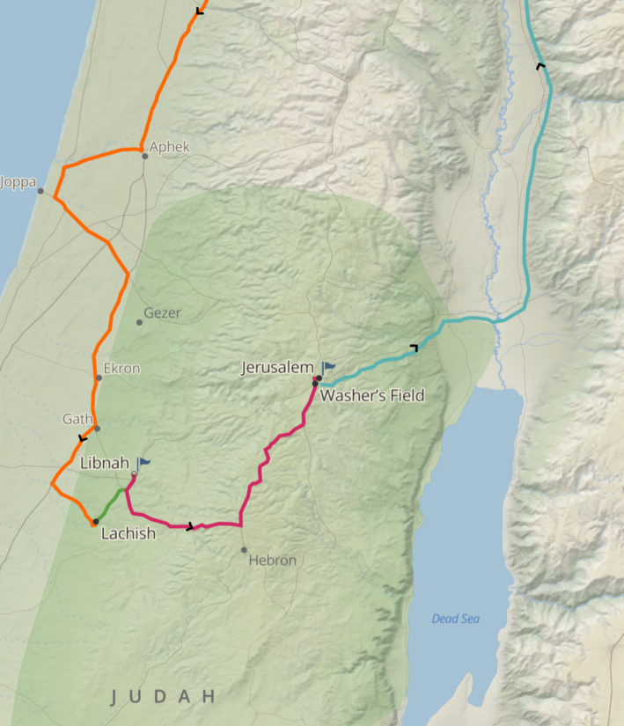
Sennacherib war path
Sennacherib made his way to Jerusalem, destroying the fortified cities of Judah, he sent Rabshakeh to Jerusalem to tell them they needed to simply surrender to Assyria. We are told in Isaiah 37:9 that Tirhakah king of Ethiopia had come to war against Sennacherib.
TIRHAKAH (תִּרְהָקָה; Θαρακα in the LXX). Also known as Taharqa the third pharaoh of the twenty-fifth (Ethiopian) dynasty of Egypt. Tirhakah appears in the parallel accounts of Hezekiah, king of Judah’s troubles with Assyria in 2 Kings 19:9 and Isaiah 37:9.
Isaiah / ישעיה
http://www.matsati.com

Slide 14
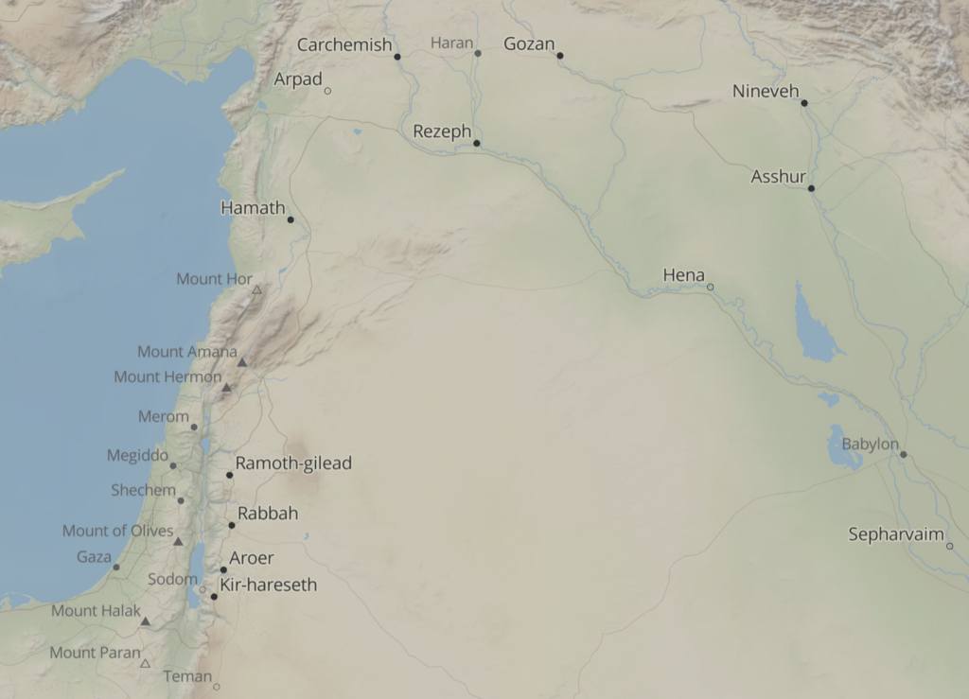
Isaiah / ישעיה
http://www.matsati.com

Slide 15
Rabbinic Literature
ספרות רבנית
Part 3
Isaiah / ישעיה
http://www.matsati.com

Slide 16
Targum Jonathan son of Uziel Isaiah 37:7-12
37:7 Behold, I will put a spirit within him, and he shall hear a rumour, and return to his own land: and I will cause him to fall by the sword in his own land. 37:8 So Rabshakeh returned, and found the king of Assyria waging war against Libnah: for he had heard that he had departed from Lachish. 37:9 And Sennacherib heard say concerning Tirhaka king of Ethiopia, he hath gone forth to wage war against thee. And when he heard it, he sent messengers to Hezekiah, saying, 37:10 Thus shall ye speak to Hezekiah, king of the tribe of the house of Judah, saying, Let not thy God, in whom thou trustest, cause thee to err, saying, Jerusalem shall not be delivered into the hand of the king of Assyria. 37:11 Behold, thou hast heard what the kings of Assyria have done to all lands by destroying them utterly; and dost thou imagine that thou wilt be delivered? 37:12 Have the gods of the nations delivered those whom my fathers have destroyed, as Gozan, and Haran, and Rezeph, and the inhabitants of Eden which were in Telassar? (TgJ)
Isaiah / ישעיה
http://www.matsati.com

Slide 17
2 Kings 19:6–10
19:6 And Isaiah said unto them, Thus shall ye say to your master, Thus saith the LORD, Be not afraid of the words which thou hast heard, with which the servants of the king of Assyria have blasphemed me. 19:7 Behold, I will send a blast upon him, and he shall hear a rumour, and shall return to his own land; and I will cause him to fall by the sword in his own land. 19:8 So Rab-shakeh returned, and found the king of Assyria warring against Libnah: for he had heard that he was departed from Lachish. 19:9 And when he heard say of Tirhakah king of Ethiopia, Behold, he is come out to fight against thee: he sent messengers again unto Hezekiah, saying, 19:10 Thus shall ye speak to Hezekiah king of Judah, saying, Let not thy God in whom thou trustest deceive thee, saying, Jerusalem shall not be delivered into the hand of the king of Assyria. (KJV וַיֹּ֤אמֶר לָהֶם֙ יְשַֽׁעְיָ֔הוּ כֹּ֥ה תֹאמְר֖וּן אֶל־אֲדֹֽנֵיכֶ֑ם כֹּ֣ה׀ אָמַ֣ר יְהוָ֗ה אַל־תִּירָא֙ מִפְּנֵ֤י הַדְּבָרִים֙ אֲשֶׁ֣ר שָׁמַ֗עְתָּ אֲשֶׁ֧ר גִּדְּפ֛וּ נַעֲרֵ֥י מֶֽלֶךְ־אַשּׁ֖וּר אֹתִֽי׃ הִנְנִ֨י נֹתֵ֥ן בּוֹ֙ ר֔וּחַ וְשָׁמַ֥ע שְׁמוּעָ֖ה וְשָׁ֣ב לְאַרְצ֑וֹ וְהִפַּלְתִּ֥יו בַּחֶ֖רֶב בְּאַרְצֽוֹ׃ וַיָּ֙שָׁב֙ רַב־שָׁקֵ֔ה וַיִּמְצָא֙ אֶת־מֶ֣לֶךְ אַשּׁ֔וּר נִלְחָ֖ם עַל־לִבְנָ֑ה כִּ֣י שָׁמַ֔ע כִּ֥י נָסַ֖ע מִלָּכִֽישׁ׃ וַיִּשְׁמַ֗ע אֶל־תִּרְהָ֤קָה מֶֽלֶך־כּוּשׁ֙ לֵאמֹ֔ר הִנֵּ֥ה יָצָ֖א לְהִלָּחֵ֣ם אִתָּ֑ךְ וַיָּ֙שָׁב֙ וַיִּשְׁלַ֣ח מַלְאָכִ֔ים אֶל־חִזְקִיָּ֖הוּ לֵאמֹֽר׃ כֹּ֣ה תֹאמְר֗וּן אֶל־חִזְקִיָּ֤הוּ מֶֽלֶךְ־יְהוּדָה֙ לֵאמֹ֔ר אַל־יַשִּׁאֲךָ֣ אֱלֹהֶ֔יךָ אֲשֶׁ֥ר אַתָּ֛ה בֹּטֵ֥חַ בּ֖וֹ לֵאמֹ֑ר לֹ֤א תִנָּתֵן֙ יְר֣וּשָׁלִַ֔ם בְּיַ֖ד מֶ֥לֶךְ אַשּֽׁוּר׃)
Isaiah / ישעיה
http://www.matsati.com

Slide 18
Aramaic Idioms and Interpretations
The word for “spirit” (רוּחָא) can also mean “wind” or “breath” in Hebrew, but in Aramaic it is more likely to mean a disposition or mood, such as fear or courage..
The word for “rumor” (וְיִשמַע בְסֹורָא) can also mean “news” or “revelation” in Hebrew, but in Aramaic it may imply something uncertain or false.
The phrase “return to his land” (וִיתוּב לְאַרעֵיה) in Hebrew, but in Aramaic it may imply a final judgment or punishment.
Isaiah / ישעיה
http://www.matsati.com

Slide 19
Examples of False Spirits and False Prophets
Matthew 7:15 states: "Beware of false prophets, who come to you in sheep’s clothing but inwardly are ravenous wolves."
1 John 4:1 states: "Beloved, do not believe every spirit, but test the spirits to see whether they are from God, for many false prophets have gone out into the world."
2 Peter 2:1 states: "But false prophets also arose among the people, just as there will be false teachers among you, who will secretly bring in destructive heresies, even denying the Master who bought them, bringing upon themselves swift destruction."
Isaiah / ישעיה
http://www.matsati.com

Slide 20
Criteria for Testing the Spirits and Discerning the Truth
1 John 4:2-3 states: "By this you know the Spirit of God: every spirit that confesses that Jesus Christ has come in the flesh is from God, and every spirit that does not confess Jesus is not from God. This is the spirit of the antichrist, which you heard was coming and now is in the world already."
Matthew 7:16-20 states: "You will recognize them by their fruits. Are grapes gathered from thornbushes, or figs from thistles? So, every healthy tree bears good fruit, but the diseased tree bears bad fruit. A healthy tree cannot bear bad fruit, nor can a diseased tree bear good fruit. Every tree that does not bear good fruit is cut down and thrown into the fire. Thus you will recognize them by their fruits."
Isaiah / ישעיה
http://www.matsati.com

Slide 21
Rashi on Isaiah 37:9 Parts 1-4
וישמע. מלך אשור:
And he heard i.e., the king of Assyria.
על תרהקה. לאמר יצא תרהקה להלחם אתך:
about Tirhakah...saying Tirhakah went out to wage war against you.
וישמע וישלח מלאכים. אין וישמע השני כמו וישמע הראשון הראשון ל' שמוע' והשני ל' קבל' קבל דברי השלוחי' וייטבו בעיניו לתת לב להסתלק מעל ירושלי' להלחם תחלה עם כוש:
And he heard, and he sent emissaries The second “and he heard” is not like the first “and he heard.” The first is an expression of hearing, and the second is an expression of accepting. He accepted the report of the messengers, and it appealed to him to give thought to withdraw from Jerusalem to fight first with Cush.
וישלח מלאכים אל חזקיהו. להודיעו שאינו מסתלק לגמרי אלא ע"מ לשוב:
and he sent emissaries to Hezekiah to notify [him] that he was not withdrawing completely, but with the intention of returning.
Isaiah / ישעיה
http://www.matsati.com

