Slide 1
MATSATI.COM Teaching Ministry
Website: https://www.matsati.com YouTube Channel: https://www.youtube.com/user/MATSATI/
ישעיהו לז:א-ו / Isaiah 37:1-6
LIVE STREAM: 6:30 pm EST Thursday
Join us at Telegram:
https://t.me/MessianicChat
Rabbi Jeremiah
– Hebrew Language Labs: FREE
– Weekly Torah Portion: Triennial cycle
A Community
for Learning
Weekly Teachings Free Online
Check Telegram for weekly scheduling of teachings.
YouTube Channels
https://YouTube.com/c/HebrewLiteracy
https://www.youtube.com/channel/UC5_qPfruat-sCJJypz0_OBw
Discuss the Scriptures,
learn the languages,
and fellowship

Slide 2
Isaiah 37:1-6
ישעיהו לז:א-ו
[title]
Isaiah / ישעיה
http://www.matsati.com

Slide 3
מבוא לישעיהו
Part 1
Isaiah / ישעיה
http://www.matsati.com

Slide 4
ספר ויקרא פרק ה
ה וְהָיָה כִי-יֶאְשַׁם לְאַחַת מֵאֵלֶּה וְהִתְוַדָּה אֲשֶׁר חָטָא עָלֶיהָ:
Vayikra / Leviticus 5:5
5:5 And it shall be, when he shall be guilty in one of these things, that he shall confess that he hath sinned in that thing: (KJV)
Isaiah / ישעיה
http://www.matsati.com

Slide 5
ספר יחזקאל פרק לו
טז וַיְהִי דְבַר-יְהֹוָה אֵלַי לֵאמֹר: יז בֶּן-אָדָם בֵּית יִשְֹרָאֵל יֹשְׁבִים עַל-אַדְמָתָם וַיְטַמְּאוּ אוֹתָהּ בְּדַרְכָּם וּבַעֲלִילוֹתָם כְּטֻמְאַת הַנִּדָּה הָיְתָה דַרְכָּם לְפָנָי: יח וָאֶשְׁפֹּךְ חֲמָתִי עֲלֵיהֶם עַל-הַדָּם אֲשֶׁר-שָׁפְכוּ עַל-הָאָרֶץ וּבְגִלּוּלֵיהֶם טִמְּאוּהָ: יט וָאָפִיץ אֹתָם בַּגּוֹיִם וַיִּזָּרוּ בָּאֲרָצוֹת כְּדַרְכָּם וְכַעֲלִילוֹתָם שְׁפַטְתִּים: כ וַיָּבוֹא אֶל-הַגּוֹיִם אֲשֶׁר-בָּאוּ שָׁם וַיְחַלְּלוּ אֶת-שֵׁם קָדְשִׁי בֶּאֱמֹר לָהֶם עַם-יְהֹוָה אֵלֶּה וּמֵאַרְצוֹ יָצָאוּ:
Isaiah / ישעיה
http://www.matsati.com

Slide 6
ספר ישעיה
Part 2
Isaiah / ישעיה
http://www.matsati.com

Slide 7
﻿ספר ישעיה פרק לז
﻿א וַיְהִי כִּשְׁמֹעַ הַמֶּלֶךְ חִזְקִיָּהוּ וַיִּקְרַע אֶת-בְּגָדָיו וַיִּתְכַּס בַּשָּׂק וַיָּבֹא בֵּית יְהֹוָה: ב וַיִּשְׁלַח אֶת-אֶלְיָקִים אֲשֶׁר-עַל-הַבַּיִת וְאֵת | שֶׁבְנָא הַסּוֹפֵר וְאֵת זִקְנֵי הַכֹּהֲנִים מִתְכַּסִּים בַּשַּׂקִּים אֶל-יְשַׁעְיָהוּ בֶן-אָמוֹץ הַנָּבִיא: ג וַיֹּאמְרוּ אֵלָיו כֹּה אָמַר חִזְקִיָּהוּ יוֹם-צָרָה וְתוֹכֵחָה וּנְאָצָה הַיּוֹם הַזֶּה כִּי בָאוּ בָנִים עַד-מַשְׁבֵּר וְכֹחַ אַיִן לְלֵדָה: ד אוּלַי יִשְׁמַע יְהֹוָה אֱלֹהֶיךָ אֵת | דִּבְרֵי רַבשָׁקֵה אֲשֶׁר שְׁלָחוֹ מֶלֶךְ-אַשּׁוּר | אֲדֹנָיו לְחָרֵף אֱלֹהִים חַי וְהוֹכִיחַ בַּדְּבָרִים אֲשֶׁר שָׁמַע יְהֹוָה אֱלֹהֶיךָ וְנָשָֹאתָ תְפִלָּה בְּעַד הַשְּׁאֵרִית הַנִּמְצָאָה: ה וַיָּבֹאוּ עַבְדֵי הַמֶּלֶךְ חִזְקִיָּהוּ אֶל-יְשַׁעְיָהוּ: ו וַיֹּאמֶר אֲלֵיהֶם יְשַׁעְיָהוּ כֹּה תֹאמְרוּן אֶל-אֲדֹנֵיכֶם כֹּה | אָמַר יְהֹוָה אַל-תִּירָא מִפְּנֵי הַדְּבָרִים אֲשֶׁר שָׁמַעְתָּ אֲשֶׁר גִּדְּפוּ נַעֲרֵי מֶלֶךְ-אַשּׁוּר אוֹתִי:
Isaiah / ישעיה
http://www.matsati.com

Slide 8
Isaiah 22:15–19
22:15 Thus saith the Lord GOD of hosts, Go, get thee unto this treasurer, even unto Shebna, which is over the house, and say, 22:16 What hast thou here? and whom hast thou here, That thou hast hewed thee out a sepulcher here, As he that heweth him out a sepulcher on high, And that graveth an habitation for himself in a rock? 22:17 Behold, the LORD will carry thee away with a mighty captivity, And will surely cover thee. 22:18 He will surely violently turn and toss thee like a ball Into a large country: There shalt thou die, And there the chariots of thy glory Shall be the shame of thy lord’s house. 22:19 And I will drive thee from thy station, And from thy state shall he pull thee down. (KJV כֹּ֥ה אָמַ֛ר אֲדֹנָ֥י יְהוִ֖ה צְבָא֑וֹת לֶךְ־בֹּא֙ אֶל־הַסֹּכֵ֣ן הַזֶּ֔ה עַל־שֶׁבְנָ֖א אֲשֶׁ֥ר עַל־הַבָּֽיִת׃ מַה־לְּךָ֥ פֹה֙ וּמִ֣י לְךָ֣ פֹ֔ה כִּֽי־חָצַ֧בְתָּ לְּךָ֛ פֹּ֖ה קָ֑בֶר חֹצְבִ֤י מָרוֹם֙ קִבְר֔וֹ חֹקְקִ֥י בַסֶּ֖לַע מִשְׁכָּ֥ן לֽוֹ׃ הִנֵּ֤ה יְהוָה֙ מְטַלְטֶלְךָ֔ טַלְטֵלָ֖ה גָּ֑בֶר וְעֹטְךָ֖ עָטֹֽה׃ צָנ֤וֹף יִצְנָפְךָ֙ צְנֵפָ֔ה כַּדּ֕וּר אֶל־אֶ֖רֶץ רַחֲבַ֣ת יָדָ֑יִם שָׁ֣מָּה תָמ֗וּת וְשָׁ֙מָּה֙ מַרְכְּב֣וֹת כְּבוֹדֶ֔ךָ קְל֖וֹן בֵּ֥ית אֲדֹנֶֽיךָ׃ וַהֲדַפְתִּ֖יךָ מִמַּצָּבֶ֑ךָ וּמִמַּעֲמָֽדְךָ֖ יֶהֶרְסֶֽךָ׃)
Isaiah / ישעיה
http://www.matsati.com

Slide 9
Isaiah 22:23–25
22:23 And I will fasten him as a nail in a sure place; And he shall be for a glorious throne to his father’s house. 22:24 And they shall hang upon him all the glory of his father’s house, The offspring and the issue, All vessels of small quantity, From the vessels of cups, even to all the vessels of flagons. 22:25 In that day, saith the LORD of hosts, Shall the nail that is fastened in the sure place be removed, And be cut down, and fall; And the burden that was upon it shall be cut off: For the LORD hath spoken it. (KJV וּתְקַעְתִּ֥יו יָתֵ֖ד בְּמָק֣וֹם נֶאֱמָ֑ן וְהָיָ֛ה לְכִסֵּ֥א כָב֖וֹד לְבֵ֥ית אָבִֽיו׃ וְתָל֨וּ עָלָ֜יו כֹּ֣ל׀ כְּב֣וֹד בֵּית־אָבִ֗יו הַצֶּֽאֱצָאִים֙ וְהַצְּפִע֔וֹת כֹּ֖ל כְּלֵ֣י הַקָּטָ֑ן מִכְּלֵי֙ הָֽאַגָּנ֔וֹת וְעַ֖ד כָּל־כְּלֵ֥י הַנְּבָלִֽים׃ בַּיּ֣וֹם הַה֗וּא נְאֻם֙ יְהוָ֣ה צְבָא֔וֹת תָּמוּשׁ֙ הַיָּתֵ֔ד הַתְּקוּעָ֖ה בְּמָק֣וֹם נֶאֱמָ֑ן וְנִגְדְּעָ֣ה וְנָפְלָ֗ה וְנִכְרַת֙ הַמַּשָּׂ֣א אֲשֶׁר־עָלֶ֔יהָ כִּ֥י יְהוָ֖ה דִּבֵּֽר׃)
Isaiah / ישעיה
http://www.matsati.com

Slide 10
1 John 1:7–10
1:7 But if we walk in the light, as he is in the light, we have fellowship one with another, and the blood of Jesus Christ his Son cleanseth us from all sin. 1:8 If we say that we have no sin, we deceive ourselves, and the truth is not in us. 1:9 If we confess our sins, he is faithful and just to forgive us our sins, and to cleanse us from all unrighteousness. 1:10 If we say that we have not sinned, we make him a liar, and his word is not in us. (KJV ἐὰν ἐν τῷ φωτὶ περιπατῶμεν, ὡς αὐτός ἐστιν ἐν τῷ φωτί, κοινωνίαν ἔχομεν μετʼ ἀλλήλων, καὶ τὸ αἷμα Ἰησοῦ τοῦ υἱοῦ αὐτοῦ καθαρίζει ἡμᾶς ἀπὸ πάσης ἁμαρτίας. ἐὰν εἴπωμεν ὅτι ἁμαρτίαν οὐκ ἔχομεν, ἑαυτοὺς πλανῶμεν καὶ ἡ ἀλήθεια οὐκ ἔστιν ἐν ἡμῖν. ἐὰν ὁμολογῶμεν τὰς ἁμαρτίας ἡμῶν, πιστός ἐστιν καὶ δίκαιος, ἵνα ἀφῇ ἡμῖν τὰς ἁμαρτίας καὶ καθαρίσῃ ἡμᾶς ἀπὸ πάσης ἀδικίας. ἐὰν εἴπωμεν ὅτι οὐχ ἡμαρτήκαμεν, ψεύστην ποιοῦμεν αὐτόν, καὶ ὁ λόγος αὐτοῦ οὐκ ἔστιν ἐν ἡμῖν.)
Isaiah / ישעיה
http://www.matsati.com

Slide 11
“This is surely a testimony to the essential greatness of Hezekiah’s heart. He is not first concerned with his or his nation’s survival. He is chiefly concerned that their actions have provided the vehicle whereby God’s name has been brought into contempt. Furthermore, he knows that if God’s glory is made paramount, then the nation will survive. It was the putting of survival first which had brought them to this perilous state. the living God (see also Isaiah 37:17)” (John N. Oswalt, The Book of Isaiah, Chapters 1–39, The New International Commentary on the Old Testament, Grand Rapids, MI: Wm. B. Eerdmans Publishing Co., 1986, 646)
Isaiah / ישעיה
http://www.matsati.com

Slide 12
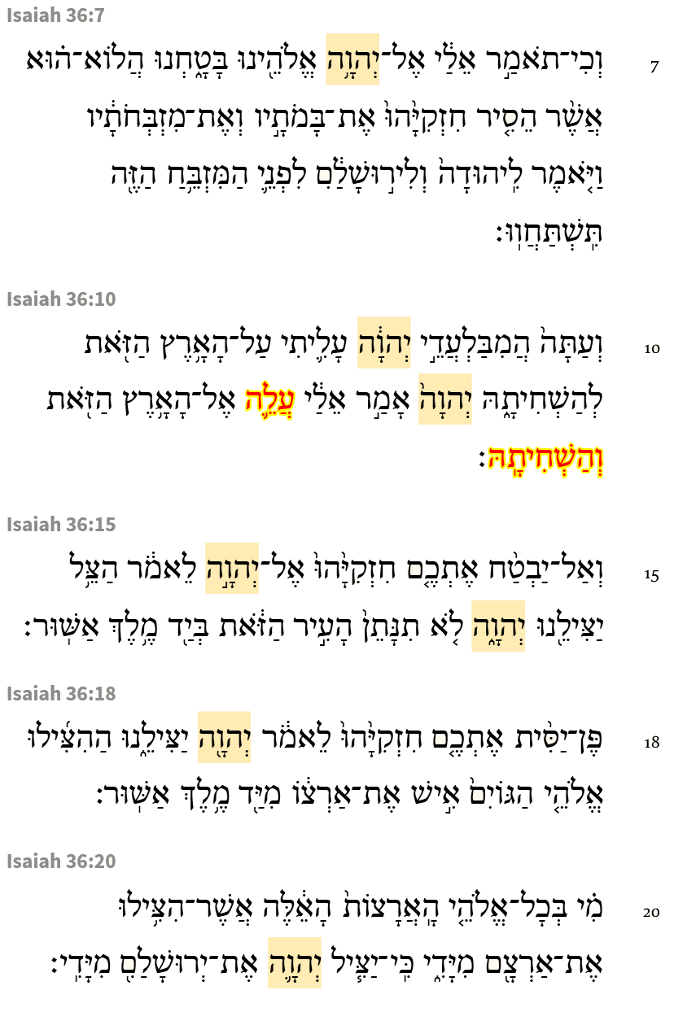
Here the YHWH was mentioned 7 times during Rabshakeh’s speech. We note that the name of God that has been passed down to us has been hidden. So Rabshakeh was using a circumlocution for the name while speaking. The circumlocution for YHWH would logically and philosophically speaking be the same as saying the name from the sense that we are to protect the name of God, whether as the YHWH or using the circumlocution. We do not blaspheme or take the name of the “Lord” “God” in vain. T
Isaiah / ישעיה
http://www.matsati.com

Slide 13
ספר שמואל א פרק יז
כו וַיֹּאמֶר דָּוִד אֶל-הָאֲנָשִׁים הָעֹמְדִים עִמּוֹ לֵאמֹר מַה-יֵּעָשֶֹה לָאִישׁ אֲשֶׁר יַכֶּה אֶת-הַפְּלִשְׁתִּי הַלָּז וְהֵסִיר חֶרְפָּה מֵעַל יִשְֹרָאֵל כִּי מִי הַפְּלִשְׁתִּי הֶעָרֵל הַזֶּה כִּי חֵרֵף מַעַרְכוֹת אֱלֹהִים חַיִּים:
1 Samuel 17:26
17:26 And David spake to the men that stood by him, saying, What shall be done to the man that killeth this Philistine, and taketh away the reproach from Israel? for who is this uncircumcised Philistine, that he should defy the armies of the living God? (KJV)
Isaiah / ישעיה
http://www.matsati.com

Slide 14
Rabbinic Literature
ספרות רבנית
Part 3
Isaiah / ישעיה
http://www.matsati.com

Slide 15
Targum Jonathan son of Uziel Isaiah 37:1-6
37:1 And it came to pass, when king Hezekiah heard it, he rent his clothes, and covered himself with sackcloth, and went into the house of the sanctuary of the Lord. 37:2 And he sent Eliakim, who was appointed over the household, and Shebna the scribe, and the elders of the priests, thus covered with sackcloth, unto Isaiah the prophet, the son of Amoz. 37:3 And they said unto him, Thus saith Hezekiah: This day is a day of distress, of reproach, and of contumely: for distress hath laid hold on us, as a woman that sitteth upon the stool of a woman in labour, and hath no strength to bring forth. 37:4 Perhaps the words of Rabshakeh may be heard by the Lord thy God, whom the king of Assyria, his master, hath sent to reproach the people of the living God, and he may take vengeance for the words which were heard before thy God, wherefore thou shalt supplicate in prayer for the remnant that is left. 37:5 So the servants of king Hezekiah came to Isaiah. 37:6 And Isaiah said unto them, Thus shall ye say unto your master, Thus saith the Lord, Be not afraid on account of the words that thou hast heard, wherewith the servants of the king of Assyria have blasphemed before me. (TgJ)
Isaiah / ישעיה
http://www.matsati.com

Slide 16
Likutei Moharan 21:7:2
For concealment/pregnancy corresponds to (Deuteronomy 32:18), “The Mighty One Who bore you, you exhausted,” as in (Isaiah 37:3), “There is no strength to give birth”—like a woman who is too exhausted to give birth. When she crouches to deliver she screams seventy screams, equal to the number of words in Psalm, “May God answer,” and then gives birth (Zohar III, 249b). These seventy screams correspond to the seven calls which David uttered over the water (Psalm 29), with each one comprised of ten <as is known>.
Isaiah / ישעיה
http://www.matsati.com

Slide 17
Rashi on Isaiah 37:3 Parts 1-3
ותוכחה. אשפרובמנ"ט בלע"ז האויבים מוכיחים בהצלחתם לאמר ידינו רמה ואין אלהים כאלהינו:
proof (Aprobement in O.F.) The enemies show evidence to praise themselves with their success, saying, “Our hand has overpowered (lit., has become high), and there is no God (like our God).”
כי באו בנים. בני ישראל בניו של הקב"ה:
for the children have come The children of Israel, children of the Holy One, blessed be He.
עד משבר וכח אין ללידה. עת צרה הדומה לאשה היושבת על המשבר ואין כח לולד לצאת:
as far as the birthstool and there is no strength to give birth It is a time of distress analogous to a woman sitting on the birthstool, and the fetus has no strength to come out.
Isaiah / ישעיה
http://www.matsati.com

Slide 18
Romans 8:13
8:13 For if ye live after the flesh, ye shall die: but if ye through the Spirit do mortify the deeds of the body, ye shall live. (KJV 13 εἰ γὰρ κατὰ σάρκα ζῆτε, μέλλετε ἀποθνῄσκειν·* εἰ δὲ πνεύματι τὰς πράξεις ⸂τοῦ σώματος⸃ θανατοῦτε, ζήσεσθε*.)
Isaiah / ישעיה
http://www.matsati.com

Slide 19
Malbim on Isaiah 37:6 Part 1
אל תירא, הודיע לו בל ירא מפני הדברים אשר שמע, כי בזה גדפו נערי מלך אשור אותי, לא את ישראל, ואני אעשה למען שמי, גם הודיע לו כי הדברים האלה לא היו בשליחות מלך אשור, כי בפעם הראשון גדפו הנערים מעצמם, ובכל זה בל ייראו כי יושיעם ה' למענם:
Don't be afraid, Bel informed him, not afraid of the things he heard, because with this the young men of the king of Assyria blasphemed me, not Israel, and I will do it for my name's sake, he also informed him that these words were not sent by the king of Assyria, because for the first time the young men blasphemed of themselves, and in this Let them not see that God will save them for their sake:
Isaiah / ישעיה
http://www.matsati.com

Slide 20
1 Peter 1:13–15
1:13 Wherefore gird up the loins of your mind, be sober, and hope to the end for the grace that is to be brought unto you at the revelation of Jesus Christ; 1:14 As obedient children, not fashioning yourselves according to the former lusts in your ignorance: 1:15 But as he which hath called you is holy, so be ye holy in all manner of conversation; (KJV *13 Διὸ ἀναζωσάμενοι τὰς ὀσφύας τῆς διανοίας ὑμῶν* νήφοντες τελείως* ἐλπίσατε ἐπὶ τὴν φερομένην ὑμῖν χάριν ἐν ἀποκαλύψει* Ἰησοῦ Χριστοῦ.* 14 ὡς τέκνα ὑπακοῆς μὴ συσχηματιζόμενοι ταῖς πρότερον* ⸂ἐν τῇ ἀγνοίᾳ⸃ ὑμῶν ἐπιθυμίαις,* 15 ἀλλὰ κατὰ τὸν καλέσαντα ὑμᾶς ἅγιον καὶ αὐτοὶ ἅγιοι ἐν πάσῃ ἀναστροφῇ γενήθητε)
Isaiah / ישעיה
http://www.matsati.com

