Slide 1
MATSATI.COM Teaching Ministry
Website: https://www.matsati.com YouTube Channel: https://www.youtube.com/user/MATSATI/
ישעיהו לו:יג-יז / Isaiah 36:13-17
LIVE STREAM: 6:30 pm EST Thursday
Join us at Telegram:
https://t.me/MessianicChat
Rabbi Jeremiah
– Hebrew Language Labs: FREE
– Weekly Torah Portion: Triennial cycle
A Community
for Learning
Weekly Teachings Free Online
Check Telegram for weekly scheduling of teachings.
YouTube Channels
https://YouTube.com/c/HebrewLiteracy
https://www.youtube.com/channel/UC5_qPfruat-sCJJypz0_OBw
Discuss the Scriptures,
learn the languages,
and fellowship

Slide 2
Isaiah 36:13-17
ישעיהו לו:יג-יז
Isaiah / ישעיה
http://www.matsati.com

Slide 3
מבוא לישעיהו
Part 1
Isaiah / ישעיה
http://www.matsati.com

Slide 4
1 John 5:18–21
5:18 We know that ﻿whosoever is born of God sinneth not; but he that is begotten of God ﻿keepeth himself, and ﻿that wicked one toucheth him not. 5:19 And we know that we are of God, and ﻿the whole world lieth in ﻿wickedness. 5:20 And we know that the Son of God is come, and ﻿hath given us an understanding, that we may know ﻿him that is true, and we are in ﻿him that is true, even in his Son Jesus Christ. ﻿This is ﻿the true God, and ﻿eternal life. 5:21 Little children, ﻿keep yourselves from idols. Amen. (KJV, 18 Οἴδαμεν ὅτι πᾶς ὁ γεγεννημένος ἐκ τοῦ θεοῦ οὐχ* ἁμαρτάνει,* ἀλλʼ ⸂ὁ γεννηθεὶς ἐκ⸃ τοῦ θεοῦ τηρεῖ ⸀ἑαυτὸν καὶ ὁ πονηρὸς οὐχ ἅπτεται αὐτοῦ.* 19 οἴδαμεν ὅτι ἐκ τοῦ* θεοῦ ἐσμεν καὶ ὁ κόσμος ὅλος ἐν τῷ πονηρῷ κεῖται.* 20 ⸂οἴδαμεν δὲ⸃ ὅτι ὁ υἱὸς τοῦ θεοῦ ἥκει καὶ ⸀δέδωκεν ἡμῖν διάνοιαν,* ἵνα ⸁γινώσκωμεν τὸν ἀληθινόν⸆, καὶ ἐσμὲν ἐν τῷ ἀληθινῷ, ἐν τῷ υἱῷ αὐτοῦ Ἰησοῦ Χριστῷ. οὗτός ἐστιν ὁ ἀληθινὸς θεὸς καὶ ⸄ζωὴ αἰώνιος⸅. 21 Τεκνία,* φυλάξατε ﻿⸀ἑαυτὰ ἀπὸ τῶν εἰδώλων. ⸆)
Isaiah / ישעיה
http://www.matsati.com

Slide 5
How the NT handles Holiness Warnings
James 2:17 Even so faith, if it hath not works, is dead, being alone. (KJV) This means that Faith without a changed life is dead.
Without holiness we will not see the Lord. (Hebrews 12:14 Follow peace with all men, and holiness, without which no man shall see the Lord: KJV)
Yeshua said “if you love me” you will obey my commands (John 14:15 If ye love me, keep my commandments. KJV)
Many will say “Lord, Lord.” Yeshua will say, “I never knew you because you are a worker of iniquity” (see Matthew 7:22 Many will say to me in that day, Lord, Lord, have we not prophesied in thy name? and in thy name have cast out devils? and in thy name done many wonderful works? 7:23 And then will I profess unto them, I never knew you: depart from me, ye that work iniquity. KJV)
Can one really walk in sin if he or she has died in Christ? (Romans 6:2 God forbid. How shall we, that are dead to sin, live any longer therein? KJV)
Isaiah / ישעיה
http://www.matsati.com

Slide 6
1 John 1:8–9
1:8 If we say that we have no sin, we deceive ourselves, and the truth is not in us. 1:9 If we confess our sins, he is faithful and just to forgive us our sins, and to cleanse us from all unrighteousness. (KJV 8 ἐὰν εἴπωμεν ὅτι ἁμαρτίαν οὐκ ἔχομεν,* ἑαυτοὺς πλανῶμεν καὶ ἡ ἀλήθεια ⸆ ♦⸉οὐκ ἔστιν ἐν ἡμῖν⸊.* 9 ἐὰν ὁμολογῶμεν τὰς ἁμαρτίας ἡμῶν, πιστός ἐστιν καὶ δίκαιος, ἵνα ἀφῇ ἡμῖν τὰς ἁμαρτίας ⸆ καὶ ⸀καθαρίσῃ ἡμᾶς ἀπὸ πάσης ἀδικίας.*)
Isaiah / ישעיה
http://www.matsati.com

Slide 7
ספר שמואל א פרק יב
יח וַיִּקְרָא שְׁמוּאֵל אֶל-יהֹוָה וַיִּתֵּן יְהֹוָה קֹלֹת וּמָטָר בַּיּוֹם הַהוּא וַיִּירָא כָל-הָעָם מְאֹד אֶת-יְהֹוָה וְאֶת-שְׁמוּאֵל: יט וַיֹּאמְרוּ כָל-הָעָם אֶל-שְׁמוּאֵל הִתְפַּלֵּל בְּעַד-עֲבָדֶיךָ אֶל-יְהֹוָה אֱלֹהֶיךָ וְאַל-נָמוּת כִּי-יָסַפְנוּ עַל-כָּל-חַטֹּאתֵינוּ רָעָה לִשְׁאֹל לָנוּ מֶלֶךְ: כ וַיֹּאמֶר שְׁמוּאֵל אֶל-הָעָם אַל-תִּירָאוּ אַתֶּם עֲשִֹיתֶם אֵת כָּל-הָרָעָה הַזֹּאת אַךְ אַל-תָּסוּרוּ מֵאַחֲרֵי יְהֹוָה וַעֲבַדְתֶּם אֶת-יְהֹוָה בְּכָל-לְבַבְכֶם: כא וְלֹא תָּסוּרוּ כִּי | אַחֲרֵי הַתֹּהוּ אֲשֶׁר לֹא-יוֹעִילוּ וְלֹא יַצִּילוּ כִּי-תֹהוּ הֵמָּה: כב כִּי לֹא-יִטֹּשׁ יְהֹוָה אֶת-עַמּוֹ בַּעֲבוּר שְׁמוֹ הַגָּדוֹל כִּי הוֹאִיל יְהֹוָה לַעֲשֹוֹת אֶתְכֶם לוֹ לְעָם: כג גַּם אָנֹכִי חָלִילָה לִּי מֵחֲטֹא לַיהֹוָה מֵחֲדֹל לְהִתְפַּלֵּל בַּעַדְכֶם וְהוֹרֵיתִי אֶתְכֶם בְּדֶרֶךְ הַטּוֹבָה וְהַיְשָׁרָה: כד אַךְ | יְראוּ אֶת-יְהֹוָה וַעֲבַדְתֶּם אֹתוֹ בֶּאֱמֶת בְּכָל-לְבַבְכֶם כִּי רְאוּ אֵת אֲשֶׁר-הִגְדִּל עִמָּכֶם: כה וְאִם-הָרֵעַ תָּרֵעוּ גַּם-אַתֶּם גַּם-מַלְכְּכֶם תִּסָּפוּ:
Isaiah / ישעיה
http://www.matsati.com

Slide 8
ספר ישעיה
Part 2
Isaiah / ישעיה
http://www.matsati.com

Slide 9
﻿ספר ישעיה פרק לו
﻿יג וַיַּעֲמֹד רַבשָׁקֵה וַיִּקְרָא בְקוֹל-גָּדוֹל יְהוּדִית וַיֹּאמֶר שִׁמְעוּ אֶת-דִּבְרֵי הַמֶּלֶךְ הַגָּדוֹל מֶלֶךְ אַשּׁוּר: יד כֹּה אָמַר הַמֶּלֶךְ אַל-יַשִּׁא לָכֶם חִזְקִיָּהו כִּי לֹא-יוּכַל לְהַצִּיל אֶתְכֶם: טו וְאַל-יַבְטַח אֶתְכֶם חִזְקִיָּהוּ אֶל-יְהֹוָה לֵאמֹר הַצֵּל יַצִּילֵנוּ יְהֹוָה לֹא תִנָּתֵן הָעִיר הַזֹּאת בְּיַד מֶלֶךְ אַשּׁוּר: טז אַל-תִּשְׁמְעוּ אֶל-חִזְקִיָּהוּ כִּי כֹה אָמַר הַמֶּלֶךְ אַשּׁוּר עֲשֹוּ-אִתִּי בְרָכָה וּצְאוּ אֵלַי וְאִכְלוּ אִישׁ-גַּפְנוֹ וְאִישׁ תְּאֵנָתוֹ וּשְׁתוּ אִישׁ מֵי-בוֹרוֹ: יז עַד-בֹּאִי וְלָקַחְתִּי אֶתְכֶם אֶל-אֶרֶץ כְּאַרְצְכֶם אֶרֶץ דָּגָן וְתִירוֹשׁ אֶרֶץ לֶחֶם וּכְרָמִים:
Isaiah / ישעיה
http://www.matsati.com

Slide 10
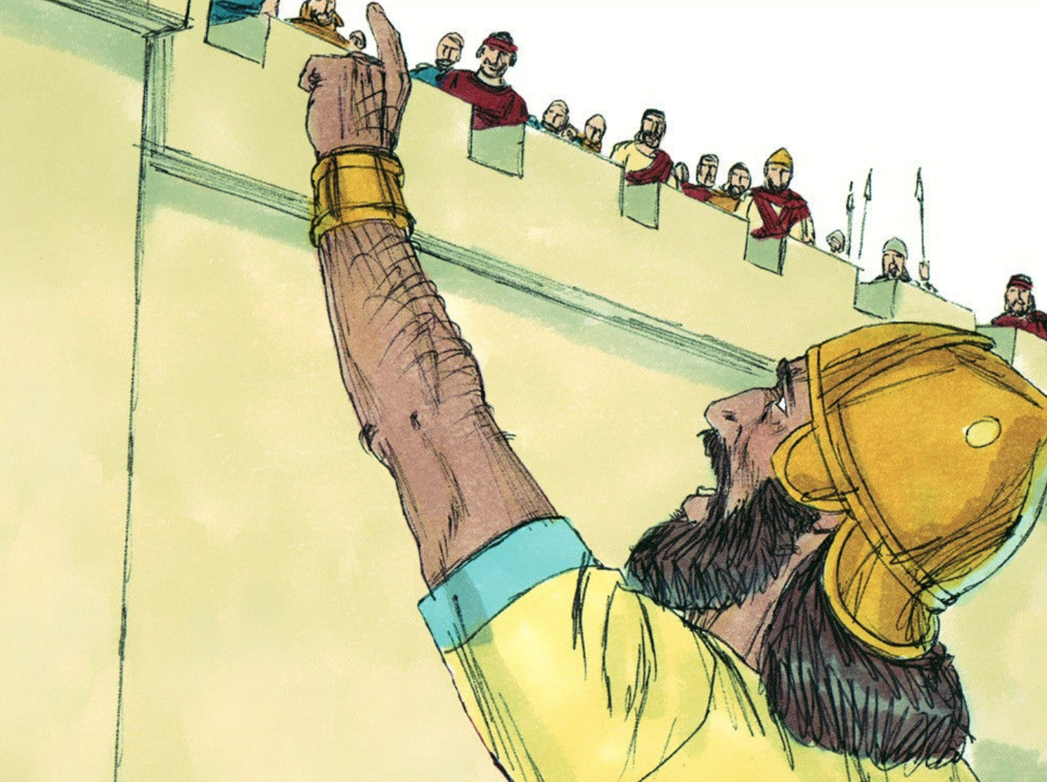
Notice how Rabshakeh states, וַיֹּאמֶר שִׁמְעוּ אֶת-דִּבְרֵי הַמֶּלֶךְ הַגָּדוֹל מֶלֶךְ אַשּׁוּר “ and said, Hear the words of the great king, the king of Assyria” when he was speaking about Assyria. He then mentions Hezekiah saying, אַל-יַשִּׁא לָכֶם חִזְקִיָּהו “ Hezekiah cannot save you.” There are differences here in the titles, Rabshakeh makes for the king of Assyria a great title, whereas for Hezekiah he just says “Hezekiah.” Again he is trying to demoralize the people in their faith, asking how they could trust in Hezekiah and his God for deliverance. Persistence in faith is absolutely necessary here, and in our daily lives today, no matter what happens, we are to remain persistent in our faith to bring glory to God!
Isaiah / ישעיה
http://www.matsati.com

Slide 11
ספר בראשית פרק ג
א וְהַנָּחָשׁ הָיָה עָרוּם מִכֹּל חַיַּת הַשָּׂדֶה אֲשֶׁר עָשָֹה יְהֹוָה אֱלֹהִים וַיֹּאמֶר אֶל-הָאִשָּׁה אַף כִּי-אָמַר אֱלֹהִים לֹא תֹאכְלוּ מִכֹּל עֵץ הַגָּן: ב וַתֹּאמֶר הָאִשָּׁה אֶל-הַנָּחָשׁ מִפְּרִי עֵץ-הַגָּן נֹאכֵל: ג וּמִפְּרִי הָעֵץ אֲשֶׁר בְּתוֹךְ-הַגָּן אָמַר אֱלֹהִים לֹא תֹאכְלוּ מִמֶּנּוּ וְלֹא תִגְּעוּ בּוֹ פֶּן תְּמֻתוּן: ד וַיֹּאמֶר הַנָּחָשׁ אֶל-הָאִשָּׁה לֹא-מוֹת תְּמֻתוּן: ה כִּי יֹדֵעַ אֱלֹהִים כִּי בְּיוֹם אֲכָלְכֶם מִמֶּנּוּ וְנִפְקְחוּ עֵינֵיכֶם וִהְיִיתֶם כֵּאלֹהִים יֹדְעֵי טוֹב וָרָע:
Bereshit / Genesis 3:1–5
3:1 Now the serpent was more subtil than any beast of the field which the LORD God had made. And he said unto the woman, Yea, hath God said, Ye shall not eat of every tree of the garden? 3:2 And the woman said unto the serpent, We may eat of the fruit of the trees of the garden: 3:3 But of the fruit of the tree which is in the midst of the garden, God hath said, Ye shall not eat of it, neither shall ye touch it, lest ye die. 3:4 And the serpent said unto the woman, Ye shall not surely die: 3:5 For God doth know that in the day ye eat thereof, then your eyes shall be opened, and ye shall be as gods, knowing good and evil. (KJV 1900)
Isaiah / ישעיה
http://www.matsati.com

Slide 12
Rabbinic Literature
ספרות רבנית
Part 3
Isaiah / ישעיה
http://www.matsati.com

Slide 13
Targum Jonathan son of Uziel Isaiah 36:13-17
36:13 Then Rabshakeh stood forth, and cried with a loud voice in the Jews’ language, and said, Hear ye the words of our great king, the king of Assyria. 36:14 Thus saith the king, Let not Hezekiah cause you to err: for he shall not be able to deliver you. 36:15 Neither let Hezekiah make you trust in the WORD of the Lord, saying, The Lord will surely deliver us: this city shall not be delivered into the hand of the king of Assyria. 36:16 Hearken not to Hezekiah: for thus saith the king of Assyria, Make peace with me, and come out to me: and eat ye every one of the fruit of his vine, and every one of the fruit of his fig tree, and drink ye every one of the waters of his cistern: 36:17 Until I come and take you away to a good land like your own land, a land of corn and wine, a land of fields and vineyards. (TgJ)
Isaiah / ישעיה
http://www.matsati.com

Slide 14
ספר דברי הימים ב פרק כח
﻿טז בָּעֵת הַהִיא שָׁלַח הַמֶּלֶךְ אָחָז עַל-מַלְכֵי אַשּׁוּר לַעְזֹר לוֹ: יז וְעוֹד אֲדוֹמִים בָּאוּ וַיַּכּוּ בִיהוּדָה וַיִּשְׁבּוּ-שֶׁבִי:
2 Chronicles 28:16
28:16 At that time did king Ahaz send unto the kings of Assyria to help him. (KJV)
﻿ספר דברי הימים ב פרק כח
﻿כב וּבְעֵת הָצֵר לוֹ וַיּוֹסֶף לִמְעוֹל בַּיהֹוָה הוּא הַמֶּלֶךְ אָחָז: כג וַיִּזְבַּח לֵאלֹהֵי דַרְמֶשֶֹק הַמַּכִּים בּוֹ וַיֹּאמֶר כִּי אֱלֹהֵי מַלְכֵי-אֲרָם הֵם מַעְזְרִים אוֹתָם לָהֶם אֲזַבֵּחַ וְיַעְזְרוּנִי וְהֵם הָיוּ-לוֹ לְהַכְשִׁילוֹ וּלְכָל-יִשְֹרָאֵל:
2 Chronicles 28:22–23
28:22 And in the time of his distress did he trespass yet more against the LORD: this is that king Ahaz. 28:23 For he sacrificed unto the gods of Damascus, which smote him: and he said, Because the gods of the kings of Syria help them, therefore will I sacrifice to them, that they may help me. But they were the ruin of him, and of all Israel. (KJV)
Isaiah / ישעיה
http://www.matsati.com

Slide 15
Akeidat Yitzchak 7:1 Part 16
There are three levels of knowledge of good and evil. 1) Complete comprehension; 2) Completely erroneous conclusions; 3) A mixture of the previous two. Anyone who falls into category two is like a beast, not knowing left from right. Such people are pere, wild, unbridled, not Adam. Compare Deut. 1,39, "And your children who do not know this day either good or evil." Category One is he who knows correctly he is nolad betzelem, born in G-d’s image, as G-d Himself has testified, "Here man has become like one of Us" (Genesis 3,22). Category Three, i.e. those who have only partial understanding, confused knowledge, are the people who delve into the source of knowledge, making research an end in itself, as did the builders of the tower of Babel. This category comprises most of the human species. The tree of knowledge, though adjacent to the tree of life, was also close to all the other trees. The observer of the scene in the garden of Eden had three choices then. He could ignore the tree completely, and be termed sub-human. Or, he could notice it and all its attractive features, gain valuable insights through smelling it, touching it, and maybe even tasting it, though not eating its fruit. The result would be G-d like appreciation of good and evil. However, the exclusive preoccupation with it called "eating," consuming it while being consumed by its charm, was forbidden and would result in mortality, abandoning oneself to the material, physical.
Isaiah / ישעיה
http://www.matsati.com

Slide 16
Akeidat Yitzchak 7:1 Part 16
We find in halachah, Jewish law, that whenever "eating" is forbidden, tasting may be permissible, since the principle is that tasting is not something of substance (Berachot 14). The deep involvement in eating from that tree produces as a corollary the result that such a person is no longer receptive to the purely spiritual/ intellectual such as represented by the tree of life. Thus one loses one's anchor in the "higher" world (called by our sages chut shel chessed). What happened to Adam when he abused the tree of knowledge is similar to what happened to King Saul after his failure to kill Agag king of Amalek, when hashgachah peratit, G-d’s Personal Providence, was withdrawn, and His kingdom was no longer considered G-d’s kingdom. When Isaac had said to Esau, "Whenever he (Jacob) will reject the yoke of the Torah, you (Esau) will break the bond" (Genesis 27,40), he also referred to the fact that G-d would then withdraw His hashgachah peratit from the people of Israel. Israel's descent to Egypt, a result of what the brothers had done to Joseph, or the survivors of the generation of spies in the desert, are all examples of the results of failures similar to what had occurred in the garden of Eden. “Mot-Tamut," you will surely die. The tragedy, according to Bereshit Rabbah 16, was that the mortality incurred by Adam was automatically conferred upon his entire offspring, i.e. upon the entire human species. This is the reason the word mot tamut is repeated. All the other trees, the tree of life excepted, contained life's necessities, therefore eating from those trees was permitted.
Isaiah / ישעיה
http://www.matsati.com

Slide 17
ספר יוחנן פרק ג
ג אַחַד הַפְּרוּשִׁים מִמַּנְהִיגֵי הַיְּהוּדִים, נַקְדִּימוֹן שְׁמוֹ, 2 בָּא אֶל יֵשׁוּעַ בַּלַּיְלָה וְאָמַר אֵלָיו׃ ״רַבִּי, אֲנַחְנוּ יוֹדְעִים כִּי מֵאֵת אֱלֹהִים בָּאתָ לִהְיוֹת מוֹרֶה, שֶׁהֲרֵי אֵין אִישׁ יָכוֹל לַעֲשׂוֹת אֶת הָאוֹתוֹת שֶׁאַתָּה עוֹשֶׂה אֶלָּא אִם כֵּן אֱלֹהִים אִתּוֹ.״ 3 הֵשִׁיב יֵשׁוּעַ וְאָמַר אֵלָיו׃ ״אָמֵן אָמֵן אֲנִי אוֹמֵר לְךָ, אִם לֹא יִוָּלֵד אָדָם מִלְמַעְלָה, לֹא יוּכַל לִרְאוֹת אֶת מַלְכוּת הָאֱלֹהִים.״ 4 שָׁאַל נַקְדִּימוֹן׃ ״אֵיךְ יָכוֹל אָדָם לְהִוָּלֵד בִּהְיוֹתוֹ זָקֵן? הַאִם הוּא יָכוֹל לְהִכָּנֵס שֵׁנִית לְרֶחֶם אִמּוֹ וּלְהִוָּלֵד?״ 5 הֵשִׁיב יֵשׁוּעַ׃ ״אָמֵן אָמֵן אֲנִי אוֹמֵר לְךָ, אִם לֹא יִוָּלֵד אִישׁ מִן הַמַּיִם וְהָרוּחַ לֹא יוּכַל לְהִכָּנֵס לְמַלְכוּת הָאֱלֹהִים. (יחזקאל לו׳ כה׳–כז׳
Isaiah / ישעיה
http://www.matsati.com

Slide 18
Rashi on Isaiah 36:16 Parts 1-3
עשו אתי ברכה. צאו אלי לשלום וברכוני והביאו אלי תשורת שלום:
Make peace with me (בְרָכָה, lit., a blessing.) Come out to me for peace and greet me and bring me a gift of peace.
ברכה. שלו"ד בלע"ז כמו ויברך יעקב את פרעה (בראשית מז י):
בְּרָכָה is saloud in O.F., salutation. Comp. (Gen. 47:10) “And Jacob greeted Pharaoh.”
ואכלו איש גפנו. ואלך מעליכם ושבו בשלום עד שאמצא ארץ טובה כארצכם ואגלה אתכם שם כי כן דרכו להעביר האומות מארץ אל ארץ כמה שנאמר (לעיל י) ואסיר גבולות עמים:
and each man will eat of his vine And I will leave you, and dwell in peace until I find a land as good as your land, and I will exile you there, for so is my wont, to transfer nations from land to land, as it is said
Isaiah / ישעיה
http://www.matsati.com

