Slide 1
MATSATI.COM Teaching Ministry
Website: https://www.matsati.com YouTube Channel: https://www.youtube.com/user/MATSATI/
ישעיהו לו:א-ו / Isaiah 36:1-6
LIVE STREAM: 6:30 pm EST Thursday
Join us at Telegram:
https://t.me/MessianicChat
Rabbi Jeremiah
– Hebrew Language Labs: FREE
– Weekly Torah Portion: Triennial cycle
A Community
for Learning
Weekly Teachings Free Online
Check Telegram for weekly scheduling of teachings.
YouTube Channels
https://YouTube.com/c/HebrewLiteracy
https://www.youtube.com/channel/UC5_qPfruat-sCJJypz0_OBw
Discuss the Scriptures,
learn the languages,
and fellowship

Slide 2
Isaiah 36:1-6
ישעיהו לו:א-ו
The God Who Works in the Background
on Behalf of His People
Isaiah / ישעיה
http://www.matsati.com

Slide 3
מבוא לישעיהו
Part 1
Isaiah / ישעיה
http://www.matsati.com

Slide 4
Three segments
Assyria at Jerusalem, Hezekiah turns to God (Isaiah 36-37)
Hezekiah is helpless due to illness, Hezekiah turns to God (Isaiah 38)
Hezekiah fails t o give glory to God giving Babylon his own glory (Isaiah 39)
Isaiah / ישעיה
http://www.matsati.com

Slide 5
Rabbinic literaturereferences to Hezekiah and messiah.
Talmud (7)
Sanhedrin 94a, 98b, 99a
Midrash (4)
Bereishit Rabbah 35:2
Ruth Rabbah 7:2
Ein Yaakov Sanhedrin 11:24
Legends of the Jews (1)
Jewish Thought (2)
Sefer HaIkkarim Maamar 4 42:3
Kol Dodi Dofek (1)
Reference (1)
The Jewish Spiritual Heroes (1)
Tanakh Commentary (3)
Rashi on Isaiah 9:6 Part 7
Ibn Ezra on Isaiah 11:10 Part 1, Isaiah 32:17 Part 1
Isaiah / ישעיה
http://www.matsati.com

Slide 6
Isaiah / ישעיה
http://www.matsati.com

Slide 7
ספר ישעיה
Part 2
Isaiah / ישעיה
http://www.matsati.com

Slide 8
﻿ספר ישעיה פרק לו
﻿א וַיְהִי בְּאַרְבַּע עֶשְֹרֵה שָׁנָה לַמֶּלֶךְ חִזְקִיָּהוּ עָלָה סַנְחֵרִיב מֶלֶךְ-אַשּׁוּר עַל כָּל-עָרֵי יְהוּדָה הַבְּצֻרוֹת וַיִּתְפְּשֵֹם: ב וַיִּשְׁלַח מֶלֶךְ-אַשּׁוּר | אֶת-רַבשָׁקֵה מִלָּכִישׁ יְרוּשָׁלְַמָה אֶל-הַמֶּלֶךְ חִזְקִיָּהוּ בְּחֵיל כָּבֵד וַיַּעֲמֹד בִּתְעָלַת הַבְּרֵכָה הָעֶלְיוֹנָה בִּמְסִלַּת שְֹדֵה כוֹבֵס: ג וַיֵּצֵא אֵלָיו אֶלְיָקִים בֶּן-חִלְקִיָּהוּ אֲשֶׁר עַל-הַבָּיִת וְשֶׁבְנָא הַסֹּפֵר וְיוֹאָח בֶּן-אָסָף הַמַּזְכִּיר: ד וַיֹּאמֶר אֲלֵיהֶם רַבשָׁקֵה אִמְרוּ-נָא אֶל-חִזְקִיָּהוּ כֹּה-אָמַר הַמֶּלֶךְ הַגָּדוֹל מֶלֶךְ אַשּׁוּר מָה הַבִּטָּחוֹן הַזֶּה אֲשֶׁר בָּטָחְתָּ: ה אָמַרְתִּי אַךְ-דְּבַר שְֹפָתַיִם עֵצָה וּגְבוּרָה לַמִּלְחָמָה עַתָּה עַל-מִי בָטַחְתָּ כִּי מָרַדְתָּ בִּי: ו הִנֵּה בָטַחְתָּ עַל-מִשְׁעֶנֶת הַקָּנֶה הָרָצוּץ הַזֶּה עַל-מִצְרַיִם אֲשֶׁר יִסָּמֵךְ אִישׁ עָלָיו וּבָא בְכַפּוֹ וּנְקָבָהּ כֵּן פַּרְעֹה מֶלֶךְ-מִצְרַיִם לְכָל-הַבֹּטְחִים עָלָיו:
Isaiah / ישעיה
http://www.matsati.com

Slide 9
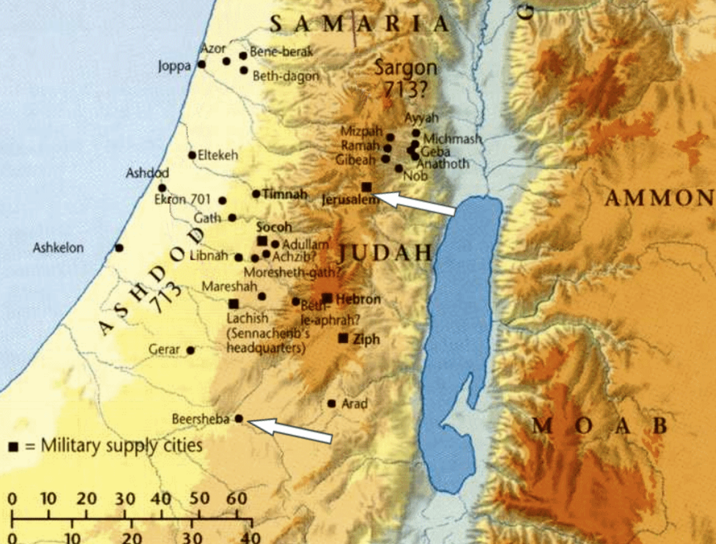
Isaiah / ישעיה
http://www.matsati.com

Slide 10
Isaiah / ישעיה
http://www.matsati.com

Slide 11
“All three officers bear Akkadian titles. As is shown from a number of royal inscriptions from this period, the Tartan (Akk. turtanu) was second to the king in command of the army (Isaiah 20:1). The precise function of the other two officers is less clear. The tide Rabsaris is unattested in any Akkadian documents thus far. On the basis of Hebrew, its meaning would be chief eunuch, but the term “eunuch” seems to represent “officer” in the OT (as Potiphar, Gen. 39:1; so also 2 K. 25:19; for this title see Jer. 39:3, 13). Rabshaqeh, if from Akk. šaqû, “to drink,” means “chief cupbearer.” This person may have been the king’s personal advisor (cf. Nehemiah’s position, Neh. 1:11). If so, this would explain why it is this person who makes the representation and not the Tartan.” (John Oswalt Commentary)
Isaiah / ישעיה
http://www.matsati.com

Slide 12
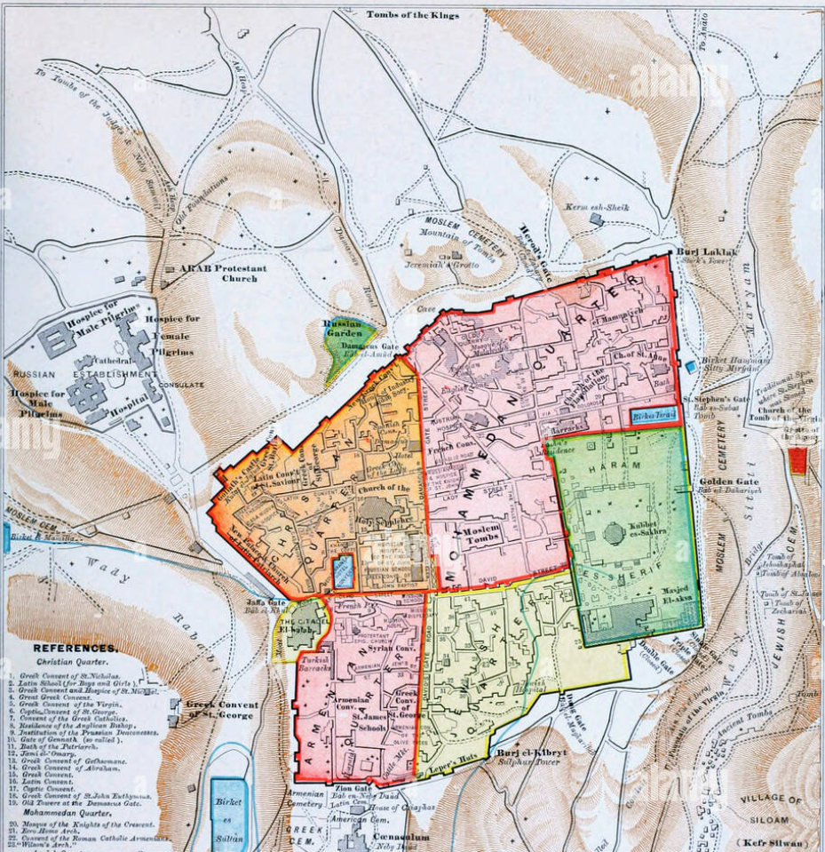
The one place where a large military force could assemble would be at the northwest corner of the city. The upper pool was apparently associated with the Gihon system at the south edge of the city. We note that generally speaking when an army attacked a city they would take the water supply first which is at the south of the city, however here the army is located at the northwest corner of Jerusalem.
Isaiah / ישעיה
http://www.matsati.com

Slide 13
Isaiah 19:14–16
19:14 The LORD hath mingled a perverse spirit in the midst thereof: And they have caused Egypt to err in every work thereof, As a drunken man staggereth in his vomit. 19:15 Neither shall there be any work for Egypt, Which the head or tail, branch or rush, may do. 19:16 In that day shall Egypt be like unto women: And it shall be afraid and fear Because of the shaking of the hand of the LORD of hosts, Which he shaketh over it. (KJV, יְהוָ֛ה מָסַ֥ךְ בְּקִרְבָּ֖הּ ר֣וּחַ עִוְעִ֑ים וְהִתְע֤וּ אֶת־מִצְרַ֙יִם֙ בְּכָֽל־מַעֲשֵׂ֔הוּ כְּהִתָּע֥וֹת שִׁכּ֖וֹר בְּקִיאֽוֹ׃ וְלֹֽא־יִהְיֶ֥ה לְמִצְרַ֖יִם מַֽעֲשֶׂ֑ה אֲשֶׁ֧ר יַעֲשֶׂ֛ה רֹ֥אשׁ וְזָנָ֖ב כִּפָּ֥ה וְאַגְמֽוֹן׃ בַּיּ֣וֹם הַה֔וּא יִֽהְיֶ֥ה מִצְרַ֖יִם כַּנָּשִׁ֑ים וְחָרַ֣ד׀ וּפָחַ֗ד מִפְּנֵי֙ תְּנוּפַת֙ יַד־יְהוָ֣ה צְבָא֔וֹת אֲשֶׁר־ה֖וּא מֵנִ֥יף עָלָֽיו׃)
Isaiah 30:7
30:7 For the Egyptians shall help in vain, and to no purpose: Therefore have I cried concerning this, Their strength is to sit still. (KJV, וּמִצְרַ֕יִם הֶ֥בֶל וָרִ֖יק יַעְזֹ֑רוּ לָכֵן֙ קָרָ֣אתִי לָזֹ֔את רַ֥הַב הֵ֖ם שָֽׁבֶת׃)
Isaiah 31:3
31:3 Now the Egyptians are men, and not God; And their horses flesh, and not spirit. When the LORD shall stretch out his hand, Both he that helpeth shall fall, and he that is holpen shall fall down, And they all shall fail together. (KJV, וּמִצְרַ֤יִם אָדָם֙ וְֽלֹא־אֵ֔ל וְסוּסֵיהֶ֥ם בָּשָׂ֖ר וְלֹא־ר֑וּחַ וַֽיהוָ֞ה יַטֶּ֣ה יָד֗וֹ וְכָשַׁ֤ל עוֹזֵר֙ וְנָפַ֣ל עָזֻ֔ר וְיַחְדָּ֖ו כֻּלָּ֥ם יִכְלָיֽוּן׃)
Isaiah / ישעיה
http://www.matsati.com

Slide 14
Rabbinic Literature
ספרות רבנית
Part 3
Isaiah / ישעיה
http://www.matsati.com

Slide 15
Targum Jonathan son of Uziel Isaiah 36:1-6
36:1 Now it came to pass in the fourteenth year of king Hezekiah, that Sennacherib king of Assyria came up against all the fenced cities of the house of Judah, and took them. 36:2 And the king of Assyria sent Rabshakeh from Lachish to Jerusalem unto king Hezekiah with a great army. And he stood by the conduit of the upper pool in the highway of the field of the fullers. 36:3 Then came forth unto him Eliakim, Hilkiah’s son, who was appointed over the household, and Shebna, the scribe, and Joah, Asaph’s son, who was appointed over the records. 36:4 And Rabshakeh said unto them, say ye now to Hezekiah, Thus saith our great king, the king of Assyria, What confidence is this wherein thou trustest? 36:5 I say (you speak but empty words) I make war with counsel and might: now, in whom dost thou trust, that thou hast rebelled against me? 36:6 Behold, thou trustest in the support of this broken reed, in Pharaoh, the king of Egypt; on which if a man lean, it will enter his hand and wound him: so is Pharaoh the king of Egypt to all that trust in him.(TgJ)
Isaiah / ישעיה
http://www.matsati.com

Slide 16
Isaiah 7:1–4
7:1 And it came to pass in the days of Ahaz the son of Jotham, the son of Uzziah, king of Judah, that Rezin the king of Syria, and Pekah the son of Remaliah, king of Israel, went up toward Jerusalem to war against it, but could not prevail against it. 7:2 And it was told the house of David, saying, Syria is confederate with Ephraim. And his heart was moved, and the heart of his people, as the trees of the wood are moved with the wind. 7:3 Then said the Lord unto Isaiah, Go forth now to meet Ahaz, thou, and Shear-jashub thy son, at the end of the conduit of the upper pool in the highway of the fuller’s field; 7:4 And say unto him, Take heed, and be quiet; Fear not, neither be fainthearted For the two tails of these smoking firebrands, For the fierce anger of Rezin with Syria, and of the son of Remaliah. (KJV וַיְהִ֡י בִּימֵ֣י אָ֠חָז בֶּן־יֹותָ֨ם בֶּן־עֻזִּיָּ֜הוּ מֶ֣לֶךְ יְהוּדָ֗ה עָלָ֣ה רְצִ֣ין מֶֽלֶךְ־אֲ֠רָם וּפֶ֨קַח בֶּן־רְמַלְיָ֤הוּ מֶֽלֶךְ־יִשְׂרָאֵל֙ יְר֣וּשָׁלִַ֔ם לַמִּלְחָמָ֖ה עָלֶ֑יהָ וְלֹ֥א יָכֹ֖ל לְהִלָּחֵ֥ם עָלֶֽיהָ׃ וַיֻּגַּ֗ד לְבֵ֤ית דָּוִד֙ לֵאמֹ֔ר נָ֥חָֽה אֲרָ֖ם עַל־אֶפְרָ֑יִם וַיָּ֤נַע לְבָבֹו֙ וּלְבַ֣ב עַמֹּ֔ו כְּנֹ֥ועַ עֲצֵי־יַ֖עַר מִפְּנֵי־רֽוּחַ׃ וַיֹּ֣אמֶר יְהוָה֮ אֶֽל־יְשַׁעְיָהוּ֒ צֵא־נָא֙ לִקְרַ֣את אָחָ֔ז אַתָּ֕ה וּשְׁאָ֖ר יָשׁ֣וּב בְּנֶ֑ךָ אֶל־קְצֵ֗ה תְּעָלַת֙ הַבְּרֵכָ֣ה הָעֶלְיֹונָ֔ה אֶל־מְסִלַּ֖ת שְׂדֵ֥ה כֹובֵֽס׃ וְאָמַרְתָּ֣ אֵ֠לָיו הִשָּׁמֵ֨ר וְהַשְׁקֵ֜ט אַל־תִּירָ֗א וּלְבָבְךָ֙ אַל־יֵרַ֔ךְ מִשְּׁנֵ֨י זַנְבֹ֧ות הָאוּדִ֛ים הָעֲשֵׁנִ֖ים הָאֵ֑לֶּה בָּחֳרִי־אַ֛ף רְצִ֥ין וַאֲרָ֖ם וּבֶן־רְמַלְיָֽהוּ׃)
Isaiah / ישעיה
http://www.matsati.com

Slide 17
God is love. Devarim / Deuteronomy 7:7 says, "The Lord your God is God of gods and Lord of lords, the great, the mighty, and the awesome God, who shows no partiality and accepts no bribes. He executes justice for the orphan and the widow, and loves the stranger, giving him food and clothing." This passage shows the great extent of God’s love, and that He cares for the weak and the vulnerable.
God is gracious. Shemot / Exodus 34:6 says, "The Lord, the Lord, a God merciful and gracious, slow to anger, and abounding in steadfast love and faithfulness." This passage shows that God is gracious, and that He is willing to forgive those who repent.
God is forgiving. Nehemiah 9:17 says, "You are a God of compassion, gracious, slow to anger, abounding in love and faithfulness." This passage shows that God is forgiving, and that He is willing to forget our sins when we repent, turn from them and believe in Him.
God is patient. Lamentations 3:22-23 says, "The steadfast love of the Lord never ceases; his mercies never come to an end; they are new every morning; great is your faithfulness." This passage shows that God is patient, and that He is always willing to give us another chance.
God is faithful. Tehillim / Psalm 86:15 says, "But you, O Lord, are a God merciful and gracious, slow to anger, and abounding in steadfast love and faithfulness." This passage shows that God is faithful, and that He will always keep His promises.
Isaiah / ישעיה
http://www.matsati.com

Slide 18
Isaiah 36:6, the prophet Isaiah uses the phrase to warn the people of Judah not to trust in Egypt for help because Pharaoh is deceitful, and the nation is weak and unstable. “Lo, thou trustest in the staff of this broken reed, on Egypt; whereon if a man lean, it will go into his hand, and pierce it: so is Pharaoh king of Egypt to all that trust in him. (הִנֵּה בָטַחְתָּ עַל-מִשְׁעֶנֶת הַקָּנֶה הָרָצוּץ הַזֶּה עַל-מִצְרַיִם אֲשֶׁר יִסָּמֵךְ אִישׁ עָלָיו וּבָא בְכַפּוֹ וּנְקָבָהּ כֵּן פַּרְעֹה מֶלֶךְ-מִצְרַיִם לְכָל-הַבֹּטְחִים עָלָיו)”
Ezekiel 29:6-7, the prophet Ezekiel uses the phrase to describe Egypt's relationship with the Israelites. He says that Egypt has been a "staff of reed" to the Israelites. This means that Egypt has been a weak and unreliable support for the Israelites. Egypt has often betrayed the Israelites and has not been there for them in times of need. As a result, the Israelites should not trust in Egypt for help. Ezekiel 29:6–7, 29:6 And all the inhabitants of Egypt shall know that I am the LORD, because they have been a staff of reed to the house of Israel. 29:7 When they took hold of thee by thy hand, thou didst break, and rend all their shoulder: and when they leaned upon thee, thou brakest, and madest all their loins to be at a stand. (KJV וְיָֽדְעוּ֙ כָּל־יֹשְׁבֵ֣י מִצְרַ֔יִם כִּ֖י אֲנִ֣י יְהוָ֑ה יַ֧עַן הֱיֹותָ֛ם מִשְׁעֶ֥נֶת קָנֶ֖ה לְבֵ֥ית יִשְׂרָאֵֽל׃ בְּתָפְשָׂ֨ם בְּךָ֤ בַכַּפ֙ך תֵּרֹ֔וץ וּבָקַעְתָּ֥ לָהֶ֖ם כָּל־כָּתֵ֑ף וּבְהִֽשָּׁעֲנָ֤ם עָלֶ֨יךָ֙ תִּשָּׁבֵ֔ר וְהַעֲמַדְתָּ֥ לָהֶ֖ם כָּל־מָתְנָֽיִם׃ ס)
Isaiah / ישעיה
http://www.matsati.com

Slide 19
Matthew 12:20, Yeshua uses the phrase to describe Himself. He says that He will not break a bruised reed or quench a smoldering wick. This means that He will not harm those who are weak or vulnerable. He will be gentle with them and will help them to grow. Matthew 12:20, 12:20 A bruised reed shall he not break, and smoking flax shall he not quench, till he send forth judgment unto victory. (KJV κάλαμον συντετριμμένον οὐ κατεάξει καὶ λίνον τυφόμενον οὐ σβέσει, ἕως ἂν ἐκβάλῃ εἰς νῖκος τὴν κρίσιν.)
James 4:6, the author of James uses the phrase to warn people not to trust in their own strength. He says that "God opposes the proud but shows favor to the humble." This means that we should not rely on our own strength, but should instead rely on God. He is the only one who can truly help us. James 4:6, 4:6 But he giveth more grace. Wherefore he saith, God resisteth the proud, but giveth grace unto the humble. (KJV μείζονα δὲ δίδωσιν χάριν; διὸ λέγει· ὁ θεὸς ὑπερηφάνοις ἀντιτάσσεται, ταπεινοῖς δὲ δίδωσιν χάριν.)
Isaiah / ישעיה
http://www.matsati.com

