Slide 1
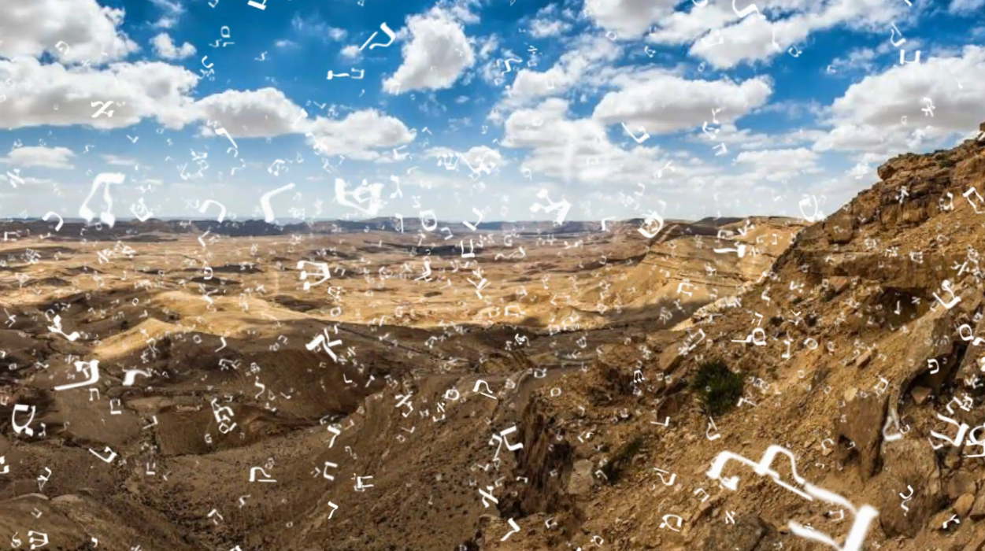

MATSATI.COM Teaching Ministry
Website: https://www.matsati.com YouTube Channel: https://www.youtube.com/user/MATSATI/
ישעיהו לד:ז-יב / Isaiah 34:7-12
LIVE STREAM: 6:30 pm EST Thursday
Join us at Telegram:
https://t.me/MessianicChat
Rabbi Jeremiah
– Hebrew Language Labs: FREE
– Weekly Torah Portion: Triennial cycle
A Community
for Learning
Weekly Teachings Free Online
Check Telegram for weekly scheduling of teachings.
YouTube Channels
https://YouTube.com/c/HebrewLiteracy
https://www.youtube.com/channel/UC5_qPfruat-sCJJypz0_OBw
Discuss the Scriptures,
learn the languages,
and fellowship

Slide 2

Isaiah 34:7-12
ישעיהו לד:ז-יב
Isaiah / ישעיה
http://www.matsati.com

Slide 3
מבוא לישעיהו
Part 1
Isaiah / ישעיה
http://www.matsati.com

Slide 4








ספר במדבר פרק כ
יד וַיִּשְׁלַח מֹשֶׁה מַלְאָכִים מִקָּדֵשׁ אֶל-מֶלֶךְ אֱדוֹם כֹּה אָמַר אָחִיךָ יִשְֹרָאֵל אַתָּה יָדַעְתָּ אֵת כָּל-הַתְּלָאָה אֲשֶׁר מְצָאָתְנוּ: טו וַיֵּרְדוּ אֲבֹתֵינוּ מִצְרַיְמָה וַנֵּשֶׁב בְּמִצְרַיִם יָמִים רַבִּים וַיָּרֵעוּ לָנוּ מִצְרַיִם וְלַאֲבֹתֵינוּ: טז וַנִּצְעַק אֶל-יְהוָֹה וַיִּשְׁמַע קֹלֵנוּ וַיִּשְׁלַח מַלְאָךְ וַיֹּצִאֵנוּ מִמִּצְרָיִם וְהִנֵּה אֲנַחְנוּ בְקָדֵשׁ עִיר קְצֵה גְבוּלֶךָ: יז נַעְבְּרָה-נָּא בְאַרְצֶךָ לֹא נַעֲבֹר בְּשָֹדֶה וּבְכֶרֶם וְלֹא נִשְׁתֶּה מֵי בְאֵר דֶּרֶךְ הַמֶּלֶךְ נֵלֵךְ לֹא נִטֶּה יָמִין וּשְֹמֹאול עַד אֲשֶׁר-נַעֲבֹר גְּבֻלֶךָ: יח וַיֹּאמֶר אֵלָיו אֱדוֹם לֹא תַעֲבֹר בִּי פֶּן-בַּחֶרֶב אֵצֵא לִקְרָאתֶךָ: יט וַיֹּאמְרוּ אֵלָיו בְּנֵי-יִשְֹרָאֵל בַּמְסִלָּה נַעֲלֶה וְאִם-מֵימֶיךָ נִשְׁתֶּה אֲנִי וּמִקְנַי וְנָתַתִּי מִכְרָם רַק אֵין-דָּבָר בְּרַגְלַי אֶעֱבֹרָה: כ וַיֹּאמֶר לֹא תַעֲבֹר וַיֵּצֵא אֱדוֹם לִקְרָאתוֹ בְּעַם כָּבֵד וּבְיָד חֲזָקָה: כא וַיְמָאֵן | אֱדוֹם נְתֹן אֶת-יִשְֹרָאֵל עֲבֹר בִּגְבֻלוֹ וַיֵּט יִשְֹרָאֵל מֵעָלָיו
Isaiah / ישעיה
http://www.matsati.com

Slide 5
Romans 6:15–23
6:15 What then? shall we sin, because we are not under the law, but under grace? God forbid. 6:16 Know ye not, that to whom ye yield yourselves servants to obey, his servants ye are to whom ye obey; whether of sin unto death, or of obedience unto righteousness? 6:17 But God be thanked, that ye were the servants of sin, but ye have obeyed from the heart that form of doctrine which was delivered you. 6:18 Being then made free from sin, ye became the servants of righteousness. 6:19 I speak after the manner of men because of the infirmity of your flesh: for as ye have yielded your members servants to uncleanness and to iniquity unto iniquity; even so now yield your members servants to righteousness unto holiness. 6:20 For when ye were the servants of sin, ye were free from righteousness. 6:21 What fruit had ye then in those things whereof ye are now ashamed? for the end of those things is death. 6:22 But now being made free from sin, and become servants to God, ye have your fruit unto holiness, and the end everlasting life. 6:23 For the wages of sin is death; but the gift of God is eternal life through Jesus Christ our Lord. (KJV
Isaiah / ישעיה
http://www.matsati.com

Slide 6
ספר ישעיה
Part 2
Isaiah / ישעיה
http://www.matsati.com

Slide 7


















﻿ספר ישעיה פרק לד
﻿ז וְיָרְדוּ רְאֵמִים עִמָּם וּפָרִים עִם-אַבִּירִים וְרִוְּתָה אַרְצָם מִדָּם וַעֲפָרָם מֵחֵלֶב יְדֻשָּׁן: ח כִּי יוֹם נָקָם לַיהֹוָה שְׁנַת שִׁלּוּמִים לְרִיב צִיּוֹן: ט וְנֶהֶפְכוּ נְחָלֶיהָ לְזֶפֶת וַעֲפָרָהּ לְגָפְרִית וְהָיְתָה אַרְצָהּ לְזֶפֶת בֹּעֵרָה: י לַיְלָה וְיוֹמָם לֹא תִכְבֶּה לְעוֹלָם יַעֲלֶה עֲשָׁנָהּ מִדּוֹר לָדוֹר תֶּחֱרָב לְנֵצַח נְצָחִים אֵין עֹבֵר בָּהּ: יא וִירֵשׁוּהָ קָאַת וְקִפּוֹד וְיַנְשׁוֹף וְעֹרֵב יִשְׁכְּנוּ-בָהּ וְנָטָה עָלֶיהָ קַו-תֹהוּ וְאַבְנֵי-בֹהוּ: יב חֹרֶיהָ וְאֵין-שָׁם מְלוּכָה יִקְרָאוּ וְכָל-שָֹרֶיהָ יִהְיוּ אָפֶס:
Isaiah / ישעיה
http://www.matsati.com

Slide 8
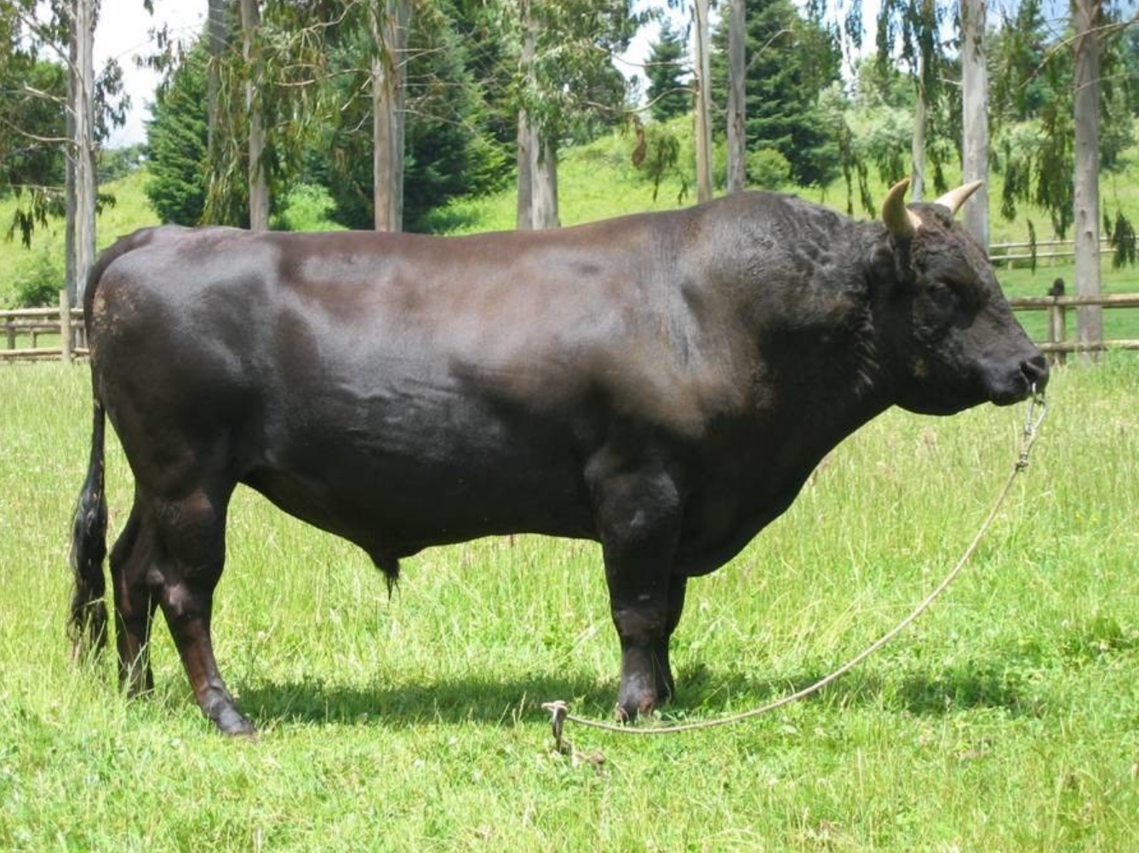
The word רְאֵמִים translates as “young ox”
Isaiah / ישעיה
http://www.matsati.com

Slide 9
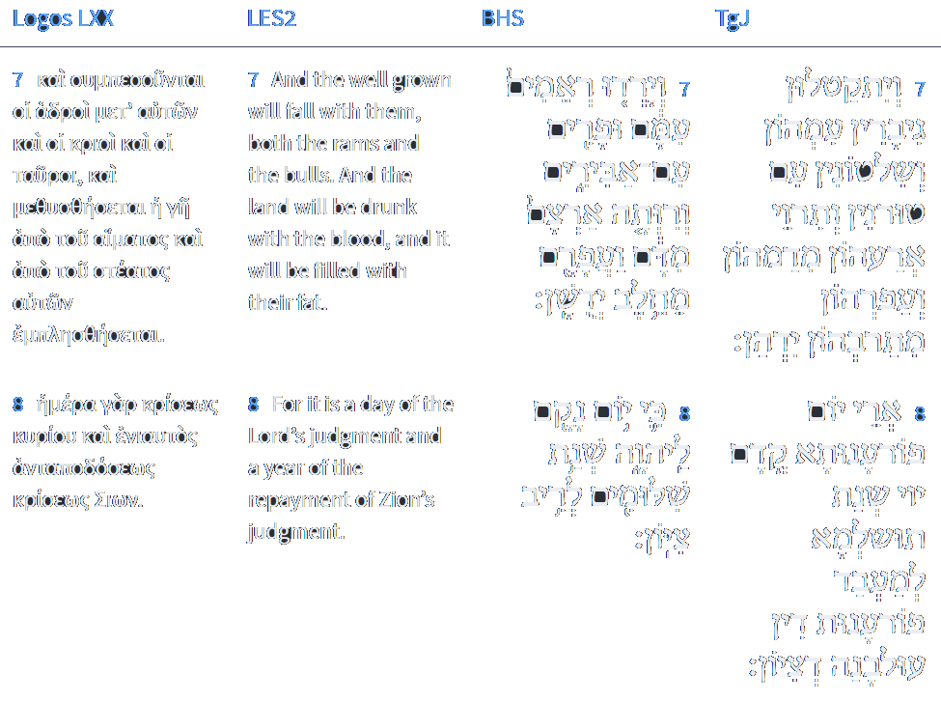

Isaiah 34:7-8
Isaiah / ישעיה
http://www.matsati.com

Slide 10

ספר בראשית פרק יט
כד וַיהֹוָה הִמְטִיר עַל-סְדֹם וְעַל-עֲמֹרָה גָּפְרִית וָאֵשׁ מֵאֵת יְהוָֹה מִן-הַשָּׁמָיִם: כה וַיַּהֲפֹךְ אֶת-הֶעָרִים הָאֵל וְאֵת כָּל-הַכִּכָּר וְאֵת כָּל-ישְׁבֵי הֶעָרִים וְצֶמַח הָאֲדָמָה: כו וַתַּבֵּט אִשְׁתּוֹ מֵאַחֲרָיו וַתְּהִי נְצִיב מֶלַח: כז וַיַּשְׁכֵּם אַבְרָהָם בַּבֹּקֶר אֶל-הַמָּקוֹם אֲשֶׁר-עָמַד שָׁם אֶת-פְּנֵי יְהוָֹה: כח וַיַּשְׁקֵף עַל-פְּנֵי סְדֹם וַעֲמֹרָה וְעַל כָּל-פְּנֵי אֶרֶץ הַכִּכָּר וַיַּרְא וְהִנֵּה עָלָה קִיטֹר הָאָרֶץ כְּקִיטֹר הַכִּבְשָׁן:
Bereshit / Genesis 19:24–28
19:24 Then the LORD rained upon Sodom and upon Gomorrah brimstone and fire from the LORD out of heaven; 19:25 And he overthrew those cities, and all the plain, and all the inhabitants of the cities, and that which grew upon the ground. 19:26 But his wife looked back from behind him, and she became a pillar of salt. 19:27 And Abraham gat up early in the morning to the place where he stood before the LORD: 19:28 And he looked toward Sodom and Gomorrah, and toward all the land of the plain, and beheld, and, lo, the smoke of the country went up as the smoke of a furnace. (KJV)
Isaiah / ישעיה
http://www.matsati.com

Slide 11



Daniel 12:1-5
12:1 And at that time shall Michael stand up, the great prince which standeth for the children of thy people: and there shall be a time of trouble, such as never was since there was a nation even to that same time: and at that time thy people shall be delivered, every one that shall be found written in the book. 12:2 And many of them that sleep in the dust of the earth shall awake, some to everlasting life, and some to shame and everlasting contempt. 12:3 And they that be wise shall shine as the brightness of the firmament; and they that turn many to righteousness as the stars for ever and ever. 12:4 But thou, O Daniel, shut up the words, and seal the book, even to the time of the end: many shall run to and fro, and knowledge shall be increased. 12:5 Then I Daniel looked, and, behold, there stood other two, the one on this side of the bank of the river, and the other on that side of the bank of the river. (KJV
Isaiah / ישעיה
http://www.matsati.com

Slide 12
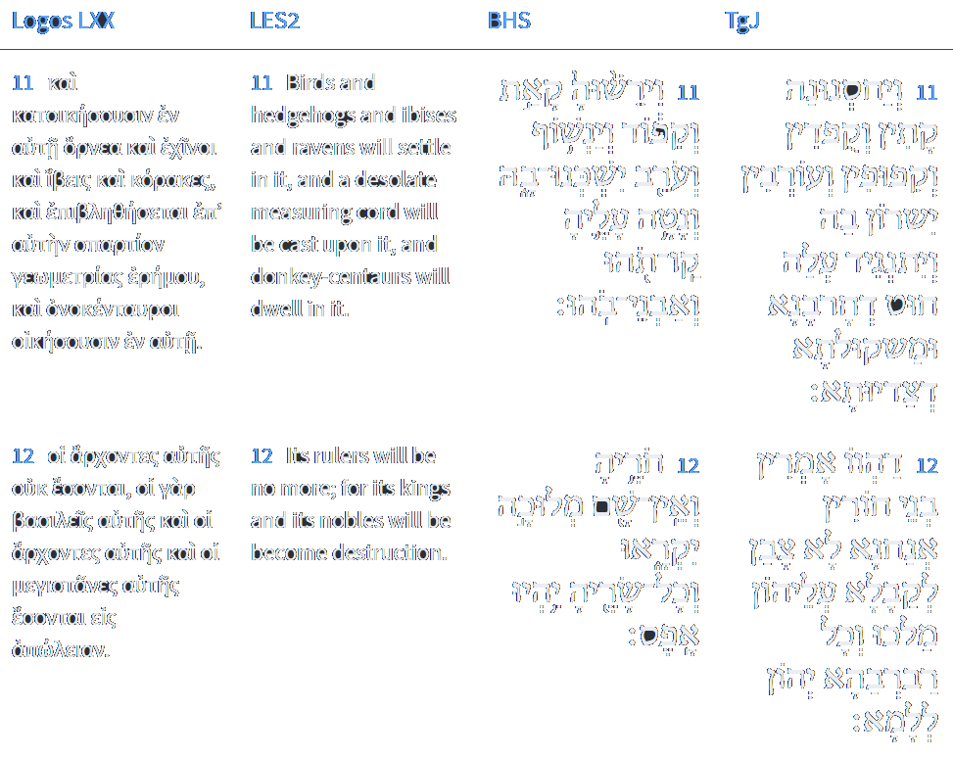

Isaiah 34:11-12
Isaiah / ישעיה
http://www.matsati.com

Slide 13
Rabbinic Literature
ספרות רבנית
Part 3
Isaiah / ישעיה
http://www.matsati.com

Slide 14


Targum Jonathan son of Uziel Isaiah 34:7-12
34:7 And the mighty men shall be slain with them, and the rulers, and the princes; and their land shall be drunken with their own blood; and their dust made fat with their own fat. 34:8 For it is the day of vengeance before the presence of the Lord; the year of recompense, to take vengeance of judgment on account of the ignominy of Zion. 34:9 And the rivers of Samaria shall be turned into pitch, and her dust into brimstone, and the land shall become burning pitch. 34:10 By night and by day it shall not be extinguished; her smoke shall ascend for ever: from generation to generation she shall lie waste; none shall pass through her to everlasting ages. 34:11 The pelican and the porcupine shall inherit her, and the owls and the ravens shall dwell in her: and the line of devastation shall be extended over her, and the plummet of desolation. 34:12 They said, we are the sons of free men, and they were not willing to accept over them a kingly government; and all her princes shall come to nothing. (TgJ)
Isaiah / ישעיה
http://www.matsati.com

Slide 15
Midrash Tanchuma, Bo 4:7
רַבִּי מֵאִיר אוֹמֵר: וְיָרְדוּ רְאֵמִים עִמָּם (ישעיה לד, ז), וְיָרְדוּ עוֹבְדֵי עֲבוֹדָה זָרָה עִמָּם. בְּמִצְרַיִם, פָּרַע מֵאֱלִילֵיהֶם וְאַחַר כָּךְ פָּרַע מֵהֶם. וּבֶאֱדוֹם, פּוֹרֵעַ מִן הַשַּׂר שֶׁלָּהֶם תְּחִלָּה וְאַחַר כָּךְ מֵהֶם, שֶׁנֶּאֱמַר: וְהָיָה בַּיּוֹם הַהוּא יִפְקֹד ה' עַל צְבָא הַמָּרוֹם בַּמָרוֹם וְעַל מַלְכֵי הָאֲדָמָה עַל הָאֲדָמָה (ישעיה כד, כא).
R. Meir said: And the wild oxen descended with them (Isa. 34:7) implies that their idols were cast down with them. In Egypt He exacted retribution from their idols, and He also punished them in Edom. He destroyed their guardian angel, and after that He destroyed them, as it is said: And it shall come to pass in that day, that the Lord will punish the host of the high heaven on high, and the kings of the earth upon the earth (ibid. 4:21).
Isaiah / ישעיה
http://www.matsati.com

Slide 16




Midrash Tanchuma, Bo 4:4
All the plagues that the Lord brought against the Egyptians in Egypt, He will bring against Edom (Rome), as it is said: When the report cometh to Egypt, they shall be sorely pained at the report of Tyre (Isa. 23:5). R. Eleazar said: Every time Scripture employs the complete spelling of the word Tyre, it refers to Egypt, but when the word Tyre (i.e., without the vav) is spelled defectively, it refers to Edom, which also oppressed Israel. The punishments visited upon the first nation will also be inflicted upon Edom. In the case of Egypt, He smote it with blood, and with reference to Edom, it is said: I will show wonders in the heavens and in the earth, blood and fire, and pillars of smoke. The sun shall be turned into darkness, and the moon into blood (Joel 3:3). In Egypt the voices of frogs were harsh, while in Edom: Hark! an uproar from the city, hark! it cometh from the Temple (Isa. 66:6). Gnats came upon Egypt: And He smote the dust of the earth, and in Edom: And the streams thereof shall be turned into pitch, and dust thereof into brimstone (Isa. 34:9). In Egypt there were swarms, and in Edom: The pelican and the bittern shall possess it, and the owl and the raven shall dwell therein (ibid., v. 11). R. Abba the son of Kahana said: Darkness and thick darkness were used as divine agents in Egypt, but void and waste never were and never will be used. When will they be used? Against a great city in Cappadocia, as it is said: And He shall stretch over it the line of confusion, and the plummet of emptiness (ibid.).
Isaiah / ישעיה
http://www.matsati.com

Slide 17
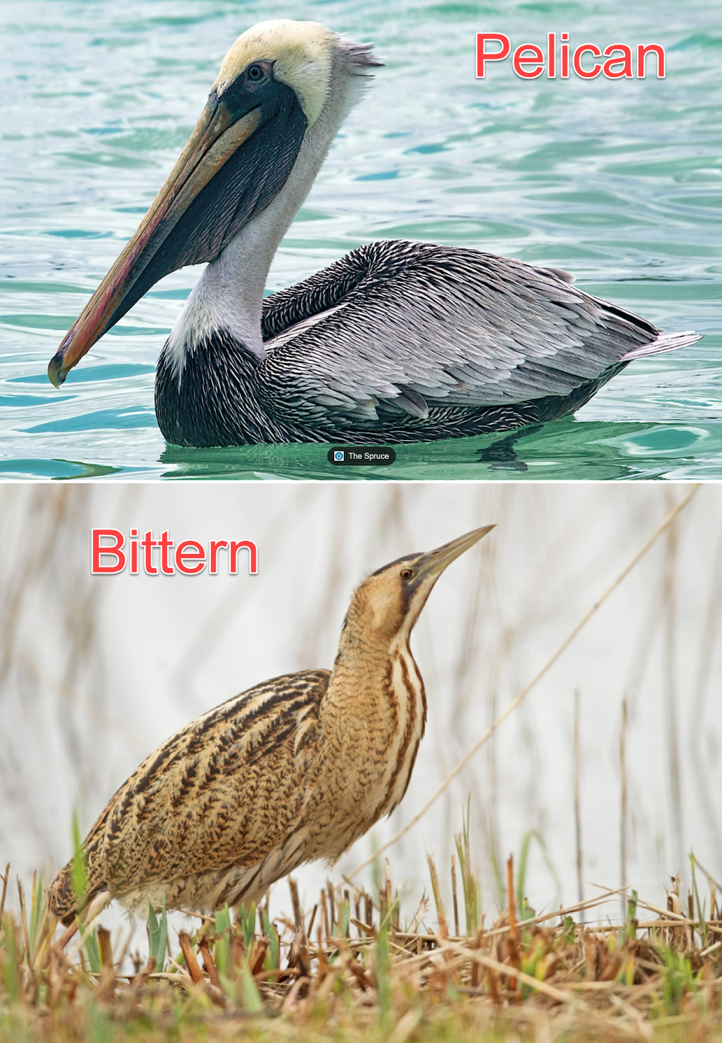
The bittern is a solitary bird and seeks its food in desolate places and so the bird is looked upon as an unlucky bird. The pelican is a kind of bird that occupies the cliffs by the sea, feeds on fish, and is extremely voracious, and is the emblem of a glutton. It is not certain why pelican is used here but the word denotes a water-fowl and to a bird that inhabits desolate places. These things describe the desolation of the land of Edom, the beast of the field and the fowl of the air will inhabit these places due to the people being driven from the land and/or killed due to their sins.
Isaiah / ישעיה
http://www.matsati.com

Slide 18

Talmud Bavli Moed Katan 25b:2
When they reached Tiberias a certain child opened his eulogy saying as follows: The shoot of an ancient line, i.e., Rabba bar Rav Huna, who was the descendant of great people, has ascended from Babylonia, and with him is the book of wars, i.e., Rav Hamnuna, who was great in Torah, which is referred to as the book of the Wars of the Lord (Numbers 21:14). The curses of the pelican and the bittern, which are symbols of the destruction of the Temple (Isaiah 34:11), have been doubled, to see the ruin and brokenness that has come from Shinar, i.e., Babylonia. The Lord became angry with His world and seized souls from it, and He rejoices over them when they come to Him like a new bride. God who rides upon the clouds is joyous and happy when an innocent and righteous soul comes to Him.
Isaiah / ישעיה
http://www.matsati.com

Slide 19

Rashi on Isaiah 34:11 Parts 1-3
וקפוד. עוף הפורח בלילה צואיט"א בלע"ז:
owl (קִפֹּד) a bird that flies at night (chouette in French), an owl.
קו תהו. משפט של שממה:
a line of waste A judgment of desolation.
ואבני בהו. משקלות של דין חורבן כמו (דברים כה) אבן שלמה:
and weights of destruction Weights of the judgment of destruction. (אַבְנֵי, lit., stones.) Comp. (Deut. 25:15) “a whole weight (אֶבֶן).”
34:12
חוריה ואין שם מלוכה יקראו. שרים שלה עומדים ואין אחד מהם קורא על עצמו שם שררה ומלוכה:
As for its nobles, there are none who proclaim the kingdom Its princes stand, and none of them calls upon himself the name of ruling and kingdom.
Isaiah / ישעיה
http://www.matsati.com

