Slide 1
MATSATI.COM Teaching Ministry
Website: https://www.matsati.com YouTube Channel: https://www.youtube.com/user/MATSATI/
ישעיהו לד:א-ו / Isaiah 34:1-6
LIVE STREAM: 6:30 pm EST Thursday
Join us at Telegram:
https://t.me/MessianicChat
Rabbi Jeremiah
– Hebrew Language Labs: FREE
– Weekly Torah Portion: Triennial cycle
A Community
for Learning
Weekly Teachings Free Online
Check Telegram for weekly scheduling of teachings.
YouTube Channels
https://YouTube.com/c/HebrewLiteracy
https://www.youtube.com/channel/UC5_qPfruat-sCJJypz0_OBw
Discuss the Scriptures,
learn the languages,
and fellowship
Join Telegram ask about Hebrew and Greek classes!

Slide 2
Isaiah 34:1-6
ישעיהו לד:א-ו
Isaiah / ישעיה
http://www.matsati.com

Slide 3
מבוא לישעיהו
Part 1
Isaiah / ישעיה
http://www.matsati.com

Slide 4
“At least since the time of Ewald, some have said that ch. 34 was dependent upon Jeremiah (see esp. Jer. 46:10; 49:7–16; 50:35–38; 51:43). Furthermore, a scholar as essentially conservative as Delitzsch recognized that the language of the two chapters showed more affinity with chs. 40–66 than with 1–39. Finally, C. C. Torrey proposed that the two chapters had originally formed the introduction to chs. 40–66. While this view has not gained absolute acceptance, it still has currency (cf. Wildberger). Others suggest even later dates.6 The fact that 1QIsa shows a gap between chs. 33 and 34 has occasioned the suggestion that the final redaction of Isaiah appeared in two volumes, roughly parallel in structure, and that chs. 34 and 35 form the introduction to the second volume in a way similar to the way chs. 1–5 introduce the first volume. However, as E. J. Young pointed out, a case may be made for the dependence of Jeremiah upon Isaiah. If this were to be correct, then the demonstrations of affinity between the language of chs. 34 and 35 and that of 40–66 would have far-reaching effects, indeed.”
John Oswalt Commentary
Isaiah / ישעיה
http://www.matsati.com

Slide 5
Romans 5:5–10
5:5 And hope maketh not ashamed; because the love of God is shed abroad in our hearts by the Holy Ghost which is given unto us. 5:6 For when we were yet without strength, in due time Christ died for the ungodly. 5:7 For scarcely for a righteous man will one die: yet peradventure for a good man some would even dare to die. 5:8 But God commendeth his love toward us, in that, while we were yet sinners, Christ died for us. 5:9 Much more then, being now justified by his blood, we shall be saved from wrath through him. 5:10 For if, when we were enemies, we were reconciled to God by the death of his Son, much more, being reconciled, we shall be saved by his life. (KJV 5 ἡ δὲ ἐλπὶς οὐ καταισχύνει, ὅτι ἡ ἀγάπη τοῦ θεοῦ ἐκκέχυται ἐν ταῖς καρδίαις ἡμῶν διὰ πνεύματος ἁγίου τοῦ δοθέντος ἡμῖν*. 6 ⸂Ἔτι γὰρ⸃ Χριστὸς ὄντων ἡμῶν ἀσθενῶν °ἔτι κατὰ καιρὸν ὑπὲρ ἀσεβῶν ἀπέθανεν*. 7 ⸀μόλις γὰρ ὑπὲρ δικαίου τις ἀποθανεῖται· ὑπὲρ γὰρ τοῦ ἀγαθοῦ τάχα τις καὶ τολμᾷ ἀποθανεῖν·* 8 συνίστησιν δὲ τὴν ἑαυτοῦ ἀγάπην ⸂εἰς ἡμᾶς ὁ θεός⸃*, ὅτι ⸆ ἔτι ἁμαρτωλῶν ὄντων ἡμῶν Χριστὸς ὑπὲρ ἡμῶν ἀπέθανεν*. 9 πολλῷ °οὖν μᾶλλον δικαιωθέντες νῦν ἐν τῷ αἵματι αὐτοῦ σωθησόμεθα διʼ αὐτοῦ ἀπὸ τῆς ὀργῆς*. 10 εἰ γὰρ ἐχθροὶ* ὄντες κατηλλάγημεν τῷ θεῷ διὰ τοῦ θανάτου τοῦ υἱοῦ αὐτοῦ*, πολλῷ μᾶλλον καταλλαγέντες σωθησόμεθα ἐν τῇ ζωῇ αὐτοῦ·*)
Isaiah / ישעיה
http://www.matsati.com

Slide 6
ספר ישעיה
Part 2
Isaiah / ישעיה
http://www.matsati.com

Slide 7
﻿ספר ישעיה פרק לד
﻿א קִרְבוּ גוֹיִם לִשְׁמֹעַ וּלְאֻמִּים הַקְשִׁיבוּ תִּשְׁמַע הָאָרֶץ וּמְלֹאָהּ תֵּבֵל וְכָל-צֶאֱצָאֶיהָ: ב כִּי קֶצֶף לַיהֹוָה עַל-כָּל-הַגּוֹיִם וְחֵמָה עַל-כָּל-צְבָאָם הֶחֱרִימָם נְתָנָם לַטָּבַח: ג וְחַלְלֵיהֶם יֻשְׁלָכוּ וּפִגְרֵיהֶם יַעֲלֶה בָאְשָׁם וְנָמַסּוּ הָרִים מִדָּמָם: ד וְנָמַקּוּ כָּל-צְבָא הַשָּׁמַיִם וְנָגֹלּוּ כַסֵּפֶר הַשָּׁמָיִם וְכָל-צְבָאָם יִבּוֹל כִּנְבֹל עָלֶה מִגֶּפֶן וּכְנֹבֶלֶת מִתְּאֵנָה: ה כִּי-רִוְּתָה בַשָּׁמַיִם חַרְבִּי הִנֵּה עַל-אֱדוֹם תֵּרֵד וְעַל-עַם חֶרְמִי לְמִשְׁפָּט: ו חֶרֶב לַיהֹוָה מָלְאָה דָם הֻדַּשְׁנָה מֵחֵלֶב מִדַּם כָּרִים וְעַתּוּדִים מֵחֵלֶב כִּלְיוֹת אֵילִים כִּי זֶבַח לַיהֹוָה בְּבָצְרָה וְטֶבַח גָּדוֹל בְּאֶרֶץ אֱדוֹם:
Isaiah / ישעיה
http://www.matsati.com

Slide 8
ספר בראשית פרק ג
יז וּלְאָדָם אָמַר כִּי שָׁמַעְתָּ לְקוֹל אִשְׁתֶּךָ וַתֹּאכַל מִן-הָעֵץ אֲשֶׁר צִוִּיתִיךָ לֵאמֹר לֹא תֹאכַל מִמֶּנּוּ אֲרוּרָה הָאֲדָמָה בַּעֲבוּרֶךָ בְּעִצָּבוֹן תֹּאכֲלֶנָּה כֹּל יְמֵי חַיֶּיךָ: יח וְקוֹץ וְדַרְדַּר תַּצְמִיחַ לָךְ וְאָכַלְתָּ אֶת-עֵשֶֹב הַשָּׂדֶה: יט בְּזֵעַת אַפֶּיךָ תֹּאכַל לֶחֶם עַד שׁוּבְךָ אֶל-הָאֲדָמָה כִּי מִמֶּנָּה לֻקָּחְתָּ כִּי-עָפָר אַתָּה וְאֶל-עָפָר תָּשׁוּב:
Bereshit / Genesis 3:17–19
3:17 And unto Adam he said, Because thou hast hearkened unto the voice of thy wife, and hast eaten of the tree, of which I commanded thee, saying, Thou shalt not eat of it: cursed is the ground for thy sake; in sorrow shalt thou eat of it all the days of thy life; 3:18 Thorns also and thistles shall it bring forth to thee; and thou shalt eat the herb of the field; 3:19 In the sweat of thy face shalt thou eat bread, till thou return unto the ground; for out of it wast thou taken: for dust thou art, and unto dust shalt thou return. (KJV)
Isaiah / ישעיה
http://www.matsati.com

Slide 9
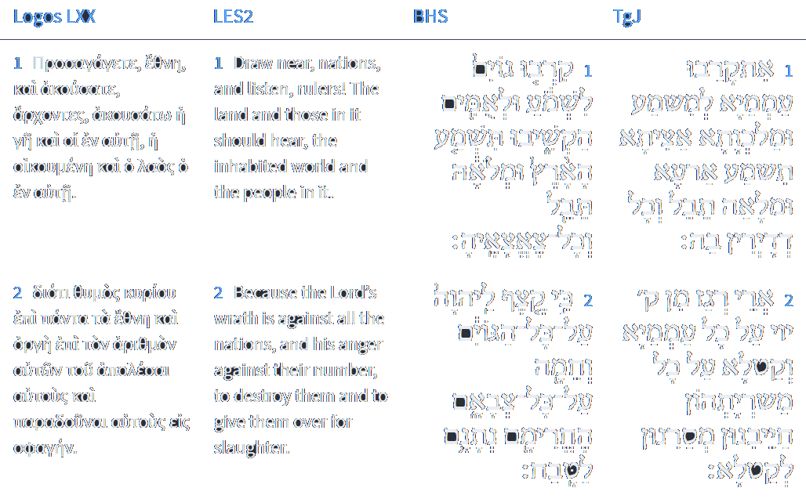
Isaiah 34:1-2
Isaiah / ישעיה
http://www.matsati.com

Slide 10
Ezekiel 39:7–12
39:7 So will I make my holy name known in the midst of my people Israel; and I will not let them pollute my holy name any more: and the heathen shall know that I am the LORD, the Holy One in Israel. 39:8 Behold, it is come, and it is done, saith the Lord GOD; this is the day whereof I have spoken. 39:9 And they that dwell in the cities of Israel shall go forth, and shall set on fire and burn the weapons, both the shields and the bucklers, the bows and the arrows, and the handstaves, and the spears, and they shall burn them with fire seven years: 39:10 So that they shall take no wood out of the field, neither cut down any out of the forests; for they shall burn the weapons with fire: and they shall spoil those that spoiled them, and rob those that robbed them, saith the Lord GOD. 39:11 And it shall come to pass in that day, that I will give unto Gog a place there of graves in Israel, the valley of the passengers on the east of the sea: and it shall stop the noses of the passengers: and there shall they bury Gog and all his multitude: and they shall call it The valley of Hamon-gog. 39:12 And seven months shall the house of Israel be burying of them, that they may cleanse the land. (KJV)
Isaiah / ישעיה
http://www.matsati.com

Slide 11
Mark 13:24–27
13:24 But in those days, after that tribulation, the sun shall be darkened, and the moon shall not give her light, 13:25 And the stars of heaven shall fall, and the powers that are in heaven shall be shaken. 13:26 And then shall they see the Son of man coming in the clouds with great power and glory. 13:27 And then shall he send his angels, and shall gather together his elect from the four winds, from the uttermost part of the earth to the uttermost part of heaven. (KJV 13:24 Ἀλλʼ ἐν ἐκείναις ταῖς ἡμέραις μετὰ τὴν θλῖψιν ἐκείνην ὁ ἥλιος σκοτισθήσεται καὶ ἡ σελήνη οὐ δώσει τὸ φέγγος αὐτῆς, 13:25 καὶ οἱ ἀστέρες ἔσονται ἐκ τοῦ οὐρανοῦ πίπτοντες, καὶ αἱ δυνάμεις αἱ ἐν τοῖς οὐρανοῖς σαλευθήσονται. 13:26 καὶ τότε ὄψονται τὸν υἱὸν τοῦ ἀνθρώπου ἐρχόμενον ἐν νεφέλαις μετὰ δυνάμεως πολλῆς καὶ δόξης. 13:27 καὶ τότε ἀποστελεῖ τοὺς ἀγγέλους καὶ ἐπισυνάξει τοὺς ἐκλεκτοὺς [αὐτοῦ] ἐκ τῶν τεσσάρων ἀνέμων ἀπʼ ἄκρου γῆς ἕως ἄκρου οὐρανοῦ.)
Isaiah / ישעיה
http://www.matsati.com

Slide 12
Matthew 24:29–31
24:29 Immediately after the tribulation of those days shall the sun be darkened, and the moon shall not give her light, and the stars shall fall from heaven, and the powers of the heavens shall be shaken: 24:30 And then shall appear the sign of the Son of man in heaven: and then shall all the tribes of the earth mourn, and they shall see the Son of man coming in the clouds of heaven with power and great glory. 24:31 And he shall send his angels with a great sound of a trumpet, and they shall gather together his elect from the four winds, from one end of heaven to the other. (KJV 24:29 Εὐθέως δὲ μετὰ τὴν θλῖψιν τῶν ἡμερῶν ἐκείνων ὁ ἥλιος σκοτισθήσεται, καὶ ἡ σελήνη οὐ δώσει τὸ φέγγος αὐτῆς, καὶ οἱ ἀστέρες πεσοῦνται ἀπὸ τοῦ οὐρανοῦ, καὶ αἱ δυνάμεις τῶν οὐρανῶν σαλευθήσονται. 24:30 καὶ τότε φανήσεται τὸ σημεῖον τοῦ υἱοῦ τοῦ ἀνθρώπου ἐν οὐρανῷ, καὶ τότε κόψονται πᾶσαι αἱ φυλαὶ τῆς γῆς καὶ ὄψονται τὸν υἱὸν τοῦ ἀνθρώπου ἐρχόμενον ἐπὶ τῶν νεφελῶν τοῦ οὐρανοῦ μετὰ δυνάμεως καὶ δόξης πολλῆς· 24:31 καὶ ἀποστελεῖ τοὺς ἀγγέλους αὐτοῦ μετὰ σάλπιγγος μεγάλης, καὶ ἐπισυνάξουσιν τοὺς ἐκλεκτοὺς αὐτοῦ ἐκ τῶν τεσσάρων ἀνέμων ἀπʼ ἄκρων οὐρανῶν ἕως [τῶν] ἄκρων αὐτῶν.)
Isaiah / ישעיה
http://www.matsati.com

Slide 13
Revelation 6:12–14
6:12 And I beheld when he had opened the sixth seal, and, lo, there was a great earthquake; and the sun became black as sackcloth of hair, and the moon became as blood; 6:13 And the stars of heaven fell unto the earth, even as a fig tree casteth her untimely figs, when she is shaken of a mighty wind. 6:14 And the heaven departed as a scroll when it is rolled together; and every mountain and island were moved out of their places. (KJV 6:12 Καὶ εἶδον ὅτε ἤνοιξεν τὴν σφραγῖδα τὴν ἕκτην, καὶ σεισμὸς μέγας ἐγένετο καὶ ὁ ἥλιος ἐγένετο μέλας ὡς σάκκος τρίχινος καὶ ἡ σελήνη ὅλη ἐγένετο ὡς αἷμα 6:13 καὶ οἱ ἀστέρες τοῦ οὐρανοῦ ἔπεσαν εἰς τὴν γῆν, ὡς συκῆ βάλλει τοὺς ὀλύνθους αὐτῆς ὑπὸ ἀνέμου μεγάλου σειομένη, 6:14 καὶ ὁ οὐρανὸς ἀπεχωρίσθη ὡς βιβλίον ἑλισσόμενον καὶ πᾶν ὄρος καὶ νῆσος ἐκ τῶν τόπων αὐτῶν ἐκινήθησαν.)
Isaiah / ישעיה
http://www.matsati.com

Slide 14
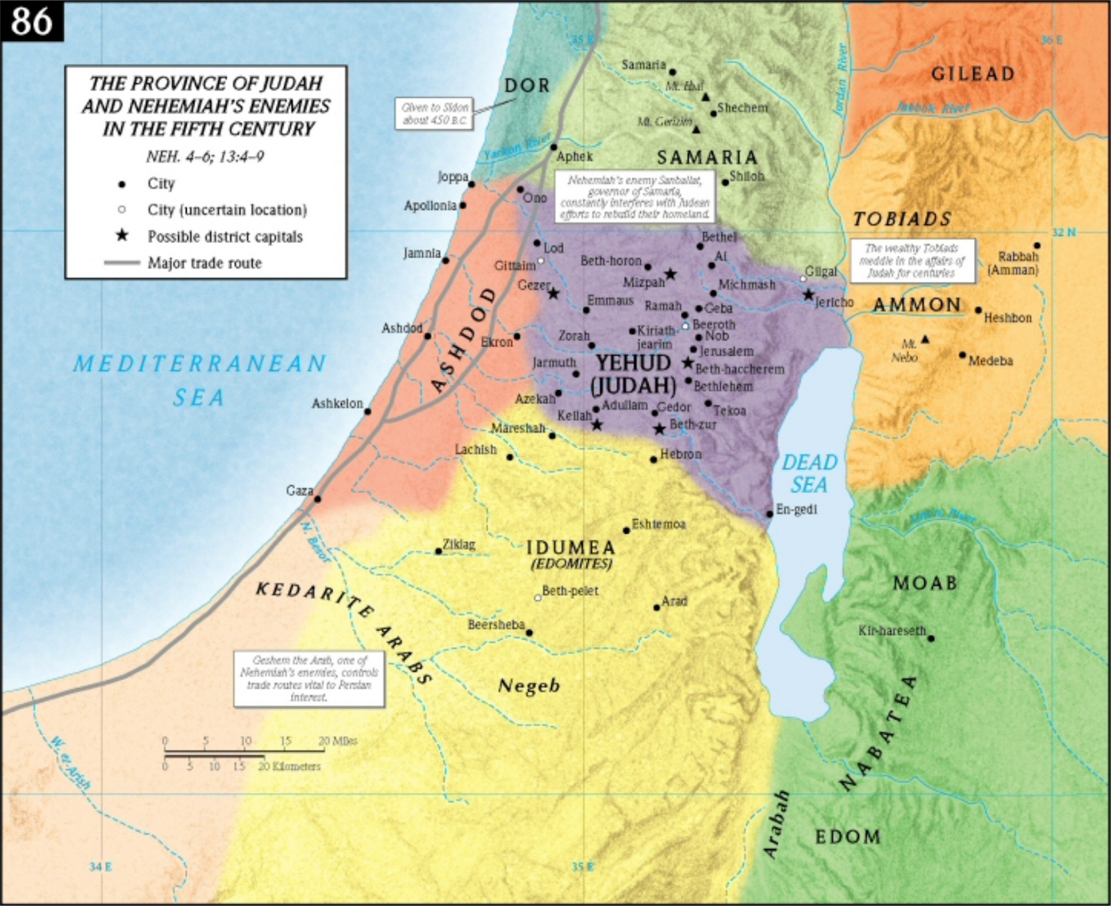
IDUMEA (Ἰδουμαια, Idoumaia). Also known as Idumaea. The Greek name for a territory located south of Judaea during the Second Temple period, in the same general area as the ancient land of Edom. Homeland of Herod the Great. Referenced once in the New Testament (Mark 3:8). Played an important role in the military conflicts of the Second Temple period.
Isaiah / ישעיה
http://www.matsati.com

Slide 15
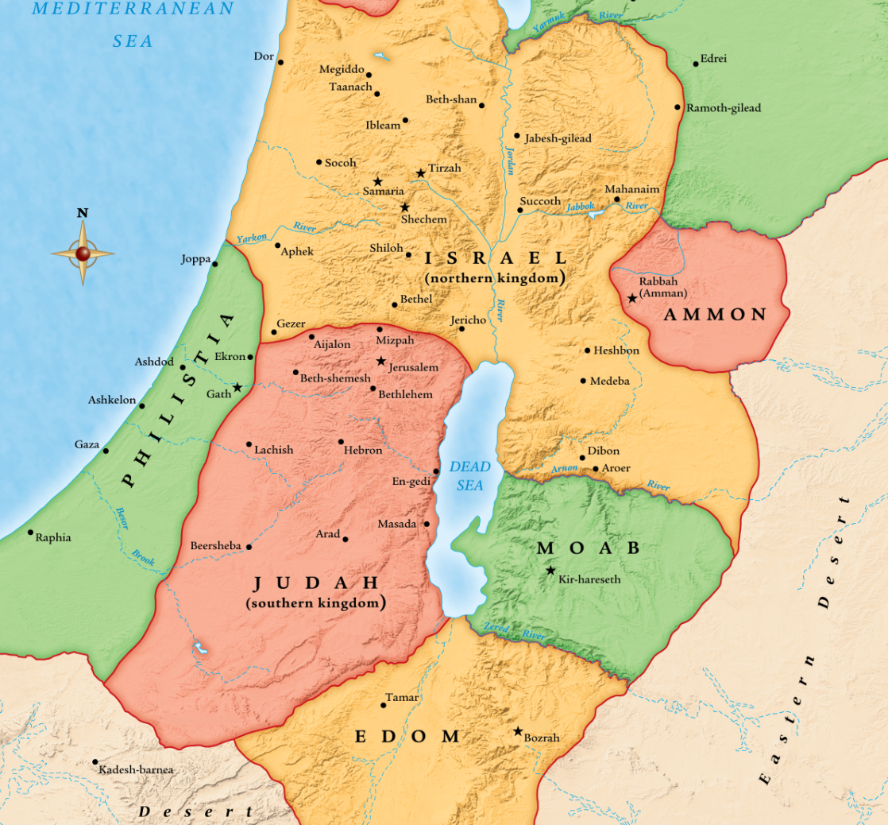
BOZRAH, IN EDOM (בצרה, btsrh). The capital city of Edom from approximately 800–582 bc. Bozrah was located in the sandstone hills approximately 20 miles (32 kilometers) southeast of the Dead Sea in the heart of what was once the territory of Edom. Now a tell situated in the modern village of Buseirah in Jordan, ancient Bozrah was a microcosm of the larger Edomite territory—representing the inaccessibility of the area due to rugged sandstone hills, sheer walls, and ravines. Bozrah was protected by steep ravines on three sides, and it was this naturally guarded position that probably contributed to its name, which in Hebrew means “inaccessible” or “enclosed” (from the Hebrew word בצר, btsr). In the introduction to its indictment against Edom, the book of Obadiah notes that the Edomites lived “in the clefts of the rock” and had their dwelling “in the heights,” and thus could say in their hearts, “Who will bring me down to the ground?” (Obad 3 NRSV; compare Jer 49:16). The prophet may have had the city of Bozrah in mind. Bozrah was situated 2.5 miles (4 kilometers) west of the international trade route between Mesopotamia and Egypt—the King’s Highway (Num 20:17; 21:22). This route ran the length of ancient Transjordan.
Isaiah / ישעיה
http://www.matsati.com

Slide 16
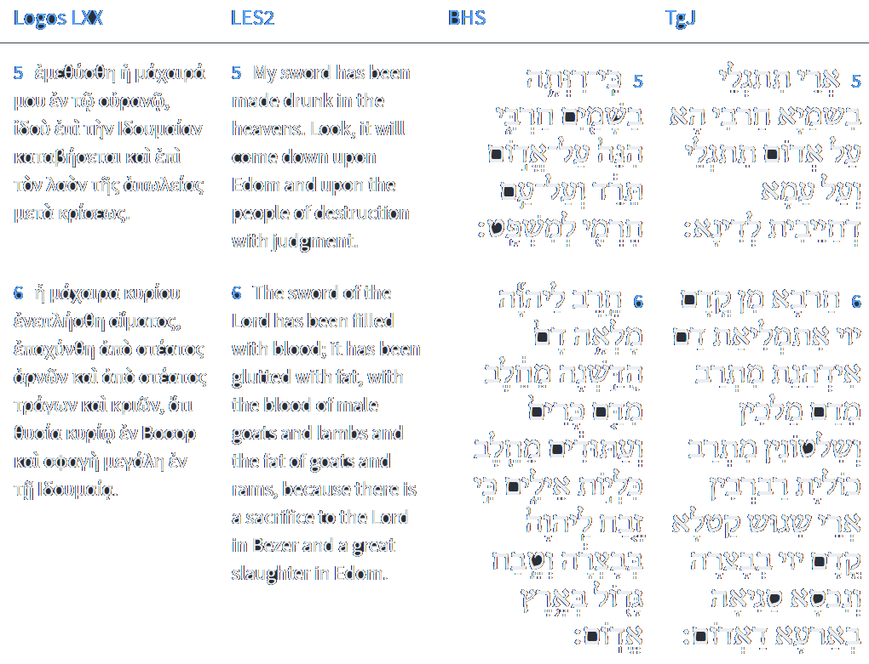
Isaiah 34:5-6
Isaiah / ישעיה
http://www.matsati.com

Slide 17
Geography and Demographics
Idumea was a territory south of Judaea during the Second Temple period. After the fall of Jerusalem to Babylon in 586 BC, Edomites increasingly migrated into the area that had formerly been part of southern Judah. Over time it became home to various people groups, including Edomites (Strabo, Geography 16.2.34), Jews (Mark 3:8; Josephus, Jewish War 2.43), Sidonians, and Nabateans (Strabo, Geography 16.2.2). These inhabitants were mainly farmers and tradesmen (Strabo, Geography 16.2.34; 16.2.2). Idumea extended from the southern part of the Judaean hill country to the north part of the Negev. Its northern border went between Beth-Zur and Alouros, and its southern border reached up to the Arad-Malatha-Beersheba-Aroer line (Gichon, Idumaea, 27–42). It was bordered by the Judaean desert and the Dead Sea to the east and the provinces of various port cities (Gaza, Ashkelon, Ashdod) to the west.
Political Affiliations
Idumea was incorporated into various administrative systems during its existence, including those of the Hasmoneans and the Romans. It was considered a toparchy during the Roman period (Jewish War 3.54–55). A governor was appointed as the region’s administrative head during the Seleucid, Hasmonean, and Roman periods (2 Macc 12:32; Josephus, Antiquities 15.254; Jewish War 2.566). After Herodian governorship ceased, Idumea was split into smaller administrative units consisting of Upper (or Greater) Idumea and East Idumea (Jewish War 4.511, 552).
Isaiah / ישעיה
http://www.matsati.com

Slide 18
Political History
Idumea played an important role during the Second Temple period both as a military power and as the homeland of important historical and biblical figures. During the first military dispute with the Seleucid Empire (165 BC), Judas Maccabeus defeated Gorgias in battle and drove parts of his army to the borders of Idumea (1 Macc 4:15; 2 Macc 10:15–17; Antiquities 12.308). After Gorgias’ defeat, Lysias attacked the Hasmoneans from Idumea, but Judas defeated him at Beth-Zur (1 Macc 4:29; 2 Macc 11:5–12; Antiquities 12.313). Shortly after Lysias’ defeat, Judas continued attacking the Idumeans (1 Macc 5:3; Antiquities 12.328) and took Hebron, Marisa, and Azotus—plundering their goods (1 Macc 5:65; Antiquities 12.353). The Seleucids continued attacking the Hasmoneans from Idumea under Lysias (1 Macc 6:31, 50; Antiquities 12.367) and later Tryphon (1 Macc 13:20; Antiquities 13.207). After John Hyrcanus conquered Idumea in 129 BC, he forced all non-Jewish inhabitants to be circumcised (1 Macc 4:36–59; 2 Macc 10:1–8; Antiquities 13.257).
The Hasmonean Dynasty
Eventually, the Hasmonean dynasty gained control over Idumea (Antiquities 13.395). Alexander Jannaeus appointed Antipater as governor; his son, also Antipater, governed after him (Antiquities 14.8). Antipater supported Hyrcanus II against his brother Aristobulus II for control of the greater Judaean area. According to Josephus, this conflict led to the Roman general Pompey’s reorganization of the Jewish state (Antiquities 14.77–79), which placed Idumea (except the city of Marisa) in the Roman province of Syria, under the dominion of a Roman governor (Antiquities 14.74–76; Jewish War 1.156).
Isaiah / ישעיה
http://www.matsati.com

Slide 19
Herod the Great
In 39 BC, the Roman senate appointed Herod the Great (the son of Antipater) as king of Judaea (Jewish War 1.282). As Herod the Great’s homeland, Idumea formed the foundation for his power base (Schalit, König Herodes, 87–91, 142–45, 200–19). Shortly after becoming king, Herod secured Idumea by dismissing Roman troops to their winter quarters (which were in Idumea) and by stationing his brother, Joseph, in Idumea along with 2,400 soldiers (Antiquities 14.411–413; Jewish War 1.302–303). Herod appointed Costobarus as governor of Idumea and gave his sister, Salome, in marriage to him (Antiquities 15.253–255). He also stationed 3,000 Idumean troops in Trachonitis in response to an uprising in the area (Antiquities 16.285, 292). When Herod’s kingdom was divided, Idumea was placed under the control of the ethnarch Archelaus (Antiquities 17.319; Jewish War 2.93–98). The city belonged to the kingdom of Agrippa I from AD 41–44 (Antiquities 19.275; Jewish War 2.215), but from AD 6–41 and after AD 44, Idumea was in the Roman administrative system as a toparchy of Judaea (Jewish War 3.55).
First Jewish Revolt
Idumea did not fare well during the first Jewish revolt against Rome. Early on, the rebels in the area appointed their own commanders over Idumea (Jewish War 2.566). John of Gischala attempted to use Idumean troops to gain an advantage over other rebel factions during the revolt (Jewish War 4.224). Vespasian, while subjugating the uprising, stationed his army in Idumea and devastated it—killing, imprisoning, or expelling its inhabitants (Jewish War 4.447–48). Simon Bar Giora’s group also went into Idumea, plundered it, and forced some of its inhabitants to flee to Jerusalem (Jewish War 4.511–37, 556, 557; 5.248–49). During the siege of Jerusalem, the Idumeans sent five delegates to Titus to defect to the Roman side. Titus offered them protection from Roman forces, but Simon Bar Giora, discovering their actions, had the delegates either executed or imprisoned (Jewish War 6.378–81). Idumea ceases to appear in contemporary records shortly after the destruction of Jerusalem.
Isaiah / ישעיה
http://www.matsati.com

Slide 20
Rabbinic Literature
ספרות רבנית
Part 3
Isaiah / ישעיה
http://www.matsati.com

Slide 21
Targum Jonathan son of Uziel Isaiah 34:1-6
34:1 Come near, ye nations, to hear; and hearken, ye kingdoms: let the earth hear, and the world’s fullness, and all that dwell in her. 34:2 For the wrath from before the presence of the Lord is upon all the nations, and slaughter upon all their hosts: He hath condemned them and delivered them over to the slaughter. 34:3 And their slain shall be cast out; and their stink shall ascend from their carcasses; and the mountains shall be melted with their blood. 34:4 And all the pleasant host of heaven shall be dissolved, and they shall be blotted out from beneath the heavens, as it is said concerning them in this book; and all their armies shall come to an end, as the fading leaf from the vine, and as the withering fig from the fig-tree. 34:5 Because my sword is revealed in heaven; behold, it shall be uncovered upon Edom, and upon the people which I have condemned to judgment. 34:6 The sword before the presence of the Lord is filled with blood, it is fattened, it is fattened with the blood of kings and rulers, it is fattened with the kidneys of princes; because there is a slaughter before the Lord in Bozrah, and a great sacrifice in the land of Edom. (TgJ)
Isaiah / ישעיה
http://www.matsati.com

Slide 22
Pirkei DeRabbi Eliezer 51:1
THE NEW HEAVENS AND EARTH
RABBAN GAMALIEL said: Just as the New Moons are renewed and sanctified in this world, so will Israel be sanctified and renewed in the future world just like the New Moons, as it is said, "Speak unto all the congregation of the children of Israel, and say unto them, Ye shall be holy: for I the Lord your God am holy" (Lev. 19:2). The sages say: The heavens and the earth are destined to pass away and to be renewed. What is written concerning them? "And all the host of the heaven shall be dissolved, and the heavens shall be rolled together as a scroll" (Isa. 34:4). Just as when a man reads in a scroll of the Torah and he rolls it, and again he opens it to read therein and he rolls it (together), likewise in the future will the Holy One, blessed be He, roll together the heavens like a scroll, as it is said, "And the heavens shall be rolled together as a scroll" (ibid.); "And the earth shall wax old like a garment" (Isa. 51:6); just as a man spreads out his garment and folds it up, and again he unfolds it || and puts it on and renews it (thereby), likewise the Holy One, blessed be He, in the future will fold up the earth and again will He spread it out and put it in its place like a garment, as it is said. "And the earth shall wax old like a garment" (ibid.).
Isaiah / ישעיה
http://www.matsati.com

Slide 23
Pirkei DeRabbi Eliezer 51:3
Rabbi Eliezer said: All the host of heaven in the future will pass away and will be renewed. What is written concerning them? "And all the host of heaven shall be dissolved" (Isa. 34:4). Just as the leaves fade from off the vine and the fig tree, and the latter remain standing as a dry tree, and again they blossom afresh and bear buds and produce new leaves and fresh leaves. Likewise in the future will all the host of heaven fade away like a vine and a fig tree, and they will again be renewed before Him to make known that there is passing away (which) does not (really) pass away. No more shall there be evil, and no more shall there be plague, and (there shall) not be the former misfortunes, as it is said, "For, behold, I create new heavens" (Isa. 65:17).
Isaiah / ישעיה
http://www.matsati.com

Slide 24
Rashi on Isaiah 34:4 Parts 1-4
ונמקו כל צבא השמים. יפחדו כשאשליך את שרי אשור ובבל:
And all the host of heaven shall melt They shall be frightened when I cast down the princes of the heathens.([Mss. yield:] the princes of the nations.) ([Warsaw edition:] of Assyria and Babylon.)
ונגולו. ל' גולל ונגלו כספר השמים ת"י ויתמחון מתחות שמיא כמא דאמר עליהן בסיפרא ואני מפרשו לפי הענין מפני שעכשיו הטובה והאורה לרשעים לכשיתמחו ויחרבו יהיה דומם העולם חשך עליהם כאילו נגלל השמש והאור כגלילת ספר:
shall be rolled (וְנָגֹלּוּ) an expression of rolling. And the heavens shall be rolled like a scroll. Jonathan renders: And they shall be erased from beneath the heavens, as it is stated about them in the Book. But I explain it according to the context, for now, the kingdoms of the Ishmaelites (the nations [ms.]) (the wicked [Warsaw ed.]) have fortune and light. When they are erased and destroyed, it will be as though the world has darkened for them, as though the sun and the light are rolled up like the rolling of a scroll.
יבול. יכמוש:
withers (יִבּוֹל) withers.
וכנובלת מתאנה. כמושה באילן קרויה נובלת וזהו שפירשו רבותינו (ברכות מ) מאי נובלות בושלי כומרא שנתבשלו בכומר לאחר לקיטתן צוברן ומתחממות ומתבשלות:
and as a withered [fig] from a fig tree The withered fruit of a tree is called נוֹבְלוֹת. This is what our Rabbis (Ber. 40b) explained: What are ‘noveloth’? Fruit ripened in the heater, that become ripe in the heater. After they are picked, he gathers them and they become heated and ripen.
Isaiah / ישעיה
http://www.matsati.com

Slide 25
Midrash Tehillim 119:8…
"Reward Your servant, that I may live and keep Your word." This is what Isaiah said (Isaiah 59:18), "According to their deeds, so will He repay wrath to His adversaries." The Lord pays the wicked according to their deeds, and to the righteous, He pays them according to their works. He pays the wicked (Isaiah 34:5), "For My sword shall be bathed in heaven; behold it shall come down upon Edom, and upon the people of My curse, to judgment." And He rewards the righteous, as it says in Psalm 73:1, "Truly God is good to Israel, to such as are pure in heart." And it says in Isaiah 63:7, "I will mention the loving-kindnesses of the Lord, and the praises of the Lord, according to all that the Lord has bestowed on us, and the great goodness toward the house of Israel, which He has bestowed on them according to His mercies, and according to the multitude of His loving-kindnesses." The Lord does not pay anything for free, neither to the wicked nor to the righteous. The evil that comes upon the wicked is not brought upon them by the Lord. As it says in Lamentations 3:38, "Out of the mouth of the Most High proceedeth not evil and good." But they bring it upon themselves. And it says in Isaiah 3:9, "The shew of their countenance doth witness against them." What does He reward the righteous with? Life, without any charge. And it says in Psalm 103:2-4, "Bless the Lord, O my soul, and forget not all His benefits, who forgiveth all thine iniquities; who healeth all thy diseases; who redeemeth thy life from destruction." And not only this, but He does many righteous deeds, as it says in Psalm 146:7, "The Lord executeth righteousness and judgment for all that are oppressed." And it says in Psalm 116:7, "Return unto thy rest, O my soul, for the Lord hath dealt bountifully with thee." And David said to the Lord, "Reward Your servant with life, that I may keep Your word." And why does He reward me with life? Because I keep Your word. Life is the Torah. And it says in Proverbs 4:13, "Take fast hold of instruction; let her not go: keep her; for she is thy life." Therefore it is said, "Recompense on Your servant, I will live.“…
Isaiah / ישעיה
http://www.matsati.com

Slide 26
Midrash Tehillim 119:8
David said to him, "Master of the universe, it is Your will that I keep Your word. Unveil my eyes that I may perceive wonders from Your Torah. And if You do not unveil my eyes, how can I know? Therefore it is said, 'Unveil my eyes and I will perceive wonders.' Even though my eyes are open, I know nothing. Come and see, even though Samuel was a prophet, he knew nothing until the Holy One, blessed be He, unveiled his ear, as it is said (I Samuel 9:15), 'And the Lord had revealed to Samuel.' Likewise, Nebuchadnezzar said (Daniel 2:47), 'Truly your God is a God of gods and a Lord of kings, and a revealer of mysteries.' And so did Daniel say (Daniel 2:30), 'But as for me, this mystery has not been revealed to me for any wisdom that I have more than any living man, but in order that the interpretation may be made known to the king.' And he said (Daniel 2:22), 'And He reveals the deep and secret things.' So did David say, 'Unveil my eyes that I may perceive wonders from Your Torah.' And why does he say (Psalms 119:129), 'Your testimonies are wonderful?' 'Wonderful' refers to the Torah. And so the Scripture says, 'Wonderful are Your testimonies.' Therefore it is said, 'Wonders from Your Torah are treasures.' And so the Scripture says (Proverbs 21:20), 'A desirable treasure.' It is a hidden treasure, as the Scripture says (Deuteronomy 33:19), 'And of the hidden treasures of the sand.' There are many doors and many entrances in it, as it says (Psalms 24:7-8), 'Lift up your heads, O gates, and be lifted up, O ancient doors, that the King of glory may come in!' And so David said, 'The Torah is full of wonders.' Moses said, 'It is not a wonder from you, as it says (Deuteronomy 30:11), 'For this commandment which I command you this day, it is not too hard for you.' It is not too hard for you, but it is a wonder from you, because you did not toil in it. Therefore it is said, 'Wonders from Your Torah.'...
Isaiah / ישעיה
http://www.matsati.com

Slide 27
ספר ירמיה פרק יב
﻿יא שָֹמָהּ לִשְׁמָמָה אָבְלָה עָלַי שְׁמֵמָה נָשַׁמָּה כָּל-הָאָרֶץ כִּי אֵין אִישׁ שָֹם עַל-לֵב: יב עַל-כָּל-שְׁפָיִם בַּמִּדְבָּר בָּאוּ שֹׁדְדִים כִּי חֶרֶב לַיהֹוָה אֹכְלָה מִקְצֵה-אֶרֶץ וְעַד-קְצֵה הָאָרֶץ אֵין שָׁלוֹם לְכָל-בָּשָֹר: יג זָרְעוּ חִטִּים וְקֹצִים קָצָרוּ נֶחְלוּ לֹא יוֹעִלוּ וּבֹשׁוּ מִתְּבוּאֹתֵיכֶם מֵחֲרוֹן אַף-יְהֹוָה:
Jeremiah 12:11–13
12:11 They have made it desolate, and being desolate it mourneth unto me; the whole land is made desolate, because no man layeth it to heart. 12:12 The spoilers are come upon all high places through the wilderness: for the sword of the LORD shall devour from the one end of the land even to the other end of the land: no flesh shall have peace. 12:13 They have sown wheat, but shall reap thorns: they have put themselves to pain, but shall not profit: and they shall be ashamed of your revenues because of the fierce anger of the LORD. (KJV)
Isaiah / ישעיה
http://www.matsati.com

Slide 28
ספר דברים פרק ט
ג וְיָדַעְתָּ הַיּוֹם כִּי יְהֹוָה אֱלֹהֶיךָ הוּא-הָעֹבֵר לְפָנֶיךָ אֵשׁ אֹכְלָה הוּא יַשְׁמִידֵם וְהוּא יַכְנִיעֵם לְפָנֶיךָ וְהוֹרַשְׁתָּם וְהַאֲבַדְתָּם מַהֵר כַּאֲשֶׁר דִּבֶּר יְהוָֹה לָךְ:
Devarim / Deuteronomy 9:3
9:3 Understand therefore this day, that the LORD thy God is he which goeth over before thee; as a consuming fire he shall destroy them, and he shall bring them down before thy face: so shalt thou drive them out, and destroy them quickly, as the LORD hath said unto thee. (KJV)
Isaiah / ישעיה
http://www.matsati.com

