Slide 1
MATSATI.COM Teaching Ministry
Website: https://www.matsati.com YouTube Channel: https://www.youtube.com/user/MATSATI/
ישעיהו לג:ז-יב / Isaiah 33:7-12
LIVE STREAM: 6:30 pm EST Thursday
Join us at Telegram:
https://t.me/MessianicChat
Rabbi Jeremiah
– Hebrew Language Labs: FREE
– Weekly Torah Portion: Triennial cycle
A Community
for Learning
Weekly Teachings Free Online
Check Telegram for weekly scheduling of teachings.
YouTube Channels
https://YouTube.com/c/HebrewLiteracy
https://www.youtube.com/channel/UC5_qPfruat-sCJJypz0_OBw
Discuss the Scriptures,
learn the languages,
and fellowship
Join Telegram ask about Hebrew and Greek classes!

Slide 2
Isaiah 33:7-12
ישעיהו לג:ז-יב
Isaiah / ישעיה
http://www.matsati.com

Slide 3
מבוא לישעיהו
Part 1
Isaiah / ישעיה
http://www.matsati.com

Slide 4
ספר תהילים פרק לז
כג מֵיְהֹוָה מִצְעֲדֵי-גֶבֶר כּוֹנָנוּ וְדַרְכּוֹ יֶחְפָּץ: כד כִּי-יִפֹּל לֹא-יוּטָל כִּי-יְהֹוָה סוֹמֵךְ יָדוֹ: כה נַעַר | הָיִיתִי גַּם-זָקַנְתִּי וְלֹא-רָאִיתִי צַדִּיק נֶעֱזָב וְזַרְעוֹ מְבַקֶּשׁ-לָחֶם: כו כָּל-הַיּוֹם חוֹנֵן וּמַלְוֶה וְזַרְעוֹ לִבְרָכָה: כז סוּר מֵרָע וַעֲשֵֹה-טוֹב וּשְׁכֹן לְעוֹלָם: כח כִּי יְהֹוָה | אֹהֵב מִשְׁפָּט וְלֹא-יַעֲזֹב אֶת-חֲסִידָיו לְעוֹלָם נִשְׁמָרוּ וְזֶרַע רְשָׁעִים נִכְרָת:
Tehillim / Psalm 37:23–28
37:23 The steps of a good man are ordered by the LORD: And he delighteth in his way. 37:24 Though he fall, he shall not be utterly cast down: For the LORD upholdeth him with his hand. 37:25 I have been young, and now am old; Yet have I not seen the righteous forsaken, Nor his seed begging bread. 37:26 He is ever merciful, and lendeth; And his seed is blessed. 37:27 Depart from evil, and do good; And dwell for evermore. 37:28 For the LORD loveth judgment, And forsaketh not his saints; They are preserved for ever: But the seed of the wicked shall be cut off. (KJV)
Isaiah / ישעיה
http://www.matsati.com

Slide 5
Romans 16:25
25 Now to him that is of power to stablish you according to my gospel, and the preaching of Jesus Christ, according to the revelation of the mystery, which was kept secret since the world began (KJV 25 Τῷ δὲ δυναμένῳ ὑμᾶς στηρίξαι κατὰ τὸ εὐαγγέλιόν μου καὶ τὸ κήρυγμα Ἰησοῦ Χριστοῦ*, κατὰ ἀποκάλυψιν μυστηρίου χρόνοις αἰωνίοις σεσιγημένου*)
1 Corinthians 2:7
7 But we speak the wisdom of God in a mystery, even the hidden wisdom, which God ordained before the world unto our glory: (KJV 7 ἀλλὰ λαλοῦμεν θεοῦ σοφίαν ἐν μυστηρίῳ τὴν ἀποκεκρυμμένην, ἣν προώρισεν ὁ θεὸς πρὸ τῶν αἰώνων εἰς δόξαν ἡμῶν,*)
1 Corinthians 4:1
Let a man so account of us, as of the ministers of Christ, and stewards of the mysteries of God. (KJV 4 Οὕτως ἡμᾶς λογιζέσθω ἄνθρωπος ὡς ὑπηρέτας Χριστοῦ καὶ οἰκονόμους μυστηρίων θεοῦ.*)
Ephesians 1:9
9 Having made known unto us the mystery of his will, according to his good pleasure which he hath purposed in himself: (KJV 9 ⸀γνωρίσας ἡμῖν τὸ μυστήριον τοῦ θελήματος αὐτοῦ,* κατὰ τὴν εὐδοκίαν °αὐτοῦ ἣν προέθετο ἐν ⸁αὐτῷ)
Isaiah / ישעיה
http://www.matsati.com

Slide 6
ספר ישעיה
Part 2
Isaiah / ישעיה
http://www.matsati.com

Slide 7
﻿ספר ישעיה פרק לג
﻿ז הֵן אֶרְאֶלָּם צָעֲקוּ חֻצָה מַלְאֲכֵי שָׁלוֹם מַר יִבְכָּיוּן: ח נָשַׁמּוּ מְסִלּוֹת שָׁבַת עֹבֵר אֹרַח הֵפֵר בְּרִית מָאַס עָרִים לֹא חָשַׁב אֱנוֹשׁ: ט אָבַל אֻמְלְלָה אָרֶץ הֶחְפִּיר לְבָנוֹן קָמַל הָיָה הַשָּׁרוֹן כָּעֲרָבָה וְנֹעֵר בָּשָׁן וְכַרְמֶל: י עַתָּה אָקוּם יֹאמַר יְהֹוָה עַתָּה אֵרוֹמָם עַתָּה אֶנָּשֵֹא: יא תַּהֲרוּ חֲשַׁשׁ תֵּלְדוּ קַשׁ רוּחֲכֶם אֵשׁ תֹּאכַלְכֶם: יב וְהָיוּ עַמִּים מִשְֹרְפוֹת שִֹיד קוֹצִים כְּסוּחִים בָּאֵשׁ יִצַּתּוּ:
Isaiah / ישעיה
http://www.matsati.com

Slide 8
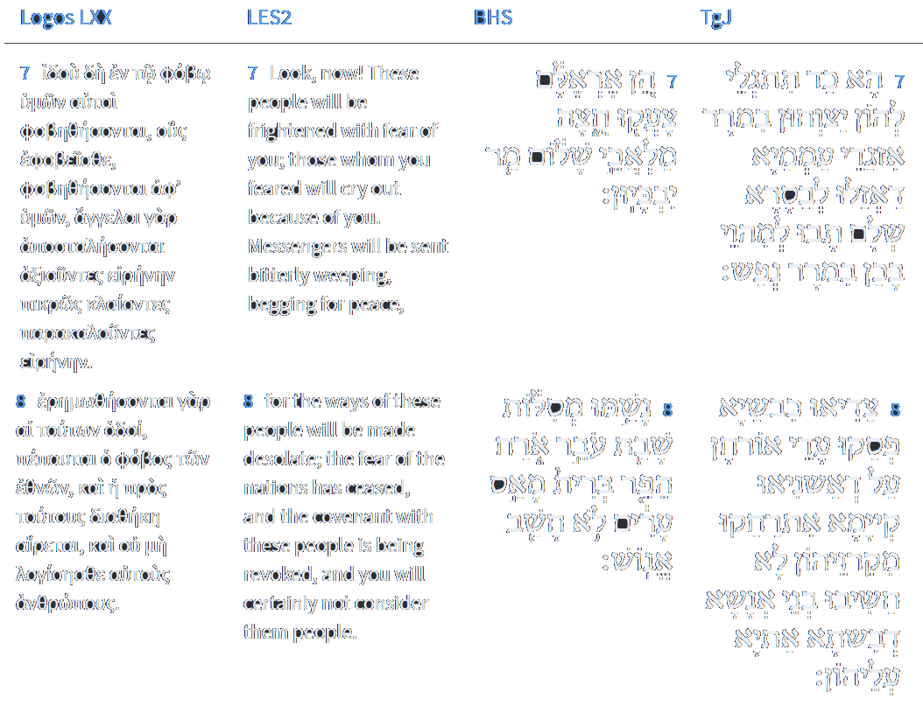
Isaiah 33:7-8
Isaiah / ישעיה
http://www.matsati.com

Slide 9
ספר בראשית פרק יז
יג הִמּוֹל | יִמּוֹל יְלִיד בֵּיתְךָ וּמִקְנַת כַּסְפֶּךָ וְהָיְתָה בְרִיתִי בִּבְשַֹרְכֶם לִבְרִית עוֹלָם: יד וְעָרֵל | זָכָר אֲשֶׁר לֹא-יִמּוֹל אֶת-בְּשַֹר עָרְלָתוֹ וְנִכְרְתָה הַנֶּפֶשׁ הַהִוא מֵעַמֶּיהָ אֶת-בְּרִיתִי הֵפַר:
Bereshit / Genesis 17:13–14
17:13 He that is born in thy house, and he that is bought with thy money, must needs be circumcised: and my covenant shall be in your flesh for an everlasting covenant. 17:14 And the uncircumcised man child whose flesh of his foreskin is not circumcised, that soul shall be cut off from his people; he hath broken my covenant. (KJV)
Isaiah / ישעיה
http://www.matsati.com

Slide 10
עַתָּה אָקוּם יֹאמַר ַיְהֹוָה עתָּה אֵרוֹמָם עַתָּה אֶנָּשֵֹא:
Isaiah / ישעיה
http://www.matsati.com

Slide 11
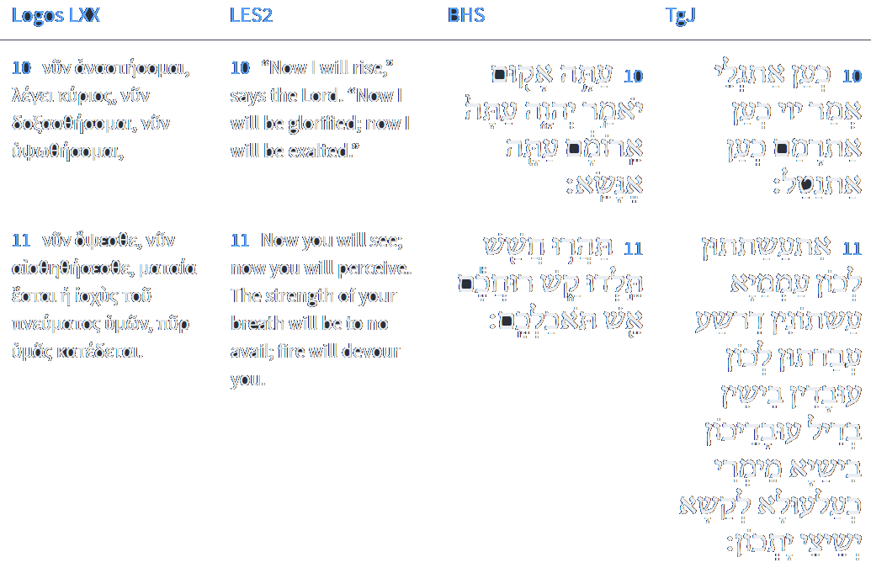
Isaiah 33:10-11
Isaiah / ישעיה
http://www.matsati.com

Slide 12
Isaiah 33:12
Isaiah / ישעיה
http://www.matsati.com

Slide 13
Rabbinic Literature
ספרות רבנית
Part 3
Isaiah / ישעיה
http://www.matsati.com

Slide 14
Targum Jonathan son of Uziel Isaiah 33:7-12
33:7 When Thou shalt reveal Thyself to them, the messengers of the nations shall cry bitterly in the street; those who had gone forth to proclaim peace, shall return to weep in the bitterness of soul. 33:8 The highways lie desolate, the wayfaring man ceaseth: because they have forgotten the covenant: they shall be removed far from their cities; they have not considered the sons of men, evil shall come upon them. 33:9 The land mourneth, it is laid desolate; Lebanon is withered, it shakes off its leaves: Sharon has become like a desert; Bashan is laid desolate, and Carmel. 33:10 Now I will reveal myself, saith the Lord; now will I lift myself up on high; now will I be exalted. 33:11 Ye, O people! have purposed for yourselves purposes of iniquity; ye have worked for yourselves evil works, because your works are evil; my WORD shall consume you, as a whirlwind consumes chaff. 33:12 And the people shall be as the burning of fire, as thorns are cut up and burnt in the fire. (TgJ)
Isaiah / ישעיה
http://www.matsati.com

Slide 15
ספר ירמיה פרק יא
א הַדָּבָר אֲשֶׁר הָיָה אֶל-יִרְמְיָהוּ מֵאֵת יְהֹוָה לֵאמֹר: ב שִׁמְעוּ אֶת-דִּבְרֵי הַבְּרִית הַזֹּאת וְדִבַּרְתֶּם אֶל-אִישׁ יְהוּדָה וְעַל-יֹשְׁבֵי יְרוּשָׁלָם: ג וְאָמַרְתָּ אֲלֵיהֶם כֹּה-אָמַר יְהֹוָה אֱלֹהֵי יִשְֹרָאֵל אָרוּר הָאִישׁ אֲשֶׁר לֹא יִשְׁמַע אֶת-דִּבְרֵי הַבְּרִית הַזֹּאת: ד אֲשֶׁר צִוִּיתִי אֶת-אֲבוֹתֵיכֶם בְּיוֹם הוֹצִיאִי-אוֹתָם מֵאֶרֶץ-מִצְרַיִם מִכּוּר הַבַּרְזֶל לֵאמֹר שִׁמְעוּ בְקוֹלִי וַעֲשִֹיתֶם אוֹתָם כְּכֹל אֲשֶׁר-אֲצַוֶּה אֶתְכֶם וִהְיִיתֶם לִי לְעָם וְאָנֹכִי אֶהְיֶה לָכֶם לֵאלֹהִים: ה לְמַעַן הָקִים אֶת-הַשְּׁבוּעָה אֲשֶׁר-נִשְׁבַּעְתִּי לַאֲבוֹתֵיכֶם לָתֵת לָהֶם אֶרֶץ זָבַת חָלָב וּדְבַשׁ כַּיּוֹם הַזֶּה וָאַעַן וָאֹמַר אָמֵן | יְהֹוָה:
Jeremiah 11:1–5
11:1 The word that came to Jeremiah from the LORD, saying, 11:2 Hear ye the words of this covenant, and speak unto the men of Judah, and to the inhabitants of Jerusalem; 11:3 And say thou unto them, Thus saith the LORD God of Israel; Cursed be the man that obeyeth not the words of this covenant, 11:4 Which I commanded your fathers in the day that I brought them forth out of the land of Egypt, from the iron furnace, saying, Obey my voice, and do them, according to all which I command you: so shall ye be my people, and I will be your God: 11:5 That I may perform the oath which I have sworn unto your fathers, to give them a land flowing with milk and honey, as it is this day. Then answered I, and said, So be it, O LORD. (KJV)
Isaiah / ישעיה
http://www.matsati.com

Slide 16
Akeidat Yitzchak 24:1:9
To come back to the Midrash quoted at the beginning, when man's eyesight is perfect, he makes few errors in perception. Denial of physical health does not originate in heaven. On the contrary, heaven helps in the attainment of perfect health. Therefore, since failing health is usually the result of some moral failure, the deterioration in Isaac's eyesight seems doubly baffling. When someone looks into the king's bedchamber accidentally, observing the most intimate aspects of the king's private life, such a person may become a source of major embarrassment to the king. If the person in question happens to be an average citizen, the king might have him executed to save himself future embarrassment. If he is the king's son, however, the king may prefer to shutter the son's windows rather than to execute him. At the time of the akeydah, Isaac had become privy to some of G-d’s secrets while he was lying bound on the altar. Afraid that what Isaac had seen might become a source of future embarrassment, and to help Isaac avoid making fatal mistakes in the use of his eyes, G-d decided to shutter his "windows," as it were. When Moses complained about his speech defect, using it as an excuse to decline the role of leader of the Jewish people, G-d countered by saying, "Who gave man a mouth?" (Exodus 4,11). This means that imperfections in man's physical attributes do not occur through oversight on the part of G-d, but on the contrary; since they are the results of G-d’s actions, they serve a constructive purpose, even though that purpose may not yet have been recognized by the person suffering the handicap.
Isaiah / ישעיה
http://www.matsati.com

Slide 17
Otzar Midrashim, Midrash Temurah 1:33
Once an unbeliever came to Rabbi Akiva and asked him: "This world, who created it?" Rabbi Akiva said: "The Holy Blessed One." The other said: "Show me a clear indication." Rabbi Akiva said: "Come to me again tomorrow." The unbeliever came again the next day. Rabbi Akiva said to him: "What are you wearing?" The other replied: "A garment." Rabbi Akiva asked: "Who made it?" The other answered: "The weaver." Rabbi Akiva said: "I don't believe you. Show me a clear indication." The other said: "What can I show you? Don't you know that a weaver makes clothes?" Rabbi Akiva said: "And don't you know that The Holy Blessed One created the world?" The unbeliever departed, and Rabbi Akiva's students asked him: "Is the indication so clear?" He said to them: "My children, just as the house makes known its builder, and the garment makes known its weaver, and the door makes known its carpenter, so to the world makes known God as the one who created it."
Isaiah / ישעיה
http://www.matsati.com

Slide 18
Duties of the Heart, Third Treatise on Service of God 6:3
The first is the universal goodness of G-d which embraces all mankind, in having brought human creatures into existence when previously they were naught; in keeping them in life and bestowing on them bounties which we have cited in the second treatise of this work. They are accordingly under a universal obligation of service to the blessed Creator. This consists of obedience to all the rational laws observed by Adam, Enoch, Noah and his sons, Job and his companions, up to the days of our teacher Moses, peace be upon him. If one adheres to all these laws for the sake of G-d's service, the Almighty will bestow on him favors beyond those enjoyed by other men, and give him a higher degree in this existence and a great reward in the World to Come, as was the case with Abraham, to whom G-d said, "Do not fear, Abraham; I am your shield; your reward is exceedingly great" (Bereishis 15:1). But one who rebels against G-d, despite His beneficence, will fall from the degree of rational beings and their excellencies, sink to the low condition of irrational creatures and share the fate of the beasts of the earth, as it is said: "And the enemies of the L-ord shall be as the fat lambs (they shall be consumed; into smoke shall they be consumed)" (Tehilim 37:20). And in the next world they will be sentenced to an evil of which there is none greater, as it is said: "As to your spirit - fire shall devour you" (Yeshaya 33:11).
Isaiah / ישעיה
http://www.matsati.com

Slide 19
Pirkei DeRabbi Eliezer 40:9
למה הראה הקב"ה למשה מתוך הסנה? אלא האש אלו ישראל שנמשלו כאש, שנ' והיה בית יעקב אש ובית יוסף להבה, והסנה אלו אומות העולם שנמשלו כקוצים ודרדרים. א"ל, כך יהיו ישראל בתוך העמים, לא אש של ישראל אוכלת העמים שנמשלו כקוצים וכחרולים, ואין אומות העולם מכבין שלהבתן של ישראל שהן מדברי תורה, לעתיד לבא אשן של ישראל אוכלת העמים שנמשלו כקוצים, שנ' והיו העמים משרפות סיד.
Why did He show unto Moses the fire in the midst of the thorn-bush? || But the fire refers to Israel, who are compared to fire, as it is said, "And the house of Jacob shall be a fire" (Obad. 18). The thorn-bush refers to the nations of the world, who are compared to thorns and thistles. He said to him: Likewise shall Israel be in the midst of the nations. The fire of Israel shall not consume the nations, who are compared to thorns and thistles; but the nations of the world shall extinguish the flames of Israel—(these flames) are the words of the Torah. But in the future that is to come the fire of Israel will consume all the nations, who are compared to thorns and thistles, as it is said, "And the peoples shall be as the burnings of lime" (Isa. 33:12).
Isaiah / ישעיה
http://www.matsati.com

