Slide 1
MATSATI.COM Teaching Ministry
Website: https://www.matsati.com YouTube Channel: https://www.youtube.com/user/MATSATI/
ישעיהו לג:יח-כד / Isaiah 33:19-24
LIVE STREAM: 6:30 pm EST Thursday
Join us at Telegram:
https://t.me/MessianicChat
Rabbi Jeremiah
– Hebrew Language Labs: FREE
– Weekly Torah Portion: Triennial cycle
A Community
for Learning
Weekly Teachings Free Online
Check Telegram for weekly scheduling of teachings.
YouTube Channels
https://YouTube.com/c/HebrewLiteracy
https://www.youtube.com/channel/UC5_qPfruat-sCJJypz0_OBw
Discuss the Scriptures,
learn the languages,
and fellowship
Join Telegram ask about Hebrew and Greek classes!

Slide 2
Isaiah 33:19-24
ישעיהו לג:יח-כד
Isaiah / ישעיה
http://www.matsati.com

Slide 3
מבוא לישעיהו
Part 1
Isaiah / ישעיה
http://www.matsati.com

Slide 4
ספר שמות פרק כ
א וַיְדַבֵּר אֱלֹהִים אֵת כָּל-הַדְּבָרִים הָאֵלֶּה לֵאמֹר: ס ב אָנֹכִי יְהוָֹה אֱלֹהֶיךָ אֲשֶׁר הוֹצֵאתִיךָ מֵאֶרֶץ מִצְרַיִם מִבֵּית עֲבָדִים: ג לֹא-יִהְיֶה לְךָ אֱלֹהִים אֲחֵרִים עַל-פָּנָי: ד לֹא-תַעֲשֶֹה לְךָ פֶסֶל וְכָל-תְּמוּנָה אֲשֶׁר בַּשָּׁמַיִם מִמַּעַל וַאֲשֶׁר בָּאָרֶץ מִתָּחַת וַאֲשֶׁר בַּמַּיִם מִתַּחַת לָאָרֶץ: ה לֹא-תִשְׁתַּחֲוֶה לָהֶם וְלֹא תָעָבְדֵם כִּי אָנֹכִי יְהוָֹה אֱלֹהֶיךָ אֵל קַנָּא פֹּקֵד עֲוֹן אָבֹת עַל-בָּנִים עַל-שִׁלֵּשִׁים וְעַל-רִבֵּעִים לְשֹֹנְאָי: ו וְעֹשֶֹה חֶסֶד לַאֲלָפִים לְאֹהֲבַי וּלְשֹׁמְרֵי מִצְוֹתָי
Isaiah / ישעיה
http://www.matsati.com

Slide 5
Twelve ways that we benefit having faith in God
He’ll Fight Our Battles.
Our Expectations Won’t Be Cut Short.
We Won’t Be Disappointed.
We Will Have Peace.
He Will Direct Our Paths.
We Will Have Hope.
We’ll Fulfill God’s Purpose For Our Lives.
We Will Have Unshakable Confidence.
Helps Us Avoid Unnecessary Stress.
We Will Have The Hope Of Eternal Life.
Helps Us Wait Patiently On Him.
Our Faith Will Become Stronger.
Isaiah / ישעיה
http://www.matsati.com

Slide 6
“from God the steps of man are set up / established / directed, and his ways are a delight.”
Tehillim / Psalms 37:23
מֵ֭יְהוָה מִֽצְעֲדֵי־גֶ֥בֶר כֹּונָ֗נוּ וְדַרְכֹּ֥ו יֶחְפָּֽץ
“from God the steps of man are set up / established / directed, and his ways are a delight.”
Isaiah / ישעיה
http://www.matsati.com

Slide 7
ספר ישעיה
Part 2
Isaiah / ישעיה
http://www.matsati.com

Slide 8
﻿ספר ישעיה פרק לג
﻿יט אֶת-עַם נוֹעָז לֹא תִרְאֶה עַם עִמְקֵי שָֹפָה מִשְּׁמוֹעַ נִלְעַג לָשׁוֹן אֵין בִּינָה: כ חֲזֵה צִיּוֹן קִרְיַת מוֹעֲדֵנוּ עֵינֶיךָ תִרְאֶינָה יְרוּשָׁלַם נָוֶה שַׁאֲנָן אֹהֶל בַּל-יִצְעָן בַּל-יִסַּע יְתֵדֹתָיו לָנֶצַח וְכָל-חֲבָלָיו בַּל-יִנָּתֵקוּ: כא כִּי אִם-שָׁם אַדִּיר יְהֹוָה לָנוּ מְקוֹם-נְהָרִים יְאֹרִים רַחֲבֵי יָדָיִם בַּל-תֵּלֶךְ בּוֹ אֳנִי-שַׁיִט וְצִי אַדִּיר לֹא יַעַבְרֶנּוּ: כב כִּי יְהֹוָה שֹׁפְטֵנוּ יְהֹוָה מְחֹקְקֵנוּ יְהֹוָה מַלְכֵּנוּ הוּא יוֹשִׁיעֵנוּ: כג נִטְּשׁוּ חֲבָלָיִךְ בַּל-יְחַזְּקוּ כֵן-תָּרְנָם בַּל-פָּרְשֹוּ נֵס אָז חֻלַּק עַד-שָׁלָל מַרְבֶּה פִּסְחִים בָּזְזוּ בַז: כד וּבַל-יֹאמַר שָׁכֵן חָלִיתִי הָעָם הַיּשֵׁב בָּהּ נְשֹֻא עָוֹן:
Isaiah / ישעיה
http://www.matsati.com

Slide 9
Matthew 6:7–8
6:7 But when ye pray, use not vain repetitions, as the heathen do: for they think that they shall be heard for their much speaking. 6:8 Be not ye therefore like unto them: for your Father knoweth what things ye have need of, before ye ask him. (KJV 7 * Προσευχόμενοι δὲ μὴ βατταλογήσητε ὥσπερ οἱ ⸀ἐθνικοί,* δοκοῦσιν γὰρ ὅτι ἐν τῇ πολυλογίᾳ αὐτῶν εἰσακουσθήσονται.* 8 μὴ οὖν ὁμοιωθῆτε αὐτοῖς· οἶδεν γὰρ ⸂ὁ πατὴρ ὑμῶν⸃ ὧν χρείαν ἔχετε πρὸ τοῦ ὑμᾶς ⸄αἰτῆσαι αὐτόν⸅.)
Isaiah / ישעיה
http://www.matsati.com

Slide 10
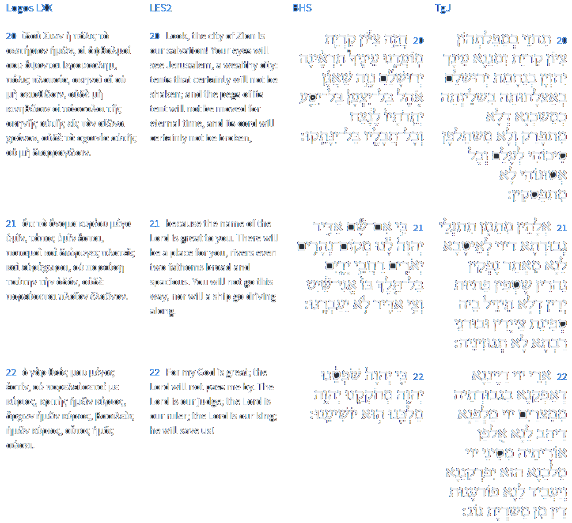
Isaiah 33:20-22
Isaiah / ישעיה
http://www.matsati.com

Slide 11
Hebrews 11:9–16
11:9 By faith he sojourned in the land of promise, as in a strange country, dwelling in tabernacles with Isaac and Jacob, the heirs with him of the same promise: 11:10 For he looked for a city which hath foundations, whose builder and maker is God. 11:11 Through faith also Sara herself received strength to conceive seed, and was delivered of a child when she was past age, because she judged him faithful who had promised. 11:12 Therefore sprang there even of one, and him as good as dead, so many as the stars of the sky in multitude, and as the sand which is by the sea shore innumerable. 11:13 These all died in faith, not having received the promises, but having seen them afar off, and were persuaded of them, and embraced them, and confessed that they were strangers and pilgrims on the earth. 11:14 For they that say such things declare plainly that they seek a country. 11:15 And truly, if they had been mindful of that country from whence they came out, they might have had opportunity to have returned. 11:16 But now they desire a better country, that is, an heavenly: wherefore God is not ashamed to be called their God: for he hath prepared for them a city. (KJV)
Isaiah / ישעיה
http://www.matsati.com

Slide 12
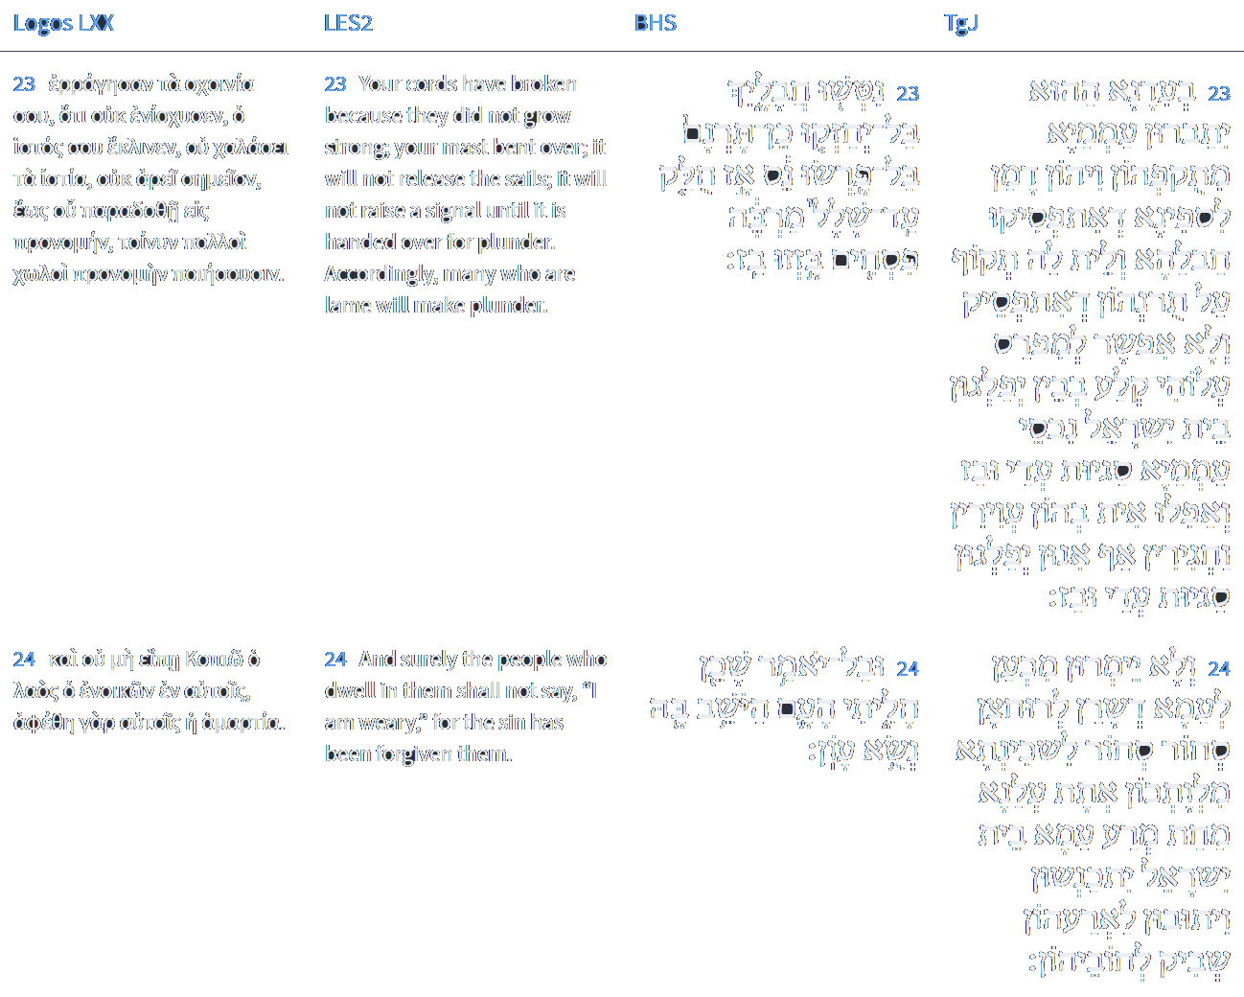
Isaiah 33:23-24
Isaiah / ישעיה
http://www.matsati.com

Slide 13
Isaiah 4:3–4
4:3 And it shall come to pass, that he that is left in Zion, And he that remaineth in Jerusalem, Shall be called holy, Even every one that is written among the living in Jerusalem: 4:4 When the Lord shall have washed away the filth of the daughters of Zion, And shall have purged the blood of Jerusalem from the midst thereof By the spirit of judgment, and by the spirit of burning. (KJV וְהָיָ֣ה׀ הַנִּשְׁאָ֣ר בְּצִיֹּ֗ון וְהַנֹּותָר֙ בִּיר֣וּשָׁלִַ֔ם קָדֹ֖ושׁ יֵאָ֣מֶר לֹ֑ו כָּל־הַכָּת֥וּב לַחַיִּ֖ים בִּירוּשָׁלִָֽם׃ אִ֣ם׀ רָחַ֣ץ אֲדֹנָ֗י אֵ֚ת צֹאַ֣ת בְּנֹות־צִיֹּ֔ון וְאֶת־דְּמֵ֥י יְרוּשָׁלִַ֖ם יָדִ֣יחַ מִקִּרְבָּ֑הּ בְּר֥וּחַ מִשְׁפָּ֖ט וּבְר֥וּחַ בָּעֵֽר׃)
Isaiah / ישעיה
http://www.matsati.com

Slide 14
Rabbinic Literature
ספרות רבנית
Part 3
Isaiah / ישעיה
http://www.matsati.com

Slide 15
Targum Jonathan son of Uziel Isaiah 33:19-24
33:19 Thou shalt not be able to see the government of a mighty people, whose language is so unintelligible that thou canst not understand it, whose tongue stammereth, because there is no understanding in them. 33:20 O Zion, thou shalt see their fall; O city of our festivals, thine eyes shall see the consolation of Jerusalem in her prosperity and security, like a tabernacle that is not taken down, and whose pegs are not drawn out for ever, and whose cords shall not be broken. 33:21 Yea, surely from thence the power of the Lord shall be revealed, to do good unto us from the place whence overflowing rivers of broad span shall flow, through which shall not pass the fishermen’s boat, nor the large pinnace go through it. 33:22 For the Lord is our judge, who by His power brought us out of Egypt; the Lord, who is our teacher, who gave us the doctrine of the law from Sinai; the Lord is our king, He will redeem us, and execute for us vengeance of judgment on the host of Gog. 33:23 At that time the people shall be bereft of their strength, and shall be like a ship, whose ropes are broken; neither shall there be strength in their mast, which is cut down, so that it is not possible to spread a sail upon it; then shall the house of Israel divide the treasures of the people, the abundance of spoil and prey; and although the blind and the lame are left among them, they also shall divide the abundance of spoil and prey. 33:24 Henceforth they shall not say to the people which dwell round about them, I shall return to the Shekinah. (From you is come upon us the evil plague.) The people, the house of Israel, shall be gathered together, and they shall return to their land, their sins being forgiven. (TgJ)
Isaiah / ישעיה
http://www.matsati.com

Slide 16
Rashi on Isaiah 33:19 Parts 1-4
את עם נועז. כמו לועז אלו אשור ובבל שאין לשונם לשון הקודש:
A people of a strange tongue (נוֹעָז) like לוֹעֵז. These are all the heathens, whose language is not the holy tongue. ([Other editions read:] These are Assyria and Babylon, whose language is not the holy tongue.) ([Manuscripts read:] These are all the nations whose language is not the holy tongue.)
לא תראה. לא תחשוב בלבך כי כולם יהיו חשכים ושפלים:
you shall not see You shall not esteem in your heart, for they shall all be dark and humble.
עמקו שפה. כמו ויהי כל הארץ שפה אחת (בראשית י״א:א׳):
speech... obscure (שָׂפָה, lit. lip.) Comp. (Gen. 11:1) “And all the land was one speech (שָׂפָה).”
נלעג לשון. עגלים, ועמקי שפה (לעיל כג) כל זה לשון נכרית שאינן מכירין בלשון הקודש:
of stammering tongue (נִלְעָג לָשׁוֹן). Comp. (32:4) “The tongue of the stammerers (לְשׁוֹן עִלְּגִים),” ( and of obscure speech. All this is a foreign language, for they do not understand the holy tongue.)
Isaiah / ישעיה
http://www.matsati.com

Slide 17
ספר דברים פרק יב
ל הִשָּׁמֶר לְךָ פֶּן-תִּנָּקֵשׁ אַחֲרֵיהֶם אַחֲרֵי הִשָּׁמְדָם מִפָּנֶיךָ וּפֶן-תִּדְרשׁ לֵאלֹהֵיהֶם לֵאמֹר אֵיכָה יַעַבְדוּ הַגּוֹיִם הָאֵלֶּה אֶת-אֱלֹהֵיהֶם וְאֶעֱשֶֹה-כֵּן גַּם-אָנִי: לא לֹא-תַעֲשֶֹה כֵן לַיהוָֹה אֱלֹהֶיךָ כִּי כָל-תּוֹעֲבַת יְהֹוָה אֲשֶׁר שָֹנֵא עָשֹוּ לֵאלֹהֵיהֶם כִּי גַם אֶת-בְּנֵיהֶם וְאֶת-בְּנֹתֵיהֶם יִשְֹרְפוּ בָאֵשׁ לֵאלֹהֵיהֶם:
﻿ספר דברים פרק יג
א אֵת כָּל-הַדָּבָר אֲשֶׁר אָנֹכִי מְצַוֶּה אֶתְכֶם אֹתוֹ תִשְׁמְרוּ לַעֲשֹוֹת לֹא-תֹסֵף עָלָיו וְלֹא תִגְרַע מִמֶּנּוּ:
Devarim / Deuteronomy 12:30–32
12:30 Take heed to thyself that thou be not snared by following them, after that they be destroyed from before thee; and that thou inquire not after their gods, saying, How did these nations serve their gods? even so will I do likewise. 12:31 Thou shalt not do so unto the LORD thy God: for every abomination to the LORD, which he hateth, have they done unto their gods; for even their sons and their daughters they have burnt in the fire to their gods. 12:32 What thing soever I command you, observe to do it: thou shalt not add thereto, nor diminish from it. (KJV)
Isaiah / ישעיה
http://www.matsati.com

Slide 18
Ephesians 2:14–16
2:14 For he is our peace, who hath made both one, and hath broken down the middle wall of partition between us; 2:15 Having abolished in his flesh the enmity, even the law of commandments contained in ordinances; for to make in himself of twain one new man, so making peace; 2:16 And that he might reconcile both unto God in one body by the cross, having slain the enmity thereby: (KJV 14 Αὐτὸς γάρ ἐστιν ἡ εἰρήνη ἡμῶν,* ὁ ποιήσας τὰ ἀμφότερα ἓν καὶ τὸ μεσότοιχον τοῦ φραγμοῦ λύσας,* τὴν ἔχθραν ἐν τῇ σαρκὶ αὐτοῦ,* 15 τὸν νόμον τῶν ἐντολῶν ⸋ἐν δόγμασιν⸌ καταργήσας,* ἵνα τοὺς δύο κτίσῃ ἐν ⸀αὐτῷ εἰς ἕνα ⸁καινὸν ἄνθρωπον ποιῶν εἰρήνην 16 καὶ ἀποκαταλλάξῃ τοὺς ἀμφοτέρους ἐν ἑνὶ σώματι τῷ θεῷ διὰ τοῦ σταυροῦ,* ἀποκτείνας τὴν ἔχθραν ἐν ⸀αὐτῷ.*)
Isaiah / ישעיה
http://www.matsati.com

Slide 19
Rashi on Isaiah 33:21 Parts 1-3
כי אם שם. כי אם מוסב על בל יסע יתדותיו ועל בל ינתקו, הרעה לא תהיה כי אם הטובה ה' יהיה שם אדיר לנו והעיר תהיה מקום נהרים יאורים כענין שנא' (ביחזקאל ד) וימד אלף ויעבירני נחל אשר לא אוכל לעבור וכן ניבא יואל ומעין מבית ה' יצא (יואל ד יח) והוא הנחל שיהא מתגבר והולך:
But there ‘But’ refers back to ‘whose pegs shall never be moved,’ and ‘shall not be torn.’ The evil shall not be, only the good. There the Lord shall be mighty for us, and the city shall be a place of rivers and streams, in the manner it is said in Ezekiel (47:4f.): “And He measured a thousand (cubits), and He led me...a stream that I could not cross.” And so did Joel prophesy (4:18) “And a spring shall emanate from the house of the Lord,” that it shall become progressively stronger.
אני שיט. אניה השטה במים:
a galley with oars a ship that floats on the water.
וצי אדיר. ובורני רבתא:
and a great ship (וְצִי אַדִּיר) and a great ship [from Jonathan].
Isaiah / ישעיה
http://www.matsati.com

Slide 20
Mei HaShiloach, Volume I, Deuteronomy, Shoftim 5
“Judges and officers shall you appoint for yourselves in all your gates .…” (Devarim, 16:18)
This is as it is written (Yeshayahu, 33:22), “God is our judge, God is our lawgiver, God is our king, He will redeem us.” “God is our judge,” this is what God illuminates man’s intellect to understand which path would most benefit him to follow. Even though at the beginning his heart is not drawn after God’s will, anyhow God shines His light into him and he will understand in his intellect, and this is “God is our judge.” “God is our lawgiver” means that God carves the desire into the heart of man. Then he begins to ask for advice on how to conduct himself according to the Torah, for he understands that there is no other path before him, even seeing that in this world no path would benefit him save the way of the Torah. “God is our king” means that God conducts the will of man according to His will, may it be blessed, even without man realizing it. When one first enters into the Torah it seems to him that he does so in order to attain an understanding of the sublime. Then afterwards he realizes that without the Torah he may not even reconcile the most simple matters. “He will redeem us,” means that in the end God will show man that all the ways He dealt with him were only for his good. He shows him that man did not remove himself from God’s will even when he acted without thinking, for God will immediately rule over all the powers that are not in the control of man, like sight and hearing. On this it is said (Bamidbar, 23:22), “He has the power of the horned beast,” meaning, God alone will control the powers that are beyond the control of man.
Isaiah / ישעיה
http://www.matsati.com

Slide 21
Devarim Rabbah 5:11
Alternatively: (Deuteronomy 17:14) "And you will say, 'I will appoint for me a king..." - Our rabbis said: Said the Holy One, blessed be He, "You want kings in this world. Jewish kings will be appointed, and they will make you fall by the sword." Shaul caused them to fall at Mt. HaGilboa. How do we know? (I Samuel 4:17) "And Israel fled from before the Philistines..." David caused a plague to be sent, as it says, (II Samuel 24:15) "And God sent a pestilence to Israel..." Achav stopped up the rains from them, as it says (I Kings 17:1) "...there shall not be dew nor rain these years..." Tzidkiyahu caused the destruction of the Holy Temple. Once Israel saw what happens under the rule of their kings, they all began to cry out, "We don't want a king of Israel! We want our first King: (Isaiah 33:22) "For God is our judge, God is our law-giver, God is our king, He will save us!" The Holy One, blessed be He, said to them, "By your lives, thus will I do." How do we know? As it says, (Zachariah 14:9) "And God will be the king over all the earth..."
Isaiah / ישעיה
http://www.matsati.com

Slide 22
Rashi on Isaiah 33:23 Parts 1-7
נטשו חבליך. המושכים את הספינה את רומי החייבת:
Your ropes that draw the ship, you sinful city. ([Mss. yield:] you, sinful Rome.)
כן. הכן היטב:
properly prepared well.
תרנם. תורן הספינה:
a sail Heb. נס, the sail of a ship.
בל פרשו נס. לא יוכלו לפרוס וילון המנהיג את הספינה:
they did not spread out a sail They will not be able to spread the sail that guides the boat.
אז חולק עד שלל. עדאה:
then plunder [and] booty were divided (עד) related to עֲדָאָה, plunder, in Aramaic.
מרבה. הרבה יחלקו שלל סנחריב:
by many Many will divide the plunder of the heathens. ([Mss. yield:] the plunder of Edom.) ([Others:] the nations.) ([Still others:] Sennacherib.)
פסחים. (ישראל) שהיו עד עכשיו חלשים:
lame Israel, who were weak until now.
Isaiah / ישעיה
http://www.matsati.com

Slide 23
Hebrews 8:9–13
8:9 Not according to the covenant that I made with their fathers in the day when I took them by the hand to lead them out of the land of Egypt; because they continued not in my covenant, and I regarded them not, saith the Lord. 8:10 For this is the covenant that I will make with the house of Israel after those days, saith the Lord; I will put my laws into their mind, and write them in their hearts: and I will be to them a God, and they shall be to me a people: 8:11 And they shall not teach every man his neighbour, and every man his brother, saying, Know the Lord: for all shall know me, from the least to the greatest. 8:12 For I will be merciful to their unrighteousness, and their sins and their iniquities will I remember no more. 8:13 In that he saith, A new covenant, he hath made the first old. Now that which decayeth and waxeth old is ready to vanish away. (KJV )
Isaiah / ישעיה
http://www.matsati.com

