Slide 1
MATSATI.COM Teaching Ministry
Website: https://www.matsati.com YouTube Channel: https://www.youtube.com/user/MATSATI/
ישעיהו לג:א-ו / Isaiah 33:1-6
LIVE STREAM: 6:30 pm EST Thursday
Join us at Telegram:
https://t.me/MessianicChat
Rabbi Jeremiah
– Hebrew Language Labs: FREE
– Weekly Torah Portion: Triennial cycle
A Community
for Learning
Weekly Teachings Free Online
Check Telegram for weekly scheduling of teachings.
YouTube Channels
https://YouTube.com/c/HebrewLiteracy
https://www.youtube.com/channel/UC5_qPfruat-sCJJypz0_OBw
Discuss the Scriptures,
learn the languages,
and fellowship
Join Telegram ask about Hebrew and Greek classes!

Slide 2
Isaiah 33:1-6
ישעיהו לג:א-ו
Isaiah / ישעיה
http://www.matsati.com

Slide 3
מביא לספר של ישעיהו
Part 1
Isaiah / ישעיה
http://www.matsati.com

Slide 4
ספר מלכים ב פרק יח
יג וּבְאַרְבַּע עֶשְֹרֵה שָׁנָה לַמֶּלֶךְ חִזְקִיָּה עָלָה סַנְחֵרִיב מֶלֶךְ-אַשּׁוּר עַל כָּל-עָרֵי יְהוּדָה הַבְּצֻרוֹת וַיִּתְפְּשֵֹם: יד וַיִּשְׁלַח חִזְקִיָּה מֶלֶךְ-יְהוּדָה אֶל-מֶלֶךְ-אַשּׁוּר | לָכִישָׁה | לֵאמֹר | חָטָאתִי שׁוּב מֵעָלַי אֵת אֲשֶׁר-תִּתֵּן עָלַי אֶשָּׂא וַיָּשֶֹם מֶלֶךְ-אַשּׁוּר עַל-חִזְקִיָּה מֶלֶךְ-יְהוּדָה שְׁלֹשׁ מֵאוֹת כִּכַּר-כֶּסֶף וּשְׁלֹשִׁים כִּכַּר זָהָב: טו וַיִּתֵּן חִזְקִיָּה אֶת-כָּל-הַכֶּסֶף הַנִּמְצָא בֵית-יְהֹוָה וּבְאוֹצְרוֹת בֵּית הַמֶּלֶךְ: טז בָּעֵת הַהִיא קִצַּץ חִזְקִיָּה אֶת-דַּלְתוֹת הֵיכַל יְהֹוָה וְאֶת-הָאֹמְנוֹת אֲשֶׁר צִפָּה חִזְקִיָּה מֶלֶךְ יְהוּדָה וַיִּתְּנֵם לְמֶלֶךְ אַשּׁוּר:
Isaiah / ישעיה
http://www.matsati.com

Slide 5
Romans 1:1–7
1:1 PAUL, a servant of Jesus Christ, called to be an apostle, separated unto the gospel of God, 1:2 (Which he had promised afore by his prophets in the holy scriptures,) 1:3 Concerning his Son Jesus Christ our Lord, which was made of the seed of David according to the flesh; 1:4 And declared to be the Son of God with power, according to the spirit of holiness, by the resurrection from the dead: 1:5 By whom we have received grace and apostleship, for obedience to the faith among all nations, for his name: 1:6 Among whom are ye also the called of Jesus Christ: 1:7 To all that be in Rome, beloved of God, called to be saints: Grace to you and peace from God our Father, and the Lord Jesus Christ. (KJV, 1 Παῦλος δοῦλος ⸉Χριστοῦ Ἰησοῦ⸊, κλητὸς ἀπόστολος ἀφωρισμένος εἰς εὐαγγέλιον θεοῦ*, 2 ὃ προεπηγγείλατο διὰ τῶν προφητῶν αὐτοῦ ἐν γραφαῖς ἁγίαις 3 περὶ τοῦ υἱοῦ αὐτοῦ τοῦ γενομένου ἐκ σπέρματος Δαυὶδ κατὰ σάρκα*, 4 τοῦ ὁρισθέντος υἱοῦ θεοῦ ἐν δυνάμει κατὰ πνεῦμα ἁγιωσύνης ἐξ ἀναστάσεως νεκρῶν*, Ἰησοῦ Χριστοῦ τοῦ κυρίου ἡμῶν*, 5 διʼ* οὗ ἐλάβομεν χάριν καὶ ἀποστολὴν εἰς ὑπακοὴν πίστεως ἐν πᾶσιν τοῖς ἔθνεσιν ὑπὲρ τοῦ ὀνόματος αὐτοῦ*, 6 ἐν οἷς ἐστε καὶ ὑμεῖς κλητοὶ Ἰησοῦ Χριστοῦ, 7 πᾶσιν τοῖς οὖσιν* ⸋ἐν Ῥώμῃ⸌ ⸂ἀγαπητοῖς θεοῦ⸃, κλητοῖς ἁγίοις, χάρις ὑμῖν καὶ εἰρήνη ἀπὸ θεοῦ πατρὸς ἡμῶν καὶ κυρίου Ἰησοῦ Χριστοῦ*.)
Isaiah / ישעיה
http://www.matsati.com

Slide 6
ספר דברים פרק כח
﻿א וְהָיָה אִם-שָׁמוֹעַ תִּשְׁמַע בְּקוֹל יְהוָֹה אֱלֹהֶיךָ לִשְׁמֹר לַעֲשֹוֹת אֶת-כָּל-מִצְוֹתָיו אֲשֶׁר אָנֹכִי מְצַוְּךָ הַיּוֹם וּנְתָנְךָ יְהוָֹה אֱלֹהֶיךָ עֶלְיוֹן עַל כָּל-גּוֹיֵי הָאָרֶץ: ב וּבָאוּ עָלֶיךָ כָּל-הַבְּרָכוֹת הָאֵלֶּה וְהִשִּׂיגֻךָ כִּי תִשְׁמַע בְּקוֹל יְהוָֹה אֱלֹהֶיךָ:
Devarim / Deuteronomy 28:1–2
28:1 And it shall come to pass, if thou shalt hearken diligently unto the voice of the LORD thy God, to observe and to do all his commandments which I command thee this day, that the LORD thy God will set thee on high above all nations of the earth: 28:2 And all these blessings shall come on thee, and overtake thee, if thou shalt hearken unto the voice of the LORD thy God. (KJV)
Isaiah / ישעיה
http://www.matsati.com

Slide 7
Process of Mercy that Leads to Change
(i) COMMUNICATION: Listening to God
(ii) COMPREHENSION: Understanding what God says
(iii) CONFIDENCE: Trusting in what God says
(iv) CHANGE: Being transformed by what God says
Isaiah / ישעיה
http://www.matsati.com

Slide 8
Romans 1:18–25
1:18 For the wrath of God is revealed from heaven against all ungodliness and unrighteousness of men, who hold the truth in unrighteousness; 1:19 Because that which may be known of God is manifest in them; for God hath shewed it unto them. 1:20 For the invisible things of him from the creation of the world are clearly seen, being understood by the things that are made, even his eternal power and Godhead; so that they are without excuse: 1:21 Because that, when they knew God, they glorified him not as God, neither were thankful; but became vain in their imaginations, and their foolish heart was darkened. 1:22 Professing themselves to be wise, they became fools, 1:23 And changed the glory of the uncorruptible God into an image made like to corruptible man, and to birds, and fourfooted beasts, and creeping things. 1:24 Wherefore God also gave them up to uncleanness through the lusts of their own hearts, to dishonour their own bodies between themselves: 1:25 Who changed the truth of God into a lie, and worshipped and served the creature more than the Creator, who is blessed for ever. Amen. (KJV)
Isaiah / ישעיה
http://www.matsati.com

Slide 9
Romans 1:26–32
1:26 For this cause God gave them up unto vile affections: for even their women did change the natural use into that which is against nature: 1:27 And likewise also the men, leaving the natural use of the woman, burned in their lust one toward another; men with men working that which is unseemly, and receiving in themselves that recompence of their error which was meet. 1:28 And even as they did not like to retain God in their knowledge, God gave them over to a reprobate mind, to do those things which are not convenient; 1:29 Being filled with all unrighteousness, fornication, wickedness, covetousness, maliciousness; full of envy, murder, debate, deceit, malignity; whisperers, 1:30 Backbiters, haters of God, despiteful, proud, boasters, inventors of evil things, disobedient to parents, 1:31 Without understanding, covenant breakers, without natural affection, implacable, unmerciful: 1:32 Who knowing the judgment of God, that they which commit such things are worthy of death, not only do the same, but have pleasure in them that do them. (KJV)
Isaiah / ישעיה
http://www.matsati.com

Slide 10
ספר ישעיה
Part 2
Isaiah / ישעיה
http://www.matsati.com

Slide 11
﻿ספר ישעיה פרק לג
﻿ ﻿א הוֹי שׁוֹדֵד וְאַתָּה לֹא שָׁדוּד וּבוֹגֵד וְלֹא-בָגְדוּ בוֹ כַּהֲתִמְךָ שׁוֹדֵד תּוּשַּׁד כַּנְּלֹתְךָ לִבְגֹּד יִבְגְּדוּ-בָךְ: ב יְהֹוָה חָנֵּנוּ לְךָ קִוִּינוּ הֱיֵה זְרֹעָם לַבְּקָרִים אַף-יְשׁוּעָתֵנוּ בְּעֵת צָרָה: ג מִקּוֹל הָמוֹן נָדְדוּ עַמִּים מֵרוֹמְמֻתֶךָ נָפְצוּ גּוֹיִם: ד וְאֻסַּף שְׁלַלְכֶם אֹסֶף הֶחָסִיל כְּמַשַּׁק גֵּבִים שֹׁקֵק בּוֹ: ה נִשְֹגָּב יְהֹוָה כִּי שֹׁכֵן מָרוֹם מִלֵּא צִיּוֹן מִשְׁפָּט וּצְדָקָה: ו וְהָיָה אֱמוּנַת עִתֶּיךָ חֹסֶן יְשׁוּעֹת חָכְמַת וָדָעַת יִרְאַת יְהֹוָה הִיא אוֹצָרוֹ:
Isaiah / ישעיה
http://www.matsati.com

Slide 12
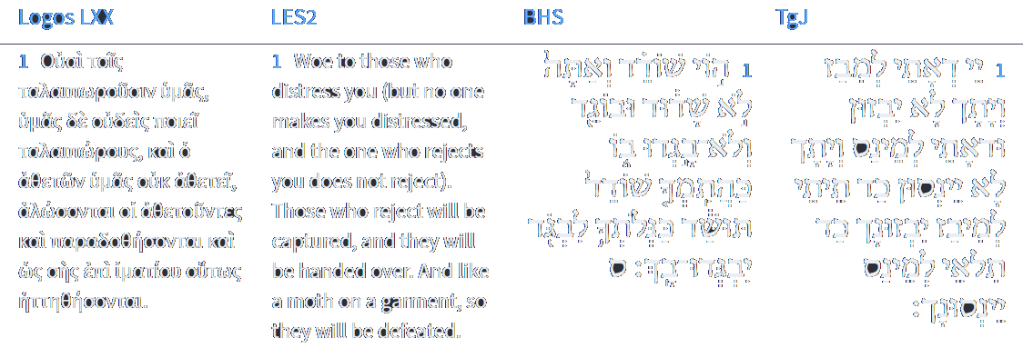
Isaiah 33:1
Isaiah / ישעיה
http://www.matsati.com

Slide 13
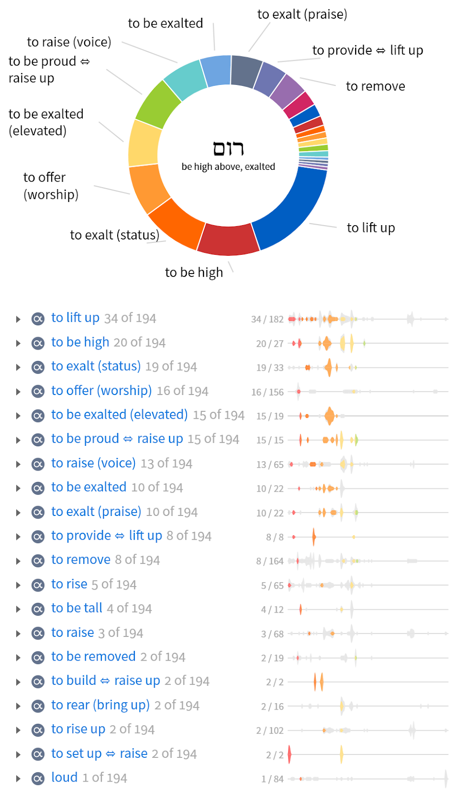
Various ways this word is used:
to lift up
to be high
to exalt
to offer worship
to raise one's voice
to build
to rise up
to rear (bring up)
loud
Isaiah / ישעיה
http://www.matsati.com

Slide 14
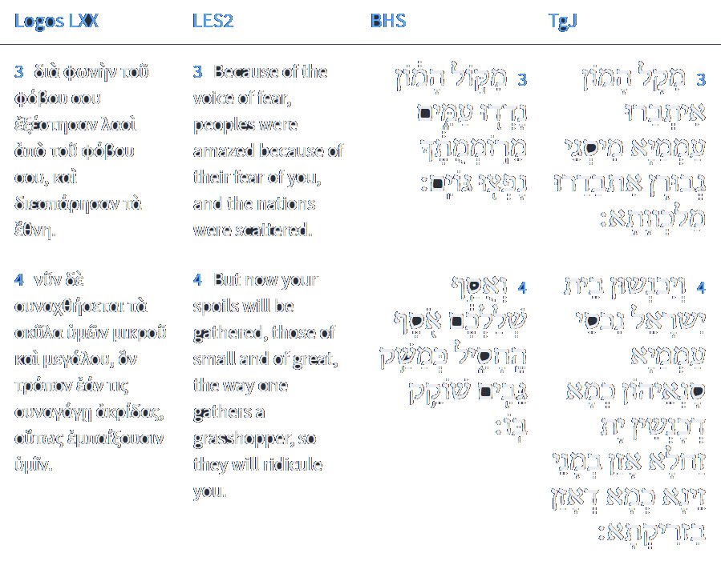
Isaiah 33:3-4
Isaiah / ישעיה
http://www.matsati.com

Slide 15
this will be the faithfulness / reliability in your time → וְהָיָה אֱמוּנַת עִתֶּיךָ
store / wealth of salvation →
חֹסֶן יְשׁוּעֹת
wisdom →
חָכְמַת
knowledge →
וָדָעַת
fear of the Lord →
יִרְאַת יְהֹוָה
His treasure / store →
הִיא אוֹצָרוֹ
Isaiah / ישעיה
http://www.matsati.com

Slide 16
1 John 2:14–17
2:14 I have written unto you, fathers, because ye have known him that is from the beginning. I have written unto you, young men, because ye are strong, and the word of God abideth in you, and ye have overcome the wicked one. 2:15 Love not the world, neither the things that are in the world. If any man love the world, the love of the Father is not in him. 2:16 For all that is in the world, the lust of the flesh, and the lust of the eyes, and the pride of life, is not of the Father, but is of the world. 2:17 And the world passeth away, and the lust thereof: but he that doeth the will of God abideth for ever. (KJV 14 ⸀ἔγραψα ὑμῖν,* παιδία, ὅτι ἐγνώκατε τὸν πατέρα. ἔγραψα ὑμῖν,* πατέρες, ὅτι ἐγνώκατε ⸁τὸν ἀπʼ ἀρχῆς. ἔγραψα ὑμῖν,* νεανίσκοι, ὅτι ἰσχυροί ἐστε καὶ ὁ λόγος ⸋τοῦ θεοῦ⸌ ἐν ὑμῖν μένει καὶ νενικήκατε τὸν πονηρόν.* 15 Μὴ ἀγαπᾶτε τὸν κόσμον μηδὲ τὰ ἐν °τῷ κόσμῳ.* ἐάν τις ἀγαπᾷ τὸν κόσμον, οὐκ ἔστιν ἡ ἀγάπη τοῦ ⸀πατρὸς ἐν αὐτῷ·* 16 ὅτι πᾶν τὸ ἐν τῷ κόσμῳ, ἡ ἐπιθυμία τῆς σαρκὸς καὶ ἡ ἐπιθυμία τῶν ὀφθαλμῶν καὶ ἡ ἀλαζονεία τοῦ βίου, οὐκ ἔστιν ἐκ τοῦ πατρὸς ἀλλʼ ἐκ τοῦ κόσμου ἐστίν. 17 καὶ ὁ κόσμος παράγεται καὶ ἡ ἐπιθυμία ♦°αὐτοῦ, ὁ δὲ ποιῶν τὸ θέλημα τοῦ θεοῦ μένει εἰς τὸν αἰῶνα.*)
Isaiah / ישעיה
http://www.matsati.com

Slide 17
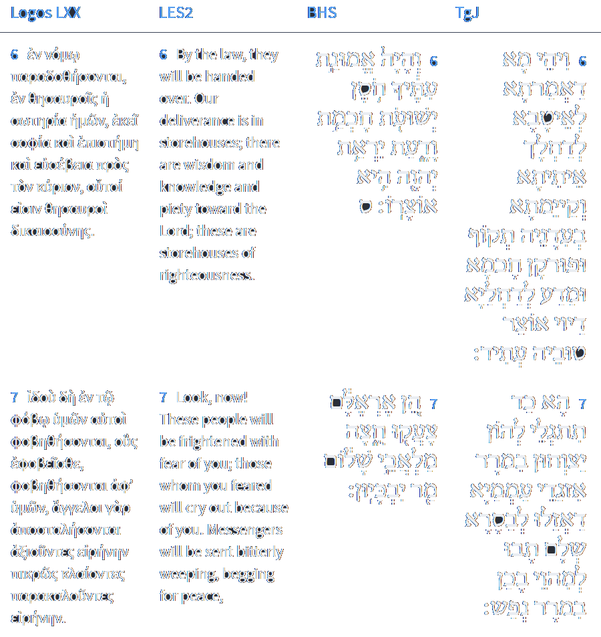
Isaiah 33:3-4
Isaiah / ישעיה
http://www.matsati.com

Slide 18
Rabbinic Literature
ספרות רבנית
Part 1
Isaiah / ישעיה
http://www.matsati.com

Slide 19
Targum Jonathan son of Uziel Isaiah 33:1-6
33:1 Woe to him who is coming to spoil thee, and shall they not spoil thee? And woe to him that is coming to plunder, and shall they not plunder thee? When thou shalt come to spoil, they shall spoil thee, and when thou shalt be weary of plundering, they shall plunder thee. 33:2 O Lord, be merciful unto us; we have hoped for Thy WORD: be Thou our strength every day, our salvation also in the time of distress. 33:3 At the voice of a tumultuous noise the people are afraid, on account of the multitude of mighty actions kingdoms are scattered. 33:4 And the house of Israel shall gather the treasures of the people, their enemies, as they gather the locusts. They shall be armed with the instruments of warfare, as they that are armed with a sling. 33:5 Mighty is the Lord who maketh His Shekinah to dwell in the highest heavens, who hath promised to fill Zion with them that do true justice and righteousness. 33:6 And it shall come to pass, whatever good Thou hast promised to them that fear Thee, Thou wilt bring and establish it in its time: strength and salvation, wisdom and knowledge. For them that fear the Lord, the treasure of His goodness is prepared.
Isaiah / ישעיה
http://www.matsati.com

Slide 20
Rashi on Isaiah 33:1 Parts 1-4
הוי. האויב שאתה שודד תמיד ואתה לא שדוד ובוגד אתה תמיד ואין אדם בוגדך ובוזזך:
Woe To the enemy, that you constantly spoil, but you are not spoiled, and you constantly deal treacherously, but no man deals treacherously with you or spoils you.
כהתימך. להיות שודד ככלותך שדידתך באותם שנגזרה גזרה עליהם להיות שדודים על ידך תושד:
when you finish being a spoiler, when you finish your spoiling of those upon whom it was decreed to be spoiled by you, you shall be spoiled.
כנלותך לבגוד. מנחם חיבר כנלותך עם לא יטה לארץ מנלם בחלק אחד ומנלם המ"ם הראשונה בו יסוד נופל כמו מ"ם של מאמר ושל מדע ויתכן להיות ל' כליון לפי הענין:
when you finish dealing treacherously (כַּנְּלֹתְךָ) Menahem classified כַּנְלֹתְךָ with (Job 15: 29) “And their destruction (מִנְלָם) shall not fall to the earth,” in one group (Machbereth Menahem, p. 123). In the word מִנְלָם, the first ‘mem’ is a radical which sometimes is absent, like the ‘mem’ of מַאֲמָר, a statement, and of מַדָּע, knowledge, and it is possibly an expression of ending, according to the context.
כנלותך. ל' ככלותך ולא יטה לארץ מנלם כליון הנגזר עליהם לא יטה לארץ להיות בטל והולך אלא הולך וחזק:
כַּנְּלֹתְךָ is an expression of ‘when you finish.’ “And מִנְלָם shall not fall to the earth,” the destruction decreed upon them shall not fall to the earth to become progressively void, but will become progressively stronger.
Isaiah / ישעיה
http://www.matsati.com

Slide 21
Sifrei Bamidbar 41:1
(Bamidbar 6:25) "The L-rd cause His countenance to shine upon you": He will give you "light" of the eyes. R. Nathan says: This refers to the light of the Shechinah, as it is written (Isaiah 60:1-2) "Arise, shine, for your Light has come. For the darkness will cover the earth, and a thick mist, the peoples, but upon you the L-rd will shine, and His glory will be seen upon you," (Psalms 67:2) "G-d will favor us and bless us. He will cause His countenance to shine upon us, Selah," (Ibid. 118:27) "… and He shone for us." Variantly: "The L-rd cause His countenance to shine upon you": This refers to the light of Torah, as it is written (Proverbs 6:23) "For a mitzvah is a lamp, and the Torah, light." "and be gracious to you": in (the granting of) your requests, as it is written (Shemot 33:19) "And I shall be gracious to whom I shall be gracious, and I shall be merciful to whom I shall be merciful." Variantly: Let Him grant you grace in the eyes of man, as it is written (Bereshit 39:21) "And He granted him grace in the eyes of the overseer of the prison," and (Esther 2:14) "And Esther found favor in the eyes of all who saw her," and (Daniel 1:9) "And G-d granted Daniel grace and mercy," and (Proverbs 3:4) "You will find favor and goodly wisdom in the eyes of G-d and man." Variantly: "and be gracious to you": with understanding, insight, mussar, and wisdom. Variantly: "and be gracious to you": in Torah study, as it is written (Proverbs 4:9) "It (Torah) will set a chaplet of grace upon your head," and (Ibid. 1:9) "For they (words of Torah) are a chaplet of grace to your head and a necklace to your throat." Variantly: "and be gracious to you": with gifts of "grace," as it is written (Psalms 123:2) "Behold, as the eyes of servants to their masters; as the eyes of a maidservant to the hand of her mistress, so are our eyes to the L-rd our G-d, until He grants us grace," and (Ibid. 3) "Grant us grace, O L-rd, grant us grace, for we are fully sated with contempt, and (Isaiah 33:2) "O L-rd, grant us grace, for in You have we hoped."
Isaiah / ישעיה
http://www.matsati.com

Slide 22
ספר שמות פרק לד
ו וַיַּעֲבֹר יְהוָֹה | עַל-פָּנָיו וַיִּקְרָא יְהוָֹה | יְהֹוָה אֵל רַחוּם וְחַנּוּן אֶרֶךְ אַפַּיִם וְרַב-חֶסֶד וֶאֱמֶת: ז נֹצֵר חֶסֶד לָאֲלָפִים נֹשֵֹא עָוֹן וָפֶשַׁע וְחַטָּאָה וְנַקֵּה לֹא יְנַקֶּה פֹּקֵד | עֲוֹן אָבוֹת עַל-בָּנִים וְעַל-בְּנֵי בָנִים עַל-שִׁלֵּשִׁים וְעַל-רִבֵּעִים:
Shemot / Exodus 34:6-7
34:6 And the LORD passed by before him, and proclaimed, The LORD, The LORD God, merciful and gracious, longsuffering, and abundant in goodness and truth, 34:7 Keeping mercy for thousands, forgiving iniquity and transgression and sin, and that will by no means clear the guilty; visiting the iniquity of the fathers upon the children, and upon the children’s children, unto the third and to the fourth generation. (KJV)
Isaiah / ישעיה
http://www.matsati.com

Slide 23
ספר תהילים פרק פו
טו וְאַתָּה אֲדֹנָי אֵל-רַחוּם וְחַנּוּן אֶרֶךְ אַפַּיִם וְרַב-חֶסֶד וֶאֱמֶת:
Tehillim / Psalm 86:15
86:15 But thou, O Lord, art a God full of compassion, and gracious, Longsuffering, and plenteous in mercy and truth. (KJV)
Isaiah / ישעיה
http://www.matsati.com

Slide 24
Sha'ar HaEmunah VeYesod HaChasidut, Entrance to the Gate of Beit Yaakov 1:2
“The beginning of wisdom is the fear of God.” (Tehillim 111:10) The consciousness called the fear of God is the vessel a person needs to receive the Torah, *On a simple level, “receiving the Torah,” means “observing the commandments”; on a deeper level, it means perceiving the very root of the Torah, which is a revelation of God. as it is written (Yeshayahu 33:6), “The fear of God is His storehouse,” *That is, the fear of God holds and stores something; in this case, the Torah. and, as the first part of this verse says, “He shall be the stability (emunah) of your times.” *The entire verse reads: “He shall be the stability of your times, a store of salvation, wisdom and knowledge, the fear of God is His storehouse” (Yeshayahu, 33:6). The Talmud (BT Shabbat 31a) regards each of the attributes as hinting to another order of the Mishnah: “Stability-Faith” - Zera’im (Seeds); “Your times” – Moed (Festival); “Strength” – Nashim (Women); “Salvation” – Nezikin (Damages); “Wisdom” – Kodoshim (Holy Things) and “knowledge” –Tehorot (Purities). The order of Zera’im deals with the laws of planting, harvesting, tithes, etc. It is alluded to by the word “emunah” (meaning both faith and stability) because a person with faith in God will plant. (See, Tosefot, ibid., who cites the Jerusalem Talmud.) There is a deeper relationship between these two uses of the word, as well. In Judaism, in general, faith is not necessarily an abstract feeling or concept, but a level of stability and unwavering commitment, in the sense of “faithfulness.” “Nevertheless,” says the Talmud, “without the fear of God as a storehouse, one has nothing.” *The last statement, “The fear of God is His storehouse,” does not hint at a particular body of knowledge or tract, but rather to the key ingredient needed in order to preserve the knowledge of all the preceding categories. Without the fear of God, or the intense awareness of God’s conduct of the world, joined with an understanding that God both rewards and punishes, the treasures will be lost. In other words, without the fear of God one cannot truly fulfill the Torah.
Isaiah / ישעיה
http://www.matsati.com

Slide 25
Sha'ar HaEmunah VeYesod HaChasidut, Entrance to the Gate of Beit Yaakov 1:2
The first consideration is faith, *The verse from Yeshayahu begins with a reference to emunah (stability, faith) and ends with a reference to fear of God (the storehouse). This alludes to the author’s statement above, that faith precedes fear, while fear gives context to faith. which is the root of the fear of God, whereas the fear of God is the vessel which holds faith. But what kind of faith are we talking about? It is the kind in which a person believes that God is all-powerful and exalted. On this, the Zohar writes: *Introduction, 11b.“In the beginning God created…” This is the very first commandment, which is called, “Fear of God.” The fear of God is called, “the beginning,” as it is written, “The beginning of wisdom is the fear of God,” and (Mishlei 1:7), “The fear of God is the beginning of knowledge.” It is the gate one must enter in order to arrive at faith. *The reader may notice a contradiction here. Above, R. Gershon Henokh stated that faith preceeds fear of God; here, the Zohar states that fear of God precedes faith. As will become clear below, there are two types of faith: a deep, inner certainty in God’s existence, which leads to fear andn awe of Him, and a higher type of faith, which actually transcends the limited intellect and the duality of this world, which is the result of this type of fear. In this way, the whole world depends on this commandment. There are three aspects to the fear of God. The first two lack a correct foundation, which the third one has. The first kind is when a person fears God in order that He not bring harm upon his children, *In retribution for the father’s own sins. or in order not to personally suffer physical retribution or financial loss. *Such as on account of his transgressions. He fears God constantly for these reasons, yet his fear lacks a foundation. The second kind is when person fears God in order not to suffer punishment in the world-to-come or in Hell. *Gehinom, more accurately translated as purgatory. These two kinds of fear are not true expressions of the fear of God.
Isaiah / ישעיה
http://www.matsati.com

Slide 26
Sha'ar HaEmunah VeYesod HaChasidut, Entrance to the Gate of Beit Yaakov 1:2
The third and true expression is when person fears God solely because He is the Great and Sovereign Ruler of the universe, the root and source of all the worlds, and that everything is considered as nothing before Him, as it is written (Daniel 4:32), “All the inhabitants of the world are considered as naught before Him.” One should place all of his desire on this place which is called “fear.” *Notice how the author, using this passage from the Zohar, has changed the definition of fear. It is no longer centered upon the human being and his concerns, reducing God’s greatness in the process; rather, it opens a person to the absolute transcendence of God and takes him beyond his petty concerns
Isaiah / ישעיה
http://www.matsati.com

Slide 27
Rashi on Isaiah 33:6 Parts 1-2
והיה אמונת עתיך וגו'. והיה לחוסן ישועות ולחכמה ודעת את אשר תאמין לבוראך עתים שקבע לך לתרומות ולמעשרות בעת הפרשתן ללקט שכחה ופיאה בעתם לקיים שמיטין ויובלות בעתם ד"א אמונת עתך. את שהאמנת בהקב"ה בעתים שעברו עליך וצפית לישועה תהיה לך לחוסן:
And the faith of your times, etc. And it shall be for you for strength of salvations and for wisdom and knowledge, that you will be faithful to your Creator concerning the times that He set for you for terumoth and tithes at the time of their separation, for gleanings, forgotten sheaves, and the corner of the field in their time, to leave them over for the poor, to keep release years and jubilee years in their time. Another explanation is: faith of your times What you believed in the Holy One, blessed be He, in times that passed over you, and you hoped for salvation, shall become your strength.
יראת ה'. שתירא מלפניו היא אוצר טוב להפתח לך מאתו על ידה:
fear of the Lord That you shall fear Him - that is a good treasure to open up for you from before Him.
Isaiah / ישעיה
http://www.matsati.com

Slide 28
John 14:11–20
14:11 Believe me that I am in the Father, and the Father in me: or else believe me for the very works’ sake. 14:12 Verily, verily, I say unto you, He that believeth on me, the works that I do shall he do also; and greater works than these shall he do; because I go unto my Father. 14:13 And whatsoever ye shall ask in my name, that will I do, that the Father may be glorified in the Son. 14:14 If ye shall ask any thing in my name, I will do it. 14:15 If ye love me, keep my commandments. 14:16 And I will pray the Father, and he shall give you another Comforter, that he may abide with you for ever; 14:17 Even the Spirit of truth; whom the world cannot receive, because it seeth him not, neither knoweth him: but ye know him; for he dwelleth with you, and shall be in you. 14:18 I will not leave you comfortless: I will come to you. 14:19 Yet a little while, and the world seeth me no more; but ye see me: because I live, ye shall live also. 14:20 At that day ye shall know that I am in my Father, and ye in me, and I in you. (KJV)
Isaiah / ישעיה
http://www.matsati.com

