Slide 1


MATSATI.COM Teaching Ministry
Website: https://www.matsati.com YouTube Channel: https://www.youtube.com/user/MATSATI/
ישעיהו לב:ח-יד / Isaiah 32:8-14
LIVE STREAM: 6:30 pm EST Thursday
Join us at Telegram:
https://t.me/MessianicChat
Rabbi Jeremiah
– Hebrew Language Labs: FREE
– Weekly Torah Portion: Triennial cycle
A Community
for Learning
Weekly Teachings Free Online
Check Telegram for weekly scheduling of teachings.
YouTube Channels
https://YouTube.com/c/HebrewLiteracy
https://www.youtube.com/channel/UC5_qPfruat-sCJJypz0_OBw
Discuss the Scriptures,
learn the languages,
and fellowship
Join Telegram ask about Hebrew and Greek classes!

Slide 2
ספר ישעיהו – מבוא
Part 1
Isaiah / ישעיה
http://www.matsati.com

Slide 3

Isaiah 32:8-14
ישעיהו לב:ח-יד
Isaiah / ישעיה
http://www.matsati.com

Slide 4



ספר תהילים פרק עד
יח זְכָר-זֹאת אוֹיֵב חֵרֵף | יְהֹוָה וְעַם-נָבָל נִאֲצוּ שְׁמֶךָ:
Tehillim / Psalm 74:18
74:18 Remember this, O Lord, how the enemy scoffs, and a foolish people reviles your name. (ESV)
Isaiah / ישעיה
http://www.matsati.com

Slide 5
1 Corinthians 5:7–8
5:7 Purge out therefore the old leaven, that ye may be a new lump, as ye are unleavened. For even Christ our passover is sacrificed for us: 5:8 Therefore let us keep the feast, not with old leaven, neither with the leaven of malice and wickedness; but with the unleavened bread of sincerity and truth. (KJV 7 ἐκκαθάρατε ⸆ τὴν παλαιὰν ζύμην, ἵνα ἦτε νέον φύραμα,* καθώς ἐστε ἄζυμοι· καὶ γὰρ τὸ πάσχα ἡμῶν ⸇ ἐτύθη Χριστός. 8 ὥστε ἑορτάζωμεν μὴ ἐν ζύμῃ παλαιᾷ ⸀μηδὲ ἐν ζύμῃ κακίας καὶ ⸁πονηρίας ἀλλʼ ἐν ἀζύμοις εἰλικρινείας καὶ ἀληθείας.*)
Isaiah / ישעיה
http://www.matsati.com

Slide 6
ספר ישעיהו
Part 2
Isaiah / ישעיה
http://www.matsati.com

Slide 7






﻿ספר ישעיה פרק לב
﻿ח וְנָדִיב נְדִיבוֹת יָעָץ וְהוּא עַל-נְדִיבוֹת יָקוּם: ט נָשִׁים שַׁאֲנַנּוֹת קֹמְנָה שְׁמַעְנָה קוֹלִי בָּנוֹת בֹּטְחוֹת הַאְזֵנָּה אִמְרָתִי: י יָמִים עַל-שָׁנָה תִּרְגַּזְנָה בֹּטְחוֹת כִּי כָּלָה בָצִיר אֹסֶף בְּלִי יָבוֹא: יא חִרְדוּ שַׁאֲנַנּוֹת רְגָזָה בֹּטְחוֹת פְּשֹׁטָה וְעֹרָה וַחֲגוֹרָה עַל-חֲלָצָיִם: יב עַל-שָׁדַיִם סֹפְדִים עַל-שְֹדֵי-חֶמֶד עַל-גֶּפֶן פֹּרִיָּה: יג עַל אַדְמַת עַמִּי קוֹץ שָׁמִיר תַּעֲלֶה כִּי עַל-כָּל-בָּתֵּי מָשֹוֹשֹ קִרְיָה עַלִּיזָה: יד כִּי-אַרְמוֹן נֻטָּשׁ הֲמוֹן עִיר עֻזָּב עֹפֶל וָבַחַן הָיָה בְעַד מְעָרוֹת עַד-עוֹלָם מְשֹוֹשֹ פְּרָאִים מִרְעֵה עֲדָרִים:
Isaiah / ישעיה
http://www.matsati.com

Slide 8
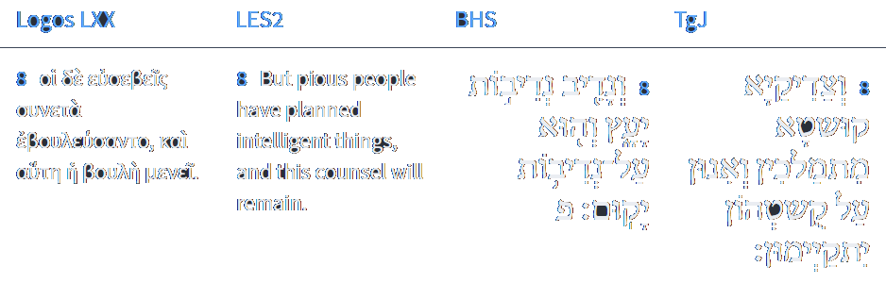


Isaiah 32:8
Isaiah / ישעיה
http://www.matsati.com

Slide 9


ספר שמות פרק יט
א בַּחֹדֶשׁ הַשְּׁלִישִׁי לְצֵאת בְּנֵי-יִשְֹרָאֵל מֵאֶרֶץ מִצְרָיִם בַּיּוֹם הַזֶּה בָּאוּ מִדְבַּר סִינָי: ב וַיִּסְעוּ מֵרְפִידִים וַיָּבֹאוּ מִדְבַּר סִינַי וַיַּחֲנוּ בַּמִּדְבָּר וַיִּחַן-שָׁם יִשְֹרָאֵל נֶגֶד הָהָר: ג וּמֹשֶׁה עָלָה אֶל-הָאֱלֹהִים וַיִּקְרָא אֵלָיו יְהוָֹה מִן-הָהָר לֵאמֹר כֹּה תֹאמַר לְבֵית יַעֲקֹב וְתַגֵּיד לִבְנֵי יִשְֹרָאֵל:
Shemot / Exodus 19:1–3
19:1 In the third month, when the children of Israel were gone forth out of the land of Egypt, the same day came they into the wilderness of Sinai. 19:2 For they were departed from Rephidim, and were come to the desert of Sinai, and had pitched in the wilderness; and there Israel camped before the mount. 19:3 And Moses went up unto God, and the LORD called unto him out of the mountain, saying, Thus shalt thou say to the house of Jacob, and tell the children of Israel; (KJV)
Isaiah / ישעיה
http://www.matsati.com

Slide 10

2 Corinthians 4:16–18
4:16 For which cause we faint not; but though our outward man perish, yet the inward man is renewed day by day. 4:17 For our light affliction, which is but for a moment, worketh for us a far more exceeding and eternal weight of glory; 4:18 While we look not at the things which are seen, but at the things which are not seen: for the things which are seen are temporal; but the things which are not seen are eternal. (KJV 16 Διὸ οὐκ ⸀ἐγκακοῦμεν*, ἀλλʼ εἰ καὶ ὁ ἔξω ἡμῶν ἄνθρωπος διαφθείρεται, ἀλλʼ ὁ ⸂ἔσω ἡμῶν⸃ ἀνακαινοῦται ἡμέρᾳ καὶ ἡμέρᾳ*. 17 τὸ γὰρ παραυτίκα ⸆ ἐλαφρὸν τῆς θλίψεως °ἡμῶν καθʼ ὑπερβολὴν εἰς ὑπερβολὴν αἰώνιον βάρος δόξης κατεργάζεται ἡμῖν*, 18 μὴ σκοπούντων ἡμῶν τὰ βλεπόμενα ἀλλὰ τὰ μὴ βλεπόμενα·* τὰ γὰρ βλεπόμενα πρόσκαιρα, τὰ δὲ μὴ βλεπόμενα αἰώνια.)
Isaiah / ישעיה
http://www.matsati.com

Slide 11
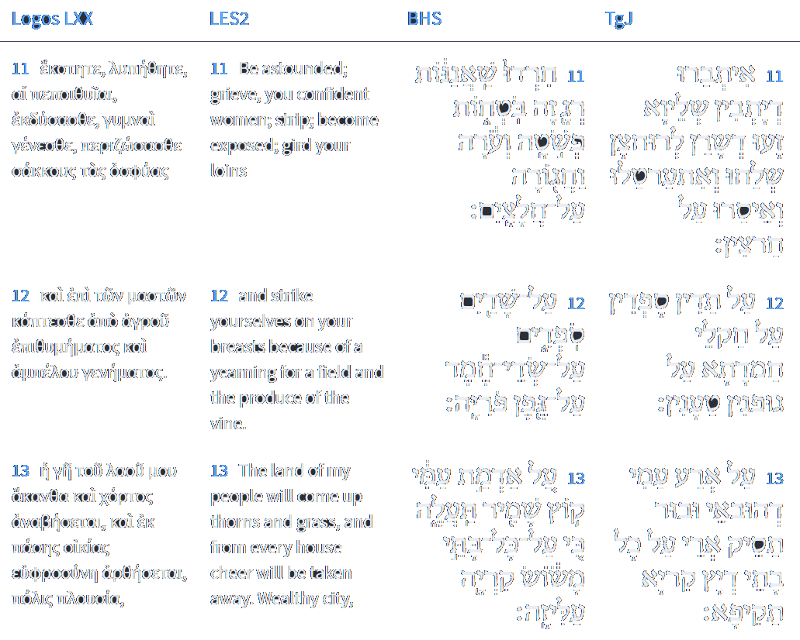






Isaiah 32:8
Isaiah / ישעיה
http://www.matsati.com

Slide 12
ספרות רבנית
Part 3
Isaiah / ישעיה
http://www.matsati.com

Slide 13



Targum Jonathan son of Uziel Isaiah 32:8-14-7
32:8 But the righteous counsel truth, and in their truth they shall be established. 32:9 Ye provinces that dwell at ease: arise, hear my voice. Ye cities that dwell in safety, listen to my word. 32:10 Those who dwell at ease shall be agitated for days and years, because the corn is come to an end, and there is no fruit to gather. 32:11 They that dwell at ease shall be broken, they that dwell in safety shall tremble; strip ye, and make you bare, and gird sackcloth upon your loins. 32:12 They beat the breasts for the pleasant fields, for the fruit-laden vines. 32:13 Upon the land of my people thorns and thistles shall come up, yea, in all the houses of joy in the fortified city. 32:14 For the house of the sanctuary shall be laid waste; the noisy city shall be desolate, in which they worship: the house of our strength and hiding place shall be searched out, dug up, desolate and waste unto a time. The place which was a house of joy and gladness for kings is now become a spoil for armies. TgJ)
Isaiah / ישעיה
http://www.matsati.com

Slide 14
Tanya, Part IV; Iggeret HaKodesh 32:1
THIRTY-TWO. May the L–rd bless their substance, and may the work of their hand be acceptable, *Par. Deuteronomy 33:11. that they may be accepted before the L–rd at all times. *Par. Exodus 28:38. So may the L–rd give and do so yet further to encourage them among the valiant. *Par. Amos 2:16. And he who is noble should ever persist by noble things, *Par. Isaiah 32:8. to be great in causing others to do *See below, note 10. in every city and congregation, *Lit., minyan; see above, Epistle 1, note 55. and it will be accounted to him for righteousness (tzedakah). *Par. Psalms 106:31.
Isaiah / ישעיה
http://www.matsati.com

Slide 15
Romans 3:21–26
3:21 But now the righteousness of God without the law is manifested, being witnessed by the law and the prophets; 3:22 Even the righteousness of God which is by faith of Jesus Christ unto all and upon all them that believe: for there is no difference: 3:23 For all have sinned, and come short of the glory of God; 3:24 Being justified freely by his grace through the redemption that is in Christ Jesus: 3:25 Whom God hath set forth to be a propitiation through faith in his blood, to declare his righteousness for the remission of sins that are past, through the forbearance of God; 3:26 To declare, I say, at this time his righteousness: that he might be just, and the justifier of him which believeth in Jesus. (KJV 21 Νυνὶ δὲ χωρὶς νόμου δικαιοσύνη θεοῦ πεφανέρωται μαρτυρουμένη ὑπὸ τοῦ νόμου καὶ τῶν προφητῶν*, 22 δικαιοσύνη δὲ θεοῦ διὰ πίστεως °Ἰησοῦ Χριστοῦ ⸂εἰς πάντας⸃ τοὺς πιστεύοντας*. οὐ γάρ ἐστιν διαστολή, 23 πάντες γὰρ ἥμαρτον καὶ ὑστεροῦνται τῆς δόξης τοῦ θεοῦ* 24 δικαιούμενοι δωρεὰν τῇ αὐτοῦ χάριτι διὰ τῆς ἀπολυτρώσεως τῆς ἐν Χριστῷ Ἰησοῦ·* 25 ὃν προέθετο ὁ θεὸς ἱλαστήριον ⸂διὰ [τῆς] πίστεως⸃ ἐν τῷ αὐτοῦ αἵματι εἰς ἔνδειξιν τῆς δικαιοσύνης αὐτοῦ διὰ τὴν πάρεσιν τῶν προγεγονότων ἁμαρτημάτων* 26 ἐν τῇ ἀνοχῇ τοῦ θεοῦ, πρὸς τὴν ἔνδειξιν τῆς δικαιοσύνης αὐτοῦ ἐν τῷ νῦν καιρῷ, εἰς τὸ εἶναι αὐτὸν δίκαιον °καὶ δικαιοῦντα τὸν ἐκ πίστεως ⸀Ἰησοῦ.)
Isaiah / ישעיה
http://www.matsati.com

Slide 16


ספר תהילים פרק קו
כח וַיִּצָּמְדוּ לְבַעַל פְּעוֹר וַיֹּאכְלוּ זִבְחֵי מֵתִים: כט וַיַּכְעִיסוּ בְּמַעַלְלֵיהֶם וַתִּפְרָץ-בָּם מַגֵּפָה: ל וַיַּעֲמֹד פִּינְחָס וַיְפַלֵּל וַתֵּעָצַר הַמַּגֵּפָה: לא וַתֵּחָשֶׁב לוֹ לִצְדָקָה לְדֹר וָדֹר עַד-עוֹלָם:
Tehillim / Psalm 106:28–31
106:28 They joined themselves also unto Baal-peor, And ate the sacrifices of the dead. 106:29 Thus they provoked him to anger with their inventions: And the plague brake in upon them. 106:30 Then stood up Phinehas, and executed judgment: And so the plague was stayed. 106:31 And that was counted unto him for righteousness Unto all generations for evermore. (KJV)
Isaiah / ישעיה
http://www.matsati.com

Slide 17

Shenei Luchot HaBerit, Torah Shebikhtav, Ki Teitzei, Torah Ohr 72
Let me explain this subject at greater length: Our sages (Berachot 32b) have said that as of the day the Temple was destroyed the gates of prayer have been locked. We know this from Lamentations 3,8: Even though I cry and plead, He shuts out my prayer." Our portion revolves around this problem. Let me first quote something from the book קול בוכים on Lamentations 5,11: "They have ravished women in Zion." The author comments as follows: We find in the Zohar that the plural "women" which Jeremiah refers to in this verse refers to two specific women, paragons of seduction, i.e. Lilith and Machalat (daughter of Ishmael). Kabbalists write that Lilith is accompanied by 480 groups of destructive agents corresponding to the numerical value of her name לילית. They follow her and indulge in wailing, etc. Machalat is accompanied by 478 groups of destructive agents corresponding to the numerical value of her name מחלת. All these 478 groups follow their mistress dancing and generally making merry. These two women never collide with one another throughout the year; they do not inflict harm on each other though there is constant warfare between them. [their philosophical outlook. Ed.] The only day in the year when they are confrontational is the Day of Atonement. Due to the confrontation these two women and their followers are engaged in on the Day of Atonement they have no time to interfere with our prayers enabling our prayers to rise heavenwards. Usually, whenever a person sins these women are alerted and told "why are you at peace at a time when there sin is about? Arise and destroy the universe!" This is the meaning of Isaiah 3,12: נשים משלו בו, " Women ruled over him" (the people of Israel). I have heard from my teacher that the women referred to in the verse in Isaiah are the wives of the two spies…
Isaiah / ישעיה
http://www.matsati.com

Slide 18
Shenei Luchot HaBerit, Torah Shebikhtav, Ki Teitzei, Torah Ohr 72
… They are the two "spies" of the earth mentioned in the Zohar which are identical with the two male goats used in the service on the Day of Atonement. As soon as Joshua wanted to enter the land of Israel these two "spies" submitted to the authority of Joshua, prostrated themselves before him and offered to be his servants. Joshua expressed his dissatisfaction with this arrangement, insisting that he would only use the services of Pinchas and Caleb as spies to reconnoiter the land of Canaan. However, he asked these two "spies" to spread feelings of demoralization among the inhabitants of the land of Canaan in order to facilitate the conquest of the land by the Jewish people. The "spies" agreed and complied with Joshua's instructions. We can derive all this from the text in the relevant verses in the Book of Joshua. In Joshua 2,3 the spies Joshua sent out are described as having come לחפור את הארץ, " To spy out the land," whereas in actual fact we do not find any word in the whole story about their having performed the mission of spying out the country. The inhabitants simply seem to have melted away much as wax melts in the presence of fire. The spies are reported as having arrived in Jericho by climbing the outer wall of the house of Rachav. They immediately became aware that the whole country was demoralized at the prospect of being invaded by the Israelites. The inhabitants simply had no backbone left. The Talmud Zevachim 116b derives from the statement of Rahav – the city's most prominent harlot – that: ולא קמה עוד רוח באיש מפניכם, " that the men of the country had all become incapable of having an erection due to their fear of the Israelites." Clearly then the two "spies" had performed their task in advance of the arrival of Pinchas and Caleb.
Isaiah / ישעיה
http://www.matsati.com

Slide 19
John 14:13–14
14:13 And whatsoever ye shall ask in my name, that will I do, that the Father may be glorified in the Son. 14:14 If ye shall ask any thing in my name, I will do it. (KJV 13 καὶ ὅ ⸂τι ἂν⸃ ⸀αἰτήσητε ⸆ ἐν τῷ ὀνόματί μου τοῦτο ποιήσω,* ἵνα δοξασθῇ ὁ πατὴρ ἐν τῷ υἱῷ.* 14 ⸋ἐάν τι αἰτήσητέ °με ἐν τῷ ὀνόματί μου ⸀ἐγὼ ποιήσω.⸌)
Isaiah / ישעיה
http://www.matsati.com

Slide 20
Rashi on Isaiah 32,9 Part 1-2
נשים שאננות. מדינן דיתבן שליון: Complacent women Provinces that dwell in tranquility [from Jonathan].
בנות בוטחות. כרכין דיתבין לרוחצן: confident daughters Walled cities that dwell confidently [from Jonathan].
Isaiah / ישעיה
http://www.matsati.com

Slide 21

Rashi on Isaiah 32,10 Part 1-2
ימים על שנה. כמו (לעיל כט) ספו שנה על שנה ותמיד עונותיכם מתגברין וסוף תרגזנה אלו שהן עכשיו לבטח כי יכלה מהם בציר הענבים ואוסף התבואה לא יבוא אל הבית: Year after year (lit., ‘days upon a year.’) Comp. (supra 29:1) “Add year to year,” and your sins are constantly becoming more serious, until eventually you shall be troubled, those who are now confident, for the vintage of the grapes shall be over for them, and the ingathering of the grain shall not come into the house.
אוסף. שם דבר לכך טעמו למעלה ונקוד פתח: the ingathering (אֹסֶף) This is a noun; therefore, its accent is on the first syllable and it is vowelized with a ‘pattah’ (now called a ‘segol’).
Isaiah / ישעיה
http://www.matsati.com

Slide 22
Colossians 1:18–20
1:18 And he is the head of the body, the church: who is the beginning, the firstborn from the dead; that in all things he might have the preeminence. 1:19 For it pleased the Father that in him should all fullness dwell; 1:20 And, having made peace through the blood of his cross, by him to reconcile all things unto himself; by him, I say, whether they be things in earth, or things in heaven. (KJV καὶ αὐτός ἐστιν ἡ κεφαλὴ τοῦ σώματος τῆς ἐκκλησίας· ὅς ἐστιν ἀρχή, πρωτότοκος ἐκ τῶν νεκρῶν, ἵνα γένηται ἐν πᾶσιν αὐτὸς πρωτεύων, ὅτι ἐν αὐτῷ εὐδόκησεν πᾶν τὸ πλήρωμα κατοικῆσαι καὶ διʼ αὐτοῦ ἀποκαταλλάξαι τὰ πάντα εἰς αὐτόν, εἰρηνοποιήσας διὰ τοῦ αἵματος τοῦ σταυροῦ αὐτοῦ, [διʼ αὐτοῦ] εἴτε τὰ ἐπὶ τῆς γῆς εἴτε τὰ ἐν τοῖς οὐρανοῖς.)
Isaiah / ישעיה
http://www.matsati.com

Slide 23
2 Corinthians 5:18–19
5:18 And all things are of God, who hath reconciled us to himself by Jesus Christ, and hath given to us the ministry of reconciliation; 5:19 To wit, that God was in Christ, reconciling the world unto himself, not imputing their trespasses unto them; and hath committed unto us the word of reconciliation. (KJV 18 τὰ δὲ πάντα ἐκ τοῦ θεοῦ τοῦ καταλλάξαντος ἡμᾶς ἑαυτῷ διὰ Χριστοῦ καὶ δόντος ἡμῖν τὴν διακονίαν τῆς καταλλαγῆς*, 19 ὡς ὅτι θεὸς ἦν ἐν Χριστῷ κόσμον καταλλάσσων ἑαυτῷ*, μὴ λογιζόμενος αὐτοῖς τὰ παραπτώματα αὐτῶν καὶ θέμενος ἐν ἡμῖν ⸂τὸν λόγον⸃ τῆς καταλλαγῆς.)
Isaiah / ישעיה
http://www.matsati.com

Slide 24
Rashi on Isaiah 32,14 Parts 1-6
כי ארמון. היכל המלך מלך יהודה נוטש: For the palace The king’s palace has been forsaken.
והמון עיר. גלה: the multitude of the city has been exiled.
עופל ובחן. בית מקדשי שהיה להם למבצר: rampart and tower My Temple, which was a fortification for them.
היה בעד מערות. יהיה בתוך חורבות מערת ל' ערו ערו (תהילים קל״ז:ז׳), ובעד כמו הבעד ערפל ישפוט (איוב כ״ב:י״ג): are amidst ruins (הָיָה בְּעַד מְעָרוֹת), shall be amidst ruins. מְעָרוֹת is an expression similar to (Psalms 137:7) “Raze it, raze it (עָרוּ עָרוּ).” בְּעַד is like “(Job 22:13) Can He judge through (הַבְעַד) a thick cloud?”
עד עולם. עד עת קץ עופל ובחן. שניהם ל' מבצר: forever Until the time of the end.
משוש פראים. לתאות ישמעאל (ולמרעה אדום) ולחיילותיו: a joy for wild donkeys For the lust of Ishmael and his hosts
Isaiah / ישעיה
http://www.matsati.com

Slide 25




ספר שמות פרק טז
ד וַיֹּאמֶר יְהוָֹה אֶל-מֹשֶׁה הִנְנִי מַמְטִיר לָכֶם לֶחֶם מִן-הַשָּׁמָיִם וְיָצָא הָעָם וְלָקְטוּ דְּבַר-יוֹם בְּיוֹמוֹ לְמַעַן אֲנַסֶּנּוּ הֲיֵלֵךְ בְּתוֹרָתִי אִם-לֹא:
Shemot / Exodus 16:4
16:4 Then said the LORD unto Moses, Behold, I will rain bread from heaven for you; and the people shall go out and gather a certain rate every day, that I may prove them, whether they will walk in my law, or no. (KJV)
Isaiah / ישעיה
http://www.matsati.com

