Slide 1
MATSATI.COM Teaching Ministry
Website: https://www.matsati.com YouTube Channel: https://www.youtube.com/user/MATSATI/
ישעיהו לב:א-ז / Isaiah 32:1-7
LIVE STREAM: 6:30 pm EST Thursday
Join us at Telegram:
https://t.me/MessianicChat
Rabbi Jeremiah
– The Apocalypse: connecting the Greek to the Ancient Hebrew text. (Wed. 9 am EST)
A Community
for Learning
Weekly Teachings Free Online
Check Telegram for weekly scheduling of teachings.
YouTube Channels
https://YouTube.com/c/HebrewLiteracy
https://www.youtube.com/channel/UC5_qPfruat-sCJJypz0_OBw
Discuss the Scriptures,
learn the languages,
and fellowship
Join Telegram ask about Hebrew and Greek classes!
Notes:
אַבָּא שֶבְּשָמַיִים, תוֹדֶה לְךָ אֲדוֹנָי עַל רַחֲמֶיךָ. הַלַיְלָה כְּשֶאָנוּ לוֹמְדִים אֶת דבריו שֶל ישעיהו, תַן לאמתך לְהִתְגַלוֹת לָנוּ. עֲזוֹר לָנוּ לְחַיוֹת אֶת חַיֵינוּ עֲבוּרֵךָ וּלְתִפְאַרְתְךָ. בַּשֵם ישוע אָנוּ מִתְפַּלְלִים.

Slide 2
Isaiah 32:1-7
ישעיהו לב:א-ז
Isaiah / ישעיה
http://www.matsati.com
Notes:
אַבָּא שֶבְּשָמַיִים, תוֹדֶה לְךָ אֲדוֹנָי עַל רַחֲמֶיךָ. הַלַיְלָה כְּשֶאָנוּ לוֹמְדִים אֶת דבריו שֶל ישעיהו, תַן לאמתך לְהִתְגַלוֹת לָנוּ. עֲזוֹר לָנוּ לְחַיוֹת אֶת חַיֵינוּ עֲבוּרֵךָ וּלְתִפְאַרְתְךָ. בַּשֵם ישוע אָנוּ מִתְפַּלְלִים.

Slide 3
ספר דברי הימים ב פרק א
א וַיִּתְחַזֵּק שְׁלֹמֹה בֶן-דָּוִיד עַל-מַלְכוּתוֹ וַיהֹוָה אֱלֹהָיו עִמּוֹ וַיְגַדְּלֵהוּ לְמָעְלָה:
2 Chronicles 1:1
1:1 AND Solomon the son of David was strengthened in his kingdom, and the LORD his God was with him, and magnified him exceedingly. (KJV)
Isaiah / ישעיה
http://www.matsati.com

Slide 4
1 Kings 11:1-13
11:1 But king Solomon loved many strange women, together with the daughter of Pharaoh, women of the Moabites, Ammonites, Edomites, Zidonians, and Hittites; 11:2 Of the nations concerning which the LORD said unto the children of Israel, Ye shall not go in to them, neither shall they come in unto you: for surely they will turn away your heart after their gods: Solomon clave unto these in love. 11:3 And he had seven hundred wives, princesses, and three hundred concubines: and his wives turned away his heart. 11:4 For it came to pass, when Solomon was old, that his wives turned away his heart after other gods: and his heart was not perfect with the LORD his God, as was the heart of David his father. 11:5 For Solomon went after Ashtoreth the goddess of the Zidonians, and after Milcom the abomination of the Ammonites. 11:6 And Solomon did evil in the sight of the LORD, and went not fully after the LORD, as did David his father. 11:7 Then did Solomon build an high place for Chemosh, the abomination of Moab, in the hill that is before Jerusalem, and for Molech, the abomination of the children of Ammon. 11:8 And likewise did he for all his strange wives, which burnt incense and sacrificed unto their gods. 11:9 And the LORD was angry with Solomon, because his heart was turned from the LORD God of Israel, which had appeared unto him twice, 11:10 And had commanded him concerning this thing, that he should not go after other gods: but he kept not that which the LORD commanded. 11:11 Wherefore the LORD said unto Solomon, Forasmuch as this is done of thee, and thou hast not kept my covenant and my statutes, which I have commanded thee, I will surely rend the kingdom from thee, and will give it to thy servant. 11:12 Notwithstanding in thy days I will not do it for David thy father’s sake: but I will rend it out of the hand of thy son. 11:13 Howbeit I will not rend away all the kingdom; but will give one tribe to thy son for David my servant’s sake, and for Jerusalem’s sake which I have chosen. (KJV)
Isaiah / ישעיה
http://www.matsati.com

Slide 5
The poor decision making comes via four steps
1. Not taking God’s Word seriously (2 Corinthians 6:14)
2. The heart is captive to something other than God (1 Kings 11:4)
3. The devotion for God is lost (1 Kings 11:4)
4. The desire to commit evil (1 Kings 11:6).
Isaiah / ישעיה
http://www.matsati.com

Slide 6
﻿ספר ישעיה פרק לב
﻿א הֵן לְצֶדֶק יִמְלָךְ-מֶלֶךְ וּלְשָֹרִים לְמִשְׁפָּט יָשֹרוּ: ב וְהָיָה-אִישׁ כְּמַחֲבֵא-רוּחַ וְסֵתֶר זָרֶם כְּפַלְגֵי-מַיִם בְּצָיוֹן כְּצֵל סֶלַע-כָּבֵד בְּאֶרֶץ עֲיֵפָה: ג וְלֹא תִשְׁעֶינָה עֵינֵי רֹאִים וְאָזְנֵי שֹׁמְעִים תִּקְשַׁבְנָה: ד וּלְבַב נִמְהָרִים יָבִין לָדָעַת וּלְשׁוֹן עִלְּגִים תְּמַהֵר לְדַבֵּר צָחוֹת: ה לֹא-יִקָּרֵא עוֹד לְנָבָל נָדִיב וּלְכִילַי לֹא יֵאָמֵר שׁוֹעַ: ו כִּי נָבָל נְבָלָה יְדַבֵּר וְלִבּוֹ יַעֲשֶֹה-אָוֶן לַעֲשֹוֹת חֹנֶף וּלְדַבֵּר אֶל-יְהֹוָה תּוֹעָה לְהָרִיק נֶפֶשׁ רָעֵב וּמַשְׁקֵה צָמֵא יַחְסִיר: ז וְכֵלַי כֵּלָיו רָעִים הוּא זִמּוֹת יָעָץ לְחַבֵּל עֲנִוִּים [עֲנִיִּים] בְּאִמְרֵי-שֶׁקֶר וּבְדַבֵּר אֶבְיוֹן מִשְׁפָּט:
Isaiah / ישעיה
http://www.matsati.com

Slide 7
ספר ישעיה פרק ט
ה כִּי-יֶלֶד יֻלַּד-לָנוּ בֵּן נִתַּן-לָנוּ וַתְּהִי הַמִּשְֹרָה עַל-שִׁכְמוֹ וַיִּקְרָא שְׁמוֹ פֶּלֶא יוֹעֵץ אֵל גִּבּוֹר אֲבִי-עַד שַֹר-שָׁלוֹם: ו לְםַרְבֵּה [לְמַרְבֵּה] הַמִּשְֹרָה וּלְשָׁלוֹם אֵין-קֵץ עַל-כִּסֵּא דָוִד וְעַל-מַמְלַכְתּוֹ לְהָכִין אֹתָהּ וּלְסַעֲדָהּ בְּמִשְׁפָּט וּבִצְדָקָה מֵעַתָּה וְעַד-עוֹלָם קִנְאַת יְהֹוָה צְבָאוֹת תַּעֲשֶֹה-זֹּאת:
Isaiah 9:6–7
9:6 For unto us a child is born, unto us a son is given: And the government shall be upon his shoulder: And his name shall be called Wonderful, Counselor, The mighty God, The everlasting Father, The Prince of Peace. 9:7 Of the increase of his government and peace there shall be no end, Upon the throne of David, and upon his kingdom, To order it, and to establish it with judgment and with justice From henceforth even for ever. The zeal of the LORD of hosts will perform this. (KJV 1900)
Isaiah / ישעיה
http://www.matsati.com

Slide 8
Isaiah 11:1–9
11:1 And there shall come forth a rod out of the stem of Jesse, And a Branch shall grow out of his roots: 11:2 And the spirit of the LORD shall rest upon him, The spirit of wisdom and understanding, The spirit of counsel and might, The spirit of knowledge and of the fear of the LORD; 11:3 And shall make him of quick understanding in the fear of the LORD: And he shall not judge after the sight of his eyes, Neither reprove after the hearing of his ears: 11:4 But with righteousness shall he judge the poor, And reprove with equity for the meek of the earth: And he shall smite the earth with the rod of his mouth, And with the breath of his lips shall he slay the wicked. 11:5 And righteousness shall be the girdle of his loins, And faithfulness the girdle of his reins. 11:6 The wolf also shall dwell with the lamb, And the leopard shall lie down with the kid; And the calf and the young lion and the fatling together; And a little child shall lead them. 11:7 And the cow and the bear shall feed; Their young ones shall lie down together: And the lion shall eat straw like the ox. 11:8 And the sucking child shall play on the hole of the asp, And the weaned child shall put his hand on the cockatrice’ den. 11:9 They shall not hurt nor destroy in all my holy mountain: For the earth shall be full of the knowledge of the LORD, As the waters cover the sea. (KJV 1900)
Isaiah / ישעיה
http://www.matsati.com

Slide 9
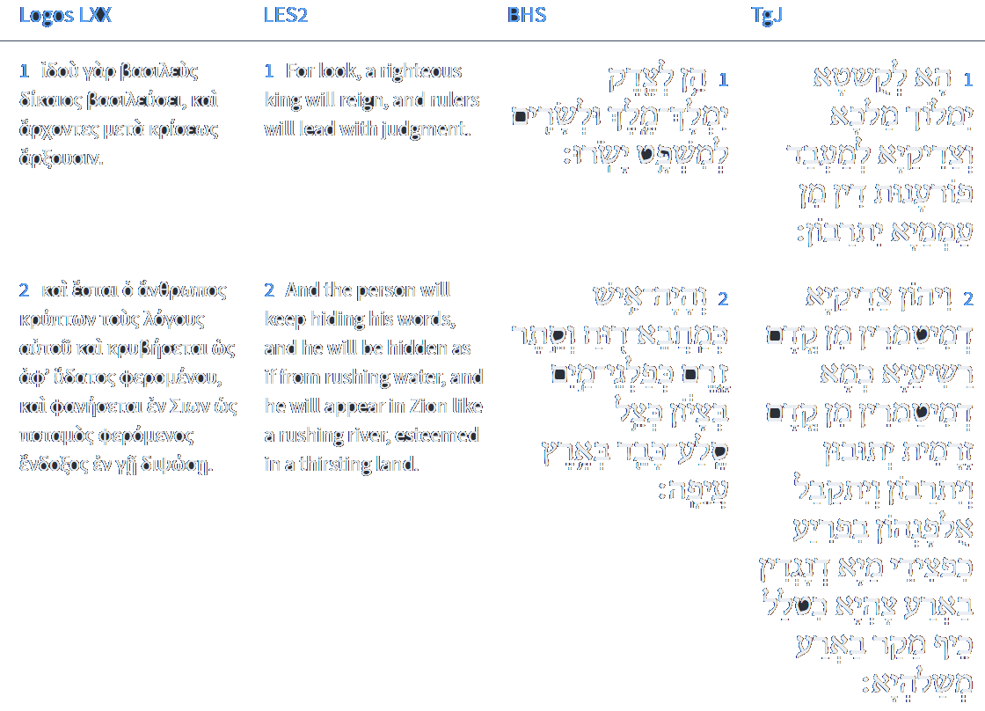
Isaiah 32:1-2
Isaiah / ישעיה
http://www.matsati.com

Slide 10
Mark 4:10–12
4:10 And when he was alone, they that were about him with the twelve asked of him the parable. 4:11 And he said unto them, Unto you it is given to know the mystery of the kingdom of God: but unto them that are without, all these things are done in parables: 4:12 That seeing they may see, and not perceive; and hearing they may hear, and not understand; lest at any time they should be converted, and their sins should be forgiven them. (KJV, Καὶ ὅτε ἐγένετο κατὰ μόνας, ἠρώτων αὐτὸν οἱ περὶ αὐτὸν σὺν τοῖς δώδεκα τὰς παραβολάς. καὶ ἔλεγεν αὐτοῖς· ὑμῖν τὸ μυστήριον δέδοται τῆς βασιλείας τοῦ θεοῦ· ἐκείνοις δὲ τοῖς ἔξω ἐν παραβολαῖς τὰ πάντα γίνεται, ἵνα βλέποντες βλέπωσιν καὶ μὴ ἴδωσιν, καὶ ἀκούοντες ἀκούωσιν καὶ μὴ συνιῶσιν, μήποτε ἐπιστρέψωσιν καὶ ἀφεθῇ αὐτοῖς.)
Isaiah / ישעיה
http://www.matsati.com

Slide 11
Mark 8:14–21
8:14 Now the disciples had forgotten to take bread, neither had they in the ship with them more than one loaf. 8:15 And he charged them, saying, Take heed, beware of the leaven of the Pharisees, and of the leaven of Herod. 8:16 And they reasoned among themselves, saying, It is because we have no bread. 8:17 And when Jesus knew it, he saith unto them, Why reason ye, because ye have no bread? perceive ye not yet, neither understand? have ye your heart yet hardened? 8:18 Having eyes, see ye not? and having ears, hear ye not? and do ye not remember? 8:19 When I brake the five loaves among five thousand, how many baskets full of fragments took ye up? They say unto him, Twelve. 8:20 And when the seven among four thousand, how many baskets full of fragments took ye up? And they said, Seven. 8:21 And he said unto them, How is it that ye do not understand? (KJV)
Isaiah / ישעיה
http://www.matsati.com

Slide 12
ספר דברים פרק כח
﻿סט אֵלֶּה דִבְרֵי הַבְּרִית אֲשֶׁר-צִוָּה יְהוָֹה אֶת-מֹשֶׁה לִכְרֹת אֶת-בְּנֵי יִשְֹרָאֵל בְּאֶרֶץ מוֹאָב מִלְּבַד הַבְּרִית אֲשֶׁר-כָּרַת אִתָּם בְּחֹרֵב: פ
﻿ספר דברים פרק כט
א וַיִּקְרָא מֹשֶׁה אֶל-כָּל-יִשְֹרָאֵל וַיֹּאמֶר אֲלֵהֶם אַתֶּם רְאִיתֶם אֵת כָּל-אֲשֶׁר עָשָֹה יְהוָֹה לְעֵינֵיכֶם בְּאֶרֶץ מִצְרַיִם לְפַרְעֹה וּלְכָל-עֲבָדָיו וּלְכָל-אַרְצוֹ: ב הַמַּסּוֹת הַגְּדֹלֹת אֲשֶׁר רָאוּ עֵינֶיךָ הָאֹתֹת וְהַמֹּפְתִים הַגְּדֹלִים הָהֵם: ג וְלֹא-נָתַן יְהֹוָה לָכֶם לֵב לָדַעַת וְעֵינַיִם לִרְאוֹת וְאָזְנַיִם לִשְׁמֹעַ עַד הַיּוֹם הַזֶּה:
Devarim / Deuteronomy 29:1–4
29:1 These are the words of the covenant, which the LORD commanded Moses to make with the children of Israel in the land of Moab, beside the covenant which he made with them in Horeb. 29:2 And Moses called unto all Israel, and said unto them, Ye have seen all that the LORD did before your eyes in the land of Egypt unto Pharaoh, and unto all his servants, and unto all his land; 29:3 The great temptations which thine eyes have seen, the signs, and those great miracles: 29:4 Yet the LORD hath not given you an heart to perceive, and eyes to see, and ears to hear, unto this day. (KJV)
Isaiah / ישעיה
http://www.matsati.com

Slide 13
ספר ישעיה פרק לב
ה לֹא-יִקָּרֵא עוֹד לְנָבָל נָדִיב וּלְכִילַי לֹא יֵאָמֵר שׁוֹעַ:
לֹא-יִקָּרֵא עוֹד לְנָבָל נָדִיב
וּלְכִילַי לֹא יֵאָמֵר שׁוֹעַ
לְנָבָל ← לְכִילַי
נָדִיב ← שׁוֹעַ
Isaiah / ישעיה
http://www.matsati.com
Notes:
The vile person shall be no more called liberal,
nor the churl said to be bountiful.

Slide 14
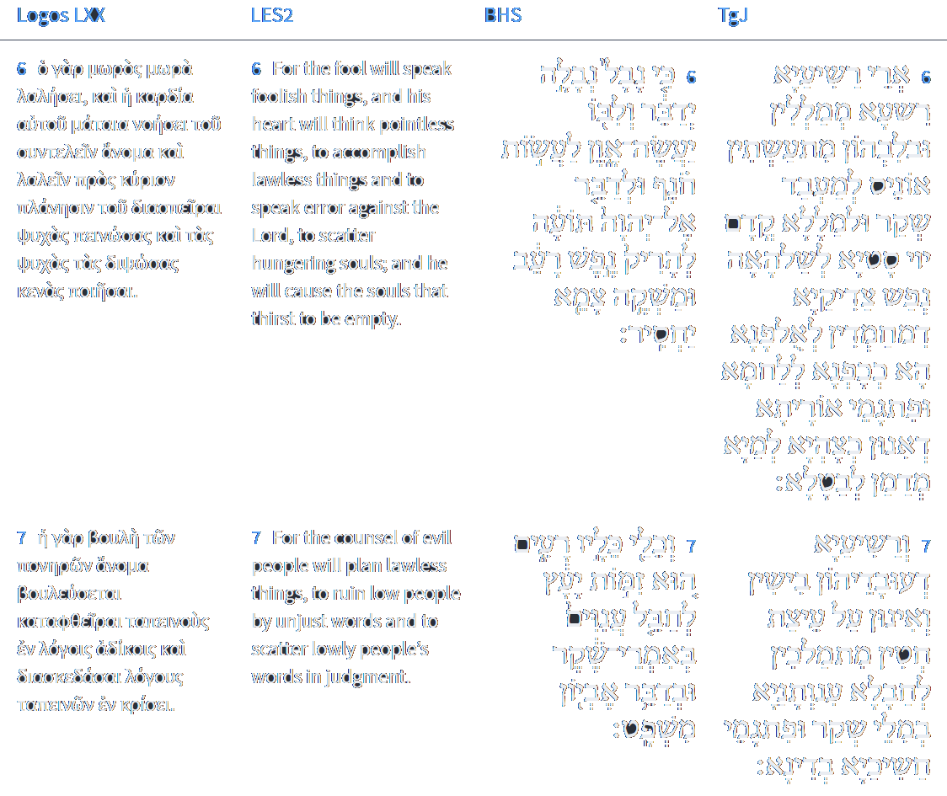
Isaiah 32:6-7
Isaiah / ישעיה
http://www.matsati.com

Slide 15
How do I deny myself?
We give up the right to take revenge on others (Romans 12:19–20)
We give up the right to hate our enemy (Matthew 5:43–47)
We give up the right to be honored and served (Mark 10:42–45)
We give up the right to live by our own rules (John 14:23–24)
We give up the right to hold a grudge against others (Colossians 3:13)
We give up the right to complain (Philipians 2:14, 1 Thessalonians 5:18)
We give up the right to put self first (Philipians 2:3–4)
We give up the right to express one’s sexuality freely (1 Corinthians. 6:18–20)
We give up the right to rebel against authority (1 Peter 2:13–15)
Isaiah / ישעיה
http://www.matsati.com

Slide 16
Rabbinic Literature
ספרות רבנית
Part 2
Isaiah / ישעיה
http://www.matsati.com

Slide 17
Targum Jonathan son of Uziel Isaiah 32:1-7
32:1 Behold, a King shall reign in truth, and the righteous shall be magnified to execute just vengeance on the people. 32:2 And the just that were hidden because of the wicked, as those who hide themselves on account of a storm, shall return, and shall be magnified, and their instruction shall be received quickly, like the waters that flow into a dry land, like the shadow of a great rock in a parched land. 32:3 And the eyes of the righteous shall not be shut, and the ears of those who receive instruction shall hear. 32:4 Even the heart of the rash shall understand knowledge, and the tongue of those that was tied shall be ready to speak plainly. 32:5 And the wicked man shall no more be called just, and he that transgresses against His WORD shall not be called mighty. 32:6 For the wicked will talk wickedness, and in their heart they meditate violence, to practice falsehood, and to speak revolt against the Lord, to weary the soul of the righteous, who long after instruction, as the hungry after bread; and after the words of the law, which are like water to him that is athirst, they purpose to make to cease. 32:7 And the wicked, whose works are evil, take counsel with sinners to destroy the poor with lying words, and the words of the needy in judgment. (TgJ)
Isaiah / ישעיה
http://www.matsati.com

Slide 18
Rashi on Isaiah 32:1 Parts 1-2
הן לצדק ימלך מלך. הן אין משפט מלך למלוך כי אם לעשות משפט צדק: Behold, for righteousness shall a king reign Behold a king has no right to reign except to execute righteous judgment.
ולשרים למשפט ישורו. ועל מי יש לו למלוך על שרים אשר למשפט ישורו, ואמר הנביא זאת על אחז שהיה רשע אבל חזקיהו בנו ימלוך וכדי הוא: and over princes who rule with justice And over whom should he reign? Over princes who rule with justice. The prophet says this concerning Ahaz, who was a wicked man, but Hezekiah his son shall rule, and he is worthy. ([Manuscripts read:] And he is worthy of reigning.)
Isaiah / ישעיה
http://www.matsati.com

Slide 19
Rashi on Isaiah 32:2 Parts 1-4
והיה איש. הגבור ביראת הקב"ה הוא חזקיה יהיה לישראל:
And the man shall be The hero in the fear of the Holy One, blessed be He - that is Hezekiah - shall be for Israel.
כמחבא רוח. כמחסה סלע שנחבאים בו מפני רוח ונסתרים שם מפני חורב כן יבטחו בו הנותרים מי' השבטי':
as a hiding place from the wind As a shelter of a rock, where people hide because of the wind, and they hide there because of the heat ([mss. read:] because of the rain), so will those remaining from the ten tribes trust in him.
בציון. ל' יובש ציה:
in an arid land. (בְּצָיוֹן) an expression of dryness, desolation (צִיָּה).
כצל סלע כבד בארץ עיפה. במקום שמש שהארץ עיפה שם וחריבה ותאבה לצל:
as the shade of a huge rock in a weary land In a sunny place, where the earth is weary and dry and yearning for shade.
Isaiah / ישעיה
http://www.matsati.com

Slide 20
Actions of King Hezekiah
Tunneling a shaft through 1,748 feet of solid rock to supply water to the city in time of siege (2 Kings 20:20).
Stopping up springs around Jerusalem that could supply water to an attacking army (2 Chronicles 32:1-4).
Extending and strengthening the wall of Jerusalem (2 Chronicles 32:5).
Increasing the production of shields and weapons (2 Chronicles 32:5).
Isaiah / ישעיה
http://www.matsati.com

Slide 21
Likutei Moharan, Part II 2:5 Part 1
ה וּשְׁלֵמוּת הַדִּבּוּר הוּא בְּחִינַת לְשׁוֹן הַקֹּדֶשׁ, כִּי כָל לְשׁוֹנוֹת הָעַמִּים הֵם חֲסֵרִים, וְאֵין לָהֶם שְׁלֵמוּת, כִּי נִקְרָאִין לְשׁוֹן עִלְּגִים (ישעיהו ל״ב:ד׳), וְאֵין שְׁלֵמוּת רַק לִלְשׁוֹן־הַקֹּדֶשׁ.
5. Now, perfected speech is the concept of the Holy Tongue. All the languages of the nations are lacking. They are imperfect and are called “the tongue of stammerers” (Isaiah 32:4). Perfection applies only to the Holy Tongue.
Isaiah / ישעיה
http://www.matsati.com

Slide 22
Rashi on Isaiah 32:4 Part 1
ולבב נמהרים יבין לדעת. לא כמו שעכשיו השמן לב העם (שם): And the heart of the hasty shall understand to know Not like now, that “this people’s heart is becoming fat” (ibid.).
ולשון עלגים וגו'. ולא כמו שעכשיו כי בלעגי שפה (לעיל כח): and the tongue of the stammerers, etc. Not like now, “for with distorted speech” (supra 28:11).
עלגים. כל מי שאינו יודע לכוין דיבורו להיות צח קרוי עלג ונלעג: stammerers Anyone who does not know how to direct his speech to be clear is termedעִלֵּג or נִלְעַג.
Isaiah / ישעיה
http://www.matsati.com

Slide 23
Mishneh Torah, Human Dispositions 1:1
Each and every man possesses many character traits. Each trait is very different and distant from the others. Many commentaries assume that the Rambam is stating simply that there are many personality types, which he proceeds to describe: e.g., the angry man, the calm man, etc. They quote various sources in support of this viewpoint, among them Berachot 58a: "Whoever sees a multitude of Jews recites the blessing: 'Blessed is...the wise who knows the hidden secrets,' because just as their natures are not similar, neither are their faces." However, by stating that the many character traits are possessed by "each and every man," it is possible that Rambam is implying more than that there are people with different traits. Though in Moreh Nevuchim (The Guide to the Perplexed) 2:40 the Rambam himself elaborates upon that idea, it can be said that here his intent is different. He is emphasizing the degree to which each individual's personality is a combination of different traits, which may be unrelated and even distant from each other. Anger, generosity, and modesty, for example, can be found together in the same person, much in the same way that tenants of all sorts - unrelated to each other - can be housed in a common building. To illustrate these traits, the Rambam employs concrete examples of extreme personalities, so that the contrasts can be appreciated more easily. One type of man is wrathful; he is constantly angry. [In contrast,] there is the calm individual who is never moved to anger,2Obviously, anger or passivity are not these individuals' only traits. Surely, they share the full spectrum of human emotions. However, in these individuals, these traits are most prominent. See Halachah 2:3 for a further discussion of anger. or, if at all, he will be slightly angry, [perhaps once] during a period of several years. or, if at all, he will be slightly angry, [perhaps once] during a period of several years.
Isaiah / ישעיה
http://www.matsati.com

Slide 24
Mishneh Torah, Human Dispositions 1:1 …cont…
There is the prideful man and the one who is exceptionally humble.4Chapter 2, Halachah 3, also deals at length with the contrasts between pride and humility. There is the man ruled by his appetites - he will never be satisfied from pursuing his desires,5Kohelet Rabbah 1:34 states: "No person will die having accomplished [even] half of what he desires." This statement is difficult to comprehend since there appear to be many successful individuals who achieve their desires. Nevertheless, their accomplishments do not necessitate that their desires will be satisfied. As the Midrash continues: "A person who possesses 100 silver pieces desires 200. One who possesses 200 desires 400." Desire itself is never satisfied. Instead, it puts the person on a constantly moving treadmill, with ever-increasing aims. As soon as one reaches one goal, he instinctively begins the pursuit of another. and [conversely,] the very pure of heart, who does not desire even the little that the body needs. This pair of contrasting personality types deal with a person's appetites which can be satisfied by sensual experience. For example, gluttony is stimulated and satisfied by taste. In contrast, the traits mentioned below - the desire for money or the lack of desire for it - do not involve the senses. There is the greedy man, who cannot be satisfied Literally, "whose soul is not satisfied." Perhaps the Rambam uses "soul," both here and with regard to the man ruled by his sensual appetites, because it is the desire that characterizes the man, not the performance of an action as such. A man may never indulge his passion for food, or actually amass money and yet, be gluttonous or greedy. Though, in practice, his ability to gratify his ambitions may be limited by external factors, the desires of his soul are, nonetheless, unlimited. with all the money in the world, as [Ecclesiastes 5:9] states: "A lover of money never has his fill of money."
Isaiah / ישעיה
http://www.matsati.com

Slide 25
Mishneh Torah, Human Dispositions 1:1 …cont…
Here, the Rambam describes an example where the desire for money becomes a goal in itself. In contrast, a man who gathers money so that he can buy things or achieve power is not interested in money per se. Although he may be faulted for different reasons, he is not greedy for money. On the other hand, for the "lover of money," money itself becomes his raison d'etre. [In contrast,] there is the man who puts a check on himself;9literally, he "cuts himself short." II Kings 19:26 employs a similar usage of the root ketzar: "And the inhabitants are broken, with shortened (i.e., weakened or useless) arms." he is satisfied with even a little, which is not enough for his needs, and he does not bother to pursue and attain what he lacks. This refers to a lazy person, who will not bestir himself even for that which is necessary. In Chapter 2, Halachah 7, this type is described clearly as: "lazy and an idler." This is the description, too, in the Rambam's Introduction to Avot - Shemonah Perakim, Chapter 4. There is [the miser,] In contrast to the "lover of money" mentioned above, the miser is not as bent on acquiring new wealth as much as hoarding the money and possessions he has. who torments himself with hunger, gathering [his possessions] close to himself. - The terminology the Rambam uses emphasizes the miser's need to be close to his money and possessions. Similar, but not exactly correspondent, expressions are found in the Bible (Proverbs 13:11 and the Talmud (Bava Kama 80a). who torments himself with hunger, gathering [his possessions] close to himself. Whenever he spends a penny of his own, he does so with great pain. [Conversely,] there is [the spendthrift,] who consciously wastes his entire fortune. Chullin 84b gives examples of such behavior: wearing linen clothing, using glass utensils, and hiring workers without supervising them. All other traits follow the same pattern [of contrast]. For example: the overly elated and the depressed;
Isaiah / ישעיה
http://www.matsati.com

Slide 26
Mishneh Torah, Human Dispositions 1:1 …cont…
The Rambam is not referring to an average optimist and a pessimist. Rather, he describes personalities who do not have a grip on reality. onain is the term used for the bereaved who has not yet buried his dead. mehulal, the other extreme, is used by Jeremiah 51:7 to refer to a state of intoxication and delirious drunkenness. the stingy and the freehanded; Our translation of shua is clearly evident from Hilchot Matnot Ani'im 7:11. It follows that chili represents the opposite extreme. (See also Ibn Ezra, Isaiah 32:5.) The difference between this pair of traits and the miser-spendthrift pair mentioned above is that the latter refers to a person's conduct toward himself, while the former refers to his conduct with regard to others. The stingy man, unlike the miser, may spend money for his own needs, but is tightfisted when others are concerned. By the same token, a freehanded man need not necessarily indulge himself, though he is generous when giving charity. Though this may sound praiseworthy, when taken to extremes it can also prove dangerous, because a person may hurt himself in the process of giving excessively to another. (See Lechem Mishneh.) the cruel and the softhearted; the coward and the rash. and the like. We find a longer treatment of personal characteristics in the Rambam's Shemonah Perakim, Chapter 4.
Isaiah / ישעיה
http://www.matsati.com

Slide 27
Rashi on Isaiah 32:6 Parts 1-4
נבלה ידבר. מדבר ל' הוה הוא: speaks villainy (יְדַבֵּר) like מְדַבֵּר, a present tense.
יעשה און. יקבץ מחשבות און כמו (דברים ח׳:י״ז) עשה לי החיל הזה: works iniquity (יַעֲשֶׂה) Gathers thoughts of iniquity. Comp. (Deut. 8:17) “Gathered (עָשָׂה) for me this wealth.”
לעשות חונף. חושב מחשבות איך יוכל לעשות חנופה, חונף שם דבר לכך טעמו למעלה ונקוד פתח: to practice flattery (לֲַעֲשׂוֹת) He thinks thoughts how he can practice flattery. חֹנֵף is a noun; therefore, the accent is on the first syllable, it is vowelized with a ‘pattah’ (now called a ‘segol’).
ומשקה צמא יחסיר. לפי פשוטו שגוזלין העניים ותרגומו פתגמי אורייתא דאינון כמיא לצחייא מדמן לבטלא: and the drink of the thirsty he causes to fail According to the simple meaning, they rob the poor. The Targum, (however, paraphrases:) The words of the Torah, which are like water to the thirsty, they plan to nullify.
Isaiah / ישעיה
http://www.matsati.com

