Slide 1
MATSATI.COM Teaching Ministry
Website: https://www.matsati.com YouTube Channel: https://www.youtube.com/user/MATSATI/
ישעיהו לא:ה-ט / Isaiah 31:5-9
LIVE STREAM: 6:30 pm EST Thursday
Join us at Telegram:
https://t.me/MessianicChat
Rabbi Jeremiah
– The Apocalypse: connecting the Greek to the Ancient Hebrew text. (Wed. 9 am EST)
A Community
for Learning
Weekly Teachings Free Online
Check Telegram for weekly scheduling of teachings.
YouTube Channels
https://YouTube.com/c/HebrewLiteracy
https://www.youtube.com/channel/UC5_qPfruat-sCJJypz0_OBw
Discuss the Scriptures,
learn the languages,
and fellowship
Join Telegram ask about Hebrew and Greek classes!

Slide 2
Isaiah 31:5-9
ישעיהו לא:ה-ט
Isaiah / ישעיה
http://www.matsati.com

Slide 3
John 17:3
17:3 And this is life eternal, that they might know thee the only true God, and Jesus Christ, whom thou hast sent. (KJV 3 αὕτη δέ ἐστιν ἡ αἰώνιος ζωὴ ἵνα* ⸀γινώσκωσιν σὲ τὸν μόνον ἀληθινὸν θεὸν καὶ ὃν ⸁ἀπέστειλας Ἰησοῦν* Χριστόν⸆.)
וְאֵלֶּה הֵם חַיֵּי עוֹלָם׃ שֶׁיַכִּירוּ אוֹתְךָ, אֱלֹהֵי הָאֱמֶת לְבַדּוֹ, וְאֶת אֲשֶׁר שָׁלַחְתָּ –– אֶת יֵשׁוּעַ הַמָּשִׁיחַ.
Isaiah / ישעיה
http://www.matsati.com

Slide 4
Ephesians 4:20–24
4:20 But ye have not so learned Christ; 4:21 If so be that ye have heard him, and have been taught by him, as the truth is in Jesus: 4:22 That ye put off concerning the former conversation the old man, which is corrupt according to the deceitful lusts; 4:23 And be renewed in the spirit of your mind; 4:24 And that ye put on the new man, which after God is created in righteousness and true holiness. (KJV 20 Ὑμεῖς δὲ οὐχ οὕτως ἐμάθετε τὸν Χριστόν, 21 εἴ γε αὐτὸν ἠκούσατε καὶ ἐν αὐτῷ ἐδιδάχθητε,* καθώς ἐστιν ἀλήθεια ἐν τῷ Ἰησοῦ,* 22 ἀποθέσθαι ὑμᾶς κατὰ τὴν προτέραν ἀναστροφὴν τὸν παλαιὸν ἄνθρωπον τὸν φθειρόμενον κατὰ ⸂τὰς ἐπιθυμίας⸃ τῆς ἀπάτης,* 23 ⸀ἀνανεοῦσθαι δὲ ⸆ τῷ πνεύματι τοῦ νοὸς ὑμῶν* 24 καὶ ⸀ἐνδύσασθαι τὸν καινὸν ἄνθρωπον τὸν κατὰ θεὸν κτισθέντα ἐν δικαιοσύνῃ καὶ ὁσιότητι ⸂τῆς ἀληθείας⸃.*)
Isaiah / ישעיה
http://www.matsati.com

Slide 5
ספר יהושע פרק כג
ו וַחֲזַקְתֶּם מְאֹד לִשְׁמֹר וְלַעֲשֹוֹת אֵת כָּל-הַכָּתוּב בְּסֵפֶר תּוֹרַת מֹשֶׁה לְבִלְתִּי סוּר מִמֶּנּוּ יָמִין וּשְֹמֹאול: ז לְבִלְתִּי-בוֹא בַּגּוֹיִם הָאֵלֶּה הַנִּשְׁאָרִים הָאֵלֶּה אִתְּכֶם וּבְשֵׁם אֱלֹהֵיהֶם לֹא-תַזְכִּירוּ וְלֹא תַשְׁבִּיעוּ וְלֹא תַעַבְדוּם וְלֹא תִשְׁתַּחֲווּ לָהֶם:
Joshua 23:6–7
23:6 Be ye therefore very courageous to keep and to do all that is written in the book of the law of Moses, that ye turn not aside therefrom to the right hand or to the left; 23:7 That ye come not among these nations, these that remain among you; neither make mention of the name of their gods, nor cause to swear by them, neither serve them, nor bow yourselves unto them: (KJV)
Isaiah / ישעיה
http://www.matsati.com

Slide 6
Matthew 7:12–20
7:12 Therefore all things whatsoever ye would that men should do to you, do ye even so to them: for this is the law and the prophets. 7:13 Enter ye in at the strait gate: for wide is the gate, and broad is the way, that leadeth to destruction, and many there be which go in thereat: 7:14 Because strait is the gate, and narrow is the way, which leadeth unto life, and few there be that find it. 7:15 Beware of false prophets, which come to you in sheep’s clothing, but inwardly they are ravening wolves. 7:16 Ye shall know them by their fruits. Do men gather grapes of thorns, or figs of thistles? 7:17 Even so every good tree bringeth forth good fruit; but a corrupt tree bringeth forth evil fruit. 7:18 A good tree cannot bring forth evil fruit, neither can a corrupt tree bring forth good fruit. 7:19 Every tree that bringeth not forth good fruit is hewn down, and cast into the fire. 7:20 Wherefore by their fruits ye shall know them. (KJV)
Isaiah / ישעיה
http://www.matsati.com

Slide 7
﻿ספר ישעיה פרק לא
﻿ה כְּצִפֳּרִים עָפוֹת כֵּן יָגֵן יְהֹוָה צְבָאוֹת עַל-יְרוּשָׁלָם גָּנוֹן וְהִצִּיל פָּסוֹחַ וְהִמְלִיט: ו שׁוּבוּ לַאֲשֶׁר הֶעְמִיקוּ סָרָה בְּנֵי יִשְֹרָאֵל: ז כִּי בַּיּוֹם הַהוּא יִמְאָסוּן אִישׁ אֱלִילֵי כַסְפּוֹ וֶאֱלִילֵי זְהָבוֹ אֲשֶׁר עָשֹוּ לָכֶם יְדֵיכֶם חֵטְא: ח וְנָפַל אַשּׁוּר בְּחֶרֶב לֹא-אִישׁ וְחֶרֶב לֹא-אָדָם תֹּאכְלֶנּוּ וְנָס לוֹ מִפְּנֵי-חֶרֶב וּבַחוּרָיו לָמַס יִהְיוּ: ט וְסַלְעוֹ מִמָּגוֹר יַעֲבוֹר וְחַתּוּ מִנֵּס שָֹרָיו נְאֻם-יְהֹוָה אֲשֶׁר-אוּר לוֹ בְּצִיּוֹן וְתַנּוּר לוֹ בִּירוּשָׁלָם:
Isaiah / ישעיה
http://www.matsati.com

Slide 8
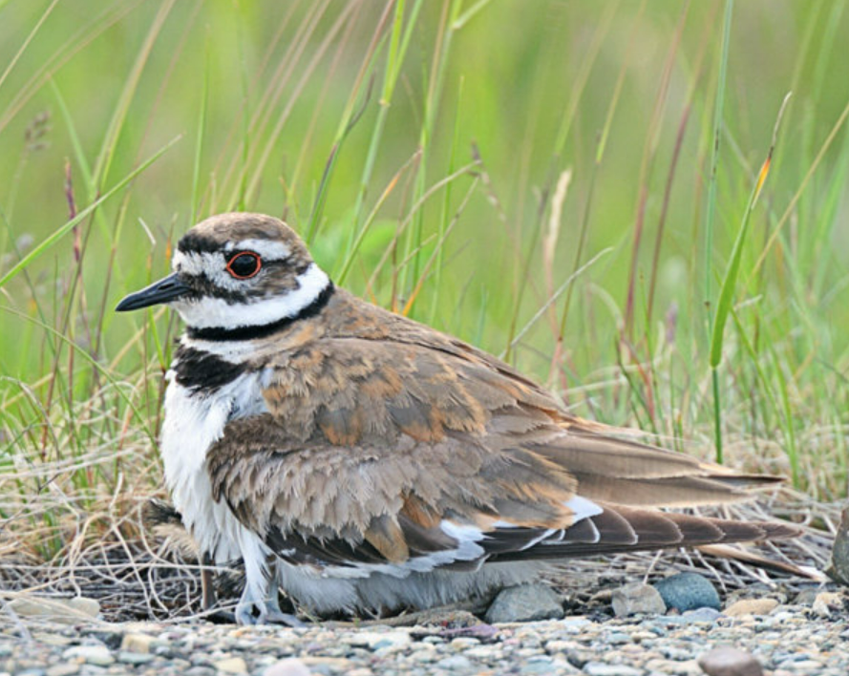
Bird: Killdeer
Build their nests on the ground
Defense Mechanism:
Pretend to be hurt…
Isaiah / ישעיה
http://www.matsati.com

Slide 9
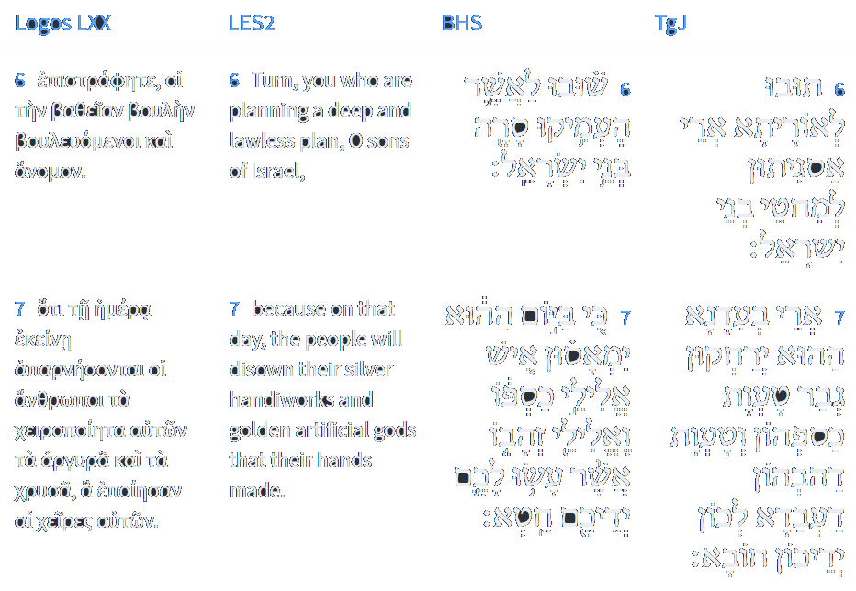
Isaiah 31:6-7
Isaiah / ישעיה
http://www.matsati.com

Slide 10
ספר ישעיה פרק נט
יב כִּי-רַבּוּ פְשָׁעֵינוּ נֶגְדֶּךָ וְחַטֹּאותֵינוּ עָנְתָה בָּנוּ כִּי-פְשָׁעֵינוּ אִתָּנוּ וַעֲוֹנֹתֵינוּ יְדַעֲנוּם:
Isaiah 59:12
59:12 For our transgressions are multiplied before thee, And our sins testify against us: For our transgressions are with us; And as for our iniquities, we know them; (KJV 1900)
Isaiah / ישעיה
http://www.matsati.com

Slide 11
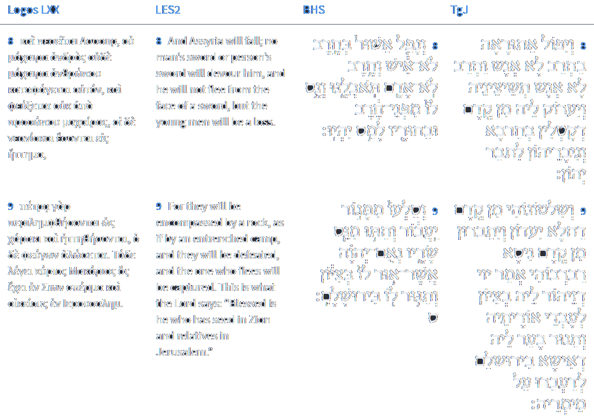
Isaiah 31:8-9
Isaiah / ישעיה
http://www.matsati.com

Slide 12
Rabbinic Literature
ספרות רבנית
Part 3
Isaiah / ישעיה
http://www.matsati.com

Slide 13
Targum Jonathan son of Uziel Isaiah 31:5-9
31:5 As a bird by flying, so the power of the Lord of hosts shall be revealed; He shall protect, He shall deliver, He shall save, and He shall make to pass away. 31:6 Return to the law; for you have multiplied sin, O sons of Israel! 31:7 At that time each man shall abhor the idols of their silver and the idols of their gold, which your hands have made for you for a god. 31:8 Then shall the Assyrian fall by a sword not of man; and the sword not of a man shall destroy him: and he shall betake himself to flight as from before those who slay with the sword, and his heroes shall be for destruction. 31:9 And his princes shall flee through fear, they shall move away; and his princes shall be broken on account of the miracle, saith the Lord, whose splendor is in Zion to them who obey the law, and whose burning furnace of fire is in Jerusalem for them who transgress His word. (TgJ)
Isaiah / ישעיה
http://www.matsati.com

Slide 14
Rashi on Isaiah 31,5 Part 1-2
פסוח. דילוג ויש עוד לפותרו לשון חיים: passing over (פָּסוֹחַ) passing over. Alternatively, it may be interpreted as an expression of sparing.
והמליט. יוציא את ישראל מן הצרה ל' המלטה אישקמוציי"ר בלע"ז: and rescuing He will extricate Israel from the strait. This is an expression of rescue (esmoucer in O. F.).
Isaiah / ישעיה
http://www.matsati.com

Slide 15
ספר שמות פרק יב
כג וְעָבַר יְהוָֹה לִנְגֹּף אֶת-מִצְרַיִם וְרָאָה אֶת-הַדָּם עַל-הַמַּשְׁקוֹף וְעַל שְׁתֵּי הַמְּזוּזֹת וּפָסַח יְהוָֹה עַל-הַפֶּתַח וְלֹא יִתֵּן הַמַּשְׁחִית לָבֹא אֶל-בָּתֵּיכֶם לִנְגֹּף:
Shemot / Exodus 12:23
12:23 For the LORD will pass through to smite the Egyptians; and when he seeth the blood upon the lintel, and on the two side posts, the LORD will pass over the door, and will not suffer the destroyer to come in unto your houses to smite you. (KJV)
Isaiah / ישעיה
http://www.matsati.com

Slide 16
Shaarei Teshuvah 1,1 - In explanation of repentance and its principles
Among the good things which God, may He be blessed, has bestowed upon His creations is the path which He prepared for them to ascend from the baseness of their actions, to escape the trap of their inequities, to hold their souls back from destruction and to remove His anger from upon them. Because of His goodness and uprightness, He has taught them and warned them to return to Him when they sin against Him - for He understands their nature, as it is stated (Psalms 25:8), "Good and upright is the Lord; therefore He shows sinners the way." [Even] if they greatly sin and rebel and act like treacherous betrayers - He does not close the doors of repentance to them, as it is stated (Isaiah 31:6), "Return, to Him to whom they have been so shamefully false." It is [also] stated (Jeremiah 3:22), "Turn back, O rebellious children, I will heal your afflictions." We are warned about repentance in several places in the Torah. It is explained that repentance is accepted even when the sinner repents because of his many troubles - how much more so [will it be accepted] if he returns because of fear or love of God - as it is stated (Deuteronomy 4:30), "When you are in distress because all these things have befallen you and, in the end, return to the Lord your God and obey Him." It is explained in the Torah that God will help those who repent beyond what their natural ability would allow; and that He renews a pure spirit within them, to reach great heights in His love - as it is stated (Deuteronomy 30:2), "And you return to the Lord your God, and you and your children heed His command with all your heart and soul, just as I enjoin upon you this day." Further, it is stated about the body of the matter (Deuteronomy 30:6), "Then the Lord, your God, will circumcise your heart and the hearts of your offspring," to acquire love for Him. And the Prophets and Writings constantly speak on the subject of repentance, such that the principles of repentance are all explained in their words, as will be explained.
Isaiah / ישעיה
http://www.matsati.com

Slide 17
2 Peter 2:9–19
2:9 The Lord knoweth how to deliver the godly out of temptations, and to reserve the unjust unto the day of judgment to be punished: 2:10 But chiefly them that walk after the flesh in the lust of uncleanness, and despise government. Presumptuous are they, selfwilled, they are not afraid to speak evil of dignities. 2:11 Whereas angels, which are greater in power and might, bring not railing accusation against them before the Lord. 2:12 But these, as natural brute beasts, made to be taken and destroyed, speak evil of the things that they understand not; and shall utterly perish in their own corruption; 2:13 And shall receive the reward of unrighteousness, as they that count it pleasure to riot in the day time. Spots they are and blemishes, sporting themselves with their own deceivings while they feast with you; 2:14 Having eyes full of adultery, and that cannot cease from sin; beguiling unstable souls: an heart they have exercised with covetous practices; cursed children: 2:15 Which have forsaken the right way, and are gone astray, following the way of Balaam the son of Bosor, who loved the wages of unrighteousness; 2:16 But was rebuked for his iniquity: the dumb ass speaking with man’s voice forbad the madness of the prophet. 2:17 These are wells without water, clouds that are carried with a tempest; to whom the mist of darkness is reserved for ever. 2:18 For when they speak great swelling words of vanity, they allure through the lusts of the flesh, through much wantonness, those that were clean escaped from them who live in error. 2:19 While they promise them liberty, they themselves are the servants of corruption: for of whom a man is overcome, of the same is he brought in bondage. (KJV)
Isaiah / ישעיה
http://www.matsati.com

Slide 18
Rashi on Isaiah 31,6 Part 1
שובו. למי שהעמקתם מחשבות היאך לסור ממנו וסרתם מעליו עתה שובו אליו: Return To the One about Whom you have thought deeply how to turn away from Him, now return to Him
Ibn Ezra on Isaiah 31:8 Part 1-2
ונפל. בחרב לא איש רק ביד המלאך וחרבו השלופה, ואם הוא כדרך משל להבין השומעים: With a sword, not of a mighty man, but with the drawn sword of an angel. The sword is a figurative expression.
ובחוריו. הנמלטים ילקחו בדרך: And his young men that will have escaped shall be discomfited, shall be overtaken on the ways in which they try to flee.
Isaiah / ישעיה
http://www.matsati.com

Slide 19
Ein Yaakov (Glick Edition), Eiruvin 2:3
(Fol. 19a) R. Jeremiah b. Elazar said further: "Gehenna has three entrances: one in the desert, one in the sea, and one in Jerusalem. In the desert, as it is written, (Num. 16, 33) And they went down, they, and all that appertained to them, alive into the pit. In the sea, as it is written (Jonah 2, 3.) Out of the depth of the grave have I cried, and Thou hast heard my voice. In Jerusalem, as it is written (Is. 31, 9.) Who hath a fire in Zion, and a furnace in Jerusalem." In the academy of Ishmael it was taught that a fire in Zion refers to Gehenna. And are there no more entrances to Gehenna? Has not R. Muryun, in the name of R. Joshua b. Levi, said, and according to others, Rabba b. Muryun taught, in the school of R. Jochanan b. Zakai: "There are two palm-trees in the valley of Ben Hinnom from which a smoke arises; and this was meant when we are taught that 'The palm-trees of Mt. Barzel aro properly used [for the Lulab on the Tabernacle festival], and at this place is the gate of Gehenna.' [Hence there is another gate besides the three previously mentioned.] "It must be the same one that was mentioned as the gate of Jerusalem."
Isaiah / ישעיה
http://www.matsati.com

Slide 20
16 αλλ ου παντες υπηκουσαν τω ευαγγελιω ησαιας γαρ λεγει κυριε τις επιστευσεν τη ακοη ημων 17 αρα η πιστις εξ ακοης η δε ακοη δια ρηματος θεου Stephen’s 1550 Textus Receptus: With Morphology (Bellingham, WA: Logos Bible Software, 2002), Romans 10:16–17. | 16 Ἀλλʼ οὐ πάντες ὑπήκουσαν τῷ εὐαγγελίῳ*. Ἠσαΐας γὰρ λέγει· κύριε, τίς ἐπίστευσεν τῇ ἀκοῇ ἡμῶν; 17 ἄρα ἡ πίστις ἐξ ἀκοῆς, ἡ δὲ ἀκοὴ διὰ ῥήματος ⸀Χριστοῦ*. Kurt Aland et al., Novum Testamentum Graece, 28th Edition. (Stuttgart: Deutsche Bibelgesellschaft, 2012), Romans 10:16–17.
Isaiah / ישעיה
http://www.matsati.com

