Slide 1
MATSATI.COM Teaching Ministry
Website: https://www.matsati.com YouTube Channel: https://www.youtube.com/user/MATSATI/
ישעיהו לא:א-ד / Isaiah 31:1-4
LIVE STREAM: 6:30 pm EST Thursday
Join us at Telegram:
https://t.me/MessianicChat
Rabbi Jeremiah
– The Apocalypse: connecting the Greek to the Ancient Hebrew text. (Wed. 9 am EST)
A Community
for Learning
Weekly Teachings Free Online
Check Telegram for weekly scheduling of teachings.
YouTube Channels
https://YouTube.com/c/HebrewLiteracy
https://www.youtube.com/channel/UC5_qPfruat-sCJJypz0_OBw
Discuss the Scriptures,
learn the languages,
and fellowship
Join Telegram ask about Hebrew and Greek classes!

Slide 2
Isaiah 31:1-4
ישעיהו לא:א-ד
Isaiah / ישעיה
http://www.matsati.com

Slide 3
ספר דברים פרק יז
טז רַק לֹא-יַרְבֶּה-לּוֹ סוּסִים וְלֹא-יָשִׁיב אֶת-הָעָם מִצְרַיְמָה לְמַעַן הַרְבּוֹת סוּס וַיהוָֹה אָמַר לָכֶם לֹא תֹסִפוּן לָשׁוּב בַּדֶּרֶךְ הַזֶּה עוֹד:
Devarim / Deuteronomy 17:16
17:16 But he shall not multiply horses to himself, nor cause the people to return to Egypt, to the end that he should multiply horses: forasmuch as the Lord hath said unto you, Ye shall henceforth return no more that way. (KJV)
Isaiah / ישעיה
http://www.matsati.com

Slide 4
ספר דברים פרק כח
כ יְשַׁלַּח יְהוָֹה | בְּךָ אֶת-הַמְּאֵרָה אֶת-הַמְּהוּמָה וְאֶת-הַמִּגְעֶרֶת בְּכָל-מִשְׁלַח יָדְךָ אֲשֶׁר תַּעֲשֶֹה עַד הִשָּׁמֶדְךָ וְעַד-אֲבָדְךָ מַהֵר מִפְּנֵי רֹעַ מַעֲלָלֶיךָ אֲשֶׁר עֲזַבְתָּנִי:
Devarim / Deuteronomy 28:20
28:20 “The Lord will send on you curses, confusion, and frustration in all that you undertake to do, until you are destroyed and perish quickly on account of the evil of your deeds, because you have forsaken me. (ESV)
Isaiah / ישעיה
http://www.matsati.com

Slide 5
Hebrews 10:26
10:26 For if we go on sinning deliberately after receiving the knowledge of the truth, there no longer remains a sacrifice for sins, (ESV 26 Ἑκουσίως °γὰρ ἁμαρτανόντων ἡμῶν μετὰ τὸ λαβεῖν τὴν ἐπίγνωσιν τῆς ἀληθείας,* οὐκέτι περὶ ⸀ἁμαρτιῶν* ⸁ἀπολείπεται θυσία,)
Isaiah / ישעיה
http://www.matsati.com

Slide 6
﻿ספר ישעיה פרק לא
א הוֹי הַיֹּרְדִים מִצְרַיִם לְעֶזְרָה עַל-סוּסִים יִשָּׁעֵנוּ וַיִּבְטְחוּ עַל-רֶכֶב כִּי רָב וְעַל פָּרָשִׁים כִּי-עָצְמוּ מְאֹד וְלֹא שָׁעוּ עַל-קְדוֹשׁ יִשְֹרָאֵל וְאֶת-יְהֹוָה לֹא דָרָשׁוּ: ב וְגַם-הוּא חָכָם וַיָּבֵא רָע וְאֶת-דְּבָרָיו לֹא הֵסִיר וְקָם עַל-בֵּית מְרֵעִים וְעַל-עֶזְרַת פֹּעֲלֵי אָוֶן: ג וּמִצְרַיִם אָדָם וְלֹא-אֵל וְסוּסֵיהֶם בָּשָֹר וְלֹא-רוּחַ וַיהֹוָה יַטֶּה יָדוֹ וְכָשַׁל עוֹזֵר וְנָפַל עָזֻר וְיַחְדָּו כֻּלָּם יִכְלָיוּן: ד כִּי-כֹה אָמַר-יְהֹוָה | אֵלַי כַּאֲשֶׁר יֶהְגֶּה הָאַרְיֵה וְהַכְּפִיר עַל-טַרְפּוֹ אֲשֶׁר יִקָּרֵא עָלָיו מְלֹא רֹעִים מִקּוֹלָם לֹא יֵחָת וּמֵהֲמוֹנָם לֹא יַעֲנֶה כֵּן יֵרֵד יְהֹוָה צְבָאוֹת לִצְבֹּא עַל-הַר-צִיּוֹן וְעַל-גִּבְעָתָהּ:
Isaiah / ישעיה
http://www.matsati.com

Slide 7
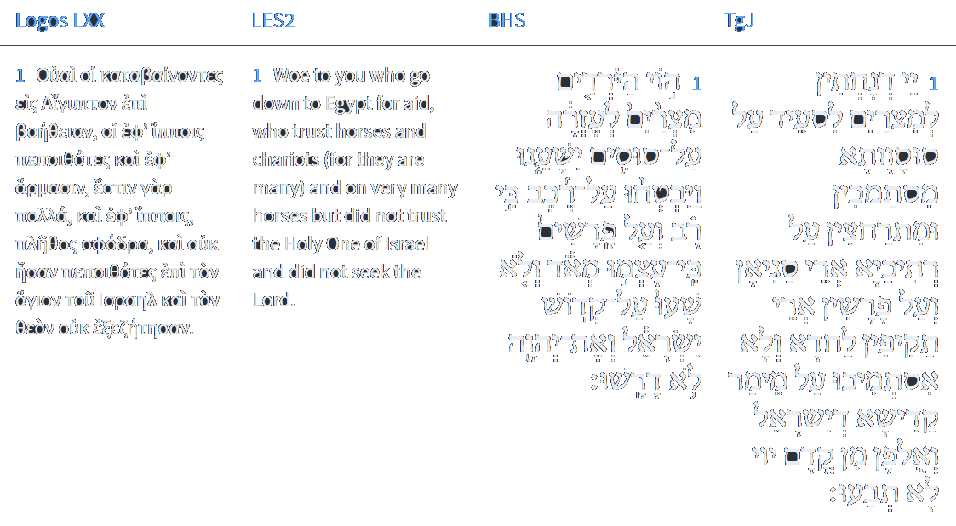
Isaiah 31:1
Isaiah / ישעיה
http://www.matsati.com

Slide 8
ספר בראשית פרק ב
יט וַיִּצֶר יְהֹוָה אֱלֹהִים מִן-הָאֲדָמָה כָּל-חַיַּת הַשָּׂדֶה וְאֵת כָּל-עוֹף הַשָּׁמַיִם וַיָּבֵא אֶל-הָאָדָם לִרְאוֹת מַה-יִּקְרָא-לוֹ וְכֹל אֲשֶׁר יִקְרָא-לוֹ הָאָדָם נֶפֶשׁ חַיָּה הוּא שְׁמוֹ:
Bereshit / Genesis 2:19
2:19 And out of the ground the LORD God formed every beast of the field, and every fowl of the air; and brought them unto Adam to see what he would call them: and whatsoever Adam called every living creature, that was the name thereof. (KJV)
Isaiah / ישעיה
http://www.matsati.com

Slide 9
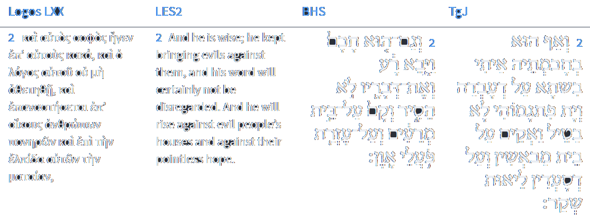
Isaiah 31:2
Isaiah / ישעיה
http://www.matsati.com

Slide 10
Romans 8:35–39
8:35 Who shall separate us from the love of Christ? shall tribulation, or distress, or persecution, or famine, or nakedness, or peril, or sword? 8:36 As it is written, For thy sake we are killed all the day long; we are accounted as sheep for the slaughter. 8:37 Nay, in all these things we are more than conquerors through him that loved us. 8:38 For I am persuaded, that neither death, nor life, nor angels, nor principalities, nor powers, nor things present, nor things to come, 8:39 Nor height, nor depth, nor any other creature, shall be able to separate us from the love of God, which is in Christ Jesus our Lord. (KJV Μὴ ἀποβάλητε οὖν τὴν παρρησίαν ὑμῶν, ἥτις ἔχει μεγάλην μισθαποδοσίαν. ὑπομονῆς γὰρ ἔχετε χρείαν ἵνα τὸ θέλημα τοῦ θεοῦ ποιήσαντες κομίσησθε τὴν ἐπαγγελίαν. ἔτι γὰρ μικρὸν ὅσον ὅσον, ὁ ἐρχόμενος ἥξει καὶ οὐ χρονίσει· ὁ δὲ δίκαιός μου ἐκ πίστεως ζήσεται, καὶ ἐὰν ὑποστείληται, οὐκ εὐδοκεῖ ἡ ψυχή μου ἐν αὐτῷ. ἡμεῖς δὲ οὐκ ἐσμὲν ὑποστολῆς εἰς ἀπώλειαν ἀλλὰ πίστεως εἰς περιποίησιν ψυχῆς.)
Isaiah / ישעיה
http://www.matsati.com

Slide 11
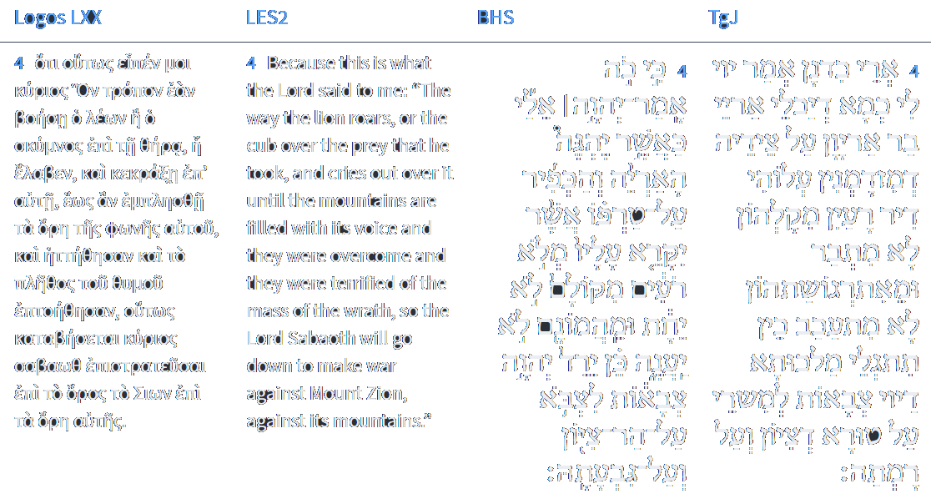
Isaiah 31:4
Isaiah / ישעיה
http://www.matsati.com

Slide 12
Rabbinic Literature
ספרות רבנית
Part 2
Isaiah / ישעיה
http://www.matsati.com

Slide 13
Targum Jonathan son of Uziel Isaiah 31:1-4
31:1 Woe to them that go down to Egypt for help, who stay themselves upon horses, and trust in chariots, because they are many: and in horsemen, because they are very strong; but they stay not themselves upon the WORD of the Holy One of Israel, neither seek instruction from the Lord. 31:2 And also He in His wisdom will bring evil on account of what he is doing; and He will not make to fail His words, but He will arise against the house of evildoers; and against those who help the work of a lie. 31:3 And the Egyptians are men, and none of them a mighty one, and their horses are flesh, and not spirit: and the Lord shall deal the stroke of His power, and he that helpeth shall stumble, and he that is holpen shall fall, and all of them together shall be destroyed. 31:4 For thus the Lord hath said unto me: Like as the lion and the lion’s whelp roar over their prey, when a multitude of shepherds are come together, he will not be afraid of their voice, neither be terrified at their tumult; thus shall the kingdom of the Lord of hosts be revealed encamping upon the mountain of Zion, and upon its hill. (TgJ)
Isaiah / ישעיה
http://www.matsati.com

Slide 14
Mekhilta d'Rabbi Yishmael 14:13:2
"For as you see Egypt": In three places the L rd exhorted Israel not to return to Egypt: (Here:) "for as you see Egypt this day, you shall see them no more, forever", (Devarim 17:16) "You must not go back this way again", (Ibid. 28:68) "… by the way which I told you, you shall not see it again." Three times they returned and three times they fell. The first, in the days of Sancheriv, viz. (Isaiah 31:1) "Woe unto those who go down to Egypt for help!" The second, in the days of Yochanan ben Kareach, (Jeremiah 42:16-17) "And it shall be, the sword which you fear will overtake you there in the land of Egypt and the famine which you worry over will follow after you in Egypt, and there will you die." The third, in the days of Trajanus. Three times they returned and three times they fell. As it is written, (Hoshea 7:11) "Ephraim is a silly dove, without a heart. They have called to Egypt, etc. Israel were four factions at the sea: One was for lunging into the sea; another, for returning to Egypt; another for warring against them; another, for crying out against them. Those who were for lunging into the sea — it was said to them: "Stand ready to see the salvation of the L rd. Those who were for returning to Egypt — it was said to them: "For as you see Egypt this day, you shall see them no more, forever." Those who were for warring against it" — it was said to them: "the L rd will war for you." Those who were for crying out against them — it was said to them: "And you be still."
Isaiah / ישעיה
http://www.matsati.com

Slide 15
Rashi on Isaiah 31,1 Parts 1-3
הוי. על הושע ועשרת השבטים היורדים מצרימה לעזרה אשר שלחו מלאכים אל סוא מלך מצרים (מלכים ב י״ז:ד׳): Woe Concerning Hoshea and the ten tribes who went down to Egypt for aid, who sent emissaries to So, king of Egypt (II Kings 17).
ועל סוסים. הבאים משם שהם קלים לרוץ: on horses that come from there, for they are swift runners.
ישענו. (כמו ולא שעו אל קדוש ישראל) כמו שעשה חזקיה שנ' (מלכים ב י״ח:ה׳) בה' אלהי ישראל בטח וימרוד במלך אשור: rely (יִשָּׁעֵנוּ) and they did not rely on the Holy One of Israel as Hezekiah did, concerning whom it is written: (II Kings 18:5,7): “He trusted in the Lord God of Israel...and he rebelled against the king of Assyria.”
Isaiah / ישעיה
http://www.matsati.com

Slide 16
Rashi on Isaiah 31,2 Part 1-2
ואת דבריו לא הסיר. אשר אמר והשיבך ה' מצרים באניות (דברים כ״ח:ס״ח) מדה כנגד מדה שאמרתי לך (שם) לא תוסיף עוד לראותה ואתה הלכת מדעתך סופך לילך בגלות על כרחך: and His words He did not retract What He said, “And the Lord shall take you back to Egypt in ships” (Deut. 28:68). This is payment in kind, for I said to you, “You shall no longer see it (ibid.),” and you went there of your own free will. Eventually, you shall go there in exile against your will.
וקם. על עשרת השבטים שהם בית מרעים ועל מצרים אשר הם להם לעזרה: and He rose on the ten tribes, who are a house of evildoers, and on the Egyptians who came to their aid.
Isaiah / ישעיה
http://www.matsati.com

Slide 17
Akeidat Yitzchak 24,1 Part 5
G-d says, "Do not be afraid for I am with you" (Isaiah 41:10). The implication is that without Me, you will not prevail since you have no enduring foundations. In Isaiah 31,3, we read, "As soon as G-d withdraws His hand, the helper will fail, the recipient of help will collapse." Here the prophet describes that relying on human help is useless, since human power endures only as long as He does not withdraw His power. For that reason, our sages describe all material wealth as kinyanim medumim, as apparent possessions. On occasion, failure to own such possessions may be preferable to owning them. Our sages teach that whereas virtues fulfill their functions only when we acquire them, material goods may only fulfill their purpose when we spend them. If these material possessions then are useful only as a means to an end, they themselves cannot be of enduring value. Since material possessions evoke in man the desire to amass forever more of them, they cannot be true possessions, since they do not satisfy the owner, but act as a reminder of all the things the owner has not yet acquired. Proverbs 23:1-4 warns us not to wear ourselves out in the pursuit of riches, but to exercise restraint when a guest at the lavish banquet tendered by the king, since whatever is offered is based on deceit. His advice, if translated into the jargon of Mussar teachers, is, “Do not let the goodies dangled before your eyes by the yetzer hara, evil urge, bedazzle you, since what is being dangled before your eyes is merely a mirage.” Sanhedrin 107 describes a small organ, which if fed, becomes insatiable, but which if starved, i.e. kept to strict rations, will find its satisfaction. The organs are the eye and the heart; both have enormous appetites as attested in Numbers 16:39, "Do not follow the dictates of your hearts or your eyes which are apt to lead you astray." The Talmud relates the lesson learned by Alexander the Great, who tried to weigh a human eye handed to him from beyond the borders of Paradise; he found that all his silver and gold did not equal the weight of that eye (Tamid 32). When frustrated at this discovery, he was advised to sprinkle some dust on the eye. He was then able to determine the weight of the eye immediately. The lesson conveyed is that while alive, the eye is insatiable in its greed, and all the gold in the world does not suffice to still its appetite. As soon as it is dead however, all these appetites evaporate.
Isaiah / ישעיה
http://www.matsati.com

Slide 18
Rashi on Isaiah 31,4 Parts 1-4
כאשר יהגה. המיית קול כמו וכיונים הגו נהגה (לקמן נט): As...growls (יֶהְגֶּה) a roaring sound. Comp. (infra 59:11) “And like doves we will moan (הָגֹה נֶהְגֶּה) .”
אשר יקרא עליו מלא רועים. יאספון עליו בקריאת קול המון: although a band of shepherds gather against him (יִקָּרֵא, lit., will be called.) They will gather upon him with a stirring shout.
מלא רועים. אסיפת רועים וכן קראו אחריך מלא (ירמיהו י״ב:ו׳) וכן יחד עלי יתמלאון (איוב ט״ז:י׳) כולם ל' קיבוץ: band of shepherds (מְלֹא) a gathering of shepherds. Comp. (Jer. 12:6) “They called after you a band (מָלֵא).” Comp. also (Job 16:10) “Together they gather (יִתְמַלָּאוּן) against me.” All of these are expressions of gathering.
לא יענה. לא יכנע לא יעשה עצמו עני וכן לענות מפני (שמות יא) וכן וענה גאון ישראל (הושע ה׳:ה׳): he is not subdued (יַעֲנֶה) he will not humble himself, he will not make himself as a poor man. Comp. (Exodus 10:3) “To humble yourself (לֵעָנוֹת) from before Me.” Comp. also (Hosea 5:5) “And the pride of Israel shall be humbled (וְעָנָה).”
Isaiah / ישעיה
http://www.matsati.com

