Slide 1
MATSATI.COM Teaching Ministry
Website: https://www.matsati.com YouTube Channel: https://www.youtube.com/user/MATSATI/
ישעיהו ל:כח-לג / Isaiah 30:28-33
LIVE STREAM: 6:30 pm EST Thursday
Join us at Telegram:
https://t.me/MessianicChat
Rabbi Jeremiah
– The Apocalypse: connecting the Greek to the Ancient Hebrew text. (Wed. 9 am EST)
A Community
for Learning
Weekly Teachings Free Online
Check Telegram for weekly scheduling of teachings.
YouTube Channels
https://YouTube.com/c/HebrewLiteracy
https://www.youtube.com/channel/UC5_qPfruat-sCJJypz0_OBw
Discuss the Scriptures,
learn the languages,
and fellowship
Join Telegram ask about Hebrew and Greek classes!

Slide 2
Isaiah 30:28-33
ישעיהו ל:כח-לג
Isaiah / ישעיה
http://www.matsati.com

Slide 3
Romans 1:19–20
1:19 Because that which may be known of God is manifest in them; for God hath shewed it unto them. 1:20 For the invisible things of him from the creation of the world are clearly seen, being understood by the things that are made, even his eternal power and Godhead; so that they are without excuse: (KJV, 19 διότι τὸ γνωστὸν τοῦ θεοῦ φανερόν ἐστιν ἐν αὐτοῖς·* ὁ θεὸς γὰρ αὐτοῖς ἐφανέρωσεν. 20 τὰ γὰρ ἀόρατα αὐτοῦ ἀπὸ κτίσεως κόσμου τοῖς ποιήμασιν νοούμενα καθορᾶται, ἥ τε* °ἀΐδιος αὐτοῦ δύναμις καὶ θειότης, εἰς τὸ εἶναι αὐτοὺς ἀναπολογήτους)
Isaiah / ישעיה
http://www.matsati.com

Slide 4
2 Peter 1:16–21
1:16 For we have not followed cunningly devised fables, when we made known unto you the power and coming of our Lord Jesus Christ, but were eyewitnesses of his majesty. 1:17 For he received from God the Father honour and glory, when there came such a voice to him from the excellent glory, This is my beloved Son, in whom I am well pleased. 1:18 And this voice which came from heaven we heard, when we were with him in the holy mount. 1:19 We have also a more sure word of prophecy; whereunto ye do well that ye take heed, as unto a light that shineth in a dark place, until the day dawn, and the day star arise in your hearts: 1:20 Knowing this first, that no prophecy of the scripture is of any private interpretation. 1:21 For the prophecy came not in old time by the will of man: but holy men of God spake as they were moved by the Holy Ghost. (KJV)
Isaiah / ישעיה
http://www.matsati.com

Slide 5
﻿ספר ישעיה פרק ל
﻿כח וְרוּחוֹ כְּנַחַל שׁוֹטֵף עַד-צַוָּאר יֶחֱצֶה לַהֲנָפָה גוֹיִם בְּנָפַת שָׁוְא וְרֶסֶן מַתְעֶה עַל לְחָיֵי עַמִּים: כט הַשִּׁיר יִהְיֶה לָכֶם כְּלֵיל הִתְקַדֶּשׁ-חָג וְשִֹמְחַת לֵבָב כַּהוֹלֵךְ בֶּחָלִיל לָבוֹא בְהַר-יְהֹוָה אֶל-צוּר יִשְֹרָאֵל: ל וְהִשְׁמִיעַ יְהֹוָה אֶת-הוֹד קוֹלוֹ וְנַחַת זְרוֹעוֹ יַרְאֶה בְּזַעַף אַף וְלַהַב אֵשׁ אוֹכֵלָה נֶפֶץ וָזֶרֶם וְאֶבֶן בָּרָד: לא כִּי-מִקּוֹל יְהֹוָה יֵחַת אַשּׁוּר בַּשֵּׁבֶט יַכֶּה: לב וְהָיָה כֹּל מַעֲבַר מַטֵּה מוּסָדָה אֲשֶׁר יָנִיחַ יְהֹוָה עָלָיו בְּתֻפִּים וּבְכִנֹּרוֹת וּבְמִלְחֲמוֹת תְּנוּפָה נִלְחַם-בָּה [בָּם]: לג כִּי-עָרוּךְ מֵאֶתְמוּל תָּפְתֶּה גַּם-הִוא [הִיא] לַמֶּלֶךְ הוּכָן הֶעְמִיק הִרְחִב מְדֻרָתָהּ אֵשׁ וְעֵצִים הַרְבֵּה נִשְׁמַת יְהֹוָה כְּנַחַל גָּפְרִית בֹּעֲרָה בָּהּ:
Isaiah / ישעיה
http://www.matsati.com

Slide 6
Romans 1:21–32
1:21 Because that, when they knew God, they glorified him not as God, neither were thankful; but became vain in their imaginations, and their foolish heart was darkened. 1:22 Professing themselves to be wise, they became fools, 1:23 And changed the glory of the incorruptible God into an image made like to corruptible man, and to birds, and four footed beasts, and creeping things. 1:24 Wherefore God also gave them up to uncleanness through the lusts of their own hearts, to dishonor their own bodies between themselves: 1:25 Who changed the truth of God into a lie, and worshiped and served the creature more than the Creator, who is blessed for ever. Amen. 1:26 For this cause God gave them up unto vile affections: for even their women did change the natural use into that which is against nature: 1:27 And likewise also the men, leaving the natural use of the woman, burned in their lust one toward another; men with men working that which is unseemly, and receiving in themselves that recompence of their error which was meet. 1:28 And even as they did not like to retain God in their knowledge, God gave them over to a reprobate mind, to do those things which are not convenient; 1:29 Being filled with all unrighteousness, fornication, wickedness, covetousness, maliciousness; full of envy, murder, debate, deceit, malignity; whisperers, 1:30 Backbiters, haters of God, despiteful, proud, boasters, inventors of evil things, disobedient to parents, 1:31 Without understanding, covenant breakers, without natural affection, implacable, unmerciful: 1:32 Who knowing the judgment of God, that they which commit such things are worthy of death, not only do the same, but have pleasure in them that do them. (KJV
Isaiah / ישעיה
http://www.matsati.com

Slide 7
ספר שמות פרק כ
טו וְכָל-הָעָם רֹאִים אֶת-הַקּוֹלֹת וְאֶת-הַלַּפִּידִם וְאֵת קוֹל הַשֹּׁפָר וְאֶת-הָהָר עָשֵׁן וַיַּרְא הָעָם וַיָּנֻעוּ וַיַּעַמְדוּ מֵרָחֹק: טז וַיֹּאמְרוּ אֶל-מֹשֶׁה דַּבֶּר-אַתָּה עִמָּנוּ וְנִשְׁמָעָה וְאַל-יְדַבֵּר עִמָּנוּ אֱלֹהִים פֶּן-נָמוּת:
Shemot / Exodus 20:18–19
20:18 And all the people saw the thunderings, and the lightnings, and the noise of the trumpet, and the mountain smoking: and when the people saw it, they removed, and stood afar off. 20:19 And they said unto Moses, Speak thou with us, and we will hear: but let not God speak with us, lest we die. (KJV)
Isaiah / ישעיה
http://www.matsati.com

Slide 8
Devarim / Deuteronomy 4:9–13
4:9 Only take heed to thyself, and keep thy soul diligently, lest thou forget the things which thine eyes have seen, and lest they depart from thy heart all the days of thy life: but teach them thy sons, and thy sons’ sons; 4:10 Specially the day that thou stoodest before the Lord thy God in Horeb, when the Lord said unto me, Gather me the people together, and I will make them hear my words, that they may learn to fear me all the days that they shall live upon the earth, and that they may teach their children. 4:11 And ye came near and stood under the mountain; and the mountain burned with fire unto the midst of heaven, with darkness, clouds, and thick darkness. 4:12 And the Lord spake unto you out of the midst of the fire: ye heard the voice of the words, but saw no similitude; only ye heard a voice. 4:13 And he declared unto you his covenant, which he commanded you to perform, even ten commandments; and he wrote them upon two tables of stone. (KJV ﻿ט רַק הִשָּׁמֶר לְךָ וּשְׁמֹר נַפְשְׁךָ מְאֹד פֶּן-תִּשְׁכַּח אֶת-הַדְּבָרִים אֲשֶׁר-רָאוּ עֵינֶיךָ וּפֶן-יָסוּרוּ מִלְּבָבְךָ כֹּל יְמֵי חַיֶּיךָ וְהוֹדַעְתָּם לְבָנֶיךָ וְלִבְנֵי בָנֶיךָ: י יוֹם אֲשֶׁר עָמַדְתָּ לִפְנֵי יְהוָֹה אֱלֹהֶיךָ בְּחֹרֵב בֶּאֱמֹר יְהֹוָה אֵלַי הַקְהֶל-לִי אֶת-הָעָם וְאַשְׁמִעֵם אֶת-דְּבָרָי אֲשֶׁר יִלְמְדוּן לְיִרְאָה אֹתִי כָּל-הַיָּמִים אֲשֶׁר הֵם חַיִּים עַל-הָאֲדָמָה וְאֶת-בְּנֵיהֶם יְלַמֵּדוּן: יא וַתִּקְרְבוּן וַתַּעַמְדוּן תַּחַת הָהָר וְהָהָר בֹּעֵר בָּאֵשׁ עַד-לֵב הַשָּׁמַיִם חשֶׁךְ עָנָן וַעֲרָפֶל: יב וַיְדַבֵּר יְהוָֹה אֲלֵיכֶם מִתּוֹךְ הָאֵשׁ קוֹל דְּבָרִים אַתֶּם שֹׁמְעִים וּתְמוּנָה אֵינְכֶם רֹאִים זוּלָתִי קוֹל: יג וַיַּגֵּד לָכֶם אֶת-בְּרִיתוֹ אֲשֶׁר צִוָּה אֶתְכֶם לַעֲשֹוֹת עֲשֶֹרֶת הַדְּבָרִים וַיִּכְתְּבֵם עַל-שְׁנֵי לֻחוֹת אֲבָנִים:)
Isaiah / ישעיה
http://www.matsati.com

Slide 9
Devarim / Deuteronomy 4:32–36
4:32 For ask now of the days that are past, which were before thee, since the day that God created man upon the earth, and ask from the one side of heaven unto the other, whether there hath been any such thing as this great thing is, or hath been heard like it? 4:33 Did ever people hear the voice of God speaking out of the midst of the fire, as thou hast heard, and live? 4:34 Or hath God assayed to go and take him a nation from the midst of another nation, by temptations, by signs, and by wonders, and by war, and by a mighty hand, and by a stretched out arm, and by great terrors, according to all that the Lord your God did for you in Egypt before your eyes? 4:35 Unto thee it was shewed, that thou mightest know that the Lord he is God; there is none else beside him. 4:36 Out of heaven he made thee to hear his voice, that he might instruct thee: and upon earth he shewed thee his great fire; and thou heardest his words out of the midst of the fire. (KJV ﻿לב כִּי שְׁאַל-נָא לְיָמִים רִאשֹׁנִים אֲשֶׁר-הָיוּ לְפָנֶיךָ לְמִן-הַיּוֹם אֲשֶׁר בָּרָא אֱלֹהִים | אָדָם עַל-הָאָרֶץ וּלְמִקְצֵה הַשָּׁמַיִם וְעַד-קְצֵה הַשָּׁמָיִם הֲנִהְיָה כַּדָּבָר הַגָּדוֹל הַזֶּה אוֹ הֲנִשְׁמַע כָּמֹהוּ: לג הֲשָׁמַע עָם קוֹל אֱלֹהִים מְדַבֵּר מִתּוֹךְ-הָאֵשׁ כַּאֲשֶׁר-שָׁמַעְתָּ אַתָּה וַיֶּחִי: לד אוֹ | הֲנִסָּה אֱלֹהִים לָבוֹא לָקַחַת לוֹ גוֹי מִקֶּרֶב גּוֹי בְּמַסֹּת בְּאֹתֹת וּבְמוֹפְתִים וּבְמִלְחָמָה וּבְיָד חֲזָקָה וּבִזְרוֹעַ נְטוּיָה וּבְמוֹרָאִים גְּדֹלִים כְּכֹל אֲשֶׁר-עָשָֹה לָכֶם יְהוָֹה אֱלֹהֵיכֶם בְּמִצְרַיִם לְעֵינֶיךָ: לה אַתָּה הָרְאֵתָ לָדַעַת כִּי יְהוָֹה הוּא הָאֱלֹהִים אֵין עוֹד מִלְּבַדּוֹ: לו מִן-הַשָּׁמַיִם הִשְׁמִיעֲךָ אֶת-קֹלוֹ לְיַסְּרֶךָּ וְעַל-הָאָרֶץ הֶרְאֲךָ אֶת-אִשּׁוֹ הַגְּדוֹלָה וּדְבָרָיו שָׁמַעְתָּ מִתּוֹךְ הָאֵשׁ:)
Isaiah / ישעיה
http://www.matsati.com

Slide 10
Devarim / Deuteronomy 5:1–4
5:1 And Moses called all Israel, and said unto them, Hear, O Israel, the statutes and judgments which I speak in your ears this day, that ye may learn them, and keep, and do them. 5:2 The Lord our God made a covenant with us in Horeb. 5:3 The Lord made not this covenant with our fathers, but with us, even us, who are all of us here alive this day. 5:4 The Lord talked with you face to face in the mount out of the midst of the fire, (KJV ﻿א וַיִּקְרָא מֹשֶׁה אֶל-כָּל-יִשְֹרָאֵל וַיֹּאמֶר אֲלֵהֶם שְׁמַע יִשְֹרָאֵל אֶת-הַחֻקִּים וְאֶת-הַמִּשְׁפָּטִים אֲשֶׁר אָנֹכִי דֹּבֵר בְּאָזְנֵיכֶם הַיּוֹם וּלְמַדְתֶּם אֹתָם וּשְׁמַרְתֶּם לַעֲשֹֹתָם: ב יְהוָֹה אֱלֹהֵינוּ כָּרַת עִמָּנוּ בְּרִית בְּחֹרֵב: ג לֹא אֶת-אֲבֹתֵינוּ כָּרַת יְהוָֹה אֶת-הַבְּרִית הַזֹּאת כִּי אִתָּנוּ אֲנַחְנוּ אֵלֶּה פֹה הַיּוֹם כֻּלָּנוּ חַיִּים: ד פָּנִים | בְּפָנִים דִּבֶּר יְהוָֹה עִמָּכֶם בָּהָר מִתּוֹךְ הָאֵשׁ:)
Isaiah / ישעיה
http://www.matsati.com

Slide 11
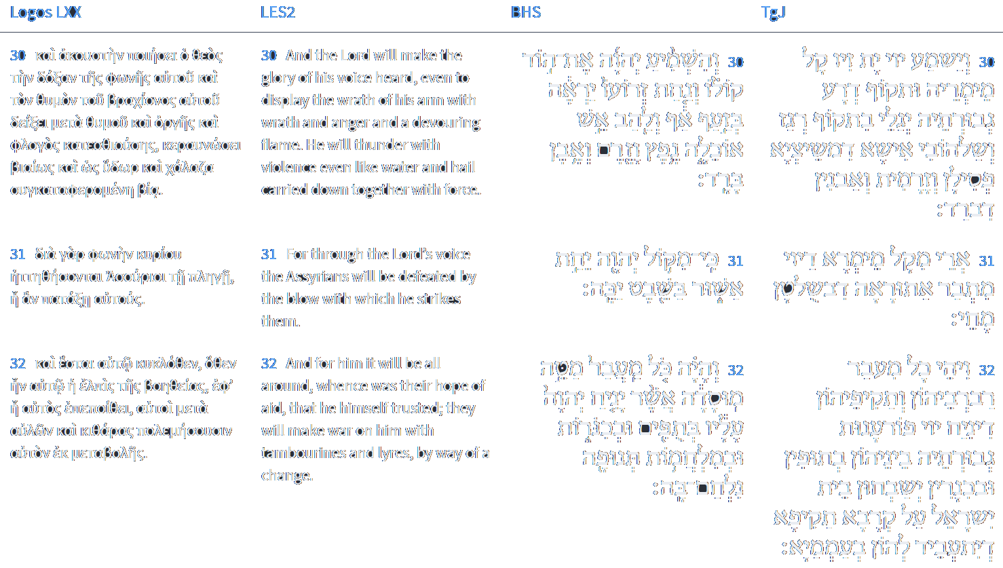
Isaiah 30:30-32
Isaiah / ישעיה
http://www.matsati.com

Slide 12
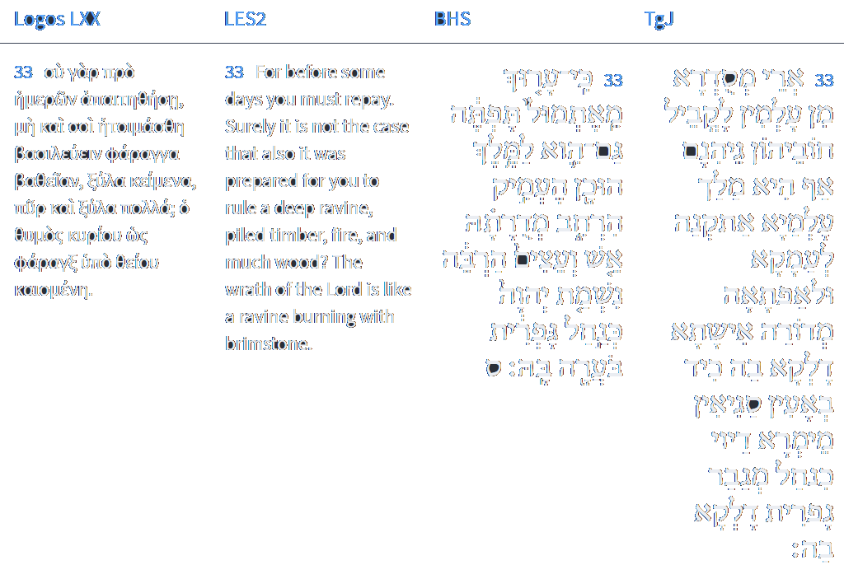
Isaiah 30:33
Isaiah / ישעיה
http://www.matsati.com

Slide 13
Rabbinic Literature
ספרות רבנית
Part 2
Isaiah / ישעיה
http://www.matsati.com

Slide 14
Targum Jonathan son of Uziel Isaiah 30:28-33
30:28 And His word is as an overwhelming river reaching unto the neck: He shall slay the mighty; He will assuredly agitate the nations with the agitation of vanity: and there shall be a bridle of error in the jaws of the people. 30:29 Ye shall have a song as in the night, as in the night when the festival is sanctified with joy of heart, as when they march with thanksgivings and the pipe, to enter the holy mountain of the Lord, to appear before the mighty One of Israel. 30:30 And the Lord shall proclaim the brightness of the voice of His WORD, and He shall reveal the strength of His arm in the fury of His anger, and in flames of fire, destroying the graven images with scattering, and storm, and hailstones. 30:31 For through the voice of the WORD of the Lord the Assyrian shall be broken, he that smote by his power. 30:32 And it shall come to pass, that the Lord shall cause to rest the vengeance of His might in every pass of their princes and mighty ones, even amongst them. The house of Israel shall praise with tabrets and harps, because of the mighty war which shall be waged for them against the people. 30:33 For hell is made ready from eternity on account of their sins; yea, the eternal King hath prepared it deep and wide: a fiery pyre as of abundance of fuel burns in it: the WORD of the Lord, like an overwhelming torrent of brimstone, shall kindle it. (TgJ)
Isaiah / ישעיה
http://www.matsati.com

Slide 15
Midrash Tanchuma Buber, Pekudei 8,5
יפה נוף וגו'. ר' לוי אמר נאה היא לעצמה, שהיא מניפה לאומות העולם, שנאמר להנפה גוים בנפת שוא ורסן מתעה על לחיי עמים (ישעיה ל כח). ( Ps. 48:3 [2]:) BEAUTEOUS LANDSCAPE (NWP)…. R. Levi said: <Jerusalem> is beautiful (N'P) in itself, because it sifts (rt.: NPH) the peoples of the world.38Cf.: PR 41:2. Thus it is stated (in Is. 30:28): TO SIFT (HNPH) THE NATIONS WITH THE SIEVE (rt.: NPH) OF DESTRUCTION, AND A MISLEADING BRIDLE SHALL BE IN THE JAWS OF THE PEOPLES.
Ibn Ezra on Isaiah 30,28 Part 2
להנפה. Most of the commentaries say that להנפה is the same as להניף, to wave;46A. V., To sift with the sieve of vanity.46A. V., To sift with the sieve of vanity. but R. Moses Hakkohen is of opinion, that it means to bridle, and that by the breath of God, the false spirit, described by Micaiah (1 Kgs. 22:19—23) is to be understood; and this is the right explanation. And there shall be a bridle in the jaws of the people, causing them to err. The bridle is put in the mouth of the horse, to make it go the right way, but the spirit mentioned here, will be רסן מתעה a misleading bridle. The same idea is expressed by ,בנפת שוא and this proves that להנפה has the meaning to bridle.
Isaiah / ישעיה
http://www.matsati.com

Slide 16
1 Kings 22:19–23
22:19 And he said, Hear thou therefore the word of the Lord: I saw the Lord sitting on his throne, and all the host of heaven standing by him on his right hand and on his left. 22:20 And the Lord said, Who shall persuade Ahab, that he may go up and fall at Ramoth-gilead? And one said on this manner, and another said on that manner. 22:21 And there came forth a spirit, and stood before the Lord, and said, I will persuade him. 22:22 And the Lord said unto him, Wherewith? And he said, I will go forth, and I will be a lying spirit in the mouth of all his prophets. And he said, Thou shalt persuade him, and prevail also: go forth, and do so. 22:23 Now therefore, behold, the Lord hath put a lying spirit in the mouth of all these thy prophets, and the Lord hath spoken evil concerning thee. (KJV וַיֹּ֕אמֶר לָכֵ֖ן שְׁמַ֣ע דְּבַר־יְהוָ֑ה רָאִ֤יתִי אֶת־יְהוָה֙ יֹשֵׁ֣ב עַל־כִּסְאֹ֔ו וְכָל־צְבָ֤א הַשָּׁמַ֨יִם֙ עֹמֵ֣ד עָלָ֔יו מִימִינֹ֖ו וּמִשְּׂמֹאלֹֽו׃ וַיֹּ֣אמֶר יְהוָ֗ה מִ֤י יְפַתֶּה֙ אֶת־אַחְאָ֔ב וְיַ֕עַל וְיִפֹּ֖ל בְּרָמֹ֣ת גִּלְעָ֑ד וַיֹּ֤אמֶר זֶה֙ בְּכֹ֔ה וְזֶ֥ה אֹמֵ֖ר בְּכֹֽה׃ וַיֵּצֵ֣א הָר֗וּחַ וַֽיַּעֲמֹד֙ לִפְנֵ֣י יְהוָ֔ה וַיֹּ֖אמֶר אֲנִ֣י אֲפַתֶּ֑נּוּ וַיֹּ֧אמֶר יְהוָ֛ה אֵלָ֖יו בַּמָּֽה׃ וַיֹּ֗אמֶר אֵצֵא֙ וְהָיִ֨יתִי֙ ר֣וּחַ שֶׁ֔קֶר בְּפִ֖י כָּל־נְבִיאָ֑יו וַיֹּ֗אמֶר תְּפַתֶּה֙ וְגַם־תּוּכָ֔ל צֵ֖א וַעֲשֵׂה־כֵֽן׃ וְעַתָּ֗ה הִנֵּ֨ה נָתַ֤ן יְהוָה֙ ר֣וּחַ שֶׁ֔קֶר בְּפִ֖י כָּל־נְבִיאֶ֣יךָ אֵ֑לֶּה וַֽיהוָ֔ה דִּבֶּ֥ר עָלֶ֖יךָ רָעָֽה׃)
Isaiah / ישעיה
http://www.matsati.com

Slide 17
Rashi on Isaiah 30,29 Parts 1-3
השיר יהיה לכם. בליל הפסח תבא לכם שמחה זו: This song shall be to you On the night of Passover shall this joy come to you.
כליל התקדש חג. כמו שאמרת' שיר של הפסחים במצרים ונראה מקרא זה כאילו בא ללמד על סנחרב ולימד על פרעה שאמרו הלל בליל אכילת פסחים מדרש תהלים: as the night of the sanctification of the festival Just as you recited a song over the Paschal sacrifices in Egypt [It appears from this verse as though he wishes to teach us about Sennacherib, but he teaches us about Pharaoh, that they recited Hallel on the night of the eating of the Paschal sacrifices. In Midrash Tehillim (1:20)].
כהולך בחליל. ותשמחו במפלת סנחריב כשמחת מביאי ביכורים שהיה החליל מכה לפניהם לבוא בהר ה', כמו ששנינו במס' בכורים: like one who goes with a flute And you shall rejoice with the downfall of Sennacherib like the joy of those who bring the First Fruits, before whom the flute would play, to come upon the mountain of God, as we learned in Tractate Bikkurim (3:4).
Isaiah / ישעיה
http://www.matsati.com

Slide 18
1 John 1:5–10
1:5 This then is the message which we have heard of him, and declare unto you, that God is light, and in him is no darkness at all. 1:6 If we say that we have fellowship with him, and walk in darkness, we lie, and do not the truth: 1:7 But if we walk in the light, as he is in the light, we have fellowship one with another, and the blood of Jesus Christ his Son cleanseth us from all sin. 1:8 If we say that we have no sin, we deceive ourselves, and the truth is not in us. 1:9 If we confess our sins, he is faithful and just to forgive us our sins, and to cleanse us from all unrighteousness. 1:10 If we say that we have not sinned, we make him a liar, and his word is not in us. (KJV 5 Καὶ ⸉ἔστιν αὕτη⸊ ἡ ⸀ἀγγελία ἣν ἀκηκόαμεν ἀπʼ αὐτοῦ καὶ ἀναγγέλλομεν ὑμῖν,* ὅτι ὁ θεὸς φῶς ἐστιν καὶ σκοτία ⸉1ἐν αὐτῷ οὐκ ἔστιν⸊ οὐδεμία.* 6 ἐὰν εἴπωμεν ὅτι κοινωνίαν ἔχομεν μετʼ* αὐτοῦ καὶ ἐν τῷ σκότει περιπατῶμεν,* ψευδόμεθα καὶ οὐ ποιοῦμεν τὴν ἀλήθειαν·* 7 ἐὰν* ♦⸆ἐν τῷ φωτὶ περιπατῶμεν,* ὡς αὐτός ἐστιν ἐν τῷ φωτί, κοινωνίαν ἔχομεν μετʼ ἀλλήλων,* καὶ τὸ αἷμα ⸂Ἰησοῦ τοῦ υἱοῦ αὐτοῦ⸃ ⸀καθαρίζει ἡμᾶς ἀπὸ πάσης ἁμαρτίας. 8 ἐὰν εἴπωμεν ὅτι ἁμαρτίαν οὐκ ἔχομεν,* ἑαυτοὺς πλανῶμεν καὶ ἡ ἀλήθεια ⸆ ♦⸉οὐκ ἔστιν ἐν ἡμῖν⸊.* 9 ἐὰν ὁμολογῶμεν τὰς ἁμαρτίας ἡμῶν, πιστός ἐστιν καὶ δίκαιος, ἵνα ἀφῇ ἡμῖν τὰς ἁμαρτίας ⸆ καὶ ⸀καθαρίσῃ ἡμᾶς ἀπὸ πάσης ἀδικίας.* 10 ἐὰν εἴπωμεν ὅτι οὐχ ⸀ἡμαρτήκαμεν, ψεύστην ποιοῦμεν αὐτόν,* καὶ ὁ λόγος αὐτοῦ ⸉οὐκ ἔστιν ἐν ἡμῖν⸊.)
Isaiah / ישעיה
http://www.matsati.com

Slide 19
Rashi on Isaiah 30,32 Part 1
והיה כל מעבר מטה מוסדה. כל מעברות תוקף יסודות אוכלוסיו כל המקומות אשר עברו שם והשחיתום וביום מפלתם יניח ה' עליהם על שמועת מפלתם והם יהיו בתפים ובכינורות, וכה פתרון המקרא בסירוס והיה בתפים ובכינורות כל מעבר מטה מוסדה אשר יניחם ה' עליו ובמלחמות תנופת שוא מעלה ומוריד נלחם בם הקב"ה, ומדרש אגדה תנופת קציר העומר עמדה לישראל באותה מלחמה כי ליל ששה עשר בניסן היה:
And it shall be, every place where the established staff shall pass All the crossings of the strength of the foundations of his armies; all the places they passed and destroyed, and on the day of their downfall the Lord shall grant peace upon them through the news of their downfall, and they shall be joyful with drums and harps. And this is the interpretation of the verse in inverted order: And it shall be with drums and harps, every passing of the established staff upon which the Lord shall grant peace, and with wars of vain waving, lifting and lowering, did the Holy One, blessed be He, fight against them. And, according to Midrash Aggadah, the waving of the harvest of the Omer stood up for Israel in that war, for it was the night of the sixteenth of Nissan
Isaiah / ישעיה
http://www.matsati.com

Slide 20
Talmud Bavli Eruvin 19a:19
וְהָאִיכָּא ״תׇּפְתֶּה״, דִּכְתִיב: ״כִּי עָרוּךְ מֵאֶתְמוּל תׇּפְתֶּה״, הָהוּא שֶׁכׇּל הַמִּתְפַּתֶּה בְּיִצְרוֹ יִפּוֹל שָׁם. The Gemara asks: Isn’t there also the name Tofte, as it is written: “For its hearth [tofte] is ordained of old” (Isaiah 30:33). The Gemara answers: That name too is a description, meaning that anyone who allows himself to be seduced [mitpateh] by his evil inclination will fall there.
Talmud Bavli Menachot 100a:2
ושמא תאמר למלך לא הוכנה תלמוד לאמר (ישעיהו ל, לג) גם היא למלך הוכן ושמא תאמר אין בה עצים תלמוד לאמר (ישעיהו ל, לג) מדורתה אש ועצים הרבה ושמא תאמר זה הוא שכרה תלמוד לומר (איוב לו, טז) ונחת שולחנך מלא דשן: And lest you say that Gehenna is prepared only for ordinary people, but it is not prepared for important individuals such as a king, the verse states: “It has been prepared even for the king.” And lest you say there is no wood in Gehenna, the verse states: “Its pile is fire and much wood.” And lest you say that this, i.e., escaping Gehenna, is the only reward for Torah study, the verse states: “And that which is set on your table is full of fatness” (Job 36:16). This indicates that one who obeys God and turns from the paths of death to the paths of life is not only saved from Gehenna, he also attains tranquility and prosperity
Isaiah / ישעיה
http://www.matsati.com

Slide 21
Akeidat Yitzchak 101:1 Part 3
The Talmud Nedarim 39, reports that seven things were created prior to the universe itself. They are: Torah, Teshuvah, the gan Eden, Gehinnom, G-d’s throne, the holy Temple and the name of the Messiah. Scriptural proof is provided. Concerning the Torah it is written "The Lord made me at the beginning of His ways." (Proverbs 8,22) Concerning Teshuvah, it is written before mountains were born and the earth suffered birth pangs, You turn man to contrition and say "return, ye children of man!" (Psalms 90,3) Of the garden of Eden (Genesis 2,8) it is said: "and the Lord planted a garden in Eden heretofore." Concerning Gehinnom it is written (Isaiah 30,33) "For Tophet in the valley of Hinnom has been prepared of old. He made it very deep; the pile thereof is fire and much wood; the breath of the Lord kindles it like a stream of brimstone." Of the throne of G-d it is said: (Psalms 93,2) "Your throne is firmly established from time immemorial." Of the holy Temple it is written in Jeremiah 17,22: "on high from the beginning, the place of Your sanctuary." Of the name of the Messiah it states (Psalms 72,17) "His name continues since prior to the sun."
Isaiah / ישעיה
http://www.matsati.com

Slide 22
Ein Yaakov (Glick Edition), Eiruvin 2:4
R. Joshua b. Levi said: "Gehenna has seven names; Grave, Place of Destruction, Dungeon, Horrible Pit, Miry Clay, Shadow of Death, and Subterranean Land. Grave, as it is written (Jonah 2, 3.) Out of the depth of the grave have I cried. Place of Destruction, as it is written (Ps. 88, 12.) Shall thy kindness be related in the grave, and thy righteousness in the place of destruction? Dungeon, as it is written (Ib. 16, 10.) For Thou wilt not abandon my soul to the grave; Thou wilt not suffer thy pious to see dungeon. And Horrible Pit, and Miry Clay, as it is written (Ib. 40, 3.) And he brought me up out of the horrible pit, and of the miry clay. Shadow of Death, as it is written (Ib. 107, 10.) Such as sit in darkness and in the shadow of death; and it is known by tradition under the name of Subterranean Land.'" Is there no other name [for Gehenna]? Behold, there is also Gei Hinom? This means only a valley which is as deep as Gehenna and to which people go to practice lewdness. There still remains the name, Topheth, as it is written (Is. 30, 33.) For already of old is Topheth made ready. This means that whoever is persuaded by his evil impulse, will fall in there. Concerning the locality of Paradise. Resh Lakish said: 'If it is in Palestine, its gate must be in the city of Beth Shean, [since it yields the best fruits]; If Paradise is situated in Araby then its gate is in the city of Beth Gerem [the most productive spot]. And if it is between the rivers it must be in Damaskanun." In Babylon, Abaye would praise the fruit growing on the other side of the Euphrates and Rabba would praise the fruit of the City of Harphania.
Isaiah / ישעיה
http://www.matsati.com

