Slide 1
MATSATI.COM Teaching Ministry
Website: https://www.matsati.com YouTube Channel: https://www.youtube.com/user/MATSATI/
ישעיהו ל:כא-כז / Isaiah 30:21-27
LIVE STREAM: 6:30 pm EST Thursday
Join us at Telegram:
https://t.me/MessianicChat
Rabbi Jeremiah
– The Apocalypse: connecting the Greek to the Ancient Hebrew text. (Wed. 9 am EST)
A Community
for Learning
Weekly Teachings Free Online
Check Telegram for weekly scheduling of teachings.
YouTube Channels
https://YouTube.com/c/HebrewLiteracy
https://www.youtube.com/channel/UC5_qPfruat-sCJJypz0_OBw
Discuss the Scriptures,
learn the languages,
and fellowship
Join Telegram ask about Hebrew and Greek classes!

Slide 2
Isaiah 30:21-27
ישעיהו ל:כא-כז
Isaiah / ישעיה
http://www.matsati.com

Slide 3
ספר דברים פרק כח
יד וְלֹא תָסוּר מִכָּל-הַדְּבָרִים אֲשֶׁר אָנֹכִי מְצַוֶּה אֶתְכֶם הַיּוֹם יָמִין וּשְֹמֹאול לָלֶכֶת אַחֲרֵי אֱלֹהִים אֲחֵרִים לְעָבְדָם: פ טו וְהָיָה אִם-לֹא תִשְׁמַע בְּקוֹל יְהוָֹה אֱלֹהֶיךָ לִשְׁמֹר לַעֲשֹוֹת אֶת-כָּל-מִצְוֹתָיו וְחֻקֹּתָיו אֲשֶׁר אָנֹכִי מְצַוְּךָ הַיּוֹם וּבָאוּ עָלֶיךָ כָּל-הַקְּלָלוֹת הָאֵלֶּה וְהִשִּׂיגוּךָ: טז אָרוּר אַתָּה בָּעִיר וְאָרוּר אַתָּה בַּשָּׂדֶה: יז אָרוּר טַנְאֲךָ וּמִשְׁאַרְתֶּךָ: יח אָרוּר פְּרִי-בִטְנְךָ וּפְרִי אַדְמָתֶךָ שְׁגַר אֲלָפֶיךָ וְעַשְׁתְּרֹת צֹאנֶךָ: יט אָרוּר אַתָּה בְּבֹאֶךָ וְאָרוּר אַתָּה בְּצֵאתֶךָ: כ יְשַׁלַּח יְהוָֹה | בְּךָ אֶת-הַמְּאֵרָה אֶת-הַמְּהוּמָה וְאֶת-הַמִּגְעֶרֶת בְּכָל-מִשְׁלַח יָדְךָ אֲשֶׁר תַּעֲשֶֹה עַד הִשָּׁמֶדְךָ וְעַד-אֲבָדְךָ מַהֵר מִפְּנֵי רֹעַ מַעֲלָלֶיךָ אֲשֶׁר עֲזַבְתָּנִי: כא יַדְבֵּק יְהוָֹה בְּךָ אֶת-הַדָּבֶר עַד כַּלֹּתוֹ אֹתְךָ מֵעַל הָאֲדָמָה אֲשֶׁר-אַתָּה בָא-שָׁמָּה לְרִשְׁתָּהּ: כב יַכְּכָה יְהֹוָה בַּשַּׁחֶפֶת וּבַקַּדַּחַת וּבַדַּלֶּקֶת וּבַחַרְחֻר וּבַחֶרֶב וּבַשִּׁדָּפוֹן וּבַיֵּרָקוֹן וּרְדָפוּךָ עַד אָבְדֶךָ: כג וְהָיוּ שָׁמֶיךָ אֲשֶׁר עַל-רֹאשְׁךָ נְחשֶׁת וְהָאָרֶץ אֲשֶׁר-תַּחְתֶּיךָ בַּרְזֶל:
Isaiah / ישעיה
http://www.matsati.com

Slide 4
ספר דברים פרק כח
א וְהָיָה אִם-שָׁמוֹעַ תִּשְׁמַע בְּקוֹל יְהוָֹה אֱלֹהֶיךָ לִשְׁמֹר לַעֲשֹוֹת אֶת-כָּל-מִצְוֹתָיו אֲשֶׁר אָנֹכִי מְצַוְּךָ הַיּוֹם וּנְתָנְךָ יְהוָֹה אֱלֹהֶיךָ עֶלְיוֹן עַל כָּל-גּוֹיֵי הָאָרֶץ: ב וּבָאוּ עָלֶיךָ כָּל-הַבְּרָכוֹת הָאֵלֶּה וְהִשִּׂיגֻךָ כִּי תִשְׁמַע בְּקוֹל יְהוָֹה אֱלֹהֶיךָ:
Devarim / Deuteronomy 28:1–2
28:1 And it shall come to pass, if thou shalt hearken diligently unto the voice of the Lord thy God, to observe and to do all his commandments which I command thee this day, that the Lord thy God will set thee on high above all nations of the earth: 28:2 And all these blessings shall come on thee, and overtake thee, if thou shalt hearken unto the voice of the Lord thy God. (KJV)
Isaiah / ישעיה
http://www.matsati.com

Slide 5
﻿ספר ישעיה פרק ל
﻿כא וְאָזְנֶיךָ תִּשְׁמַעְנָה דָבָר מֵאַחֲרֶיךָ לֵאמֹר זֶה הַדֶּרֶךְ לְכוּ בוֹ כִּי תַאֲמִינוּ וְכִי תַשְֹמְאִילוּ: כב וְטִמֵּאתֶם אֶת-צִפּוּי פְּסִילֵי כַסְפֶּךָ וְאֶת-אֲפֻדַּת מַסֵּכַת זְהָבֶךָ תִּזְרֵם כְּמוֹ דָוָה צֵא תֹּאמַר לוֹ: כג וְנָתַן מְטַר זַרְעֲךָ אֲשֶׁר-תִּזְרַע אֶת-הָאֲדָמָה וְלֶחֶם תְּבוּאַת הָאֲדָמָה וְהָיָה דָשֵׁן וְשָׁמֵן יִרְעֶה מִקְנֶיךָ בַּיּוֹם הַהוּא כַּר נִרְחָב: כד וְהָאֲלָפִים וְהָעֲיָרִים עֹבְדֵי הָאֲדָמָה בְּלִיל חָמִיץ יֹאכֵלוּ אֲשֶׁר-זֹרֶה בָרַחַת וּבַמִּזְרֶה: כה וְהָיָה | עַל-כָּל-הַר גָּבֹהַּ וְעַל כָּל-גִּבְעָה נִשָּׂאָה פְּלָגִים יִבְלֵי-מָיִם בְּיוֹם הֶרֶג רָב בִּנְפֹל מִגְדָּלִים: כו וְהָיָה אוֹר-הַלְּבָנָה כְּאוֹר הַחַמָּה וְאוֹר הַחַמָּה יִהְיֶה שִׁבְעָתַיִם כְּאוֹר שִׁבְעַת הַיָּמִים בְּיוֹם חֲבֹשׁ יְהֹוָה אֶת-שֶׁבֶר עַמּוֹ וּמַחַץ מַכָּתוֹ יִרְפָּא: כז הִנֵּה שֵׁם-יְהֹוָה בָּא מִמֶּרְחָק בֹּעֵר אַפּוֹ וְכֹבֶד מַשָּׂאָה שְֹפָתָיו מָלְאוּ זַעַם וּלְשׁוֹנוֹ כְּאֵשׁ אֹכָלֶת:
Isaiah / ישעיה
http://www.matsati.com

Slide 6
ספר דברים פרק ד
יב וַיְדַבֵּר יְהוָֹה אֲלֵיכֶם מִתּוֹךְ הָאֵשׁ קוֹל דְּבָרִים אַתֶּם שֹׁמְעִים וּתְמוּנָה אֵינְכֶם רֹאִים זוּלָתִי קוֹל:
Devarim / Deuteronomy 4:12
4:12 And the Lord spake unto you out of the midst of the fire: ye heard the voice of the words, but saw no similitude; only ye heard a voice. (KJV)
Isaiah / ישעיה
http://www.matsati.com

Slide 7
Galatians 5:16–25
5:16 This I say then, Walk in the Spirit, and ye shall not fulfil the lust of the flesh. 5:17 For the flesh lusteth against the Spirit, and the Spirit against the flesh: and these are contrary the one to the other: so that ye cannot do the things that ye would. 5:18 But if ye be led of the Spirit, ye are not under the law. 5:19 Now the works of the flesh are manifest, which are these; Adultery, fornication, uncleanness, lasciviousness, 5:20 Idolatry, witchcraft, hatred, variance, emulations, wrath, strife, seditions, heresies, 5:21 Envyings, murders, drunkenness, revellings, and such like: of the which I tell you before, as I have also told you in time past, that they which do such things shall not inherit the kingdom of God. 5:22 But the fruit of the Spirit is love, joy, peace, longsuffering, gentleness, goodness, faith, 5:23 Meekness, temperance: against such there is no law. 5:24 And they that are Christ’s have crucified the flesh with the affections and lusts. 5:25 If we live in the Spirit, let us also walk in the Spirit. (KJV,)
Isaiah / ישעיה
http://www.matsati.com

Slide 8
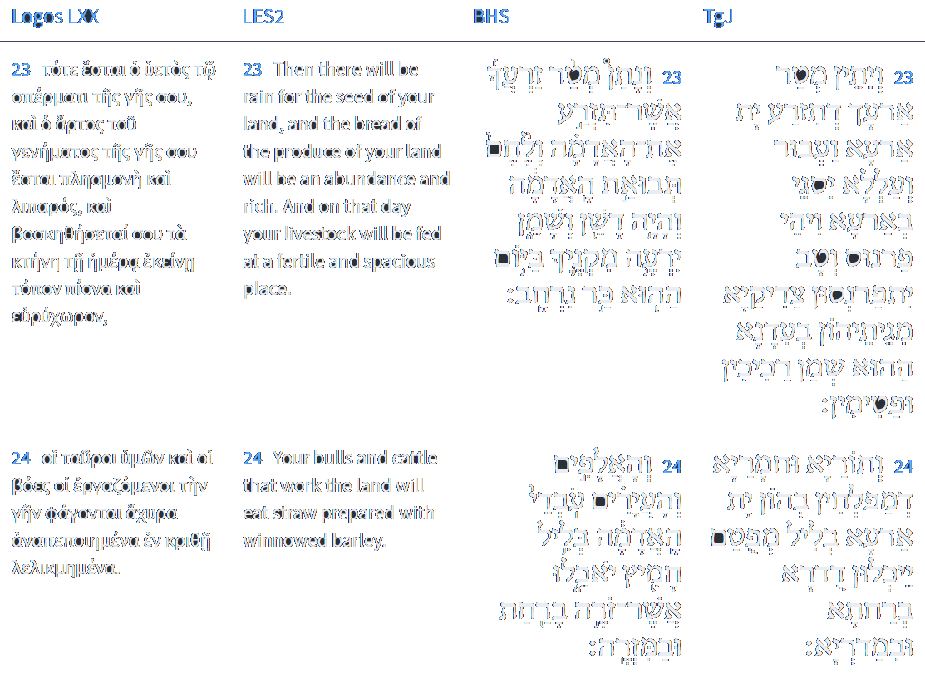
Isaiah 30:23-24
Isaiah / ישעיה
http://www.matsati.com

Slide 9
Sibylline Oracles 3.680-685
680* He will break the lofty summits of the mountains and the mounds of giants and the dark abyss will appear to all. High ravines in lofty mountains will be full of corpses. Rocks will flow with blood and every torrent will fill the plain. 685 All well-constructed walls of hostile men will fall to the ground, because they knew neither the law nor the judgment of the great God, but with mindless spirit you all launched an attack and raised spears against the sanctuary. God will judge all men by war and sword. (James H. Charlesworth, The Old Testament Pseudepigrapha, vol. 1, New York; London: Yale University Press, 1983, 377)
Isaiah / ישעיה
http://www.matsati.com

Slide 10
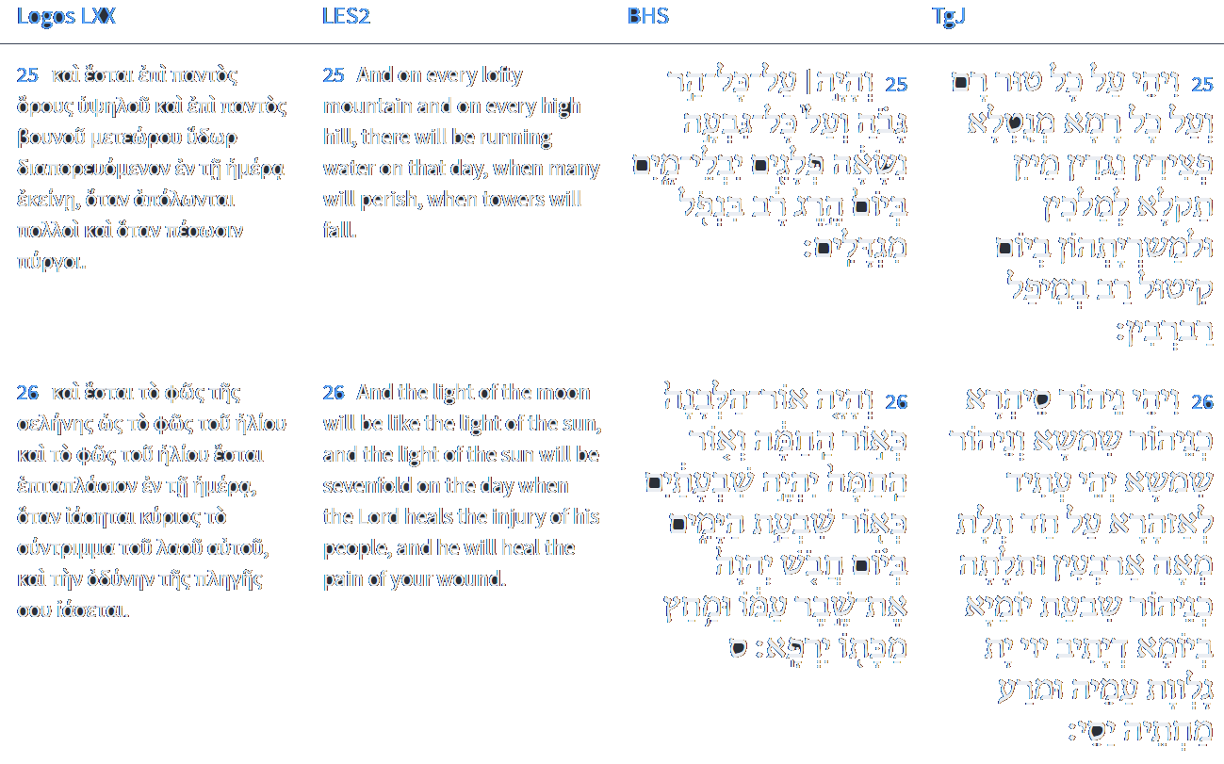
Isaiah 30:25-26
Isaiah / ישעיה
http://www.matsati.com

Slide 11
Rabbinic Literature
ספרות רבנית
Part 2
Isaiah / ישעיה
http://www.matsati.com

Slide 12
Targum Jonathan son of Uziel Isaiah 30:21-27
30:21 And thine ears shall hear a word behind thee, saying, This is the right way, walk ye in it, and turn ye not from it to the right, or to the left. 30:22 And ye shall defile the covering of your idols of silver, and the ornament of thy molten images of gold; ye shall abominate it, as they abominate the impurity of a menstruous woman, thus ye shall abominate it. 30:23 Then shall He give rain for thy seed, with which thou shalt sow the ground, and corn and fruit shall increase in the land, and there shall be sustenance and goodness; and at that time, the just shall be nourished from their cattle, with the marrow of the tender and the fat ones. 30:24 And the oxen and the asses, with which they plough the ground, shall eat fattening meslin, which has been winnowed with the shovel and with the fan. 30:25 And there shall be upon every high mountain, and upon every high and lofty hill, rivers flowing with water at the time of the ruin of the kings and their armies, in the day of the great slaughter, at the falling of the princes. 30:26 Moreover the light of the moon shall be as the light of the sun, and the light of the sun shall in future shine three hundred and forty-three times more brightly, as the light of seven days, in the day that the Lord shall turn the captivity of His people, and heal the sickness caused by His blow. 30:27 Behold, the Name of the Lord shall be revealed, as the prophets of old have prophesied concerning Him: His wrath is mighty, and too heavy to bear. His curse shall go forth from before Him upon the wicked, and His word as a consuming fire. (TgJ)
Isaiah / ישעיה
http://www.matsati.com

Slide 13
Ephesians 4:22-24
22 That ye put off concerning the former conversation the old man, which is corrupt according to the deceitful lusts; 23 And be renewed in the spirit of your mind; 24 And that ye put on the new man, which after God is created in righteousness and true holiness. (KJV, 22 ἀποθέσθαι ὑμᾶς κατὰ τὴν προτέραν ἀναστροφὴν τὸν παλαιὸν ἄνθρωπον τὸν φθειρόμενον κατὰ ⸂τὰς ἐπιθυμίας⸃ τῆς ἀπάτης,* 23 ⸀ἀνανεοῦσθαι δὲ ⸆ τῷ πνεύματι τοῦ νοὸς ὑμῶν* 24 καὶ ⸀ἐνδύσασθαι τὸν καινὸν ἄνθρωπον τὸν κατὰ θεὸν κτισθέντα ἐν δικαιοσύνῃ καὶ ὁσιότητι ⸂τῆς ἀληθείας⸃.*)
Isaiah / ישעיה
http://www.matsati.com

Slide 14
Akeidat Yitzchak 100:1:5
Since man's purpose therefore cannot be achieved without valiant effort on his part, and we observe more people regressing rather than progressing, the Lord, in His infinite wisdom created the vehicle of repentance. This will give those who have erred along the way a chance to return to the proper path. Each group of people,- in accordance with their respective characteristics,- is given a chance to do repentance accordingly. The best kind of baal teshuvah, penitent sinner, is the person or group of persons who is constantly worried about having committed a sin, and who therefore repents instantly, as soon as he becomes aware of an error committed. Such people seek to prove their having repented by exposing themselves to circumstances similar to the ones in which they had previously failed. In this fashion they can prove the viability of their repentance. Another type of baal teshuvah is the sinner who is aware of errors committed, but who lacks a sense of urgency and needs to be prodded into active repentance. Such people call on the Priests and the Levites for guidance in order to find the way back to Hashem. Then there is the third group of sinners, who do not consider repentance until the consequences of their sins have caught up with them, and they have discovered that the path they had chosen for themselves was useless.
Isaiah / ישעיה
http://www.matsati.com

Slide 15
Rashi on Isaiah 30,21 Part 1
ואזניך תשמענה וגו'. לא כמו שאתם עושים עתה שאתם מואסים בדברו ואומרים לא תחזו לנו נכוחות כי אם אזניך יהיו נטויות אף אחריך לשמוע דבר מאתי אולי יבא נביא ויורך דרך ללכת בין ימין ובין שמאל: And your ears shall hear from behind you Not as you do now, that you despise My words and say, “You shall not prophesy for us true things” (verse 10), but your ears shall be bent also behind you to hear from Me, perhaps a prophet will come and instruct you the way to go, whether right or left
Isaiah / ישעיה
http://www.matsati.com

Slide 16
Rashi on Isaiah 30,24 Parts 1-5
והאלפים. שוורי': And the oxen. (אֲלָפִים) oxen.
בליל חמיץ. כמו (איוב ז) על בלילו, קשין ותבן מחומצין ומחוזקין בתבואה שבתוכם יאכלו: enriched provender (בְּלִיל חָמִיץ) comp. (Job 6:5) “On his provender (בְּלִילוֹ).” Stubble and straw, strengthened and enriched with the grain within them, they shall eat.
אשר זורה. התבואה פעמיים אחת ברחת ואחת במזרה כדי לנקות התבואה לפיכך יהיה התבן בלול בתבוא' שזורה במזרה אצל הקשין: which was winnowed The grain is winnowed twice, once with a shovel and once with a fan, in order to clean the grain. Therefore, the straw will be mixed with grain that was winnowed with a fan near the stubble.
רחת. פיל"א בלע"ז: shovel (רַחַת) paile (pelle) in O.F.
מזרה. יו"ן בלע"ז, ומדרש אגדה בליל ל' בלול שיהא האוכל בלול בתבן: (fan, [מִזְרֶה] van in O.F.) And the Midrash Aggadah states that בְּלִיל is an expression of mixing, that the food will be mixed into the straw. (I.e., the grain will be so plentiful that it will be mixed into the straw eaten by the cattle and donkeys.)
Isaiah / ישעיה
http://www.matsati.com

Slide 17
Da'at Tevunoth 122
122 And indeed, what needs to be understood now is the measure of the strength of the soul which is given to it to and within this body. And this, for if its strength was great and its light very powerful - certainly it would give so much great illumination to the body that it would elevate it in its existence, and its deficiencies would be completed in one moment, and the evil inclination - it is essential in the deficiencies which the Master may he be blessed wanted for the purpose of free will and reward and punishment - behold would not rule over man at all, as it does not rule over angels because of the abundance of their illumination and the perfection of their knowledge and importance. You should know that in the future it says (Isaiah 11:9), "They shall not do evil nor corrupt throughout my holy mountain for the land will be filled with knowledge"; and at that same time it says (Ezekiel 36:26), "and I shall remove the heart of stone from their flesh...", to the greatness of the elevation of the soul which will be greater in that time. And indeed from another aspect, behold if the soul were in its essential existence of lowliness and not greatness, it would not be able to stand in the face of the glory and greatness which will be done to it in the future, to be greater than the angels of service:
Isaiah / ישעיה
http://www.matsati.com

Slide 18
Daniel 12:2–3
12:2 And many of them that sleep in the dust of the earth shall awake, some to everlasting life, and some to shame and everlasting contempt. 12:3 And they that be wise shall shine as the brightness of the firmament; and they that turn many to righteousness as the stars for ever and ever. (KJV וְרַבִּ֕ים מִיְּשֵׁנֵ֥י אַדְמַת־עָפָ֖ר יָקִ֑יצוּ אֵ֚לֶּה לְחַיֵּ֣י עֹולָ֔ם וְאֵ֥לֶּה לַחֲרָפֹ֖ות לְדִרְאֹ֥ון עֹולָֽם׃ ס וְהַ֨מַּשְׂכִּלִ֔ים יַזְהִ֖רוּ כְּזֹ֣הַר הָרָקִ֑יעַ וּמַצְדִּיקֵי֙ הָֽרַבִּ֔ים כַּכֹּוכָבִ֖ים לְעֹולָ֥ם וָעֶֽד׃ פ)
Matthew 5:16
5:16 Let your light so shine before men, that they may see your good works, and glorify your Father which is in heaven. (KJV 16 οὕτως λαμψάτω τὸ φῶς ὑμῶν ἔμπροσθεν τῶν ἀνθρώπων,* ὅπως ἴδωσιν ὑμῶν τὰ καλὰ °ἔργα καὶ δοξάσωσιν τὸν πατέρα ὑμῶν τὸν ἐν τοῖς οὐρανοῖς.)
Isaiah / ישעיה
http://www.matsati.com

Slide 19
Matthew 13:42–43
13:42 And shall cast them into a furnace of fire: there shall be wailing and gnashing of teeth. 13:43 Then shall the righteous shine forth as the sun in the kingdom of their Father. Who hath ears to hear, let him hear. (KJV 43 τότε οἱ δίκαιοι ἐκλάμψουσιν ὡς ὁ ἥλιος ἐν τῇ βασιλείᾳ ⸂τοῦ πατρὸς αὐτῶν⸃. ὁ ἔχων ὦτα ⸆ ἀκουέτω.)
Philippians 2:14–15
2:14 Do all things without murmurings and disputings: 2:15 That ye may be blameless and harmless, the sons of God, without rebuke, in the midst of a crooked and perverse nation, among whom ye shine as lights in the world; (KJV, 14 Πάντα ποιεῖτε χωρὶς γογγυσμῶν καὶ διαλογισμῶν,* 15 ἵνα ⸀γένησθε ἄμεμπτοι καὶ ἀκέραιοι, τέκνα θεοῦ ⸁ἄμωμα μέσον γενεᾶς σκολιᾶς καὶ διεστραμμένης,* ἐν οἷς φαίνεσθε ὡς φωστῆρες ἐν κόσμῳ,*)
Isaiah / ישעיה
http://www.matsati.com

Slide 20
Bereishit Rabbah 3:6
And God called the light day - Is it not day when there's light? This is surprising! It is taught: the light that was created in the six days of Creation cannot illuminate during the day because it dims the sun, and at night it cannot since it was only created to illuminate during the day. And where is it? It is hidden,and is prepared for the righteous for the Future, as it says "and the light of the moon will be like the light of the sun, and the light of the sun will be seven times like the light of the seven days" (Isaiah 30:26). This is surprising! Seven? Aren't they three (days)? Weren't the luminaries created on the fourth? Rather, it is like a person who says 'such and such way I order for the seven days of my wedding feast.' Rabbi Nechemiah said: these are the seven days of mourning for the righteous Metushelach, that the Holy One of Blessing gave to them light in abundance. 'And God saw that the light was good' - Rabbi Ze'ira the son of Rabbi Abahu explained in Cesarea: from where do we know that we do not say a blessing over the candle before its light is established? From here: and He saw; and He separated. Rabbi Yehudah in the name of Rabbi Simon said: He separated it for Himself. The rabbis say: He separated it for the righteous in the Future. This is similar to a king who had a beautiful meal and separated it for his son. Said Rabbi Berachiah: 'Rabbi Yochanan and Rabbi Shimeon ben Lakish, two great ones of the world, explained this: 'and He separated' is a complete separation. This is similar to a king who had two commanders, one to command during the day and one to command during the night, and the two were disputing with one another, one saying 'I command during the day' and the other saying 'I command during the day.' So the king called the first one and said: 'Ploni, the day will be your charge.' And so to the second and said: 'Ploni, the night will be your charge.' Said Rabbi Yochanan: 'This is what the Holy One of Blessing said to Job: "Have you commanded the morning since your days began, and caused the dawn to know its place?" (Job 38:12) Do you know your place? This is surprising. Said Rabbi Tanchuma: 'I will say its reason: "Fashioner of Light and Creator of Darkness, Maker of Peace" (Isaiah 45:7) From the moment of its creation, He makes peace. 'And God called the light day' - said Rabbi Eleazar: The Holy One of Blessing never unites His name to evil, only to goodness: it is not written 'and God called the light day; and the darkness God called night'; rather, [it is written] 'and the darkness, called night.'
Isaiah / ישעיה
http://www.matsati.com

