Slide 1
MATSATI.COM Teaching Ministry
Website: https://www.matsati.com YouTube Channel: https://www.youtube.com/user/MATSATI/
ישעיהו ל:טו-כ / Isaiah 30:15-20
LIVE STREAM: 6:30 pm EST Thursday
Join us at Telegram:
https://t.me/MessianicChat
Rabbi Jeremiah
– The Apocalypse: Book of Revelation
– Psalms Studies: Intermediate Hebrew
A Community
for Learning
Weekly Teachings Free Online
Check Telegram for weekly scheduling of teachings.
YouTube Channels
https://YouTube.com/c/HebrewLiteracy
https://www.youtube.com/channel/UC5_qPfruat-sCJJypz0_OBw
Discuss the Scriptures,
learn the languages,
and fellowship
Join Telegram ask about Hebrew and Greek classes!

Slide 2
Isaiah 30:15-20
ישעיהו ל:טו-כ
Isaiah / ישעיה
http://www.matsati.com

Slide 3
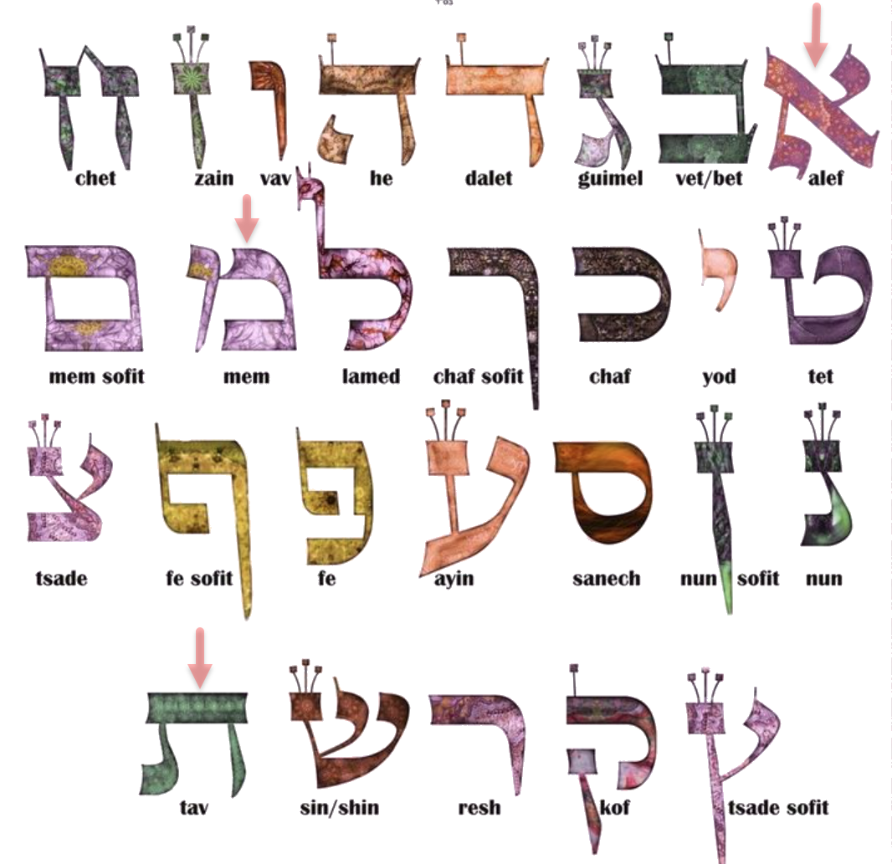
Isaiah / ישעיה
http://www.matsati.com

Slide 4
ספר מלאכי פרק ב
ו תֹּורַ֤ת אֱמֶת֙ הָיְתָ֣ה בְּפִ֔יהוּ וְעַוְלָ֖ה לֹא־נִמְצָ֣א בִשְׂפָתָ֑יו בְּשָׁלֹ֤ום וּבְמִישֹׁור֙ הָלַ֣ךְ אִתִּ֔י וְרַבִּ֖ים הֵשִׁ֥יב מֵעָוֹֽן׃
Malachi 2:6
2:6 The law of truth was in his mouth, And iniquity was not found in his lips: He walked with me in peace and equity, And did turn many away from iniquity. (KJV)
Isaiah / ישעיה
http://www.matsati.com

Slide 5
Bereishit Rabbah 1:7
רַבִּי יִצְחָק פָּתַח (תהלים קיט, קס): רֹאשׁ דְּבָרְךָ אֱמֶת וגו', אָמַר רַבִּי יִצְחָק מִתְּחִלַּת בְּרִיָּתוֹ שֶׁל עוֹלָם רֹאשׁ דְּבָרְךָ אֱמֶת. בְּרֵאשִׁית בָּרָא אֱלֹהִים, (ירמיה י, י): וַה' אֱלֹהִים אֱמֶת. וּלְעוֹלָם כָּל מִשְׁפַּט צִדְקֶךָ, שֶׁכָּל גְּזֵרָה וּגְזֵרָה שֶׁאַתָּה גּוֹזֵר עַל בְּרִיּוֹתֶיךָ הֵן מַצְדִיקִין עֲלֵיהֶם אֶת הַדִּין וּמְקַבְּלִין אוֹתוֹ בֶּאֱמוּנָה, וְאֵין כָּל בְּרִיָה יְכוֹלָה לוֹמַר שְׁתֵּי רְשֻׁיּוֹת בָּרְאוּ הָעוֹלָם. וַיְדַבְּרוּ אֱלֹהִים, אֵין כְּתִיב כָּאן, אֶלָּא וַיְדַבֵּר אֱלֹהִים. וַיֹּאמְרוּ אֱלֹהִים, אֵין כְּתִיב כָּאן, אֶלָּא וַיֹּאמֶר אֱלֹהִים. בְּרֵאשִׁית בָּרְאוּ אֱלֹהִים, אֵין כְּתִיב כָּאן, אֶלָּא בָּרָא אֱלֹהִים.
Rabbi Yitzchak opened with (Psalms 119:160): "The beginning of Your word is truth, and Your righteous law is forever." Rabbi Yitzchak said: From the beginning of the creation of the world "the beginning of Your word is truth." "In the beginning God created"--(Jeremiah 10:10) "Your God is true." "And Your righteous law is forever"--that for every restriction that you place on your creations, they affirm the righteousness of your judgement and accept it with faith. No creation can say that two powers created the world. It is not written: "the gods spoke", but rather: "God spoke". It is not written: "the gods said", but rather: "God said". It is not written: "in the beginning the gods created", but rather: "God created”
Isaiah / ישעיה
http://www.matsati.com

Slide 6
ספר בראשית פרק ב
ג וַיְבָ֤רֶךְ אֱלֹהִים֙ אֶת־יֹ֣ום הַשְּׁבִיעִ֔י וַיְקַדֵּ֖שׁ אֹתֹ֑ו כִּ֣י בֹ֤ו שָׁבַת֙ מִכָּל־מְלַאכְתֹּ֔ו אֲשֶׁר־בָּרָ֥א אֱלֹהִ֖ים לַעֲשֹֽׂות׃
Bereshit / Genesis 2:3
2:3 And God blessed the seventh day, and sanctified it: because that in it he had rested from all his work which God created and made. (KJV)
Isaiah / ישעיה
http://www.matsati.com

Slide 7
﻿ספר ישעיה פרק ל
﻿טו כִּי כֹה-אָמַר אֲדֹנָי יְהֶוִֹה קְדוֹשׁ יִשְֹרָאֵל בְּשׁוּבָה וָנַחַת תִּוָּשֵׁעוּן בְּהַשְׁקֵט וּבְבִטְחָה תִּהְיֶה גְּבוּרַתְכֶם וְלֹא אֲבִיתֶם: טז וַתֹּאמְרוּ לֹא-כִי עַל-סוּס נָנוּס עַל-כֵּן תְּנוּסוּן וְעַל-קַל נִרְכָּב עַל-כֵּן יִקַּלּוּ רֹדְפֵיכֶם: יז אֶלֶף אֶחָד מִפְּנֵי גַּעֲרַת אֶחָד מִפְּנֵי גַּעֲרַת חֲמִשָּׁה תָּנֻסוּ עַד אִם-נוֹתַרְתֶּם כַּתֹּרֶן עַל-רֹאשׁ הָהָר וְכַנֵּס עַל-הַגִּבְעָה: יח וְלָכֵן יְחַכֶּה יְהֹוָה לַחֲנַנְכֶם וְלָכֵן יָרוּם לְרַחֶמְכֶם כִּי-אֱלֹהֵי מִשְׁפָּט יְהֹוָה אַשְׁרֵי כָּל-חוֹכֵי לוֹ: יט כִּי-עַם בְּצִיּוֹן יֵשֵׁב בִּירוּשָׁלָם בָּכוֹ לֹא-תִבְכֶּה חָנוֹן יָחְנְךָ לְקוֹל זַעֲקֶךָ כְּשָׁמְעָתוֹ עָנָךְ: כ וְנָתַן לָכֶם אֲדֹנָי לֶחֶם צָר וּמַיִם לָחַץ וְלֹא-יִכָּנֵף עוֹד מוֹרֶיךָ וְהָיוּ עֵינֶיךָ רֹאוֹת אֶת-מוֹרֶיךָ:
Isaiah / ישעיה
http://www.matsati.com

Slide 8
Acts 3:19
3:19 Repent ye therefore, and be converted, that your sins may be blotted out, when the times of refreshing shall come from the presence of the Lord; (KJV, 19 μετανοήσατε οὖν καὶ ἐπιστρέψατε ⸀εἰς τὸ ἐξαλειφθῆναι ὑμῶν τὰς ἁμαρτίας,*)
Isaiah / ישעיה
http://www.matsati.com

Slide 9
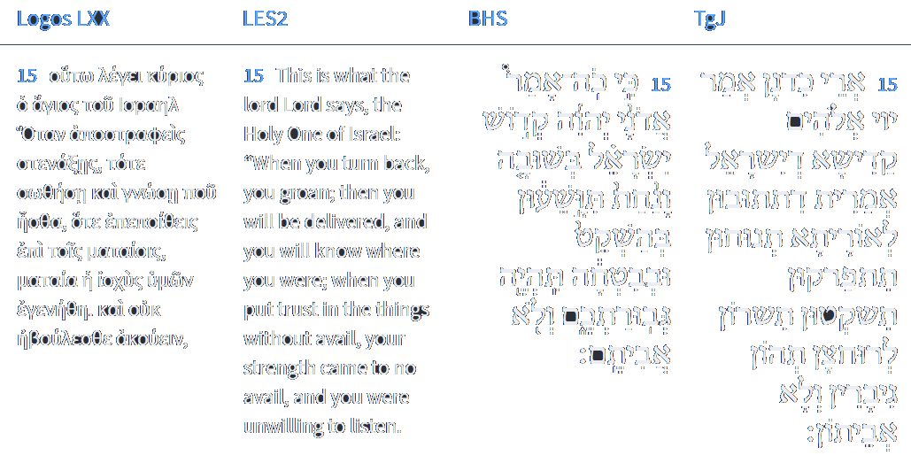
Isaiah 30:15
Isaiah / ישעיה
http://www.matsati.com

Slide 10
ספר דברים פרק יז
טז רַק לֹא-יַרְבֶּה-לּוֹ סוּסִים וְלֹא-יָשִׁיב אֶת-הָעָם מִצְרַיְמָה לְמַעַן הַרְבּוֹת סוּס וַיהוָֹה אָמַר לָכֶם לֹא תֹסִפוּן לָשׁוּב בַּדֶּרֶךְ הַזֶּה עוֹד:
Devarim / Deuteronomy 17:16
17:16 But he shall not multiply horses to himself, nor cause the people to return to Egypt, to the end that he should multiply horses: forasmuch as the Lord hath said unto you, Ye shall henceforth return no more that way. (KJV)
Isaiah / ישעיה
http://www.matsati.com

Slide 11
Mekhilta d'Rabbi Yishmael 14:13 Part 2
For as you see Egypt: In three places the L rd exhorted Israel not to return to Egypt: (Here:) "for as you see Egypt this day, you shall see them no more, forever", (Devarim 17:16) "You must not go back this way again", (Ibid. 28:68) "… by the way which I told you, you shall not see it again." Three times they returned and three times they fell. The first, in the days of Sancheriv, viz. (Isaiah 31:1) "Woe unto those who go down to Egypt for help!" The second, in the days of Yochanan ben Kareach, (Jeremiah 42:16-17) "And it shall be, the sword which you fear will overtake you there in the land of Egypt and the famine which you worry over will follow after you in Egypt, and there will you die." The third, in the days of Trajanus. Three times they returned and three times they fell. As it is written, (Hoshea 7:11) "Ephraim is a silly dove, without a heart. They have called to Egypt, etc. Israel were four factions at the sea: One was for lunging into the sea; another, for returning to Egypt; another for warring against them; another, for crying out against them. Those who were for lunging into the sea — it was said to them: "Stand ready to see the salvation of the L rd. Those who were for returning to Egypt — it was said to them: "For as you see Egypt this day, you shall see them no more, forever." Those who were for warring against it — it was said to them: "the L rd will war for you." Those who were crying out against them — it was said to them: "And you be still."
Isaiah / ישעיה
http://www.matsati.com

Slide 12
Devarim / Deuteronomy 28:20–28
28:20 The Lord shall send upon thee cursing, vexation, and rebuke, in all that thou settest thine hand unto for to do, until thou be destroyed, and until thou perish quickly; because of the wickedness of thy doings, whereby thou hast forsaken me. 28:21 The Lord shall make the pestilence cleave unto thee, until he have consumed thee from off the land, whither thou goest to possess it. 28:22 The Lord shall smite thee with a consumption, and with a fever, and with an inflammation, and with an extreme burning, and with the sword, and with blasting, and with mildew; and they shall pursue thee until thou perish. 28:23 And thy heaven that is over thy head shall be brass, and the earth that is under thee shall be iron. 28:24 The Lord shall make the rain of thy land powder and dust: from heaven shall it come down upon thee, until thou be destroyed. 28:25 The Lord shall cause thee to be smitten before thine enemies: thou shalt go out one way against them, and flee seven ways before them: and shalt be removed into all the kingdoms of the earth. 28:26 And thy carcase shall be meat unto all fowls of the air, and unto the beasts of the earth, and no man shall fray them away. 28:27 The Lord will smite thee with the botch of Egypt, and with the emerods, and with the scab, and with the itch, whereof thou canst not be healed. 28:28 The Lord shall smite thee with madness, and blindness, and astonishment of heart: (KJV)
Isaiah / ישעיה
http://www.matsati.com

Slide 13
ספר דברים פרק כח
﻿ז יִתֵּן יְהוָֹה אֶת-אֹיְבֶיךָ הַקָּמִים עָלֶיךָ נִגָּפִים לְפָנֶיךָ בְּדֶרֶךְ אֶחָד יֵצְאוּ אֵלֶיךָ וּבְשִׁבְעָה דְרָכִים יָנוּסוּ לְפָנֶיךָ:
Devarim / Deuteronomy 28:7
28:7 The Lord shall cause thine enemies that rise up against thee to be smitten before thy face: they shall come out against thee one way, and flee before thee seven ways. (KJV)
Isaiah / ישעיה
http://www.matsati.com

Slide 14
Shemot / Exodus 34:1–10
34:1 And the Lord said unto Moses, Hew thee two tables of stone like unto the first: and I will write upon these tables the words that were in the first tables, which thou brakest. 34:2 And be ready in the morning, and come up in the morning unto mount Sinai, and present thyself there to me in the top of the mount. 34:3 And no man shall come up with thee, neither let any man be seen throughout all the mount; neither let the flocks nor herds feed before that mount. 34:4 And he hewed two tables of stone like unto the first; and Moses rose up early in the morning, and went up unto mount Sinai, as the Lord had commanded him, and took in his hand the two tables of stone. 34:5 And the Lord descended in the cloud, and stood with him there, and proclaimed the name of the Lord. 34:6 And the Lord passed by before him, and proclaimed, The Lord, The Lord God, merciful and gracious, longsuffering, and abundant in goodness and truth, 34:7 Keeping mercy for thousands, forgiving iniquity and transgression and sin, and that will by no means clear the guilty; visiting the iniquity of the fathers upon the children, and upon the children’s children, unto the third and to the fourth generation. 34:8 And Moses made haste, and bowed his head toward the earth, and worshipped. 34:9 And he said, If now I have found grace in thy sight, O Lord, let my Lord, I pray thee, go among us; for it is a stiffnecked people; and pardon our iniquity and our sin, and take us for thine inheritance. 34:10 And he said, Behold, I make a covenant: before all thy people I will do marvels, such as have not been done in all the earth, nor in any nation: and all the people among which thou art shall see the work of the Lord: for it is a terrible thing that I will do with thee. (KJV)
Isaiah / ישעיה
http://www.matsati.com

Slide 15
John 3:16–21
3:16 For God so loved the world, that he gave his only begotten Son, that whosoever believeth in him should not perish, but have everlasting life. 3:17 For God sent not his Son into the world to condemn the world; but that the world through him might be saved. 3:18 He that believeth on him is not condemned: but he that believeth not is condemned already, because he hath not believed in the name of the only begotten Son of God. 3:19 And this is the condemnation, that light is come into the world, and men loved darkness rather than light, because their deeds were evil. 3:20 For every one that doeth evil hateth the light, neither cometh to the light, lest his deeds should be reproved. 3:21 But he that doeth truth cometh to the light, that his deeds may be made manifest, that they are wrought in God. (KJV, 16 οὕτως γὰρ ἠγάπησεν ὁ θεὸς τὸν κόσμον, ὥστε τὸν υἱὸν ⸆ τὸν μονογενῆ ἔδωκεν, ἵνα πᾶς ὁ πιστεύων εἰς αὐτὸν μὴ ἀπόληται ἀλλʼ ἔχῃ ζωὴν αἰώνιον.* 17 οὐ γὰρ ἀπέστειλεν ὁ θεὸς τὸν υἱὸν ⸆ εἰς τὸν κόσμον ἵνα κρίνῃ τὸν κόσμον, ἀλλʼ ἵνα σωθῇ ὁ κόσμος διʼ αὐτοῦ. 18 ὁ πιστεύων εἰς αὐτὸν οὐ κρίνεται· ὁ °δὲ μὴ πιστεύων ἤδη κέκριται, ὅτι μὴ πεπίστευκεν εἰς τὸ ὄνομα τοῦ μονογενοῦς υἱοῦ τοῦ θεοῦ. 19 αὕτη δέ ἐστιν ἡ κρίσις ὅτι* °τὸ φῶς ἐλήλυθεν εἰς τὸν κόσμον καὶ ⸉ἠγάπησαν οἱ ἄνθρωποι μᾶλλον τὸ σκότος⸊* ἢ τὸ φῶς· ἦν γὰρ ⸉1αὐτῶν πονηρὰ⸊ τὰ ἔργα.* 20 πᾶς γὰρ ὁ φαῦλα πράσσων μισεῖ τὸ φῶς καὶ οὐκ ἔρχεται πρὸς τὸ φῶς, ἵνα μὴ ἐλεγχθῇ ⸂τὰ ἔργα αὐτοῦ⸃· * 21 ὁ δὲ ποιῶν τὴν ἀλήθειαν ἔρχεται πρὸς τὸ φῶς, ἵνα φανερωθῇ αὐτοῦ τὰ ἔργα ὅτι ἐν θεῷ ἐστιν εἰργασμένα.*)
Isaiah / ישעיה
http://www.matsati.com

Slide 16
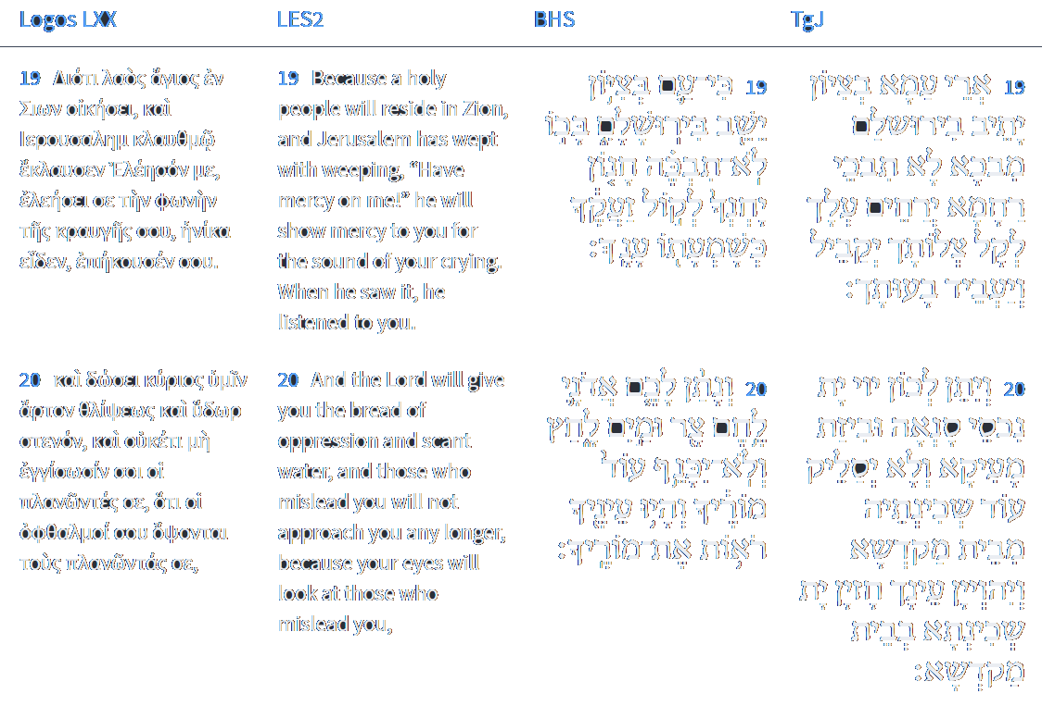
Isaiah 30:19-20
Isaiah / ישעיה
http://www.matsati.com

Slide 17
Rabbinic Literature
ספרות רבנית
Part 2
Isaiah / ישעיה
http://www.matsati.com

Slide 18
Targum Jonathan son of Uziel Isaiah 30:15-20
30:15 For thus saith the Lord God, the Holy One of Israel: I have said, If ye return to my law, ye shall have rest, and ye shall be redeemed, ye shall be quiet, and ye shall dwell in safety, and be mighty; but ye would not. 30:16 And ye said: Nay, but we will flee on horses; therefore shall ye flee; and, We will ride upon the swift; therefore shall they be swift that pursue you. 30:17 One thousand of you shall flee because of the rebuke of one, because of the rebuke of five: till ye be left as a signalfire on the top of a mountain; and as a beacon on a high hill. 30:18 And therefore the Lord will shew you pity, and He that is mighty will compassionate you; for the Lord is the God who doeth judgment: blessed are the righteous who wait for His salvation. 30:19 For the people of Zion shall dwell in Jerusalem; thou shalt weep no more. He will assuredly shew thee compassion: the voice of thy prayer He will hear, and He will answer thy supplication. 30:20 And the Lord shall give unto you the treasures of the enemy, and the spoil of the oppressor, and He will no more take away His Shekinah from the house of the sanctuary, and thine eyes shall behold my Shekinah in the house of the sanctuary. (TgJ)
Isaiah / ישעיה
http://www.matsati.com

Slide 19
ספר דברים פרק ל
א וְהָיָה כִי-יָבֹאוּ עָלֶיךָ כָּל-הַדְּבָרִים הָאֵלֶּה הַבְּרָכָה וְהַקְּלָלָה אֲשֶׁר נָתַתִּי לְפָנֶיךָ וַהֲשֵׁבֹתָ אֶל-לְבָבֶךָ בְּכָל-הַגּוֹיִם אֲשֶׁר הִדִּיחֲךָ יְהוָֹה אֱלֹהֶיךָ שָׁמָּה:
Devarim / Deuteronomy 30:1
30:1 And it shall come to pass, when all these things are come upon thee, the blessing and the curse, which I have set before thee, and thou shalt call them to mind among all the nations, whither the Lord thy God hath driven thee, (KJV)
Isaiah / ישעיה
http://www.matsati.com

Slide 20
ספר במדבר פרק כד
יז אֶרְאֶנּוּ וְלֹא עַתָּה אֲשׁוּרֶנּוּ וְלֹא קָרוֹב דָּרַךְ כּוֹכָב מִיַּעֲקֹב וְקָם שֵׁבֶט מִיִּשְֹרָאֵל וּמָחַץ פַּאֲתֵי מוֹאָב וְקַרְקַר כָּל-בְּנֵי-שֵׁת: יח וְהָיָה אֱדוֹם יְרֵשָׁה וְהָיָה יְרֵשָׁה שֵֹעִיר אֹיְבָיו וְיִשְֹרָאֵל עֹשֶֹה חָיִל: יט וְיֵרְדְּ מִיַּעֲקֹב וְהֶאֱבִיד שָֹרִיד מֵעִיר: כ וַיַּרְא אֶת-עֲמָלֵק וַיִּשָּׂא מְשָׁלוֹ וַיֹּאמַר רֵאשִׁית גּוֹיִם עֲמָלֵק וְאַחֲרִיתוֹ עֲדֵי אֹבֵד:
Bamidbar / Numbers 24:17-20
24:17 I shall see him, but not now: I shall behold him, but not nigh: There shall come a Star out of Jacob, And a Sceptre shall rise out of Israel, And shall smite the corners of Moab, And destroy all the children of Sheth. 24:18 And Edom shall be a possession, Seir also shall be a possession for his enemies; And Israel shall do valiantly. 24:19 Out of Jacob shall come he that shall have dominion, And shall destroy him that remaineth of the city. 24:20 And when he looked on Amalek, he took up his parable, and said, Amalek was the first of the nations; But his latter end shall be that he perish for ever. (KJV)
Isaiah / ישעיה
http://www.matsati.com

Slide 21
The Messiah
“Moshiach will be a man who possesses extraordinary qualities. He will be proficient in both the written and oral Torah traditions. He will incessantly campaign for Torah observance among Jews, and observance of the seven universal Noahide laws by non-Jews. He will be scrupulously observant, and encourage the highest standards from others. He will defend religious principles and repair breaches in their observance. Above all, Moshiach will be heralded as a true Jewish king, a person who leads the way in the service of G‑d, totally humble yet enormously inspiring.” (www.chabad.org)
Isaiah / ישעיה
http://www.matsati.com

Slide 22
Kol HaTor 2,16
(Isa. 30:15) “in quietness and in security will be your might” -- In the same chapter, we find, “in returning and rest you will be saved.” The meaning of “in quietness” is like the verse “place it ! ‘in the ears of’ Yehoshua.” The word ! in gematria equals (70). “In returning and rest you will be saved” means ‘heh’ will return to ‘vau, ’ As it says in the Zohar about the word ‘Teshuva.’ Then ‘vau’ will return to ‘heh’ as explained in the Zohar which is the revelation of the Redemption, and in this manner you will be saved [see 21]. Also, there is a hint of this in the word which in gematria equals Eretz Israel.
Isaiah / ישעיה
http://www.matsati.com

Slide 23
Rashi on Isaiah 30,15 Parts 1-3
כי כה אמר. הקב"ה לכם זה ימים אין אתם צריכים לבקש לכם מעוז מצרים ולאבד ממונכם כי בשובה ונחת תהיה לכם תשועה בלא שום טורח אם תשמעו לי: For so said the Holy One, blessed be He, to you long ago, “You need not seek for yourselves the strength of Egypt and waste your money, for with tranquility and restfulness you shall have salvation, without any toil, if you listen to Me.”
בשובה. לשון ישוב ומרגוע וכן שובה ה' רבבות אלפי ישראל (במדבר י): with tranquility (בְּשׁוּבָה) an expression of restfulness and tranquility, Comp. (Num. 10:36): “Rest (שׁוּבָה), O Lord, with the ten thousands of the thousands of Israel.”
בהשקט. הבא לכם מאתי ובבטחה תהיה גבורתכם: with quietude that comes to you from Me, and with trust, shall be your might.
Isaiah / ישעיה
http://www.matsati.com

Slide 24
ספר שמות פרק יז
יד וַיֹּאמֶר יְהֹוָה אֶל-מֹשֶׁה כְּתֹב זֹאת זִכָּרוֹן בַּסֵּפֶר וְשִֹים בְּאָזְנֵי יְהוֹשֻׁעַ כִּי-מָחֹה אֶמְחֶה אֶת-זֵכֶר עֲמָלֵק מִתַּחַת הַשָּׁמָיִם:
Shemot / Exodus 17:14
17:14 And the Lord said unto Moses, Write this for a memorial in a book, and rehearse it in the ears of Joshua: for I will utterly put out the remembrance of Amalek from under heaven. (KJV)
Isaiah / ישעיה
http://www.matsati.com

Slide 25
Zohar 1:181a:3
Rabbi Elazar said that the Holy One, blessed be He, does everything according to Justice. (If He brings suffering it is) to purify that soul (Nefesh) and bring it to the World to Come, for all the deeds of the Holy One, blessed be He, are true and just. To remove from the soul the filth it accumulated in this world, the body is crushed and the soul cleansed. Therefore the Holy One, blessed be He, brings pain to the just man, so that he will be cleansed from all sins and thereby merit life in the World to Come. As it is written, "Hashem tries the righteous" (Tehilim 11:5), as we have already learned.
Isaiah / ישעיה
http://www.matsati.com

Slide 26
Midrash Tanchuma, Mishpatim 16,1
If thou at all take thy neighbor’s garment to pledge (Exod. 22:25). The Holy One, blessed be He, declared: How guilty are your sins before Me, yet I have been patient with you. And though your soul ascends unto Me at twilight each day to render an accounting and is found guilty,27There is a tradition that the soul ascends to heaven while the body is sleeping. nevertheless I return the soul to you. Just as you are obligated to me, so also are you obligated to them (the poor). If thou at all take thy neighbor’s garment to pledge, thou shalt restore it to him by that the sun goeth down; for that may be his only covering (Exod. 22:25). You have one thing that belongs to Me, and therefore, if you take your neighbor’s garment to pledge, and do not return his pledge to him, I will not return your soul to you. Scripture says of this: Takest thy neighbor’s garment. And it shall come to pass, when he crieth unto Me that I will hear; for I am gracious (ibid., v. 26). If anyone complains to Me of injustice, saying: “Master of the Universe, I am a man and he is a man, yet he sleeps on his bed, but where can I sleep?” I will listen to him for I am gracious. The Holy One, blessed be He, said: I pay attention to the complaints of the lonely ones in this world, but in the day to come, It shall come to pass, that before they call, I will answer (Isa. 56:4). The prophet also said: For, O people that dwelleth in Zion at Jerusalem, thou shalt weep no more (ibid. 30:19).
Isaiah / ישעיה
http://www.matsati.com

Slide 27
Nefesh HaChayim, Gate IV 28:10
As is written in Zohar B’ha-a-lote-kha (152a): “The Torah has a body…, the world’s fools only gaze upon that clothing…, those who know more don’t gaze upon the clothes but rather upon the body which is under the clothes. The wise, servants of the supernal King, those who stood at Mount Sinai gaze only upon the soul-Neshama which is the actual core of the entire Torah, and in the future they will come to gaze upon the soul-Neshama of-the-soul-Neshama that is within the Torah.” And as is written (Yeshayahu 30:20): “And your own eyes will behold your Teacher” and “and your Teacher will no longer be hidden behind His garment”1196Rav Chayyim reverses the order of these two phrases relative to their order in Y’shaya.
Isaiah / ישעיה
http://www.matsati.com

Slide 28
Rashi on Isaiah 30,20 Parts 1-3
לחם צר ומים לחץ. לא תהיו כרוכים אחר תענוגים כאשר אתם עתה כמה שנאמר השותים במזרקי יין (עמוס ו׳:ו׳) הנה ששון ושמחה (לעיל כב): scant bread and water of oppression You shall not run after pleasures as you do now, as it is said (Amos 6:6): “Who drink from basins of wine.” (Above 22:13) “And behold joy and happiness.”
ולא יכנף. לא יתכסה ממך בכנף בגדיו כלומר לא יסתיר ממך פניו: shall no longer be concealed (לֹא יִכָּנֵף) shall not be covered from you with the skirt of His garments, i.e., He shall not hide His countenance from you.
מוריך. הקב"ה המלמדך להועיל: your Teacher The Holy One, blessed be He, who teaches you for your profit.
Isaiah / ישעיה
http://www.matsati.com

Slide 29
Romans 7:14
7:14 For we know that the law is spiritual: but I am carnal, sold under sin. (KJV, 14 ⸀Οἴδαμεν γὰρ ὅτι ὁ νόμος πνευματικός ἐστιν, ἐγὼ δὲ ⸁σάρκινός εἰμι πεπραμένος ὑπὸ τὴν ἁμαρτίαν*.)
“Do I run after the pleasures of this world?”
“Does my relationship with God in heaven and in His Messiah Yeshua cause me to seek righteousness and holiness in this world?”
“If not, why not?”
Isaiah / ישעיה
http://www.matsati.com

