Slide 1
MATSATI.COM Teaching Ministry
Website: https://www.matsati.com YouTube Channel: https://www.youtube.com/user/MATSATI/
ישעיהו ל:ח-יד / Isaiah 30:8-14
LIVE STREAM: 6:30 pm EST Thursday
Join us at Telegram:
https://t.me/MessianicChat
Rabbi Jeremiah
– The Apocalypse: connecting the Greek to the Ancient Hebrew text. (Wed. 9 am EST)
A Community
for Learning
Weekly Teachings Free Online
Check Telegram for weekly scheduling of teachings.
YouTube Channels
https://YouTube.com/c/HebrewLiteracy
https://www.youtube.com/channel/UC5_qPfruat-sCJJypz0_OBw
Discuss the Scriptures,
learn the languages,
and fellowship
Join Telegram ask about Hebrew and Greek classes!

Slide 2
Isaiah 30:8-14
ישעיהו ל:ח-יד
Isaiah / ישעיה
http://www.matsati.com

Slide 3
James 2:14–26
2:14 What doth it profit, my brethren, though a man say he hath faith, and have not works? can faith save him? 2:15 If a brother or sister be naked, and destitute of daily food, 2:16 And one of you say unto them, Depart in peace, be ye warmed and filled; notwithstanding ye give them not those things which are needful to the body; what doth it profit? 2:17 Even so faith, if it hath not works, is dead, being alone. 2:18 Yea, a man may say, Thou hast faith, and I have works: shew me thy faith without thy works, and I will shew thee my faith by my works. 2:19 Thou believest that there is one God; thou doest well: the devils also believe, and tremble. 2:20 But wilt thou know, O vain man, that faith without works is dead? 2:21 Was not Abraham our father justified by works, when he had offered Isaac his son upon the altar? 2:22 Seest thou how faith wrought with his works, and by works was faith made perfect? 2:23 And the scripture was fulfilled which saith, Abraham believed God, and it was imputed unto him for righteousness: and he was called the Friend of God. 2:24 Ye see then how that by works a man is justified, and not by faith only. 2:25 Likewise also was not Rahab the harlot justified by works, when she had received the messengers, and had sent them out another way? 2:26 For as the body without the spirit is dead, so faith without works is dead also. (KJV)
Isaiah / ישעיה
http://www.matsati.com

Slide 4
Romans 3:21–22
3:21 But now the righteousness of God without the law is manifested, being witnessed by the law and the prophets; 3:22 Even the righteousness of God which is by faith of Jesus Christ unto all and upon all them that believe: for there is no difference: (KJV, 21 Νυνὶ δὲ χωρὶς νόμου δικαιοσύνη θεοῦ πεφανέρωται μαρτυρουμένη ὑπὸ τοῦ νόμου καὶ τῶν προφητῶν*, 22 δικαιοσύνη δὲ θεοῦ διὰ πίστεως °Ἰησοῦ Χριστοῦ ⸂εἰς πάντας⸃ τοὺς πιστεύοντας*. οὐ γάρ ἐστιν διαστολή)
Romans 3:30–31
3:30 Seeing it is one God, which shall justify the circumcision by faith, and uncircumcision through faith. 3:31 Do we then make void the law through faith? God forbid: yea, we establish the law. (KJV, 30 ⸀εἴπερ εἷς ὁ θεὸς ὃς δικαιώσει περιτομὴν ἐκ πίστεως καὶ ἀκροβυστίαν διὰ τῆς πίστεως*. 31 νόμον οὖν καταργοῦμεν διὰ τῆς πίστεως; μὴ γένοιτο·* ἀλλὰ νόμον ἱστάνομεν*.)
Isaiah / ישעיה
http://www.matsati.com

Slide 5
Romans 12:1–3
12:1 I beseech you therefore, brethren, by the mercies of God, that ye present your bodies a living sacrifice, holy, acceptable unto God, which is your reasonable service. 12:2 And be not conformed to this world: but be ye transformed by the renewing of your mind, that ye may prove what is that good, and acceptable, and perfect, will of God. 12:3 For I say, through the grace given unto me, to every man that is among you, not to think of himself more highly than he ought to think; but to think soberly, according as God hath dealt to every man the measure of faith. (KJV, *12 Παρακαλῶ οὖν ὑμᾶς, ἀδελφοί, διὰ τῶν οἰκτιρμῶν τοῦ θεοῦ παραστῆσαι τὰ σώματα ὑμῶν θυσίαν ζῶσαν ἁγίαν ⸂εὐάρεστον τῷ θεῷ⸃, τὴν λογικὴν λατρείαν ὑμῶν·* 2 καὶ μὴ ⸀συσχηματίζεσθε τῷ αἰῶνι τούτῳ, ἀλλὰ ⸁μεταμορφοῦσθε τῇ ἀνακαινώσει τοῦ νοὸς ⸆ εἰς τὸ δοκιμάζειν ὑμᾶς τί τὸ θέλημα τοῦ θεοῦ, τὸ ἀγαθὸν καὶ εὐάρεστον καὶ τέλειον*. 3 Λέγω γὰρ διὰ τῆς χάριτος* ⸆ τῆς δοθείσης μοι παντὶ τῷ ὄντι ἐν ὑμῖν μὴ ὑπερφρονεῖν παρʼ ὃ δεῖ φρονεῖν ἀλλὰ φρονεῖν εἰς τὸ σωφρονεῖν, ἑκάστῳ ὡς ὁ θεὸς ἐμέρισεν μέτρον πίστεως*.)
Isaiah / ישעיה
http://www.matsati.com

Slide 6
﻿ספר ישעיה פרק ל
﻿ח עַתָּה בּוֹא כָתְבָהּ עַל-לוּחַ אִתָּם וְעַל-סֵפֶר חֻקָּהּ וּתְהִי לְיוֹם אַחֲרוֹן לָעַד עַד-עוֹלָם: ט כִּי עַם מְרִי הוּא בָּנִים כֶּחָשִׁים בָּנִים לֹא-אָבוּ שְׁמוֹעַ תּוֹרַת יְהֹוָה: י אֲשֶׁר אָמְרוּ לָרֹאִים לֹא תִרְאוּ וְלַחֹזִים לֹא תֶחֱזוּ-לָנוּ נְכֹחוֹת דַּבְּרוּ-לָנוּ חֲלָקוֹת חֲזוּ מַהֲתַלּוֹת: יא סוּרוּ מִנֵּי-דֶרֶךְ הַטּוּ מִנֵּי-אֹרַח הַשְׁבִּיתוּ מִפָּנֵינוּ אֶת-קְדוֹשׁ יִשְֹרָאֵל: יב לָכֵן כֹּה אָמַר קְדוֹשׁ יִשְֹרָאֵל יַעַן מָאָסְכֶם בַּדָּבָר הַזֶּה וַתִּבְטְחוּ בְּעֹשֶׁק וְנָלוֹז וַתִּשָּׁעֲנוּ עָלָיו: יג לָכֵן יִהְיֶה לָכֶם הֶעָוֹן הַזֶּה כְּפֶרֶץ נֹפֵל נִבְעֶה בְּחוֹמָה נִשְׁגָּבָה אֲשֶׁר-פִּתְאֹם לְפֶתַע יָבוֹא שִׁבְרָהּ: יד וּשְׁבָרָהּ כְּשֵׁבֶר נֵבֶל יוֹצְרִים כָּתוּת לֹא יַחְמֹל וְלֹא-יִמָּצֵא בִמְכִתָּתוֹ חֶרֶשֹ לַחְתּוֹת אֵשׁ מִיָּקוּד וְלַחְשֹף מַיִם מִגֶּבֶא:
Isaiah / ישעיה
http://www.matsati.com

Slide 7
Revelation 20:11–15
20:11 And I saw a great white throne, and him that sat on it, from whose face the earth and the heaven fled away; and there was found no place for them. 20:12 And I saw the dead, small and great, stand before God; and the books were opened: and another book was opened, which is the book of life: and the dead were judged out of those things which were written in the books, according to their works. 20:13 And the sea gave up the dead which were in it; and death and hell delivered up the dead which were in them: and they were judged every man according to their works. 20:14 And death and hell were cast into the lake of fire. This is the second death. 20:15 And whosoever was not found written in the book of life was cast into the lake of fire. (KJV, *11 Καὶ εἶδον θρόνον μέγαν λευκὸν καὶ τὸν καθήμενον ⸂ἐπʼ αὐτόν⸃,* οὗ ἀπὸ °τοῦ προσώπου ἔφυγεν ἡ γῆ καὶ ὁ οὐρανὸς καὶ τόπος οὐχ εὑρέθη αὐτοῖς. 12 καὶ εἶδον τοὺς νεκρούς,* ⸋τοὺς μεγάλους καὶ τοὺς μικρούς,⸌ ἑστῶτας ἐνώπιον τοῦ θρόνου. καὶ βιβλία ⸀ἠνοίχθησαν, καὶ ἄλλο βιβλίον ἠνοίχθη, ὅ ἐστιν τῆς ζωῆς, καὶ ἐκρίθησαν οἱ νεκροὶ ἐκ τῶν γεγραμμένων ἐν ⸂τοῖς βιβλίοις⸃ κατὰ τὰ ἔργα αὐτῶν. 13 καὶ ἔδωκεν ἡ θάλασσα τοὺς ⸂νεκροὺς τοὺς ἐν αὐτῇ⸃ καὶ ὁ θάνατος καὶ ὁ ᾅδης ⸀ἔδωκαν τοὺς ⸄νεκροὺς τοὺς ἐν αὐτοῖς⸅,* καὶ ⸁ἐκρίθησαν ἕκαστος κατὰ τὰ ἔργα ⸀1αὐτῶν. 14 καὶ ὁ θάνατος καὶ ὁ ᾅδης ἐβλήθησαν εἰς τὴν λίμνην τοῦ πυρός.* ⸋ ⸆ οὗτος ὁ ⸂θάνατος ὁ δεύτερός⸃ ἐστιν, ἡ λίμνη τοῦ πυρός.⸌ 15 καὶ εἴ τις οὐχ εὑρέθη ἐν ⸂τῇ βίβλῳ⸃ τῆς ζωῆς γεγραμμένος,* ἐβλήθη εἰς τὴν λίμνην τοῦ πυρός.)
Isaiah / ישעיה
http://www.matsati.com

Slide 8
Revelation 12:11
12:11 And they overcame him by the blood of the Lamb, and by the word of their testimony; and they loved not their lives unto the death. (KJV, καὶ αὐτοὶ ἐνίκησαν αὐτὸν διὰ τὸ αἷμα τοῦ ἀρνίου καὶ διὰ τὸν λόγον τῆς μαρτυρίας αὐτῶν καὶ οὐκ ἠγάπησαν τὴν ψυχὴν αὐτῶν ἄχρι θανάτου.)
Revelation 12:17
12:17 And the dragon was wroth with the woman, and went to make war with the remnant of her seed, which keep the commandments of God, and have the testimony of Jesus Christ. (KJV, καὶ ὠργίσθη ὁ δράκων ἐπὶ τῇ γυναικὶ καὶ ἀπῆλθεν ποιῆσαι πόλεμον μετὰ τῶν λοιπῶν τοῦ σπέρματος αὐτῆς τῶν τηρούντων τὰς ἐντολὰς τοῦ θεοῦ καὶ ἐχόντων τὴν μαρτυρίαν Ἰησοῦ.)
Isaiah / ישעיה
http://www.matsati.com

Slide 9
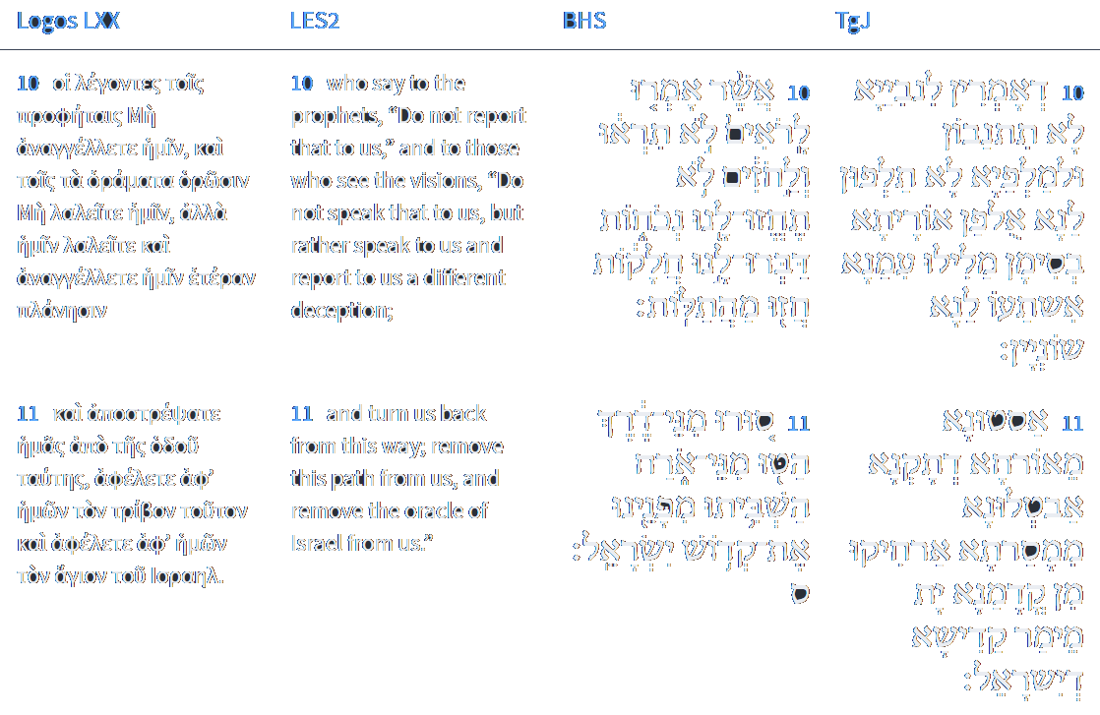
Isaiah 30:10-11
Isaiah / ישעיה
http://www.matsati.com

Slide 10
Vayikra / Leviticus 11:29-36
11:29 These also shall be unclean unto you among the creeping things that creep upon the earth; the weasel, and the mouse, and the tortoise after his kind, 11:30 And the ferret, and the chameleon, and the lizard, and the snail, and the mole. 11:31 These are unclean to you among all that creep: whosoever doth touch them, when they be dead, shall be unclean until the even. 11:32 And upon whatsoever any of them, when they are dead, doth fall, it shall be unclean; whether it be any vessel of wood, or raiment, or skin, or sack, whatsoever vessel it be, wherein any work is done, it must be put into water, and it shall be unclean until the even; so it shall be cleansed. 11:33 And every earthen vessel, whereinto any of them falleth, whatsoever is in it shall be unclean; and ye shall break it. 11:34 Of all meat which may be eaten, that on which such water cometh shall be unclean: and all drink that may be drunk in every such vessel shall be unclean. 11:35 And every thing whereupon any part of their carcase falleth shall be unclean; whether it be oven, or ranges for pots, they shall be broken down: for they are unclean, and shall be unclean unto you. 11:36 Nevertheless a fountain or pit, wherein there is plenty of water, shall be clean: but that which toucheth their carcase shall be unclean. (KJV)
Isaiah / ישעיה
http://www.matsati.com

Slide 11
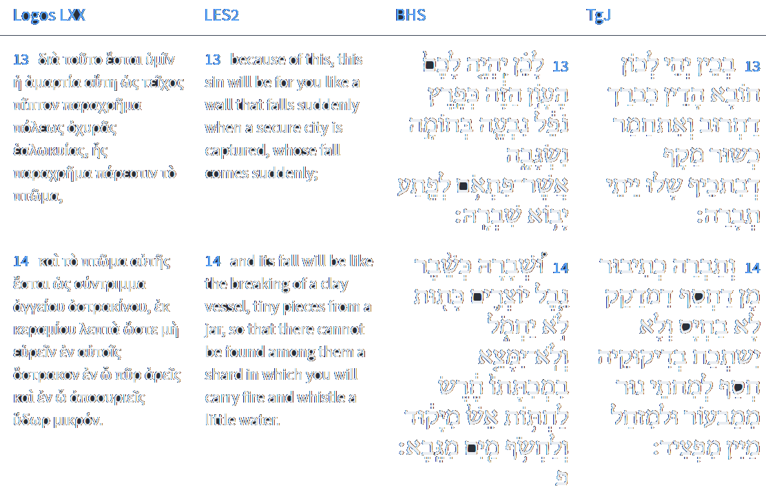
Isaiah 30:13-14
Isaiah / ישעיה
http://www.matsati.com

Slide 12
Rabbinic Literature
ספרות רבנית
Part 2
Isaiah / ישעיה
http://www.matsati.com

Slide 13
Targum Jonathan son of Uziel Isaiah 30:8-14
30:8 Now go, write it amongst them upon a tablet, and mark it upon lines of a book, that it may be for a witness before me in the day of judgment for ever: 30:9 That this is a rebellious people, lying children, children that will not receive the instruction of the law of the Lord: 30:10 Who say to the prophets, Prophesy ye not: and as for doctrines, teach us not the doctrine of the law: speak ye with us with signs, relate unto us various things: 30:11 Turn us from the right path, make us to cease from tradition; put at a distance from us the WORD of the Holy One of Israel. 30:12 Wherefore thus saith the Holy One of Israel, Because ye have despised this word, and trust in lie and oppression, and stay thereon: 30:13 Therefore this sin shall be unto you as a city laid waste, and made a ruinous heap, as a bending wall, whose breaking cometh very suddenly. 30:14 And its breaking shall be as the breaking of a potter’s vessel of clay, who is breaking it without compassion, and among its fragments there shall not be found a potsherd to take fire from the hearth, or to draw water from the cistern. (TgJ)
Isaiah / ישעיה
http://www.matsati.com

Slide 14
Ibn Ezra on Isaiah 30,11 Parts 1-2
סורו. אלה דברי העם לנביאים: Get you out of the way, etc. These words are addressed by the people to the prophets.
השביתו. ממנו זכר או שם השם: Cause the Holy One, etc. Cause the mention or the name of the Holy One of Israel to cease, etc.11
Rashi on Isaiah 30,11 Parts 1-2
הטו. אותנו: turn away (Turn) us (away).
מני אורח. חפצים אנו בנבואת שקר: from the path We want the false prophecy.
Isaiah / ישעיה
http://www.matsati.com

Slide 15
Likutei Moharan 60,8 Part 7
This is why we break an earthen dish, in the aspect of “and you put your trust in fraud and corruption… It is shattered as [one shatters] a potter’s jug… so that no earthen shard is left in its breakage…” (Isaiah 30:12, 14). The trust of holiness created by the engagement, as explained above, is the opposite of the trust of the Other Side, which is in the aspect of breaking an earthen dish, as explained above. In addition, we hint to [the couple] that if they fail to conduct themselves in holiness and betray the aspect of trust/procreation, God forbid, then they will be in the aspect of breaking an earthen dish, which is caused by “the trust of the unfaithful” (Proverbs 25:19), as explained above.
Isaiah / ישעיה
http://www.matsati.com

Slide 16
Ibn Ezra on Isaiah 30,13 Parts 1-3
לכן. טע' ותבטחו בממון שתתנו למלך אשור ולא יבוא, העון הזה, ישחתכם: Therefore,15לכן, in the Hebrew original, is not part of the explanation, but the first word of the next verse, which is to be explained. because you trust in the money, which you send to the King of Assyria, that he shall not come.16Comp. 2 Kings 18:15, 16. This iniquity shall be to you, etc., that is, it will destroy you.
כפרץ [נפל נבעה]. כמגדל נופל או דבר נבעה, והוא מטעם נפוח מגזרת אבעבועות (שמות ט' ט') או יהיה נבעה תואר פרץ: כפרץ מגדל נופל ═ נופל כפרץ As a breach of a falling tower.17A. V., As a breach ready to fall, swelling out.17A. V., As a breach ready to fall, swelling out. דבר נבעה ═ נבעה A swelling thing. Of the same root is אבעבועות blains (Exod. 9:9). נבעה can also be joined with פרץ: a swelling breach.
פתע גם פתאום קרובים. כטעם אדמת עפר: לפתע פתאם Suddenly at an instant. The two words have nearly the same meaning; comp. אדמת עפר the dust of the earth (Dan. 12:12).18 This construction, the combination of two similar nouns, the one in the genitive governed by the other, is met with more frequently than I. E. seems to suppose. It expresses a kind of superlative, e. g., קדש הקדשים the most holy; so also לפתע פתאם most suddenly.
Isaiah / ישעיה
http://www.matsati.com

Slide 17
Rashi on Isaiah 30,13 Parts 1-2
כפרץ. של חומה שנפל: as a breach of a fallen wall.
נבעה בחומה נשגבה. מגולה ליכנס בה בחומות משגבכם נבעה לשון גלוי כמו בעובדיה (א ו) נבעו מצפוניו אתגליין מטמרוהי, ודונש פתר נבעה בליטה שהחומה נעשית כמין אבעבועות מפני הגשמים וקילקול טיט רעוע: revealed in a fortified wall Revealed to enter thereby the walls of your fortification. נִבְעֶה is an expression of revealing, as in Obadiah (1:6): “His hidden things were revealed” (נִבְעוּ). Dunash, however, interprets נִבְעֶה as a protrusion, since the wall develops blisters (אֲבַעְבּוּעוֹת) because of the rains and the deterioration of the weak mortar.
Isaiah / ישעיה
http://www.matsati.com

Slide 18
Midrash Tanchuma Buber, Terumah 6,2
ד"א למה נמשלה בברזל ובחרס, Another interpretation: Why was it likened to iron and clay? Just as iron is hard, so is this wicked kingdom hard. And why is it like clay? Because the Holy One is going to break it like clay, as stated (in Is. 30:14): HE SHALL BREAK IT AS A POTTER'S VESSEL IS BROKEN…. Now < Daniel > had seen the Messianic King, as stated (in Dan. 2:34): YOU LOOKED ON UNTIL A STONE WAS CUT OUT WITHOUT THE USE OF HANDS…. Resh Laqish said: This <stone> is the Messianic King. (Ibid., cont.:) THEN IT STRUCK THE STATUE ON ITS FEET, <i.e., struck> all the kingdoms, which were set in the statue. Now by virtue of what is the Messianic King likened to a stone (even)? By virtue of Jacob, < of whom >27 “Of whom” is the reading in Tanh., Exod. 7:7. it is stated (in Gen. 49:24): FROM THERE <COMES> THE SHEPHERD, THE ROCK (even) OF ISRAEL28In the biblical context these words would naturally refer to the Holy One, but the midrash understands them as an allusion to Jacob, as does Rashi, ad loc. So also below, 9:12. (Dan. 2:45:) < BECAUSE YOU SAW> THAT A ROCK (even) WAS CUT FROM THE MOUNTAIN, so that it consumes the whole world, as stated (in Is. 11:4): AND HE SHALL SMITE THE EARTH WITH THE ROD OF HIS MOUTH. In that hour Israel shall dwell in tranquillity and security, as stated (in Ezek. 28:26:) AND THEY SHALL DWELL ON IT (their own soil) IN SECURITY
Isaiah / ישעיה
http://www.matsati.com

