Slide 1
MATSATI.COM Teaching Ministry
Website: https://www.matsati.com YouTube Channel: https://www.youtube.com/user/MATSATI/
ישעיהו ל:א-ז / Isaiah 30:1-7
LIVE STREAM: 6:30 pm EST Thursday
Join us at Telegram:
https://t.me/MessianicChat
Rabbi Jeremiah
– The Apocalypse: connecting the Greek to the Ancient Hebrew text. (Wed. 9 am EST)
A Community
for Learning
Weekly Teachings Free Online
Check Telegram for weekly scheduling of teachings.
YouTube Channels
https://YouTube.com/c/HebrewLiteracy
https://www.youtube.com/channel/UC5_qPfruat-sCJJypz0_OBw
Discuss the Scriptures,
learn the languages,
and fellowship
Join Telegram ask about Hebrew and Greek classes!

Slide 2
Isaiah 30:1-7
ישעיהו ל:א-ז
Isaiah / ישעיה
http://www.matsati.com

Slide 3
﻿ספר במדבר פרק יד
א וַתִּשָּׂא כָּל-הָעֵדָה וַיִּתְּנוּ אֶת-קוֹלָם וַיִּבְכּוּ הָעָם בַּלַּיְלָה הַהוּא: ב וַיִּלֹּנוּ עַל-מֹשֶׁה וְעַל-אַהֲרֹן כֹּל בְּנֵי יִשְֹרָאֵל וַיֹּאמְרוּ אֲלֵהֶם כָּל-הָעֵדָה לוּ-מַתְנוּ בְּאֶרֶץ מִצְרַיִם אוֹ בַּמִּדְבָּר הַזֶּה לוּ-מָתְנוּ: ג וְלָמָה יְהֹוָה מֵבִיא אֹתָנוּ אֶל-הָאָרֶץ הַזֹּאת לִנְפֹּל בַּחֶרֶב נָשֵׁינוּ וְטַפֵּנוּ יִהְיוּ לָבַז הֲלוֹא טוֹב לָנוּ שׁוּב מִצְרָיְמָה: ד וַיֹּאמְרוּ אִישׁ אֶל-אָחִיו נִתְּנָה רֹאשׁ וְנָשׁוּבָה מִצְרָיְמָה: ה וַיִּפֹּל מֹשֶׁה וְאַהֲרֹן עַל-פְּנֵיהֶם לִפְנֵי כָּל-קְהַל עֲדַת בְּנֵי יִשְֹרָאֵל: ו וִיהוֹשֻׁעַ בִּן-נוּן וְכָלֵב בֶּן-יְפֻנֶּה מִן-הַתָּרִים אֶת-הָאָרֶץ קָרְעוּ בִּגְדֵיהֶם: ז וַיֹּאמְרוּ אֶל-כָּל-עֲדַת בְּנֵי-יִשְֹרָאֵל לֵאמֹר הָאָרֶץ אֲשֶׁר עָבַרְנוּ בָהּ לָתוּר אֹתָהּ טוֹבָה הָאָרֶץ מְאֹד מְאֹד: ח אִם-חָפֵץ בָּנוּ יְהֹוָה וְהֵבִיא אֹתָנוּ אֶל-הָאָרֶץ הַזֹּאת וּנְתָנָהּ לָנוּ אֶרֶץ אֲשֶׁר-הִוא זָבַת חָלָב וּדְבָשׁ: ט אַךְ בַּיהוָֹה אַל-תִּמְרֹדוּ וְאַתֶּם אַל-תִּירְאוּ אֶת-עַם הָאָרֶץ כִּי לַחְמֵנוּ הֵם סָר צִלָּם מֵעֲלֵיהֶם וַיהוָֹה אִתָּנוּ אַל-תִּירָאֻם:
Isaiah / ישעיה
http://www.matsati.com

Slide 4
Revelation 14:12–13
14:12 Here is the patience of the saints: here are they that keep the commandments of God, and the faith of Jesus. 14:13 And I heard a voice from heaven saying unto me, Write, Blessed are the dead which die in the Lord from henceforth: Yea, saith the Spirit, that they may rest from their labours; and their works do follow them. (KJV, 12 Ὧδε ἡ ὑπομονὴ τῶν ἁγίων ἐστίν,* ⸆ ⸂οἱ τηροῦντες⸃ τὰς ἐντολὰς* τοῦ θεοῦ καὶ τὴν πίστιν Ἰησοῦ.* 13 Καὶ ἤκουσα φωνῆς ἐκ τοῦ οὐρανοῦ λεγούσης⸆·* γράψον·* μακάριοι οἱ νεκροὶ οἱ ἐν ⸀κυρίῳ ἀποθνῄσκοντες ἀπʼ ἄρτι.* ⸂ναί, λέγει⸃ τὸ πνεῦμα, ⸁ἵνα ⸀1ἀναπαήσονται ἐκ τῶν κόπων αὐτῶν, τὰ ⸀2γὰρ ἔργα αὐτῶν ἀκολουθεῖ μετʼ αὐτῶν.* *14 Καὶ εἶδον,* καὶ ἰδοὺ νεφέλη λευκή, καὶ ἐπὶ τὴν νεφέλην ⸂καθήμενον ὅμοιον⸃ ⸀υἱὸν ἀνθρώπου,* ⸁ἔχων ἐπὶ ⸄τῆς κεφαλῆς⸅ αὐτοῦ στέφανον χρυσοῦν καὶ ἐν τῇ χειρὶ αὐτοῦ δρέπανον ὀξύ.*)
Isaiah / ישעיה
http://www.matsati.com

Slide 5
﻿ספר ישעיה פרק ל
﻿א הוֹי בָּנִים סוֹרְרִים נְאֻם-יְהֹוָה לַעֲשֹוֹת עֵצָה וְלֹא מִנִּי וְלִנְסֹךְ מַסֵּכָה וְלֹא רוּחִי לְמַעַן סְפוֹת חַטָּאת עַל-חַטָּאת: ב הַהֹלְכִים לָרֶדֶת מִצְרַיִם וּפִי לֹא שָׁאָלוּ לָעוֹז בְּמָעוֹז פַּרְעֹה וְלַחְסוֹת בְּצֵל מִצְרָיִם: ג וְהָיָה לָכֶם מָעוֹז פַּרְעֹה לְבֹשֶׁת וְהֶחָסוּת בְּצֵל-מִצְרַיִם לִכְלִמָּה: ד כִּי-הָיוּ בְצֹעַן שָֹרָיו וּמַלְאָכָיו חָנֵס יַגִּיעוּ: ה כֹּל הֹבִאישׁ עַל-עַם לֹא-יוֹעִילוּ לָמוֹ לֹא לְעֵזֶר וְלֹא לְהוֹעִיל כִּי לְבֹשֶׁת וְגַם-לְחֶרְפָּה: ו מַשָּׂא בַּהֲמוֹת נֶגֶב בְּאֶרֶץ צָרָה וְצוּקָה לָבִיא וָלַיִשׁ מֵהֶם אֶפְעֶה וְשָֹרָף מְעוֹפֵף יִשְֹאוּ עַל-כֶּתֶף עֲוָרִים [עֲיָרִים] חֵילֵהֶם וְעַל-דַּבֶּשֶׁת גְּמַלִּים אוֹצְרֹתָם עַל-עַם לֹא יוֹעִילוּ: ז וּמִצְרַיִם הֶבֶל וָרִיק יַעְזֹרוּ לָכֵן קָרָאתִי לָזֹאת רַהַב הֵם שָׁבֶת:
Isaiah / ישעיה
http://www.matsati.com

Slide 6
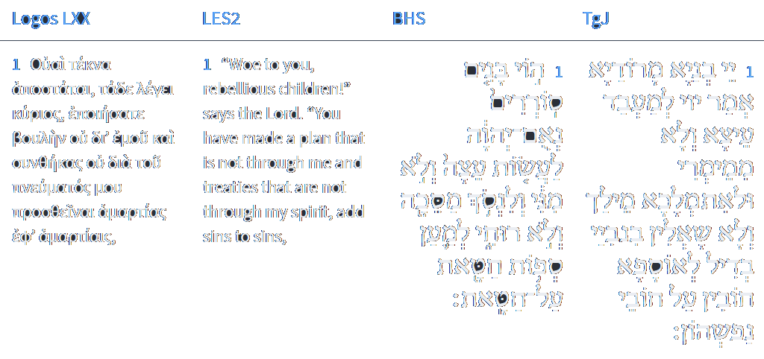
Isaiah 30:1
Isaiah / ישעיה
http://www.matsati.com

Slide 7
Shemot / Exodus 13:17
13:17 And it came to pass, when Pharaoh had let the people go, that God led them not through the way of the land of the Philistines, although that was near; for God said, Lest peradventure the people repent when they see war, and they return to Egypt: (KJV וַיְהִ֗י בְּשַׁלַּ֣ח פַּרְעֹה֮ אֶת־הָעָם֒ וְלֹא־נָחָ֣ם אֱלֹהִ֗ים דֶּ֚רֶךְ אֶ֣רֶץ פְּלִשְׁתִּ֔ים כִּ֥י קָרֹ֖וב ה֑וּא כִּ֣י׀ אָמַ֣ר אֱלֹהִ֗ים פֶּֽן־יִנָּחֵ֥ם הָעָ֛ם בִּרְאֹתָ֥ם מִלְחָמָ֖ה וְשָׁ֥בוּ מִצְרָֽיְמָה׃)
Devarim / Deuteronomy 17:16
17:16 But he shall not multiply horses to himself, nor cause the people to return to Egypt, to the end that he should multiply horses: forasmuch as the Lord hath said unto you, Ye shall henceforth return no more that way. (KJV רַק֮ לֹא־יַרְבֶּה־לֹּ֣ו סוּסִים֒ וְלֹֽא־יָשִׁ֤יב אֶת־הָעָם֙ מִצְרַ֔יְמָה לְמַ֖עַן הַרְבֹּ֣ותa‬ ס֑וּס וַֽיהוָה֙ אָמַ֣רb‬ לָכֶ֔םc‬ לֹ֣א תֹסִפ֗וּן לָשׁ֛וּב בַּדֶּ֥רֶךְ הַזֶּ֖ה עֹֽוד׃)
Isaiah / ישעיה
http://www.matsati.com

Slide 8
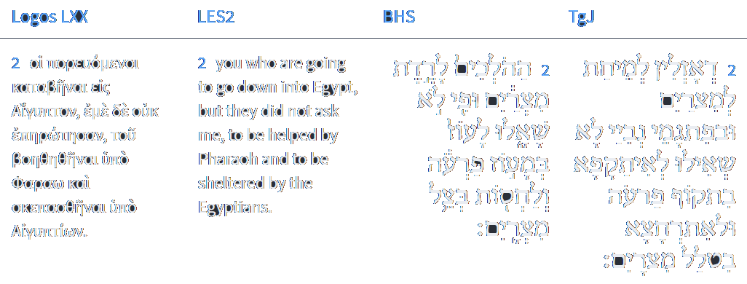
Isaiah 30:2
Isaiah / ישעיה
http://www.matsati.com

Slide 9
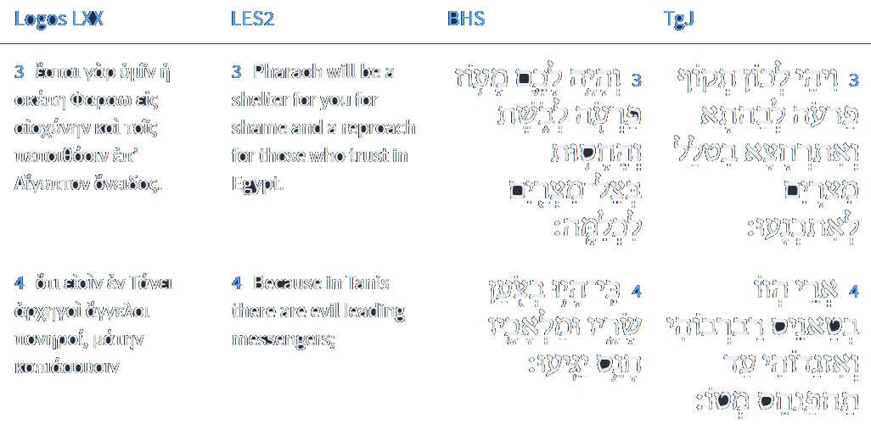
Isaiah 30:3-4
Isaiah / ישעיה
http://www.matsati.com

Slide 10
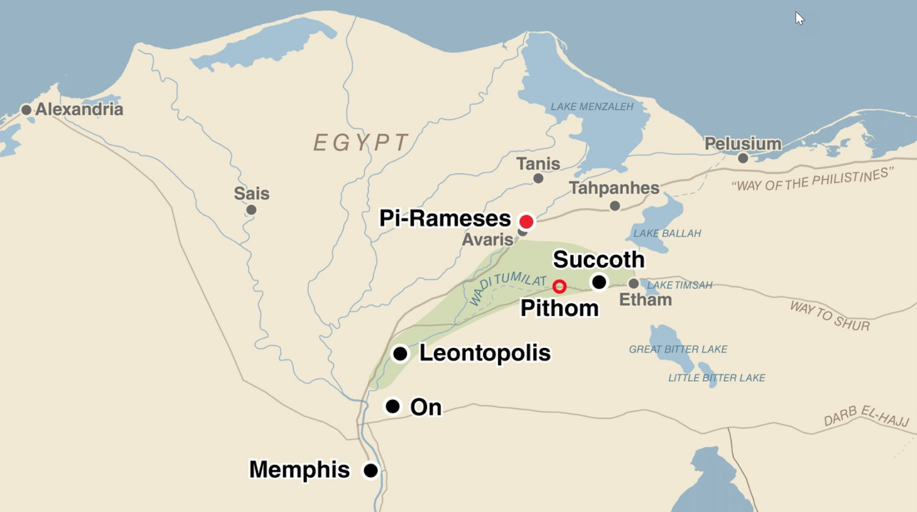
טַאֲנֵיס, טָאנֵיס, טָנֵיס pr. n. pl. (h. צֹעַן) Tanis (Zoan) in Lower Egypt
תַּחְפַּנְחֵס, תַּחְפְּנֵס (b. h.) pr. n. pl. Tahpanhes, Tahpenes, in Egypt
These are Egyptian locations:
Isaiah / ישעיה
http://www.matsati.com

Slide 11
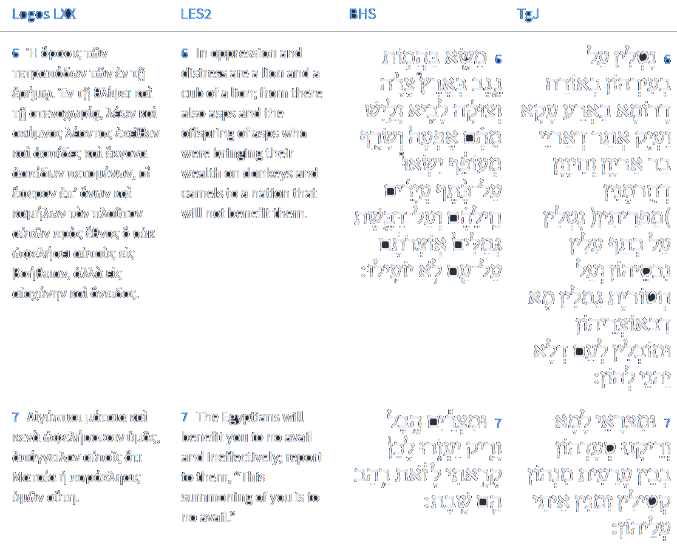
Isaiah 30:6-7
Isaiah / ישעיה
http://www.matsati.com

Slide 12
ספר במדבר פרק כא
ו וַיְשַׁלַּח יְהוָֹה בָּעָם אֵת הַנְּחָשִׁים הַשְּׂרָפִים וַיְנַשְּׁכוּ אֶת-הָעָם וַיָּמָת עַם-רָב מִיִּשְֹרָאֵל:
Bamidbar / Numbers 21:6
21:6 And the LORD sent fiery serpents among the people, and they bit the people; and much people of Israel died. (KJV)
﻿ספר דברים פרק ח
טו הַמּוֹלִיכֲךָ בַּמִּדְבָּר | הַגָּדֹל וְהַנּוֹרָא נָחָשׁ | שָֹרָף וְעַקְרָב וְצִמָּאוֹן אֲשֶׁר אֵין-מָיִם הַמּוֹצִיא לְךָ מַיִם מִצּוּר הַחַלָּמִישׁ:
Devarim / Deuteronomy 8:15
8:15 Who led thee through that great and terrible wilderness, wherein were fiery serpents, and scorpions, and drought, where there was no water; who brought thee forth water out of the rock of flint; (KJV)
Isaiah / ישעיה
http://www.matsati.com

Slide 13
Matthew 21:18–22
21:18 Now in the morning as he returned into the city, he hungered. 21:19 And when he saw a fig tree in the way, he came to it, and found nothing thereon, but leaves only, and said unto it, Let no fruit grow on thee henceforward for ever. And presently the fig tree withered away. 21:20 And when the disciples saw it, they marvelled, saying, How soon is the fig tree withered away! 21:21 Jesus answered and said unto them, Verily I say unto you, If ye have faith, and doubt not, ye shall not only do this which is done to the fig tree, but also if ye shall say unto this mountain, Be thou removed, and be thou cast into the sea; it shall be done. 21:22 And all things, whatsoever ye shall ask in prayer, believing, ye shall receive. (KJV, *18 ⸀Πρωῒ δὲ ⸁ἐπανάγων εἰς τὴν πόλιν ἐπείνασεν. 19 καὶ ἰδὼν συκῆν μίαν ἐπὶ τῆς ὁδοῦ ἦλθεν ἐπʼ* αὐτὴν καὶ οὐδὲν εὗρεν ἐν αὐτῇ εἰ μὴ φύλλα μόνον, καὶ λέγει αὐτῇ· ⸆ μηκέτι ἐκ σοῦ καρπὸς ⸀γένηται εἰς τὸν αἰῶνα. καὶ ἐξηράνθη παραχρῆμα ἡ συκῆ. 20 Καὶ ἰδόντες οἱ μαθηταὶ ἐθαύμασαν λέγοντες·* πῶς παραχρῆμα ἐξηράνθη ἡ συκῆ; *21 ἀποκριθεὶς δὲ ὁ Ἰησοῦς εἶπεν αὐτοῖς· ἀμὴν λέγω ὑμῖν,* ἐὰν ἔχητε πίστιν καὶ μὴ διακριθῆτε, οὐ μόνον τὸ τῆς συκῆς ποιήσετε,* ἀλλὰ κἂν τῷ ὄρει τούτῳ εἴπητε· ἄρθητι καὶ βλήθητι εἰς τὴν θάλασσαν, γενήσεται· *22 καὶ πάντα ὅσα ⸀ἂν αἰτήσητε ἐν τῇ προσευχῇ πιστεύοντες λήμψεσθε.*)
Isaiah / ישעיה
http://www.matsati.com

Slide 14
ספר שמות פרק יד
י וּפַרְעֹה הִקְרִיב וַיִּשְֹאוּ בְנֵי-יִשְֹרָאֵל אֶת-עֵינֵיהֶם וְהִנֵּה מִצְרַיִם נֹסֵעַ אַחֲרֵיהֶם וַיִּירְאוּ מְאֹד וַיִּצְעֲקוּ בְנֵי-יִשְֹרָאֵל אֶל-יְהוָֹה: יא וַיֹּאמְרוּ אֶל-מֹשֶׁה הֲמִבְּלִי אֵין-קְבָרִים בְּמִצְרַיִם לְקַחְתָּנוּ לָמוּת בַּמִּדְבָּר מַה-זֹּאת עָשִֹיתָ לָּנוּ לְהוֹצִיאָנוּ מִמִּצְרָיִם: יב הֲלֹא-זֶה הַדָּבָר אֲשֶׁר דִּבַּרְנוּ אֵלֶיךָ בְמִצְרַיִם לֵאמֹר חֲדַל מִמֶּנּוּ וְנַעַבְדָה אֶת-מִצְרָיִם כִּי טוֹב לָנוּ עֲבֹד אֶת-מִצְרַיִם מִמֻּתֵנוּ בַּמִּדְבָּר: יג וַיֹּאמֶר מֹשֶׁה אֶל-הָעָם אַל-תִּירָאוּ הִתְיַצְּבוּ וּרְאוּ אֶת-יְשׁוּעַת יְהֹוָה אֲשֶׁר-יַעֲשֶֹה לָכֶם הַיּוֹם כִּי אֲשֶׁר רְאִיתֶם אֶת-מִצְרַיִם הַיּוֹם לֹא תֹסִפוּ לִרְאֹתָם עוֹד עַד-עוֹלָם: יד יְהוָֹה יִלָּחֵם לָכֶם וְאַתֶּם תַּחֲרִשׁוּן:
Isaiah / ישעיה
http://www.matsati.com

Slide 15
Rabbinic Literature
ספרות רבנית
Part 2
Isaiah / ישעיה
http://www.matsati.com

Slide 16
Targum Jonathan son of Uziel Isaiah 30:1-7
30:1 Woe unto the rebellious children, saith the Lord, who take counsel, but not of my WORD, who consult a consultation, but do not ask my prophets, that they may add sin unto the sins of their soul. 30:2 Who go to descend into Egypt, but ask not the words of my prophets: to strengthen themselves with the strength of Pharaoh, and to trust in the shadow of Egypt. 30:3 Therefore the strength of Pharaoh shall be unto you for confusion; and confidence in the shadow of Egypt for disgrace. 30:4 For their princes were in Tanes, and their messengers have reached Taphnes. 30:5 All of them go unto a people to be confounded, a people that shall not profit them, who shall be of no help, and of no profit, but for a confusion, and reproaches. 30:6 They carry upon their beasts of burden on the way southward, into a land of oppression and distress, a place of the lion, and the whelps of the lionesses, and serpents, and of the flying basilisks—they carry upon the shoulders of their young cattle their treasures, and they bring upon the bunches of camels whatever is in their treasuries unto a people, that shall not profit them. 30:7 And as for the Egyptians, their help is vanity and emptiness; therefore I shall meet many of them slain: I will bring armed men upon them. (TgJ)
Isaiah / ישעיה
http://www.matsati.com

Slide 17
Rashi on Isaiah 30,1 Parts 1-2
סוררים. סרים מן הדרך: rebellious (סוֹרְרִים) who turn away from the way of God.לנסוך מסכה. להמשיל עליהם מושל ולא רוחי ודעתי בדבר ומהו הנסוך הוא פרעה: and to appoint a ruler (וְלִנְסֹךְ מַסֵּכָה) to appoint a ruler to rule over them, with neither My spirit nor My will in the matter, and what is this appointing? This is Pharaoh.
Rashi on Isaiah 30,2 Parts 1-3
ההולכים לרדת מצרים. על הושע בן אלה אשר שלח מלאכים אל סוא מלך מצרים (מלכים ב י״ז:ד׳): Those who go to descend to Egypt This alludes to Hoshea, son of Elah, who sent emissaries to So, king of Egypt (II Kings 17:4). לרדת מצרים. ארץ ישראל גבוהה מכל הארצו' דבר אחר ירידה היא להם: to descend to Egypt The land of Israel is higher than all the other lands. Alternatively, this is a degradation for them. ולחסות. להתכסות אבריאי"ר בלע"ז: and to take shelter (lit.) to cover themselves, abrier in O. F. (This is the equivalent of sabriter in Modern French, to take shelter.)
Isaiah / ישעיה
http://www.matsati.com

Slide 18
Talmud Bavli Ketubot 112a:7
And you have no more outstanding earth among all the lands other than the land of Egypt, as it is stated: “Like the garden of the Lord, like the land of Egypt” (Genesis 13:10). And you have no more outstanding region in all of the land of Egypt than Zoan. The superior quality of Zoan is derived from the fact that they would raise kings there, as it is written: “For his princes are at Zoan” (Isaiah 30:4). And you have no rockier terrain in all of Eretz Yisrael than Hebron, as people would bury their dead there, e.g., the Patriarchs in the Cave of Machpelah, because the land was not arable.
Isaiah / ישעיה
http://www.matsati.com

Slide 19
Ein Yaakov, Ketubot 13:20
Our Rabbis were taught: During a prosperous year in Israel, a space wherein a S'ah of seed is sown would produce five myriad Khor of grain. In the tilled districts of Z'oan, one measure of seed produced seventy Khor; for we are taught that Rabbi Maier said: "I myself have witnessed in the vale of Beth She'an an instance of one measure of seed producing seventy Khors." And there is no better land anywhere than the land of Egypt; for it is said (Gen. 13) As the garden of the Lord, like the land of Egypt. And there is no better laud in all Egypt than Zo'an, where several kings resided; as it is written (Is. 30, 4) His princes were in Z'oan! In all Israel there was no other stony soil than Hebron, for this reason it was devoted for a burying place: and yet Hebron was seven times more prolific than Zo'an, as it is written (Num. 13, 22), Now Hebron was built seven years before Zo'an in Egypt. What does that mean? Shall we assume that it means literally? How is it possible that one should build a house for his smallest son at first? Since it is said (Gen. 10, 6) And the sons of Ham, Cush, Mizriam (Egypt), Phut, and Canaan. It must therefore mean that it was seven times more prolific than Zo'an, This is only in the stony soil of the land of Israel, but in the suitable soil [the increase] is five hundred times. All this applies to a year of average return; but in one of special prosperity it is written (Gen. 26, 12) Then Isaac sewed in that land, and received in the same year a hundred-fold.
Isaiah / ישעיה
http://www.matsati.com

Slide 20
Sifrei Devarim 37:2
— You say that Scripture speaks of the superiority of Eretz Yisrael? Perhaps it speaks of the superiority of Egypt! It is, therefore, written (Bamidbar 13:22) "And Chevron (the lowest-grade soil in Canaan [later, Eretz Yisrael,]) was superior, seven-fold to Tzoan (the highest-grade soil) in Egypt." (lit., "Chevron was built seven years before Tzoan") For Tzoan was the seat of Egyptian royalty, as it is written (Isaiah 30:4) "For its (Egypt's) officers were in Tozan,"
Isaiah / ישעיה
http://www.matsati.com

Slide 21
Rashi on Isaiah 30,6 Parts 1-4
משא בהמות נגב. מטולין על בעירהון באורח דרומא לפי שארץ מצרים בדרומה של א"י וזהו הגידוף והחרפה שמחרפין אותן (ורואין) את אלו שטוענין משאות ממונם על בהמתם להוליך שוחד למצרים חנם ומסכנין עצמן במדברות ארץ צרה וצוקה וכו': The burden of the beasts of the southland The burdens on their beasts on the way to the southland (Jonathan), for Egypt is in the south of Eretz Israel, and this is the insult and the derision that they would insult them: See these people, whose burdens of money are laden on their beasts to transport bribes to Egypt for nothing, and they imperil themselves in the deserts, in a land of trouble and anguish, etc.
אפעה. מין נחש רע הוא ואין בעולם כי אם שנים זכר ונקבה והם יולדים לשבעים שנה ואף שרף מעופף מין נחש הוא ולא שיהיו לו כנפים לעוף אלא קופץ ומדלג רחוק מאד וזורק להב מפיו: viper It is a species of deadly snakes, and there are only two of them in the world, a male and a female, which reproduce after seventy years, (i.e. its gestation period is seventy years) (Bechoroth 8a). The flying serpent, too, is a species of snake, not that it has wings with which to fly, but it jumps and springs long distances and throws a flame from its mouth.
חיליהם. ממונם: their wealth (חֵילֵיהֶם) their money.
דבשת. חטוטר' חלדרוב"א בלע"ז יש לו לגמל במקום טעינת המשא וע"ש שמתרקבת תמיד וסכין שם דבש לרפואה קרויה דבשת כדאמרינן בב"מ דבש והדביש חזי לכתישא דגמלי: the humps (דַּבֶּשֶׁת) hidroba in O.F. A camel has this in the place the burden is laden, and since it always becomes sore, and they smear honey there to heal it, it is called דַּבֶּשֶׁת, (from דְּבַשׁ, honey,) as we say in Baba Mezia 38b: Honey that lost its sweetness is fit for the sores of the camels.
Isaiah / ישעיה
http://www.matsati.com

Slide 22
Midrash Tanchuma, Beshalach 18:2
It is related that while King Shapur (of Persia) was passing through that place with the members of his family, a serpent swallowed one of them. As he continued along, a second member of his family was swallowed up and then a third. King Shapur was deeply saddened, but he did not know what to do. His counselors advised him: “Summon ten mighty men to fill the place with a layer of straw.” He summoned them and they did so. They placed straw around the serpent, and he swallowed it. Then they placed more straw around him, and he swallowed it as well. This continued until his belly swelled up, and they killed him. Hence, Who led thee through the great and dreadful wilderness, wherein were serpents, fiery serpents, and scorpions, and thirsty ground where was no water; who brought thee forth water out of the rock of flint (Deut. 8:15). It says also: The burden of the beasts of the south. Through the land of trouble and anguish, from whence come the lioness and the lion, the viper and the flying serpent (Isa. 30:6). The word ef’eh is employed with reference to a viper. They say that when a viper looks at the shadow of a bird flying through the air, the bird immediately becomes entranced and falls apart. Nevertheless, they did not say: Where is the Lord that brought us out of the land of Egypt, that led us through the wilderness, through a land of deserts and of pits, through a land of drought and of the shadow of death (Jer. 2:6). What is meant by the word tzalmavet (“shadow of death”)? A place where there is tzal (“shadow”) accompanied by mavet (“death”).
Isaiah / ישעיה
http://www.matsati.com

