Slide 1
MATSATI.COM Teaching Ministry
Website: https://www.matsati.com YouTube Channel: https://www.youtube.com/user/MATSATI/
ישעיהו כט:ז-יב / Isaiah 29:7-12
LIVE STREAM: 6:30 pm EST Thursday
Join us at Telegram:
https://t.me/MessianicChat
Rabbi Jeremiah
– The Apocalypse: connecting the Greek to the Ancient Hebrew text. (Wed. 9 am EST)
A Community
for Learning
Weekly Teachings Free Online
Check Telegram for weekly scheduling of teachings.
YouTube Channels
https://YouTube.com/c/HebrewLiteracy
https://www.youtube.com/channel/UC5_qPfruat-sCJJypz0_OBw
Discuss the Scriptures,
learn the languages,
and fellowship
Join Telegram ask about Hebrew and Greek classes!

Slide 2
Isaiah 29:7-12
ישעיהו כט:ז-יב
Isaiah / ישעיה
http://www.matsati.com

Slide 3
Matthew 18:1–9
18:1 At the same time came the disciples unto Jesus, saying, Who is the greatest in the kingdom of heaven? 18:2 And Jesus called a little child unto him, and set him in the midst of them, 18:3 And said, Verily I say unto you, Except ye be converted, and become as little children, ye shall not enter into the kingdom of heaven. 18:4 Whosoever therefore shall humble himself as this little child, the same is greatest in the kingdom of heaven. 18:5 And whoso shall receive one such little child in my name receiveth me. 18:6 But whoso shall offend one of these little ones which believe in me, it were better for him that a millstone were hanged about his neck, and that he were drowned in the depth of the sea. 18:7 Woe unto the world because of offenses! for it must needs be that offenses come; but woe to that man by whom the offense cometh! 18:8 Wherefore if thy hand or thy foot offend thee, cut them off, and cast them from thee: it is better for thee to enter into life halt or maimed, rather than having two hands or two feet to be cast into everlasting fire. 18:9 And if thine eye offend thee, pluck it out, and cast it from thee: it is better for thee to enter into life with one eye, rather than having two eyes to be cast into hell fire. (KJV)
Isaiah / ישעיה
http://www.matsati.com

Slide 4
Colossians 3:12–17
3:12 Put on therefore, as the elect of God, holy and beloved, bowels of mercies, kindness, humbleness of mind, meekness, longsuffering; 3:13 Forbearing one another, and forgiving one another, if any man have a quarrel against any: even as Christ forgave you, so also do ye. 3:14 And above all these things put on charity, which is the bond of perfectness. 3:15 And let the peace of God rule in your hearts, to the which also ye are called in one body; and be ye thankful. 3:16 Let the word of Christ dwell in you richly in all wisdom; teaching and admonishing one another in psalms and hymns and spiritual songs, singing with grace in your hearts to the Lord. 3:17 And whatsoever ye do in word or deed, do all in the name of the Lord Jesus, giving thanks to God and the Father by him. (KJV,12 Ἐνδύσασθε οὖν,* ὡς ἐκλεκτοὶ °τοῦ θεοῦ ἅγιοι °1καὶ ἠγαπημένοι,* σπλάγχνα οἰκτιρμοῦ χρηστότητα ταπεινοφροσύνην πραΰτητα μακροθυμίαν,* 13 ἀνεχόμενοι ἀλλήλων καὶ χαριζόμενοι ἑαυτοῖς ἐάν τις πρός τινα ἔχῃ ⸀μομφήν·* καθὼς καὶ ὁ ⸁κύριος ἐχαρίσατο ὑμῖν, οὕτως καὶ ὑμεῖς·* 14 ἐπὶ πᾶσιν δὲ τούτοις τὴν ἀγάπην, ⸀ὅ ἐστιν σύνδεσμος τῆς ⸁τελειότητος.* 15 καὶ ἡ εἰρήνη τοῦ ⸀Χριστοῦ βραβευέτω ἐν ταῖς καρδίαις ὑμῶν, εἰς ἣν καὶ ἐκλήθητε ἐν °ἑνὶ σώματι·* καὶ εὐχάριστοι γίνεσθε. *16 Ὁ λόγος τοῦ ⸀Χριστοῦ ἐνοικείτω ἐν ὑμῖν πλουσίως, ἐν πάσῃ σοφίᾳ διδάσκοντες καὶ νουθετοῦντες ἑαυτούς, ψαλμοῖς ⸁ὕμνοις ᾠδαῖς πνευματικαῖς ἐν °[τῇ] χάριτι ᾄδοντες ἐν ⸂ταῖς καρδίαις⸃ ὑμῶν τῷ ⸀1θεῷ·* 17 καὶ πᾶν ὅ τι ἐὰν ποιῆτε ἐν λόγῳ ἢ ἐν ἔργῳ, πάντα ἐν ὀνόματι ⸂κυρίου Ἰησοῦ⸃,* εὐχαριστοῦντες τῷ θεῷ ⸆ πατρὶ διʼ αὐτοῦ.*)
Isaiah / ישעיה
http://www.matsati.com

Slide 5
ספר תהילים פרק קלט
כג חָקְרֵנִי אֵל וְדַע לְבָבִי בְּחָנֵנִי וְדַע שַֹרְעַפָּי: כד וּרְאֵה אִם-דֶּרֶךְ-עֹצֶב בִּי וּנְחֵנִי בְּדֶרֶךְ עוֹלָם:
Tehillim / Psalm 139:23–24
139:23 Search me, O God, and know my heart: Try me, and know my thoughts: 139:24 And see if there be any wicked way in me, And lead me in the way everlasting. (KJV)
Isaiah / ישעיה
http://www.matsati.com

Slide 6
﻿ספר ישעיה פרק כט
﻿ז וְהָיָה כַּחֲלוֹם חֲזוֹן לַיְלָה הֲמוֹן כָּל-הַגּוֹיִם הַצֹּבְאִים עַל-אֲרִיאֵל וְכָל-צֹבֶיהָ וּמְצֹדָתָהּ וְהַמְּצִיקִים לָהּ: ח וְהָיָה כַּאֲשֶׁר יַחֲלֹם הָרָעֵב וְהִנֵּה אוֹכֵל וְהֵקִיץ וְרֵיקָה נַפְשׁוֹ וְכַאֲשֶׁר יַחֲלֹם הַצָּמֵא וְהִנֵּה שֹׁתֶה וְהֵקִיץ וְהִנֵּה עָיֵף וְנַפְשׁוֹ שׁוֹקֵקָה כֵּן יִהְיֶה הֲמוֹן כָּל-הַגּוֹיִם הַצֹּבְאִים עַל-הַר צִיּוֹן: ט הִתְמַהְמְהוּ וּתְמָהוּ הִשְׁתַּעַשְׁעוּ וָשֹׁעוּ שָׁכְרוּ וְלֹא-יַיִן נָעוּ וְלֹא שֵׁכָר: י כִּי-נָסַךְ עֲלֵיכֶם יְהֹוָה רוּחַ תַּרְדֵּמָה וַיְעַצֵּם אֶת-עֵינֵיכֶם אֶת-הַנְּבִיאִים וְאֶת-רָאשֵׁיכֶם הַחֹזִים כִּסָּה: יא וַתְּהִי לָכֶם חָזוּת הַכֹּל כְּדִבְרֵי הַסֵּפֶר הֶחָתוּם אֲשֶׁר-יִתְּנוּ אֹתוֹ אֶל-יוֹדֵעַ הסֵפֶר [סֵפֶר] לֵאמֹר קְרָא נָא-זֶה וְאָמַר לֹא אוּכַל כִּי חָתוּם הוּא: יב וְנִתַּן הַסֵּפֶר עַל אֲשֶׁר לֹא-יָדַע סֵפֶר לֵאמֹר קְרָא נָא-זֶה וְאָמַר לֹא יָדַעְתִּי סֵפֶר:
Isaiah / ישעיה
http://www.matsati.com

Slide 7
ספר איוב פרק לג
טו בַּחֲלוֹם | חֶזְיוֹן לַיְלָה בִּנְפֹל תַּרְדֵּמָה עַל-אֲנָשִׁים בִּתְנוּמוֹת עֲלֵי מִשְׁכָּב: טז אָז יִגְלֶה אֹזֶן אֲנָשִׁים וּבְמֹסָרָם יַחְתֹּם: יז לְהָסִיר אָדָם מַעֲשֶֹה וְגֵוָה מִגֶּבֶר יְכַסֶּה: יח יַחְשֹךְ נַפְשׁוֹ מִנִּי-שָׁחַת וְחַיָּתוֹ מֵעֲבֹר בַּשָּׁלַח: יט וְהוּכַח בְּמַכְאוֹב עַל-מִשְׁכָּבוֹ וְרֹיב [וְרוֹב] עֲצָמָיו אֵתָן: כ וְזִהֲמַתּוּ חַיָּתוֹ לָחֶם וְנַפְשׁוֹ מַאֲכַל תַּאֲוָה: כא יִכֶל בְּשָֹרוֹ מֵרֹאִי וְשֻׁפּיּ [וְשֻׁפּוּ] עַצְמֹתָיו לֹא רֻאוּ: כב וַתִּקְרַב לַשַּׁחַת נַפְשׁוֹ וְחַיָּתוֹ לַמְמִתִים:
Job 33:15–22
33:15 In a dream, in a vision of the night, When deep sleep falleth upon men, In slumberings upon the bed; 33:16 Then he openeth the ears of men, And sealeth their instruction, 33:17 That he may withdraw man from his purpose, And hide pride from man. 33:18 He keepeth back his soul from the pit, And his life from perishing by the sword. 33:19 He is chastened also with pain upon his bed, And the multitude of his bones with strong pain: 33:20 So that his life abhorreth bread, And his soul dainty meat. 33:21 His flesh is consumed away, that it cannot be seen; And his bones that were not seen stick out. 33:22 Yea, his soul draweth near unto the grave, And his life to the destroyers. (KJV)
Isaiah / ישעיה
http://www.matsati.com

Slide 8
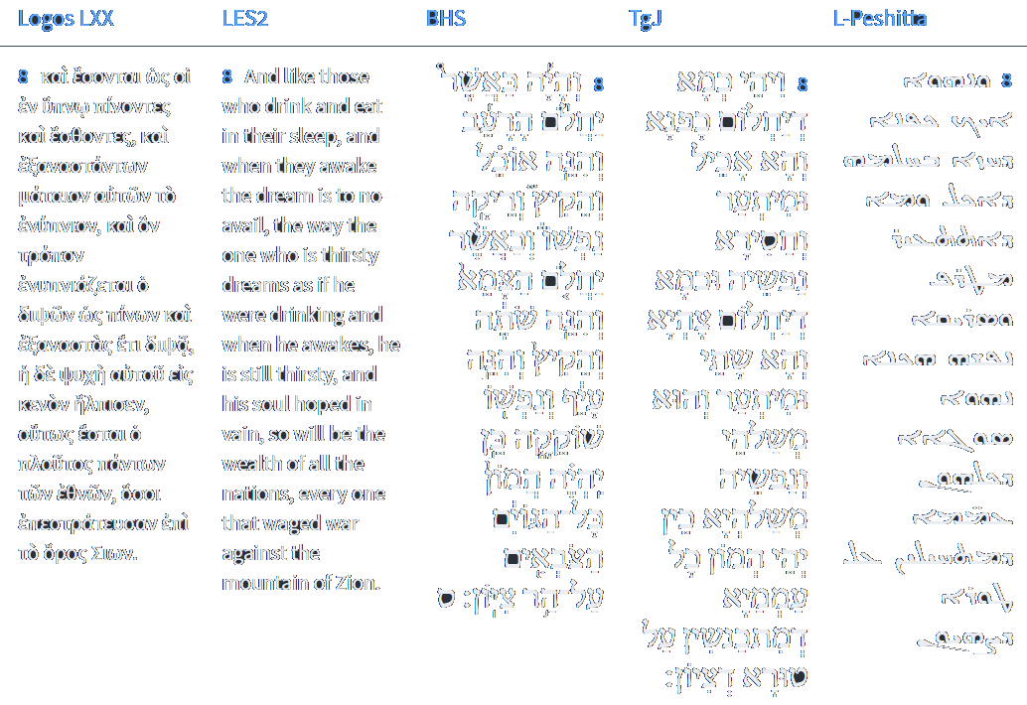
Isaiah 29:8
Isaiah / ישעיה
http://www.matsati.com

Slide 9
ספר משלי פרק יד
יב יֵשׁ דֶּרֶךְ יָשָׁר לִפְנֵי-אִישׁ וְאַחֲרִיתָהּ דַּרְכֵי-מָוֶת:
Mishley / Proverbs 14:12
14:12 There is a way which seemeth right unto a man, But the end thereof are the ways of death. (KJV)
Isaiah / ישעיה
http://www.matsati.com

Slide 10
Romans 1:18–32
1:18 For the wrath of God is revealed from heaven against all ungodliness and unrighteousness of men, who hold the truth in unrighteousness; 1:19 Because that which may be known of God is manifest in them; for God hath shewed it unto them. 1:20 For the invisible things of him from the creation of the world are clearly seen, being understood by the things that are made, even his eternal power and Godhead; so that they are without excuse: 1:21 Because that, when they knew God, they glorified him not as God, neither were thankful; but became vain in their imaginations, and their foolish heart was darkened. 1:22 Professing themselves to be wise, they became fools, 1:23 And changed the glory of the uncorruptible God into an image made like to corruptible man, and to birds, and fourfooted beasts, and creeping things. 1:24 Wherefore God also gave them up to uncleanness through the lusts of their own hearts, to dishonour their own bodies between themselves: 1:25 Who changed the truth of God into a lie, and worshipped and served the creature more than the Creator, who is blessed for ever. Amen. 1:26 For this cause God gave them up unto vile affections: for even their women did change the natural use into that which is against nature: 1:27 And likewise also the men, leaving the natural use of the woman, burned in their lust one toward another; men with men working that which is unseemly, and receiving in themselves that recompence of their error which was meet. 1:28 And even as they did not like to retain God in their knowledge, God gave them over to a reprobate mind, to do those things which are not convenient; 1:29 Being filled with all unrighteousness, fornication, wickedness, covetousness, maliciousness; full of envy, murder, debate, deceit, malignity; whisperers, 1:30 Backbiters, haters of God, despiteful, proud, boasters, inventors of evil things, disobedient to parents, 1:31 Without understanding, covenantbreakers, without natural affection, implacable, unmerciful: 1:32 Who knowing the judgment of God, that they which commit such things are worthy of death, not only do the same, but have pleasure in them that do them. (KJV
Isaiah / ישעיה
http://www.matsati.com

Slide 11
Revelation 5:1–10
5:1 And I saw in the right hand of him that sat on the throne a book written within and on the backside, sealed with seven seals. 5:2 And I saw a strong angel proclaiming with a loud voice, Who is worthy to open the book, and to loose the seals thereof? 5:3 And no man in heaven, nor in earth, neither under the earth, was able to open the book, neither to look thereon. 5:4 And I wept much, because no man was found worthy to open and to read the book, neither to look thereon. 5:5 And one of the elders saith unto me, Weep not: behold, the Lion of the tribe of Judah, the Root of David, hath prevailed to open the book, and to loose the seven seals thereof. 5:6 And I beheld, and, lo, in the midst of the throne and of the four beasts, and in the midst of the elders, stood a Lamb as it had been slain, having seven horns and seven eyes, which are the seven Spirits of God sent forth into all the earth. 5:7 And he came and took the book out of the right hand of him that sat upon the throne. 5:8 And when he had taken the book, the four beasts and four and twenty elders fell down before the Lamb, having every one of them harps, and golden vials full of odours, which are the prayers of saints. 5:9 And they sung a new song, saying, Thou art worthy to take the book, and to open the seals thereof: for thou wast slain, and hast redeemed us to God by thy blood out of every kindred, and tongue, and people, and nation; 5:10 And hast made us unto our God kings and priests: and we shall reign on the earth. (KJV)
Isaiah / ישעיה
http://www.matsati.com

Slide 12
Rabbinic Literature
ספרות רבנית
Part 2
Isaiah / ישעיה
http://www.matsati.com

Slide 13
Targum Jonathan son of Uziel Isaiah 29:7-12
29:7 And the multitude of all the nations, that are gathered together against the city, and the altar which is in her, and all their camps and their armies, that are oppressing her, shall be like a phantom of the night. 29:8 And it shall be as when a hungry man dreameth, behold, he eateth; but he awakes, and he is in want: or as when a thirsty man dreameth, and behold, he drinketh; but he awaketh, and behold, he is faint, he is spent: so shall the multitude of all the nations be, that gather themselves together against the mountain of Zion. 29:9 Be astounded, wonder, be ye terrified, and muse, and marvel. They are drunk, but not with wine; they stagger, but not with old wine. 29:10 Because the Lord shall cast among you a spirit of error; and He shall hide the prophets from you, and He shall hide the scribes, and the teachers, who teach you the instruction of the law. 29:11 And all the prophecy shall be unto you as the words of a sealed book, which if one gives to a man that is learned, saying, “Read this now;” then he shall answer, “I am not able, because it is sealed.” 29:12 Or should the book be given to one that is not learned, saying, “Read this now,” then he shall answer, “I am not learned.” (TgJ)
Isaiah / ישעיה
http://www.matsati.com

Slide 14
ספר תהילים פרק לט
ז אַךְ-בְּצֶלֶם | יִתְהַלֶּךְ-אִישׁ אַךְ-הֶבֶל יֶהֱמָיוּן יִצְבֹּר וְלֹא-יֵדַע מִי-אֹסְפָם: ח וְעַתָּה מַה-קִּוִּיתִי אֲדֹנָי תּוֹחַלְתִּי לְךָ הִיא: ט מִכָּל-פְּשָׁעַי הַצִּילֵנִי חֶרְפַּת נָבָל אַל-תְּשִֹימֵנִי:
Tehillim / Psalm 39:6–8
39:6 Surely every man walketh in a vain shew: Surely they are disquieted in vain: He heapeth up riches, and knoweth not who shall gather them. 39:7 And now, Lord, what wait I for? My hope is in thee. 39:8 Deliver me from all my transgressions: Make me not the reproach of the foolish. (KJV)
Isaiah / ישעיה
http://www.matsati.com

Slide 15
Mark 2:21–22
2:21 No man also seweth a piece of new cloth on an old garment: else the new piece that filled it up taketh away from the old, and the rent is made worse. 2:22 And no man putteth new wine into old bottles: else the new wine doth burst the bottles, and the wine is spilled, and the bottles will be marred: but new wine must be put into new bottles. (KJV, 21 Οὐδεὶς ἐπίβλημα ῥάκους ἀγνάφου ἐπιράπτει ἐπὶ ἱμάτιον παλαιόν·* εἰ δὲ μή, αἴρει τὸ πλήρωμα ἀπʼ αὐτοῦ τὸ καινὸν τοῦ παλαιοῦ καὶ χεῖρον σχίσμα γίνεται. 22 καὶ οὐδεὶς βάλλει οἶνον νέον εἰς ἀσκοὺς παλαιούς· εἰ δὲ μή, ⸂ῥήξει ὁ οἶνος τοὺς ἀσκοὺς⸃ καὶ ὁ οἶνος ⸄ἀπόλλυται καὶ οἱ ἀσκοί⸅· * ⸋ἀλλʼ οἶνον νέον εἰς ἀσκοὺς καινούς⸆.⸌)
Isaiah / ישעיה
http://www.matsati.com

Slide 16
Rashi on Isaiah 29,9 Parts 1-4
התמהמהו. הוו מתונים להתבונן לחשוב על מעלליכם: stop Be patient to reflect [to think] about your deeds.
ותמהו. ותהיו תמהים על קילקולכם: and wonder And wonder about your corruption.
השתעשעו. ל' עיניו השע (לעיל ו) היו עורים מראות: they became blind (הִשְׁתַּעַשְׁעוּ) an expression related to (supra 6:10) “And his eyes are becoming sealed (הָשַׁע),” they were blind, not being able to see [lit., from seeing].
שכרו. עצמכם ולא מיין למה: They were intoxicated yourselves (sic) but not from wine. Why? ([Parshandatha claims that this reading is erroneous. The correct reading, according to all manuscripts is:] their wise men, but not from wine.)
Isaiah / ישעיה
http://www.matsati.com

Slide 17
Rashi on Isaiah 29,10 Part 1
כי נסך עליכם ה'. וגו' לשון מזג כמו מסכה יינה (משלי ט׳:ב׳) או לשון נסיכות השליט בכם רוח תרדמה על פושעי ישראל היה ניבא שהיו חוזים בכוכבים: For the Lord has poured upon you, etc. (נָסַךְ) an expression of mixing wine. Comp. (Prov. 9: 2) “She mixed (מָסְכָה) her wine.” It may also be an expression of princedom (נְסִיכוּת). He caused a spirit of deep sleep to overcome you, (lit., to rule over you). Concerning the transgressors of Israel he was prophesying, for they were stargazers and were experts in adjuring the heavenly princes, each one with the proper name for adjuring him. Therefore, they say, “Who will encamp upon us (Jer. 21:13)? If the enemy comes upon us, we can make for it a wall of fire around, ([Most manuscripts read:] If the enemy comes upon the city, we can make for it a wall of fire around,) or surround it with the Great Sea.” Said the Holy One, blessed be He, “I will change the heavenly princes; the one appointed over fire, is appointed over water. When he adjures the prince of fire to bring him fire, he will reply, “This is not mine,” And, likewise, the prince of water. And even the name by which you adjure him, he does not recognize. This is the closing of the eyes and the covering of the heads of the stargazers
Isaiah / ישעיה
http://www.matsati.com

Slide 18
Guide for the Perplexed, Part 2 29:1
If we hear a person speaking whose language we do not understand, we undoubtedly know that he speaks, but do not know what his words mean; it may even happen that we hear some words which mean one thing in the tongue of the speaker, and exactly the reverse in our language, and taking the words in the sense which they have in our language, we imagine that the speaker employed them in that sense. Suppose, e.g., an Arab hears of a Hebrew the word abah, he thinks that the Hebrew relates how a man despised and refused a certain thing, whilst the Hebrew in reality says that the man was pleased and satisfied with it. The very same thing happens to the ordinary reader of the Prophets: some of their words he does not understand at all, like those to whom the prophet says (Isa. 29:11), “the vision of all is become unto you as the words of a book that is sealed”; in other passages he finds the opposite or the reverse of what the prophet meant; to this case reference is made in the words, “Ye have perverted the words of the living God” (Jer. 23:36). Besides, it must be borne in mind that every prophet has his own peculiar diction, which is, as it were, his language, and it is in that language that the prophecy addressed to him is communicated to those who understand it.
Isaiah / ישעיה
http://www.matsati.com

Slide 19
Rashi on Isaiah 29,12 Part 1
ונתן הספר על אשר לא ידע ספר. וכשנוטלין ממנו ופותחין חותמה ונותנין אותה למי שאינו מכיר ל' אגרת ואומרין לו קרא נא זה ואמר לא ידעתי ספר כך כשתשביע שר האש יאמר לא אוכל כי חתום הדבר ממני וכשתשביע את חבירו יאמר איני מכיר את השם הזה שאתה משביעני בו שאין זה שמי וזהו שאמר ירמיה הנני מיסב את כלי המלחמה אשר בידכם (ירמיהו כ״א:ד׳) זה השם המפורש במדר' תהלי': And if the book is given And when they take it from him and open its seal and give it to one who does not understand the language of the letter, and they say to him, “now read this,” he will say, “I cannot read.” Similarly, when you adjure the prince of fire, he will say, “I cannot, for the matter is sealed from me,” and when you adjure his colleague, he will say, “I do not recognize this name, by which you adjure me, for this is not my name.” This is what Jeremiah said (Jer. 21:4): “Behold I will turn around my implements of war that are in your hands.” This refers to the Explicit Name. In Midrash Tehillim 36:8
Isaiah / ישעיה
http://www.matsati.com

Slide 20
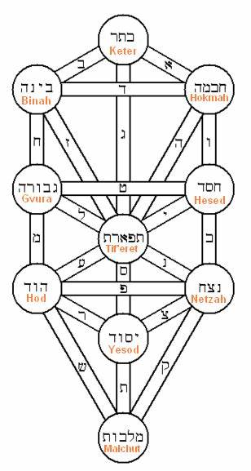
Zohar 1.16a:3
(עד כאן מההשמטות) 4. Rabbi Berachiah said: It is written (Genesis 1:2), "The earth was Chaos (Tohu) and Desolation (Bohu).” What is the meaning of the word "was" in this verse? This indicates that the Chaos existed previously [and already was] . What is Chaos (Tohu)? Something that confounds (Taha) people. What is Desolation (Bohu)? It is something that has substance. This is the reason that it is called Bohu, that is, Bo Hu — "it is in it." Why is it written (Eccl. 7:14) "God has made one corresponding to the other". He created Bohu and set its place in peace. He created Tohu and set its place in evil. Bohu in peace, as it is written (Job 25:2) "He makes peace in His heights". We learn that Michael, the Prince of the Right Side of Hashem, water and hail. And Gabriel, the Prince of His Left, Fire. The Prince of Peace is between them, deciding. That is why it is written "He makes peace in His heights". And from where do we know that Bohu is peace, as it is written (Isaiah 45:7) "Who makes peace and creates evil". This is how we get evil from Tohu and peace from Bohu. He created Tohu and set its place in evil, as it is written ibid. He created Bohu and set its place in peace as it is says, "He makes peace in His heights". (Until here is from the omissions).
Isaiah / ישעיה
http://www.matsati.com

