Slide 1
MATSATI.COM Teaching Ministry
Website: https://www.matsati.com YouTube Channel: https://www.youtube.com/user/MATSATI/
ישעיהו כט:יג-יח / Isaiah 29:13-18
LIVE STREAM: 6:30 pm EST Thursday
Join us at Telegram:
https://t.me/MessianicChat
Rabbi Jeremiah
– The Apocalypse: connecting the Greek to the Ancient Hebrew text. (Wed. 9 am EST)
A Community
for Learning
Weekly Teachings Free Online
Check Telegram for weekly scheduling of teachings.
YouTube Channels
https://YouTube.com/c/HebrewLiteracy
https://www.youtube.com/channel/UC5_qPfruat-sCJJypz0_OBw
Discuss the Scriptures,
learn the languages,
and fellowship
Join Telegram ask about Hebrew and Greek classes!

Slide 2
Isaiah 29:13-18
ישעיהו כט:יג-יח
Isaiah / ישעיה
http://www.matsati.com

Slide 3
The Definition of Idolatry
“anything we serve, love, desire, trust, fear, and worship…apart from God to give us love, joy, peace, freedom, status, identity, control, happiness, security, fulfillment, health, pleasure, significance, acceptance, and respect.”
ספר דברים פרק ו
ד שְׁמַע יִשְֹרָאֵל יְהוָֹה אֱלֹהֵינוּ יְהוָֹה | אֶחָד: ה וְאָהַבְתָּ אֵת יְהוָֹה אֱלֹהֶיךָ בְּכָל-לְבָבְךָ וּבְכָל-נַפְשְׁךָ וּבְכָל-מְאֹדֶךָ: ו וְהָיוּ הַדְּבָרִים הָאֵלֶּה אֲשֶׁר אָנֹכִי מְצַוְּךָ הַיּוֹם עַל-לְבָבֶךָ: ז וְשִׁנַּנְתָּם לְבָנֶיךָ וְדִבַּרְתָּ בָּם בְּשִׁבְתְּךָ בְּבֵיתֶךָ וּבְלֶכְתְּךָ בַדֶּרֶךְ וּבְשָׁכְבְּךָ וּבְקוּמֶךָ: ח וּקְשַׁרְתָּם לְאוֹת עַל-יָדֶךָ וְהָיוּ לְטֹטָפֹת בֵּין עֵינֶיךָ: ט וּכְתַבְתָּם עַל-מְזֻזוֹת בֵּיתֶךָ וּבִשְׁעָרֶיךָ:
Isaiah / ישעיה
http://www.matsati.com
Notes:
6:4 Hear, O Israel: The LORD our God is one LORD: 6:5 And thou shalt love the LORD thy God with all thine heart, and with all thy soul, and with all thy might. 6:6 And these words, which I command thee this day, shall be in thine heart: 6:7 And thou shalt teach them diligently unto thy children, and shalt talk of them when thou sittest in thine house, and when thou walkest by the way, and when thou liest down, and when thou risest up. 6:8 And thou shalt bind them for a sign upon thine hand, and they shall be as frontlets between thine eyes. 6:9 And thou shalt write them upon the posts of thy house, and on thy gates. (KJV)

Slide 4
Acts 7:39–42
7:39 To whom our fathers would not obey, but thrust him from them, and in their hearts turned back again into Egypt, 7:40 Saying unto Aaron, Make us gods to go before us: for as for this Moses, which brought us out of the land of Egypt, we wot not what is become of him. 7:41 And they made a calf in those days, and offered sacrifice unto the idol, and rejoiced in the works of their own hands. 7:42 Then God turned, and gave them up to worship the host of heaven; as it is written in the book of the prophets, O ye house of Israel, have ye offered to me slain beasts and sacrifices by the space of forty years in the wilderness? (KJV, 39 ⸀ᾧ οὐκ ἠθέλησαν ὑπήκοοι γενέσθαι οἱ πατέρες ⸁ἡμῶν, ἀλλʼ ἀπώσαντο καὶ ⸀1ἐστράφησαν ⸂ἐν ταῖς καρδίαις αὐτῶν⸃ εἰς Αἴγυπτον* 40 εἰπόντες τῷ Ἀαρών·* ποίησον ἡμῖν θεοὺς οἳ προπορεύσονται ἡμῶν· ὁ γὰρ Μωϋσῆς οὗτος, ὃς ἐξήγαγεν ἡμᾶς ἐκ γῆς Αἰγύπτου, οὐκ οἴδαμεν τί ⸀ἐγένετο αὐτῷ. 41 καὶ ἐμοσχοποίησαν ἐν ταῖς ἡμέραις ἐκείναις καὶ ἀνήγαγον θυσίαν τῷ εἰδώλῳ καὶ εὐφραίνοντο ἐν τοῖς ἔργοις τῶν χειρῶν αὐτῶν.* 42 ἔστρεψεν δὲ ὁ θεὸς καὶ παρέδωκεν αὐτοὺς* λατρεύειν τῇ στρατιᾷ τοῦ οὐρανοῦ καθὼς γέγραπται ἐν βίβλῳ τῶν προφητῶν·* μὴ σφάγια καὶ θυσίας προσηνέγκατέ μοι ἔτη τεσσεράκοντα ἐν τῇ ἐρήμῳ, οἶκος Ἰσραήλ;*)
Isaiah / ישעיה
http://www.matsati.com

Slide 5
Romans 1:24–25
1:24 Wherefore God also gave them up to uncleanness through the lusts of their own hearts, to dishonour their own bodies between themselves: 1:25 Who changed the truth of God into a lie, and worshipped and served the creature more than the Creator, who is blessed for ever. Amen. (KJV, 24 Διὸ ⸆ παρέδωκεν* αὐτοὺς ὁ θεὸς ἐν ταῖς ἐπιθυμίαις τῶν καρδιῶν αὐτῶν εἰς ἀκαθαρσίαν τοῦ ἀτιμάζεσθαι τὰ σώματα αὐτῶν ἐν* ⸀αὐτοῖς·* 25 οἵτινες μετήλλαξαν τὴν ἀλήθειαν τοῦ θεοῦ ἐν τῷ ψεύδει καὶ ἐσεβάσθησαν καὶ ἐλάτρευσαν τῇ κτίσει παρὰ τὸν κτίσαντα*, ὅς ἐστιν εὐλογητὸς εἰς τοὺς αἰῶνας, ἀμήν*)
Isaiah / ישעיה
http://www.matsati.com

Slide 6
﻿ספר ישעיה פרק כט
﻿יג וַיֹּאמֶר אֲדֹנָי יַעַן כִּי נִגַּשׁ הָעָם הַזֶּה בְּפִיו וּבִשְֹפָתָיו כִּבְּדוּנִי וְלִבּוֹ רִחַק מִמֶּנִּי וַתְּהִי יִרְאָתָם אֹתִי מִצְוַת אֲנָשִׁים מְלֻמָּדָה: יד לָכֵן הִנְנִי יוֹסִף לְהַפְלִיא אֶת-הָעָם-הַזֶּה הַפְלֵא וָפֶלֶא וְאָבְדָה חָכְמַת חֲכָמָיו וּבִינַת נְבֹנָיו תִּסְתַּתָּר: טו הוֹי הַמַּעֲמִיקִים מֵיהֹוָה לַסְתִּר עֵצָה וְהָיָה בְמַחְשָׁךְ מַעֲשֵֹיהֶם וַיֹּאמְרוּ מִי רֹאֵנוּ וּמִי יֹדְעֵנוּ: טז הַפְכְּכֶם אִם-כְּחֹמֶר הַיֹּצֵר יֵחָשֵׁב כִּי-יֹאמַר מַעֲשֶֹה לְעֹשֵֹהוּ לֹא עָשָֹנִי וְיֵצֶר אָמַר לְיֹצְרוֹ לֹא הֵבִין: יז הֲלֹא-עוֹד מְעַט מִזְעָר וְשָׁב לְבָנוֹן לַכַּרְמֶל וְהַכַּרְמֶל לַיַּעַר יֵחָשֵׁב: יח וְשָׁמְעוּ בַיּוֹם-הַהוּא הַחֵרְשִׁים דִּבְרֵי-סֵפֶר וּמֵאֹפֶל וּמֵחֹשֶׁךְ עֵינֵי עִוְרִים תִּרְאֶינָה:
Isaiah / ישעיה
http://www.matsati.com

Slide 7
Matthew 15:1–9
15:1 Then came to Jesus scribes and Pharisees, who were of Jerusalem, saying, 15:2 Why do thy disciples transgress the tradition of the elders? for they wash not their hands when they eat bread. 15:3 But he answered and said unto them, Why do ye also transgress the commandment of God by your tradition? 15:4 For God commanded, saying, Honour thy father and mother: and, He that curseth father or mother, let him die the death. 15:5 But ye say, Whosoever shall say to his father or his mother, It is a gift, by whatsoever thou mightest be profited by me; 15:6 And honour not his father or his mother, he shall be free. Thus have ye made the commandment of God of none effect by your tradition. 15:7 Ye hypocrites, well did Esaias prophesy of you, saying, 15:8 This people draweth nigh unto me with their mouth, and honoureth me with their lips; but their heart is far from me. 15:9 But in vain they do worship me, teaching for doctrines the commandments of men. (KJV, *15 Τότε προσέρχονται τῷ Ἰησοῦ* ⸆ ἀπὸ Ἱεροσολύμων ⸉Φαρισαῖοι καὶ γραμματεῖς⸊ λέγοντες·* 2 διὰ τί οἱ μαθηταί σου παραβαίνουσιν τὴν παράδοσιν τῶν πρεσβυτέρων;* οὐ γὰρ νίπτονται τὰς χεῖρας °[αὐτῶν]* ὅταν ἄρτον ἐσθίωσιν. 3 ὁ δὲ ἀποκριθεὶς εἶπεν αὐτοῖς· διὰ τί καὶ ὑμεῖς παραβαίνετε τὴν ἐντολὴν τοῦ θεοῦ διὰ τὴν παράδοσιν ὑμῶν;* 4 ὁ γὰρ θεὸς ⸀εἶπεν· τίμα τὸν πατέρα ⸆ καὶ τὴν μητέρα ⸇,* καί· ὁ κακολογῶν πατέρα ἢ μητέρα θανάτῳ τελευτάτω.* 5 ὑμεῖς δὲ λέγετε· ὃς ἂν εἴπῃ τῷ πατρὶ ἢ τῇ μητρί· δῶρον ὃ ἐὰν ἐξ ἐμοῦ ὠφεληθῇς ⸆, 6 ⸆οὐ μὴ τιμήσει τὸν πατέρα °αὐτοῦ ⸇· καὶ ἠκυρώσατε ⸂τὸν λόγον⸃ τοῦ θεοῦ διὰ τὴν παράδοσιν ὑμῶν. 7 ὑποκριταί,* καλῶς ἐπροφήτευσεν περὶ ὑμῶν Ἠσαΐας λέγων· 8 ⸂ὁ λαὸς οὗτος⸃ τοῖς χείλεσίν με τιμᾷ,* ἡ δὲ καρδία αὐτῶν πόρρω ⸀ἀπέχει ἀπʼ ἐμοῦ 9 μάτην δὲ σέβονταί με διδάσκοντες διδασκαλίας ἐντάλματα ἀνθρώπων.*)
Isaiah / ישעיה
http://www.matsati.com

Slide 8
ספר דברים פרק כח
ט יְקִימְךָ יְהוָֹה לוֹ לְעַם קָדוֹשׁ כַּאֲשֶׁר נִשְׁבַּע-לָךְ כִּי תִשְׁמֹר אֶת-מִצְוֹת יְהוָֹה אֱלֹהֶיךָ וְהָלַכְתָּ בִּדְרָכָיו: י וְרָאוּ כָּל-עַמֵּי הָאָרֶץ כִּי שֵׁם יְהוָֹה נִקְרָא עָלֶיךָ וְיָרְאוּ מִמֶּךָּ:
Devarim / Deuteronomy 28:9–10
28:9 The LORD shall establish thee an holy people unto himself, as he hath sworn unto thee, if thou shalt keep the commandments of the LORD thy God, and walk in his ways. 28:10 And all people of the earth shall see that thou art called by the name of the LORD; and they shall be afraid of thee. (KJV)
Isaiah / ישעיה
http://www.matsati.com

Slide 9
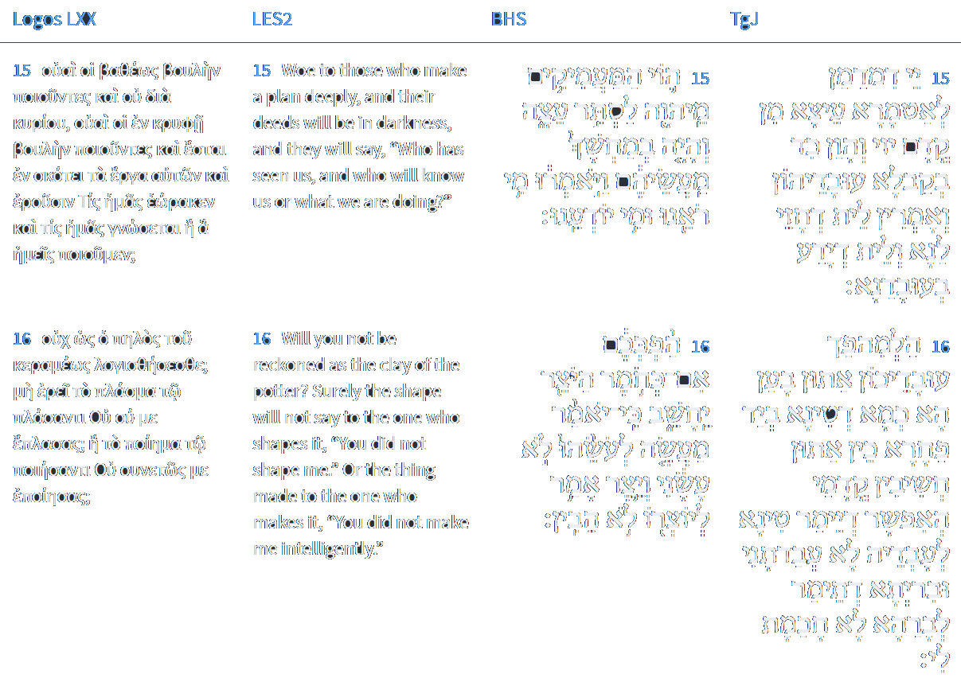
Isaiah 29:15-16
Isaiah / ישעיה
http://www.matsati.com

Slide 10
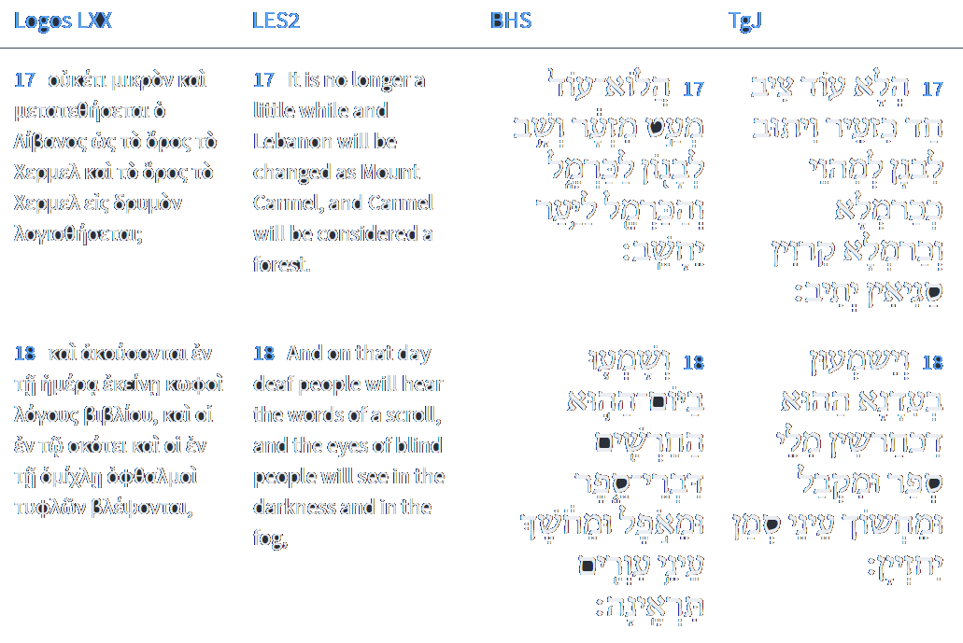
Isaiah 29:17-18
Isaiah / ישעיה
http://www.matsati.com

Slide 11
Rabbinic Literature
ספרות רבנית
Part 2
Isaiah / ישעיה
http://www.matsati.com

Slide 12
Targum Jonathan son of Uziel Isaiah 29:13-18
29:13 Wherefore the Lord hath said: Because I am magnified by the mouth of this people, and with their lips they do honor me, but their heart is far from my fear, and their fear towards me is as the commandment of men teaching them: 29:14 Therefore, behold, I shall again strike this people with wonderful strokes; the wisdom of their wise men shall perish, and the understanding of their prudent men shall be hidden. 29:15 Woe unto them that purpose to hide counsel from before the Lord, that their works may be in darkness, and they say, None sees us, and none takes cognizance of our works. 29:16 Why do ye seek to pervert your works? Behold, as the clay in the hand of the potter, thus are ye accounted before me. Is it possible that the clay should say to its maker, Thou hast not made me? or should the creature say to its creator, Thou dost not understand me? 29:17 Is it not yet a very little while, and Lebanon shall turn into a fruitful field, and the fruitful field shall be inhabited by many cities. 29:18 And at that time those that are like the deaf shall hear the words of the book, and the eyes of the blind shall see out of obscurity, and out of darkness. (TgJ)
Isaiah / ישעיה
http://www.matsati.com

Slide 13
Duties of the Heart, Third Treatise on Service of God 4:46
Of the fourth degree are those in whose consciousness the genuineness of the Torah and the truthfulness of reward and punishment in the world to come are firmly established. But their disposition inclines them to love of the world and its lusts; and they use the practices of the service of G-d as snares with which to obtain worldly advantages. They accept the Torah outwardly but not inwardly, with their tongues and not with their hearts. Of such people it is said, "One speaks peaceably to his neighbor with his mouth, but in his heart he waits in ambush for him" (Yirmiya 9:7). Further, "With mouth and lips, they honor Me; but their heart is far from Me" (Yeshaya 29:13).
Isaiah / ישעיה
http://www.matsati.com

Slide 14
Baal Shem Tov, Noach 59:1
There are some who pray in melancholy, from an excess of black bile, and think that they are praying with great awe. So too, there are some who think that they are praying out of great love for the Creator, on account of their blood, the red humor. When, however, one is in a state of loving God, and as a result shame falls upon them, and they want to glorify the Blessed One and defeat the evil urge on God's account - this is very good. One is not considered a worshiper of God without the qualities of awe and love. One should allow awe to fall on them, and not arouse themselves to awe, which would be drawing up the mayim nukvin, the feminine waters. Real awe is when fear and terror fall upon you, and out of fear you have no idea where you are, and the mind clears and tears fall on their own. When it is not like this, even though it may seem that one loves the Creator, it is surely not so for "This is the gate to God" (Psalms 118:20): awe is the gate that leads to love, and if one does not go through the gate of awe, how can one be in a state of love? Such a person is not even a servant, much less a person on the level of having awe fall on them - they are not worshiping in a way that befits a Jew at all, only serving God out of automatic reflexes (Isaiah 29:13) and fooling themselves that they are actually serving God and worshiping God with joy. This is nothing but flippant joy, and one should return to God with their entire heart and soul.
Isaiah / ישעיה
http://www.matsati.com

Slide 15
1 Corinthians 13:1-7
13:1 IF I speak with the tongues of men and of angels, but do not have love, I have become a noisy gong or a clanging cymbal. 13:2 And if I have the gift of prophecy, and know all mysteries and all knowledge; and if I have all faith, so as to remove mountains, but do not have love, I am nothing. 13:3 And if I give all my possessions to feed the poor, and if I deliver my body to be burned, but do not have love, it profits me nothing. 13:4 Love is patient, love is kind, and is not jealous; love does not brag and is not arrogant, 13:5 does not act unbecomingly; it does not seek its own, is not provoked, does not take into account a wrong suffered, 13:6 does not rejoice in unrighteousness, but rejoices with the truth; 13:7 abears all things, believes all things, hopes all things, endures all things. (NASB, 13 Ἐὰν ταῖς γλώσσαις τῶν ἀνθρώπων λαλῶ καὶ τῶν ἀγγέλων, ἀγάπην δὲ μὴ ἔχω, γέγονα χαλκὸς ἠχῶν ἢ κύμβαλον ἀλαλάζον.* 2 καὶ *ἐὰν ἔχω προφητείαν καὶ εἰδῶ τὰ μυστήρια πάντα καὶ πᾶσαν τὴν γνῶσιν καὶ* ἐὰν ἔχω πᾶσαν τὴν πίστιν ὥστε ὄρη ⸀μεθιστάναι,* ἀγάπην δὲ μὴ ἔχω, οὐθέν εἰμι. 3 κἂν ψωμίσω πάντα τὰ ὑπάρχοντά μου καὶ ἐὰν παραδῶ τὸ σῶμά μου ἵνα ⸀καυχήσωμαι,* ἀγάπην δὲ μὴ ἔχω, οὐδὲν ὠφελοῦμαι. 4 Ἡ ἀγάπη μακροθυμεῖ,* χρηστεύεται˸ ἡ ἀγάπη˸1, οὐ ζηλοῖ, ⸋[ἡ ἀγάπη]⸌ οὐ περπερεύεται, οὐ φυσιοῦται, 5 οὐκ ⸀ἀσχημονεῖ,* οὐ ζητεῖ ⸁τὰ ἑαυτῆς, οὐ παροξύνεται, οὐ λογίζεται τὸ κακόν, 6 οὐ χαίρει ἐπὶ τῇ ἀδικίᾳ, συγχαίρει δὲ τῇ ἀληθείᾳ·* 7 πάντα στέγει,* πάντα πιστεύει, πάντα ἐλπίζει, πάντα ὑπομένει.)
Isaiah / ישעיה
http://www.matsati.com

Slide 16
Rashi on Isaiah 29,13 Parts 1-2
יען כי נגש העם הזה. יונתן תירגם חלף דאיתרברב עמא הדין כלומר נגשו להגביה עצמן עד לשמים הם מראין עצמן כמכבדין אותי בפה ושפה ואת לבם הרחיקו ממני: Because this people has come near Jonathan renders: Because this people has aggrandized itself. I.e., they have come near to raise themselves up to the heavens. They show themselves as though honoring Me with mouth and lip, but their heart they have drawn far away from Me.
ותהי יראתם אותי. לא בלב שלם כי אם במצות האנשים המלמדים אותם התראו כנכנעים מלפניו כדי לפתותו בפיכם: and their fear of Me has become not wholehearted, but by the command of the people who teach them, they show themselves as humbled before Him in order to entice Him with your mouth.
Isaiah / ישעיה
http://www.matsati.com

Slide 17
Midrash Rabbah Bereishit 1:6
Rabbi Yehudah Bar Simon opened with (Daniel 2:22): "He reveals the deep and secret. He knows what is in the darkness, and the light dwells with Him." "He reveals the deep"--this is Hell, as it says (Proverbs 9:18): "He does not know there are spirits there," and it says (Isaiah 30:33): "deep and large". "And secret"--this is Paradise, as it says (Isaiah 4:6): "for a cover and refuge from storm and rain," and it says (Psalms 31:21): "You hide them in the cover of Your presence." Alternatively, "he reveals the deep and secret"--these are the acts of the wicked, as it says (Isaiah 29:15): "Woe to the ones who seek deep from God to make their counsel secret." "And secret"--these are the acts of the wicked, as the verse states. "He knows what is in the dark"--these are the acts of the wicked, as it says in Isaiah: "Their acts are in the dark." "The light dwells with Him"--these are the acts of the righteous, as it is written (Proverbs 4:18): "The path of the righteous is like the light at dawn," and it says (Psalms 97:11): "Light is sown for the righteous." Rabbi Abba Srungia said: "The light dwells with Him"--this is the Messiah, as it says (Isaiah 60:1): "Arise, shine, for your light has come." Rabbi Yehudah Bar Simon said: From the beginning of the creation of the world, "he revealed the dark and secret". "In the beginning God created the heavens," but it is not explained. Where is it explained? Here (Isaiah 40:22): "He stretches out the heavens like a curtain." "And the land," but it is not explained. Where is it explained? Here (Job 37:6): "For He says to the snow: 'Fall on the earth.'" and (Job 38:38) "When the dust runs into a mass, and the clods cleave together." "And God said: 'Let there be light,'" and it is not explained. Where is it explained? (Psalms 104:2) "You cover Yourself with light like a garment."
Isaiah / ישעיה
http://www.matsati.com

Slide 18
Rashi on Isaiah 29,16 Parts 1-4
הפככם אם כחומר היוצר יחשב. תהפוכות שלכם הזאת אתם יודעים שהוא כחומר היוצר שאין החומר יכול לומר לעושהו לא עשאני כך אינכם יכולין לומר שאיני מבין מעשיכם: Shall your perversion be regarded like the potter’s clay (Heb. הָפְכְּכֶם) Your perversions. Do you know this, that it is like the potter’s clay? Just as the clay cannot say of its maker, “He did not make me,” so you cannot say that I do not understand your deeds.
כחומר וגו'. ל' תמיה הוא ויש תמיהות המתקיימות: Shall...like the potter’s clay, etc. This is an expression of a question, but there are questions to be answered in the affirmative.
לעושהו. כמו על עושהו ודוגמתו ואמר פרעה לבני ישראל (שמות יד), פן יאמרו לי אשה הרגתהו (שופטי' ט): of him who made it (לְעֹשֵׂהוּ, lit. to him who made it.) Like עַל עֹשֵׂהוּ. Comp. (Ex. 14:3) “And Pharaoh shall say of the children of Israel (וְלִבְנֵי יִשְׂרָאֵל).” ( Jud. 9:54) “Lest they say of me (לִי), ‘ A woman killed him.’”
ויצר אמר ליוצרו לא הבין. אמר על יוצרו לא הבין מה ביצרו והלא הוא בנה את המטמוניו' והחדרי' והמחשבות: and the impulse say concerning the One Who formed it, “He does not understand”? Did he say concerning the One Who formed it, “He does not understand what is in my impulse”? Did He not build the hidden recesses, the inner chambers, and the thoughts?
Isaiah / ישעיה
http://www.matsati.com

Slide 19
Midrash Rabbah Bereishit 24:1
This is the book of the Generations of Adam, It is written, Woe unto them that seek deep to hide their counsel from the Lord, etc. (Isaiah 29:15) R. Levi said, This may be compared to a master builder who built a country with (secret) chambers, canals, and caves. Subsequently he became a tax collector, and the inhabitants of the country hid from him in those chambers and caves. Said he to them, It is I who built all these chambers and caves; to what purpose then is your hiding? Similarly, Woe unto them that seek deep! … And their works are in the darkness, etc. (ib.). O your perversity! Shall the potter be esteemed as the clay (Isaiah 29:16)? You liken the created object to its creator, the plant to its planter! That the thing made should say unto him that made it, He made me not, etc. (Isaiah 29:16). Is it not yet a very little while, and Lebanon shall be turned into a fruitful field (Isaiah 29:17) - i.e. as a forest - i.e. as a forest of men. And in that day shall the deaf hear the words of a book (Isaiah 29:18), viz. The book of the generations of Adam; hence it is written, This is the book of the generations of Adam.
Isaiah / ישעיה
http://www.matsati.com

Slide 20
ספר ישעיה פרק ו
י הַשְׁמֵן לֵב-הָעָם הַזֶּה וְאָזְנָיו הַכְבֵּד וְעֵינָיו הָשַׁע פֶּן-יִרְאֶה בְעֵינָיו וּבְאָזְנָיו יִשְׁמָע וּלְבָבוֹ יָבִין וָשָׁב וְרָפָא לוֹ:
Isaiah 6:10
6:10 Make the heart of this people fat, And make their ears heavy, and shut their eyes; Lest they see with their eyes, and hear with their ears, And understand with their heart, and convert, and be healed. (KJV)
Matthew 13:15
13:15 For this people’s heart is waxed gross, and their ears are dull of hearing, and their eyes they have closed; lest at any time they should see with their eyes, and hear with their ears, and should understand with their heart, and should be converted, and I should heal them. (KJV, 15 ἐπαχύνθη γὰρ ἡ καρδία τοῦ λαοῦ τούτου,* καὶ τοῖς ὠσὶν ⸆ βαρέως ἤκουσαν καὶ τοὺς ὀφθαλμοὺς αὐτῶν ἐκάμμυσαν, μήποτε ἴδωσιν τοῖς ὀφθαλμοῖς καὶ τοῖς ὠσὶν ἀκούσωσιν καὶ τῇ καρδίᾳ συνῶσιν καὶ ἐπιστρέψωσιν καὶ ἰάσομαι αὐτούς.*)
Isaiah / ישעיה
http://www.matsati.com

