Slide 1
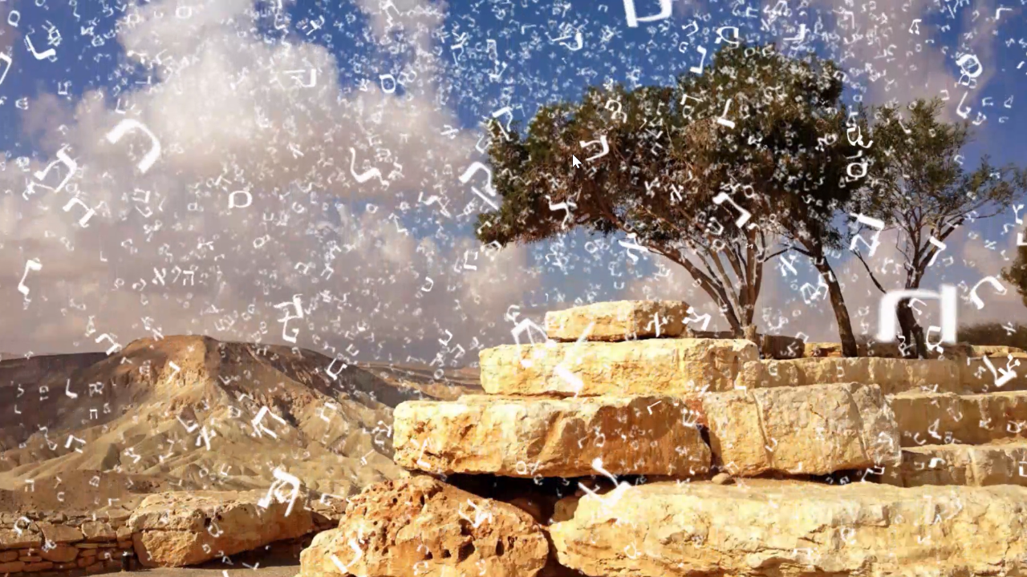

MATSATI.COM Teaching Ministry
Website: https://www.matsati.com YouTube Channel: https://www.youtube.com/user/MATSATI/
ישעיהו כט:א-ו / Isaiah 29:1-6
LIVE STREAM: 6:30 pm EST Thursday
Join us at Telegram:
https://t.me/MessianicChat
Rabbi Jeremiah
– The Apocalypse: connecting the Greek to the Ancient Hebrew text. (Wed. 9 am EST)
A Community
for Learning
Weekly Teachings Free Online
Check Telegram for weekly scheduling of teachings.
YouTube Channels
https://YouTube.com/c/HebrewLiteracy
https://www.youtube.com/channel/UC5_qPfruat-sCJJypz0_OBw
Discuss the Scriptures,
learn the languages,
and fellowship
Join Telegram ask about Hebrew and Greek classes!

Slide 2

Isaiah 29:1-6
ישעיהו כט:א-ו
Isaiah / ישעיה
http://www.matsati.com

Slide 3







ספר שמות פרק לב
א וַיַּרְא הָעָם כִּי-בֹשֵׁשׁ מֹשֶׁה לָרֶדֶת מִן-הָהָר וַיִּקָּהֵל הָעָם עַל-אַהֲרֹן וַיֹּאמְרוּ אֵלָיו קוּם | עֲשֵֹה-לָנוּ אֱלֹהִים אֲשֶׁר יֵלְכוּ לְפָנֵינוּ כִּי-זֶה | מֹשֶׁה הָאִישׁ אֲשֶׁר הֶעֱלָנוּ מֵאֶרֶץ מִצְרַיִם לֹא יָדַעְנוּ מֶה-הָיָה לוֹ: ב וַיֹּאמֶר אֲלֵהֶם אַהֲרֹן פָּרְקוּ נִזְמֵי הַזָּהָב אֲשֶׁר בְּאָזְנֵי נְשֵׁיכֶם בְּנֵיכֶם וּבְנֹתֵיכֶם וְהָבִיאוּ אֵלָי: ג וַיִּתְפָּרְקוּ כָּל-הָעָם אֶת-נִזְמֵי הַזָּהָב אֲשֶׁר בְּאָזְנֵיהֶם וַיָּבִיאוּ אֶל-אַהֲרֹן: ד וַיִּקַּח מִיָּדָם וַיָּצַר אֹתוֹ בַּחֶרֶט וַיַּעֲשֵֹהוּ עֵגֶל מַסֵּכָה וַיֹּאמְרוּ אֵלֶּה אֱלֹהֶיךָ יִשְֹרָאֵל אֲשֶׁר הֶעֱלוּךָ מֵאֶרֶץ מִצְרָיִם: ה וַיַּרְא אַהֲרֹן וַיִּבֶן מִזְבֵּחַ לְפָנָיו וַיִּקְרָא אַהֲרֹן וַיֹּאמַר חַג לַיהוָֹה מָחָר: ו וַיַּשְׁכִּימוּ מִמָּחֳרָת וַיַּעֲלוּ עֹלֹת וַיַּגִּשׁוּ שְׁלָמִים וַיֵּשֶׁב הָעָם לֶאֱכֹל וְשָׁתוֹ וַיָּקֻמוּ לְצַחֵק: פ ז וַיְדַבֵּר יְהֹוָה אֶל-מֹשֶׁה לֶךְ-רֵד כִּי שִׁחֵת עַמְּךָ אֲשֶׁר הֶעֱלֵיתָ מֵאֶרֶץ מִצְרָיִם: ח סָרוּ מַהֵר מִן-הַדֶּרֶךְ אֲשֶׁר צִוִּיתִם עָשֹוּ לָהֶם עֵגֶל מַסֵּכָה וַיִּשְׁתַּחֲווּ-לוֹ וַיִּזְבְּחוּ-לוֹ וַיֹּאמְרוּ אֵלֶּה אֱלֹהֶיךָ יִשְֹרָאֵל אֲשֶׁר הֶעֱלוּךָ מֵאֶרֶץ מִצְרָיִם: ט וַיֹּאמֶר יְהֹוָה אֶל-מֹשֶׁה רָאִיתִי אֶת-הָעָם הַזֶּה וְהִנֵּה עַם-קְשֵׁה-עֹרֶף הוּא: י וְעַתָּה הַנִּיחָה לִּי וְיִחַר-אַפִּי בָהֶם וַאֲכַלֵּם וְאֶעֱשֶֹה אוֹתְךָ לְגוֹי גָּדוֹל: יא וַיְחַל מֹשֶׁה אֶת-פְּנֵי יְהוָֹה אֱלֹהָיו וַיֹּאמֶר לָמָה יְהוָֹה יֶחֱרֶה אַפְּךָ בְּעַמֶּךָ אֲשֶׁר הוֹצֵאתָ מֵאֶרֶץ מִצְרַיִם בְּכֹחַ גָּדוֹל וּבְיָד חֲזָקָה: יב לָמָּה יֹאמְרוּ מִצְרַיִם לֵאמֹר בְּרָעָה הוֹצִיאָם לַהֲרֹג אֹתָם בֶּהָרִים וּלְכַלֹּתָם מֵעַל פְּנֵי הָאֲדָמָה שׁוּב מֵחֲרוֹן אַפֶּךָ וְהִנָּחֵם עַל-הָרָעָה לְעַמֶּךָ: יג זְכֹר לְאַבְרָהָם לְיִצְחָק וּלְיִשְֹרָאֵל עֲבָדֶיךָ אֲשֶׁר נִשְׁבַּעְתָּ לָהֶם בָּךְ וַתְּדַבֵּר אֲלֵהֶם אַרְבֶּה אֶת-זַרְעֲכֶם כְּכוֹכְבֵי הַשָּׁמָיִם וְכָל-הָאָרֶץ הַזֹּאת אֲשֶׁר אָמַרְתִּי אֶתֵּן לְזַרְעֲכֶם וְנָחֲלוּ לְעֹלָם: יד וַיִּנָּחֶם יְהוָֹה עַל-הָרָעָה אֲשֶׁר דִּבֶּר לַעֲשֹוֹת לְעַמּוֹ
Isaiah / ישעיה
http://www.matsati.com

Slide 4




Bereshit / Genesis 39:14
וַתִּקְרָ֞א לְאַנְשֵׁ֣י בֵיתָ֗הּ וַתֹּ֤אמֶר לָהֶם֙ לֵאמֹ֔ר רְא֗וּ הֵ֥בִיא לָ֛נוּ אִ֥ישׁ עִבְרִ֖י לְצַ֣חֶק בָּ֑נוּ בָּ֤א אֵלַי֙ לִשְׁכַּ֣ב עִמִּ֔י וָאֶקְרָ֖א בְּקֹ֥ול גָּדֹֽול׃
Bereshit / Genesis 39:17
וַתְּדַבֵּ֣ר אֵלָ֔יו כַּדְּבָרִ֥ים הָאֵ֖לֶּה לֵאמֹ֑ר בָּֽא־אֵלַ֞י הָעֶ֧בֶד הָֽעִבְרִ֛י אֲשֶׁר־הֵבֵ֥אתָ לָּ֖נוּ לְצַ֥חֶק בִּֽי׃
Bereshit / Exodus 32:6
וַיַּשְׁכִּ֨ימוּ֙‬ מִֽמָּחֳרָ֔ת וַיַּעֲל֣וּ‬ עֹלֹ֔ת וַיַּגִּ֖שׁוּ‬ שְׁלָמִ֑ים‬ וַיֵּ֤שֶׁב הָעָם֙ לֶֽאֱכֹ֣ל וְשָׁתֹ֔ו וַיָּקֻ֖מוּ לְצַחֵֽק׃
Isaiah / ישעיה
http://www.matsati.com

Slide 5















﻿ספר ישעיה פרק כט
﻿א הוֹי אֲרִיאֵל אֲרִיאֵל קִרְיַת חָנָה דָוִד סְפוּ שָׁנָה עַל-שָׁנָה חַגִּים יִנְקֹפוּ: ב וַהֲצִיקוֹתִי לַאֲרִיאֵל וְהָיְתָה תַאֲנִיָּה וַאֲנִיָּה וְהָיְתָה לִּי כַּאֲרִיאֵל: ג וְחָנִיתִי כַדּוּר עָלָיִךְ וְצַרְתִּי עָלַיִךְ מֻצָּב וַהֲקִימֹתִי עָלַיִךְ מְצֻרֹת: ד וְשָׁפַלְתְּ מֵאֶרֶץ תְּדַבֵּרִי וּמֵעָפָר תִּשַּׁח אִמְרָתֵךְ וְהָיָה כְּאוֹב מֵאֶרֶץ קוֹלֵךְ וּמֵעָפָר אִמְרָתֵךְ תְּצַפְצֵף: ה וְהָיָה כְּאָבָק דַּק הֲמוֹן זָרָיִךְ וּכְמֹץ עֹבֵר הֲמוֹן עָרִיצִים וְהָיָה לְפֶתַע פִּתְאֹם: ו מֵעִם יְהֹוָה צְבָאוֹת תִּפָּקֵד בְּרַעַם וּבְרַעַשׁ וְקוֹל גָּדוֹל סוּפָה וּסְעָרָה וְלַהַב אֵשׁ אוֹכֵלָה:
Isaiah / ישעיה
http://www.matsati.com

Slide 6
ARIEL (PERSON)אֲרִיאֵל Even though the Hebrew terms that stand behind the transliteration “ariel” occur rarely in the Bible, “ariel” seems to carry a wide range of meanings: (1) a poetic name for Jerusalem (Isa 29:1–2, 7); (2) a common noun for “heroes” or “champions” (2 Sam 23:20; 1 Chr 11:22; cf. Isa 33:7); (3) a common noun for “altar hearth” (Ezek 43:15–16; cf. Mesha Inscription, line 12); and (4) a personal name, a proper noun (Ezra 8:16). (Anchor Yale Bible Dictionary)
Isaiah / ישעיה
http://www.matsati.com

Slide 7
ARIEL (PLACE)אֲרִיאֵל When used to refer to a place, Ariel is a descriptive term applied to the city of Jerusalem: “Ho Ariel, Ariel, the city where David encamped”; “Yet I will distress Ariel …”; “And the multitudes of all the nations that fight against Ariel …” (Isa 29:1, 2, 7). The suggestion that the term is a compound of ʾari and ʾel to mean “lion[ness] of God” is inferred by some from references to Judah (whose capital was Jerusalem) as “a lion’s whelp” (Gen 49:9) and to the leader of Judah, Jesus Christ, “the Lion of the tribe of Judah, the Root of David” (Rev 5:5). References in 2 Sam 23:20 to one of David’s men as a valiant man who killed men of Moab and a lion, and in Isa 33:7 (where some postulate ʾerʾellam to be derived from ʾarı̂ʾel; cf. BDB, 72) to the brave men of Judah during Sennacherib’s onslaught are cited in support of this view. It is noted that in 2 Sam 23:20 the LXX reads, “the two sons of Ariel of Moab,” while the MT has “the two ariel(s) of Moab.” In Ezek 43:15 there is a curious MT reading, harʾēl, “mountain of God,” in the context of a description of the altar; some versions here have ʾarı̂ʾēl (“lioness of God”) and ʾarı̄ʾêl (“altar hearth, hearth of God”; the Qere has ʾarı̄ʾêl). This latter interpretation, “altar hearth, hearth of God,” is supported by some scholars because it fits the meaning of Ezek 43:15 where an altar for Jerusalem is described, an altar with four “horns,” or projections, one at each of the four corners, and they see a parallel in the ʾarʾel (?) dwd which the Moabite Stone (line 12) says Mesha king of Moab dragged before the god Chemosh (ANET, 320). On this view the concept of altar hearth comes for ʾarah, “burn,” similar to the Arabic ʾira tun, feminine “hearth.” If this is the root, the lamed at the end of the word ʾariʾel is considered a formative. Thus, Isa 29:1, 2, 7 speaks of Jerusalem in solemn terms as the city on which God will bring his wrath, and Jerusalem will be like a burning altar hearth. (Anchor Yale Bible Dictionary)
Isaiah / ישעיה
http://www.matsati.com

Slide 8
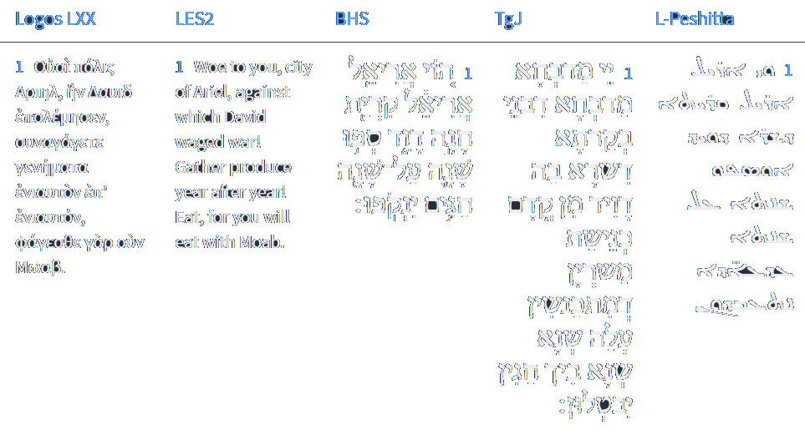


Isaiah 29:1
Isaiah / ישעיה
http://www.matsati.com

Slide 9




ספר שמות פרק כג
אכ הִנֵּה אָנֹכִי שֹׁלֵחַ מַלְאָךְ לְפָנֶיךָ לִשְׁמָרְךָ בַּדָּרֶךְ וְלַהֲבִיאֲךָ אֶל-הַמָּקוֹם אֲשֶׁר הֲכִנֹתִי: כא הִשָּׁמֶר מִפָּנָיו וּשְׁמַע בְּקֹלוֹ אַל-תַּמֵּר בּוֹ כִּי לֹא יִשָּׂא לְפִשְׁעֲכֶם כִּי שְׁמִי בְּקִרְבּוֹ: כב כִּי אִם-שָׁמוֹעַ תִּשְׁמַע בְּקֹלוֹ וְעָשִֹיתָ כֹּל אֲשֶׁר אֲדַבֵּר וְאָיַבְתִּי אֶת-אֹיְבֶיךָ וְצַרְתִּי אֶת-צֹרְרֶיךָ:
Shemot / Exodus 23:20–22
23:20 Behold, I send an Angel before thee, to keep thee in the way, and to bring thee into the place which I have prepared. 23:21 Beware of him, and obey his voice, provoke him not; for he will not pardon your transgressions: for my name is in him. 23:22 But if thou shalt indeed obey his voice, and do all that I speak; then I will be an enemy unto thine enemies, and an adversary unto thine adversaries. (KJV)
Isaiah / ישעיה
http://www.matsati.com

Slide 10
LXX on Shemot 23:20-22
20 Καὶ ἰδοὺ ἐγὼ ἀποστέλλω τὸν ἄγγελόν μου πρὸ προσώπου σου, ἵνα φυλάξῃ σε ἐν τῇ ὁδῷ, ὅπως εἰσαγάγῃ σε εἰς τὴν γῆν, ἣν ἡτοίμασά σοι. 21 πρόσεχε σεαυτῷ καὶ εἰσάκουε αὐτοῦ καὶ μὴ ἀπείθει αὐτῷ, οὐ γὰρ μὴ ὑποστείληταί σε, τὸ γὰρ ὄνομά μού ἐστιν ἐπʼ αὐτῷ. 22 ἐὰν ἀκοῇ ἀκούσητε τῆς ἐμῆς φωνῆς καὶ ποιήσῃς πάντα, ὅσα ἂν ἐντείλωμαί σοι, καὶ φυλάξητε τὴν διαθήκην μου, ἔσεσθέ μοι λαὸς περιούσιος ἀπὸ πάντων τῶν ἐθνῶν, ἐμὴ γάρ ἐστιν πᾶσα ἡ γῆ, ὑμεῖς δὲ ἔσεσθέ μοι βασίλειον ἱεράτευμα καὶ ἔθνος ἅγιον. ταῦτα τὰ ῥήματα ἐρεῖς τοῖς υἱοῖς Ισραηλ Ἐὰν ἀκοῇ ἀκούσητε τῆς φωνῆς μου καὶ ποιήσῃς πάντα, ὅσα ἂν εἴπω σοι, ἐχθρεύσω τοῖς ἐχθροῖς σου καὶ ἀντικείσομαι τοῖς ἀντικειμένοις σοι.
Shemot / Exodus 23:20-22
20 “ ‘And look, I myself am sending out my angel before your face, so that he may watch over you along the way, in order that he may guide you to the land that I have prepared for you. 21 Be mindful of yourself and listen to him, and do not disobey him, for he will certainly not put up with you, for my name is on him. 22 If you listen with hearing to my voice and you do all the things that I command you and keep my covenant, you will be a people special to me from among all the peoples, for all the earth is mine. But you yourselves will be a royal priesthood to me and a holy nation. You will say these words to the sons of Israel: If you listen with hearing to my voice and do everything that I say to you, I will be an enemy to your enemies, and I will be an adversary to those hostile to you. (LES)
Isaiah / ישעיה
http://www.matsati.com

Slide 11





וּמֵעָפָר תִּשַּׁח אִמְרָתֵךְ וְהָיָה כְּאוֹב מֵאֶרֶץ קוֹלֵךְ וּמֵעָפָר אִמְרָתֵךְ תְּצַפְצֵף
We break down this verse to say:
וּמֵעָפָר תִּשַּׁח אִמְרָתֵךְ“ and from the dust crouch down you will speak.”
וְהָיָה כְּאוֹב מֵאֶרֶץ קוֹלֵךְ“ and your voice will be like a necromancer from the earth”
וּמֵעָפָר אִמְרָתֵךְ תְּצַפְצֵף“ and from the dust you will chirp.”
Isaiah / ישעיה
http://www.matsati.com

Slide 12

ספר בראשית פרק ג
יד וַיֹּאמֶר יְהֹוָה אֱלֹהִים | אֶל-הַנָּחָשׁ כִּי עָשִֹיתָ זֹּאת אָרוּר אַתָּה מִכָּל-הַבְּהֵמָה וּמִכֹּל חַיַּת הַשָּׂדֶה עַל-גְּחֹנְךָ תֵלֵךְ וְעָפָר תֹּאכַל כָּל-יְמֵי חַיֶּיךָ:
Bereshit / Genesis 3:14
3:14 And the LORD God said unto the serpent, Because thou hast done this, thou art cursed above all cattle, and above every beast of the field; upon thy belly shalt thou go, and dust shalt thou eat all the days of thy life: (KJV)
Isaiah / ישעיה
http://www.matsati.com

Slide 13
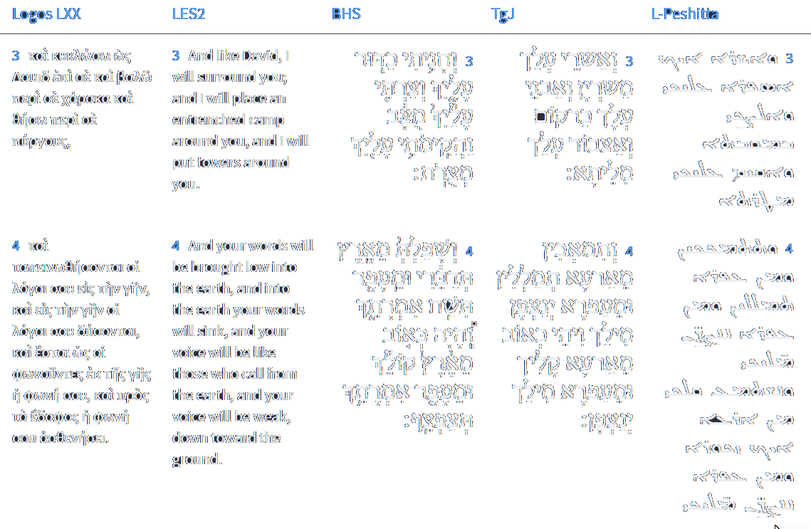



Isaiah 29:3-4
Isaiah / ישעיה
http://www.matsati.com

Slide 14
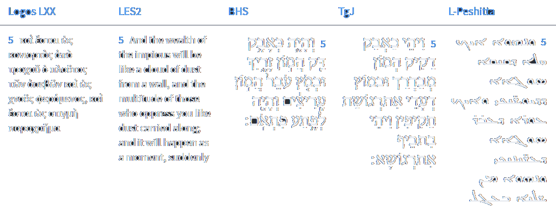


Isaiah 29:5
Isaiah / ישעיה
http://www.matsati.com

Slide 15

2 Thessalonians 1:3–12
1:3 We are bound to thank God always for you, brethren, as it is meet, because that your faith groweth exceedingly, and the charity of every one of you all toward each other aboundeth; 1:4 So that we ourselves glory in you in the churches of God for your patience and faith in all your persecutions and tribulations that ye endure: 1:5 Which is a manifest token of the righteous judgment of God, that ye may be counted worthy of the kingdom of God, for which ye also suffer: 1:6 Seeing it is a righteous thing with God to recompense tribulation to them that trouble you; 1:7 And to you who are troubled rest with us, when the Lord Jesus shall be revealed from heaven with his mighty angels, 1:8 In flaming fire taking vengeance on them that know not God, and that obey not the gospel of our Lord Jesus Christ: 1:9 Who shall be punished with everlasting destruction from the presence of the Lord, and from the glory of his power; 1:10 When he shall come to be glorified in his saints, and to be admired in all them that believe (because our testimony among you was believed) in that day. 1:11 Wherefore also we pray always for you, that our God would count you worthy of this calling, and fulfill all the good pleasure of his goodness, and the work of faith with power: 1:12 That the name of our Lord Jesus Christ may be glorified in you, and ye in him, according to the grace of our God and the Lord Jesus Christ. (KJV)
Isaiah / ישעיה
http://www.matsati.com

Slide 16
Rabbinic Literature
ספרות רבנית
Part 2
Isaiah / ישעיה
http://www.matsati.com

Slide 17
Targum Jonathan son of Uziel Isaiah 29:1-6
29:1 Woe to the altar, the altar which is built in the city in which David dwelt; because of the assembly of the armies which are gathering themselves together against her year by year, because the festivals shall cease. 29:2 And I will distress the city, in which the altar is, and she shall be desolate and empty; and she shall be surrounded before me with the blood of the slain, as the altar is surrounded round about with the blood of the holy sacrifices in the day of the festival. 29:3 And I will encamp against thee with armies; and I will build a fortified camp against thee, and I will cast up a mound against thee. 29:4 And thou shalt be brought low, and shalt speak from beneath the earth, thy words shall gibber from the dust; and thy voice shall come like that of a necromancer out of the ground; yea, thy words shall gibber from the dust. 29:5 Moreover the multitude of those scattering thee shall be like small dust, and the tumultuous assembly of the mighty as chaff that passeth away; and there shall be a tumult suddenly. 29:6 Thou shalt be visited with thunder from the Lord of hosts, and with earthquake, and with a great noise; with storm, and tempest, and a flame of devouring fire. (TgJ)
Isaiah / ישעיה
http://www.matsati.com

Slide 18
ספר שמות פרק כז
א וְעָשִֹיתָ אֶת-הַמִּזְבֵּחַ עֲצֵי שִׁטִּים חָמֵשׁ אַמּוֹת אֹרֶךְ וְחָמֵשׁ אַמּוֹת רֹחַב רָבוּעַ יִהְיֶה הַמִּזְבֵּחַ וְשָׁלֹשׁ אַמּוֹת קֹמָתוֹ: ב וְעָשִֹיתָ קַרְנֹתָיו עַל אַרְבַּע פִּנֹּתָיו מִמֶּנּוּ תִּהְיֶין ָ קַרְנֹתָיו וְצִפִּיתָ אֹתוֹ נְחֹשֶׁת:
Shemot / Exodus 27:2
27:1 And thou shalt make an altar of shittim wood, five cubits long, and five cubits broad; the altar shall be foursquare: and the height thereof shall be three cubits. 27:2 And thou shalt make the horns of it upon the four corners thereof: his horns shall be of the same: and thou shalt overlay it with brass. (KJV)
Isaiah / ישעיה
http://www.matsati.com

Slide 19
ספר שמות פרק לז
כה וַיַּעַשֹ אֶת-מִזְבַּח הַקְּטֹרֶת עֲצֵי שִׁטִּים אַמָּה אָרְכּוֹ וְאַמָּה רָחְבּוֹ רָבוּעַ וְאַמָּתַיִם קֹמָתוֹ מִמֶּנּוּ הָיוּ קַרְנֹתָיו: כו וַיְצַף אֹתוֹ זָהָב טָהוֹר אֶת-גַּגּוֹ וְאֶת-קִירֹתָיו סָבִיב וְאֶת-קַרְנֹתָיו וַיַּעַשֹ לוֹ זֵר זָהָב סָבִיב:
Shemot / Exodus 37:25-26
37:25 And he made the incense altar of shittim wood: the length of it was a cubit, and the breadth of it a cubit; it was foursquare; and two cubits was the height of it; the horns thereof were of the same. 37:26 And he overlaid it with pure gold, both the top of it, and the sides thereof round about, and the horns of it: also he made unto it a crown of gold round about. (KJV)
Isaiah / ישעיה
http://www.matsati.com

Slide 20
ספר עמוס פרק ג
יד כִּ֗י בְּיֹ֛ום פָּקְדִ֥י פִשְׁעֵֽי־יִשְׂרָאֵ֖ל עָלָ֑יו וּפָֽקַדְתִּי֙ עַל־מִזְבְּחֹ֣ות בֵּֽית־אֵ֔ל וְנִגְדְּעוּ֙ קַרְנֹ֣ות הַמִּזְבֵּ֔חַ וְנָפְל֖וּ לָאָֽרֶץ׃
Amos 3:14
3:14 That in the day that I shall visit the transgressions of Israel upon him I will also visit the altars of Beth-el: And the horns of the altar shall be cut off, And fall to the ground. (KJV)
Isaiah / ישעיה
http://www.matsati.com

Slide 21
Talmud Bavli Berakhot 18b:1
״בֶּן אִישׁ חַי״: אַטּוּ כּוּלֵּי עָלְמָא בְּנֵי מֵתֵי נִינְהוּ? אֶלָּא: ״בֶּן אִישׁ חַי״ — שֶׁאֲפִילּוּ בְּמִיתָתוֹ קָרוּי חַי. ״רַב פְּעָלִים מִקַּבְצְאֵל״ — שֶׁרִיבָּה וְקִבֵּץ פּוֹעֲלִים לַתּוֹרָה. ״וְהוּא הִכָּה אֵת שְׁנֵי אֲרִאֵל מוֹאָב״ — שֶׁלֹּא הִנִּיחַ כְּמוֹתוֹ לֹא בְּמִקְדָּשׁ רִאשׁוֹן וְלֹא בְּמִקְדָּשׁ שֵׁנִי.
He was referred to in the verse as son of a living man. The Gemara wonders: Is that to say, the fact that the Bible referred to him with that appellation, that all others are children of the dead? Rather, the verse should be explained as follows: The son of a living man who lives forever, who even in death is referred to as living. Man of Kabze’el who had done mighty deeds, as he accumulated and gathered many workers for the sake of the Torah. Who killed the two lion-hearted men [Ariel] of Moab, as after his death he left no one his equal, in either the First Temple or the Second Temple periods, as the Temple is called Ariel (see Isaiah 29:1), and the two Ariel refers to the two Temples
Isaiah / ישעיה
http://www.matsati.com

Slide 22
Pesikta Rabbati 27,1
... The angels said before the Holy One, ‘Master of the World! Isn’t this Jerusalem?!’ as it is said “This is Jerusalem; in the midst of the nations I have placed her…” (Yechezkel 5:5) He replied to them, “But she exchanged My judgments for wickedness more than the nations…” (Yechezkel 5:6) They said to Him, “But they are Your people and Your inheritance, which You brought out with Your great strength…” (Devarim 9:29) He replied to them, “For My people have forgotten Me; they burn incense to vanity…” (Yirmiyahu 18:15) They said to Him, ‘act for the sake of the forefathers!’ He replied to them, “…the fathers are kindling fire…” (Yirmiyahu 7:18) They said to Him, ‘act for the sake of the children!’ He replied to them, “But they rebelled against Me and would not consent to hearken to Me…” (Yechezkel 20:8) They said to Him, ‘act for the sake of the tribe of Yehudah!’ “And Judah did what displeased the Lord…” (Melachim I 14:22) They said to Him, ‘act for the sake of the leaders!’ He replied to them, “Its heads judge for bribes…” (Micha 3:11) They said to Him, ‘act for the sake of the tribes!’ He replied to them, ‘and Gad, and Reuven and the half tribe of Menashe…’ They said to Him, ‘act for the sake of the tribe of Dan!’ He replied to them, “And the children of Dan set up for themselves the graven image.” (Shoftim 18:30) They said to Him,’ act for the sake of the students!’
Isaiah / ישעיה
http://www.matsati.com

Slide 23
Pesikta Rabbati 27,1 …continued…
He replied to them, “…And those who hold onto the Torah did not know Me…” (Yirmiyahu 2:8) They said to Him, ‘act for the sake of the prophets!’ He replied to them, “[It was] for the sins of her prophets, the iniquities of her priests…” (Eicha 4:13) They said to Him, ‘act for the sake of the kings!’ He replied to them, “And the altars that were on the roof, [the roof of] Ahaz's upper chamber, which the kings of Judah had made…” (Melachim II 23:12) The ministering angels said to Him, ‘act for our sake!’ He replied to them, “But they mocked the messengers of God…” (Divre HaYamim II 36:16) They said to Him, ‘act for the sake of Your name which is called upon them!’ He replied to them, ‘they have profaned My holy name.’ They said to Him, ‘You do not want to be appeased, what is the image of their father doing by You?’ “He has cast down from heaven to earth the glory of Israel…” (Eicha 2:1) This statement with which they clothed You, what has it done to You?! If the thing were not written, it would be impossible to say “The Lord has done what He devised, He has carried out His word…” (Eicha 2:17) They said to Him, ‘Master of the World! Is this not Jerusalem about whom you wrote “Behold on [My] hands have I engraved you…”’ (Yeshayahu 49:16) He replied to them, “I, too, shall clap My hands, one upon the other, and I shall put My fury to rest…” (Yechezkel 21:22) Since Zion saw that He did not want to be appeased, she started up and said “The Lord has forsaken me, and the Lord has forgotten me." (Yeshayahu 49:14) May it be Your will Lord our God and God of our fathers that Your Temple be rebuilt speedily in our days, that your Presence return within it, that You gather my exiles from the four corners of the world, that they rebuild the cities of Yehudah and settle Shechem and inherit it speedily. Amen.
Isaiah / ישעיה
http://www.matsati.com

Slide 24









ספר דברים פרק כח:א-ב ו’כח:טו-כ
א וְהָיָה אִם-שָׁמוֹעַ תִּשְׁמַע בְּקוֹל יְהוָֹה אֱלֹהֶיךָ לִשְׁמֹר לַעֲשֹוֹת אֶת-כָּל-מִצְוֹתָיו אֲשֶׁר אָנֹכִי מְצַוְּךָ הַיּוֹם וּנְתָנְךָ יְהוָֹה אֱלֹהֶיךָ עֶלְיוֹן עַל כָּל-גּוֹיֵי הָאָרֶץ: ב וּבָאוּ עָלֶיךָ כָּל-הַבְּרָכוֹת הָאֵלֶּה וְהִשִּׂיגֻךָ כִּי תִשְׁמַע בְּקוֹל יְהוָֹה אֱלֹהֶיךָ: ... טו וְהָיָה אִם-לֹא תִשְׁמַע בְּקוֹל יְהוָֹה אֱלֹהֶיךָ לִשְׁמֹר לַעֲשֹוֹת אֶת-כָּל-מִצְוֹתָיו וְחֻקֹּתָיו אֲשֶׁר אָנֹכִי מְצַוְּךָ הַיּוֹם וּבָאוּ עָלֶיךָ כָּל-הַקְּלָלוֹת הָאֵלֶּה וְהִשִּׂיגוּךָ: טז אָרוּר אַתָּה בָּעִיר וְאָרוּר אַתָּה בַּשָּׂדֶה: יז אָרוּר טַנְאֲךָ וּמִשְׁאַרְתֶּךָ: יח אָרוּר פְּרִי-בִטְנְךָ וּפְרִי אַדְמָתֶךָ שְׁגַר אֲלָפֶיךָ וְעַשְׁתְּרֹת צֹאנֶךָ: יט אָרוּר אַתָּה בְּבֹאֶךָ וְאָרוּר אַתָּה בְּצֵאתֶךָ: כ יְשַׁלַּח יְהוָֹה | בְּךָ אֶת-הַמְּאֵרָה אֶת-הַמְּהוּמָה וְאֶת-הַמִּגְעֶרֶת בְּכָל-מִשְׁלַח יָדְךָ אֲשֶׁר תַּעֲשֶֹה עַד הִשָּׁמֶדְךָ וְעַד-אֲבָדְךָ מַהֵר מִפְּנֵי רֹעַ מַעֲלָלֶיךָ אֲשֶׁר עֲזַבְתָּנִי:
Isaiah / ישעיה
http://www.matsati.com

Slide 25
Galatians 3:6–14
3:6 Even as Abraham believed God, and it was accounted to him for righteousness. 3:7 Know ye therefore that they which are of faith, the same are the children of Abraham. 3:8 And the scripture, foreseeing that God would justify the heathen through faith, preached before the gospel unto Abraham, saying, In thee shall all nations be blessed. 3:9 So then they which be of faith are blessed with faithful Abraham. 3:10 For as many as are of the works of the law are under the curse: for it is written, Cursed is every one that continueth not in all things which are written in the book of the law to do them. 3:11 But that no man is justified by the law in the sight of God, it is evident: for, The just shall live by faith. 3:12 And the law is not of faith: but, The man that doeth them shall live in them. 3:13 Christ hath redeemed us from the curse of the law, being made a curse for us: for it is written, Cursed is every one that hangeth on a tree: 3:14 That the blessing of Abraham might come on the Gentiles through Jesus Christ; that we might receive the promise of the Spirit through faith. (KJV, 6 Καθὼς Ἀβραὰμ ἐπίστευσεν τῷ θεῷ,* καὶ ἐλογίσθη αὐτῷ εἰς δικαιοσύνην·* *7 γινώσκετε ἄρα ὅτι οἱ ἐκ πίστεως, οὗτοι ⸂υἱοί εἰσιν⸃ Ἀβραάμ.* 8 προϊδοῦσα δὲ ἡ γραφὴ ὅτι ἐκ πίστεως δικαιοῖ τὰ ἔθνη ὁ θεός,* προευηγγελίσατο τῷ Ἀβραὰμ ὅτι ἐνευλογηθήσονται ἐν σοὶ πάντα τὰ ἔθνη·* 9 ὥστε οἱ ἐκ πίστεως εὐλογοῦνται σὺν τῷ πιστῷ Ἀβραάμ. *10 Ὅσοι γὰρ ἐξ ἔργων νόμου εἰσίν, ὑπὸ κατάραν εἰσίν· γέγραπται γὰρ ὅτι ἐπικατάρατος πᾶς ὃς οὐκ ἐμμένει ⸆* πᾶσιν τοῖς γεγραμμένοις ἐν τῷ βιβλίῳ τοῦ νόμου τοῦ ποιῆσαι αὐτά.* 11 ὅτι δὲ ἐν νόμῳ οὐδεὶς δικαιοῦται παρὰ τῷ θεῷ δῆλον, ὅτι ὁ δίκαιος ἐκ πίστεως ζήσεται·* 12 ὁ δὲ νόμος οὐκ ἔστιν ἐκ πίστεως,* ἀλλʼ ὁ ποιήσας αὐτὰ ⸆ ζήσεται ἐν αὐτοῖς.* 13 Χριστὸς ἡμᾶς ἐξηγόρασεν ἐκ τῆς κατάρας τοῦ νόμου γενόμενος ὑπὲρ ἡμῶν κατάρα,* ὅτι γέγραπται· ἐπικατάρατος πᾶς ὁ κρεμάμενος ἐπὶ ξύλου, 14 ἵνα εἰς τὰ ἔθνη ἡ εὐλογία τοῦ Ἀβραὰμ γένηται ἐν ⸉Χριστῷ Ἰησοῦ⸊, ἵνα τὴν ⸀ἐπαγγελίαν τοῦ πνεύματος λάβωμεν διὰ τῆς πίστεως.*)
Isaiah / ישעיה
http://www.matsati.com

Slide 26
1 John 1:1-10
1:1 THAT which was from the beginning, which we have heard, which we have seen with our eyes, which we have looked upon, and our hands have handled, of the Word of life; 1:2 (For the life was manifested, and we have seen it, and bear witness, and shew unto you that eternal life, which was with the Father, and was manifested unto us;) 1:3 That which we have seen and heard declare we unto you, that ye also may have fellowship with us: and truly our fellowship is with the Father, and with his Son Jesus Christ. 1:4 And these things write we unto you, that your joy may be full. 1:5 This then is the message which we have heard of him, and declare unto you, that God is light, and in him is no darkness at all. 1:6 If we say that we have fellowship with him, and walk in darkness, we lie, and do not the truth: 1:7 But if we walk in the light, as he is in the light, we have fellowship one with another, and the blood of Jesus Christ his Son cleanseth us from all sin. 1:8 If we say that we have no sin, we deceive ourselves, and the truth is not in us. 1:9 If we confess our sins, he is faithful and just to forgive us our sins, and to cleanse us from all unrighteousness. 1:10 If we say that we have not sinned, we make him a liar, and his word is not in us. (KJV)
Isaiah / ישעיה
http://www.matsati.com

Slide 27
ספר במדבר פרק לה
ל כָּל-מַכֵּה-נֶפֶשׁ לְפִי עֵדִים יִרְצַח אֶת-הָרֹצֵחַ וְעֵד אֶחָד לֹא-יַעֲנֶה בְנֶפֶשׁ לָמוּת: לא וְלֹא-תִקְחוּ כֹפֶר לְנֶפֶשׁ רֹצֵחַ אֲשֶׁר-הוּא רָשָׁע לָמוּת כִּי-מוֹת יוּמָת: לב וְלֹא-תִקְחוּ כֹפֶר לָנוּס אֶל-עִיר מִקְלָטוֹ לָשׁוּב לָשֶׁבֶת בָּאָרֶץ עַד-מוֹת הַכֹּהֵן: לג וְלֹא-תַחֲנִיפוּ אֶת-הָאָרֶץ אֲשֶׁר אַתֶּם בָּהּ כִּי הַדָּם הוּא יַחֲנִיף אֶת-הָאָרֶץ וְלָאָרֶץ לֹא-יְכֻפַּר לַדָּם אֲשֶׁר שֻׁפַּךְ-בָּהּ כִּי-אִם בְּדַם שֹׁפְכוֹ: לד וְלֹא תְטַמֵּא אֶת-הָאָרֶץ אֲשֶׁר אַתֶּם ישְׁבִים בָּהּ אֲשֶׁר אֲנִי שֹׁכֵן בְּתוֹכָהּ כִּי אֲנִי יְהֹוָה שֹׁכֵן בְּתוֹךְ בְּנֵי יִשְֹרָאֵל:
Bamidbar / Numbers 35:30–34
35:30 Whoso killeth any person, the murderer shall be put to death by the mouth of witnesses: but one witness shall not testify against any person to cause him to die. 35:31 Moreover ye shall take no satisfaction for the life of a murderer, which is guilty of death: but he shall be surely put to death. 35:32 And ye shall take no satisfaction for him that is fled to the city of his refuge, that he should come again to dwell in the land, until the death of the priest. 35:33 So ye shall not pollute the land wherein ye are: for blood it defileth the land: and the land cannot be cleansed of the blood that is shed therein, but by the blood of him that shed it. 35:34 Defile not therefore the land which ye shall inhabit, wherein I dwell: for I the LORD dwell among the children of Israel. (KJV)
Isaiah / ישעיה
http://www.matsati.com

Slide 28
Rashi on Isaiah 29,3 Parts 1-3
כדור. כשורה של גייסות מקיפות: in a circle like a row of surrounding troops. ([Other editions read:] In a row of surrounding troops.) ([Some manuscripts read:] An expression of the encampment of surrounding troops.)
מוצב. ל' כרקום המוצב על העיירות: a camp of siege (מֻצַּב, lit. stationed,) an expression of a camp of siege stationed against the towns.
מצורות. ל' מצור: siege works (מְצֻרוֹת) an expression of מָצוֹר, a siege.
Isaiah / ישעיה
http://www.matsati.com

Slide 29
Likutei Moharan 60,8 Part 9
And this is “Let him put his mouth to the dust; there may yet be hope” (Lamentations 3:29). “Dust” is the aspect of an absence of speech, as it is written (Isaiah 29:4), “and your speech will be lower than the dust.” That is, a person must instill the aspect of speech <in the one who is the aspect of “dust,” since he is in the aspect of a mute, in order> to unbind the mouth of the mute, as explained above. Through this, the strength of the words reaches those who hope in God, who are the reproductive organs, as explained above. This is <“Let him put his mouth to the dust,” as explained,> “there may yet be hope”—in order that the words might reach those who hope in God. And this is “your descendants will be like the dust of the earth” (Genesis 28:14), since procreation is dependent on the aforementioned aspect of “Let him put his mouth to the dust.”
Isaiah / ישעיה
http://www.matsati.com

Slide 30
Or Neerav, Appendix The Introductory Material 4,17
If the spirit which rules all fails and they prophesy, my words will be fulfilled on those who rise against me (Ps. 92:12). Is Saul also among the prophets? (I Sam. 10:11). This you will answer, And who is their father? (I Sam. 10:12). These things go after the intention of the heart. I, in my innocence (Ps. 26:1), plead before my judges: Let him judge all the words of this epistle leniently in its quantity and quality. If my soul does not speak from worry (Josh. 22:24), consider me as one who mentions and reminds the enlightened ones of my bountiful nation (Song 6:12). “Dear is man, who was created in [God’s] image” (Avot 3:15). Speaking as a righteous company (Ps. 58:2), He will judge righteousness. For my heart is not haughty (Ps. 131:1), all my senses are in me (Job 20:2), and my eyes are not haughty (Ps. 131:1) before the God of Sinai (Ps, 68:9). I have not walked in greatness or wonders (Ps. 131:1) with the King, the Lord of Hosts (Isa. 6:5). For the maidservant has seen7The reference is to the midrash which states that a maidservant at the parting of the Red Sea saw more than the prophet Ezekiel in his visions. Cf. Mekhilta, Shirta 3. and is more righteous than I (Gen. 38:26). I am lighter [in consequence] than she is (II Sam. 6:22). I am lower than the earth (Isa. 29:4). I speak in honor of our God, who dwells in Zion (Josh. 4:21). And He, being merciful, will forgive [my] sin (Ps. 78:38).
Isaiah / ישעיה
http://www.matsati.com

Slide 31
Rashi on Isaiah 29,6 Part 1
מעם ה' צבאות תפקד. ואחרי שתשפלי ותצפצף אמרתך תפקד אריאל מאתי להושיעה ברעם וברעש וגו': From the Lord of Hosts shall he be visited And after you become humble and your speech chirps, Ariel shall be visited by Me to save them, with thunder and with earthquake, etc
Isaiah / ישעיה
http://www.matsati.com

