Slide 1
MATSATI.COM Teaching Ministry
Website: https://www.matsati.com YouTube Channel: https://www.youtube.com/user/MATSATI/
ישעיהו כח:כב-כט / Isaiah 28:22-29
LIVE STREAM: 6:30 pm EST Thursday
Join us at Telegram:
https://t.me/MessianicChat
Rabbi Jeremiah
– The Apocalypse: connecting the Greek to the Ancient Hebrew text. (Wed. 9 am EST)
A Community
for Learning
Weekly Teachings Free Online
Check Telegram for weekly scheduling of teachings.
YouTube Channels
https://YouTube.com/c/HebrewLiteracy
https://www.youtube.com/channel/UC5_qPfruat-sCJJypz0_OBw
Discuss the Scriptures,
learn the languages,
and fellowship
Join Telegram ask about Hebrew and Greek classes!

Slide 2
Isaiah 28:22-29
ישעיהו כח:כב-כט
Isaiah / ישעיה
http://www.matsati.com

Slide 3
ספר ישעיה פרק כח
כא כִּ֤י כְהַר־פְּרָצִים֙ יָק֣וּם יְהוָ֔ה כְּעֵ֖מֶק בְּגִבְעֹ֣ון יִרְגָּ֑ז לַעֲשֹׂ֤ות מַעֲשֵׂ֨הוּ֙ זָ֣ר מַעֲשֵׂ֔הוּ וְלַֽעֲבֹד֙ עֲבֹ֣דָתֹ֔ו נָכְרִיָּ֖ה עֲבֹדָתֹֽו׃
Isaiah 28:21
28:21 For the LORD shall rise up as in mount Perazim, he shall be wroth as in the valley of Gibeon, that he may do his work, his strange work; and bring to pass his act, his strange act. (KJV)
Isaiah / ישעיה
http://www.matsati.com

Slide 4
ספר ירמיה פרק יד
יד וַיֹּאמֶר יְהֹוָה אֵלַי שֶׁקֶר הַנְּבִאִים נִבְּאִים בִּשְׁמִי לֹא שְׁלַחְתִּים וְלֹא צִוִּיתִים וְלֹא דִבַּרְתִּי אֲלֵיהֶם חֲזוֹן שֶׁקֶר וְקֶסֶם וֶאֱלִול [וֶאֱלִיל] וְתַרְמִות [וְתַרְמִית] לִבָּם הֵמָּה מִתְנַבְּאִים לָכֶם: טו לָכֵן כֹּה-אָמַר יְהֹוָה עַל-הַנְּבִאִים הַנִּבְּאִים בִּשְׁמִי וַאֲנִי לֹא-שְׁלַחְתִּים וְהֵמָּה אֹמְרִים חֶרֶב וְרָעָב לֹא יִהְיֶה בָּאָרֶץ הַזֹּאת בַּחֶרֶב וּבָרָעָב יִתַּמּוּ הַנְּבִאִים הָהֵמָּה: טז וְהָעָם אֲשֶׁר-הֵמָּה נִבְּאִים לָהֶם יִהְיוּ מֻשְׁלָכִים בְּחֻצוֹת יְרוּשָׁלַם מִפְּנֵי | הָרָעָב וְהַחֶרֶב וְאֵין מְקַבֵּר לָהֵמָּה הֵמָּה נְשֵׁיהֶם וּבְנֵיהֶם וּבְנֹתֵיהֶם וְשָׁפַכְתִּי עֲלֵיהֶם אֶת-רָעָתָם:
Jeremiah 14:14–16
14:14 Then the LORD said unto me, The prophets prophesy lies in my name: I sent them not, neither have I commanded them, neither spake unto them: they prophesy unto you a false vision and divination, and a thing of nought, and the deceit of their heart. 14:15 Therefore thus saith the LORD concerning the prophets that prophesy in my name, and I sent them not, yet they say, Sword and famine shall not be in this land; By sword and famine shall those prophets be consumed. 14:16 And the people to whom they prophesy shall be cast out in the streets of Jerusalem because of the famine and the sword; and they shall have none to bury them, them, their wives, nor their sons, nor their daughters: for I will pour their wickedness upon them. (KJV)
Isaiah / ישעיה
http://www.matsati.com

Slide 5
Matthew 7:15–18
7:15 Beware of false prophets, which come to you in sheep’s clothing, but inwardly they are ravening wolves. 7:16 Ye shall know them by their fruits. Do men gather grapes of thorns, or figs of thistles? 7:17 Even so every good tree bringeth forth good fruit; but a corrupt tree bringeth forth evil fruit. 7:18 A good tree cannot bring forth evil fruit, neither can a corrupt tree bring forth good fruit. (KJV, ܐܷܙܕܱ݁ܗ̄ܪܘ ܡܶܢ ܢܒ݂ܺܝܷ̈ܐ ܕܱ݁ܓܴ̈݁ܠܷܐ ܇ ܕܴ݁ܐܬ݂ܷܝܢ ܠܘܳܬ݂ܟ݂ܽܘܢ ܒܱ݁ܠܒ݂ܽܘܫܶܐ ܕܷ݁ܐܡܪܷ̈ܐ ܆ ܡܶܢ ܠܓ݂ܰܘ ܕܷ݁ܝܢ ܐܻܝܬ݂ܱܝܗܽܘܢ ܕܻ݁ܐܒ݂ܷ̈ܐ ܂ ܚܳܛܾܘ̈ܦ݂ܶܐ ܂ܡܶܢ ܦܻ݁ܐܪܱ̈ܝܗܽܘܢ ܕܷ݁ܝܢ ܬܷ݁ܕ݁ܥܽܘܢ ܐܷܢܽܘܢ ܂ ܠܡܳܐ ܆ ܠܴܩܛܻܝܢ ܡܶܢ ܟܾ݁ܘ̈ܒܷ݁ܐ ܥܶܢ̈ܒܷ݁ܐ ܞ ܐܱܘ ܡܶܢ ܩܽܘܪ̈ܛܒܷ݁ܐ ܬܻ݁ܐܢܷ̈ܐ ܂ ܗܳܟ݂ܰܢܳܐ ܟܾ݁ܠ ܐܻܝܠܴܢܳܐ ܛܴܒ݂ܳܐ ܂ ܦܻ݁ܐܪܷ̈ܐ ܫܰܦܻ݁ܝܪܷ̈ܐ ܥܳܒ݂ܶܕ݂ ܂ ܐܻܝܠܴܢܳܐ ܕܷ݁ܝܢ ܒܻ݁ܝܫܳܐ ܂ ܦܻ݁ܐܪܷ̈ܐ ܒܻ݁ܝ̈ܫܶܐ ܥܳܒ݂ܶܕ݂ ܂ ܠܴܐ ܡܶܫܟܱ݁ܚ ܐܻܝܠܴܢܳܐ ܛܴܒ݂ܳܐ ܦܻ݁ܐܪܷ̈ܐ ܒܻ݁ܝ̈ܫܶܐ ܠܡܶܥܒܱ݁ܕ݂ ܂ ܘܠܴܐ ܐܻܝܠܴܢܳܐ ܒܻ݁ܝܫܳܐ ܦܻ݁ܐܪܷ̈ܐ ܛܴܒ݂ܷ̈ܐ ܠܡܶܥܒܱ݁ܕ݂ ܂ *15 Προσέχετε ⸆ ἀπὸ τῶν ψευδοπροφητῶν,* οἵτινες ἔρχονται πρὸς ὑμᾶς ἐν ἐνδύμασιν προβάτων, ἔσωθεν δέ εἰσιν λύκοι ἅρπαγες.* 16 ἀπὸ τῶν καρπῶν αὐτῶν ἐπιγνώσεσθε αὐτούς.* μήτι συλλέγουσιν ἀπὸ ἀκανθῶν ⸀σταφυλὰς ἢ ἀπὸ τριβόλων σῦκα; *17 Οὕτως πᾶν δένδρον ἀγαθὸν καρποὺς ⸉καλοὺς ποιεῖ⸊,* τὸ δὲ σαπρὸν δένδρον καρποὺς πονηροὺς ποιεῖ. 18 οὐ δύναται δένδρον ἀγαθὸν καρποὺς πονηροὺς ⸀ποιεῖν οὐδὲ δένδρον σαπρὸν καρποὺς καλοὺς ⸁ποιεῖν.*)
Isaiah / ישעיה
http://www.matsati.com

Slide 6
﻿ספר ישעיה פרק כח
﻿כב וְעַתָּה אַל-תִּתְלוֹצָצוּ פֶּן-יֶחְזְקוּ מוֹסְרֵיכֶם כִּי-כָלָה וְנֶחֱרָצָה שָׁמַעְתִּי מֵאֵת אֲדֹנָי יְהֶוִֹה צְבָאוֹת עַל-כָּל-הָאָרֶץ: כג הַאֲזִינוּ וְשִׁמְעוּ קוֹלִי הַקְשִׁיבוּ וְשִׁמְעוּ אִמְרָתִי: כד הֲכֹל הַיּוֹם יַחֲרֹשׁ הַחֹרֵשׁ לִזְרֹעַ יְפַתַּח וִישַֹדֵּד אַדְמָתוֹ: כה הֲלוֹא אִם-שִׁוָּה פָנֶיהָ וְהֵפִיץ קֶצַח וְכַמֹּן יִזְרֹק וְשָֹם חִטָּה שֹוֹרָה וּשְֹעֹרָה נִסְמָן וְכֻסֶּמֶת גְּבֻלָתוֹ: כו וְיִסְּרוֹ לַמִּשְׁפָּט אֱלֹהָיו יוֹרֶנּוּ: כז כִּי לֹא בֶחָרוּץ יוּדַשׁ קֶצַח וְאוֹפַן עֲגָלָה עַל-כַּמֹּן יוּסָּב כִּי בַמַּטֶּה יֵחָבֶט קֶצַח וְכַמֹּן בַּשָּׁבֶט: כח לֶחֶם יוּדָק כִּי לֹא לָנֶצַח אָדוֹשׁ יְדוּשֶׁנּוּ וְהָמַם גִּלְגַּל עֶגְלָתוֹ וּפָרָשָׁיו לֹא-יְדֻקֶּנּוּ: כט גַּם-זֹאת מֵעִם יְהֹוָה צְבָאוֹת יָצָאָה הִפְלִיא עֵצָה הִגְדִּיל תּוּשִׁיָּה:
Isaiah / ישעיה
http://www.matsati.com

Slide 7
ספר ישעיה פרק ו
ט וַיֹּאמֶר לֵךְ וְאָמַרְתָּ לָעָם הַזֶּה שִׁמְעוּ שָׁמוֹעַ וְאַל-תָּבִינוּ וּרְאוּ רָאוֹ וְאַל-תֵּדָעוּ: י הַשְׁמֵן לֵב-הָעָם הַזֶּה וְאָזְנָיו הַכְבֵּד וְעֵינָיו הָשַׁע פֶּן-יִרְאֶה בְעֵינָיו וּבְאָזְנָיו יִשְׁמָע וּלְבָבוֹ יָבִין וָשָׁב וְרָפָא לוֹ:
Isaiah 6:9–10
6:9 And he said, Go, and tell this people, Hear ye indeed, but understand not; And see ye indeed, but perceive not. 6:10 Make the heart of this people fat, And make their ears heavy, and shut their eyes; Lest they see with their eyes, and hear with their ears, And understand with their heart, and convert, and be healed. (KJV)
Isaiah / ישעיה
http://www.matsati.com

Slide 8
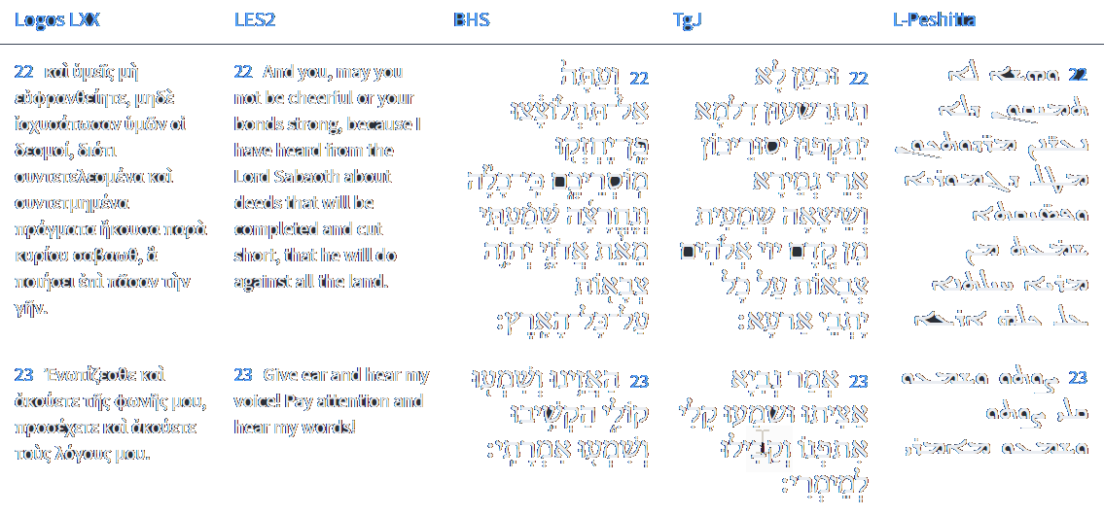
Isaiah 28:22-23
Isaiah / ישעיה
http://www.matsati.com

Slide 9
ספר שמות פרק ה
ה וַיֹּאמֶר פַּרְעֹה הֵן-רַבִּים עַתָּה עַם-הָאָרֶץ וְהִשְׁבַּתֶּם אֹתָם מִסִּבְלֹתָם:
Shemot / Exodus 5:5
5:5 And Pharaoh said, Behold, the people of the land now are many, and ye make them rest from their burdens. (KJV)
Isaiah / ישעיה
http://www.matsati.com

Slide 10
Multitude. The Hebrew word used for multitude here in Shemot / Exodus 5:5 is רַבִּים plural meaning "great," "many," or "large." The word רַבִּים can refer to people or things, and represents plurality in numbers or amount. In Shemot / Exodus 5:5 ה וַיֹּאמֶר פַּרְעֹה הֵן-רַבִּים עַתָּה עַם-הָאָרֶץ וְהִשְׁבַּתֶּם אֹתָם מִסִּבְלֹתָם: Pharaoh, speaking to Moshe and Aaron, alludes to the population of Israel mixed with Gentiles calling them רַבִּים, " many." So, the mixed multitude was large, perhaps consisting of thousands or millions of individuals. This was the whole reason the Pharaoh enslaved the people, because of fear they would join with another nation to fight against Egypt.(See Shemot / Exodus 1:7-14)
Mixed. The Hebrew word translated mixed, עֵ֥רֶב, appears 15 times in the Tanakh. Five times the word עֵ֥רֶב is used for the people mixing (Shemot / Exodus 12:38, Nehemiah 13:3) in reference to the nations (Gentiles). In Shemot / Exodus 12:38, וְגַם־עֵ֥רֶב רַ֖ב עָלָ֣ה אִתָּ֑ם וְצֹ֣אן וּבָקָ֔ר מִקְנֶ֖ה‬ כָּבֵ֥ד מְאֹֽד we get the strongest indication of its meaning as a reference to both Israel and the non-Israel joining with Israel in the passover and standing before the mountain of Sinai in Shemot / Exodus 19.
Isaiah / ישעיה
http://www.matsati.com

Slide 11
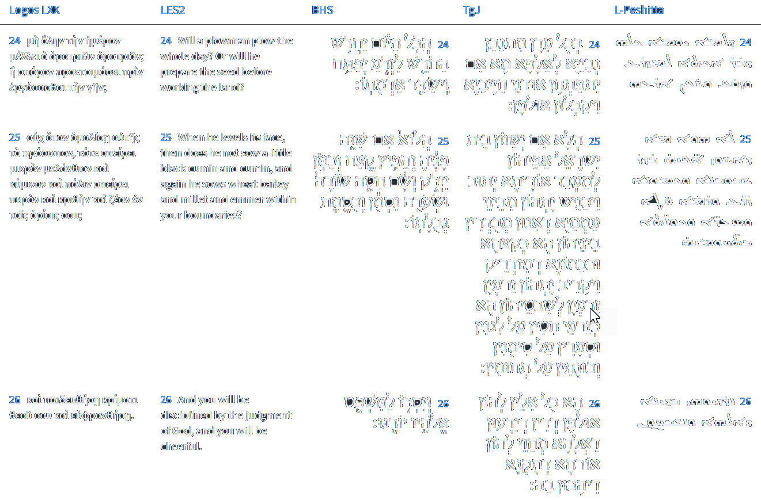
Isaiah 28:24-26
Isaiah / ישעיה
http://www.matsati.com

Slide 12
1 Corinthians 1:26–31
1:26 For ye see your calling, brethren, how that not many wise men after the flesh, not many mighty, not many noble, are called: 1:27 But God hath chosen the foolish things of the world to confound the wise; and God hath chosen the weak things of the world to confound the things which are mighty; 1:28 And base things of the world, and things which are despised, hath God chosen, yea, and things which are not, to bring to nought things that are: 1:29 That no flesh should glory in his presence. 1:30 But of him are ye in Christ Jesus, who of God is made unto us wisdom, and righteousness, and sanctification, and redemption: 1:31 That, according as it is written, He that glorieth, let him glory in the Lord. (KJV, 26 Βλέπετε ⸀γὰρ τὴν κλῆσιν ὑμῶν,* ἀδελφοί, ὅτι οὐ πολλοὶ σοφοὶ κατὰ σάρκα,* οὐ πολλοὶ δυνατοί, οὐ πολλοὶ εὐγενεῖς·* 27 ἀλλὰ τὰ μωρὰ τοῦ κόσμου ἐξελέξατο ὁ θεός, ἵνα καταισχύνῃ τοὺς σοφούς, καὶ τὰ ἀσθενῆ τοῦ κόσμου ἐξελέξατο ὁ θεός, ἵνα καταισχύνῃ τὰ ἰσχυρά, 28 καὶ τὰ ἀγενῆ τοῦ κόσμου καὶ τὰ ἐξουθενημένα ἐξελέξατο ὁ θεός,* ⸆ τὰ μὴ ὄντα, ἵνα τὰ ὄντα καταργήσῃ, 29 ὅπως μὴ καυχήσηται πᾶσα σὰρξ ἐνώπιον ⸂τοῦ θεοῦ⸃. 30 ἐξ αὐτοῦ δὲ ὑμεῖς ἐστε ἐν Χριστῷ Ἰησοῦ,* ὃς ἐγενήθη σοφία ἡμῖν ἀπὸ θεοῦ, ⸂δικαιοσύνη τε⸃ καὶ ἁγιασμὸς καὶ ἀπολύτρωσις,* 31 ἵνα καθὼς γέγραπται· ὁ καυχώμενος ἐν κυρίῳ καυχάσθω.)
Isaiah / ישעיה
http://www.matsati.com

Slide 13
2 Peter 1:3–11
1:3 According as his divine power hath given unto us all things that pertain unto life and godliness, through the knowledge of him that hath called us to glory and virtue: 1:4 Whereby are given unto us exceeding great and precious promises: that by these ye might be partakers of the divine nature, having escaped the corruption that is in the world through lust. 1:5 And beside this, giving all diligence, add to your faith virtue; and to virtue knowledge; 1:6 And to knowledge temperance; and to temperance patience; and to patience godliness; 1:7 And to godliness brotherly kindness; and to brotherly kindness charity. 1:8 For if these things be in you, and abound, they make you that ye shall neither be barren nor unfruitful in the knowledge of our Lord Jesus Christ. 1:9 But he that lacketh these things is blind, and cannot see afar off, and hath forgotten that he was purged from his old sins. 1:10 Wherefore the rather, brethren, give diligence to make your calling and election sure: for if ye do these things, ye shall never fall: 1:11 For so an entrance shall be ministered unto you abundantly into the everlasting kingdom of our Lord and Saviour Jesus Christ. (KJV)
Isaiah / ישעיה
http://www.matsati.com

Slide 14
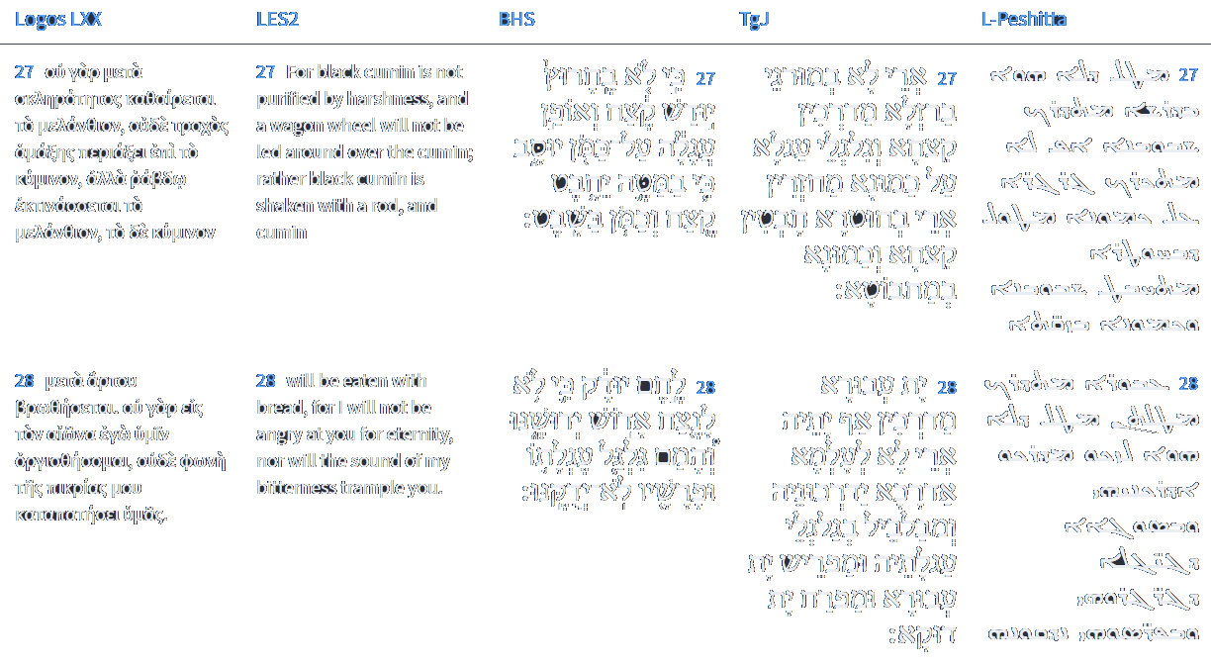
Isaiah 28:27-28
Isaiah / ישעיה
http://www.matsati.com

Slide 15
ספר ירמיה פרק א
ה בְּטֶרֶם אֶצָּורְךָ [אֶצָּרְךָ] בַבֶּטֶן יְדַעְתִּיךָ וּבְטֶרֶם תֵּצֵא מֵרֶחֶם הִקְדַּשְׁתִּיךָ נָבִיא לַגּוֹיִם נְתַתִּיךָ:
Jeremiah 1:5
5 Before I formed thee in the belly I knew thee; and before thou camest forth out of the womb I sanctified thee, and I ordained thee a prophet unto the nations. (KJV)
Isaiah / ישעיה
http://www.matsati.com

Slide 16
פר דברים פרק י
טו רַק בַּאֲבֹתֶיךָ חָשַׁק יְהוָֹה לְאַהֲבָה אוֹתָם וַיִּבְחַר בְּזַרְעָם אַחֲרֵיהֶם בָּכֶם מִכָּל-הָעַמִּים כַּיּוֹם הַזֶּה:
Devarim / Deuteronomy 10:15
15 Only the LORD had a delight in thy fathers to love them, and he chose their seed after them, even you above all people, as it is this day. (KJV)
Isaiah / ישעיה
http://www.matsati.com

Slide 17
1 Peter 2:9
9 But ye are a chosen generation, a royal priesthood, an holy nation, a peculiar people; that ye should shew forth the praises of him who hath called you out of darkness into his marvellous light: (KJV, ܐܱܢ̄ܬܾ݁ܘܢ ܕܷ݁ܝܢ ܫܰܪܒ݁ܬ݂ܴܐ ܐܱܢ̄ܬܾ݁ܘܢ ܓ݁ܒ݂ܺܝܬ݂ܴܐ ܇ ܕܱ݁ܡܟ݂ܰܗܢܳܐ ܠܡܰܠܟܾ݁ܘܬ݂ܴܐ ܂ ܥܰܡܳܐ ܩܰܕܻ݁ܝܫܳܐ ܂ ܟܷ݁ܢܫܳܐ ܦ݁ܪܻܝܩܳܐ ܂ ܬ݁ܣܰܒ݁ܪܾܘܢ ܬܷ݁ܫܒ݁ܚܴ̈ܬ݂ܷܗ ܕ݁ܗܰܘ ܕܱ݁ܩܪܴܟ݂ܽܘܢ ܡܶܢ ܚܶܫܽܘܟ݂ܳܐ ܠܢܽܘܗܪܷܗ ܡܝܰܬ݁ܪܴܐ ܂ 9 ὑμεῖς δὲ γένος ἐκλεκτόν, βασίλειον ἱεράτευμα, ἔθνος ἅγιον, λαὸς εἰς περιποίησιν, ὅπως τὰς ἀρετὰς ἐξαγγείλητε τοῦ ἐκ σκότους ὑμᾶς καλέσαντος εἰς τὸ θαυμαστὸν °αὐτοῦ φῶς·)
Isaiah / ישעיה
http://www.matsati.com

Slide 18
Rabbinic Literature
ספרות רבנית
Part 2
Isaiah / ישעיה
http://www.matsati.com

Slide 19
Targum Jonathan son of Uziel Isaiah 28:22-29
28:22 But now deal not wickedly, lest your bands be made strong: for I have heard from the Lord, the God of hosts, a consummation, and an end, upon all the inhabitants of the land. 28:23 The prophet said, Listen to, and hear my voice, turn and hear my word. 28:24 The prophets prophesied at all times in order to teach, if peradventure the ears of sinners might be opened, and receive instruction. 28:25 Is it not so? If the house of Israel would set their faces to do the law, and repent, then behold, He would gather them from among the nations, amongst whom they were dispersed, like fitches and cumin that are scattered: and, behold, he would bring their offspring together according to their tribes, as seed of wheat in the uncultivated field, and barley in the appointed place, and spelt in the borders. 28:26 All these things are instruction of judgment, that they may know, that our God shows them the right path, in which they ought to walk. 28:27 For they do not tread out the fitches with an iron threshing instrument, nor do they turn the wheels of a cart upon the cumin; but they beat out the fitches with a staff, and the cumin with a rod. 28:28 Corn they tread out, yet they will not continue to tread it out for ever; but he will throw it into confusion with the wheel of his wain, and would separate the corn, and blow away the chaff. 28:29 This also cometh forth from the Lord of hosts, who in the vast knowledge of His mind hath established the world; He hath multiplied His works in the beginning by His great wisdom. (TgJ)
Isaiah / ישעיה
http://www.matsati.com

Slide 20
ספר ישעיה פרק נח
ו הֲלוֹא זֶה צוֹם אֶבְחָרֵהוּ פַּתֵּחַ חַרְצֻבּוֹת רֶשַׁע הַתֵּר אֲגֻדּוֹת מוֹטָה וְשַׁלַּח רְצוּצִים חָפְשִׁים וְכָל-מוֹטָה תְּנַתֵּקוּ:
Isaiah 58:6
58:6 Is not this the fast that I have chosen? To loose the fetters of wickedness, To undo the bands of the yoke, And to let the oppressed go free, And that ye break every yoke?
Isaiah / ישעיה
http://www.matsati.com

Slide 21
Galatians 4:29–5:6
4:29 But as then he that was born after the flesh persecuted him that was born after the Spirit, even so it is now. 4:30 Nevertheless what saith the scripture? Cast out the bondwoman and her son: for the son of the bondwoman shall not be heir with the son of the freewoman. 4:31 So then, brethren, we are not children of the bondwoman, but of the free. 5:1 Stand fast therefore in the liberty wherewith Christ hath made us free, and be not entangled again with the yoke of bondage. 5:2 Behold, I Paul say unto you, that if ye be circumcised, Christ shall profit you nothing. 5:3 For I testify again to every man that is circumcised, that he is a debtor to do the whole law. 5:4 Christ is become of no effect unto you, whosoever of you are justified by the law; ye are fallen from grace. 5:5 For we through the Spirit wait for the hope of righteousness by faith. 5:6 For in Jesus Christ neither circumcision availeth any thing, nor uncircumcision; but faith which worketh by love.(KJV)
Isaiah / ישעיה
http://www.matsati.com

Slide 22
Talmud Bavli Avodah Zarah 18b:13
Rabbi Eliezer says: Concerning anyone who scoffs, suffering will befall him, as it is stated: “Now therefore do not be scoffers, lest your suffering be made strong” (Isaiah 28:22). Similarly, Rava said to the Sages who were sitting before him: Please, I ask of you that you not scoff, so that suffering will not befall you.
Talmud Bavli Avodah Zarah 18b:15
Rabbi Oshaya says, based on the same verse: Anyone who is haughty falls into Gehenna, as it is stated: “A proud and haughty man, scorner is his name, he acts in arrogant wrath” (Proverbs 21:24). And wrath means nothing other than Gehenna, as it is stated: “That day is a day of wrath” (Zephaniah 1:15). Rabbi Ḥanilai bar Ḥanilai says: Anyone who scoffs causes extermination to be wrought upon the world, as it is stated: “Now therefore do not be scoffers, lest your suffering be made strong; for an extermination wholly determined have I heard from the Lord, the God of hosts, upon the whole land” (Isaiah 28:22).
Isaiah / ישעיה
http://www.matsati.com

Slide 23
Rashi on Isaiah 28,24 Parts 1-3
הכל היום. לשון תמיהה הוא לכך נקוד חטף פתח: all day This is the interrogative. Therefore, it is voweled with a hataf pattah.
יחרוש. מי שחורש לזרוע וכי החורש כדי לזרע לעולמים חורש א"כ מה יועיל אף הנביאים מוכיחים אתכם להחזירכם למוטב הלעולמים יוכיחו ולא יועילו: shall...plow One who plows to sow - does the one who plows to sow plow forever? If so, what does he accomplish? Similarly, the prophets admonish you to bring you back to do good deeds. Shall they admonish forever and not accomplish?
יפתח וישדד אדמתו. וכי לעולם לא יזרע אלא תמיד יפתח את האדמ' באתים ובכלי מחרישה, וישדד לשון עבודת שדה יפתח וישדד בתחלה הוא עושה תלמים רחבים וסוף הוא עושה תלמים קטנים במדרש ר' תנחומא: Shall he open and harrow his soil? Shall he never sow but always open the soil with plowshares and plowing implements? יְשַׂדֵּד is an expression of work of the field. Shall he open and harrow? First he makes wide furrows and later he makes small furrows. This we learned in the Midrash of Rabbi Tanhuma.
Isaiah / ישעיה
http://www.matsati.com

Slide 24
Philippians 2:12–16
2:12 Wherefore, my beloved, as ye have always obeyed, not as in my presence only, but now much more in my absence, work out your own salvation with fear and trembling. 2:13 For it is God which worketh in you both to will and to do of his good pleasure. 2:14 Do all things without murmurings and disputings: 2:15 That ye may be blameless and harmless, the sons of God, without rebuke, in the midst of a crooked and perverse nation, among whom ye shine as lights in the world; 2:16 Holding forth the word of life; that I may rejoice in the day of Christ, that I have not run in vain, neither laboured in vain. (KJV, 12 Ὥστε, ἀγαπητοί μου, καθὼς πάντοτε ὑπηκούσατε, μὴ °ὡς ἐν τῇ παρουσίᾳ μου μόνον ἀλλὰ νῦν πολλῷ μᾶλλον ἐν τῇ ἀπουσίᾳ μου, μετὰ φόβου καὶ τρόμου τὴν ἑαυτῶν σωτηρίαν κατεργάζεσθε·* 13 ⸆ θεὸς γάρ ἐστιν ὁ ἐνεργῶν ἐν ὑμῖν καὶ τὸ θέλειν καὶ τὸ ἐνεργεῖν ὑπὲρ τῆς εὐδοκίας.* 14 Πάντα ποιεῖτε χωρὶς γογγυσμῶν καὶ διαλογισμῶν,* 15 ἵνα ⸀γένησθε ἄμεμπτοι καὶ ἀκέραιοι, τέκνα θεοῦ ⸁ἄμωμα μέσον γενεᾶς σκολιᾶς καὶ διεστραμμένης,* ἐν οἷς φαίνεσθε ὡς φωστῆρες ἐν κόσμῳ,* 16 λόγον ζωῆς ἐπέχοντες,* εἰς καύχημα ἐμοὶ εἰς ἡμέραν Χριστοῦ, ὅτι οὐκ εἰς κενὸν ἔδραμον οὐδὲ εἰς κενὸν ἐκοπίασα.)
Isaiah / ישעיה
http://www.matsati.com

Slide 25
Talmud Bavli Sanhedrin 105a:6
With regard to the verse: “And chastise in judgment; his God will instruct him” (Isaiah 28:26), Rabba bar bar Ḥana says that the prophet said to the Jewish people: Repent. They said to him: We cannot, since the evil inclination dominates us. He said to them: Chastise your inclinations. They said to him: “His God will instruct him,” i.e., God should instruct the evil inclination to allow us to overcome him, as we are incapable of doing so on our own.
Isaiah / ישעיה
http://www.matsati.com

Slide 26
Bereshit / Genesis 17:1-3, 'And when Abram was ninety years old and nine, tho Lord appeared unto Abram, and said unto him, I am Almighty God: walk before Me, and be thou perfect. And I will make My covenant between Me and thee, and will multiply thee exceedingly. And Abram fell on his face: and God talked with him.' (KJV, וַיְהִ֣י אַבְרָ֔ם בֶּן־תִּשְׁעִ֥ים שָׁנָ֖ה וְתֵ֣שַׁע שָׁנִ֑ים וַיֵּרָ֨א יְהוָ֜ה אֶל־אַבְרָ֗ם וַיֹּ֤אמֶר אֵלָיו֙ אֲנִי־אֵ֣ל שַׁדַּ֔י הִתְהַלֵּ֥ךְ לְפָנַ֖י וֶהְיֵ֥ה תָמִֽים׃ וְאֶתְּנָ֥ה בְרִיתִ֖י בֵּינִ֣י וּבֵינֶ֑ךָ וְאַרְבֶּ֥ה אֹותְךָ֖ בִּמְאֹ֥ד מְאֹֽד׃ וַיִּפֹּ֥ל אַבְרָ֖ם עַל־פָּנָ֑יו וַיְדַבֵּ֥ר אִתֹּ֛ו אֱלֹהִ֖ים לֵאמֹֽר׃)
Devarim / Deuteronomy 18:13, 'Thou shall be perfect with the Lord thy God.' (KJV, תָּמִ֣ים תִּֽהְיֶ֔ה עִ֖ם יְהוָ֥ה אֱלֹהֶֽיךָ׃ ס)
1 Kings 8:61, 'Let your heart be perfect with the Lord our God to walk in His statutes.' (KJV, וְהָיָ֤ה לְבַבְכֶם֙ שָׁלֵ֔ם עִ֖ם יְהוָ֣ה אֱלֹהֵ֑ינוּ לָלֶ֧כֶת בְּחֻקָּ֛יו וְלִשְׁמֹ֥ר מִצְוֹתָ֖יו כַּיֹּ֥ום הַזֶּֽה׃)
Isaiah / ישעיה
http://www.matsati.com

Slide 27
Talmud Bavli Sanhedrin 26b:7
The Gemara answers: As it is written: “He raises up the poor out of the dust, He lifts up the needy from the dung hill, to make them sit with princes and inherit the throne of glory; for the pillars of the earth are the Lord’s, and He has set [vayyashet] the world upon them” (I Samuel 2:8). Since the righteous are considered the foundations of the world, this verse is interpreted in reference to them. And if you wish, say instead that it is derived from here: “Wonderful is His counsel, and great His wisdom [tushiyya]” (Isaiah 28:29). Accordingly, the wise, righteous people are called shatot.
Isaiah / ישעיה
http://www.matsati.com

