Slide 1
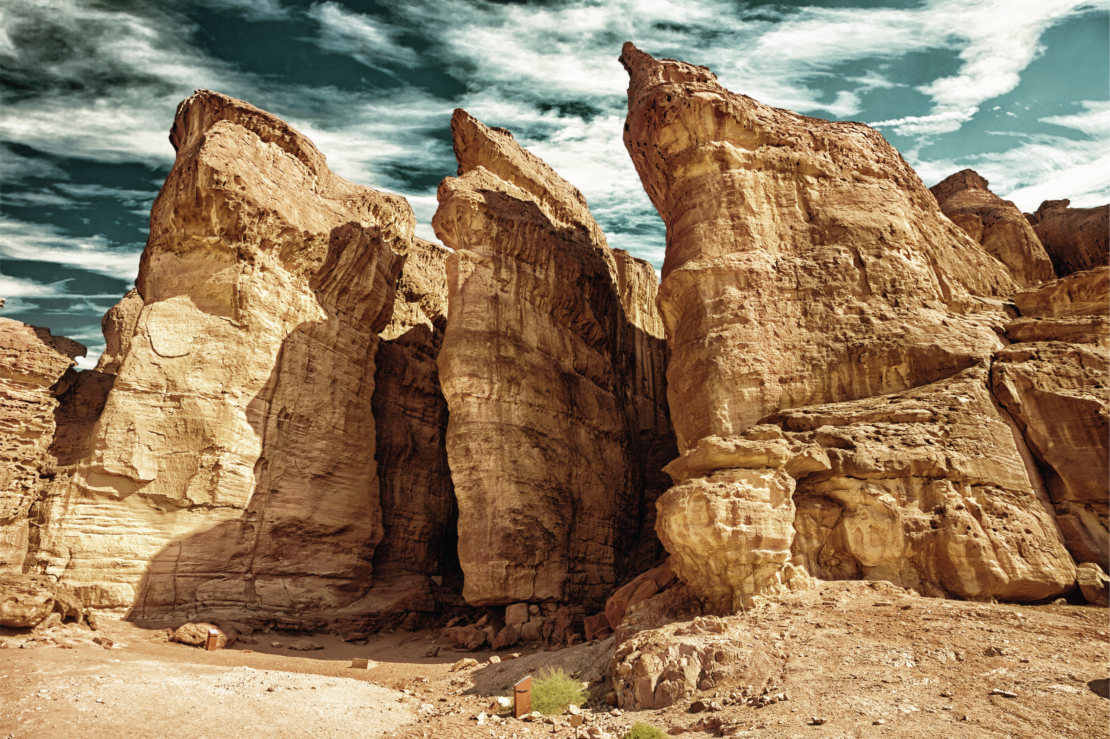

MATSATI.COM Teaching Ministry
Website: https://www.matsati.com YouTube Channel: https://www.youtube.com/user/MATSATI/
ישעיהו כח:א-ז / Isaiah 28:1-7
LIVE STREAM: 6:30 pm EST Thursday
Join us at Telegram:
https://t.me/MessianicChat
Rabbi Jeremiah
– The Apocalypse: connecting the Greek to the Ancient Hebrew text. (Wed. 9 am EST)
A Community
for Learning
Weekly Teachings Free Online
Check Telegram for weekly scheduling of teachings.
Discuss the Scriptures,
learn the languages,
and fellowship
YouTube Channels
https://YouTube.com/c/HebrewLiteracy
https://www.youtube.com/channel/UC5_qPfruat-sCJJypz0_OBw
Join Telegram ask about Hebrew and Greek classes!

Slide 2

Isaiah 28:1-7
ישעיהו כח:א-ז
Isaiah / ישעיה
http://www.matsati.com

Slide 3
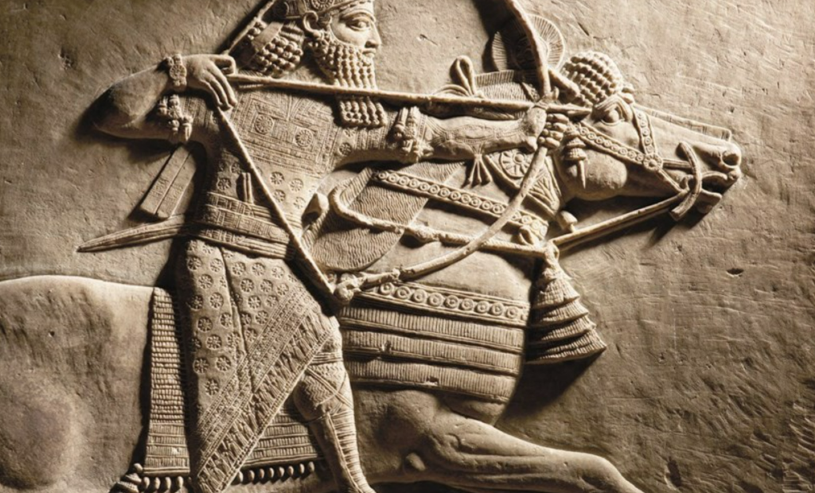


The reigns of five different Kings of Judah:
Josiah (640–609 BC)
Jehoahaz (609 BC)
Jehoiakim (609-598 BC)
Jehoiachin (598-597 BC)
Zedekiah - The last king of Judah (597-586 BC)
Isaiah / ישעיה
http://www.matsati.com

Slide 4









ספר ירמיה פרק ה
טו הִנְנִי מֵבִיא עֲלֵיכֶם גּוֹי מִמֶּרְחָק בֵּית יִשְֹרָאֵל נְאֻם-יְהֹוָה גּוֹי | אֵיתָן הוּא גּוֹי מֵעוֹלָם הוּא גּוֹי לֹא-תֵדַע לְשֹׁנוֹ וְלֹא תִשְׁמַע מַה-יְדַבֵּר: טז אַשְׁפָּתוֹ כְּקֶבֶר פָּתוּחַ כֻּלָּם גִּבּוֹרִים: יז וְאָכַל קְצִירְךָ וְלַחְמֶךָ יֹאכְלוּ בָּנֶיךָ וּבְנוֹתֶיךָ יֹאכַל צֹאנְךָ וּבְקָרֶךָ יֹאכַל גַּפְנְךָ וּתְאֵנָתֶךָ יְרשֵׁשׁ עָרֵי מִבְצָרֶיךָ אֲשֶׁר אַתָּה בּוֹטֵחַ בָּהֵנָּה בֶּחָרֶב: יח וְגַם בַּיָּמִים הָהֵמָּה נְאֻם-יְהוָֹה לֹא-אֶעֱשֶֹה אִתְּכֶם כָּלָה:
Jeremiah 5:15–18
5:15 Lo, I will bring a nation upon you from far, O house of Israel, saith the LORD: it is a mighty nation, it is an ancient nation, a nation whose language thou knowest not, neither understandest what they say. 5:16 Their quiver is as an open sepulchre, they are all mighty men. 5:17 And they shall eat up thine harvest, and thy bread, which thy sons and thy daughters should eat: they shall eat up thy flocks and thine herds: they shall eat up thy vines and thy fig trees: they shall impoverish thy fenced cities, wherein thou trustedst, with the sword. 5:18 Nevertheless in those days, saith the LORD, I will not make a full end with you. KJV
Isaiah / ישעיה
http://www.matsati.com

Slide 5





ספר ירמיה פרק ז
ה כִּי אִם-הֵיטֵיב תֵּיטִיבוּ אֶת-דַּרְכֵיכֶם וְאֶת-מַעַלְלֵיכֶם אִם-עָשֹוֹ תַעֲשֹוּ מִשְׁפָּט בֵּין אִישׁ וּבֵין רֵעֵהוּ: ו גֵּר יָתוֹם וְאַלְמָנָה לֹא תַעֲשֹׁקוּ וְדָם נָקִי אַל-תִּשְׁפְּכוּ בַּמָּקוֹם הַזֶּה וְאַחֲרֵי אֱלֹהִים אֲחֵרִים לֹא תֵלְכוּ לְרַע לָכֶם: ז וְשִׁכַּנְתִּי אֶתְכֶם בַּמָּקוֹם הַזֶּה בָּאָרֶץ אֲשֶׁר נָתַתִּי לַאֲבוֹתֵיכֶם לְמִן-עוֹלָם וְעַד-עוֹלָם: ח הִנֵּה אַתֶּם בֹּטְחִים לָכֶם עַל-דִּבְרֵי הַשָּׁקֶר לְבִלְתִּי הוֹעִיל:
Jeremiah 7:5-8
7:5 For if ye throughly amend your ways and your doings; if ye throughly execute judgment between a man and his neighbour; 7:6 If ye oppress not the stranger, the fatherless, and the widow, and shed not innocent blood in this place, neither walk after other gods to your hurt: 7:7 Then will I cause you to dwell in this place, in the land that I gave to your fathers, for ever and ever. 7:8 Behold, ye trust in lying words, that cannot profit. (KJV)
Isaiah / ישעיה
http://www.matsati.com

Slide 6

ספר דברים פרק כח
א וְהָיָה אִם-שָׁמוֹעַ תִּשְׁמַע בְּקוֹל יְהוָֹה אֱלֹהֶיךָ לִשְׁמֹר לַעֲשֹוֹת אֶת-כָּל-מִצְוֹתָיו אֲשֶׁר אָנֹכִי מְצַוְּךָ הַיּוֹם וּנְתָנְךָ יְהוָֹה אֱלֹהֶיךָ עֶלְיוֹן עַל כָּל-גּוֹיֵי הָאָרֶץ: ב וּבָאוּ עָלֶיךָ כָּל-הַבְּרָכוֹת הָאֵלֶּה וְהִשִּׂיגֻךָ כִּי תִשְׁמַע בְּקוֹל יְהוָֹה אֱלֹהֶיךָ:
Devarim / Deuteronomy 28:1–2
28:1 And it shall come to pass, if thou shalt hearken diligently unto the voice of the LORD thy God, to observe and to do all his commandments which I command thee this day, that the LORD thy God will set thee on high above all nations of the earth: 28:2 And all these blessings shall come on thee, and overtake thee, if thou shalt hearken unto the voice of the LORD thy God. (KJV)
Isaiah / ישעיה
http://www.matsati.com

Slide 7














﻿ספר ישעיה פרק כח
﻿א הוֹי עֲטֶרֶת גֵּאוּת שִׁכֹּרֵי אֶפְרַיִם וְצִיץ נֹבֵל צְבִי תִפְאַרְתּוֹ אֲשֶׁר עַל-רֹאשׁ גֵּיא-שְׁמָנִים הֲלוּמֵי יָיִן: ב הִנֵּה חָזָק וְאַמִּץ לַאדֹנָי כְּזֶרֶם בָּרָד שַֹעַר קָטֶב כְּזֶרֶם מַיִם כַּבִּירִים שֹׁטְפִים הִנִּיחַ לָאָרֶץ בְּיָד: ג בְּרַגְלַיִם תֵּרָמַסְנָה עֲטֶרֶת גֵּאוּת שִׁכּוֹרֵי אֶפְרָיִם: ד וְהָיְתָה צִיצַת נֹבֵל צְבִי תִפְאַרְתּוֹ אֲשֶׁר עַל-רֹאשׁ גֵּיא שְׁמָנִים כְּבִכּוּרָהּ בְּטֶרֶם קַיִץ אֲשֶׁר יִרְאֶה הָרֹאֶה אוֹתָהּ בְּעוֹדָהּ בְּכַפּוֹ יִבְלָעֶנָּה: ה בַּיּוֹם הַהוּא יִהְיֶה יְהֹוָה צְבָאוֹת לַעֲטֶרֶת צְבִי וְלִצְפִירַת תִּפְאָרָה לִשְׁאָר עַמּוֹ: ו וּלְרוּחַ מִשְׁפָּט לַיּוֹשֵׁב עַל-הַמִּשְׁפָּט וְלִגְבוּרָה מְשִׁיבֵי מִלְחָמָה שָׁעְרָה: ז וְגַם-אֵלֶּה בַּיַּיִן שָׁגוּ וּבַשֵּׁכָר תָּעוּ כֹּהֵן וְנָבִיא שָׁגוּ בַשֵּׁכָר נִבְלְעוּ מִן-הַיַּיִן תָּעוּ מִן-הַשֵּׁכָר שָׁגוּ בָּרֹאֶה פָּקוּ פְּלִילִיָּה:
Isaiah / ישעיה
http://www.matsati.com

Slide 8
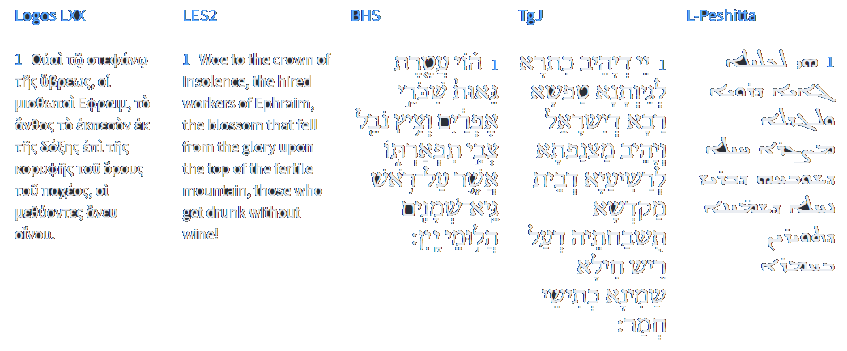




Isaiah 28:1
Isaiah / ישעיה
http://www.matsati.com

Slide 9
Luke 21:29-36
21:29 And he spake to them a parable; Behold the fig tree, and all the trees; 21:30 When they now shoot forth, ye see and know of your own selves that summer is now nigh at hand. 21:31 So likewise ye, when ye see these things come to pass, know ye that the kingdom of God is nigh at hand. 21:32 Verily I say unto you, This generation shall not pass away, till all be fulfilled. 21:33 Heaven and earth shall pass away: but my words shall not pass away. 21:34 And take heed to yourselves, lest at any time your hearts be overcharged with surfeiting, and drunkenness, and cares of this life, and so that day come upon you unawares. 21:35 For as a snare shall it come on all them that dwell on the face of the whole earth. 21:36 Watch ye therefore, and pray always, that ye may be accounted worthy to escape all these things that shall come to pass, and to stand before the Son of man. (KJV, 29 Καὶ εἶπεν παραβολὴν αὐτοῖς· ἴδετε τὴν συκῆν καὶ πάντα τὰ δένδρα· 30 ὅταν προβάλωσιν ⸂ἤδη, βλέποντες ἀφʼ ἑαυτῶν γινώσκετε ὅτι ἤδη ἐγγὺς⸃ τὸ θέρος ἐστίν·* 31 οὕτως καὶ ὑμεῖς, ὅταν ἴδητε ταῦτα ⸀γινόμενα, ⸁γινώσκετε ὅτι ἐγγύς ἐστιν ἡ βασιλεία τοῦ θεοῦ.* 32 ἀμὴν λέγω ὑμῖν ὅτι οὐ μὴ παρέλθῃ ἡ γενεὰ αὕτη ἕως °ἂν ⸀πάντα γένηται.* 33 ὁ οὐρανὸς καὶ ἡ γῆ παρελεύσονται,* οἱ δὲ λόγοι μου οὐ μὴ ⸀παρελεύσονται. *34 Προσέχετε °δὲ ἑαυτοῖς μήποτε βαρηθῶσιν ⸉ὑμῶν αἱ καρδίαι⸊ ἐν κραιπάλῃ καὶ μέθῃ καὶ μερίμναις βιωτικαῖς καὶ ἐπιστῇ ἐφʼ* ὑμᾶς αἰφνίδιος ἡ ἡμέρα ἐκείνη 35 ⸂ὡς παγίς· ἐπεισελεύσεται γὰρ⸃ ἐπὶ πάντας τοὺς καθημένους ἐπὶ πρόσωπον πάσης τῆς γῆς.* 36 ἀγρυπνεῖτε ⸀δὲ ἐν παντὶ καιρῷ δεόμενοι ἵνα ⸁κατισχύσητε ἐκφυγεῖν ταῦτα πάντα τὰ μέλλοντα γίνεσθαι καὶ ⸀1σταθῆναι ἔμπροσθεν τοῦ υἱοῦ τοῦ ἀνθρώπου.)
Isaiah / ישעיה
http://www.matsati.com

Slide 10
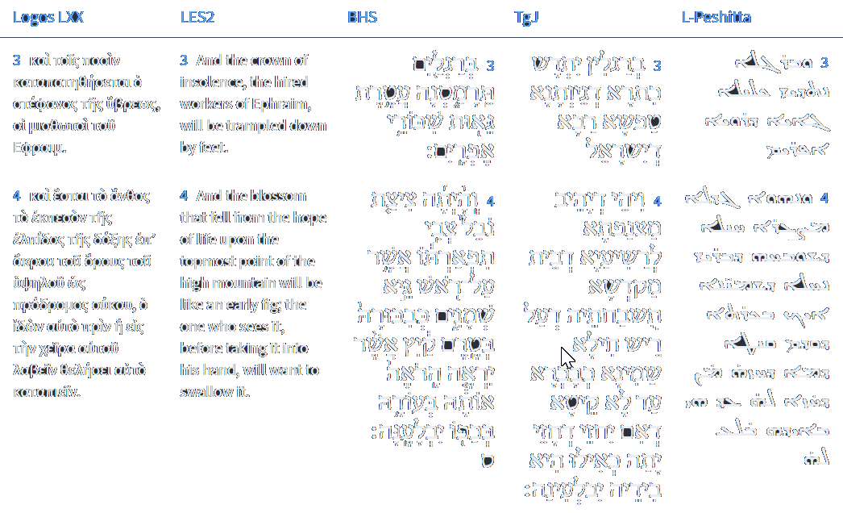







Isaiah 28:3-4
Isaiah / ישעיה
http://www.matsati.com

Slide 11
2 Timothy 4:1-8
4:1 I charge thee therefore before God, and the Lord Jesus Christ, who shall judge the quick and the dead at his appearing and his kingdom; 4:2 Preach the word; be instant in season, out of season; reprove, rebuke, exhort with all longsuffering and doctrine. 4:3 For the time will come when they will not endure sound doctrine; but after their own lusts shall they heap to themselves teachers, having itching ears; 4:4 And they shall turn away their ears from the truth, and shall be turned unto fables. 4:5 But watch thou in all things, endure afflictions, do the work of an evangelist, make full proof of thy ministry. 4:6 For I am now ready to be offered, and the time of my departure is at hand. 4:7 I have fought a good fight, I have finished my course, I have kept the faith: 4:8 Henceforth there is laid up for me a crown of righteousness, which the Lord, the righteous judge, shall give me at that day: and not to me only, but unto all them also that love his appearing. (KJV, 4 Διαμαρτύρομαι ⸆ ἐνώπιον τοῦ θεοῦ καὶ Χριστοῦ* Ἰησοῦ τοῦ μέλλοντος ⸀κρίνειν ζῶντας καὶ νεκρούς ⸁,* καὶ τὴν ἐπιφάνειαν αὐτοῦ καὶ τὴν βασιλείαν αὐτοῦ·* 2 κήρυξον τὸν λόγον,* ἐπίστηθι εὐκαίρως ἀκαίρως, ἔλεγξον, ⸉ἐπιτίμησον, παρακάλεσον⸊, ἐν πάσῃ μακροθυμίᾳ καὶ διδαχῇ.** 3 Ἔσται γὰρ καιρὸς ὅτε τῆς ὑγιαινούσης διδασκαλίας οὐκ ἀνέξονται ἀλλὰ κατὰ τὰς ⸂ἰδίας ἐπιθυμίας⸃* ἑαυτοῖς ἐπισωρεύσουσιν διδασκάλους κνηθόμενοι τὴν ἀκοὴν 4 καὶ ἀπὸ μὲν τῆς ἀληθείας τὴν ἀκοὴν ἀποστρέψουσιν,* ἐπὶ δὲ τοὺς μύθους ἐκτραπήσονται.* 5 Σὺ δὲ νῆφε ἐν πᾶσιν,* °κακοπάθησον⸆, ἔργον ποίησον εὐαγγελιστοῦ, τὴν διακονίαν σου πληροφόρησον.* *6 Ἐγὼ γὰρ ἤδη σπένδομαι, καὶ ὁ καιρὸς τῆς ⸂ἀναλύσεώς μου⸃ ἐφέστηκεν. 7 τὸν ⸂καλὸν ἀγῶνα⸃ ἠγώνισμαι,* τὸν δρόμον τετέλεκα, τὴν πίστιν τετήρηκα· 8 λοιπὸν ἀπόκειταί μοι ὁ τῆς δικαιοσύνης στέφανος,* ὃν ἀποδώσει μοι ὁ κύριος ἐν ἐκείνῃ τῇ ἡμέρᾳ, ὁ δίκαιος κριτής, οὐ μόνον δὲ ἐμοὶ ἀλλὰ καὶ °πᾶσιν τοῖς ἠγαπηκόσιν τὴν ἐπιφάνειαν αὐτοῦ.*)
Isaiah / ישעיה
http://www.matsati.com

Slide 12
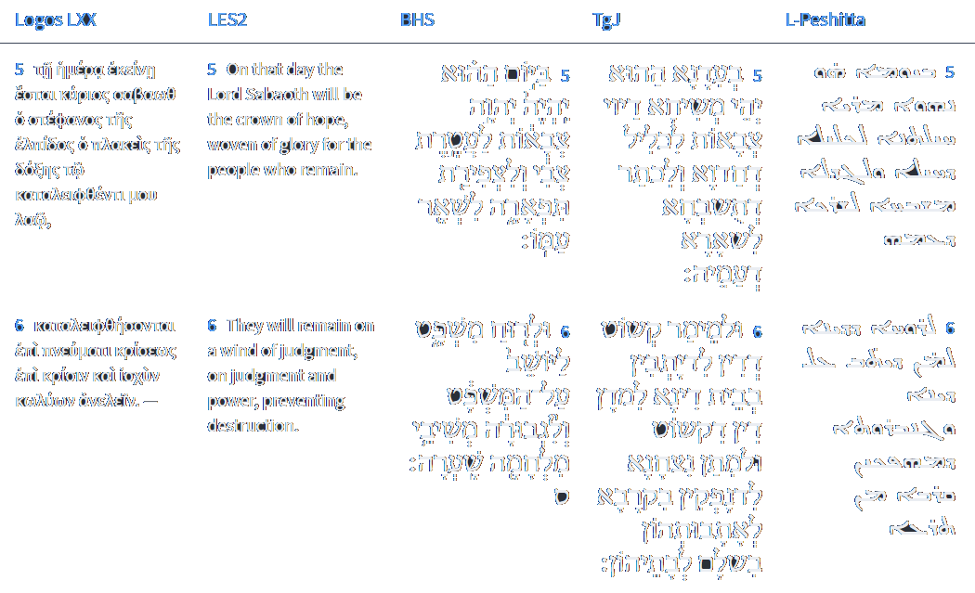




Isaiah 28:5-6
Isaiah / ישעיה
http://www.matsati.com

Slide 13
Revelation 5:5–14
5:5 And one of the elders saith unto me, Weep not: behold, the Lion of the tribe of Judah, the Root of David, hath prevailed to open the book, and to loose the seven seals thereof. 5:6 And I beheld, and, lo, in the midst of the throne and of the four beasts, and in the midst of the elders, stood a Lamb as it had been slain, having seven horns and seven eyes, which are the seven Spirits of God sent forth into all the earth. 5:7 And he came and took the book out of the right hand of him that sat upon the throne. 5:8 And when he had taken the book, the four beasts and four and twenty elders fell down before the Lamb, having every one of them harps, and golden vials full of odors, which are the prayers of saints. 5:9 And they sung a new song, saying, Thou art worthy to take the book, and to open the seals thereof: for thou wast slain, and hast redeemed us to God by thy blood out of every kindred, and tongue, and people, and nation; 5:10 And hast made us unto our God kings and priests: and we shall reign on the earth. 5:11 And I beheld, and I heard the voice of many angels round about the throne and the beasts and the elders: and the number of them was ten thousand times ten thousand, and thousands of thousands; 5:12 Saying with a loud voice, Worthy is the Lamb that was slain to receive power, and riches, and wisdom, and strength, and honor, and glory, and blessing. 5:13 And every creature which is in heaven, and on the earth, and under the earth, and such as are in the sea, and all that are in them, heard I saying, Blessing, and honor, and glory, and power, be unto him that sitteth upon the throne, and unto the Lamb for ever and ever. 5:14 And the four beasts said, Amen. And the four and twenty elders fell down and worshiped him that liveth for ever and ever. (KJV)
Isaiah / ישעיה
http://www.matsati.com

Slide 14
Midrash Tanchuma, Vayera 8:4
מֵעֲשׂת הַדָּבָר הַזֶּה אֵין אוֹמֵר כָּאן, אֶלָּא כַּדָּבָר, לֹא זֶה וְלֹא כָמוֹהוּ. הֲשֹׁפֵט כָּל הָאָרֶץ לֹא יַעֲשֶׂה מִשְׁפָּט, אוּלַי יֵשׁ חֲמִשִּׁים וְגוֹ', וַיֹּאמֶר ה' אִם אֶמְצָא בִסְדֹם, פָּתַח וְהָלַךְ מֵחֲמִשִּׁים וְעַד עֲשָׂרָה, שֶׁעֲשָׂרָה יֵשׁ כֹּחַ בָּהֶן לְכַלּוֹת אֶת הַפֻּרְעָנוּת. כֵּיוָן שֶׁלֹּא מָצָא, וַיֵּלֶךְ ה' כַּאֲשֶׁר כִּלָּה וְגוֹ'. מַה כְּתִיב אַחֲרָיו? וַיָּבֹאוּ שְׁנֵי הַמַּלְאָכִים סְדֹמָה. “ To do this thing” is not written in this verse, but rather “(to do) like this”—not this and not like this,12The use of the preposition kaf, meaning “as” or like,” rather than the definite article heh, implies “nothing like this.” that is, not even anything that resembles it. Shall not the Judge of all the world do justly? (Gen. 18:25). Perhaps there are fifty righteous in the city (ibid., v. 24). Thereupon the Holy One, blessed be He, replied: If I find fifty righteous men in Sodom … then I will forgive (ibid., v. 26). Though He started with fifty men, He decreased the number ultimately to ten men, for even ten righteous men (the number required for a minyan) possess the power to ward off retribution. However, when even that number could not be found, The Lord went His way, as soon as He had left speaking with Abraham (ibid., v. 33). And after that is written: And the two angels came to Sodom (ibid., 19:1)
Isaiah / ישעיה
http://www.matsati.com

Slide 15
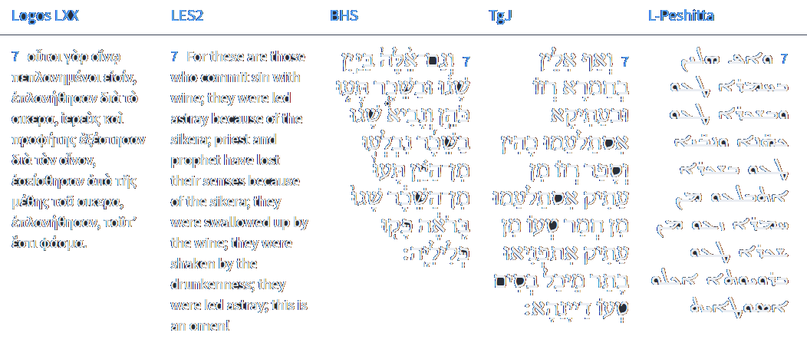



Isaiah 28:7
Isaiah / ישעיה
http://www.matsati.com

Slide 16
Rabbinic Literature
ספרות רבנית
Part 2
Isaiah / ישעיה
http://www.matsati.com

Slide 17


Targum Jonathan son of Uziel Isaiah 28:1-7
28:1 Woe that He gave a crown to the proud and foolish prince of Israel, and that He gave a diadem to the wicked of the house of the sanctuary of His praise; they who are at the head of the valley of fatness are smitten with wine. 28:2 Behold, plagues, strong and mighty, are coming from the Lord: like a storm of hail, like a whirlwind, like a storm of mighty waters, overflowing, thus the nations shall come upon them, and shall lead them into captivity to another land on account of the sins which are in their hands. 28:3 The crown of the pride of the foolish prince of Israel shall be trodden down with feet. 28:4 And the diadem, which He gave to the wicked of the house of the sanctuary of His praise, which is on the head of the valley of fatness, shall be as the first ripe fig before the summer, which, when one sees it, no sooner is it in the hand, than one devours it. 28:5 At that time, the Messiah of the Lord of hosts shall be for a crown of rejoicing, and for a crown of praise to the remnant of His people: 28:6 For a word of true judgment to them that sit in the house of justice, in order that they should judge according to truth; and to give victory to them that are going forth into battle, to bring them back in peace to their homes. 28:7 But verily these are drunk with wine, they are swallowed up of old wine: the priest and the scribe are drunk, in old wine they are swallowed up: on account of wine they have erred; they are turned after sweet food; their judges have erred. (TgJ)
Isaiah / ישעיה
http://www.matsati.com

Slide 18

ספר דברים פרק לב
טו וַיִּשְׁמַן יְשֻׁרוּן וַיִּבְעָט שָׁמַנְתָּ עָבִיתָ כָּשִֹיתָ וַיִּטּשׁ אֱלוֹהַּ עָשָֹהוּ וַיְנַבֵּל צוּר יְשֻׁעָתוֹ:
Devarim / Deuteronomy 32:15
32:15 But Jeshurun waxed fat, and kicked: Thou art waxen fat, thou art grown thick, thou art covered with fatness; Then he forsook God which made him, And lightly esteemed the Rock of his salvation. (KJV)
﻿ספר דברים פרק לג
ה וַיְהִי בִישֻׁרוּן מֶלֶךְ בְּהִתְאַסֵּף רָאשֵׁי עָם יַחַד שִׁבְטֵי יִשְֹרָאֵל: ו יְחִי רְאוּבֵן וְאַל-יָמֹת וִיהִי מְתָיו מִסְפָּר:
Devarim / Deuteronomy 33:5
33:5 And he was king in Jeshurun, When the heads of the people And the tribes of Israel were gathered together. (KJV)
Isaiah / ישעיה
http://www.matsati.com

Slide 19

ספר דברים פרק לג
כו אֵין כָּאֵל יְשֻׁרוּן רֹכֵב שָׁמַיִם בְּעֶזְרֶךָ וּבְגַאֲוָתוֹ שְׁחָקִים: [ששי] כז מְעֹנָה אֱלֹהֵי קֶדֶם וּמִתַּחַת זְרֹעֹת עוֹלָם וַיְגָרֶשׁ מִפָּנֶיךָ אוֹיֵב וַיֹּאמֶר הַשְׁמֵד:
Devarim / Deuteronomy 33:26–27
33:26 There is none like unto the God of Jeshurun, Who rideth upon the heaven in thy help, And in his excellency on the sky. 33:27 The eternal God is thy refuge, And underneath are the everlasting arms: And he shall thrust out the enemy from before thee; And shall say, Destroy them. (KJV)
Isaiah / ישעיה
http://www.matsati.com

Slide 20
Shabbat HaAretz, Introduction 30
So the land will shake off the impurity of the “drunkards of Ephraim”54 Isa. 28:1. The full verse reads: “Ah, the proud crowns of the drunkards of Ephraim, whose glorious beauty is but wilted flowers on the heads of men bloated with rich food, who are overcome with wine.”—the rebellious rulers and gangs of thieves who love bribery and pursue only their own gain, kicking against God out of their abundance of good things. They will melt away, along with all their power and glory. After a long time, scattered individuals gradually began returning to the land, drawn there by God’s hand and by the holiness of the land rather than by any concern with material well-being or with reestablishing national government.55 Rav Kook refers to the trickle of pious individual Jews who found their way to the Land of Israel from the thirteenth century onward. In the early nine-teenth century, the numbers of such immigrants increased, motivated by the messianic expectations directed to the 600th year of the sixth millennium (1840), based on prophecies of the Zohar. Between 1808 and 1840, the Jew-ish community in the Land of Israel more than doubled in size. The most notable group consisted of more than 500 disciples of the Gaon of Vilna, who arrived around 1813. See Arie Morgenstern, Hastening Redemption: Messianism and the Resettlement of the Land of Israel (Oxford: Oxford Univer-sity Press, 2006), for an account of the fascinating and little-known episode of pre-Zionist Jewish immigration to Israel.
Isaiah / ישעיה
http://www.matsati.com

Slide 21
1 Corinthians 9:24–27
9:24 Know ye not that they which run in a race run all, but one receiveth the prize? So run, that ye may obtain. 9:25 And every man that striveth for the mastery is temperate in all things. Now they do it to obtain a corruptible crown; but we an incorruptible. 9:26 I therefore so run, not as uncertainly; so fight I, not as one that beateth the air: 9:27 But I keep under my body, and bring it into subjection: lest that by any means, when I have preached to others, I myself should be a castaway. (KJV, ܠܴܐ ܝܳܕ݂ܥܺܝܢ ܐܢ̄ܬܾ݁ܘܢ ܕܱ݁ܐܝܠܷܝܢ ܕ݁ܒ݂ܶܐܣܛܱܕ݂ܺܝܳܘܢ ܪܴܗܛܻܝܢ ܆ ܟܾ݁ܠܗܽܘܢ ܗ̄ܽܘ ܪܴܗܛܻܝܢ ܇ ܐܷܠܴܐ ܚܰܕ݂ ܗ̄ܽܘ ܢܳܣܶܒ݂ ܠܴܗ ܙܳܟ݂ܽܘܬ݂ܴܐ ܂ ܗܳܟ݂ܰܢܳܐ ܗܰܪ̱ܛܘ ܂ ܐܱܝܟ݂ ܕ݁ܬ݂ܱܕ݂ܪܟ݂ܽܘܢ ܂ܟܾ݁ܠ ܐ̱ܢܳܫ ܕܷ݁ܝܢ ܕܱ݁ܐܓ݂ܽܘܢܳܐ ܥܳܒ݂ܶܕ݂ ܆ ܡܶܢ ܟܾ݁ܠ ܡܶܕܷ݁ܡ ܐܴܚܶܕ݂ ܪܷܥܝܳܢܶܗ ܂ ܘܗܳܠܷܝܢ ܪܴܗܛܻܝܢ ܕ݁ܢܶܣܒ݂ܽܘܢ ܟ݁ܠܻܝܠܴܐ ܕ݁ܡܶܬ݂ܚܰܒܱ݁ܠ ܆ ܚܢܰܢ ܕܷ݁ܝܢ ܕ݁ܠܴܐ ܡܶܬ݂ܚܰܒܱ݁ܠ ܂ ܐܷܢܳܐ ܗܳܟ݂ܺܝܠ ܗܳܟ݂ܰܢܳܐ ܪܴܗܶܛ ܐ̱ܢܳܐ ܂ ܠܴܐ ܗ̄ܘܳܐ ܐܱܝܟ݂ ܕ݁ܥܰܠ ܡܶܕܷ݁ܡ ܕ݁ܠܴܐ ܝܺܕ݂ܺܝܥ ܂ ܘܗܳܟ݂ܰܢܳܐ ܡܶܬ݂ܟܱ݁ܬܱ݁ܫ ܐ̱ܢܳܐ ܂ ܠܴܐ ܐܱܝܟ݂ ܗܰܘ ܕ݁ܠܴܐܐܱܪ ܟܴ݁ܬ݂ܷܫ ܂ ܐܷܠܴܐ ܦܱ݁ܓ݂ܪܝ ܗ̄ܽܘ ܟܴ݁ܒ݂ܶܫ ܐ̱ܢܳܐ ܘܰܡܫܰܥܒܷ݁ܕ݂ ܐ̱ܢܳܐ ܆ ܕ݁ܕ݂ܰܠܡܳܐ ܐ̱ܢܳܐ ܕ݁ܠܱܐ̱ܚܪܴ̈ܢܶܐ ܐܱܟ݂ܪܙܶܬ݂ ܇ ܐܷܢܳܐ ܩܢܽܘܡܝ ܐܷܣܬ݁ܠܷܐ ܠܻܝ ܁܀܁܀܁ *24 Οὐκ οἴδατε ὅτι οἱ ἐν σταδίῳ τρέχοντες πάντες μὲν τρέχουσιν,* εἷς δὲ λαμβάνει τὸ βραβεῖον; οὕτως τρέχετε ἵνα καταλάβητε.* 25 πᾶς δὲ ὁ ἀγωνιζόμενος πάντα ἐγκρατεύεται, ἐκεῖνοι μὲν °οὖν ἵνα φθαρτὸν στέφανον λάβωσιν, ἡμεῖς δὲ ἄφθαρτον. 26 ἐγὼ τοίνυν οὕτως τρέχω ὡς οὐκ ἀδήλως, οὕτως πυκτεύω ὡς οὐκ ἀέρα δέρων·* 27 ἀλλʼ ὑπωπιάζω μου τὸ σῶμα καὶ δουλαγωγῶ, μή πως ἄλλοις κηρύξας αὐτὸς ἀδόκιμος γένωμαι.*)
Isaiah / ישעיה
http://www.matsati.com

Slide 22
ספר דברים פרק ז
כא לֹא תַעֲרֹץ מִפְּנֵיהֶם כִּי-יְהוָֹה אֱלֹהֶיךָ בְּקִרְבֶּךָ אֵל גָּדוֹל וְנוֹרָא:
Devarim / Deuteronomy 7:21
7:21 Thou shalt not be affrighted at them: for the LORD thy God is among you, a mighty God and terrible. (KJV)
Talmud Bavli Sanhedrin 111b:3
§ Rabbi Elazar says that Rabbi Ḥanina says: The Holy One, Blessed be He, is destined to be a crown on the head of each and every righteous person, as it is stated: “In that day shall the Lord of hosts be for a crown of glory, and for a diadem of beauty, unto the remnant of His people” (Isaiah 28:5). What is the meaning of the phrase: “For a crown of glory, and for a diadem of beauty”? It means: A crown for those who perform His will and a diadem for those who await His salvation. One might have thought that this extends to everyone in those categories. Therefore, the verse states: “Unto the remnant of His people,” meaning that God will be a crown and a diadem to one who humbly establishes himself like a remnant and does not conduct himself with self-importance.
Isaiah / ישעיה
http://www.matsati.com

Slide 23
Talmud Bavli Sanhedrin 111b:4
The Gemara interprets a verse in Isaiah. “And for a spirit of justice to him that sits in judgment and for strength to them who retaliate in battle to the gate” (Isaiah 28:6). “And for a spirit of justice”; this is referring to one who subdues his evil inclination and prevents himself from sinning. “To him that sits in judgment”; this is referring to one who judges a true judgment truthfully. “And for strength”; this is referring to one who overcomes his evil inclination. “Them who retaliate in battle”; this is referring to one who gives and takes and engages in the battle, i.e., in the discourse of Torah. “To the gate” is referring to those Torah scholars who arrive early and remain late within the gates of synagogues and study halls.
Isaiah / ישעיה
http://www.matsati.com

Slide 24
Pirkei Avot 4:1
בֶּן זוֹמָא אוֹמֵר, אֵיזֶהוּ חָכָם, הַלּוֹמֵד מִכָּל אָדָם, שֶׁנֶּאֱמַר (תהלים קיט) מִכָּל מְלַמְּדַי הִשְׂכַּלְתִּי כִּי עֵדְוֹתֶיךָ שִׂיחָה לִּי. אֵיזֶהוּ גִבּוֹר, הַכּוֹבֵשׁ אֶת יִצְרוֹ, שֶׁנֶּאֱמַר (משלי טז) טוֹב אֶרֶךְ אַפַּיִם מִגִּבּוֹר וּמשֵׁל בְּרוּחוֹ מִלֹּכֵד עִיר. אֵיזֶהוּ עָשִׁיר, הַשָּׂמֵחַ בְּחֶלְקוֹ, שֶׁנֶּאֱמַר (תהלים קכח) יְגִיעַ כַּפֶּיךָ כִּי תֹאכֵל אַשְׁרֶיךָ וְטוֹב לָךְ. אַשְׁרֶיךָ, בָּעוֹלָם הַזֶּה. וְטוֹב לָךְ, לָעוֹלָם הַבָּא. אֵיזֶהוּ מְכֻבָּד, הַמְכַבֵּד אֶת הַבְּרִיּוֹת, שֶׁנֶּאֱמַר (שמואל א ב) כִּי מְכַבְּדַי אֲכַבֵּד וּבֹזַי יֵקָלּוּ:
Ben Zoma said:Who is wise? He who learns from every man, as it is said: “From all who taught me have I gained understanding” (Psalms 119:99). Who is mighty? He who subdues his [evil] inclination, as it is said: “He that is slow to anger is better than the mighty; and he that rules his spirit than he that takes a city” (Proverbs 16:32). Who is rich? He who rejoices in his lot, as it is said: “You shall enjoy the fruit of your labors, you shall be happy and you shall prosper” (Psalms 128:2) “You shall be happy” in this world, “and you shall prosper” in the world to come. Who is he that is honored? He who honors his fellow human beings as it is said: “For I honor those that honor Me, but those who spurn Me shall be dishonored” (I Samuel 2:30)
Isaiah / ישעיה
http://www.matsati.com

Slide 25



ספר בראשית פרק ו
ה וַיַּרְא יְהֹוָה כִּי רַבָּה רָעַת הָאָדָם בָּאָרֶץ וְכָל-יֵצֶר מַחְשְׁבֹת לִבּוֹ רַק רַע כָּל-הַיּוֹם:
Bereshit / Genesis 6:5
6:5 And GOD saw that the wickedness of man was great in the earth, and that every imagination of the thoughts of his heart was only evil continually. (KJV)
﻿ספר בראשית פרק ח
כא וַיָּרַח יְהוָֹה אֶת-רֵיחַ הַנִּיחֹחַ וַיֹּאמֶר יְהֹוָה אֶל-לִבּוֹ לֹא אֹסִף לְקַלֵּל עוֹד אֶת-הָאֲדָמָה בַּעֲבוּר הָאָדָם כִּי יֵצֶר לֵב הָאָדָם רַע מִנְּעֻרָיו וְלֹא-אֹסִף עוֹד לְהַכּוֹת אֶת-כָּל-חַי כַּאֲשֶׁר עָשִֹיתִי:
Bereshit / Genesis 8:21
21 And the LORD smelled a sweet savor; and the LORD said in his heart, I will not again curse the ground any more for man’s sake; for the imagination of man’s heart is evil from his youth; neither will I again smite any more everything living, as I have done. (KJV)
Isaiah / ישעיה
http://www.matsati.com

Slide 26
Rashi on Isaiah 28,7 Part 1-4
וגם אלה. יושבי משפט ומשיבי מלחמה שבדור הזה כלומר טובים וחשובים שבהן ביין שגו כי עתה אין טוב בהם: These too who sit in judgment and return the war in this generation, i.e., the best and most esteemed among them, erred because of wine, for now there is no good in them.
שגו ברואה. הלעיגו בדברי הנביאים וי"ת במאכל מעדנים שראוהו עונג להם: they erred against the seer They mocked the words of the prophets. Jonathan renders: with eating delicacies, which they saw as a pleasure to them.
פקו פליליה. הכשילו המשפט: they caused justice to stumble (פָּקוּ פְּלִילֶיהָ), they caused justice to stumble.
פקו. לשון פיק ברכים (נחום ב׳:י״א) פוקה (שמואל א' כ"ה): פָּקוּ is an expression similar to (Nahum 2:11), “The stumblingפִּיק) ) of knees”; (I Sam. 25:31) “A stumbling block פּוּקָה))”
Isaiah / ישעיה
http://www.matsati.com

