Slide 1
MATSATI.COM Teaching Ministry
Website: https://www.matsati.com YouTube Channel: https://www.youtube.com/user/MATSATI/
ישעיהו כז:א-ו / Isaiah 27:1-6
LIVE STREAM: 6:30 pm EST Thursday
Join us at Telegram:
https://t.me/MessianicChat
Foundation of the Word Outreach Ministry
https://www.thefoundationoftheword.org
A Community
for Learning
Weekly Teachings Free Online
Check Telegram for weekly scheduling of teachings.
Discuss the Scriptures,
learn the languages,
and fellowship
YouTube Channel
https://www.youtube.com/c/TheFoundationofTheWordOutreachMinistries
Join Telegram ask about Hebrew and Greek classes!
Rabbi Jeremiah
– The Apocalypse: connecting the Greek to the Ancient Hebrew text. (Wed. 9 am EST)
YouTube Channels
https://YouTube.com/c/HebrewLiteracy
https://www.youtube.com/channel/UC5_qPfruat-sCJJypz0_OBw

Slide 2
Isaiah 27:7-13
ישעיהו כז:ז-יג
Isaiah / ישעיה
http://www.matsati.com

Slide 3
ספר דברים פרק ל
טו רְאֵה נָתַתִּי לְפָנֶיךָ הַיּוֹם אֶת-הַחַיִּים וְאֶת-הַטּוֹב וְאֶת-הַמָּוֶת וְאֶת-הָרָע: טז אֲשֶׁר אָנֹכִי מְצַוְּךָ הַיּוֹם לְאַהֲבָה אֶת-יְהוָֹה אֱלֹהֶיךָ לָלֶכֶת בִּדְרָכָיו וְלִשְׁמֹר מִצְוֹתָיו וְחֻקֹּתָיו וּמִשְׁפָּטָיו וְחָיִיתָ וְרָבִיתָ וּבֵרַכְךָ יְהוָֹה אֱלֹהֶיךָ בָּאָרֶץ אֲשֶׁר-אַתָּה בָא-שָׁמָּה לְרִשְׁתָּהּ: יז וְאִם-יִפְנֶה לְבָבְךָ וְלֹא תִשְׁמָע וְנִדַּחְתָּ וְהִשְׁתַּחֲוִיתָ לֵאלֹהִים אֲחֵרִים וַעֲבַדְתָּם: יח הִגַּדְתִּי לָכֶם הַיּוֹם כִּי אָבֹד תֹּאבֵדוּן לֹא-תַאֲרִיכֻן יָמִים עַל-הָאֲדָמָה אֲשֶׁר אַתָּה עֹבֵר אֶת-הַיַּרְדֵּן לָבוֹא שָׁמָּה לְרִשְׁתָּהּ: יט הַעִדֹתִי בָכֶם הַיּוֹם אֶת-הַשָּׁמַיִם וְאֶת-הָאָרֶץ הַחַיִּים וְהַמָּוֶת נָתַתִּי לְפָנֶיךָ הַבְּרָכָה וְהַקְּלָלָה וּבָחַרְתָּ בַּחַיִּים לְמַעַן תִּחְיֶה אַתָּה וְזַרְעֶךָ: כ לְאַהֲבָה אֶת-יְהוָֹה אֱלֹהֶיךָ לִשְׁמֹעַ בְּקֹלוֹ וּלְדָבְקָה-בוֹ כִּי הוּא חַיֶּיךָ וְאֹרֶךְ יָמֶיךָ לָשֶׁבֶת עַל-הָאֲדָמָה אֲשֶׁר נִשְׁבַּע יְהוָֹה לַאֲבֹתֶיךָ לְאַבְרָהָם לְיִצְחָק וּלְיַעֲקֹב לָתֵת לָהֶם:
Isaiah / ישעיה
http://www.matsati.com

Slide 4
תְּפִילָּה לְחוֹדֶשׁ אֱלוּל
אֲנִי לְדוֹדִי וְדוֹדִי לִי. אָבִי שֶׁבַּשָּׁמַיִם מָלֵא רַחֲמִים עָזְרֵנִי וְזִכַּנִי לְהִתְקָרֵב אֵלֶיךָ תָּמִיד וּבִפְרָט כָּעֵת בְּחוֹדֶשׁ אֱלוּל. וְאַתָּה בְּרַחֲמֶיךָ תִּפְתַּח יָדְךָ וְתִהְיֶה יְמִינְךָ פְּשׁוּטָה לְקַבֵּל שָׁבִים.עַד אֲשֶׁר נִזְכֶּה לְהַמְשִׁיךְ וּלְתַקֵּן כָּל הַתִּיקּוּנִים הַנִּמְשָׁכִים עַל יְדֵי הַיִּחוּדִים וְהַכַּוָּונוֹת שֶׁל אֱלוּל. וּתְסַיְּיעֵנִי מִן הַשָּׁמַיִם לְטַהֲרָנֵי מֵעֲווֹנוֹתַי שֶׁאֶזְכֶּה לָשׁוּב בִּתְשׁוּבָה שְׁלֹמֹה בֶּאֱמֶת עַל כָּל עֲווֹנוֹתַי. וְעָזְרֵנִי שֶׁאֶזְכֶּה בְּכָל מָקוֹם תָּמִיד לִמְצוֹא אוֹתְךָ. בֵּין בְּעָלֶיהָ בֶּן בִּירִידָה אֲנִי לְדוֹדִי וְדוֹדִי לִי אָמֵן וְאָמֵן.
A prayer for the month of Elul
Ani L’Dodi V’Dodi Li (אֲנִי לְדוֹדִי וְדוֹדִי לִי) – I am my beloved’s and my beloved is mine – Father in heaven, full of mercy, help me and give me the merit to become closer to You always and especially during the month of Elul. And You with your great mercy will open Your hand of kindness to accept the ones who repent and do Teshuvah and seek closeness to You. So we can continue to rectify all the Tikkunim that are possible by the great powers of Yichudim (Unity) and Kavanot (meditations) of the month of Elul. Father, please help me to be cleansed from the heavens from all of my sins and may I merit to do complete Teshuvah for all of my sins. Father, bless me that I should always find You wherever I seek You, when I am in a high spiritual place or unfortunately also when I spiritually fall to a low place. Ani L’Dodi V’Dodi Li (אֲנִי לְדוֹדִי וְדוֹדִי לִי) – I am my beloved’s and my beloved is mine – Amen!
Isaiah / ישעיה
http://www.matsati.com

Slide 5
﻿ספר ישעיה פרק כו
﻿ז הַכְּמַכַּת מַכֵּהוּ הִכָּהוּ אִם-כְּהֶרֶג הֲרֻגָיו הֹרָג: ח בְּסַאסְּאָה בְּשַׁלְחָהּ תְּרִיבֶנָּה הָגָה בְּרוּחוֹ הַקָּשָׁה בְּיוֹם קָדִים: ט לָכֵן בְּזֹאת יְכֻפַּר עֲוֹן-יַעֲקֹב וְזֶה כָּל-פְּרִי הָסִר חַטָּאתוֹ בְּשֹוּמוֹ | כָּל-אַבְנֵי מִזְבֵּחַ כְּאַבְנֵי-גִר מְנֻפָּצוֹת לֹא-יָקֻמוּ אֲשֵׁרִים וְחַמָּנִים: י כִּי עִיר בְּצוּרָה בָּדָד נָוֶה מְשֻׁלָּח וְנֶעֱזָב כַּמִּדְבָּר שָׁם יִרְעֶה עֵגֶל וְשָׁם יִרְבָּץ וְכִלָּה סְעִפֶיהָ: יא בִּיבֹשׁ קְצִירָהּ תִּשָּׁבַרְנָה נָשִׁים בָּאוֹת מְאִירוֹת אוֹתָהּ כִּי לֹא עַם-בִּינוֹת הוּא עַל-כֵּן לֹא-יְרַחֲמֶנּוּ עֹשֵֹהוּ וְיֹצְרוֹ לֹא יְחֻנֶּנּוּ: יב וְהָיָה בַּיּוֹם הַהוּא יַחְבֹּט יְהֹוָה מִשִּׁבֹּלֶת הַנָּהָר עַד-נַחַל מִצְרָיִם וְאַתֶּם תְּלֻקְּטוּ לְאַחַד אֶחָד בְּנֵי יִשְֹרָאֵל: יג וְהָיָה | בַּיּוֹם הַהוּא יִתָּקַע בְּשׁוֹפָר גָּדוֹל וּבָאוּ הָאֹבְדִים בְּאֶרֶץ אַשּׁוּר וְהַנִּדָּחִים בְּאֶרֶץ מִצְרָיִם וְהִשְׁתַּחֲווּ לַיהֹוָה בְּהַר הַקֹּדֶשׁ בִּירוּשָׁלָם:
Isaiah / ישעיה
http://www.matsati.com

Slide 6
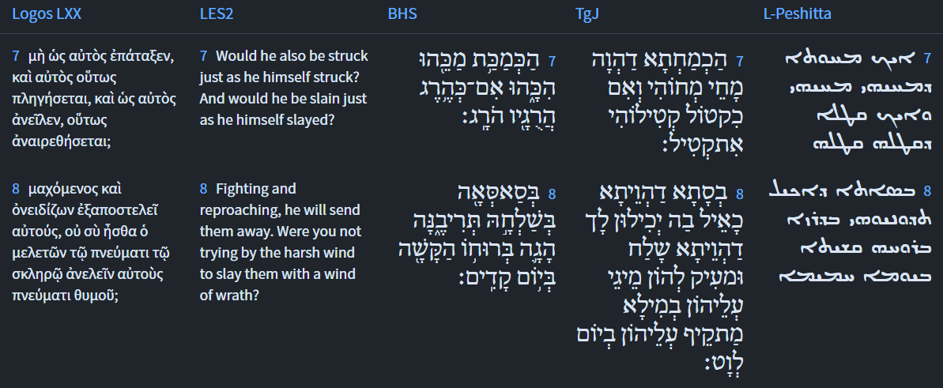
Isaiah 27:7-8
Isaiah / ישעיה
http://www.matsati.com

Slide 7
Galatians 5:22–25
5:22 But the fruit of the Spirit is love, joy, peace, longsuffering, gentleness, goodness, faith, 5:23 Meekness, temperance: against such there is no law. 5:24 And they that are Christ’s have crucified the flesh with the affections and lusts. 5:25 If we live in the Spirit, let us also walk in the Spirit. (KJV, ܦܻ݁ܐܪܷ̈ܐ ܕܷ݁ܝܢ ܕ݁ܪܾܘܚܳܐ ܐܻܝܬ݂ܱܝܗܽܘܢ ܆ ܚܽܘܒܴ݁ܐ ܂ ܚܰܕ݂ܽܘܬ݂ܴܐ ܂ ܫܠܴܡܳܐ ܂ ܡܰܓ݁ܪܱܬ݂ ܂ ܪܾܘܚܳܐ ܂ ܒܱ݁ܣܺܝܡܽܘܬ݂ܴܐ ܂ ܛܴܒ݂ܽܘܬ݂ܴܐ ܂ ܗܰܝܡܳܢܽܘܬ݂ܴܐ ܂ܡܰܟܻ݁ܝܟ݂ܽܘܬ݂ܴܐ ܂ ܡܣܰܝܒ݁ܪܴܢܽܘܬ݂ܴܐ ܂ ܥܰܠ ܗܳܠܷܝܢ ܢܳܡܽܘܣܳܐ ܠܴܐ ܣܺܝܡ ܂ ܐܱܝܠܷܝܢ ܕܷ݁ܝܢ ܕ݁ܕ݂ܰܡܫܺܝܚܳܐ ܐܷܢܽܘܢ ܆ ܒܷ݁ܣܪܗܽܘܢ ܙܩܰܦ݂ܘ ܂ ܥܰܡ ܟܾ݁ܠܗܽܘܢ ܟܻ݁ܐܒ݂ܰܘܗ̄ܝ̈ ܘܰܪ̈ܓ݂ܺܝܓ݂ܳܬ݂ܷܗ ܂ ܢܺܚܶܐ ܗܳܟ݂ܺܝܠ ܒ݁ܪܾܘܚܳܐ ܆ ܘܰܠܪܾܘܚܳܐ ܢܶܫܠܱܡ ܂ 22 ὁ δὲ καρπὸς τοῦ πνεύματός ἐστιν ἀγάπη χαρὰ εἰρήνη,* μακροθυμία χρηστότης ἀγαθωσύνη,* πίστις 23 πραΰτης ἐγκράτεια⸆· κατὰ τῶν τοιούτων οὐκ ἔστιν νόμος.* 24 οἱ δὲ τοῦ Χριστοῦ °[Ἰησοῦ] τὴν σάρκα ἐσταύρωσαν σὺν τοῖς παθήμασιν καὶ ταῖς ἐπιθυμίαις.* 25 Εἰ ζῶμεν πνεύματι,* ⸂πνεύματι καὶ⸃ στοιχῶμεν.)
Isaiah / ישעיה
http://www.matsati.com

Slide 8
Isaiah 27:7-8
Isaiah / ישעיה
http://www.matsati.com

Slide 9
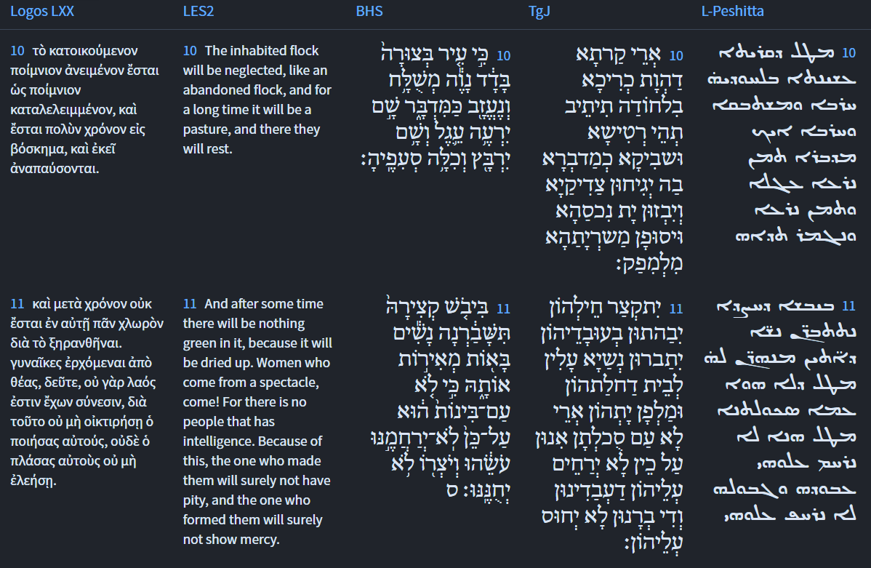
Isaiah 27:7-8
Isaiah / ישעיה
http://www.matsati.com

Slide 10
ספר שמות פרק לג
יט וַיֹּאמֶר אֲנִי אַעֲבִיר כָּל-טוּבִי עַל-פָּנֶיךָ וְקָרָאתִי בְשֵׁם יְהוָֹה לְפָנֶיךָ וְחַנֹּתִי אֶת-אֲשֶׁר אָחֹן וְרִחַמְתִּי אֶת-אֲשֶׁר אֲרַחֵם:
Shemot / Exodus 33:19
19 And he said, I will make all my goodness pass before thee, and I will proclaim the name of the LORD before thee; and will be gracious to whom I will be gracious, and will shew mercy on whom I will shew mercy. (KJV)
Isaiah / ישעיה
http://www.matsati.com

Slide 11
Romans 9:14–17
9:14 What shall we say then? Is there unrighteousness with God? God forbid. 9:15 For he saith to Moses, I will have mercy on whom I will have mercy, and I will have compassion on whom I will have compassion. 9:16 So then it is not of him that willeth, nor of him that runneth, but of God that sheweth mercy. 9:17 For the scripture saith unto Pharaoh, Even for this same purpose have I raised thee up, that I might shew my power in thee, and that my name might be declared throughout all the earth. (KJV, ܡܳܢܳܐ ܗܳܟ݂ܺܝܠ ܢܺܐܡܰܪ ܂ ܕܱ݁ܠܡܳܐ ܥܰܘܠܴܐ ܐܻܝܬ݂ ܠܘܳܬ݂ ܐܱܠܴܗܳܐ ܆ ܚܳܣ ܂ܗܳܐ ܐܴܦ݂ ܠܡܽܘܫܶܐ ܐܷܡܰܪ ܂ ܐܷܪܱܚܶܡ ܥܰܠ ܐܱܝܢܳܐ ܕܱ݁ܡܪܱܚܶܡ ܐ̱ܢܳܐ ܂ ܘܶܐܚܽܘܢ ܠܱܐܝܢܳܐ ܕ݁ܚܳܐܷܢ ܐ̱ܢܳܐ ܂ ܠܴܐ ܗܳܟ݂ܺܝܠ ܒܻ݁ܐܝ̈ܕ݂ܰܝ ܡܰܢ ܕ݁ܨܴܒ݂ܶܐ ܇ ܘܠܴܐ ܒܻ݁ܐܝ̈ܕ݂ܰܝ ܡܰܢ ܕ݁ܪܴܗܶܛ ܆ ܐܷܠܴܐ ܒܻ݁ܐܝ̈ܕ݂ܰܝ ܐܱܠܴܗܳܐ ܡܪܱܚܡܳܢܳܐ ܂ ܐܷܡܰܪ ܓܷ݁ܝܪ ܒܱ݁ܟ݂ܬ݂ܴܒ݂ܳܐ ܠܦ݂ܶܪܥܽܘܢ ܆ ܕ݁ܠܴܗ ܠܗܳܕ݂ܶܐ ܐܱܩܺܝܡܬܴ݁ܟ݂ ܂ ܕܷ݁ܐܚܰܘܶܐ ܒܴ݁ܟ݂ ܚܰܝܠܝ ܂ ܘܰܕ݂ܢܶܬ݂ܟ݁ܪܷܙ ܫܶܡܝ ܒܱ݁ܐܪܥܳܐ ܟܾ݁ܠܷܗ ܂ 14 Τί οὖν ἐροῦμεν; μὴ ἀδικία παρὰ τῷ θεῷ; μὴ γένοιτο*. 15 τῷ Μωϋσεῖ γὰρ λέγει·* ἐλεήσω ὃν ἂν ἐλεῶ καὶ οἰκτιρήσω ὃν ἂν οἰκτίρω. 16 ἄρα οὖν οὐ τοῦ θέλοντος οὐδὲ τοῦ τρέχοντος ἀλλὰ τοῦ ⸀ἐλεῶντος θεοῦ*. 17 λέγει γὰρ ἡ γραφὴ τῷ Φαραὼ ὅτι εἰς αὐτὸ τοῦτο ἐξήγειρά σε ὅπως ἐνδείξωμαι ἐν σοὶ τὴν δύναμίν μου καὶ ὅπως διαγγελῇ τὸ ὄνομά μου ἐν πάσῃ τῇ γῇ.)
Isaiah / ישעיה
http://www.matsati.com

Slide 12
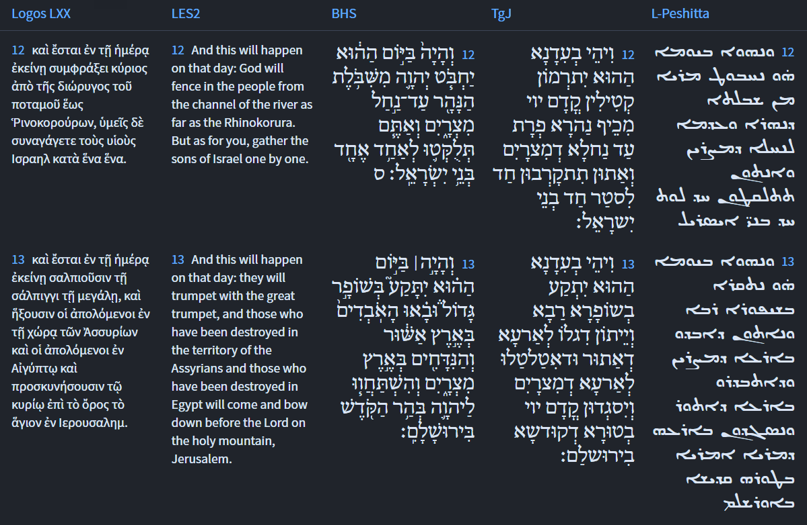
Isaiah 27:7-8
Isaiah / ישעיה
http://www.matsati.com

Slide 13
1 Corinthians 15:50–54
15:50 Now this I say, brethren, that flesh and blood cannot inherit the kingdom of God; neither doth corruption inherit incorruption. 15:51 Behold, I shew you a mystery; We shall not all sleep, but we shall all be changed, 15:52 In a moment, in the twinkling of an eye, at the last trump: for the trumpet shall sound, and the dead shall be raised incorruptible, and we shall be changed. 15:53 For this corruptible must put on incorruption, and this mortal must put on immortality. 15:54 So when this corruptible shall have put on incorruption, and this mortal shall have put on immortality, then shall be brought to pass the saying that is written, Death is swallowed up in victory. (KJV, 50 Τοῦτο ⸀δέ φημι,* ἀδελφοί, ὅτι σὰρξ καὶ αἷμα βασιλείαν θεοῦ ⸂κληρονομῆσαι οὐ δύναται⸃ οὐδὲ ἡ φθορὰ τὴν ἀφθαρσίαν κληρονομεῖ.* 51 ἰδοὺ μυστήριον ὑμῖν λέγω· ⸆ πάντες ⸇ ⸂οὐ κοιμηθησόμεθα,* πάντες δὲ⸃ ἀλλαγησόμεθα, 52 ἐν ἀτόμῳ,* ἐν ⸀ῥιπῇ ὀφθαλμοῦ, ἐν τῇ ἐσχάτῃ σάλπιγγι· σαλπίσει γὰρ καὶ οἱ νεκροὶ ⸁ἐγερθήσονται ἄφθαρτοι καὶ ἡμεῖς ἀλλαγησόμεθα. 53 Δεῖ γὰρ τὸ φθαρτὸν τοῦτο ἐνδύσασθαι ἀφθαρσίαν καὶ τὸ θνητὸν τοῦτο ἐνδύσασθαι ἀθανασίαν.* 54 ὅταν δὲ ⸂τὸ φθαρτὸν τοῦτο ἐνδύσηται ἀφθαρσίαν καὶ τὸ θνητὸν τοῦτο ἐνδύσηται ἀθανασίαν⸃, τότε γενήσεται ὁ λόγος ὁ γεγραμμένος· κατεπόθη ὁ θάνατος εἰς νῖκος.*)
Isaiah / ישעיה
http://www.matsati.com

Slide 14
Rabbinic Literature
ספרות רבנית
Part 2
Isaiah / ישעיה
http://www.matsati.com

Slide 15
Targum Jonathan son of Uziel Isaiah 27:7-13
27:7 Hath he smitten him (Judah and Israel), as He smote those that smote him? Or is he (Judah and Israel) slain according to the slaughter of them that are slain by Him (by God). 27:8 With the measure wherewith thou didst measure, they shall measure unto thee, thou didst send forth and oppress them. He meditated a word against them. He prevailed against them in the day of wrath. 27:9 By this, therefore, shall the sins of the house of Jacob be forgiven; and thus it shall be with all the works of the perverseness of their sins, namely, that they shall make all the stones of the (idolatrous) altar like chalk stones that are beaten asunder; the groves and the sun-images shall not be raised up again. 27:10 But the city that was fortified shall sit solitary: she shall totter, and be forsaken like a desert; the just shall wage war against her, and plunder her treasures, and make an end of her hosts, so that none shall go forth. 27:11 Their armies shall be cut off; and they shall be confounded on account of their works, which shall be broken: women shall enter the house of their idolatry, and teach them, because they are a people of no understanding: therefore He that made them shall not have mercy on them, and He that created them shall show them no favour. 27:12 And it shall come to pass at that time, that the slain of the Lord shall be cast from the bank of the river Euphrates into the river of Egypt; and ye shall be brought near one to the other, O ye sons of Israel. 27:13 And it shall come to pass at that time, that the great trumpet shall be blown, and they shall come, who had gone into captivity into the land of Assyria, and those who were cast into the land of Egypt, and they shall worship before the Lord, in the holy mountain at Jerusalem. (TgJ)
Isaiah / ישעיה
http://www.matsati.com

Slide 16
Matthew 7:1–5
7:1 Judge not, that ye be not judged. 7:2 For with what judgment ye judge, ye shall be judged: and with what measure ye mete, it shall be measured to you again. 7:3 And why beholdest thou the mote that is in thy brother’s eye, but considerest not the beam that is in thine own eye? 7:4 Or how wilt thou say to thy brother, Let me pull out the mote out of thine eye; and, behold, a beam is in thine own eye? 7:5 Thou hypocrite, first cast out the beam out of thine own eye; and then shalt thou see clearly to cast out the mote out of thy brother’s eye. (KJV, ܠܴܐ ܬ݁ܕ݂ܽܘܢܽܘܢ ܕ݁ܠܴܐ ܬܷ݁ܬ݁ܕ݂ܺܝܢܽܘܢ ܂ܒ݁ܕ݂ܺܝܢܳܐ ܓܷ݁ܝܪ ܕ݁ܕ݂ܳܝܢܺܝܢ ܐܢ̄ܬܾ݁ܘܢ ܂ ܬܷ݁ܬ݁ܕ݂ܺܝܢܽܘܢ ܂ ܘܒ݂ܰܟ݂ܝܳܠܬܴ݁ܐ ܕܱ݁ܡܟ݂ܺܝܠܻܝܢ ܐܢ̄ܬܾ݁ܘܢ ܂ ܡܶܬ݁ܬ݁ܟ݂ܺܝܠ ܠܟ݂ܽܘܢ ܀ ܡܳܢܳܐ ܕܷ݁ܝܢ ܚܳܙܶܐ ܐܱܢ̄ܬ݁ ܓܷ݁ܠܴܐ ܕܱ݁ܒ݂ܥܰܝܢܶܗ ܕܱ݁ܐܚܽܘܟ݂ ܆ ܘܩܳܪܻܝܬ݂ܴܐ ܕܱ݁ܒ݂ܥܰܝܢܳܟ݂ ܠܴܐ ܒܴ݁ܚܰܪ ܐܱܢ̄ܬ݁ ܂ ܐܱܘ ܐܱܝܟܱ݁ܢܳܐ ܐܴܡܰܪ ܐܱܢ̄ܬ݁ ܠܱܐܚܽܘܟ݂ ܇ ܫܒ݂ܽܘܩ ܐܱܦܷ݁ܩ ܓܷ݁ܠܴܐ ܡܶܢ ܥܰܝܢܳܟ݂ ܇ ܘܗܳܐ ܩܳܪܻܝܬܴ݁ܐ ܒ݁ܥܰܝܢܳܟ݂ ܂ ܢܳܣܶܒ݂ ܒܱ݁ܐܦܷ̈݁ܐ ܆ ܐܱܦܷ݁ܩ ܠܾܘܩܕ݂ܰܡ ܩܳܪܻܝܬܴ݁ܐ ܡܶܢ ܥܰܝܢܳܟ݂ ܆ ܘܗܳܝܕܷ݁ܝܢ ܢܶܬ݂ܒ݁ܚܰܪ ܠܴܟ݂ ܠܡܰܦܴ݁ܩܽܘ ܓܷ݁ܠܴܐ ܡܶܢ ܥܰܝܢܶܗ ܕܱ݁ܐܚܽܘܟ݂ ܀ 7 Μὴ κρίνετε, ἵνα μὴ κριθῆτε·* 2 ἐν ᾧ γὰρ κρίματι κρίνετε κριθήσεσθε,* καὶ ἐν ᾧ μέτρῳ μετρεῖτε ⸀μετρηθήσεται ὑμῖν. *3 Τί δὲ βλέπεις τὸ κάρφος τὸ ἐν τῷ ὀφθαλμῷ τοῦ ἀδελφοῦ σου, τὴν δὲ ἐν τῷ σῷ ὀφθαλμῷ δοκὸν οὐ κατανοεῖς; 4 ἢ πῶς ⸀ἐρεῖς τῷ ἀδελφῷ σου· ἄφες ἐκβάλω τὸ κάρφος ⸁ἐκ τοῦ ὀφθαλμοῦ σου, καὶ ἰδοὺ ἡ δοκὸς ἐν τῷ ὀφθαλμῷ σοῦ˸;* 5 ὑποκριτά, ἔκβαλε πρῶτον ⸉ἐκ τοῦ ὀφθαλμοῦ σοῦ τὴν δοκόν⸊, καὶ τότε διαβλέψεις ἐκβαλεῖν τὸ κάρφος ἐκ τοῦ ὀφθαλμοῦ τοῦ ἀδελφοῦ σου.)
Isaiah / ישעיה
http://www.matsati.com

Slide 17
Ein Yaakov (Glick Edition), Sotah 1:16
תניא היה ר׳ מאיר אומר מנין שבמדה שאדם מודד בה מודדין לו שנאמר (ישעיה כז ח) בסאסאה בשלחה תריבנה אין לי אלא סאה מנין לרבות אפילו תרקב וחצי תרקב קב וחצי קב רובע וחצי רובע תומן ועוקלא ת״ל (שם ט ד) כל סאון סואן ברעש ומנין שכל פרוטה ופרוטה מצטרפין לחשבון גדול ת״ל (קהלת ז כז) אחת לאחת למצוא חשבון וכן מצינו בסוטה שבמדה שמדדה בה מדדו לה:
(Fol. 8b) We are taught in a Baraitha, R. Maier was in the habit of saying, "Whence do we learn that the very same scale with which man measures others will be meted out to him [as he deals with others he will be dealt with]? It is said (Is. 27, 8) In full measure Thou sendest her away. Thou dost contend with her. This would prove only that the Lord measures by the S'ah [repays only great sins but overlooks the small ones.] Whence do we infer that even for a Tarkab, one-half of a Tarkab, one-half of a Kab, one-quarter of a Kab and one-eighth of a Kab and even smaller measures than these, that they are to be measured with the exact measure? It therefore says (Is. 9, 4) For all the weapons of the fighter in the battle's tumult. And whence do we learn that each and every little crime is added unto the total account? It is therefore said (Ecc. 7, 27) Adding one thing to the other to find out the amount. And so also do we find in the case of a Sota that with the exact measures with which she measures others, is it measured out to her, etc.
Isaiah / ישעיה
http://www.matsati.com

Slide 18
Rashi on Isaiah 27,8 Parts 1-4
בסאסאה. באותה מדה:
In that measure (בְּסַאסְּאָה) in that measure.
בשלחה תריבנה. כששילחה מצרים את ישראל תריבנה המדה בסאה שלה:
when they sent them out, it strove with it When Egypt sent Israel out, it strove with it, the seah of the measure with its seah.
הגה ברוחו הקשה. הגה דבר בדבורו הקשה:
He spoke with His harsh wind (הָגָה) He spoke with His harsh speech.
ביום קדים. ביום ויולך ה' את הים ברוח קדים עזה (שמות י״ד:כ״א):
on the day of the east wind On the day (concerning which Scripture states) (Ex. 14:21): “And the Lord led the sea with a strong east wind.”
Isaiah / ישעיה
http://www.matsati.com

Slide 19
Duties of the Heart, Seventh Treatise on Repentance 2:3
(2) One who repents in his heart and in deed. His understanding stands up to his evil inclination. He trains himself to discipline his inward being, and fight its lusts until he defeats it and restrains it from what is hateful to the Creator. But his inner being always desires to draw him to the opposite of the service of G-d, and longs to do transgressions. He exerts himself to restrain it. Sometimes he defeats it, sometimes it defeats him. This person is not complete in the way of repentance. It will not secure an atonement, until he renounces the sins completely, as written: "Therefore by this the guilt of Jacob will be atoned for, and this will be the full fruit of the removal of his sin: when he makes all the stones of the altars like chalkstones crushed to pieces, no Asherim or incense altars will remain standing" (Yeshaya 27:9).
Isaiah / ישעיה
http://www.matsati.com

Slide 20
2 Timothy 1:7
1:7 For God hath not given us the spirit of fear; but of power, and of love, and of a sound mind. (KJV, ܠܴܐ ܓܷ݁ܝܪ ܝܰܗ̄ܒ݂ ܠܱܢ ܐܱܠܴܗܳܐ ܪܾܘܚܳܐ ܕ݁ܕ݂ܶܚܠܬ݂ܴܐ ܆ ܐܷܠܴܐ ܕ݁ܚܰܝܠܴܐ ܁ ܘܰܕ݂ܚܽܘܒܴ݁ܐ ܂ ܘܰܕ݂ܡܰܪܬ݁ܝܳܢܽܘܬ݂ܴܐ ܂ 7 οὐ γὰρ ἔδωκεν ἡμῖν ὁ θεὸς πνεῦμα δειλίας ἀλλὰ δυνάμεως καὶ ἀγάπης καὶ σωφρονισμοῦ.*)
Isaiah / ישעיה
http://www.matsati.com

Slide 21
Peninei Halakhah, Days of Awe 7:15 Part 6
The Sages tell us that good things happen as a result of prostration:
Avraham returned unharmed from Mount Moriah together with Yitzḥak only in the merit of his prostration, as we read, “We will worship (ve-nishtaḥaveh) and we will return to you” (Bereishit 22:5). Israel was redeemed from slavery only in the merit of their prostration, as we read, “When they heard that the Lord had taken note of the Israelites and that He had seen their plight, they bowed low in homage (ya-yikdu va-yishtaḥavu)” (Shemot 4:31). The Torah was given only in the merit of prostration, as we read, “Then He said to Moshe, ‘Come up to the Lord, with Aharon, Nadav and Avihu, and seventy elders of Israel, and bow low from afar’” (ibid. 24:1). Ḥanna was remembered only in the merit of prostration, as we read, “And they bowed low there before the Lord” (1 Shmuel 1:28). Only in the merit of prostration will the exiles will be gathered in, as we read, “And on that day, a great ram’s horn shall be sounded; and the strayed who are in the land of Assyria and the expelled who are in the land of Egypt shall come and worship (ve-hishtaḥavu) the Lord on the holy mount in Jerusalem” (Yeshayahu 27:13). The Temple will be rebuilt only in the merit of prostration, as we read, “Exalt the Lord our God and bow down to His footstool; He is holy!” (Tehilim 99:5). The dead will be brought back to life only in the merit of prostration, as we read, “Come, let us bow down and kneel (nishtaḥaveh ve-nikhra’a), bend the knee before the Lord our Maker” (ibid. 95:6). (Bereishit Rabba 56:6)
Isaiah / ישעיה
http://www.matsati.com

