Slide 1
MATSATI.COM Teaching Ministry
Website: https://www.matsati.com YouTube Channel: https://www.youtube.com/user/MATSATI/
ישעיהו כו:ח-יד / Isaiah 26:8-14
LIVE STREAM: 6:30 pm EST Thursday
Join us at Telegram:
https://t.me/MessianicChat
Foundation of the Word Outreach Ministry
https://www.thefoundationoftheword.org
A Community
for Learning
Weekly Teachings Free Online
Check Telegram for weekly scheduling of teachings.
Discuss the Scriptures,
learn the languages,
and fellowship
YouTube Channel
https://www.youtube.com/c/TheFoundationofTheWordOutreachMinistries
Join Telegram ask about Hebrew and Greek classes!
Rabbi Jeremiah
– The Apocalypse: connecting the Greek to the Ancient Hebrew text. (Wed. 9 am EST)
YouTube Channels
https://YouTube.com/c/HebrewLiteracy
https://www.youtube.com/channel/UC5_qPfruat-sCJJypz0_OBw
United Messianic Jewish Assembly (http:\\umja.net)

Slide 2
Isaiah 26:8-14
ישעיהו כו:ח-יד
Isaiah / ישעיה
http://www.matsati.com

Slide 3
ספר ויקרא פרק יט
א וַיְדַבֵּר יְהוָֹה אֶל-מֹשֶׁה לֵּאמֹר: ב דַּבֵּר אֶל-כָּל-עֲדַת בְּנֵי-יִשְֹרָאֵל וְאָמַרְתָּ אֲלֵהֶם קְדשִׁים תִּהְיוּ כִּי קָדוֹשׁ אֲנִי יְהוָֹה אֱלֹהֵיכֶם:
Vayikra / Leviticus 19:1-2
19:1 And the LORD spake unto Moses, saying, 19:2 Speak unto all the congregation of the children of Israel, and say unto them, Ye shall be holy: for I the LORD your God am holy. (KJV)
Isaiah / ישעיה
http://www.matsati.com

Slide 4
Central Verse of the Torah
Vayikra / Leviticus 8:8
וַיָּ֥שֶׂם עָלָ֖יו אֶת־הַחֹ֑שֶׁן וַיִּתֵּן֙ אֶל־הַחֹ֔שֶׁן אֶת־הָאוּרִ֖ים וְאֶת־הַתֻּמִּֽים׃
καὶ ἐπέθηκεν ἐπʼ αὐτὴν τὸ λογεῖον καὶ ἐπέθηκεν ἐπὶ τὸ λογεῖον τὴν δήλωσιν καὶ τὴν ἀλήθειαν
And he put the breastplate upon him: also he put in the breastplate the Urim and the Thummim.
The pointing out, explanation and the truth
Isaiah / ישעיה
http://www.matsati.com

Slide 5
ספר תהילים פרק סו
יח אָוֶן אִם-רָאִיתִי בְלִבִּי לֹא יִשְׁמַע | אֲדֹנָי:
Tehillim / Psalm 66:18
66:18 If I regard iniquity in my heart, The Lord will not hear me: (KJV)
Isaiah / ישעיה
http://www.matsati.com

Slide 6
﻿ספר ישעיה פרק כו
﻿ח אַף אֹרַח מִשְׁפָּטֶיךָ יְהֹוָה קִוִּינוּךָ לְשִׁמְךָ וּלְזִכְרְךָ תַּאֲוַת-נָפֶשׁ: ט נַפְשִׁי אִוִּיתִיךָ בַּלַּיְלָה אַף-רוּחִי בְקִרְבִּי אֲשַׁחֲרֶךָּ כִּי כַּאֲשֶׁר מִשְׁפָּטֶיךָ לָאָרֶץ צֶדֶק לָמְדוּ יֹשְׁבֵי תֵבֵל: י יֻחַן רָשָׁע בַּל-לָמַד צֶדֶק בְּאֶרֶץ נְכֹחוֹת יְעַוֵּל וּבַל-יִרְאֶה גֵּאוּת יְהֹוָה: יא יְהֹוָה רָמָה יָדְךָ בַּל-יֶחֱזָיוּן יֶחֱזוּ וְיֵבֹשׁוּ קִנְאַת-עָם אַף-אֵשׁ צָרֶיךָ תֹאכְלֵם: יב יְהֹוָה תִּשְׁפֹּת שָׁלוֹם לָנוּ כִּי גַּם כָּל-מַעֲשֵֹינוּ פָּעַלְתָּ לָּנוּ: יג יְהֹוָה אֱלֹהֵינוּ בְּעָלוּנוּ אֲדֹנִים זוּלָתֶךָ לְבַד-בְּךָ נַזְכִּיר שְׁמֶךָ: יד מֵתִים בַּל-יִחְיוּ רְפָאִים בַּל-יָקֻמוּ לָכֵן פָּקַדְתָּ וַתַּשְׁמִידֵם וַתְּאַבֵּד כָּל-זֵכֶר לָמוֹ:
Isaiah / ישעיה
http://www.matsati.com

Slide 7
Isaiah 26:8
Isaiah / ישעיה
http://www.matsati.com

Slide 8
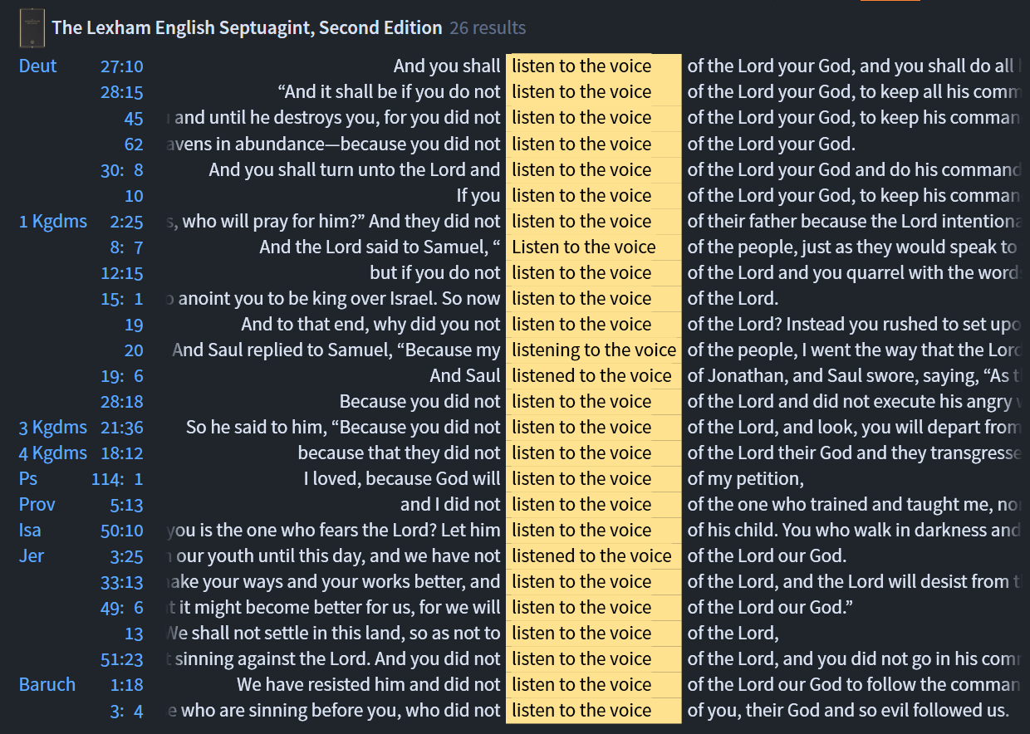
Isaiah / ישעיה
http://www.matsati.com

Slide 9
ספר דברים פרק כז
י וְשָׁמַעְתָּ בְּקוֹל יְהוָֹה אֱלֹהֶיךָ וְעָשִֹיתָ אֶת-מִצְוֹתָו וְאֶת-חֻקָּיו אֲשֶׁר אָנֹכִי מְצַוְּךָ הַיּוֹם:
Devarim / Deuteronomy 27:10
27:10 Thou shalt therefore obey the voice of the LORD thy God, and do his commandments and his statutes, which I command thee this day. (KJV)
﻿ספר דברים פרק כח
טו וְהָיָה אִם-לֹא תִשְׁמַע בְּקוֹל יְהוָֹה אֱלֹהֶיךָ לִשְׁמֹר לַעֲשֹוֹת אֶת-כָּל-מִצְוֹתָיו וְחֻקֹּתָיו אֲשֶׁר אָנֹכִי מְצַוְּךָ הַיּוֹם וּבָאוּ עָלֶיךָ כָּל-הַקְּלָלוֹת הָאֵלֶּה וְהִשִּׂיגוּךָ:
Devarim / Deuteronomy 28:15
28:15 But it shall come to pass, if thou wilt not hearken unto the voice of the Lord thy God, to observe to do all his commandments and his statutes which I command thee this day; that all these curses shall come upon thee, and overtake thee: (KJV)
Isaiah / ישעיה
http://www.matsati.com

Slide 10
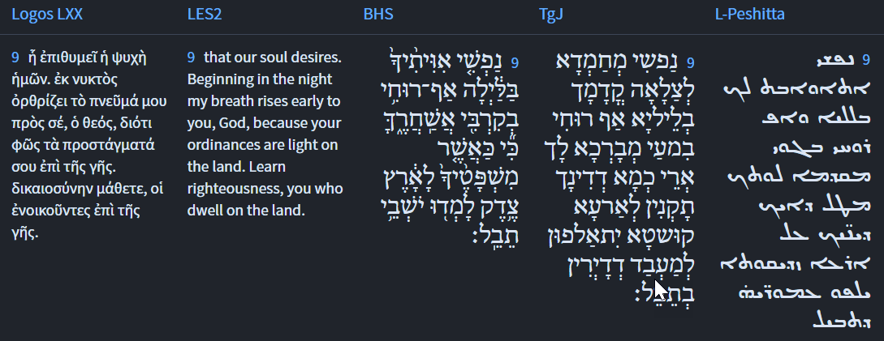
Isaiah 26:9
Isaiah / ישעיה
http://www.matsati.com

Slide 11
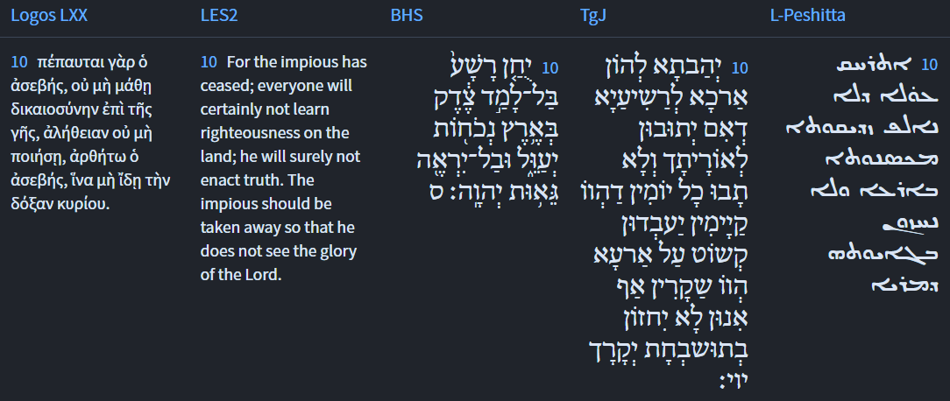
Isaiah 26:10
Isaiah / ישעיה
http://www.matsati.com

Slide 12
ספר תהילים פרק ט
יח יָשׁוּבוּ רְשָׁעִים לִשְׁאוֹלָה כָּל-גּוֹיִם שְׁכֵחֵי אֱלֹהִים:
Tehillim / Psalm 9:17
9:17 The wicked shall be turned into hell, And all the nations that forget God. (KJV)
Isaiah / ישעיה
http://www.matsati.com

Slide 13
ספר דברים פרק ח
ג וַיְעַנְּךָ וַיַּרְעִבֶךָ וַיַּאֲכִלְךָ אֶת-הַמָּן אֲשֶׁר לֹא-יָדַעְתָּ וְלֹא יָדְעוּן אֲבֹתֶיךָ לְמַעַן הוֹדִיעֲךָ כִּי לֹא עַל-הַלֶּחֶם לְבַדּוֹ יִחְיֶה הָאָדָם כִּי עַל-כָּל-מוֹצָא פִי-יְהוָֹה יִחְיֶה הָאָדָם:
יב פֶּן-תֹּאכַל וְשָֹבָעְתָּ וּבָתִּים טֹבִים תִּבְנֶה וְיָשָׁבְתָּ: יג וּבְקָרְךָ וְצֹאנְךָ יִרְבְּיֻן וְכֶסֶף וְזָהָב יִרְבֶּה-לָּךְ וְכֹל אֲשֶׁר-לְךָ יִרְבֶּה: יד וְרָם לְבָבֶךָ וְשָׁכַחְתָּ אֶת-יְהוָֹה אֱלֹהֶיךָ הַמּוֹצִיאֲךָ מֵאֶרֶץ מִצְרַיִם מִבֵּית עֲבָדִים:
Deuteronomy 8:3 and 8:12-14
8:3 And he humbled thee, and suffered thee to hunger, and fed thee with manna, which thou knewest not, neither did thy fathers know; that he might make thee know that man doth not live by bread only, but by every word that proceedeth out of the mouth of the LORD doth man live. (KJV)
8:12 Lest when thou hast eaten and art full, and hast built goodly houses, and dwelt therein; 8:13 And when thy herds and thy flocks multiply, and thy silver and thy gold is multiplied, and all that thou hast is multiplied; 8:14 Then thine heart be lifted up, and thou forget the LORD thy God, which brought thee forth out of the land of Egypt, from the house of bondage; (KJV)
Isaiah / ישעיה
http://www.matsati.com

Slide 14
ספר בראשית פרק יג
טו כִּי אֶת-כָּל-הָאָרֶץ אֲשֶׁר-אַתָּה רֹאֶה לְךָ אֶתְּנֶנָּה וּלְזַרְעֲךָ עַד-עוֹלָם: טז וְשַֹמְתִּי אֶת-זַרְעֲךָ כַּעֲפַר הָאָרֶץ אֲשֶׁר | אִם-יוּכַל אִישׁ לִמְנוֹת אֶת-עֲפַר הָאָרֶץ גַּם-זַרְעֲךָ יִמָּנֶה: יז קוּם הִתְהַלֵּךְ בָּאָרֶץ לְאָרְכָּהּ וּלְרָחְבָּהּ כִּי לְךָ אֶתְּנֶנָּה:
Bereshit / Genesis 13:15-17
13:15 For all the land which thou seest, to thee will I give it, and to thy seed for ever. 13:16 And I will make thy seed as the dust of the earth: so that if a man can number the dust of the earth, then shall thy seed also be numbered. 13:17 Arise, walk through the land in the length of it and in the breadth of it; for I will give it unto thee. (KJV)
Isaiah / ישעיה
http://www.matsati.com

Slide 15
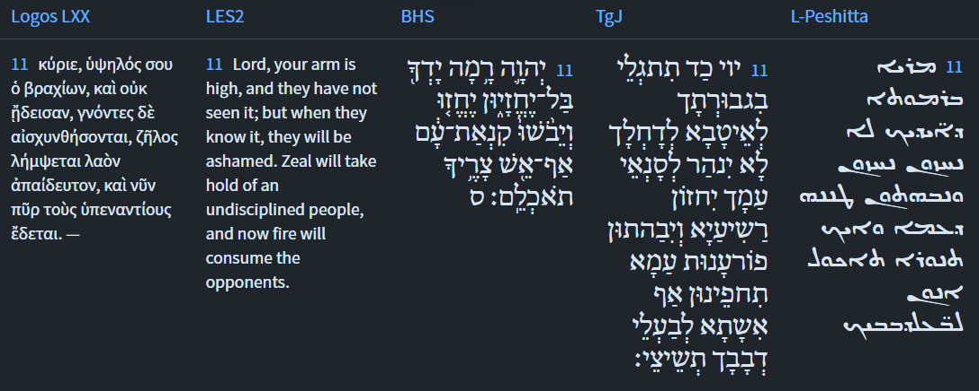
Isaiah 26:11
Isaiah / ישעיה
http://www.matsati.com

Slide 16
1 Peter 3:10-12
10 For he that will love life, and see good days, let him refrain his tongue from evil, and his lips that they speak no guile: 11 Let him eschew evil, and do good; let him seek peace, and ensue it. 12 For the eyes of the Lord are over the righteous, and his ears are open unto their prayers: but the face of the Lord is against them that do evil. (KJV, ܡܰܢ ܕ݁ܨܴܒ݂ܶܐ ܗܳܟ݂ܺܝܠ ܚܰܝܷ̈ܐ ܇ ܘܪܴܚܶܡ ܝܱ̈ܘܡܳܬ݂ܴܐ ܛܴܒ݂ܷ̈ܐ ܠܡܶܚܙܳܐ ܆ ܢܶܛܱܪ ܠܷܫܳܢܶܗ ܡܶܢ ܒܻ݁ܝܫܬܴ݁ܐ ܆ ܘܣܶܦ݂ܘܴ̈ܬ݂ܷܗ ܠܴܐ ܢܡܰܠܠܴܢ̈ ܢܶܟ݂ܠܴܐ ܂ܢܶܥܒܱ݁ܪ ܡܶܢ ܒܻ݁ܝܫܬܴ݁ܐ ܘܢܶܥܒܷ݁ܕ݂ ܛܴܒ݂ܬ݂ܴܐ ܂ ܘܢܶܒ݂ܥܶܐ ܫܠܴܡܳܐ ܘܢܶܪܗܰܛ ܒܴ݁ܬ݂ܪܷܗ ܂ ܡܶܛܾܠ ܕ݁ܥܰܝܢܱ̈ܘܗ̄ܝ ܕ݁ܡܳܪܝܳܐ ܥܰܠ ܙܰܕܻ݁ܝ̈ܩܶܐ ܆ ܘܶܐܕ݂ܢܱ̈ܘܗ̄ܝ ܠܡܶܫܡܰܥ ܐܷܢܽܘܢ ܂ ܘܰܐܦܱ݁ܘܗ̄ܝ̈ ܕ݁ܡܳܪܝܳܐ ܥܰܠ ܒܻ݁ܝ̈ܫܶܐ ܂ 10 ὁ γὰρ θέλων* ζωὴν ἀγαπᾶν καὶ ἰδεῖν ἡμέρας ἀγαθὰς παυσάτω τὴν γλῶσσαν ⸆ ἀπὸ κακοῦ καὶ χείλη ⸇ τοῦ μὴ ⸀λαλῆσαι δόλον,* 11 ἐκκλινάτω °δὲ ἀπὸ κακοῦ καὶ ποιησάτω ἀγαθόν,* ζητησάτω εἰρήνην καὶ διωξάτω αὐτήν· 12 ὅτι ὀφθαλμοὶ κυρίου ἐπὶ δικαίους καὶ ὦτα αὐτοῦ εἰς δέησιν αὐτῶν, πρόσωπον δὲ κυρίου ἐπὶ ποιοῦντας κακά⸆.)
Isaiah / ישעיה
http://www.matsati.com

Slide 17
Rabbinic Literature
ספרות רבנית
Part 2
Isaiah / ישעיה
http://www.matsati.com

Slide 18
Targum Jonathan son of Uziel Isaiah 26:8-14
26:8 Yea, for the way of thy judgment, O Lord, have we hoped; to thy name and to the remembrance of thee is the desire of our soul. 26:9 My soul desires to pray before thee in the night; yea, my spirit within me is blessing thee: when thy judgments are prepared for the earth, those that dwell in the world shall be taught to practice truth. 26:10 Thou hast granted unto the wicked continuance, that verily they should return to the law; but they did not return, all the days that they lived;—that they should practice truth in the earth, but they dealt falsely: yea, they will not regard the praise of thy glory, O Lord! 26:11 O Lord, when thou shalt be revealed in thy power to do good to them that fear thee, there will be no light to the enemies of thy people: the wicked shall see it, and shall be confounded. The vengeance of thy people shall cover them; yea, fire shall consume thy enemies. 26:12 O Lord, thou wilt ordain peace for us: for at all times, when we restrained ourselves from our sins, thou wast working for us. 26:13 O Lord our God, the nations have had dominion over us, being lords over us beside thee; but we trust in thy WORD; we praise thy name. 26:14 They worship idols, who do not live, their heroes, who shall not rise; therefore, when thou shalt visit their sins, thou wilt make an end of them, and make all memorial of them to perish. (TgJ)
Isaiah / ישעיה
http://www.matsati.com

Slide 19
Jude 1:14-15
1:14 And Enoch also, the seventh from Adam, prophesied of these, saying, Behold, the Lord cometh with ten thousands of his saints, 1:15 to execute judgment upon all, and to convince all that are ungodly among them of all their ungodly deeds which they have ungodly committed, and of all their hard speeches which ungodly sinners have spoken against him. (KJV, ܐܷܬ݂ܢܰܒܻ݁ܝ ܕܷ݁ܝܢ ܐܴܦ݂ ܠܗܳܠܷܝܢ ܆ ܗܰܘ ܕܻ݁ܐܝܬ݂ܱܘܗ̄ܝ ܕ݁ܫܰܒ݂ܥܳܐ ܡܶܢ ܐܴܕ݂ܳܡ ܁ ܚܢܽܘܟ݂ ܟܱ݁ܕ݂ ܐܴܡܰܪ ܆ ܕ݁ܗܳܐ ܡܳܪܝܳܐ ܐܴܬ݂ܷܐ ܒ݁ܪܷ̈ܒ݁ܘܳܬ݂ܴܐ ܕ݁ܩܰܕܻ݁ܝ̈ܫܶܐ ܆ܕ݁ܢܶܥܒܷ݁ܕ݂ ܕܻ݁ܝܢܳܐ ܥܰܠ ܟܾ݁ܠ ܆ ܘܰܠܡܰܟܴ݁ܣܽܘ ܠܟ݂ܽܠ ܢܱ̈ܦ݂ܫܳܬ݂ܴܐ ܇ ܡܶܛܾܠ ܟܾ݁ܠܗܽܘܢ ܥܒ݂ܴ̈ܕ݂ܶܐ ܐܱܝܠܷܝܢ ܕܱ݁ܐܪܫܥܘ ܇ ܘܡܶܛܾܠ ܟܾ݁ܠܗܶܝܢ ܡܷ̈ܠܷܐ ܩܰܫܝܴ̈ܬ݂ܴܐ ܁ ܐܱܝܠܷܝܢ ܕ݁ܡܰܠܷܠܘ ܂ ܚܰܛܴܝܷ̈ܐ ܪܱ̈ܫܺܝܥܶܐ ܂ 14 Προεφήτευσεν δὲ καὶ τούτοις ἕβδομος ἀπὸ Ἀδὰμ Ἑνὼχ λέγων·* ἰδοὺ ἦλθεν κύριος ἐν ⸂ἁγίαις μυριάσιν αὐτοῦ⸃ 15 ποιῆσαι κρίσιν κατὰ πάντων καὶ ἐλέγξαι ⸂πᾶσαν ψυχὴν⸃ περὶ πάντων ⸋τῶν ἔργων ⸄ἀσεβείας αὐτῶν⸅ ὧν ἠσέβησαν καὶ περὶ πάντων⸌ τῶν σκληρῶν ⸆ ὧν ἐλάλησαν κατʼ* αὐτοῦ ἁμαρτωλοὶ ἀσεβεῖς.*)
Isaiah / ישעיה
http://www.matsati.com

Slide 20
ספר בראשית פרק ד
ז הֲלוֹא אִם-תֵּיטִיב שְֹאֵת וְאִם לֹא תֵיטִיב לַפֶּתַח חַטָּאת רֹבֵץ וְאֵלֶיךָ תְּשׁוּקָתוֹ וְאַתָּה תִּמְשָׁל-בּוֹ:
Bereshit / Genesis 4:7
4:7 If thou doest well, shalt thou not be accepted? and if thou doest not well, sin lieth at the door. And unto thee shall be his desire, and thou shalt rule over him. (KJV)
Isaiah / ישעיה
http://www.matsati.com

Slide 21
1 Corinthians 9:25–27
9:25 And every man that striveth for the mastery is temperate in all things. Now they do it to obtain a corruptible crown; but we an incorruptible. 9:26 I therefore so run, not as uncertainly; so fight I, not as one that beateth the air: 9:27 But I keep under my body, and bring it into subjection: lest that by any means, when I have preached to others, I myself should be a castaway. (KJV, ܟܾ݁ܠ ܐ̱ܢܳܫ ܕܷ݁ܝܢ ܕܱ݁ܐܓ݂ܽܘܢܳܐ ܥܳܒ݂ܶܕ݂ ܆ ܡܶܢ ܟܾ݁ܠ ܡܶܕܷ݁ܡ ܐܴܚܶܕ݂ ܪܷܥܝܳܢܶܗ ܂ ܘܗܳܠܷܝܢ ܪܴܗܛܻܝܢ ܕ݁ܢܶܣܒ݂ܽܘܢ ܟ݁ܠܻܝܠܴܐ ܕ݁ܡܶܬ݂ܚܰܒܱ݁ܠ ܆ ܚܢܰܢ ܕܷ݁ܝܢ ܕ݁ܠܴܐ ܡܶܬ݂ܚܰܒܱ݁ܠ ܂ܐܷܢܳܐ ܗܳܟ݂ܺܝܠ ܗܳܟ݂ܰܢܳܐ ܪܴܗܶܛ ܐ̱ܢܳܐ ܂ ܠܴܐ ܗ̄ܘܳܐ ܐܱܝܟ݂ ܕ݁ܥܰܠ ܡܶܕܷ݁ܡ ܕ݁ܠܴܐ ܝܺܕ݂ܺܝܥ ܂ ܘܗܳܟ݂ܰܢܳܐ ܡܶܬ݂ܟܱ݁ܬܱ݁ܫ ܐ̱ܢܳܐ ܂ ܠܴܐ ܐܱܝܟ݂ ܗܰܘ ܕ݁ܠܴܐܐܱܪ ܟܴ݁ܬ݂ܷܫ ܂ ܐܷܠܴܐ ܦܱ݁ܓ݂ܪܝ ܗ̄ܽܘ ܟܴ݁ܒ݂ܶܫ ܐ̱ܢܳܐ ܘܰܡܫܰܥܒܷ݁ܕ݂ ܐ̱ܢܳܐ ܆ ܕ݁ܕ݂ܰܠܡܳܐ ܐ̱ܢܳܐ ܕ݁ܠܱܐ̱ܚܪܴ̈ܢܶܐ ܐܱܟ݂ܪܙܶܬ݂ ܇ ܐܷܢܳܐ ܩܢܽܘܡܝ ܐܷܣܬ݁ܠܷܐ ܠܻܝ ܁܀܁܀܁ 25 πᾶς δὲ ὁ ἀγωνιζόμενος πάντα ἐγκρατεύεται, ἐκεῖνοι μὲν °οὖν ἵνα φθαρτὸν στέφανον λάβωσιν, ἡμεῖς δὲ ἄφθαρτον. 26 ἐγὼ τοίνυν οὕτως τρέχω ὡς οὐκ ἀδήλως, οὕτως πυκτεύω ὡς οὐκ ἀέρα δέρων·* 27 ἀλλʼ ὑπωπιάζω μου τὸ σῶμα καὶ δουλαγωγῶ, μή πως ἄλλοις κηρύξας αὐτὸς ἀδόκιμος γένωμαι.*)
Isaiah / ישעיה
http://www.matsati.com

Slide 22
Ibn Ezra on Isaiah 26,8 Part 1
אף וגו'. אלה דברי צדיקים שיקוו השם ל הראות משפטו בעולם כי הנפש מתאוה לשמך, ויחסר אות למ"ד כאילו אמר לאורח משפטיך:
We waited for thee, O Lord, even for the way of Thy judgment,7A. V., In the way of thy judgment. etc. These are the words of the righteous that hope in the Lord, that He will show His judgment in the universe; for the soul is longing for Thy name. Before ארח path supply the preposition ל for.
Isaiah / ישעיה
http://www.matsati.com

Slide 23
Talmud Bavli Megillah 6a:18
וְאָמַר רַבִּי יִצְחָק, מַאי דִּכְתִיב: ״יוּחַן רָשָׁע בַּל לָמַד צֶדֶק״. אָמַר יִצְחָק לִפְנֵי הַקָּדוֹשׁ בָּרוּךְ הוּא: רִבּוֹנוֹ שֶׁל עוֹלָם, יוּחַן עֵשָׂו. אָמַר לוֹ: רָשָׁע הוּא! אָמַר לוֹ: ״בַּל לָמַד צֶדֶק״. אָמַר לוֹ: ״בְּאֶרֶץ נְכוֹחוֹת יְעַוֵּל״. אָמַר לוֹ: אִם כֵּן, ״בַּל יִרְאֶה גֵּאוּת ה׳״.
§ Having mentioned Edom, the Gemara cites what Rabbi Yitzḥak said: What is the meaning of that which is written: “Let favor be shown to the wicked, yet will he not learn righteousness; in the land of uprightness he will deal wrongfully, and will not behold the majesty of the Lord” (Isaiah 26:10)? Isaac said before the Holy One, Blessed be He: Master of the Universe, let favor be shown to Esau, my beloved son. God said to him: Esau is wicked. Isaac said to God: “Yet will he not learn righteousness,” i.e., is there no one who can find merit in him? God said to him: “In the land of uprightness he will deal wrongfully,” meaning that he is destined to destroy Eretz Yisrael. Isaac said to God: If it is so that he is that wicked, “he will not behold the majesty of the Lord.”
Isaiah / ישעיה
http://www.matsati.com

Slide 24
Rashi on Isaiah 26,10 Part 1-3
יוחן רשע בל למד צדק. וכי יש לך לחון את עשו הרשע אשר דר בין שני צדיקים ולא למד צדק: Shall the wicked be favored who did not learn righteousness Should you favor the wicked Esau, who lived between two righteous men and did not learn righteousness?
בארץ נכוחות. ירושלים ובית המקדש יעול לשלול ולבוז ולהשחית: in the land of uprightness Jerusalem and the Temple, he will deal unjustly, to pillage and spoil and to destroy.
ובל יראה גאות ה'. לא חשב בעיניו גדלך וגאותך ובל יראה ל' רגילות ותמידות לא ראה לא חשב כמו ככה יעשה איוב (איוב א׳:ה׳): and he does not see the pride of the Lord He did not regard Your pride and greatness. The expression, וּבַל יִרְאֶה, ( lit., he shall not see,) is an expression of a habitual act, meaning: he did not see, he did not regard. Comp. (Job 1:5) “In this manner, Job was wont to do (יַעֲשֶׂה).”
Isaiah / ישעיה
http://www.matsati.com

Slide 25
Rashi on Isaiah 26,13 Part 1-3
בעלונו. נעשו לנו אדונים ונגשונו: have possessed us They have become our masters and have oppressed us.
זולתך. בדבר שלא כרצונך דרוש לאלהים אחרים לעבור על תורתך ואנחנו לבד בך הזכרנו ולא נזכיר שם אלהותו באל אחר אלא בו לבדו: other than You In a matter contrary to Your will, to seek other gods, to transgress Your Torah, but we - only concerning You have we mentioned Godliness, and we will not ascribe the name of His Godliness to another god, only to Him alone.
שמך. שם אלהותך נזכיר לאמר כי אלהינו לבד הוא אלהים: Your name The name of Your Godliness we will mention, saying that our God alone is God.
Isaiah / ישעיה
http://www.matsati.com

Slide 26
Possible Conversation Scenario with a Cannanite:
By Rabbi Jeremiah
Israeli #1: Hey do you worship El too?
Canaanite #1: yes, he is the ‘god over all other gods’ Come worship him together with us
Israeli #1: ‘Cool! Let’s go!’
End scene.
Isaiah / ישעיה
http://www.matsati.com

Slide 27
Ein Yaakov (Glick Edition), Ketubot 13:16
R. Elazar said: "Ignorants will not enjoy the resurrection,” as it is said (Is. 26, 14) “The dead will not live again; the departed will not rise again." We have also a Baritha to the same effect: The dead live not. One might think that this refers to everyone. Scripture therefore says, the departed will not rise again; i.e., only to him who weakened himself (departed) from studying the Torah refers the passage. R. Jochanan then said to R. Elazar: "Your interpretation is not acceptable, since the passage speaks concerning one who weakens himself for the purpose of serving idols." "I have another passage which supports my explanations, came the answer, (Ib., ib., 19) For Thy dew is as dew of light, and the earth shall bring to life the departed, which means that whoever makes use of the light of (studies) the Torah, the Torah will cause his revival; but whoever does not make use of (study) the Torah, the Torah in return will not cause his revival." Noticing this, R. Jochanan felt discouraged over the severity of the above interpretation. R. Elazar said to him: "I found for them a remedy hinted in the Scripture (Deut. 4, 4) But ye that did cleave unto the Lord your God, are alive, every one of you this day. How is it possible to cleave unto Shechina, since it is written (lb. ib. 24) For the Lord thy God is a consuming fire? We must therefore say that whoever marries his daughter to a scholar, whoever does business in partnership with a scholar, or whoever benefits a scholar by his estate. Scripture considers him as if he did cleave unto Schechina." Similar to this we find the following (Ib. 30, 20) To love the Lord, thy God, etc., and to cleave unto Him. How is it possible to cleave unto Shechina? We must therefore say that whoever marries his daughter to a scholar, whoever does business in partnership with a scholar, or whoever benefits a scholar by his estate. Scripture considers him as if he did cleave unto Shechina.
Isaiah / ישעיה
http://www.matsati.com

Slide 28
Rashi on Isaiah 26,14 Part 1-2
מתים בל יחיו. יהי רצון מלפניך שלא יחיו הרשעים האלה לעולם הבא, והרפאים האלה שריפו ידיהם ממצותיך בל תהיה להם תקומה: The dead shall not live May it be Your will that these wicked men shall not live in the World to Come, and that these slackers who slackened their hands from Your commandments shall not have restoration.
לכן פקדת ותשמידם. הלא פקד' עליהם כבר ותשמיד' באמרי פיך כענין שנאמר כי מחה אמחה את זכר עמלק (שמות י״ז:י״ד): therefore, You visited [upon them] and You destroyed them Have You not already visited upon them and destroyed them with the words of Your mouth, like the matter that is stated (Exodus 17:14): “For I will surely erase the memory of Amalek.”
Isaiah / ישעיה
http://www.matsati.com

