Slide 1
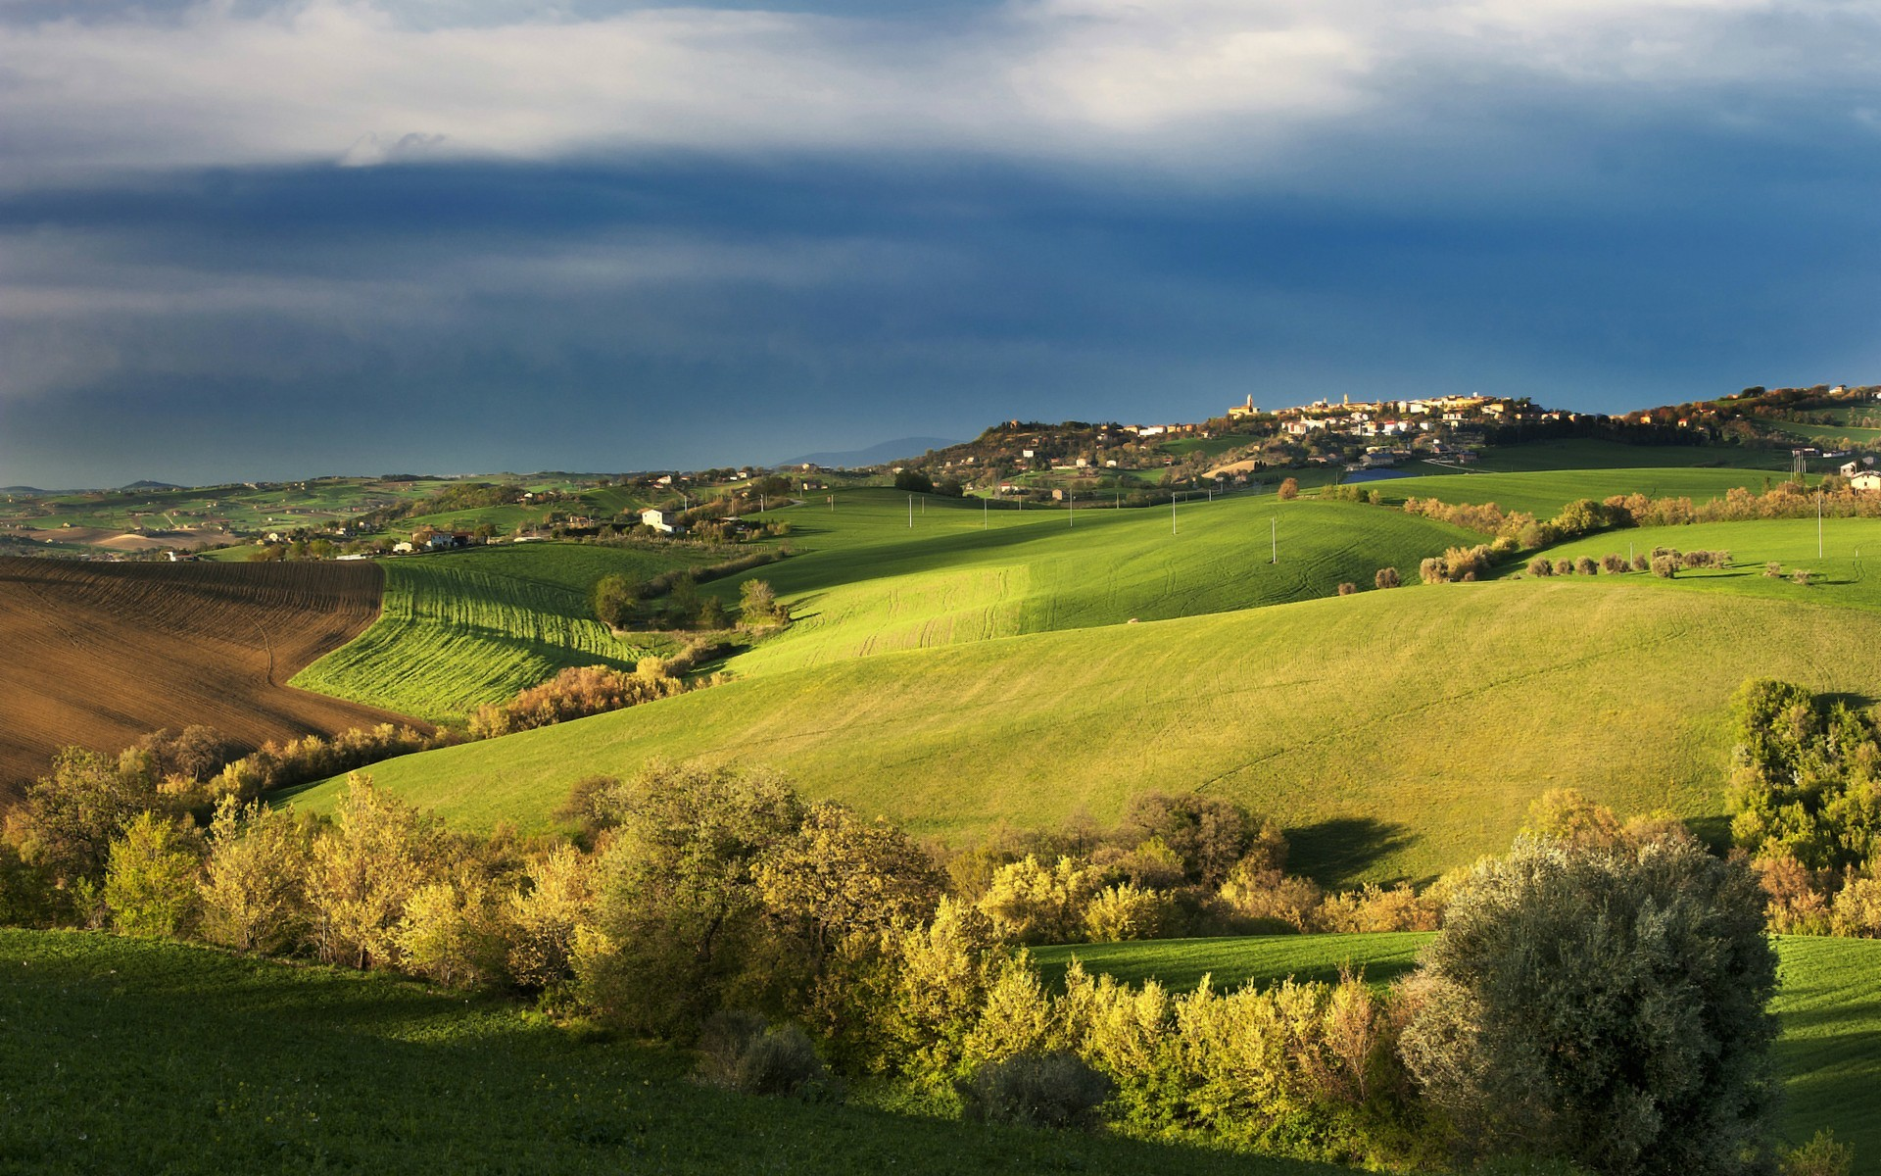

MATSATI.COM Teaching Ministry
Website: https://www.matsati.com YouTube Channel: https://www.youtube.com/user/MATSATI/
ישעיהו כו:טו-כא / Isaiah 26:15-21
LIVE STREAM: 6:30 pm EST Thursday
Join us at Telegram:
https://t.me/MessianicChat
Foundation of the Word Outreach Ministry
https://www.thefoundationoftheword.org
A Community
for Learning
Weekly Teachings Free Online
Check Telegram for weekly scheduling of teachings.
Discuss the Scriptures,
learn the languages,
and fellowship
YouTube Channel
https://www.youtube.com/c/TheFoundationofTheWordOutreachMinistries
Join Telegram ask about Hebrew and Greek classes!
Rabbi Jeremiah
– The Apocalypse: connecting the Greek to the Ancient Hebrew text. (Wed. 9 am EST)
YouTube Channels
https://YouTube.com/c/HebrewLiteracy
https://www.youtube.com/channel/UC5_qPfruat-sCJJypz0_OBw

Slide 2

Isaiah 26:15-21
ישעיהו כו:טו-כא
Isaiah / ישעיה
http://www.matsati.com

Slide 3







ספר ויקרא פרק כו
ו וְנָתַתִּי שָׁלוֹם בָּאָרֶץ וּשְׁכַבְתֶּם וְאֵין מַחֲרִיד וְהִשְׁבַּתִּי חַיָּה רָעָה מִן-הָאָרֶץ וְחֶרֶב לֹא-תַעֲבֹר בְּאַרְצְכֶם: ז וּרְדַפְתֶּם אֶת-אֹיְבֵיכֶם וְנָפְלוּ לִפְנֵיכֶם לֶחָרֶב: ח וְרָדְפוּ מִכֶּם חֲמִשָּׁה מֵאָה וּמֵאָה מִכֶּם רְבָבָה יִרְדֹּפוּ וְנָפְלוּ אֹיְבֵיכֶם לִפְנֵיכֶם לֶחָרֶב: ט וּפָנִיתִי אֲלֵיכֶם וְהִפְרֵיתִי אֶתְכֶם וְהִרְבֵּיתִי אֶתְכֶם וַהֲקִימֹתִי אֶת-בְּרִיתִי אִתְּכֶם:
Vayikra / Leviticus 26:6-8
6 “ ‘I will grant peace in the land, and you will lie down, and no one will make you afraid. I will remove wild beasts from the land, and the sword will not pass through your country. 7 You will pursue your enemies, and they will fall by the sword before you. 8 Five of you will chase a hundred, and a hundred of you will chase ten thousand, and your enemies will fall by the sword before you. 9 “ ‘I will look on you with favor and make you fruitful and increase your numbers, and I will keep my covenant with you. (NIV)
Isaiah / ישעיה
http://www.matsati.com

Slide 4
פרשת בחקותי
ג אִם-בְּחֻקֹּתַי תֵּלֵכוּ וְאֶת-מִצְוֹתַי תִּשְׁמְרוּ וַעֲשִֹיתֶם אֹתָם
Modeh Ani - מוֹדֶה אֲנִי
מוֹדֶה אֲנִי לְפָנֶֽיךָ מֶֽלֶךְ חַי וְקַיָּים. שֶׁהֶֽחֱזַֽרְתָּ בִּי נִשְׁמָתִי ,בְּחֶמְלָה. רַבָּה אֱמֽוּנָתֶֽךָ׃
I thank before you, living and enduring king, for You have graciously returned my soul within me. Great is your faithfulness.
Isaiah / ישעיה
http://www.matsati.com

Slide 5


















﻿ספר ישעיה פרק כו
﻿טו יָסַפְתָּ לַגּוֹי יְהֹוָה יָסַפְתָּ לַגּוֹי נִכְבָּדְתָּ רִחַקְתָּ כָּל-קַצְוֵי-אָרֶץ: טז יְהֹוָה בַּצַּר פְּקָדוּךָ צָקוּן לַחַשׁ מוּסָרְךָ לָמוֹ: יז כְּמוֹ הָרָה תַּקְרִיב לָלֶדֶת תָּחִיל תִּזְעַק בַּחֲבָלֶיהָ כֵּן הָיִינוּ מִפָּנֶיךָ יְהֹוָה: יח הָרִינוּ חַלְנוּ כְּמוֹ יָלַדְנוּ רוּחַ יְשׁוּעֹת בַּל-נַעֲשֶֹה אֶרֶץ וּבַל-יִפְּלוּ יֹשְׁבֵי תֵבֵל: יט יִחְיוּ מֵתֶיךָ נְבֵלָתִי יְקוּמוּן הָקִיצוּ וְרַנְּנוּ שֹׁכְנֵי עָפָר כִּי טַל אוֹרֹת טַלֶּךָ וָאָרֶץ רְפָאִים תַּפִּיל: כ לֵךְ עַמִּי בֹּא בַחֲדָרֶיךָ וּסְגֹר דְּלָתְיךָ [דְּלָתְךָ] בַּעֲדֶךָ חֲבִי כִמְעַט-רֶגַע עַד-יַעֲבָור- [יַעֲבָר] -זָעַם: כא כִּי-הִנֵּה יְהֹוָה יֹצֵא מִמְּקוֹמוֹ לִפְקֹד עֲוֹן ישֵׁב-הָאָרֶץ עָלָיו וְגִלְּתָה הָאָרֶץ אֶת-דָּמֶיהָ וְלֹא-תְכַסֶּה עוֹד עַל-הֲרוּגֶיהָ:
Isaiah / ישעיה
http://www.matsati.com

Slide 6




ספר ישעיה פרק לג
יז מֶלֶךְ בְּיָפְיוֹ תֶּחֱזֶינָה עֵינֶיךָ תִּרְאֶינָה אֶרֶץ מַרְחַקִּים:
Isaiah 33:17
17 Thine eyes shall see the king in his beauty: They shall behold the land that is very far off. (KJV)
Isaiah / ישעיה
http://www.matsati.com

Slide 7

DSS - 4Q504 Frags. 1–2 v:15-16
15 [כי]א יצקתה את רוח קודשכה עלינו 16 [לה]ביא ברכותיכה לנו ל{מ}פקודכה בצר לנו | 15 [Fo]r you have poured your holy spirit upon us, 16 [to be]stow your blessings to us, so that we would look for you in our anguish,
Isaiah / ישעיה
http://www.matsati.com

Slide 8
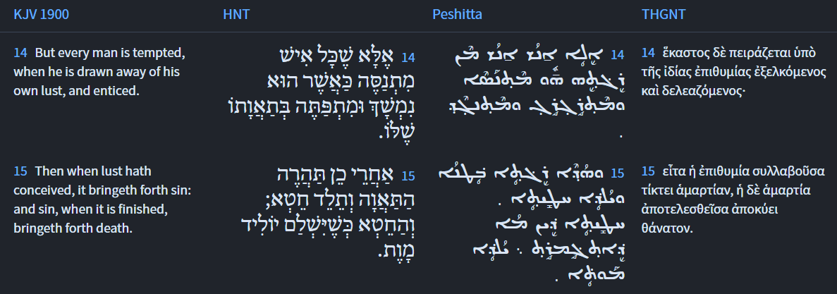
James 1:14-15
Isaiah / ישעיה
http://www.matsati.com

Slide 9
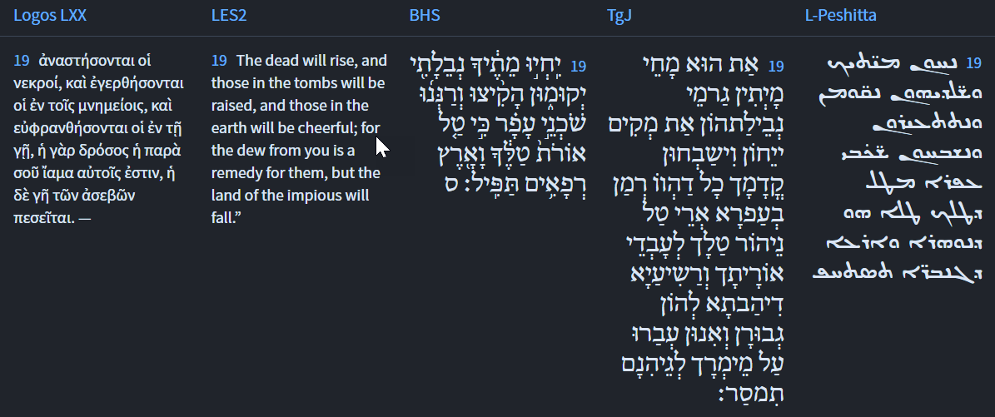




Isaiah 26:19
Isaiah / ישעיה
http://www.matsati.com

Slide 10

ספר בראשית פרק ד
י וַיֹּאמֶר מֶה עָשִֹיתָ קוֹל דְּמֵי אָחִיךָ צֹעֲקִים אֵלַי מִן-הָאֲדָמָה:
Bereshit / Genesis 4:10
And He said, “What have you done? The voice of your brother’s blood cries out to Me from the ground.” (KJV)
Isaiah / ישעיה
http://www.matsati.com

Slide 11
Rabbinic Literature
ספרות רבנית
Part 2
Isaiah / ישעיה
http://www.matsati.com

Slide 12
Targum Jonathan son of Uziel Isaiah 26:15-21
26:15 Thou shalt reveal thyself to gather the dispersed of thy people, thou wilt bring together their captivity. Thou wilt reveal thyself in thy power to cast all the wicked into hell. 26:16 O Lord, in distress they remembered thy fear: in their trouble they were ardently learning the doctrine of thy law. 26:17 Like as a woman with child, who draweth near the time of her delivery, trembleth, and crieth out in her pangs, so have we been, because we have sinned before thee. 26:18 Distress swift as the wind hath seized us, like a woman with child, who draweth near the time of her delivery; the inhabitants of the world have not brought deliverance: they have not tilled the earth, neither have they been able to perform any miracles. 26:19 Thou art he who dost quicken the dead, the bones of their dead bodies thou dost raise up. They shall live, and offer praise before thee, all that were cast into the dust, because thy dew is the dew of light to them who do thy law; but thou wilt deliver the wicked into hell, to whom thou hast given power, for they have transgressed against thy WORD. 26:20 Come, O my people; produce for thyself good works, which shall protect thee in the time of distress: hide thyself as it were for a little moment, until the curse shall have passed away. 26:21 For, behold, the Lord is revealing himself from the place of his Shekinah, to punish the inhabitants of the earth for their sins; and the earth shall disclose the innocent blood that was shed in her, and shall no more cover her slain. (TgJ)
Isaiah / ישעיה
http://www.matsati.com

Slide 13
The IVP Bible Background Commentary: Old Testament
“There are several different concepts of afterlife that are evidenced in the ancient Near East. The most fundamental concept is continued existence in a gravelike netherworld where there is no differentiation in the treatment of the righteous and wicked. The Israelites called this place Sheol (see comments on Is 14:9), and they believed that it allowed for no interaction with God. In Canaan and Mesopotamia netherworld deities governed this realm. In Egypt the netherworld existence is more congenial for those who pass the judgment and enter its confines. Those who are not approved are devoured. None of these concepts include the idea of resurrection out of the netherworld. In general, in the ancient worldview the only awakening that took place was the calling up of spirits of the dead (which was not permanent and not a bodily presence) or the awakening of the fertility gods of nature cycles. These died annually when the agricultural cycle came to an end and “wintered” in the netherworld. Then they were ritually awakened in the spring. None of this bears any resemblance to a theological doctrine of resurrection. Likewise, not comparable are the occasional revivifications (when an individual is restored to life) or the indications of national return to life (Ezekiel’s dry bones). A fully developed doctrine of resurrection in the modern sense includes six elements: (1) it is individual, not national; (2) it is material, not spiritual; (3) it is universal, not isolated; (4) it takes place outside the netherworld; (5) it leads to permanent immortality; and (6) it involves distinctions between the righteous and the wicked. Zoroastrianism appears to have all of these elements, but the nature of the sources makes it difficult to determine how early the Persians developed these concepts.”
Isaiah / ישעיה
http://www.matsati.com

Slide 14
Shir HaShirim Rabbah 2,1 Part 3
The Rabbis say: The congregation of Israel said it. The congregation of Israel said: I am as I am, yet I am beloved. I am situated in the depths of Gehenna, but when the Holy One blessed be He will rescue me from its depths—that is what is written: “He raised me from the pit of destruction” (Psalms 40:3)—I will blossom good deeds and sing songs before Him. That is what is written: “He placed a new song in my mouth” (Psalms 40:4). The opinion of the Rabbis corresponds with what Rabbi Elazar HaModa’i said: The princes of the nations are destined in the future to come to denounce Israel before the Holy One blessed be He, and say: ‘These engaged in idol worship and those engaged in idol worship, these engaged in forbidden sexual relations and those engaged in forbidden sexual relations, these shed blood and those shed blood; why are these descending to Gehenna and those are not descending?’9Why are the gentiles descending to Gehenna while the Jews are not? The Holy One blessed be He responds to them and says: ‘If that is so, all the peoples will descend with their gods to Gehenna.’ That is what is written: “For all the peoples will walk, each in the name of its god, [but we will walk in the name of the Lord our God forever and ever]” (Micah 4:5). Rabbi Reuven said: Had this matter not been written, it would have been impossible to say it: As it were, “for the Lord will judge [nishpat]10This is the reflexive [nifal] conjugation, indicating, as it were, that God will be judged. in fire” (Isaiah 66:16). Shofet11This conjugation is the standard way of expressing that God will judge. is not written here, but rather nishpat. This is what David said, inspired by the Divine Spirit: “Even if I were to walk through the valley of the shadow of death, I will fear no evil, for You are with me [your rod and your staff they will comfort me]” (Psalms 23:4). Another matter, “your rod,” this is the suffering, “and your staff,” this is Torah. “They will comfort me…” Is it perhaps without suffering? The verse states: “Only [Akh].”12The term akh is always understood to be a restrictive term. Here, it indicates that not everyone will merit Torah, and therefore goodness and kindness, as in the continuation of the verse; only those who have experienced suffering will experience these blessings. Is it perhaps in this world? The verse states: “May only [akh] goodness and kindness pursue me all the days of my life, and I will dwell in the House of the Lord forever [le’orekh yamim]” (Psalms 23:6).13Le’orekh yamim is expounded to mean a world where the day is infinitely long [yom shekulo arokh]. Thus, the goodness and kindness will be experienced in the World to Come.
Isaiah / ישעיה
http://www.matsati.com

Slide 15
Shev Shmat'ta, Introduction 20
(Peh) A man shall give redemption for his soul by doing good to the good – which are the Torah scholars – when he benefits them with his property. As through this, he merits to give life to his soul at the time that ‘corpses will arise.’ It is like the statement of [the Sages], may their memory be blessed [in the] chapter [entitled] HaNoseh (Ketuvot 111b): Rabbi Elazar said, “The common, uneducated people (amei ha-arets) will not live [in the future to come].” Rabbi Yocḥanan said to him, “Their master, (i.e. God), is not pleased that you say this about them.” He said to him, ‘I expound it from a […] verse […] (Isaiah 26:19), ‘For Your dew is as the dew of light, etc.’” When he saw that [Rabbi Yocḥanan] was grieved, he said to him, “My teacher, I have found a remedy for them from the Torah, ‘But You who cleave to the Lord [your God, are alive every one of you this day]’ (Deut. 4:4). But is it possible to cleave to the Divine Presence? Isn’t it written, ‘For the Lord your God is a devouring fire’ (Deut. 4:24)? Rather, [it teaches] that anyone […] who conducts business on behalf of Torah scholars, and one who benefits Torah scholars with his property, [it is] as though he is cleaving to the Divine Presence, [and it is written, ‘are alive every one of you this day’].” [See there.] Behold that the revival of the dead is [dependent] only upon the dew of Torah – only one who [utilizes his wealth to] benefit Torah scholars has their dew, like the matter of Zevulun and Yissachar.55See Bamidbar Rabbah 13:17 which speaks about such an arrangement between these two tribes. And this is the intention of their statement, may their memory be blessed, in the chapter [entitled] Chelek (Sanhedrin 90a), “These are the ones that do not have a share in the world to come: One who says that the revival of the dead is not from the Torah.”56The traditional meaning of this – as understood in the Talmud – is that he denies that there is a source in the Torah for the revival of the dead. And they say [further on the same page] in the Talmud, “He denied the revival of the dead; therefore, he has no resurrection.” Its explanation is that even though he agrees with the principle of resurrection, he says that it is not caused by Torah and [so] denies its cause – [such a one] has no resurrection. [This is] since there is no cause for it besides Torah – his or that of others who benefit from him. And since he denies this, it will not resurrect him. Indeed, every man should believe that this is the essence of the resurrection; and then he will merit to arise with ‘the sleepers of Chevron,’57This is referring to the patriarchs and matriarchs buried in Chevron. and rejoice in the joy of Zion, may it be built and established speedily in our days!
Isaiah / ישעיה
http://www.matsati.com

Slide 16
Talmud Bavli Ketubot 111a:17
Rabbi Abba bar Memel raised an objection from a different verse: “Your dead shall live; my dead bodies shall arise” (Isaiah 26:19). What, is it not the case that the phrase “Your dead shall live” is referring to the dead of Eretz Yisrael, whereas the subsequent phrase “My dead bodies shall arise” is referring to the dead of the lands outside of Eretz Yisrael? And if so, what is the meaning of the verse “And I will set glory [tzvi] in the land of the living”? This verse is written with regard to Nebuchadnezzar, as the Merciful One states: I will bring upon you a king who is as swift as a deer [tzvi].
Isaiah / ישעיה
http://www.matsati.com

Slide 17
Ephesians 2:6-10
2:6 And hath raised us up together and made us sit together in heavenly places in Christ Jesus: 7 That in the ages to come he might shew the exceeding riches of his grace in his kindness toward us through Christ Jesus. 2:8 For by grace are ye saved through faith; and that not of yourselves: it is the gift of God: 2:9 Not of works, lest any man should boast. 2:10 For we are his workmanship, created in Christ Jesus unto good works, which God hath before ordained that we should walk in them. (KJV, ܘܰܐܩܺܝܡܰܢ ܥܰܡܶܗ ܂ ܘܰܐܘܬ݁ܒ݂ܰܢ ܥܰܡܶܗ ܒܱ݁ܫܡܰܝܳܐ ܂ ܒ݁ܝܶܫܽܘܥ ܡܫܺܝܚܳܐ ܆ܕܱ݁ܢܚܰܘܶܐ ܠܥܳܠܡܷ̈ܐ ܕܴ݁ܐܬ݂ܷܝܢ ܂ ܪܱܒܾ݁ܘܬ݂ܴܐ ܕ݁ܥܽܘܬ݂ܪܴܐ ܕ݁ܛܱܝܒܾ݁ܘܬ݂ܷܗ ܇ ܘܒ݂ܰܣܺܝܡܽܘܬ݂ܷܗ ܕܱ݁ܗܘܳܬ݂ ܥܠܱܝܢ ܒ݁ܝܶܫܽܘܥ ܡܫܺܝܚܳܐ ܂ ܒ݁ܛܱܝܒܾ݁ܘܬ݂ܷܗ ܗ̄ܽܘ ܓܷ݁ܝܪ ܐܷܬ݂ܦ݁ܪܷܩܢ ܂ ܒ݁ܗܰܝܡܳܢܽܘܬ݂ܴܐ ܂ ܘܗܳܕ݂ܶܐ ܠܴܐ ܗ̄ܘܳܬ݂ ܡܶܢܟ݂ܽܘܢ ܆ ܐܷܠܴܐ ܡܰܘܗܰܒ݂ܬܴ݁ܐ ܗ̄ܝ ܕܱ݁ܐܠܴܗܳܐ ܂ ܠܴܐ ܡܶܢ ܥܒ݂ܴ̈ܕ݂ܶܐ ܆ ܕ݁ܠܴܐ ܐ̱ܢܳܫ ܢܶܫܬܱ݁ܒ݂ܗܰܪ ܂ ܒ݁ܪܻܝܬ݂ܴܐ ܚܢܰܢ ܓܷ݁ܝܪ ܕܻ݁ܝܠܷܗ ܆ ܕܷ݁ܐܬ݂ܒ݁ܪܻܝܢ ܒ݁ܝܶܫܽܘܥ ܡܫܺܝܚܳܐ ܠܱܥܒ݂ܴ̈ܕ݂ܶܐ ܛܴܒ݂ܷ̈ܐ ܇ ܗܳܢܽܘܢ ܕ݁ܡܶܢ ܩܕ݂ܺܝܡ ܛܱܝܶܒ݂ ܐܱܠܴܗܳܐ ܕܱ݁ܒ݂ܗܽܘܢ ܢܗܰܠܷܟ݂ ܀ 6 καὶ συνήγειρεν καὶ συνεκάθισεν ἐν τοῖς ἐπουρανίοις ἐν Χριστῷ Ἰησοῦ,* 7 ἵνα ἐνδείξηται ἐν τοῖς αἰῶσιν τοῖς ἐπερχομένοις ⸂τὸ ὑπερβάλλον πλοῦτος⸃ τῆς χάριτος αὐτοῦ ἐν χρηστότητι ἐφʼ* ἡμᾶς ἐν Χριστῷ* Ἰησοῦ.* 8 Τῇ γὰρ χάριτί ἐστε σεσῳσμένοι διὰ ⸆ πίστεως· καὶ τοῦτο οὐκ ἐξ ὑμῶν,* θεοῦ τὸ δῶρον· 9 οὐκ ἐξ ἔργων, ἵνα μή τις καυχήσηται.* 10 αὐτοῦ γάρ ἐσμεν ποίημα, κτισθέντες ἐν Χριστῷ Ἰησοῦ ἐπὶ ἔργοις ἀγαθοῖς οἷς προητοίμασεν ὁ θεός,* ἵνα ἐν αὐτοῖς περιπατήσωμεν.)
Isaiah / ישעיה
http://www.matsati.com

