Slide 1
MATSATI.COM Teaching Ministry
Website: https://www.matsati.com YouTube Channel: https://www.youtube.com/user/MATSATI/
ישעיהו כה:א-ו / Isaiah 25:1-6
LIVE STREAM: 6:30 pm EST Thursday
Join us at Telegram:
https://t.me/MessianicChat
Foundation of the Word Outreach Ministry
https://www.thefoundationoftheword.org
A Community
for Learning
Weekly Teachings Free Online
Check Telegram for weekly scheduling of teachings.
Discuss the Scriptures,
learn the languages,
and fellowship
YouTube Channel
https://www.youtube.com/c/TheFoundationofTheWordOutreachMinistries
Join Telegram ask about Hebrew and Greek classes!
Rabbi Jeremiah
– The Apocalypse: connecting the Greek to the Ancient Hebrew text. (Wed. 9 am EST)
YouTube Channels
https://YouTube.com/c/HebrewLiteracy
https://www.youtube.com/channel/UC5_qPfruat-sCJJypz0_OBw

Slide 2
Isaiah 25:1-6
ישעיהו כה:א-ו
Isaiah / ישעיה
http://www.matsati.com

Slide 3
ספר ישעיה פרק מה
ו לְמַעַן יֵדְעוּ מִמִּזְרַח-שֶׁמֶשׁ וּמִמַּעֲרָבָה כִּי-אֶפֶס בִּלְעָדָי אֲנִי יְהֹוָה וְאֵין עוֹד: ז יוֹצֵר אוֹר וּבוֹרֵא חֹשֶׁךְ עֹשֶֹה שָׁלוֹם וּבוֹרֵא רָע אֲנִי יְהֹוָה עֹשֶֹה כָל-אֵלֶּה:
Isaiah 45:6-7
45:6 That they may know from the rising of the sun, and from the west, That there is none beside me. I am the LORD, and there is none else. 45:7 I form the light, and create darkness: I make peace, and create evil: I the LORD do all these things. (KJV)
Isaiah / ישעיה
http://www.matsati.com

Slide 4
Jewish prayer that includes a blessing that recalls God’s absolute power over all the universe.
Isaiah / ישעיה
http://www.matsati.com

Slide 5
Romans 9:18-24
9:18 Therefore hath he mercy on whom he will have mercy, and whom he will he hardeneth. 9:19 Thou wilt say then unto me, Why doth he yet find fault? For who hath resisted his will? 9:20 Nay but, O man, who art thou that repliest against God? Shall the thing formed say to him that formed it, Why hast thou made me thus? 9:21 Hath not the potter power over the clay, of the same lump to make one vessel unto honor, and another unto dishonor? 9:22 What if God, willing to shew his wrath, and to make his power known, endured with much longsuffering the vessels of wrath fitted to destruction: 9:23 And that he might make known the riches of his glory on the vessels of mercy, which he had afore prepared unto glory, 9:24 Even us, whom he hath called, not of the Jews only, but also of the Gentiles? (KJV, ܡܳܕ݂ܶܝܢ ܥܰܠ ܡܰܢ ܕ݁ܨܴܒ݂ܶܐ ܗ̄ܘ ܡܪܱܚܶܡ ܆ ܘܥܰܠ ܡܰܢ ܕ݁ܨܴܒ݂ܶܐ ܡܩܰܫܶܐ ܂ܘܰܟ݂ܒ݂ܰܪ ܬܻ݁ܐܡܰܪ ܆ ܕܱ݁ܠܡܳܢܳܐ ܪܴܫܶܐ ܂ ܡܰܢܽܘ ܓܷ݁ܝܪ ܕܱ݁ܢܩܽܘܡ ܠܾܘܩܒ݂ܰܠ ܨܷܒ݂ܝܳܢܶܗ ܂ ܐܱܢ̄ܬ݁ ܗܳܟ݂ܺܝܠ ܡܰܢ ܐܱܢ̄ܬ݁ ܐܴܘ ܒܱ݁ܪܢܳܫܳܐ ܇ ܕ݁ܦ݂ܶܬ݂ܓ݂ܳܡܳܐ ܠܱܐܠܴܗܳܐ ܝܳܗܶܒ݂ ܐܱܢ̄ܬ݁ ܂ ܕܱ݁ܠܡܳܐ ܐܴܡܪܴܐ ܓ݁ܒ݂ܺܝܠܬܴ݁ܐ ܠܡܰܢ ܕ݁ܓ݂ܰܒ݂ܠܴܗ ܕܱ݁ܠܡܳܢܳܐ ܗܳܟ݂ܰܢܳܐ ܓ݁ܒ݂ܰܠܬܴ݁ܢܝ ܂ ܐܱܘ ܠܴܐ ܫܰܠܻܝܛ ܦܱ݁ܚܳܪܴܐ ܥܰܠ ܛܻܝܢܶܗ ܇ ܕ݁ܡܶܢܳܗ ܡܶܢ ܓ݁ܒ݂ܺܝܠܬܴ݁ܐ ܢܶܥܒܷ݁ܕ݂ ܡܳܐܢܷ̈ܐ ܇ ܚܰܕ݂ ܠܻܐܝܩܳܪܴܐ ܂ ܘܚܰܕ݂ ܠܨܱܥܪܴܐ ܂ ܐܷܢ ܕܷ݁ܝܢ ܨܒ݂ܳܐ ܐܱܠܴܗܳܐ ܕܱ݁ܢܚܰܘܶܐ ܪܾܘܓ݂ܙܶܗ ܂ ܘܢܰܘܕܱ݁ܥ ܚܰܝܠܷܗ ܆ ܐܱܝܬܻ݁ܝ ܒ݁ܣܽܘܓ݂ܳܐܐ ܕ݁ܡܰܓ݁ܪܱܬ݂ ܪܾܘܚܶܗ ܪܾܘܓ݂ܙܳܐ ܇ ܥܰܠ ܡܳܐܢܷ̈ܐ ܕ݁ܪܾܘܓ݂ܙܳܐ ܕܱ݁ܓ݂ܡܺܝܪܻܝܢ ܠܱܐܒ݂ܕ݂ܳܢܳܐ ܆ ܘܰܐܫܦܱ݁ܥ ܪܱ̈ܚܡܰܘܗ̄ܝ ܥܰܠ ܡܳܐܢܷ̈ܐ ܕ݁ܪܱ̈ܚܡܶܐ ܂ ܕܱ݁ܡܛܱܝܒ݂ܺܝܢ ܗ̄ܘܰܘ ܠܱܐܠܴܗܳܐ ܠܬ݂ܷܫܒܾ݁ܘܚܬܴ݁ܐ ܂ ܕܻ݁ܐܝܬ݂ܱܝܢ ܚ̄ܢܰܢ ܩܪܱ̈ܝܳܐ ܆ ܠܴܐ ܗ̄ܘܳܐ ܒܱ݁ܠܚܽܘܕ݂ ܡܶܢ ܝܺܗܽܘܕ݂ܳܝܷ̈ܐ ܇ ܐܷܠܴܐ ܐܴܦ݂ ܡܶܢ ܥܰܡ̄ܡܷ̈ܐ ܂ 18 ἄρα οὖν ὃν θέλει ⸆ ἐλεεῖ, ὃν δὲ θέλει σκληρύνει. 19 Ἐρεῖς μοι οὖν·* τί °[οὖν] ἔτι μέμφεται; τῷ γὰρ βουλήματι αὐτοῦ τίς ἀνθέστηκεν*; 20 ⸂ὦ ἄνθρωπε, μενοῦνγε⸃ σὺ τίς εἶ ὁ ἀνταποκρινόμενος τῷ θεῷ; μὴ ἐρεῖ τὸ πλάσμα τῷ πλάσαντι·* τί με ⸀ἐποίησας οὕτως*; 21 ἢ οὐκ ἔχει ἐξουσίαν ὁ κεραμεὺς τοῦ πηλοῦ ἐκ τοῦ αὐτοῦ φυράματος ποιῆσαι ὃ μὲν εἰς τιμὴν σκεῦος ὃ δὲ εἰς ἀτιμίαν*; 22 εἰ δὲ θέλων ὁ θεὸς ἐνδείξασθαι τὴν ὀργὴν καὶ γνωρίσαι τὸ δυνατὸν αὐτοῦ °ἤνεγκεν ἐν πολλῇ μακροθυμίᾳ ⸆ σκεύη ὀργῆς κατηρτισμένα εἰς ἀπώλειαν*, 23 °καὶ ἵνα γνωρίσῃ τὸν πλοῦτον τῆς ⸀δόξης αὐτοῦ ἐπὶ σκεύη ἐλέους ἃ προητοίμασεν εἰς δόξαν*; 24 Οὓς καὶ ἐκάλεσεν ἡμᾶς οὐ μόνον ἐξ Ἰουδαίων ἀλλὰ καὶ ἐξ ἐθνῶν)
Isaiah / ישעיה
http://www.matsati.com

Slide 6
﻿ספר ישעיה פרק כה
﻿א יְהֹוָה אֱלֹהַי אַתָּה אֲרוֹמִמְךָ אוֹדֶה שִׁמְךָ כִּי עָשִֹיתָ פֶּלֶא עֵצוֹת מֵרָחוֹק אֱמוּנָה אֹמֶן: ב כִּי שַֹמְתָּ מֵעִיר לַגָּל קִרְיָה בְצוּרָה לְמַפֵּלָה אַרְמוֹן זָרִים מֵעִיר לְעוֹלָם לֹא יִבָּנֶה: ג עַל-כֵּן יְכַבְּדוּךָ עַם-עָז קִרְיַת גּוֹיִם עָרִיצִים יִירָאוּךָ: ד כִּי-הָיִיתָ מָעוֹז לַדָּל מָעוֹז לָאֶבְיוֹן בַּצַּר-לוֹ מַחְסֶה מִזֶּרֶם צֵל מֵחֹרֶב כִּי רוּחַ עָרִיצִים כְּזֶרֶם קִיר: ה כְּחֹרֶב בְּצָיוֹן שְׁאוֹן זָרִים תַּכְנִיעַ חֹרֶב בְּצֵל עָב זְמִיר עָרִיצִים יַעֲנֶה: ו וְעָשָֹה יְהֹוָה צְבָאוֹת לְכָל-הָעַמִּים בָּהָר הַזֶּה מִשְׁתֵּה שְׁמָנִים מִשְׁתֵּה שְׁמָרִים שְׁמָנִים מְמֻחָיִם שְׁמָרִים מְזֻקָּקִים:
Isaiah / ישעיה
http://www.matsati.com

Slide 7
ספר בראשית פרק יח
כג וַיִּגַּשׁ אַבְרָהָם וַיֹּאמַר הַאַף תִּסְפֶּה צַדִּיק עִם-רָשָׁע:
LXX on Genesis 18:23
23 καὶ ἐγγίσας Αβρααμ εἶπεν Μὴ συναπολέσῃς δίκαιον μετὰ ἀσεβοῦς καὶ ἔσται ὁ δίκαιος ὡς ὁ ἀσεβής;
Bereshit / Genesis 18:23
18:23 And Abraham drew near, and said, Wilt thou also destroy the righteous with the wicked? (KJV)
Isaiah / ישעיה
http://www.matsati.com

Slide 8
ספר ישעיה פרק כט
יד לָכֵן הִנְנִי יוֹסִף לְהַפְלִיא אֶת-הָעָם-הַזֶּה הַפְלֵא וָפֶלֶא וְאָבְדָה חָכְמַת חֲכָמָיו וּבִינַת נְבֹנָיו תִּסְתַּתָּר:
Isaiah 29:14
29:14 Therefore, behold, I will proceed to do a marvelous work among this people, Even a marvelous work and a wonder: For the wisdom of their wise men shall perish, And the understanding of their prudent men shall be hid. (KJV)
Isaiah / ישעיה
http://www.matsati.com

Slide 9
Matthew 3:2
3:2 2 And saying, Repent ye: for the kingdom of heaven is at hand (KJV, 2 °[καὶ] λέγων· μετανοεῖτε·* ἤγγικεν γὰρ ἡ βασιλεία τῶν οὐρανῶν)
Matthew 4:17
4:17 From that time Jesus began to preach, and to say, Repent: for the kingdom of heaven is at hand. (KJV, 17 * Ἀπὸ τότε ἤρξατο ὁ Ἰησοῦς κηρύσσειν καὶ λέγειν·* μετανοεῖτε· ἤγγικεν γὰρ ἡ βασιλεία τῶν οὐρανῶν)
Matthew 21:1
21:1 And when they drew nigh unto Jerusalem, and were come to Bethphage, unto the mount of Olives, then sent Jesus two disciples, (KJV, Καὶ ὅτε ⸀ἤγγισαν εἰς Ἱεροσόλυμα καὶ ⸁ἦλθον εἰς Βηθφαγὴ ⸀1εἰς τὸ ὄρος τῶν ἐλαιῶν,* τότε ⸀2Ἰησοῦς ἀπέστειλεν δύο μαθητὰς)
Isaiah / ישעיה
http://www.matsati.com

Slide 10
Luke 22:47
22:47 And while he yet spake, behold a multitude, and he that was called Judas, one of the twelve, went before them, and drew near unto Jesus to kiss him. (KJV, 47 Ἔτι ⸆ αὐτοῦ λαλοῦντος ἰδοὺ ὄχλος ⸇,* καὶ ὁ ⸂λεγόμενος Ἰούδας⸃ εἷς τῶν δώδεκα ⸀προήρχετο αὐτοὺς ✽ καὶ ἤγγισεν τῷ Ἰησοῦ φιλῆσαι αὐτόν)
Acts 21:33
21:33 Then the chief captain came near, and took him, and commanded him to be bound with two chains; and demanded who he was, and what he had done. (KJV, 33 τότε ἐγγίσας ὁ χιλίαρχος ἐπελάβετο αὐτοῦ καὶ ἐκέλευσεν δεθῆναι ἁλύσεσιν δυσίν, καὶ ἐπυνθάνετο τίς εἴη καὶ τί ἐστιν πεποιηκώς.)
Isaiah / ישעיה
http://www.matsati.com

Slide 11
James 4:8
4:8 Draw nigh to God, and he will draw nigh to you. Cleanse your hands, ye sinners; and purify your hearts, ye double minded. (KJV, 8 ἐγγίσατε τῷ θεῷ καὶ ἐγγιεῖ ὑμῖν.* καθαρίσατε χεῖρας, ἁμαρτωλοί, καὶ ἁγνίσατε καρδίας, δίψυχοι.)
Isaiah / ישעיה
http://www.matsati.com

Slide 12
כִּ֣י שַׂ֤מְתָּ מֵעִיר֙ לַגָּ֔ל
“For you have placed a city to be a heap”
קִרְיָ֥ה בְצוּרָ֖ה לְמַפֵּלָ֑ה
“A fortified city to be a ruin”
אַרְמֹ֤ון זָרִים֙ מֵעִ֔יר לְעֹולָ֖ם לֹ֥א יִבָּנֶֽה׃
“a tower of strangers from a city, forever not to be built”
Isaiah / ישעיה
http://www.matsati.com

Slide 13
ספר ויקרא פרק יא
מד כִּי אֲנִי יְהוָֹה אֱלֹהֵיכֶם וְהִתְקַדִּשְׁתֶּם וִהְיִיתֶם קְדֹשִׁים כִּי קָדוֹשׁ אָנִי וְלֹא תְטַמְּאוּ אֶת-נַפְשֹׁתֵיכֶם בְּכָל-הַשֶּׁרֶץ הָרֹמֵשֹ עַל-הָאָרֶץ:
Vayikra / Leviticus 11:44
11:44 For I am the LORD your God: ye shall therefore sanctify yourselves, and ye shall be holy; for I am holy: neither shall ye defile yourselves with any manner of creeping thing that creepeth upon the earth. (KJV)
Isaiah / ישעיה
http://www.matsati.com

Slide 14
Isaiah 25:3
What does it mean to exalt the Lord God Almighty?
What does it mean to bless or praise the Lord God who is in heaven?
Isaiah / ישעיה
http://www.matsati.com

Slide 15
ספר תהילים פרק לז
א לְדָוִד | אַל-תִּתְחַר בַּמְּרֵעִים אַל-תְּקַנֵּא בְּעֹשֵֹי עַוְלָה: ב כִּי כֶחָצִיר מְהֵרָה יִמָּלוּ וּכְיֶרֶק דֶּשֶׁא יִבּוֹלוּן:
Tehillim / Psalms 37:1-2
37:1 To David, Fret not thyself because of evildoers, Neither be thou envious against the workers of iniquity. 37:2 For they shall soon be cut down like the grass, And wither as the green herb. (KJV)
Isaiah / ישעיה
http://www.matsati.com

Slide 16
Revelation 3:20-21
3:20 Behold, I stand at the door, and uknock: if any man hear my voice, and open the door, I will come in to him, and will sup with him, and he with me. 3:21 To him that overcometh will I grant to sit with me in my throne, even as I also overcame, and am set down with my Father in his throne. (KJV, 20 Ἰδοὺ ἕστηκα ἐπὶ τὴν θύραν καὶ κρούω· ἐάν τις ἀκούσῃ τῆς φωνῆς μου καὶ ⸀ἀνοίξῃ τὴν θύραν,* °[καὶ] εἰσελεύσομαι πρὸς αὐτὸν καὶ δειπνήσω μετʼ* αὐτοῦ καὶ αὐτὸς μετʼ ἐμοῦ. 21 Ὁ νικῶν δώσω αὐτῷ καθίσαι μετʼ ἐμοῦ ἐν τῷ θρόνῳ μου,* ὡς κἀγὼ ἐνίκησα καὶ ἐκάθισα μετὰ τοῦ πατρός μου ἐν τῷ θρόνῳ αὐτοῦ.)
Isaiah / ישעיה
http://www.matsati.com

Slide 17
ספר דברים פרק כח
א וְהָיָה אִם-שָׁמוֹעַ תִּשְׁמַע בְּקוֹל יְהוָֹה אֱלֹהֶיךָ לִשְׁמֹר לַעֲשֹוֹת אֶת-כָּל-מִצְוֹתָיו אֲשֶׁר אָנֹכִי מְצַוְּךָ הַיּוֹם וּנְתָנְךָ יְהוָֹה אֱלֹהֶיךָ עֶלְיוֹן עַל כָּל-גּוֹיֵי הָאָרֶץ: ב וּבָאוּ עָלֶיךָ כָּל-הַבְּרָכוֹת הָאֵלֶּה וְהִשִּׂיגֻךָ כִּי תִשְׁמַע בְּקוֹל יְהוָֹה אֱלֹהֶיךָ:
LXX Devarim / Deuteronomy 28:1-2
1 Καὶ ἔσται ὡς ἂν διαβῆτε τὸν Ιορδάνην εἰς τὴν γῆν, ἣν κύριος ὁ θεὸς ὑμῶν δίδωσιν ὑμῖν, ἐὰν ἀκοῇ εἰσακούσητε τῆς φωνῆς κυρίου τοῦ θεοῦ ὑμῶν φυλάσσειν καὶ ποιεῖν πάσας τὰς ἐντολὰς αὐτοῦ, ἃς ἐγὼ ἐντέλλομαί σοι σήμερον, καὶ δώσει σε κύριος ὁ θεός σου ὑπεράνω πάντων τῶν ἐθνῶν τῆς γῆς,† 2 καὶ ἥξουσιν ἐπὶ σὲ πᾶσαι αἱ εὐλογίαι αὗται καὶ εὑρήσουσίν σε, ἐὰν ἀκοῇ ἀκούσῃς τῆς φωνῆς κυρίου τοῦ θεοῦ σου.†
Devarim / Deuteronomy 28:1-2
28:28 And it shall come to pass, if thou shalt hearken diligently unto the voice of the LORD thy God, to observe and to do all his commandments which I command thee this day, that the LORD thy God will set thee on high above all nations of the earth: 28:2 And all these blessings shall come on thee, and overtake thee, if thou shalt hearken unto the voice of the LORD thy God. (KJV)
Isaiah / ישעיה
http://www.matsati.com

Slide 18
Rabbinic Literature
ספרות רבנית
Part 2
Isaiah / ישעיה
http://www.matsati.com

Slide 19
Targum Jonathan son of Uziel Isaiah 25:1-6
25:1 O Lord, thou art my God: I will exalt thee; I will praise thy name; for thou hast done wonderful things; surely thou hast brought to pass and hast established the counsels which thou hadst promised of old to bring to pass. 25:2 For thou hast made the unfortified cities heaps; the fortified city is a ruin; the idolatrous house of the nations in the city of Jerusalem, shall never be built up again. 25:3 Therefore shall the strong people glorify thee, the city of terrible nations shall fear thee. 25:4 For thou hast been a strength to the poor, a help to the needy in the time of distress; as those who are protected from before a storm, or who are protected as in a shade from the scorching heat; thus the words of the wicked against the righteous are as a storm that beats against the wall. 25:5 As the scorching heat in a dry land thou shalt bring low the tumult of the mighty: as the shade of a cooling rock in a parched land, thus peace of mind shall be to the righteous, when the wicked shall be humbled. 25:6 And in this mountain shall the Lord of hosts make a feast and a banquet; they think that it shall be for their glory; but it shall be to them for disgrace and for mighty afflictions, from which they shall not deliver themselves, afflictions through which they shall come to an end. (TgJ)
Isaiah / ישעיה
http://www.matsati.com

Slide 20
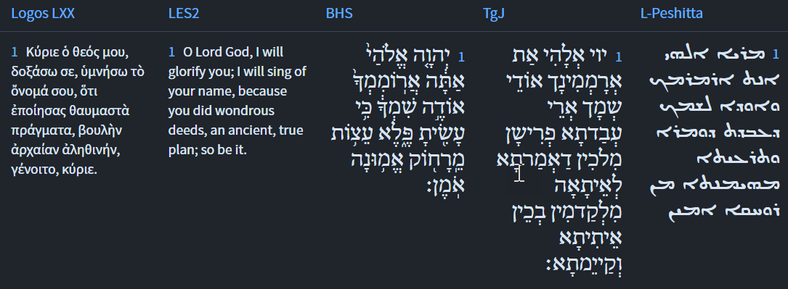
Isaiah 25:1
Isaiah / ישעיה
http://www.matsati.com

Slide 21
Ibn Ezra on Isaiah 25,1 Part 2
עצות מרחוק Counsels of old. Objective case governed by עשית thou hast done.—The counsels of old are the plans of God predicted by the prophets.
Rashi on Isaiah 25,1 Parts 1-2
עצות מרחוק אמונה אומן. עצות שיעצת מרחוק לאברהם בברית בין הבתרים: counsels from long ago in true faith Counsels that You advised from long ago to Abraham in the Covenant between the Parts.
אמונה אומן. אמונה נאמנת אומן כמו אוהל אוכל ואינו ל' פועל אלא ל' מפעל אבויי"רמינט בלע"ז: true faith (אֱמוּנָה אֹמֶן). אֹמֶן is like אֹהֶל, tent, אֹכֶל, food, and it is not a verb in present tense but an expression of a noun, obrement (truth) in O.F.
Isaiah / ישעיה
http://www.matsati.com

Slide 22
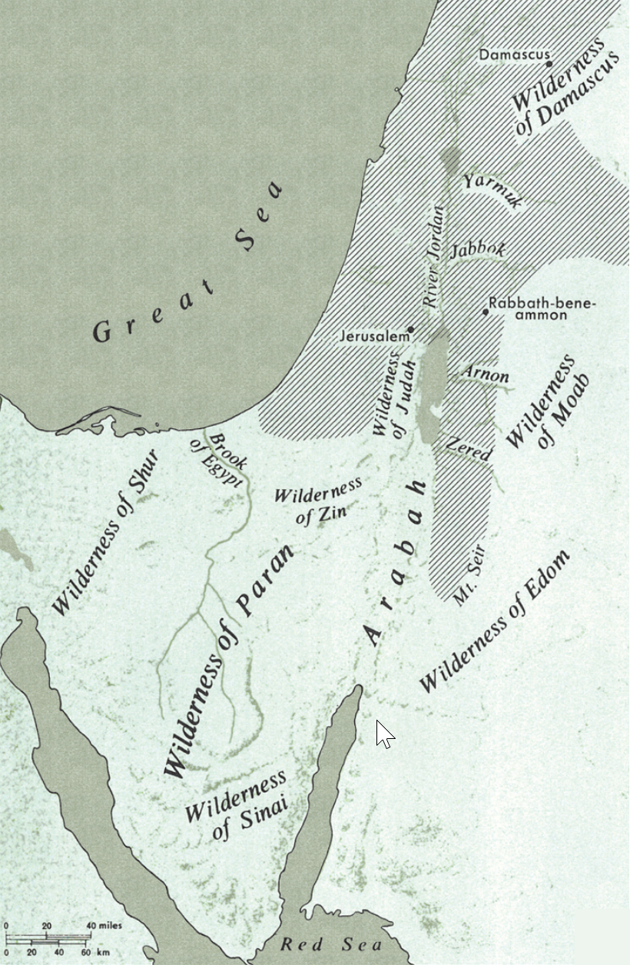
Rashi on Isaiah 25,2 Parts 1-2
כי שמת. הר שעיר מעיר לגל: For You have made Mount Seir from a city into a heap.
ארמון זרים מעיר. מעון שעשו בעירך שהחריבוה תתן ארמונותיה חורבן אשר לעולם לא יבנה: a palace of strangers, because of the city Because of the iniquity they committed in Your city, that they destroyed it, You shall make its palaces a ruin, which shall never be rebuilt.
Isaiah / ישעיה
http://www.matsati.com

Slide 23
Rashi on Isaiah 25,5 Parts 1-3
כחורב בציון. בעת יובש שמייבש הזרעים להתמולל כן תכניע שאון זרים: Like heat in the dry season In the dry season, when the seeds dry out to be cut off, so shall You humble the multitude of the strangers. חורב בצל עב. כשהמים מתקשרים בענן עב בימי השרב שהכל שמחים בו כן יענה שיר הצדיקים על זמיר עריצים ומפלתן: like heat with a thick cloud When the heavens thicken with thick clouds in the hot season, with which everyone rejoices, so will the song of the righteous be sung concerning the cutting down of the tyrants and their downfall. (זמיר. ל' לא תזמור (ויקרא כה the downfall of (lit., the cutting down of. זְמִיר). An expression related to (Lev. 25:4): “You shall not prune (תִזְמֹר).”
Isaiah / ישעיה
http://www.matsati.com

