Slide 1
MATSATI.COM Teaching Ministry
Website: https://www.matsati.com YouTube Channel: https://www.youtube.com/user/MATSATI/
ישעיהו כד:ט-טז / Isaiah 24:9-16
LIVE STREAM: 6:30 pm EST Thursday
Join us at Telegram:
https://t.me/MessianicChat
Foundation of the Word Outreach Ministry
https://www.thefoundationoftheword.org
A Community
for Learning
Weekly Teachings Free Online
Check Telegram for weekly scheduling of teachings.
Discuss the Scriptures,
learn the languages,
and fellowship
YouTube Channel
https://www.youtube.com/c/TheFoundationofTheWordOutreachMinistries
Join Telegram ask about Hebrew and Greek classes!
Rabbi Jeremiah
– The Apocalypse: connecting the Greek to the Ancient Hebrew text. (Wed. 9 am EST)
YouTube Channels
https://YouTube.com/c/HebrewLiteracy
https://www.youtube.com/channel/UC5_qPfruat-sCJJypz0_OBw
UMJA
http://www.umja.net/

Slide 2
Isaiah 24:9-16
ישעיהו כד:ט-טז
Isaiah / ישעיה
http://www.matsati.com

Slide 3
ספר יואל פרק א
א דְּבַר־יְהוָה֙ אֲשֶׁ֣ר הָיָ֔ה אֶל־יוֹאֵ֖ל בֶּן־פְּתוּאֵֽל׃ ב שִׁמְעוּ־זֹאת֙ הַזְּקֵנִ֔ים וְהַֽאֲזִ֔ינוּ כֹּ֖ל יוֹשְׁבֵ֣י הָאָ֑רֶץ הֶהָ֤יְתָה זֹּאת֙ בִּֽימֵיכֶ֔ם וְאִ֖ם בִּימֵ֥י אֲבֹֽתֵיכֶֽם׃ ג עָלֶ֖יהָ לִבְנֵיכֶ֣ם סַפֵּ֑רוּ וּבְנֵיכֶם֙ לִבְנֵיהֶ֔ם וּבְנֵיהֶ֖ם לְד֥וֹר אַחֵֽר׃ ד יֶ֤תֶר הַגָּזָם֙ אָכַ֣ל הָֽאַרְבֶּ֔ה וְיֶ֥תֶר הָאַרְבֶּ֖ה אָכַ֣ל הַיָּ֑לֶק וְיֶ֣תֶר הַיֶּ֔לֶק אָכַ֖ל הֶחָסִֽיל׃ ה הָקִ֤יצוּ שִׁכּוֹרִים֙ וּבְכ֔וּ וְהֵילִ֖לוּ כָּל־שֹׁ֣תֵי יָ֑יִן עַל־עָסִ֕יס כִּ֥י נִכְרַ֖ת מִפִּיכֶֽם׃ ו כִּֽי־גוֹי֙ עָלָ֣ה עַל־אַרְצִ֔י עָצ֖וּם וְאֵ֣ין מִסְפָּ֑ר שִׁנָּיו֙ שִׁנֵּ֣י אַרְיֵ֔ה וּֽמְתַלְּע֥וֹת לָבִ֖יא לֽוֹ׃
Joel 1:1-6
1:1 The word of the LORD that came to Joel the son of Pethuel. 1:2 Hear this, ye old men, and give ear, all ye inhabitants of the land. Hath this been in your days, or even in the days of your fathers? 1:3 Tell ye your children of it, and let your children tell their children, and their children another generation. 1:4 That which the palmerworm hath left hath the locust eaten; and that which the locust hath left hath the cankerworm eaten; and that which the cankerworm hath left hath the caterpiller eaten. 1:5 Awake, ye drunkards, and weep; and howl, all ye drinkers of wine, because of the new wine; for it is cut off from your mouth. 1:6 For a nation is come up upon my land, strong, and without number, whose teeth are the teeth of a lion, and he hath the cheek teeth of a great lion. (KJV)
Isaiah / ישעיה
http://www.matsati.com

Slide 4
﻿ספר ישעיה פרק כד
﻿ט בַּשִּׁיר לֹא יִשְׁתּוּ-יָיִן יֵמַר שֵׁכָר לְשֹׁתָיו: י נִשְׁבְּרָה קִרְיַת-תֹּהוּ סֻגַּר כָּל-בַּיִת מִבּוֹא: יא צְוָחָה עַל-הַיַּיִן בַּחוּצוֹת עָרְבָה כָּל-שִֹמְחָה גָּלָה מְשֹוֹשֹ הָאָרֶץ: יב נִשְׁאָר בָּעִיר שַׁמָּה וּשְׁאִיָּה יֻכַּת-שָׁעַר: יג כִּי-כֹה יִהְיֶה בְּקֶרֶב הָאָרֶץ בְּתוֹךְ הָעַמִּים כְּנֹקֶף זַיִת כְּעוֹלֵלֹת אִם-כָּלָה בָצִיר: יד הֵמָּה יִשְֹאוּ קוֹלָם יָרֹנּוּ בִּגְאוֹן יְהֹוָה צָהֲלוּ מִיָּם: טו עַל-כֵּן בָּאֻרִים כַּבְּדוּ יְהֹוָה בְּאִיֵּי הַיָּם שֵׁם יְהֹוָה אֱלֹהֵי יִשְֹרָאֵל: טז מִכְּנַף הָאָרֶץ זְמִרֹת שָׁמַעְנוּ צְבִי לַצַּדִּיק וָאֹמַר רָזִי-לִי רָזִי-לִי אוֹי לִי בֹּגְדִים בָּגָדוּ וּבֶגֶד בּוֹגְדִים בָּגָדוּ:
Isaiah / ישעיה
http://www.matsati.com

Slide 5
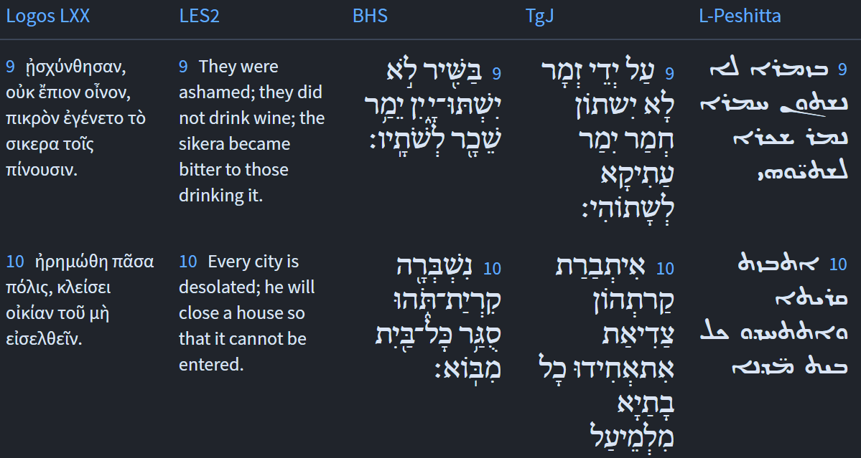
Isaiah 24:9-10
Isaiah / ישעיה
http://www.matsati.com

Slide 6
ספר דברים פרק לב
ז זְכֹר יְמוֹת עוֹלָם בִּינוּ שְׁנוֹת דֹּר וָדֹר שְׁאַל אָבִיךָ וְיַגֵּדְךָ זְקֵנֶיךָ וְיֹאמְרוּ לָךְ: ח בְּהַנְחֵל עֶלְיוֹן גּוֹיִם בְּהַפְרִידוֹ בְּנֵי אָדָם יַצֵּב גְּבֻלֹת עַמִּים לְמִסְפַּר בְּנֵי יִשְֹרָאֵל: ט כִּי חֵלֶק יְהוָֹה עַמּוֹ יַעֲקֹב חֶבֶל נַחֲלָתוֹ: י יִמְצָאֵהוּ בְּאֶרֶץ מִדְבָּר וּבְתֹהוּ יְלֵל יְשִׁמֹן יְסֹבֲבֶנְהוּ יְבוֹנֲנֵהוּ יִצְּרֶנְהוּ כְּאִישׁוֹן עֵינוֹ:
Devarim / Deuteronomy 32:7-10
32:7 Remember the days of old, consider the years of many generations: ask thy father, and he will shew thee; thy elders, and they will tell thee. 32:8 When the Most High divided to the nations their inheritance, when he separated the sons of Adam, he set the bounds of the people according to the number of the children of Israel. 32:9 For the LORD's portion is his people; Jacob is the lot of his inheritance. 32:10 He found him in a desert land, and in the waste howling wilderness; he led him about, he instructed him, he kept him as the apple of his eye. (KJV)
Isaiah / ישעיה
http://www.matsati.com

Slide 7
ספר ויקרא פרק יט
ט וּבְקֻצְרְכֶם אֶת-קְצִיר אַרְצְכֶם לֹא תְכַלֶּה פְּאַת שָֹדְךָ לִקְצֹר וְלֶקֶט קְצִירְךָ לֹא תְלַקֵּט: י וְכַרְמְךָ לֹא תְעוֹלֵל וּפֶרֶט כַּרְמְךָ לֹא תְלַקֵּט לֶעָנִי וְלַגֵּר תַּעֲזֹב אֹתָם אֲנִי יְהוָֹה אֱלֹהֵיכֶם:
Vayikra / Leviticus 19:9-10
19:9 And when ye reap the harvest of your land, thou shalt not wholly reap the corners of thy field, neither shalt thou gather the gleanings of thy harvest. 19:10 And thou shalt not glean thy vineyard, neither shalt thou gather every grape of thy vineyard; thou shalt leave them for the poor and stranger: I am the LORD your God. (KJV)
Isaiah / ישעיה
http://www.matsati.com

Slide 8
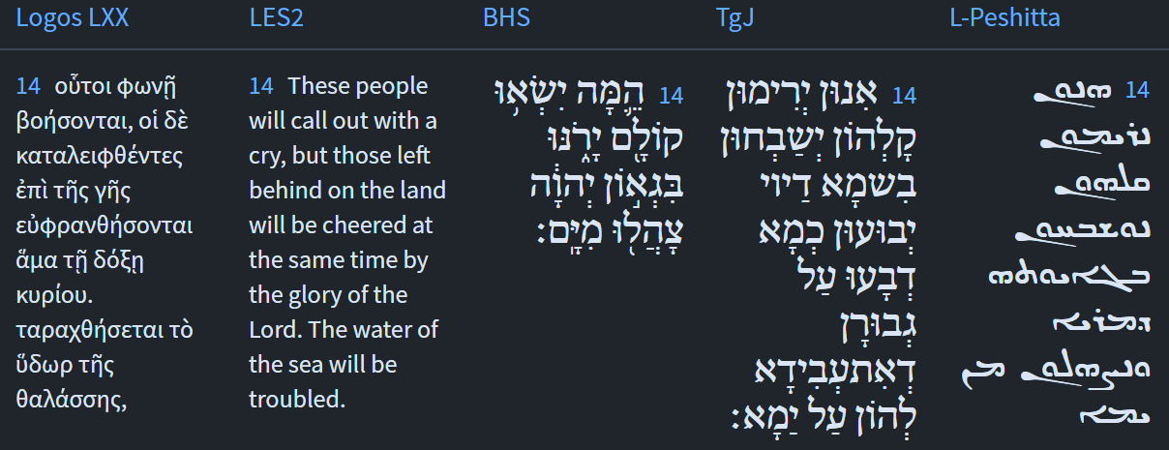
Isaiah 24:14
Isaiah / ישעיה
http://www.matsati.com

Slide 9
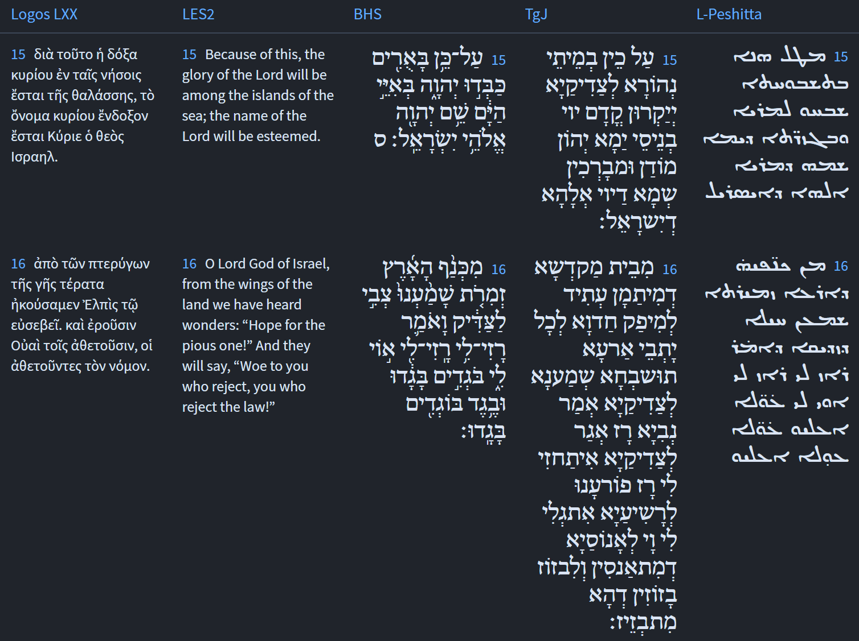
Isaiah 24:15-16
Isaiah / ישעיה
http://www.matsati.com

Slide 10
ספר תהילים פרק קיב
ד זָרַח בַּחשֶׁךְ אוֹר לַיְשָׁרִים חַנּוּן וְרַחוּם וְצַדִּיק: ה טוֹב אִישׁ חוֹנֵן וּמַלְוֶה יְכַלְכֵּל דְּבָרָיו בְּמִשְׁפָּט: ו כִּי-לְעוֹלָם לֹא יִמּוֹט לְזֵכֶר עוֹלָם יִהְיֶה צַדִּיק:
Tehillim / Psalm 112:4-6
112:4 Unto the upright there ariseth light in the darkness: He is gracious, and full of compassion, and righteous. 112:5 A good man sheweth favour, and lendeth: He will guide his affairs with discretion. 112:6 Surely he shall not be moved for ever: The righteous shall be in everlasting remembrance. (KJV)
Isaiah / ישעיה
http://www.matsati.com

Slide 11
Philippians 2:9-13
2:9 Wherefore God also hath highly exalted him, and given him a name which is above every name: 2:10 That at the name of Jesus every knee should bow, of things in heaven, and ethings in earth, and things under the earth; 2:11 And that every tongue should confess that Jesus Christ is Lord, to the glory of God the Father. 2:12 Wherefore, my beloved, as ye have always obeyed, not as in my presence only, but now much more in my absence, work out your own salvation with fear and trembling. 2:13 For it is God which worketh in you both to will and to do of his good pleasure. (KJV, ܡܶܛܾܠ ܗܳܢܳܐ ܐܴܦ݂ ܐܱܠܴܗܳܐ ܐܱܣܓܻ݁ܝ ܪܱܡܪܡܶܗ ܂ ܘܝܰܗ̄ܒ݂ ܠܷܗ ܫܡܳܐ ܕܱ݁ܡܝܰܬܱ݁ܪ ܡܶܢ ܟܾ݁ܠ ܫܡܳܗܺܝ̈ܢ ܆ܕ݁ܒ݂ܰܫܡܶܗ ܕ݁ܝܶܫܽܘܥ ܟܾ݁ܠ ܒ݁ܪܾܘܟ݂ ܬܷ݁ܟܾ݁ܘܦ݂ ܁ ܕ݁ܒ݂ܰܫܡܰܝܳܐ ܂ ܘܒ݂ܰܐܪܥܳܐ ܂ ܘܕ݂ܰܠܬ݂ܱܚܬ݁ ܡܶܢ ܐܱܪܥܳܐ ܇ ܘܟ݂ܽܠ ܠܷܫܳܢ ܢܰܘܕܷ݁ܐ ܕ݁ܡܳܪܝܳܐ ܗ̄ܘ ܝܶܫܽܘܥ ܡܫܺܝܚܳܐ ܠܫܽܘܒ݂ܚܳܐ ܕܱ݁ܐܠܴܗܳܐ ܐܱܒ݂ܽܘܗ̄ܝ ܀ ܡܶܟܻ݁ܝܠ ܚܰܒܻ݁ܝ̈ܒ݂ܰܝ ܆ ܐܱܝܟܱ݁ܢܳܐ ܕܱ݁ܒ݂ܟ݂ܽܠܙܒ݂ܰܢ ܐܷܫܬ݁ܡܰܥܬܾ݁ܘܢ ܆ ܠܴܐ ܟܱ݁ܕ݂ ܩܰܪܻܝܒ݂ ܐ̱ܢܳܐ ܠܟ݂ܽܘܢ ܒܱ݁ܠܚܽܘܕ݂ ܂ ܐܷܠܴܐ ܗܳܫܳܐ ܕ݁ܪܱܚܺܝܩ ܐ̱ܢܳܐ ܡܶܢܟ݂ܽܘܢ ܆ ܝܰܬܻ݁ܝܪܴܐܝܺܬ݂ ܒ݁ܕ݂ܶܚܠܬ݂ܴܐ ܘܒ݂ܰܪܬ݂ܻܝܬ݂ܴܐ ܇ ܦ݁ܠܾܘܚܘ ܦܾ݁ܘܠܚܳܢܳܐ ܕ݁ܚܰܝܰܝ̈ܟܾ݁ܘܢ ܂ ܐܱܠܴܗܳܐ ܗ̄ܘ ܓܷ݁ܝܪ ܡܚܰܦܷ݁ܛ ܒ݁ܟ݂ܽܘܢ ܆ ܐܴܦ݂ ܠܡܶܨܒܴ݁ܐ ܁ ܐܴܦ݂ ܠܡܶܣܥܰܪ ܇ ܗܰܘ ܡܶܕܷ݁ܡ ܕ݁ܨܴܒ݂ܶܝܢ ܐܢ̄ܬܾ݁ܘܢ ܂ 9 διὸ καὶ ὁ θεὸς αὐτὸν ὑπερύψωσεν καὶ ἐχαρίσατο αὐτῷ τὸ ὄνομα τὸ ὑπὲρ πᾶν ὄνομα, 10 ἵνα ἐν τῷ ὀνόματι Ἰησοῦ πᾶν γόνυ κάμψῃ ἐπουρανίων καὶ ἐπιγείων καὶ καταχθονίων, 11 καὶ πᾶσα γλῶσσα ἐξομολογήσηται ὅτι κύριος Ἰησοῦς χριστὸς εἰς δόξαν θεοῦ πατρός. 12 Ὥστε, ἀγαπητοί μου, καθὼς πάντοτε ὑπηκούσατε, μὴ ὡς ἐν τῇ παρουσίᾳ μου μόνον ἀλλὰ νῦν πολλῷ μᾶλλον ἐν τῇ ἀπουσίᾳ μου, μετὰ φόβου καὶ τρόμου τὴν ἑαυτῶν σωτηρίαν κατεργάζεσθε· 13 θεὸς γάρ ἐστιν ὁ ἐνεργῶν ἐν ὑμῖν καὶ τὸ θέλειν καὶ τὸ ἐνεργεῖν ὑπὲρ τῆς εὐδοκίας.)
Isaiah / ישעיה
http://www.matsati.com

Slide 12
Rabbinic Literature
ספרות רבנית
Part 2
Isaiah / ישעיה
http://www.matsati.com

Slide 13
Targum Jonathan son of Uziel Isaiah 24:9-16
24:9 They shall no more drink wine with songs; strong drink shall be bitter to them that drink it. 24:10 Their city is broken down, and laid desolate: all their houses are shut up, so that no one can enter. 24:11 They cry for wine in the streets; all joy is ended: all gladness is removed from the land. 24:12 Desolation is left in the city, and there is a tumult in the destruction of the gates. 24:13 When thus the righteous shall be left alone in the midst of the earth, among the kingdoms, as the shaking of olives, as the gleaning of grapes after the vintage. 24:14 They shall lift up their voice, they shall praise on account of the WORD of the Lord: they shall rejoice as they rejoiced on account of the mighty works which were done for them by the sea. 24:15 When light shall come to the righteous, they shall glorify the Lord: in the islands of the sea they shall laud and bless the name of the Lord, the God of Israel. 24:16 From the house of the sanctuary, yea, from thence joy shall go forth to all the inhabitants of the earth, for we have heard the praise of the righteous! The prophet said, a secret! A reward to the righteous is shown to me, a secret! A punishment for the wicked is revealed to me. Woe to the oppressors, for they shall be oppressed; and to those who spoil, for, behold, they shall be spoiled. (TgJ)
Isaiah / ישעיה
http://www.matsati.com

Slide 14
Signs for Alcohol Abuse Disorders
Increased tolerance: Does it take more alcohol to get the same effect?
Trouble stopping: Do you have a hard time cutting off your drinking once you start?
Unhealthy focus: Do you spend time thinking about drinking?
Solo style: Do you drink alone?
Morning maintenance: Do you drink when you wake up?
Harm to relationships: Do you get into more arguments with loved ones when you drink?
Decreased productivity: Have you neglected other things because drinking has taken its place? Have you missed work because of drinking?
Physical symptoms: Has a withdrawal from alcohol caused you to become shaky, nauseous and sweaty?
Dangerous behavior: You are more promiscuous when you drink, or have you driven a car after drinking?
Isaiah / ישעיה
http://www.matsati.com

Slide 15
Ein Yaakov (Glick Edition), Sotah 9:15
(Fol. 48) "Since the Sanhedrin were abolished, with them was abolished the custom of singing [while in the wine-houses drinking], as it is said (Is. 24, 9) Amidst singing, etc." And whence do we know that this refers to the Sanhedrin? Said R. Huna, the son of R. Joshua: "The passage says (Lam. 5, 14) The elders have ceased from the gate, young men from their singing." R. Udna said: "He who listens to songs will at the end suffer punishment," Raba said: "In a house where there is frequent singing destruction will be the result, as it is said (Zef. 2, 14) Singing birds shall sing in the windows, ruin shall be on the threshholds; for the cedar waves shall be cut away. What does for the cedar waves shall be cut away, mean? Said R. Isaac, "Even a house covered with cedars will at the end be cut away." R. Assi said: "From this it may be inferred that ruin of a house begins with the threshold, as it is said, Ruins shall be on the threshold, and if you wish I shall say it may be inferred from the following: (Is. 24, 12) And in ruins is bitten the gate." R. Huna said: '"Singing while at work on a ship or while plowing is permitted, but otherwise is prohibited." R. Huna caused the abolition of singing, thereupon the market became so cheap that one hundred geese were bought for a Zuza and even for that amount there was no demand. Thereupon R. Chisda came and did not enforce the act of abolition when it came about that each goose was bought for a Zuza and even at that price there was not sufficient supply. R. Joseph said: "Men singing, and women responding is considered licentiousness. When women sing and men respond it is like flax placed before fire." What is the difference since both of them are prohibited? The difference is against which one we should put more efforts to have it abolished. Said R. Jochanan: "Whoever serves a banquet accompanied by four instruments of music, will bring five calamities upon the world, as it is said (Is. 5, 11) Woe unto those that get up early in the morning, that they may run for strong drink… . and the harp and the psaltry, the tabaret and the pipe, and wine are in their feasts.” What is written after this (Ib., ib. 1.5) Therefore were My people lead unto exile, for want of knowledge, ie., this causes exile upon the world; and the honorable men suffer of famine, i.e., which brings hunger upon the world; and their multitude are panting with thirst, i.e., which causes the Torah to be forgotten from its learnings, (Ib., ib. 15) And then shall be the son of earth, and humble shall he the man, i.e., who caused lowering down to the enemies of the Holy One, praised be He, and the word Ish refers to the Lord as it is said (Ex. 15, 3) The Eternal is the Lord of war (Ish Milchama). (Is. 5, 15) And the eye of the lofty shall be hungry, who caused humbleness to Israel. What is written afterwards (Ib., ib. 14) Therefore hath the deep enlarged her desire, etc.
Isaiah / ישעיה
http://www.matsati.com

Slide 16
Talmud Bavli Sotah 48a:17
The word “uncovered” [era] could be read to mean: Its city [ira]. The Gemara asks: What is the meaning of: For its cedar work shall be its city? Furthermore, Rabbi Yitzḥak wondered when he said: Is a house interlaced with cedars not as strong as a city, and therefore not threatened by desolation? Rather, it means that even a house interlaced with cedars will become unstable [mitroe’a] if song is heard there. Rav Ashi said: Learn from it that when the destruction starts it starts with the threshold, as it is stated: “Desolation shall be in the posts.” And if you wish, say instead that they derive this idea from here: “In the city is left desolation, and the gate is smitten unto ruin [she’iyya]” (Isaiah 24:12). The term “ruin” here is referring to the destructive demon known as She’iyya, who strikes the gate first. Mar bar Rav Ashi said: I saw it, this She’iyya, and it was goring and wreaking havoc like an ox.
Rashi on Isaiah 24,12 Part 1
Through desolation, the gate is battered Through the desolation of loneliness, that the houses are desolate, without an occupant, the gates shall become battered by demons and destructive creatures.
Isaiah / ישעיה
http://www.matsati.com

Slide 17
Matthew 16:18-19
16:18 And I say also unto thee, That thou art Peter, and upon this rock I will build my church; and the gates of hell shall not prevail against it. 16:19 And I will give unto thee the keys of the kingdom of heaven: and whatsoever thou shalt bind on earth shall be bound in heaven: and whatsoever thou shalt loose on earth shall be loosed in heaven. (KJV, ܐܴܦ݂ ܐܷܢܳܐ ܐܴܡܰܪ ܐ̱ܢܳܐ ܠܴܟ݂ ܂ ܕܱ݁ܐܢ̄ܬ݁ ܗ̄ܽܘ ܟܻ݁ܐܦ݂ܳܐ ܂ ܘܥܰܠ ܗܳܕ݂ܶܐ ܟܻ݁ܐܦ݂ܳܐ ܐܷܒ݂ܢܶܝܗ ܠܥܺܕ̱݁ܬ݁ܝ ܂ ܘܬ݂ܱܪ̈ܥܶܐ ܕܱ݁ܫܝܽܘܠ ܂ ܠܴܐ ܢܶܚܣܢܽܘܢܳܗ ܂ܠܴܟ݂ ܐܷܬܷ݁ܠ ܩܠܻܝ̈ܕ݂ܶܐ ܕ݁ܡܰܠܟܾ݁ܘܬ݂ܴܐ ܕܱ݁ܫܡܰܝܳܐ ܂ ܘܟ݂ܽܠ ܡܶܕܷ݁ܡ ܕ݁ܬ݂ܷܐܣܽܘܪ ܒܱ݁ܐܪܥܳܐ ܂ ܢܶܗܘܶܐ ܐܱܣܺܝܪ ܒܱ݁ܫܡܰܝܳܐ ܂ ܘܡܶܕܷ݁ܡ ܕ݁ܬ݂ܷܫܪܷܐ ܒܱ݁ܐܪܥܳܐ ܂ ܢܶܗܘܶܐ ܫܪܷܐ ܒܱ݁ܫܡܰܝܳܐ ܀ 18 κἀγὼ δέ σοι λέγω ὅτι σὺ εἶ Πέτρος καὶ ἐπὶ ταύτῃ τῇ πέτρᾳ οἰκοδομήσω μου τὴν ἐκκλησίαν, καὶ πύλαι ἅδου οὐ κατισχύσουσιν αὐτῆς. 19 δώσω σοι τὰς κλεῖδας τῆς βασιλείας τῶν οὐρανῶν, καὶ ὃ ἐὰν δήσῃς ἐπὶ τῆς γῆς, ἔσται δεδεμένον ἐν τοῖς οὐρανοῖς, καὶ ὃ ἐὰν λύσῃς ἐπὶ τῆς γῆς, ἔσται λελυμένον ἐν τοῖς οὐρανοῖς.)
Isaiah / ישעיה
http://www.matsati.com

Slide 18
Akeidat Yitzchak 48:1 Part 7
The menorah, candelabra and altar of incense in the sanctuary symbolize the planetary orbits. The showbreads are presented on the Sabbath, to remind us of the fact that as soon as G-d had stopped creating, He turned His attention to the problem of providing parnassah, a livelihood, for all His creatures. The various tools, appurtenances of the table are reminders that we must not sit with our hands folded waiting to be provided for but must do our share. We omit much of the commentary at this point, since it revolves around the premise of a universe with seven major planets, an outdated concept. The author also illustrates how different parts of the tabernacle legislation tie in with the seven-day creation cycle.
Isaiah / ישעיה
http://www.matsati.com

