Slide 1
Isaiah 24:1-8
ישעיהו כד:א-ח
Isaiah / ישעיה
http://www.matsati.com

Slide 2
ספר בראשית פרק ג
יז וּלְאָדָם אָמַר כִּי שָׁמַעְתָּ לְקוֹל אִשְׁתֶּךָ וַתֹּאכַל מִן-הָעֵץ אֲשֶׁר צִוִּיתִיךָ לֵאמֹר לֹא תֹאכַל מִמֶּנּוּ אֲרוּרָה הָאֲדָמָה בַּעֲבוּרֶךָ בְּעִצָּבוֹן תֹּאכֲלֶנָּה כֹּל יְמֵי חַיֶּיךָ: יח וְקוֹץ וְדַרְדַּר תַּצְמִיחַ לָךְ וְאָכַלְתָּ אֶת-עֵשֶֹב הַשָּׂדֶה: יט בְּזֵעַת אַפֶּיךָ תֹּאכַל לֶחֶם עַד שׁוּבְךָ אֶל-הָאֲדָמָה כִּי מִמֶּנָּה לֻקָּחְתָּ כִּי-עָפָר אַתָּה וְאֶל-עָפָר תָּשׁוּב:
Bereshit / Genesis 3:17-19
3:17 And unto Adam he said, Because thou hast hearkened unto the voice of thy wife, and hast eaten of the tree, of which I commanded thee, saying, Thou shalt not eat of it: cursed is the ground for thy sake; in sorrow shalt thou eat of it all the days of thy life; 3:18 Thorns also and thistles shall it bring forth to thee; and thou shalt eat the herb of the field; 3:19 In the sweat of thy face shalt thou eat bread, till thou return unto the ground; for out of it wast thou taken: for dust thou art, and unto dust shalt thou return. (KJV
τῷ δὲ Αδαμ εἶπεν Ὅτι ἤκουσας τῆς φωνῆς τῆς γυναικός σου καὶ ἔφαγες ἀπὸ τοῦ ξύλου, οὗ ἐνετειλάμην σοι τούτου μόνου μὴ φαγεῖν ἀπʼ αὐτοῦ, ἐπικατάρατος ἡ γῆ ἐν τοῖς ἔργοις σου, ἐν λύπαις φάγῃ αὐτὴν πάσας τὰς ἡμέρας τῆς ζωῆς σου, ἀκάνθας καὶ τριβόλους ἀνατελεῖ σοι, καὶ φάγῃ τὸν χόρτον τοῦ ἀγροῦ. ἐν ἱδρῶτι τοῦ προσώπου σου φάγῃ τὸν ἄρτον σου ἕως τοῦ ἀποστρέψαι σε εἰς τὴν γῆν, ἐξ ἧς ἐλήμφθης, ὅτι γῆ εἶ καὶ εἰς γῆν ἀπελεύσῃ.)
Isaiah / ישעיה
http://www.matsati.com

Slide 3
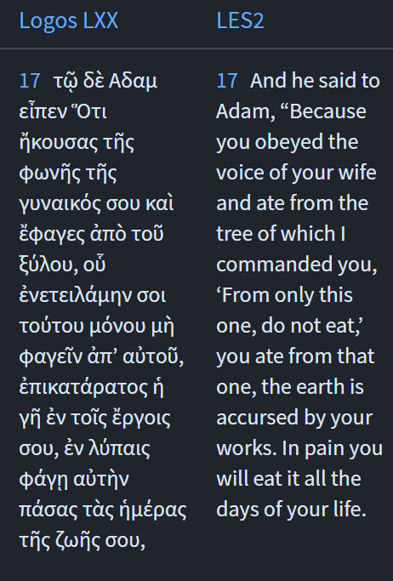
The LXX writes, ἐπικατάρατος ἡ γῆ ἐν τοῖς ἔργοις σου “cursed is the ground because of your works.”
We note how this drives forward the concept of the imperfection of our works, of the things that we do, and how we are always relying upon the mercy of God, even in the things we do out of our love for God in heaven. We note how
Isaiah 24:4 states: אאָבְלָ֤ה נָֽבְלָה֙ הָאָ֔רֶץ אֻמְלְלָ֥ה נָבְלָ֖ה תֵּבֵ֑ל אֻמְלָ֖לוּ מְרֹ֥ום עַם־הָאָֽרֶץ׃
“The earth mourneth and fadeth away, the world languisheth and fadeth away, the haughty people of the earth do languish,”
Isaiah / ישעיה
http://www.matsati.com

Slide 4
﻿ספר ישעיה פרק כד
﻿א הִנֵּה יְהֹוָה בּוֹקֵק הָאָרֶץ וּבוֹלְקָהּ וְעִוָּה פָנֶיהָ וְהֵפִיץ יֹשְׁבֶיהָ: ב וְהָיָה כָעָם כַּכֹּהֵן כַּעֶבֶד כַּאדֹנָיו כַּשִּׁפְחָה כַּגְּבִרְתָּהּ כַּקּוֹנֶה כַּמּוֹכֵר כַּמַּלְוֶה כַּלּוֶֹה כַּנֹּשֶׁה כַּאֲשֶׁר נֹשֶׁא בוֹ: ג הִבּוֹק | תִּבּוֹק הָאָרֶץ וְהִבּוֹז | תִּבּוֹז כִּי יְהֹוָה דִּבֶּר אֶת-הַדָּבָר הַזֶּה: ד אָבְלָה נָבְלָה הָאָרֶץ אֻמְלְלָה נָבְלָה תֵּבֵל אֻמְלָלוּ מְרוֹם עַם-הָאָרֶץ: ה וְהָאָרֶץ חָנְפָה תַּחַת יֹשְׁבֶיהָ כִּי-עָבְרוּ תוֹרֹת חָלְפוּ חֹק הֵפֵרוּ בְּרִית עוֹלָם: ו עַל-כֵּן אָלָה אָכְלָה אֶרֶץ וַיֶּאְשְׁמוּ ישְׁבֵי בָהּ עַל-כֵּן חָרוּ ישְׁבֵי אֶרֶץ וְנִשְׁאַר אֱנוֹשׁ מִזְעָר: ז אָבַל תִּירוֹשׁ אֻמְלְלָה-גָפֶן נֶאֶנְחוּ כָּל-שִֹמְחֵי-לֵב: ח שָׁבַת מְשֹוֹשֹ תֻּפִּים חָדַל שְׁאוֹן עַלִּיזִים שָׁבַת מְשֹוֹשֹ כִּנּוֹר:
Isaiah / ישעיה
http://www.matsati.com

Slide 5
ספר בראשית פרק יא
﻿א וַיְהִי כָל-הָאָרֶץ שָֹפָה אֶחָת וּדְבָרִים אֲחָדִים: ב וַיְהִי בְּנָסְעָם מִקֶּדֶם וַיִּמְצְאוּ בִקְעָה בְּאֶרֶץ שִׁנְעָר וַיֵּשְׁבוּ שָׁם: ג וַיֹּאמְרוּ אִישׁ אֶל-רֵעֵהוּ הָבָה נִלְבְּנָה לְבֵנִים וְנִשְֹרְפָה לִשְֹרֵפָה וַתְּהִי לָהֶם הַלְּבֵנָה לְאָבֶן וְהַחֵמָר הָיָה לָהֶם לַחֹמֶר: ד וַיֹּאמְרוּ הָבָה | נִבְנֶה-לָּנוּ עִיר וּמִגְדָּל וְרֹאשׁוֹ בַשָּׁמַיִם וְנַעֲשֶֹה-לָּנוּ שֵׁם פֶּן-נָפוּץ עַל-פְּנֵי כָל-הָאָרֶץ: ה וַיֵּרֶד יְהֹוָה לִרְאֹת אֶת-הָעִיר וְאֶת-הַמִּגְדָּל אֲשֶׁר בָּנוּ בְּנֵי הָאָדָם: ו וַיֹּאמֶר יְהֹוָה הֵן עַם אֶחָד וְשָֹפָה אַחַת לְכֻלָּם וְזֶה הַחִלָּם לַעֲשֹוֹת וְעַתָּה לֹא-יִבָּצֵר מֵהֶם כֹּל אֲשֶׁר יָזְמוּ לַעֲשֹוֹת: ז הָבָה נֵרְדָה וְנָבְלָה שָׁם שְֹפָתָם אֲשֶׁר לֹא יִשְׁמְעוּ אִישׁ שְֹפַת רֵעֵהוּ: ח וַיָּפֶץ יְהֹוָה אֹתָם מִשָּׁם עַל-פְּנֵי כָל-הָאָרֶץ וַיַּחְדְּלוּ לִבְנֹת הָעִיר:
Bereshit / Genesis 11:1-8
11:1 And the whole earth was of one language, and of one speech. 11:2 And it came to pass, as they journeyed from the east, that they found a plain in the land of Shinar; and they dwelt there. 11:3 And they said one to another, Go to, let us make brick, and burn them thoroughly. And they had brick for stone, and slime had they for morter. 11:4 And they said, Go to, let us build us a city and a tower, whose top may reach unto heaven; and let us make us a name, lest we be scattered abroad upon the face of the whole earth. 11:5 And the LORD came down to see the city and the tower, which the children of men builded. 11:6 And the LORD said, Behold, the people is one, and they have all one language; and this they begin to do: and now nothing will be restrained from them, which they have imagined to do. 11:7 Go to, let us go down, and there confound their language, that they may not understand one another's speech. 11:8 So the LORD scattered them abroad from thence upon the face of all the earth: and they left off to build the city. (KJV)
http://www.matsati.com

Slide 6
ספר ויקרא פרק כו
יד וְאִם-לֹא תִשְׁמְעוּ לִי וְלֹא תַעֲשֹוּ אֵת כָּל-הַמִּצְוֹת הָאֵלֶּה: טו וְאִם-בְּחֻקֹּתַי תִּמְאָסוּ וְאִם אֶת-מִשְׁפָּטַי תִּגְעַל נַפְשְׁכֶם לְבִלְתִּי עֲשֹוֹת אֶת-כָּל-מִצְוֹתַי לְהַפְרְכֶם אֶת-בְּרִיתִי: טז אַף-אֲנִי אֶעֱשֶֹה-זֹּאת לָכֶם וְהִפְקַדְתִּי עֲלֵיכֶם בֶּהָלָה אֶת-הַשַּׁחֶפֶת וְאֶת-הַקַּדַּחַת מְכַלּוֹת עֵינַיִם וּמְדִיבֹת נָפֶשׁ וּזְרַעְתֶּם לָרִיק זַרְעֲכֶם וַאֲכָלֻהוּ אֹיְבֵיכֶם: יז וְנָתַתִּי פָנַי בָּכֶם וְנִגַּפְתֶּם לִפְנֵי אֹיְבֵיכֶם וְרָדוּ בָכֶם שֹֹנְאֵיכֶם וְנַסְתֶּם וְאֵין-רֹדֵף אֶתְכֶם: יח וְאִם-עַד-אֵלֶּה לֹא תִשְׁמְעוּ לִי וְיָסַפְתִּי לְיַסְּרָה אֶתְכֶם שֶׁבַע עַל-חַטֹּאתֵיכֶם: יט וְשָׁבַרְתִּי אֶת-גְּאוֹן עֻזְּכֶם וְנָתַתִּי אֶת-שְׁמֵיכֶם כַּבַּרְזֶל וְאֶת-אַרְצְכֶם כַּנְּחֻשָׁה: כ וְתַם לָרִיק כֹּחֲכֶם וְלֹא-תִתֵּן אַרְצְכֶם אֶת-יְבוּלָהּ וְעֵץ הָאָרֶץ לֹא יִתֵּן פִּרְיוֹ:
Vayikra / Leviticus 26:14-20
26:14 ‘But if you do not obey Me and do not carry out all these commandments, 26:15 if, instead, you reject My statutes, and if your soul abhors My ordinances so as not to carry out all My commandments, and so break My covenant, 26:16 I, in turn, will do this to you: I will appoint over you a sudden terror, consumption and fever that shall waste away the eyes and cause the soul to pine away; also, you shall sow your seed uselessly, for your enemies shall eat it up. 26:17 ‘And I will set My face against you so that you shall be struck down before your enemies; and those who hate you shall rule over you, and you shall flee when no one is pursuing you.
26:18 ‘If also after these things, you do not obey Me, then I will punish you seven times more for your sins. 26:19 ‘And I will also break down your pride of power; I will also make your sky like iron and your earth like bronze. 26:20 ‘And your strength shall be spent uselessly, for your land shall not yield its produce and the trees of the land shall not yield their fruit. (NASB)
Isaiah / ישעיה
http://www.matsati.com

Slide 7
ספר ויקרא פרק י
א וַיִּקְחוּ בְנֵי-אַהֲרֹן נָדָב וַאֲבִיהוּא אִישׁ מַחְתָּתוֹ וַיִּתְּנוּ בָהֵן אֵשׁ וַיָּשִֹימוּ עָלֶיהָ קְטֹרֶת וַיַּקְרִיבוּ לִפְנֵי יְהוָֹה אֵשׁ זָרָה אֲשֶׁר לֹא צִוָּה אֹתָם: ב וַתֵּצֵא אֵשׁ מִלִּפְנֵי יְהוָֹה וַתֹּאכַל אוֹתָם וַיָּמֻתוּ לִפְנֵי יְהוָֹה: ג וַיֹּאמֶר מֹשֶׁה אֶל-אַהֲרֹן הוּא אֲשֶׁר-דִּבֶּר יְהוָֹה | לֵאמֹר בִּקְרֹבַי אֶקָּדֵשׁ וְעַל-פְּנֵי כָל-הָעָם אֶכָּבֵד וַיִּדֹּם אַהֲרֹן:
Vayikra / Leviticus 10:1-3
10 And Nadab and Abihu, the sons of Aaron, took either of them his censer, and put fire therein, and put incense thereon, and offered strange fire before the LORD, which he commanded them not. 2 And there went out fire from the LORD, and devoured them, and they died before the LORD. 3 Then Moses said unto Aaron, This is it that the LORD spake, saying, I will be sanctified in them that come nigh me, and before all the people I will be glorified. And Aaron held his peace. (KJV)
Isaiah / ישעיה
http://www.matsati.com

Slide 8
ספר ויקרא פרק י
א וַיִּקְחוּ בְנֵי-אַהֲרֹן נָדָב וַאֲבִיהוּא אִישׁ מַחְתָּתוֹ וַיִּתְּנוּ בָהֵן אֵשׁ וַיָּשִֹימוּ עָלֶיהָ קְטֹרֶת וַיַּקְרִיבוּ לִפְנֵי יְהוָֹה אֵשׁ זָרָה אֲשֶׁר לֹא צִוָּה אֹתָם: ב וַתֵּצֵא אֵשׁ מִלִּפְנֵי יְהוָֹה וַתֹּאכַל אוֹתָם וַיָּמֻתוּ לִפְנֵי יְהוָֹה: ג וַיֹּאמֶר מֹשֶׁה אֶל-אַהֲרֹן הוּא אֲשֶׁר-דִּבֶּר יְהוָֹה | לֵאמֹר בִּקְרֹבַי אֶקָּדֵשׁ וְעַל-פְּנֵי כָל-הָעָם אֶכָּבֵד וַיִּדֹּם אַהֲרֹן:
Vayikra / Leviticus 10:1-3
10 And Nadab and Abihu, the sons of Aaron, took either of them his censer, and put fire therein, and put incense thereon, and offered strange fire before the LORD, which he commanded them not. 2 And there went out fire from the LORD, and devoured them, and they died before the LORD. 3 Then Moses said unto Aaron, This is it that the LORD spake, saying, I will be sanctified in them that come nigh me, and before all the people I will be glorified. And Aaron held his peace. (KJV)
Isaiah / ישעיה
http://www.matsati.com

Slide 9
THE ADMONITIONS OF IPU-WER
(i 1) … Door[keepers] say: “Let us go and plunder.” … The laundryman refuses to carry his load.… Bird [catchers] have marshaled the battle array.… [Men of] the Delta marshes carry shields. … (5) … A man regards his son as his enemy.… A man of character goes in mourning because of what has happened in the land.… Foreigners have become people everywhere.…
(ii 2) …WHY REALLY, the [face] is pale. The bow-man is ready. Robbery is everywhere. There is no man of yesterday.5…
WHY REALLY, the Nile is in flood, (but) no one plows for himself, (because) every man says: “We do not know what may happen throughout the land!”
WHY REALLY, women are dried up, and none can conceive. Khnum cannot fashion (mortals) because of the state of the land.
WHY REALLY, poor men have become the possessors of treasures. He who could not make himself (5) a pair of sandals is (now) the possessor of riches.…
WHY REALLY, many dead are buried in the river. The stream is a tomb, and the embalming-place has really become the stream.
WHY REALLY, nobles are in lamentation, while poor men have joy. Every town says: “Let us banish many from us.”
WHY REALLY, … dirt is throughout the land. There are really none (whose) clothes are white in these times.
WHY REALLY, the land spins around as a potter’s wheel does. The robber is (now) the possessor of riches.…
Isaiah / ישעיה
http://www.matsati.com

Slide 10
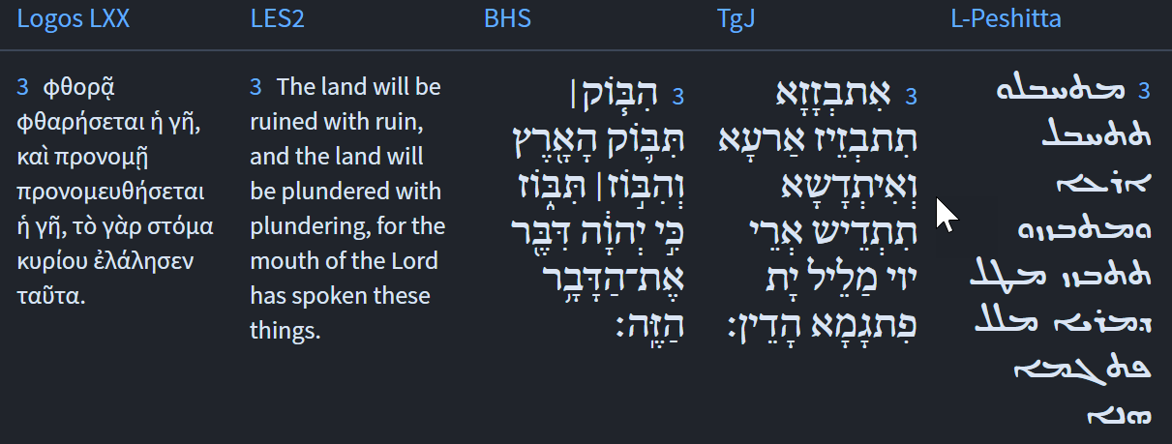
Isaiah / ישעיה
http://www.matsati.com

Slide 11
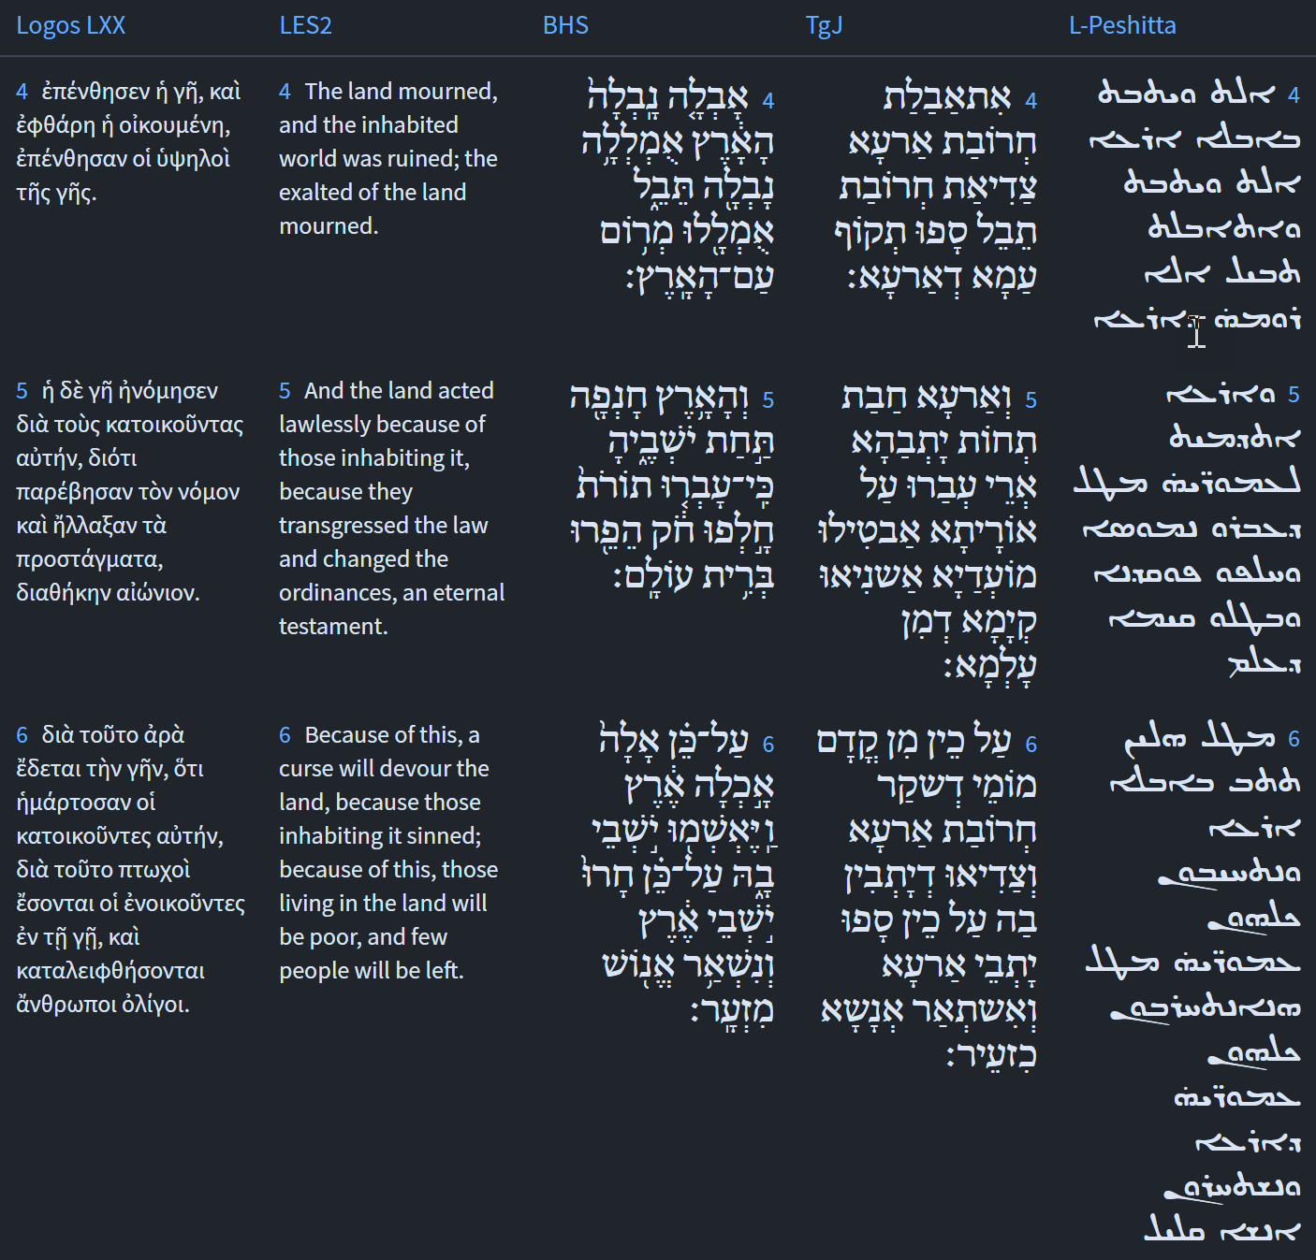
Isaiah / ישעיה
http://www.matsati.com

Slide 12
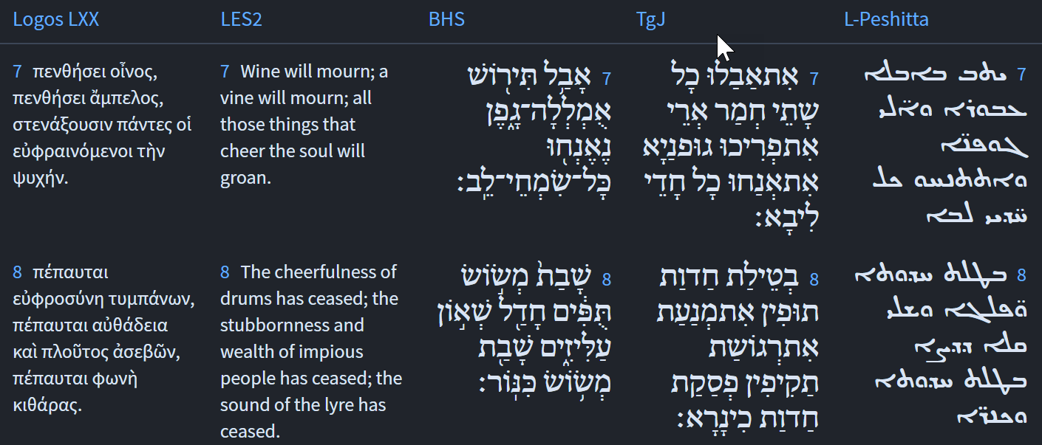
Isaiah / ישעיה
http://www.matsati.com

Slide 13
Rabbinic Literature
ספרות רבנית
Part 2
Isaiah / ישעיה
http://www.matsati.com

Slide 14
Targum Jonathan son of Uziel Isaiah 24:1-8
24:1 Behold, the Lord shall spoil the land and deliver it over to the enemy; and confusion shall cover the faces of the princes, because they have transgressed the law, and scattered its inhabitants. 24:2 And it shall be, as with the laity, so with the priest; as with the servant, so with his master; as with the handmaid, so with her mistress; as with the buyer, so with the seller; as with the borrower, so with the lender: as with the giver of usury, so with the usurer. 24:3 The land shall be utterly destroyed, it shall be utterly trampled under foot; for the Lord hath spoken this word. 24:4 The land mourneth, it is laid desolate; the world is laid waste, it is laid desolate: the strength of the people of the land hath come to an end. 24:5 The land hath become guilty beneath her inhabitants, because they have transgressed the law, and they have made the festivals to cease, they have changed the everlasting covenant. 24:6 Because of perjury the land hath become a desert, and all the inhabitants in it are laid desolate: therefore are the inhabitants of the land destroyed, and the men that are left are but few. 24:7 All that drink wine mourn, because the vines are broken down, all the merry-hearted sigh. 24:8 The mirth of tabrets ceaseth; the tumultuous assembly of the mighty is restrained, the joy of the harp ceaseth. (TgJ)
Isaiah / ישעיה
http://www.matsati.com

Slide 15
ספר תהילים פרק יט
ח תּוֹרַת יְהֹוָה תְּמִימָה מְשִׁיבַת נָפֶשׁ עֵדוּת יְהֹוָה נֶאֱמָנָה מַחְכִּימַת פֶּתִי:
Tehillim / Psalms 19:7
19:7 The law of the LORD is perfect, converting the soul: The testimony of the LORD is sure, making wise the simple. (KJV)
﻿ספר תהילים פרק קיט
א אַשְׁרֵי תְמִימֵי-דָרֶךְ הַהֹלְכִים בְּתוֹרַת יְהֹוָה:
Tehillim / Psalms 119:1
119:1 Blessed are the undefiled in the way, Who walk in the law of the LORD. (KJV)
Isaiah / ישעיה
http://www.matsati.com

Slide 16
Talmud Bavli Shabbat 119b:8
Rav Hamnuna said: Jerusalem was destroyed only because schoolchildren there were interrupted from studying Torah, as it is stated: “And I am filled with the wrath of God, I cannot contain it, pour it onto the infants in the street and onto the gathering of youths together, for men and women alike will be captured, the elderly along with those of advanced years” (Jeremiah 6:11). Rav Hamnuna explains: What is the reason that the wrath is poured? It is because infants are outside in the streets and are not studying Torah. Ulla said: Jerusalem was destroyed only because people had no shame before each other, as it is stated: “They acted shamefully; they have performed abominations, yet they neither were ashamed nor did they know humiliation. Therefore, they will fall among the fallen, they will fail at the time that I punish them, said God” (Jeremiah 6:15). Rabbi Yitzḥak said: Jerusalem was destroyed only because its small and the great citizens were equated. They did not properly value the prominent leaders of their generation, as it is stated: “And the common people were like the priest, the slave like his master, the maidservant like her mistress, the buyer like the seller, the lender like the borrower, the creditor like the one indebted to him” (Isaiah 24:2). And it is written afterward: “The land shall be utterly desolate and completely plundered, for God has said this” (Isaiah 24:3).
Isaiah / ישעיה
http://www.matsati.com

Slide 17
ספר שמות פרק יט
ג וּמֹשֶׁה עָלָה אֶל-הָאֱלֹהִים וַיִּקְרָא אֵלָיו יְהוָֹה מִן-הָהָר לֵאמֹר כֹּה תֹאמַר לְבֵית יַעֲקֹב וְתַגֵּיד לִבְנֵי יִשְֹרָאֵל: ד אַתֶּם רְאִיתֶם אֲשֶׁר עָשִֹיתִי לְמִצְרָיִם וָאֶשָּׂא אֶתְכֶם עַל-כַּנְפֵי נְשָׁרִים וָאָבִא אֶתְכֶם אֵלָי: ה וְעַתָּה אִם-שָׁמוֹעַ תִּשְׁמְעוּ בְּקֹלִי וּשְׁמַרְתֶּם אֶת-בְּרִיתִי וִהְיִיתֶם לִי סְגֻלָּה מִכָּל-הָעַמִּים כִּי-לִי כָּל-הָאָרֶץ: ו וְאַתֶּם תִּהְיוּ-לִי מַמְלֶכֶת כֹּהֲנִים וְגוֹי קָדוֹשׁ אֵלֶּה הַדְּבָרִים אֲשֶׁר תְּדַבֵּר אֶל-בְּנֵי יִשְֹרָאֵל
Shemot / Exodus 19:3-6
19:3 And Moses went up unto God, and the LORD called unto him out of the mountain, saying, Thus shalt thou say to the house of Jacob, and tell the children of Israel; 19:4 Ye have seen what I did unto the Egyptians, and how I bare you on eagles’ wings, and brought you unto myself. 19:5 Now therefore, if ye will obey my voice indeed, and keep my covenant, then ye shall be a peculiar treasure unto me above all people: for all the earth is mine: 19:6 And ye shall be unto me a kingdom of priests, and an holy nation. These are the words which thou shalt speak unto the children of Israel. (KJV)
Isaiah / ישעיה
http://www.matsati.com

Slide 18
Rashi on Isaiah 24,4 Part 1-4
נבלה. כמו (ירמיהו ח׳:י״ג) והעלה נבל ל' כמש ותשות כח:
it has withered (נָבְלָה) Comp. (Jeremiah 8:13) “And the leaf has withered (נָבֵל).” An expression of withering and languishing.
אומללה. ל' שפלות כמו היהודים האמללים (נחמיה ה' ג):
has been humbled (אֻמְלְלָה), an expression of humility. Comp. (Neh. 3: 34) “humble Jews (אֻמְלָלִים).”
תבל. היא א"י שהיא מתובלת במצות הרבה:
The land (תֵּבֵל) This is the land of Israel, which is spiced (מְתֻבֶּלֶת) with many commandments.
מרום עם הארץ. גאון עם הארץ:
the highest of the people of the land the pride of the people of the land.
Isaiah / ישעיה
http://www.matsati.com

Slide 19
Midrash Tanchuma Buber, Re'eh 11:1
(Is. 24:5:) AND THE EARTH WAS DEFILED UNDER ITS INHABITANTS, <BECAUSE THEY TRANSGRESSED TORAHS;27Torot. Such a literal translation is required by the midrash. In the biblical context the word denotes something more general, such as teachings. THEY VIOLATED A STATUTE; THEY BROKE AN ETERNAL COVENANT>. It may show you standing grain, but it does not show you a shock of sheaves. 28 Tanh., Deut. 4:14; PRK 10:5; see PR 25:3. It may show you a shock of sheaves, but it does not show you a threshing floor. It may show you a threshing floor, but it does not show winnowed heap. Why <not>? (Ibid.:) BECAUSE THEY TRANSGRESSED TORAHS; THEY VIOLATED STATUTES, in that they did transgress two Torahs, Written Torah and Oral Torah. (Ibid.:) THEY VIOLATED A STATUTE, the statute of tithes. (Ibid.:) THEY BROKE AN ETERNAL COVENANT, an ancestral covenant. For that reason Moses warned Israel (in Deut. 14:22): YOU SHALL SURELY TITHE.
Isaiah / ישעיה
http://www.matsati.com

Slide 20
Ibn Ezra on Isaiah 24,5 Part 1-3
תורות The laws. The laws which are dictated by common sense, in which all agree.10חּוֹרה and חֹק are generally distinguished by saying that the former refers to those laws which society would make even without revelation; the latter, to such laws as would not be made without direct command in Scripture. This distinction is not applicable here, because the prophet speaks in this passage of laws that concern all nations. The explanation, however, given here by I. E., does not agree with his remark on Gen. 26:5, where תורה is explained to refer to the law of circumcision. What I. E. means by the laws contained in the natural order of things or by the covenant of the universe is more clearly stated in his commentary on Gen. 26:5, namely, שילך אדם אחרי מעשיו Man shall follow the ways of God displayed in his works. Comp. I. E. on Lev. 19:19.10חּוֹרה and חֹק A. V., Changed. are generally distinguished by saying that the former refers to those laws which society would make even without revelation; the latter, to such laws as would not be made without direct command in Scripture. This distinction is not applicable here, because the prophet speaks in this passage of laws that concern all nations. The explanation, however, given here by I. E., does not agree with his remark on Gen. 26:5, where תורה is explained to refer to the law of circumcision. What I. E. means by the laws contained in the natural order of things or by the covenant of the universe is more clearly stated in his commentary on Gen. 26:5, namely, שילך אדם אחרי מעשיו Man shall follow the ways of God displayed in his works. Comp. I. E. on Lev. 19:19.
Isaiah / ישעיה
http://www.matsati.com

Slide 21
Ibn Ezra on Isaiah 24,5 Part 1-3, cont…
והארץ חנפה. תורות, שקול הדעת שכל בני אדם משתוי' בו: תורות The laws. The laws which are dictated by common sense, in which all agree.10חּוֹרה and חֹק are generally distinguished by saying that the former refers to those laws which society would make even without revelation; the latter, to such laws as would not be made without direct command in Scripture. This distinction is not applicable here, because the prophet speaks in this passage of laws that concern all nations. The explanation, however, given here by I. E., does not agree with his remark on Gen. 26:5, where תורה is explained to refer to the law of circumcision. What I. E. means by the laws contained in the natural order of things or by the covenant of the universe is more clearly stated in his commentary on Gen. 26:5, namely, שילך אדם אחרי מעשיו Man shall follow the ways of God displayed in his works. Comp. I. E. on Lev. 19:19. חּוֹרה and חֹק A. V., Changed. are generally distinguished by saying that the former refers to those laws which society would make even without revelation; the latter, to such laws as would not be made without direct command in Scripture. This distinction is not applicable here, because the prophet speaks in this passage of laws that concern all nations. The explanation, however, given here by I. E., does not agree with his remark on Gen. 26:5, where תורה Is explained to refer to the law of circumcision. What I. E. means by the laws contained in the natural order of things or by the covenant of the universe is more clearly stated in his commentary on Gen. 26:5, namely, שילך אדם אחרי מעשיו Man shall follow the ways of God displayed in his works. Comp. I. E. on Lev. 19:19. חלפו חוק. כרתו כמו כליל יחלוף (ישעיהו ב' י"ח): חלפו They have abolished. Comp. יחלוף, he shall abolish (2:18). חק. הם חוקי השם כפי התולדת, וזה הוא טעם 'ברית עולם': חק Ordinance. The laws of God, contained in the natural order of things; and this is likewise the meaning of ברית עולם, the covenant of the universe.
Isaiah / ישעיה
http://www.matsati.com

Slide 22
ספר בראשית פרק כו
ה עֵקֶב אֲשֶׁר-שָׁמַע אַבְרָהָם בְּקֹלִי וַיִּשְׁמֹר מִשְׁמַרְתִּי מִצְוֹתַי חֻקּוֹתַי וְתוֹרֹתָי:
Bereshit / Genesis 26:5
5 Because that Abraham obeyed my voice, and kept my charge, my commandments, my statutes, and my laws. (KJV)
Isaiah / ישעיה
http://www.matsati.com

Slide 23
Romans 2:12-16
2:12 For as many as have sinned without law shall also perish without law: and as many as have sinned in the law shall be judged by the law; 2:13 (For not the hearers of the law are just before God, but the doers of the law shall be justified. 2:14 For when the Gentiles, which have not the law, do by nature the things contained in the law, these, having not the law, are a law unto themselves: 2:15 Which shew the work of the law written in their hearts, their conscience also bearing witness, and their thoughts the mean while accusing or else excusing one another;) 2:16 In the day when God shall judge the secrets of men by Jesus Christ according to my gospel. (KJV, ܐܱܝܠܷܝܢ ܓܷ݁ܝܪ ܕܱ݁ܕ݂ܠܴܐ ܢܳܡܽܘܣܳܐ ܚܛܱܘ ܆ ܐܴܦ݂ ܕ݁ܠܴܐ ܢܳܡܽܘܣܳܐ ܢܺܐܒ݂ܕܾ݁ܘܢ ܂ ܘܰܐܝܠܷܝܢ ܕܱ݁ܒ݂ܢܳܡܽܘܣܳܐ ܚܛܱܘ ܆ ܡܶܢ ܢܳܡܽܘܣܳܐ ܢܶܬ݁ܕ݂ܺܝܢܽܘܢ ܂ܠܴܐ ܗ̄ܘܳܐ ܓܷ݁ܝܪ ܫܳܡܽܘܥܰܘܗ̄ܝ̈ ܕ݁ܢܳܡܽܘܣܳܐ ܟܻ݁ܐܢܺܝܢ ܩܕ݂ܳܡ ܐܱܠܴܗܳܐ ܆ ܐܷܠܴܐ ܥܳܒ݂ܽܘܕ݂ܰܘܗ̄ܝ̈ ܕ݁ܢܳܡܽܘܣܳܐ ܡܶܙܕܱ݁ܕ݁ܩܺܝܢ ܂ ܐܷܢ ܓܷ݁ܝܪ ܥܰܡ̄ܡܷ̈ܐ ܕ݁ܢܳܡܽܘܣܳܐ ܠܱܝܬ݁ ܠܗܽܘܢ ܇ ܡܶܢ ܟ݁ܝܳܢܗܽܘܢ ܢܶܥܒ݁ܕ݂ܽܘܢ ܕ݁ܢܳܡܽܘܣܳܐ ܆ ܗܳܢܽܘܢ ܕ݁ܟ݂ܰܕ݂ ܢܳܡܽܘܣܳܐ ܠܱܝܬ݁ ܗ̄ܘܳܐ ܠܗܽܘܢ ܆ ܠܢܰܦ݂ܫܗܽܘܢ ܗܘܰܘ ܢܳܡܽܘܣܳܐ ܂ ܘܗܶܢܽܘܢ ܡܚܰܘܶܝܢ ܥܒ݂ܳܕ݂ܶܗ ܕ݁ܢܳܡܽܘܣܳܐ ܂ ܟܱ݁ܕ݂ ܟ݁ܬ݂ܻܝܒ݂ ܥܰܠ ܠܷܒ݁ܗܽܘܢ ܂ ܘܡܰܣܗܕ݂ܳܐ ܥܠܱܝܗܽܘܢ ܬܻ݁ܐܪܬ݁ܗܽܘܢ ܂ ܟܱ݁ܕ݂ ܡܰܚܫܒ݂ܳܬ݂ܗܽܘܢ̈ ܡܟ݂ܰܘܢܴ̈ܢ ܂ ܐܱܘ ܢܳܦ݂ܩܳܢ̈ ܪܾܘܚܳܐ ܂ ܠܱܚ̈ܕ݂ܳܕ݂ܶܐ ܇ ܒ݁ܝܰܘܡܳܐ ܕ݁ܕ݂ܳܐܷܢ ܐܱܠܴܗܳܐ ܟܱ݁ܣܝܴ̈ܬ݂ܴܐ ܕܱ݁ܒ݂ܢܰܝ̈ܢܳܫܳܐ ܇ ܐܱܝܟ݂ ܐܷܘܰܢܓܷ݁ܠܻܝܳܘܢ ܕܻ݁ܝܠܝ ܒ݁ܝܰܕ݂ ܝܶܫܽܘܥ ܡܫܺܝܚܳܐ 12 Ὅσοι γὰρ ἀνόμως ἥμαρτον, ἀνόμως καὶ ἀπολοῦνται· καὶ ὅσοι ἐν νόμῳ ἥμαρτον, διὰ νόμου κριθήσονται· 13 οὐ γὰρ οἱ ἀκροαταὶ νόμου δίκαιοι παρὰ τῷ θεῷ, ἀλλʼ οἱ ποιηταὶ νόμου δικαιωθήσονται. 14 ὅταν γὰρ ἔθνη τὰ μὴ νόμον ἔχοντα φύσει τὰ τοῦ νόμου ποιῶσιν, οὗτοι νόμον μὴ ἔχοντες ἑαυτοῖς εἰσὶν νόμος, 15 οἵτινες ἐνδείκνυνται τὸ ἔργον τοῦ νόμου γραπτὸν ἐν ταῖς καρδίαις αὐτῶν συνμαρτυρούσης αὐτῶν τῆς συνειδήσεως καὶ μεταξὺ ἀλλήλων τῶν λογισμῶν κατηγορούντων ἢ καὶ ἀπολογουμένων, 16 ἐν ἡμέρᾳ ὅτε κρινεῖ ὁ θεὸς τὰ κρυπτὰ τῶν ἀνθρώπων κατὰ τὸ εὐαγγέλιόν μου διὰ Ἰησοῦ χριστοῦ.)
Isaiah / ישעיה
http://www.matsati.com

Slide 24
Talmud Bavli Gittin 7a:9
וְלִישְׁלַח לְהוּ מֵהָכָא בַּשִּׁיר לֹא יִשְׁתּוּ יָיִן יֵמַר שֵׁכָר לְשׁוֹתָיו אִי מֵהָהוּא הֲוָה אָמֵינָא הָנֵי מִילֵּי זִמְרָא דְמָנָא אֲבָל דְּפוּמָּא שְׁרֵי קָא מַשְׁמַע לַן
The Gemara asks: And let him send them a response from here: “They do not drink wine with a song; strong drink is bitter to them who drink it” (Isaiah 24:9), indicating that song is no longer allowed. The Gemara answers: If he had answered by citing that verse, I would say that this matter applies only to instrumental music, in accordance with the previous verse: “The mirth of tabrets ceases, the noise of them who rejoice ends, the joy of the harp ceases” (Isaiah 24:8); however, vocal song is permitted. Therefore, Mar Ukva teaches us that all types of song are forbidden
Isaiah / ישעיה
http://www.matsati.com

