Slide 1
MATSATI.COM Teaching Ministry
The Book of Isaiah
Isaiah 23:10-18
ישעיהו כג:י-יח
Isaiah / ישעיה
http://www.matsati.com

Slide 2
﻿ספר ישעיה פרק כג
﻿י עִבְרִי אַרְצֵךְ כַּיְאֹר בַּת-תַּרְשִׁישׁ אֵין מֵזַח עוֹד: יא יָדוֹ נָטָה עַל-הַיָּם הִרְגִּיז מַמְלָכוֹת יְהֹוָה צִוָּה אֶל-כְּנַעַן לַשְׁמִד מָעֻזְנֶיהָ: יב וַיֹּאמֶר לֹא-תוֹסִיפִי עוֹד לַעֲלוֹז הַמְעֻשָּׁקָה בְּתוּלַת בַּת-צִידוֹן כִּתִּיים [כִּתִּים] קוּמִי עֲבֹרִי גַּם-שָׁם לֹא-יָנוּחַ לָךְ: יג הֵן | אֶרֶץ כַּשְֹדִּים זֶה הָעָם לֹא הָיָה אַשּׁוּר יְסָדָהּ לְצִיִּים הֵקִימוּ בַחיּנָיו [בַחוּנָיו] עוֹרְרוּ אַרְמְנוֹתֶיהָ שָֹמָהּ לְמַפֵּלָה: יד הֵילִילוּ אֳנִיּוֹת תַּרְשִׁישׁ כִּי שֻׁדַּד מָעֻזְּכֶן: טו וְהָיָה בַּיּוֹם הַהוּא וְנִשְׁכַּחַת צֹר שִׁבְעִים שָׁנָה כִּימֵי מֶלֶךְ אֶחָד מִקֵּץ שִׁבְעִים שָׁנָה יִהְיֶה לְצֹר כְּשִׁירַת הַזּוֹנָה: טז קְחִי כִנּוֹר סֹבִּי עִיר זוֹנָה נִשְׁכָּחָה הֵיטִיבִי נַגֵּן הַרְבִּי-שִׁיר לְמַעַן תִּזָּכֵרִי: יז וְהָיָה מִקֵּץ | שִׁבְעִים שָׁנָה יִפְקֹד יְהֹוָה אֶת-צֹר וְשָׁבָה לְאֶתְנַנָּה וְזָנְתָה אֶת-כָּל-מַמְלְכוֹת הָאָרֶץ עַל-פְּנֵי הָאֲדָמָה: יח וְהָיָה סַחְרָהּ וְאֶתְנַנָּהּ קֹדֶשׁ לַיהֹוָה לֹא יֵאָצֵר וְלֹא יֵחָסֵן כִּי לַיֹּשְׁבִים לִפְנֵי יְהֹוָה יִהְיֶה סַחְרָהּ לֶאֱכֹל לְשָֹבְעָה וְלִמְכַסֶּה עָתִיק:
Isaiah / ישעיה
http://www.matsati.com

Slide 3
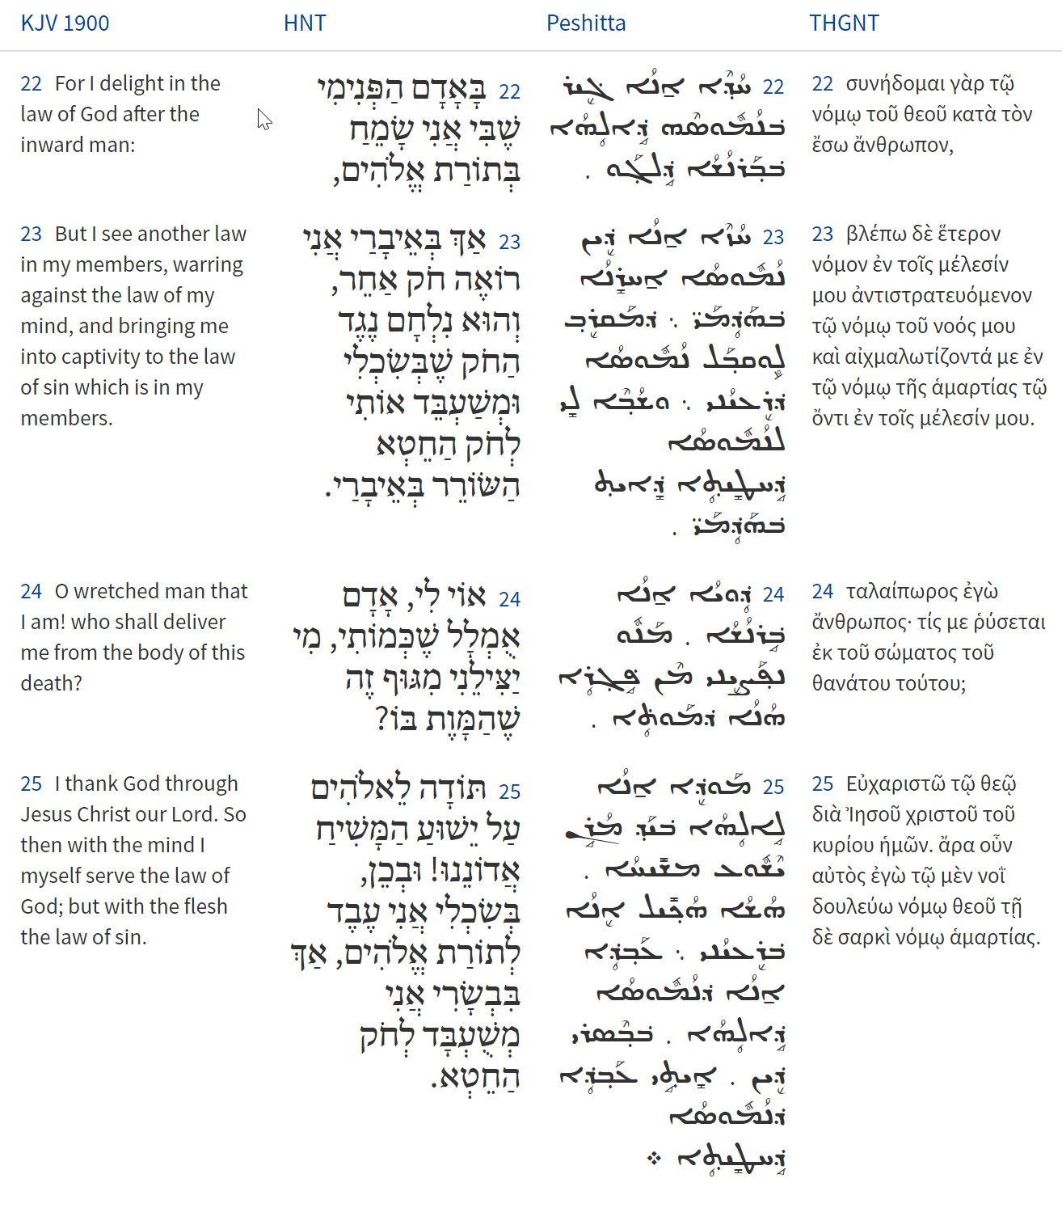
Isaiah / ישעיה
www.matsati.com

Slide 4
Isaiah / ישעיה
www.matsati.com

Slide 5
Ezekiel 27:1-36
27 The word of the LORD came again unto me, saying, 2 Now, thou son of man, take up a lamentation for Tyrus; 3 And say unto Tyrus, O thou that art situate at the entry of the sea, which art a merchant of the people for many isles, Thus saith the Lord GOD; O Tyrus, thou hast said, I am of perfect beauty. 4 Thy borders are in the midst of the seas, thy builders have perfected thy beauty. 5 They have made all thy ship boards of fir trees of Senir: they have taken cedars from Lebanon to make masts for thee. 6 Of the oaks of Bashan have they made thine oars; †the company of the Ashurites have made thy benches of ivory, brought out of the isles of Chittim. 7 Fine linen with broidered work from Egypt was that which thou spreadest forth to be thy sail; blue and purple from the isles of Elishah was that which covered thee. 8 The inhabitants of Zidon and Arvad were thy mariners: thy wise men, O Tyrus, that were in thee, were thy pilots. 9 The ancients of Gebal and the wise men thereof were in thee thy †calkers: all the ships of the sea with their mariners were in thee to occupy thy merchandise. 10 They of Persia and of Lud and of Phut were in thine army, thy men of war: they hanged the shield and helmet in thee; they set forth thy comeliness. 11 The men of Arvad with thine army were upon thy walls round about, and the Gammadims were in thy towers: they hanged their shields upon thy walls round about; they have made thy beauty perfect. 12 Tarshish was thy merchant by reason of the multitude of all kind of riches; with silver, iron, tin, and lead, they traded in thy fairs. 13 Javan, Tubal, and Meshech, they were thy merchants: they traded the persons of men and vessels of brass in thy market. 14 They of the house of Togarmah traded in thy fairs with horses and horsemen and mules. 15 The men of Dedan were thy merchants; many isles were the merchandise of thine hand: they brought thee for a present horns of ivory and ebony. 16 Syria was thy merchant by reason of the multitude of the wares of thy making: they occupied in thy fairs with emeralds, purple, and broidered work, and fine linen, and coral, and agate. 17 Judah, and the land of Israel, they were thy merchants: they traded in thy market wheat of Minnith, and Pannag, and honey, and oil, and balm. 18 Damascus was thy merchant in the multitude of the wares of thy making, for the multitude of all riches; in the wine of Helbon, and white wool.
Isaiah / ישעיה
www.matsati.com

Slide 6
Ezekiel 27:1-36
19 Dan also and Javan going to and fro occupied in thy fairs: bright iron, cassia, and calamus, were in thy market. 20 Dedan was thy merchant in precious clothes for chariots. 21 Arabia, and all the princes of Kedar, they occupied with thee in lambs, and rams, and goats: in these were they thy merchants. 22 The merchants of oSheba and Raamah, they were thy merchants: they occupied in thy fairs with chief of all spices, and with all precious stones, and gold. 23 Haran, and Canneh, and Eden, the merchants of Sheba, Asshur, and Chilmad, were thy merchants. 24 These were thy merchants in all sorts of things, in blue clothes, and broidered work, and in chests of rich apparel, bound with cords, and made of cedar, among thy merchandise. 25 The ships of Tarshish did sing of thee in thy market: and thou wast replenished, and made very glorious in the midst of the seas. 26 Thy rowers have brought thee into great waters: the east wind hath broken thee in the midst of the seas. 27 Thy riches, and thy fairs, thy merchandise, thy mariners, and thy pilots, thy calkers, and the occupiers of thy merchandise, and all thy men of war, that are in thee, and in all thy company which is in the midst of thee, shall fall into the midst of the seas in the day of thy ruin. 28 The suburbs shall shake at the sound of the cry of thy pilots. 29 And all that handle the oar, the mariners, and all the pilots of the sea, shall come down from their ships, they shall stand upon the land; 30 And shall cause their voice to be heard against thee, and shall cry bitterly, and shall cast up dust upon their heads, they shall wallow themselves in the ashes: 31 And they shall make themselves utterly bald for thee, and gird them with sackcloth, and they shall weep for thee with bitterness of heart and bitter wailing. 32 And in their wailing they shall take up a lamentation for thee, and lament over thee, saying, What city is like Tyrus, like the destroyed in the midst of the sea? 33 When thy wares went forth out of the seas, thou filledst many people; thou didst enrich the kings of the earth with the multitude of thy riches and of thy merchandise. 34 In the time when thou shalt be broken by the seas in the depths of the waters thy merchandise and all thy company in the midst of thee shall fall. 35 All the inhabitants of the isles shall be astonished at thee, and their kings shall be sore afraid, they shall be troubled in their countenance. 36 The merchants among the people shall hiss at thee; thou shalt be a terror, and never shalt be any more. (KJV)
Isaiah / ישעיה
www.matsati.com

Slide 7
The HALOT Lexicon states the following,
“Kittim n.pop., original, inhabitants ofכת Κίτιον (:: Brandenstein 72); in OT: —1. בְּנֵי יָוָן, grandchildren of יֶפֶת Gn 10:4 1C 1:7; —2. people from southern Cyprus Is 23:1, 12 Ezk 27:6 (Zimmerli 640); —3. אִיֵּי כִ׳ the Greek Archipelago :: קֵדָר as representative of the East Jr 2:10 (Rudolph 14); 1Macc 11 85 the Macedonian empire; —4. adj. צִיִּים כִּתִּים Da 11:30 the Romans, also Nu 24:24 (Vulg.); —5. in DSS: כתיאים and כתיים, in 1QpHab and Mish., 4Qp Nah, Isa; Rowley PEQ 88 (1956):1ff.; Reicke-R. Hw. 299.”
Isaiah / ישעיה
www.matsati.com

Slide 8
Isaiah / ישעיה
www.matsati.com

Slide 9
ספר דברים פרק ח
יח וְזָֽכַרְתָּ֙ אֶת־יְהוָ֣ה אֱלֹהֶ֔יךָ כִּ֣י ה֗וּא הַנֹּתֵ֥ן לְךָ֛ כֹּ֖חַ לַעֲשֹׂ֣ות חָ֑יִל לְמַ֨עַן הָקִ֧ים אֶת־בְּרִיתֹ֛ו אֲשֶׁר־נִשְׁבַּ֥ע לַאֲבֹתֶ֖יךָ כַּיֹּ֥ום הַזֶּֽה׃
Devarim / Deuteronomy 8:18
18 But thou shalt remember the LORD thy God: for it is he that giveth thee power to get wealth, that he may establish his covenant which he sware unto thy fathers, as it is this day. (KJV)
Isaiah / ישעיה
www.matsati.com

Slide 10
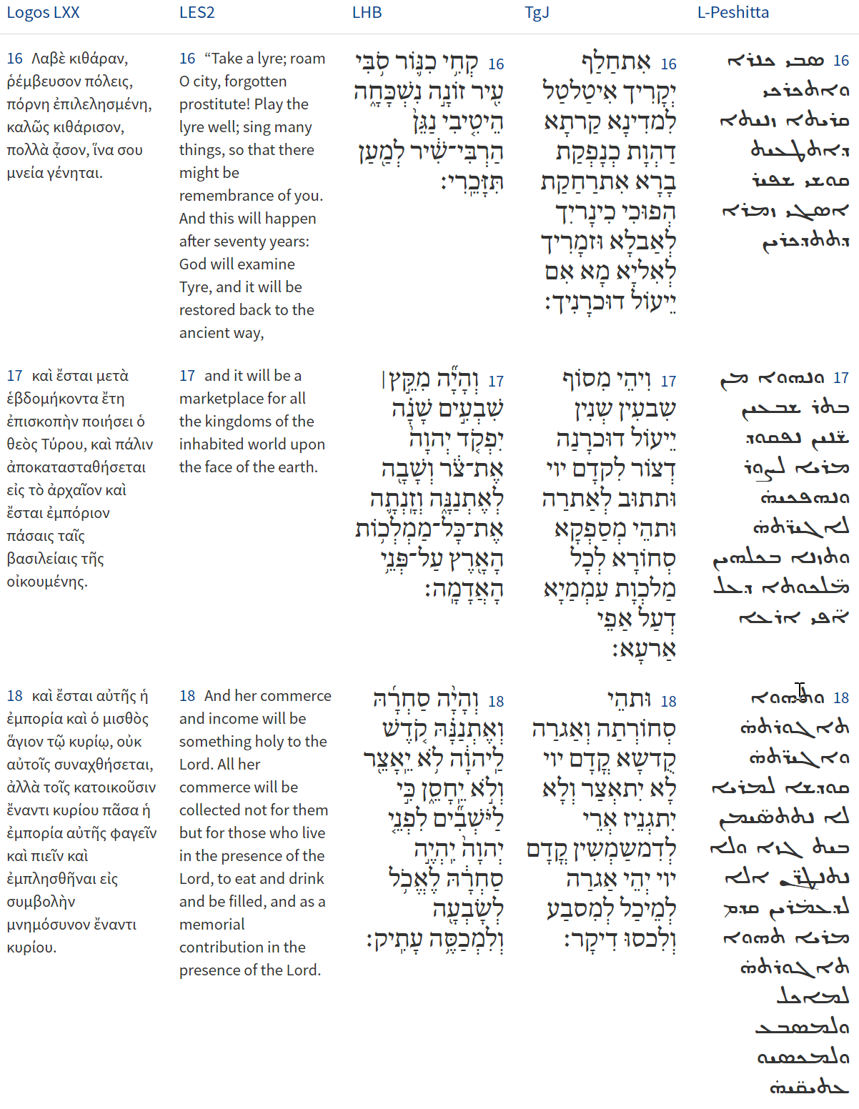
PTOLEMY (PERSON) [Gk Ptolemaios (Πτολεμαιος)]. A name of Macedonian origin (Gk ptolemaios “warlike”) borne by the founder and, as a dynastic name, by all subsequent rulers of the line of Greek-speaking kings who ruled Egypt after the death of Alexander the Great (323 b.c.) until the country’s annexation by Rome (30 b.c.). Hence the line is known as the Ptolemaic dynasty; the period of its rule is often referred to as the Ptolemaic period; and the kings are usually referred to as the Ptolemies. They are of biblical interest because the struggles of the earlier Ptolemies with the Seleucid kings of Syria for control of Palestine led them into close contact with the Jews, toward whom they were generally well-disposed. Moreover, their promotion of Alexandria as a center of literature and scholarship was to have a profound effect upon the development of scholarship and learning in the early Christian church because the Church Fathers in essence adopted the scholarly methods of the classical tradition while rejecting its pagan content. (Anchor Yale Bible Dictionary)
Isaiah / ישעיה
www.matsati.com

Slide 11
ספר דברים פרק כג
﻿יח לֹא-תִהְיֶה קְדֵשָׁה מִבְּנוֹת יִשְֹרָאֵל וְלֹא-יִהְיֶה קָדֵשׁ מִבְּנֵי יִשְֹרָאֵל:
Devarim / Deuteronomy 23:18
23:18 Thou shalt not bring the hire of a whore, or the price of a dog, into the house of the LORD thy God for any vow: for even both these are abomination unto the LORD thy God. (KJV)
Isaiah / ישעיה
www.matsati.com

Slide 12
2 Peter 1:8-11
1:8 For if these things be in you, and abound, they make you that ye shall neither be barren nor unfruitful in the knowledge of our Lord Jesus Christ. 1:9 But he that lacketh these things is blind, and cannot see afar off, and hath forgotten that he was purged from his old sins. 1:10 Wherefore the rather, brethren, give diligence to make your calling and election sure: for if ye do these things, ye shall never fall: 1:11 For so an entrance shall be ministered unto you abundantly into the everlasting kingdom of our Lord and Savior Jesus Christ. (KJV, ܗܳܠܷܝܢ ܓܷ݁ܝܪ ܟܱ݁ܕ݂ ܫܟ݂ܺܝ̈ܚܳܢ ܠܟ݂ܽܘܢ ܘܝܰܬܻ݁ܝܪܴ̈ܢ ܆ ܠܴܐ ܗ̄ܘܳܐ ܒܱ݁ܛܻܝ̈ܠܷܐ ܐܴܦ݂ܠܴܐ ܕ݁ܠܴܐ ܦܻ݁ܐܪܷ̈ܐ ܁ ܡܩܺܝ̈ܡܳܢ ܠܟ݂ܽܘܢ ܇ ܒ݁ܫܽܘܘܕܴ݁ܥܶܗ ܕ݁ܡܳܪܱܢ ܝܶܫܽܘܥ ܡܫܺܝܚܳܐ ܂ܗܰܘ ܓܷ݁ܝܪ ܕ݁ܠܴܐ ܫܟ݂ܺܝ̈ܚܳܢ ܠܷܗ ܗܳܠܷܝܢ ܆ ܣܰܡܝܳܐ ܐܻܝܬ݂ܱܘܗ̄ܝ ܁ ܕ݁ܠܴܐ ܚܳܙܶܐ ܇ ܕܱ݁ܛܥܳܐ ܕܾ݁ܘܟܴ݁ܝܳܐ ܕܱ݁ܚܛܴܗܰܘܗ̄ܝ̈ ܩܰܕ݂ܡܳܝܷ̈ܐ ܂ ܘܥܰܠ ܗܳܝ ܝܰܬܻ݁ܝܪܴܐܝܺܬ݂ ܐܱܚܰܝ̈ ܆ ܝܺܨܱܦ݂ܘ ܕܱ݁ܒ݂ܝܰܕ݂ ܥܒ݂ܳܕ݂ܰܝ̈ܟܾ݁ܘܢ ܛܴܒ݂ܷ̈ܐ ܇ ܩܪܴܝܬ݁ܟ݂ܽܘܢ ܘܰܓ݂ܒ݂ܺܝܬ݂ܟ݂ܽܘܢ ܡܫܰܪܱܪܬܴ݁ܐ ܬܷ݁ܥܒ݁ܕ݂ܽܘܢ ܂ ܟܱ݁ܕ݂ ܓܷ݁ܝܪ ܗܳܠܷܝܢ ܥܳܒ݂ܕܻ݁ܝܢ ܐܢ̄ܬܾ݁ܘܢ ܆ ܠܴܐ ܡܬ݂ܾܘܡ ܡܶܫܬܱ݁ܪܥܺܝܢ ܐܢ̄ܬܾ݁ܘܢ ܂ ܗܳܟ݂ܰܢܳܐ ܓܷ݁ܝܪ ܥܰܬܻ݁ܝܪܴܐܝܺܬ݂ ܡܶܬ݂ܝܰܗ̄ܒ݂ܳܐ ܠܟ݂ܽܘܢ ܆ ܡܰܥܰܠܬܴ݁ܐ ܕ݁ܡܰܠܟܾ݁ܘܬ݂ܴܐ ܕܱ݁ܠܥܳܠܱܡ ܁ ܕ݁ܡܳܪܱܢ ܘܦ݂ܳܪܾܘܩܰܢ ܂ ܝܶܫܽܘܥ ܡܫܺܝܚܳܐ ܀ 8 ταῦτα γὰρ ὑμῖν ὑπάρχοντα καὶ πλεονάζοντα οὐκ ἀργοὺς οὐδὲ ἀκάρπους καθίστησιν εἰς τὴν τοῦ κυρίου ἡμῶν Ἰησοῦ χριστοῦ ἐπίγνωσιν. 9 ᾯ γὰρ μὴ πάρεστιν ταῦτα, τυφλός ἐστιν μυωπάζων, λήθην λαβὼν τοῦ καθαρισμοῦ τῶν πάλαι αὐτοῦ ἁμαρτιῶν. 10 διὸ μᾶλλον, ἀδελφοί, σπουδάσατε βεβαίαν ὑμῶν τὴν κλῆσιν καὶ ἐκλογὴν ποιεῖσθαι· ταῦτα γὰρ ποιοῦντες οὐ μὴ πταίσητέ ποτε. 11 οὕτως γὰρ πλουσίως ἐπιχορηγηθήσεται ὑμῖν ἡ εἴσοδος εἰς τὴν αἰώνιον βασιλείαν τοῦ κυρίου ἡμῶν καὶ σωτῆρος Ἰησοῦ χριστοῦ.)
Isaiah / ישעיה
www.matsati.com

Slide 13
Rabbinic Literature
ספרות רבנית
Part 2
Isaiah / ישעיה
www.matsati.com

Slide 14
Targum Jonathan son of Uziel Isaiah 23:10-18
23:10 Remove from thy land, as the waters of a river; flee to a province of the sea: there is no more strength. 23:11 His power is lifted up against the sea, to make the kingdom to tremble; the Lord has given the command concerning the merchant city, to make an end of her strength. 23:12 And he said, ye shall no more be strong, ye that did violence to the people which are in Zidon. Arise, pass over to Chittim; even there ye shall have no rest. 23:13 Behold the land of the Chaldeans, this is the people that formerly did not exist; the Assyrians founded it in the islands; they raised up her beacons, they destroyed her palaces, they have made her a ruinous heap. 23:14 Howl, ye that are embarking in ships of the sea, for the seacoast of your strength is spoiled. 23:15 And it shall come to pass at that time, that Tyre shall be put by for seventy years, according to the days of one king: at the end of seventy years, it shall be unto Tyre as the song of an harlot. 23:16 Thy glory is changed: wander to another country, O city, who hast been as an harlot, thou art doomed to oblivion: thy harp is turned into mourning, and thy song to lamentation; perhaps, thou mayest be remembered. 23:17 And it shall come to pass after the end of seventy years that Tyre shall be remembered before the Lord; and she shall return to her place, and her mart shall be plentiful for all the kingdoms of the nations, which are upon the face of the earth. 23:18 And her merchandise and her gain shall be holy before the Lord, it shall not be treasured nor laid up; for it shall be for them that are serving before the Lord; her gain shall be for food sufficient, and for vestments of glory. (TgJ)
Isaiah / ישעיה
www.matsati.com

Slide 15
Isaiah / ישעיה
www.matsati.com

Slide 16
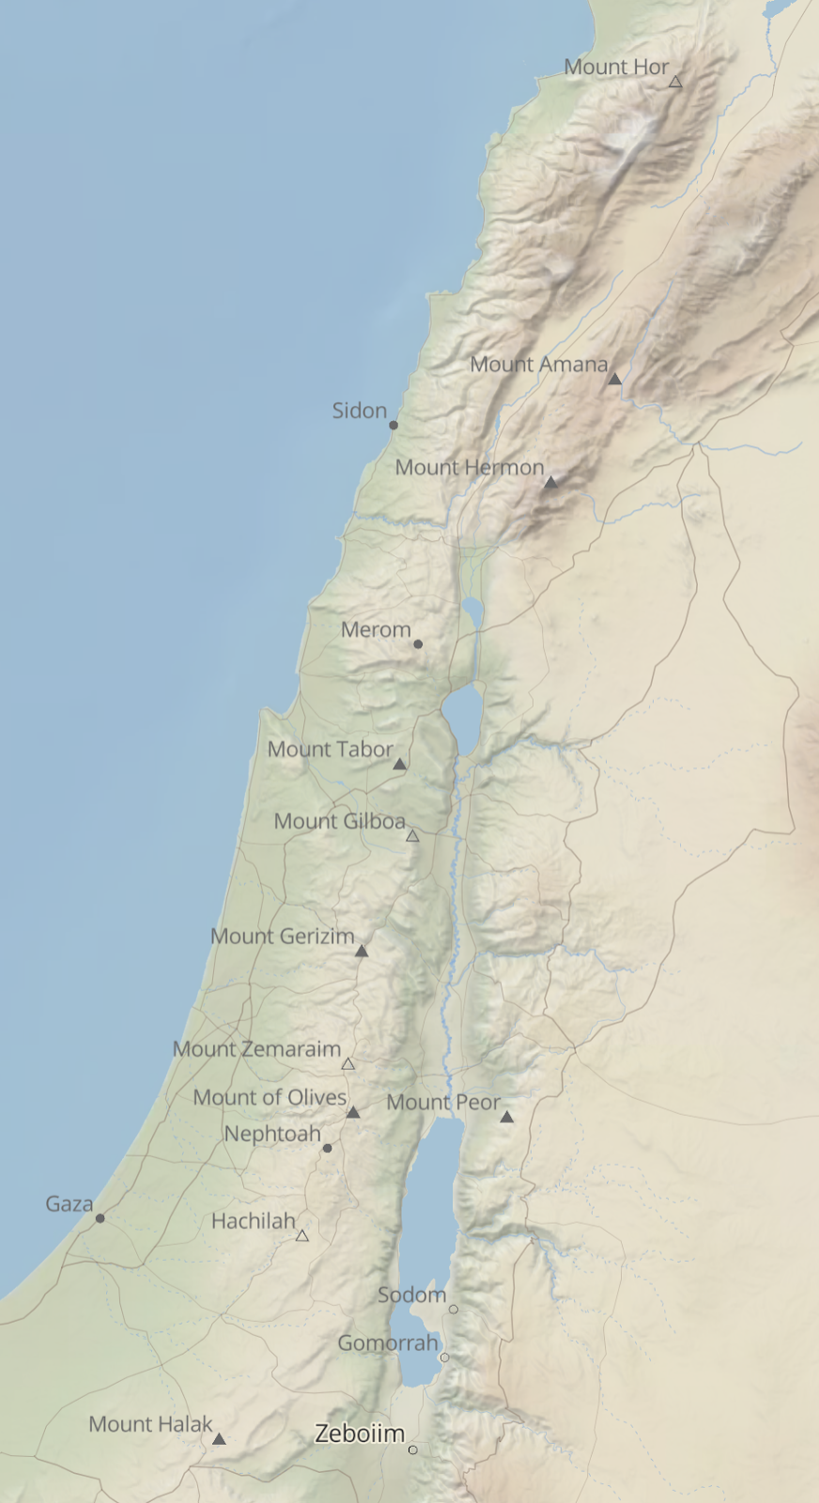
Rashi on Isaiah 23:12 Part 1
כתים. אל ארץ כתים קומי עבורי גם שם לא ינוח לך למה אני אומר קומי עבורי:
to Kittim to the land of Kittim, arise and cross; even there you shall have no rest. Why do I say, “Arise and cross over?” According to our reading, that of the printed editions, we find no answer to this question. According to some manuscripts, however, the reading is as follows:] to Kittim to the land of Kittim, arise and cross, even there you shall have no rest. Why? Behold the land of the Chaldees They shall exile you from there
Isaiah / ישעיה
www.matsati.com

Slide 17
Midrash Mishlei 30:7
"Four are among the tiniest on earth, and yet they are the wisest of the wise" (Proverbs 30:24) these relate to the various empires and monarchs. "Ants are a folk without power, and yet they prepare food for themselves in summer" (Proverbs 30:25). This refers to the Empire of Babylon. As it is written "Behold the land of Chaldea. This is the people that has ceased to be. Assyria founded it to station ships" (Isaiah 23:13). "The badger is a folk without strength, and yet it makes its home in the rock" (Proverbs 30:26). This refers to the Persian-Median Empire. And what is the meaning of "and yet it makes its home in the rock?" This refers to Ahasuerus and Cyrus who sought to rebuild the Holy Temple in Jerusalem. "The locusts have no king, and yet they all march forth in formation" (Proverbs 30:27). This refers to Alexander the Macedonian, for he overtook the entire world as locusts fly through the air. "You can catch the lizard in your hand, and yet it is found in royal palaces" (Proverbs 30:28). This refers to Edom (i.e., the Roman Empire), for of all the small creatures, none are despised like it. And so it is written "And I hated Esau" (Malachi 1:3). And what is the meaning of "and yet it is found in royal palaces?" This also refers to Edom (i.e., Roman Empire), for they destroyed the Holy Temple. "You can catch the lizard in your hand" Said Rabbi Jeremiah, this is Edom the wicked nation, for everything established there in Israel is now destroyed and forgotten.
Isaiah / ישעיה
www.matsati.com

Slide 18
Rashi on Isaiah 23,13 Part 1-4
הן ארץ כשדים זה העם לא היה. אשר לא כדאי הוא להיות עם שהרי נקראו הגוי המר והנמהר (חבקוק א׳:ו׳) עם שוטה הוא מן הבריות שהקב"ה מתחרט עליהן על שבראם כמו ששנינו שלשה הקב"ה מתחרט עליהם במסכת סוכה: Behold the land of the Chaldees, this people has never been It was not to be a people, for they are called, (Habakkuk 1:6) “bitter, impetuous nation.” They are a foolish nation, of the creatures that the Holy One, blessed be He, (so to speak,) regrets (creating) them. [Tractate Sukkah (52b)].
אשור יסדה. להשכין בה ציים שלו ספינותיו בירניות גדולות כמו צי אדיר (לקמן לג): Assyria established it to station his fleets therein, his ships, huge battle ships, as (infra 33:21): “A mighty fleet (צִי).”
הקימו בחוניו. הם יקימו מצודותיהם על צור, בחוניו ל' עופל ובוחן (לקמן לב) בורפריי"ץ בלע"ז שעושין למצור על הכרכים: they erected its towers They shall erect their fortifications (var., their siege towers) upon Tyre. (Heb.) בַּחוּנָיו, an expression similar to (infra 32:14): “tower and bastion (בֹּחַן),” bajjpred in O.F., which they erect for a siege against walled cities.
עוררו ארמנותיה. יחריבו ל' ערו ערו (תהילים קל״ז:ז׳) ל' נתיצה עד היסוד: destroyed its palaces (עוֹרְרוּ). They shall destroy. (This is) an expression like (Psalms 137:7): “Raze it, raze it ( עָרוּ עָרוּ),” an expression of demolition until the very foundation.
Isaiah / ישעיה
www.matsati.com

Slide 19
Ein Yaakov (Glick Edition), Sanhedrin 11:53
R. Simlai lectured: "What does the passage (Am. 5:18) Woe unto you that long for the day of the Lord, mean? For what do you wish the day of the Lord? It is [one of] darkness and not of light. This might be likened unto a cock and a bat, which were waiting for daybreak. The cock said to the bat, 'I look out for the light, because the light is mine (I see it), but for what purpose do you wait for it?'" Ib. 5:33) And this is what a Sadducee said to R. Abahu: "When will your Messiah appear?" And he answered: "When your people will be surrounded with darkness." "Art thou trying to curse me?" asked the Sadducee. He answered: "No, it is written so (Isa. 60:2) For behold, the darkness shall cover the earth, and a gross darkness the people; but over thee will shine forth the Lord, and His glory will be seen over thee?" We are taught in a Baraitha that R. Elazar says: "Forty years will be the Messianic period, as it is said (Ps. 95:10) Forty years did I feel loathing on this generation." R. Elazar b. Azaryah says: "Seventy years, as it is said (Is. 23:15) And it shall come to pass on that day that Tyre shall be forgotten for seventy years, like the days of one king; i.e., who is meant by the one king? The Messiah is meant." Rabbi, however, says: "It will continue for three generations," as it is said (Ps. 72:5) They shall fear thee, as long as the sun shineth, and in the presence of the moon throughout all generations." R. Hillel, however, says: "Israel has no more Messiah to expect, for they have already enjoyed him in the days of Hezekiah." R. Joseph said: "May the Lord forgive R. Hillel [for his statement] for Hezekiah was there at the time of the first Temple, and Zacharyah, who prophesied at the time of the second Temple, said (Zech. 9:9) Be exceedingly glad, O daughter of Zion; shout, O daughter of Jerusalem! Behold, thy king will come unto thee, righteous and victorious, lowly, and riding upon an ass, and upon a call the foal of a she-ass."
Isaiah / ישעיה
www.matsati.com

Slide 20
Ibn Ezra on Isaiah 23:18:7
ויש שואלים והלא התורה אסרה אתנן זונה (דברים כ"ג י"ט) ואיך אמר הנביא כי אתנן צור הזונה יהיה קודש, התשובה הכתוב בתורה הוא האמת וזה שאמר הנביא הוא על דרך משל ואיננה זונה כלל:
Some ask, How can the prophet promise that the hire of the harlot Tyre will be sanctified to the Lord, since the Law prohibits the hire of an harlot to be brought to the house of the Lord? (Deut. 23:19). The reply to this question is, that the Law prohibits the real hire of an harlot, but the prophet uses the words, her hire, in a figurative sense; in reality, he does not speak of an harlot at all
Midrash Rabbah Bamidbar 13:20 and 21:15
Like one who lights one candle with another, [the leaders of Israel] were filled with the Holy Spirit. They were filled with the Holy Spirit taken from the spirit of Moses, but the Spirit of Moses was not diminished. This is like the case of a man who lights one candle with another. The one candle ignites but the flame on the other candle is not diminished.
Isaiah / ישעיה
www.matsati.com

