Slide 1
Isaiah 22:17-25
ישעיהו כב:יז-כה
Isaiah / ישעיה
http://www.matsati.com

Slide 2
﻿ספר ישעיה פרק כב
﻿יז הִנֵּה יְהֹוָה מְטַלְטֶלְךָ טַלְטֵלָה גָּבֶר וְעֹטְךָ עָטֹה: יח צָנוֹף יִצְנָפְךָ צְנֵפָה כַּדּוּר אֶל-אֶרֶץ רַחֲבַת יָדָיִם שָׁמָּה תָמוּת וְשָׁמָּה מַרְכְּבוֹת כְּבוֹדֶךָ קְלוֹן בֵּית אֲדֹנֶיךָ: יט וַהֲדַפְתִּיךָ מִמַּצָּבֶךָ וּמִמַּעֲמָדְךָ יֶהֶרְסֶךָ: כ וְהָיָה בַּיּוֹם הַהוּא וְקָרָאתִי לְעַבְדִּי לְאֶלְיָקִים בֶּן-חִלְקִיָּהוּ: כא וְהִלְבַּשְׁתִּיו כֻּתָּנְתֶּךָ וְאַבְנֵטְךָ אֲחַזְּקֶנּוּ וּמֶמְשַׁלְתְּךָ אֶתֵּן בְּיָדוֹ וְהָיָה לְאָב לְיוֹשֵׁב יְרוּשָׁלַם וּלְבֵית יְהוּדָה: כב וְנָתַתִּי מַפְתֵּחַ בֵּית-דָּוִד עַל-שִׁכְמוֹ וּפָתַח וְאֵין סֹגֵר וְסָגַר וְאֵין פֹּתֵחַ: כג וּתְקַעְתִּיו יָתֵד בְּמָקוֹם נֶאֱמָן וְהָיָה לְכִסֵּא כָבוֹד לְבֵית אָבִיו: כד וְתָלוּ עָלָיו כֹּל | כְּבוֹד בֵּית-אָבִיו הַצֶּאֱצָאִים וְהַצְּפִעוֹת כֹּל כְּלֵי הַקָּטָן מִכְּלֵי הָאַגָּנוֹת וְעַד כָּל-כְּלֵי הַנְּבָלִים: כה בַּיּוֹם הַהוּא נְאֻם יְהֹוָה צְבָאוֹת תָּמוּשׁ הַיָּתֵד הַתְּקוּעָה בְּמָקוֹם נֶאֱמָן וְנִגְדְּעָה וְנָפְלָה וְנִכְרַת הַמַּשָּׂא אֲשֶׁר-עָלֶיהָ כִּי יְהֹוָה דִּבֵּר:
Isaiah / ישעיה
http://www.matsati.com

Slide 3
Isaiah 22:17
Isaiah / ישעיה
http://www.matsati.com

Slide 4
These events surrounding Isaiah 22:20
Sennacherib’s Campaign Against Judah, 2 Kings 18:13-19:7, 20:20, 2 Chronicles 32:1-19, 32:30, Isaiah 22:9-11, 36:1-37:7
Sennacherib Threatens Jerusalem, 2 Kings 18:17-37, 2 Chronicles 32:9-19, Isaiah 36:2-22
Isaiah Reassures Hezekiah, 2 Kings 19:1-7, Isaiah 37:1-7
Isaiah / ישעיה
http://www.matsati.com

Slide 5
Revelation 3:7
3:7 And to the angel of the church in Philadelphia write; These things saith he that is holy, he that is true, he that hath the key of David, he that openeth, and no man shutteth; and shutteth, and no man openeth; (KJV, ܘܰܠܡܰܠܱܐܟ݂ܳܐ ܕ݁ܥܺܕ̱݁ܬܴ݁ܐ ܕ݁ܦ݂ܺܝܠܱܕ݂ܶܠܦ݂ܺܝܰܐ ܟ݁ܬ݂ܾܘܒ݂ ܆ ܗܳܟ݂ܰܢܳܐ ܐܴܡܰܪ ܩܰܕܻ݁ܝܫܳܐ ܫܰܪܻܝܪܴܐ ܞ ܗܰܘ ܕܻ݁ܐܝܬ݂ ܠܷܗ ܩܠܻܝ̈ܕ݂ܶܐ ܕ݁ܕ݂ܰܘܺܝܕ݂ ܂ ܐܱܝܢܳܐ ܕ݁ܦ݂ܳܬ݂ܱܚ ܘܠܱܝܬ݁ ܕܴ݁ܐܚܶܕ݂ ܂ ܘܳܐܚܶܕ݂ ܘܠܱܝܬ݁ ܕ݁ܦ݂ܳܬ݂ܱܚ ܂ Καὶ τῷ ἀγγέλῳ τῆς ἐν Φιλαδελφίᾳ ἐκκλησίας γράψον· τάδε λέγει ὁ ἅγιος, ὁ ἀληθινός, ὁ ἔχων τὴν κλεῖν Δαυίδ, ὁ ἀνοίγων καὶ οὐδεὶς κλείσει καὶ κλείων καὶ οὐδεὶς ἀνοίγει)
Isaiah / ישעיה
http://www.matsati.com

Slide 6
Matthew 16:18-19
16:18 And I say also unto thee, That thou art Peter, and upon this rock I will build my church; and the gates of hell shall not prevail against it. 16:19 And I will give unto thee the keys of the kingdom of heaven: and whatsoever thou shalt bind on earth shall be bound in heaven: and whatsoever thou shalt loose on earth shall be loosed in heaven. (KJV, ܐܴܦ݂ ܐܷܢܳܐ ܐܴܡܰܪ ܐ̱ܢܳܐ ܠܴܟ݂ ܂ ܕܱ݁ܐܢ̄ܬ݁ ܗ̄ܽܘ ܟܻ݁ܐܦ݂ܳܐ ܂ ܘܥܰܠ ܗܳܕ݂ܶܐ ܟܻ݁ܐܦ݂ܳܐ ܐܷܒ݂ܢܶܝܗ ܠܥܺܕ̱݁ܬ݁ܝ ܂ ܘܬ݂ܱܪ̈ܥܶܐ ܕܱ݁ܫܝܽܘܠ ܂ ܠܴܐ ܢܶܚܣܢܽܘܢܳܗ ܂ܠܴܟ݂ ܐܷܬܷ݁ܠ ܩܠܻܝ̈ܕ݂ܶܐ ܕ݁ܡܰܠܟܾ݁ܘܬ݂ܴܐ ܕܱ݁ܫܡܰܝܳܐ ܂ ܘܟ݂ܽܠ ܡܶܕܷ݁ܡ ܕ݁ܬ݂ܷܐܣܽܘܪ ܒܱ݁ܐܪܥܳܐ ܂ ܢܶܗܘܶܐ ܐܱܣܺܝܪ ܒܱ݁ܫܡܰܝܳܐ ܂ ܘܡܶܕܷ݁ܡ ܕ݁ܬ݂ܷܫܪܷܐ ܒܱ݁ܐܪܥܳܐ ܂ ܢܶܗܘܶܐ ܫܪܷܐ ܒܱ݁ܫܡܰܝܳܐ ܀ 18 κἀγὼ δέ σοι λέγω ὅτι σὺ εἶ Πέτρος καὶ ἐπὶ ταύτῃ τῇ πέτρᾳ οἰκοδομήσω μου τὴν ἐκκλησίαν, καὶ πύλαι ἅδου οὐ κατισχύσουσιν αὐτῆς. 19 δώσω σοι τὰς κλεῖδας τῆς βασιλείας τῶν οὐρανῶν, καὶ ὃ ἐὰν δήσῃς ἐπὶ τῆς γῆς, ἔσται δεδεμένον ἐν τοῖς οὐρανοῖς, καὶ ὃ ἐὰν λύσῃς ἐπὶ τῆς γῆς, ἔσται λελυμένον ἐν τοῖς οὐρανοῖς.)
Isaiah / ישעיה
http://www.matsati.com

Slide 7
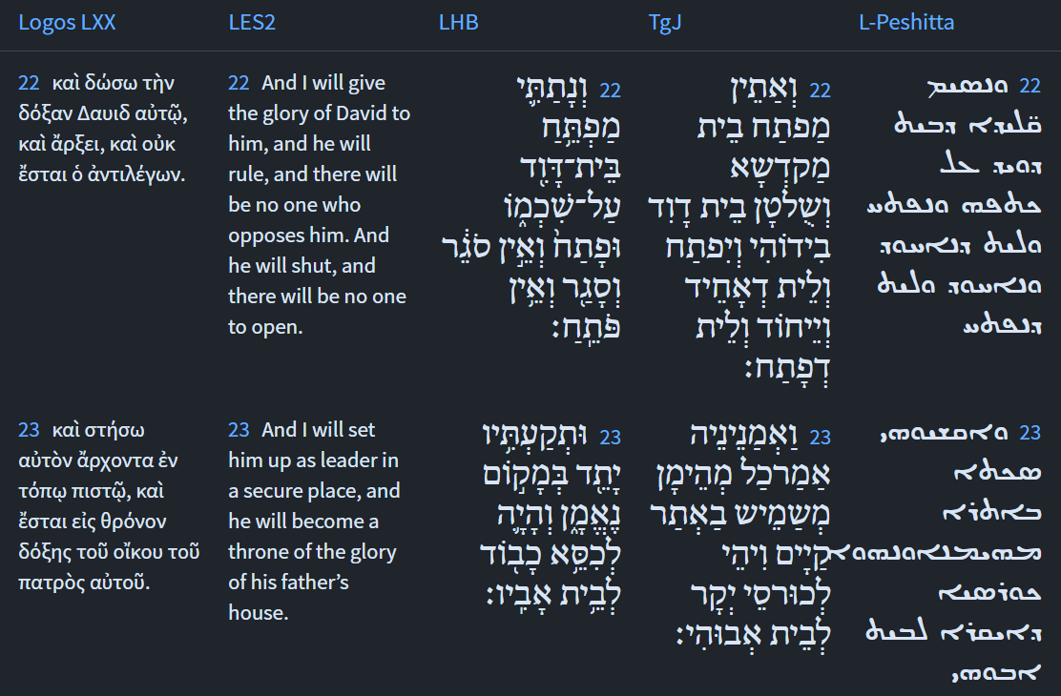
Isaiah 22:22-23
Isaiah / ישעיה
http://www.matsati.com

Slide 8
Rabbinic Literature
ספרות רבנית
Part 2
Isaiah / ישעיה
http://www.matsati.com

Slide 9
Targum Jonathan son of Uziel Isaiah 22:17-25
22:17 Behold, the Lord will cast thee out with a mighty casting out, and confusion shall cover thee. 22:18 He shall take away from thee thy tiara, and the enemies shall enclose thee, like a surrounding wall, and they shall lead thee into captivity into a spacious country, there thou shalt die, and thither the chariots of thy glory shall return in disgrace, because thou hast not preserved the honour of thy master’s house. 22:19 And I will thrust thee down from thy station, and I will divest thee of thy office. 20 And it shall come to pass at that time, that I will make my servant Eliakim great, the son of Hilkiah. 22:21 And I will clothe him with thy robe, and with thy girdle I will gird him, and I will commit thy government into his hand, and he shall be a prince to the inhabitants of Jerusalem, and to the house of Judah. 22:22 And I will place the key of the house of the sanctuary, and the government of the house of David, in his hand; and he shall open, and none shall shut; and he shall shut, and none shall open. 22:23 And I will appoint him a faithful chief-governor, an officer in a firm place, and he shall be for a glorious throne to his father’s house. 22:24 All the nobles of his father’s house shall rest themselves upon him, children, and children’s children, from young men to little ones, from the priests clothed with the ephod to the Levites that are holding the lyres. 22:25 At that time, saith the Lord of hosts, there shall be removed the faithful chief governor, who ministered in a firm place, and he shall be cut off, and he shall fall: and there shall be accomplished the burden of prophecy, which was concerning him; because the WORD of the Lord hath so decreed it. (TgJ)
Isaiah / ישעיה
http://www.matsati.com

Slide 10
﻿ספר תהילים פרק לד
יב לְכוּ-בָנִים שִׁמְעוּ-לִי יִרְאַת יְהֹוָה אֲלַמֶּדְכֶם: יג מִי-הָאִישׁ הֶחָפֵץ חַיִּים אֹהֵב יָמִים לִרְאוֹת טוֹב: יד נְצֹר לְשׁוֹנְךָ מֵרָע וּשְֹפָתֶיךָ מִדַּבֵּר מִרְמָה: טו סוּר מֵרָע וַעֲשֵֹה-טוֹב בַּקֵּשׁ שָׁלוֹם וְרָדְפֵהוּ: טז עֵינֵי יְהֹוָה אֶל-צַדִּיקִים וְאָזְנָיו אֶל-שַׁוְעָתָם: יז פְּנֵי יְהֹוָה בְּעֹשֵֹי רָע לְהַכְרִית מֵאֶרֶץ זִכְרָם:
Tehillim / Psalms 34:11-16
34:11 Come, ye children, hearken unto me: I will teach you the fear of the LORD. 34:12 What man is he that desireth life, And loveth many days, that he may see good? 34:13 Keep thy tongue from evil, And thy lips from speaking guile. 34:14 Depart from evil, and do good; Seek peace, and pursue it. 34:15 The eyes of the LORD are upon the righteous, And his ears are open unto their cry. 34:16 The face of the LORD is against them that do evil, To cut off the remembrance of them from the earth. (KJV)
Isaiah / ישעיה
http://www.matsati.com

Slide 11
Zohar 1:14b:4
אָמְרוּ רַבּוֹתֵינוּ ז''ל תְּלָתָא אִנּוּן גַּרְמִין בִּישָׁא לְגַרְמַיְיהוּ. חַד מָאן דְּלַיִּיט גַּרְמֵיהּ. תִּנְיָינָא מָאן דְּזָרַק נַהֲמָא אוֹ פֵּרוּרִין דְּאִית בְּהוּ כַּזַּיִת. תְּלִיתָאָה מָאן דְּאוֹקִיד שְׁרַגָּא בְּמִפְקָא דְּשַׁבַּתָּא עַד לָא מָטוּ יִשְׂרָאֵל לְקִדּוּשָׁא דְסִדְרָא דְּגָרִים לְנוּרָא דְּגֵיהִנֹּם לְאַדְלָקָא בְּהַאי נוּרָא עַד לָא מָטָא זִמְנַיְיהוּ. דְּחַד דּוּכְתָּא אִית בַּגִּיהִנָּם לְאִנּוּן דְּקָא מְחַלְּלֵי שַׁבָּתוֹת, וְאִנּוּן דַּעֲנוּשִׁין בַּגֵיהִנֹּם לַייטִין לֵיהּ לְהַהוּא דְּאוֹקִיד שְׁרַגָּא עַד לָא מָטָא זִמְנֵיהּ, וְאַמְרִי לֵיהּ (ישעיהו כ״ב:י״ז) הִנֵּה יְיָ מְטַלְטֶלְךָ טַלְטֵלָה גָּבֶר וְגו' (ישעיהו כ״ב:י״ח) צָנוֹף יִצְנָפְךָ צְנֵפָה כַּדּוּר אֶל אֶרֶץ רַחֲבַת יָדָיִם.
4. Our Rabbis of blessed memory said: There are three kinds of people who bring bad things on themselves. The first is he who curses himself; the second is he who throws away bread or bread crumbs as big as an olive; and the third is he who lights the candle when the Shabbat is over before Yisrael reached the recital of Sanctification, that is during Ve'Ata Kadosh. Because with that fire, he lights the flames of Gehenom before its time. There is a special place in Gehenom for those who profane the Shabbat. Those who are punished in Gehenom curse the person who lit the candle before its time, and they say to him, "Behold; Hashem will thrust you about with a mighty throw, and He will seize you firmly. He will violently roll and toss you like a ball into a large country" (Isaiah 22:17-18).
Isaiah / ישעיה
http://www.matsati.com

Slide 12
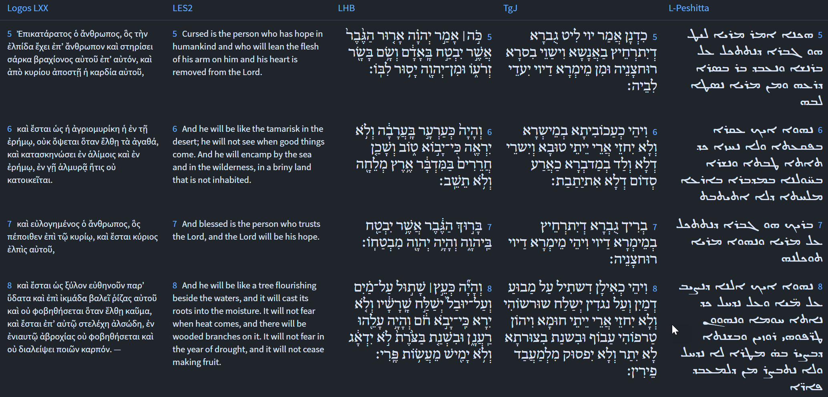
Jeremiah 17:5-8
Isaiah / ישעיה
http://www.matsati.com

Slide 13
Talmud Bavli Tractate Kallah Rabbati 8:11
‘R. Joshua b. Levi said: Every day’, etc. Whence do we know this? For it is written, Hark! the Lord crieth [yiḳra’] unto the city—and it is wisdom to have regard for Thy name.105 Micah 6, 9. Perhaps the verse speaks of an ordinary voice [calling and not a Bath Ḳol]? Here it is stated yiḳra’, and elsewhere it is stated, And the Lord called [wayyiḳra’] unto him out of the mountain:106 Ex. 19, 3. as there it was [God calling] from Sinai, so here too it is [God calling] from Sinai. Alternately, here it states yiḳra’ and of the tent of meeting it states, And the Lord called [wayyiḳra’] unto Moses, and spoke unto him out of the tent of meeting.107 Lev. 1, 1. But it might be argued that here108 In Micah 6, 9, where the word ḳol is used, translated hark. it uses the word ḳol and elsewhere it states, God answered him by a voice [beḳol]!109 Ex. 19, 19, which seems to imply that it was not God Who spoke. Then quote, Then he heard the Voice speaking.110 Num. 7, 89. Here it is clear that God is speaking. [It might also be argued,] Here it states, unto the city111 In Micah 6, 9, and therefore the comparison is not complete. and there it does not! [Draw the inference] from the following: Hark [ḳol]! one calleth [ḳore’]: Clear ye in the wilderness the way of the Lord,112 Isa. 40, 3. where ‘calling’ and ‘wilderness’ occur, and it is written, They encamped in the wilderness113 Ex. 19, 2, which refers to a time before Sinai.—perhaps this refers to the periodical ‘callings’! When it mentions ‘calling’ it implies a regular calling, as it is written, When I call unto them, they stand up together.114 Isa. 48, 13. Our Rabbis have taught:115 Ber. 55a (Sonc. ed., p. 335). R. Joḥanan there enumerates three things: famine, plenty and leadership. Five things the Holy One, blessed be He, Himself proclaims, viz.: the leader, famine, plenty, the sword, and those who escape the sword. ‘The leader’, as it is written, See, I have called by name Beẓalel.116 Ex. 31, 2. ‘Famine’, as it is written, For the Lord hath called for a famine.117 2 Kings 8, 1. ‘Plenty’, as it is written, And I will call for the corn and will increase it.118 Ezek. 36, 29. ‘The sword’, as it is written, For I will call for a sword.119 Jer. 25, 29. ‘Those who escape the sword’, as it is written, And among the remnant those whom the Lord shall call.120 Joel 3, 5. It is all right with three since the Divine Name is written in connection with them, but with And I will call for the corn, perhaps [this means] by a messenger, as it is written, I will call my servant Eliaḳim!121 Isa. 22, 20. If you do not admit this, surely there [with Eliaḳim] the Divine Presence called to him [to act as leader], because it was similar to that of Beẓalel who was a leader.
Isaiah / ישעיה
http://www.matsati.com

Slide 14
Colossians 3:23
3:23﻿ Whatever you do, do your work heartily, as for the Lord rather than for men; (NASB, ܘܟ݂ܽܠ ܕ݁ܥܳܒ݂ܕܻ݁ܝܢ ܐܢ̄ܬܾ݁ܘܢ ܆ ܡܶܢ ܟܾ݁ܠܴܗ ܢܰܦ݂ܫܟ݂ܽܘܢ ܥܒ݂ܶܕ݂ܘ ܇ ܐܱܝܟ݂ ܕܱ݁ܠܡܳܪܱܢ ܁ ܘܠܴܐ ܐܱܝܟ݂ ܕ݁ܠܱܒ݂ܢܱ̈ܝܢܳܫܳܐ ܂ 23 ὃ ἐὰν ποιῆτε, ἐκ ψυχῆς ἐργάζεσθε ὡς τῷ κυρίῳ καὶ οὐκ ἀνθρώποις·)
Isaiah / ישעיה
http://www.matsati.com

Slide 15
Midrash Sifrei Devarim 321:16
"both virgin": They were clean of sin, as a virgin, who had never tasted the taste of sin. "suckling": They sucked words of Torah as a babe sucks milk from its mother's breasts. "with the man of grey hairs": Read it not "ish seva" ("the man of grey hairs"), but "ish yeshivah," being fit to sit in "yeshivah" (a consortium of Torah scholars). And thus is it written (of the exiles, II Kings 24:16) "and the charash and the masger, one thousand, all heroes, waging war." Now what feats of strength are performed by men going into exile? What war is waged by men bound in chains? Rather, (the meaning is that they were) "heroic" in the war of Torah. As it is written (Psalms 103:20) "Bless the L-rd, O His angels, heroic in power, doing His word to hear the voice of His word." (II Kings, Ibid.) "waging war": "giving and taking" in the "war" of Torah, viz. (Bamidbar 21:14) "Therefore, it is said in the Book of the wars of the L-rd, etc." (II Kings, Ibid.) "the charash" (lit., "mute"): One (of these scholars) speaks and the rest remain silent. "and 'the masger'" (lit., the "closer": All sit before him and learn from him. After he "closes," no one "opens," and after he "opens," no one "closes," in fulfilment of (Isaiah 22:22) "And he (David) will open, and none will close; and he will close, and none will open."
Isaiah / ישעיה
http://www.matsati.com

Slide 16
Rashi on Isaiah 22,23:1
And I will thrust him like a peg in a sure place (Jonathan renders:) And I will appoint him a faithful trustee, serving in a sure place. Jonathan renders נֶאֱמָן as sure, i.e., a place that is faithful to those who lean on it, for it shall not move. Another explanation is to reverse the word order of the verse: And I will thrust him a sure peg in a place.
Isaiah / ישעיה
http://www.matsati.com

Slide 17
Likutei Moharan, Part II 8:11:5
וְזֶה בְּחִינוֹת תְּקִיעָה, תְּרוּעָה, שְׁבָרִים. תְּקִיעָה זֶה בְּחִינַת הִתְגַּלּוּת הַכָּבוֹד, בִּבְחִינַת (ישעיהו כ״ב:כ״ג): וּתְקַעְתִּיו יָתֵד בְּמָקוֹם נֶאֱמָן וְהָיָה לְכִסֵּא כָבוֹד. תְּרוּעָה זֶה בְּחִינַת רוּחַ־נְבוּאָה, בִּבְחִינַת (במדבר כ״ג:כ״א): ה' אֱלֹקָיו עִמּוֹ וּתְרוּעַת מֶלֶךְ בּוֹ, וְתַרְגּוּמוֹ: וּשְׁכִינַת מַלְכֵיהוֹן בְּהוֹן: הַיְנוּ הַשְׁרָאַת הַשְּׁכִינָה, בְּחִינַת נְבוּאָה. שְׁבָרִים זֶה בְּחִינַת בִּטּוּל אֱמוּנוֹת כָּזְבִּיּוֹת, בִּבְחִינַת (שמות כ״ג:כ״ד): שַׁבֵּר תְּשַׁבֵּר מַצֵּבֹתֵיהֶם, (כמובא בתי' י"ח ובתי' כ"א), הַיְנוּ בְּחִינַת בִּטּוּל אֱמוּנוֹת כָּזְבִּיּוֹת וְתִקּוּן הָאֱמוּנָה הַקְּדוֹשָׁה, בְּחִינַת (תהילים קמ״ה:ט״ו): עֵינֵי כֹל אֵלֶיךָ יְשַׂבֵּרוּ. וְעַל־יְדֵי אֱמוּנָה זוֹכִין לְחִדּוּשׁ הָעוֹלָם.
This is the concept of tekiah, teruah, shevarim. TeKiAh signifies the revelation of God’s glory, as in “u’ TeKAtiv (I will affix him) as a peg in a secure place, and he will be a throne of glory” (Isaiah 22:23). Teruah signifies the spirit of prophecy. This is as in “God, their Lord, is with them, the King’s teruah -blast in their midst” (Numbers 23:21), which Targum renders as “their King’s Divine Presence in their midst”—i.e., the indwelling of the Divine Presence, namely, prophecy. SheVaRim signifies the elimination of false beliefs. This is as in “ShaBeR t’ShaBeR (utterly shatter) their monuments'' (Exodus 23:24)—i.e., the elimination of false beliefs and rectification of holy faith, the concept of “Everyone’s eyes y’SaBeiRu (look to You with hope)” (Psalms 145:15). And through faith, the world merits renewal.
Isaiah / ישעיה
http://www.matsati.com

Slide 18
Hebrews 1:1-3
1:1 God, who at sundry times and in divers manners spake in time past unto the fathers by the prophets, 1:2 Hath in these last days spoken unto us by his Son, whom he hath appointed heir of all things, by whom also he made the worlds; 1:3 Who being the brightness of his glory, and the express image of his person, and upholding all things by the word of his power, when he had by himself purged our sins, sat down on the right hand of the Majesty on high: (KJV, Hebrews 1:1–3 (Peshitta): ܒ݁ܟ݂ܽܠ ܡܢܱ̈ܘܳܢ ܘܰܒ݂ܟ݂ܽܠ ܕܷ݁ܡܘܳܢ̈ ܁ ܡܰܠܷܠ ܐܱܠܴܗܳܐ ܥܰܡ ܐܱܒ݂ܳܗܰܝ̈ܢ ܒܱ݁ܢ̈ܒ݂ܺܝܶܐ ܡܶܢ ܩܕ݂ܺܝܡ ܂2 ܘܰܒ݂ܗܳܠܷܝܢ ܝܱ̈ܘܡܳܬ݂ܴܐ ܐ̱ܚܪܴ̈ܝܶܐ ܁ ܡܰܠܷܠ ܥܰܡܰܢ ܒܱ݁ܒ݂ܪܷܗ ܂ ܕ݁ܠܷܗ ܣܳܡ ܝܳܪܬܴ݁ܐ ܕ݁ܟ݂ܽܠܡܶܕܷ݁ܡ ܂ ܘܒ݂ܶܗ ܥܒ݂ܰܕ݂ ܠܥܳܠܡܷ̈ܐ ܂3 ܕ݁ܗܽܘܝܽܘ ܨܷܡܚܳܐ ܕ݁ܫܽܘܒ݂ܚܶܗ ܁ ܘܨܱܠܡܳܐ ܕܻ݁ܐܝܬ݂ܾܘܬ݂ܷܗ ܁ ܘܰܐܚܺܝܕ݂ ܟܾ݁ܠ ܒ݁ܚܰܝܠܴܐ ܕ݁ܡܶܠܬ݂ܷܗ ܂ ܘܗܽܘ ܒܱ݁ܩܢܽܘܡܶܗ ܥܒ݂ܰܕ݂ ܕܾ݁ܘܟܴ݁ܝܳܐ ܕܱ݁ܚܛܴܗܰܝ̈ܢ ܘܺܝܬ݂ܷܒ݂ ܥܰܠ ܝܰܡܺܝܢܳܐ ܕ݁ܪܱܒܾ݁ܘܬ݂ܴܐ ܒܱ݁ܡܪܱ̈ܘܡܶܐ ܂ 1 Πολυμερῶς καὶ πολυτρόπως πάλαι ὁ θεὸς λαλήσας τοῖς πατράσιν ἐν τοῖς προφήταις 2 ἐπʼ ἐσχάτου τῶν ἡμερῶν τούτων ἐλάλησεν ἡμῖν ἐν υἱῷ ὃν ἔθηκεν κληρονόμον πάντων, διʼ οὗ καὶ ἐποίησεν τοὺς αἰῶνας, 3 ὃς ὢν ἀπαύγασμα τῆς δόξης καὶ χαρακτὴρ τῆς ὑποστάσεως αὐτοῦ, φέρων τε τὰ πάντα τῷ ῥήματι τῆς δυνάμεως αὐτοῦ, καθαρισμὸν τῶν ἁμαρτιῶν ποιησάμενος ἐκάθισεν ἐν δεξιᾷ τῆς μεγαλωσύνης ἐν ὑψηλοῖς)
Isaiah / ישעיה
http://www.matsati.com

