Slide 1
Isaiah 21:10-17
ישעיהו כא:יא-יז
Isaiah / ישעיה
http://www.matsati.com

Slide 2
﻿ספר ישעיה פרק כא
﻿י מְדֻשָׁתִי וּבֶן-גָּרְנִי אֲשֶׁר שָׁמַעְתִּי מֵאֵת יְהֹוָה צְבָאוֹת אֱלֹהֵי יִשְֹרָאֵל הִגַּדְתִּי לָכֶם: יא מַשָּׂא דּוּמָה אֵלַי קֹרֵא מִשֵּׂעִיר שֹׁמֵר מַה-מִּלַּיְלָה שֹׁמֵר מַה-מִּלֵּיל: יב אָמַר שֹׁמֵר אָתָא בֹקֶר וְגַם-לָיְלָה אִם-תִּבְעָיוּן בְּעָיוּ שֻׁבוּ אֵתָיוּ: יג מַשָּׂא בַּעְרָב בַּיַּעַר בַּעְרַב תָּלִינוּ אֹרְחוֹת דְּדָנִים: יד לִקְרַאת צָמֵא הֵתָיוּ מָיִם יֹשְׁבֵי אֶרֶץ תֵּימָא בְּלַחְמוֹ קִדְּמוּ נֹדֵד: טו כִּי-מִפְּנֵי חֲרָבוֹת נָדָדוּ מִפְּנֵי | חֶרֶב נְטוּשָׁה וּמִפְּנֵי קֶשֶׁת דְּרוּכָה וּמִפְּנֵי כֹּבֶד מִלְחָמָה: טז כִּי-כֹה אָמַר אֲדֹנָי אֵלָי בְּעוֹד שָׁנָה כִּשְׁנֵי שָֹכִיר וְכָלָה כָּל-כְּבוֹד קֵדָר: יז וּשְׁאָר מִסְפַּר-קֶשֶׁת גִּבּוֹרֵי בְנֵי-קֵדָר יִמְעָטוּ כִּי יְהֹוָה אֱלֹהֵי-יִשְֹרָאֵל דִּבֵּר:
Isaiah / ישעיה
http://www.matsati.com

Slide 3
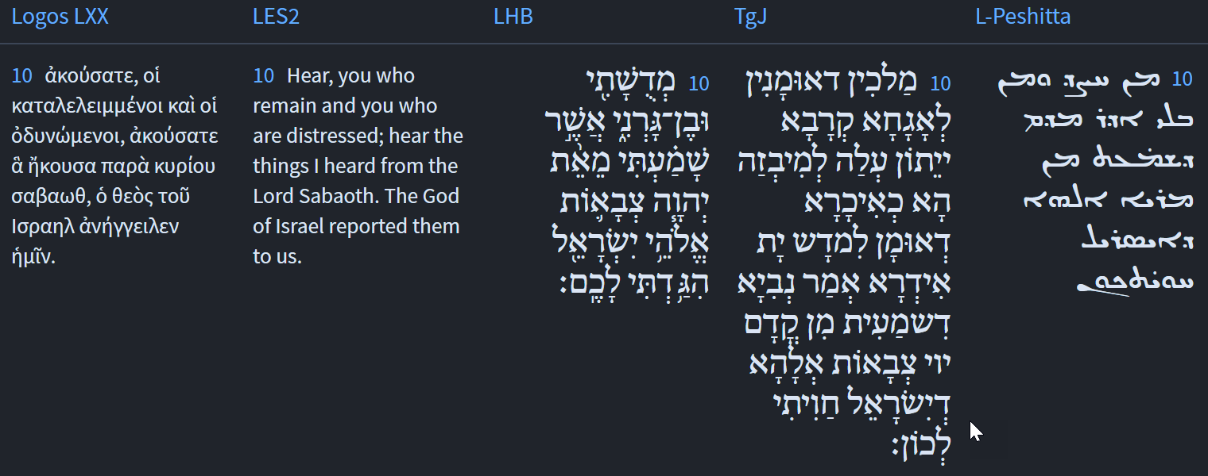
Isaiah / ישעיה
http://www.matsati.com

Slide 4
ספר שמות פרק טו
כו וַיֹּאמֶר אִם-שָׁמוֹעַ תִּשְׁמַע לְקוֹל | יְהוָֹה אֱלֹהֶיךָ וְהַיָּשָׁר בְּעֵינָיו תַּעֲשֶֹה וְהַאֲזַנְתָּ לְמִצְוֹתָיו וְשָׁמַרְתָּ כָּל-חֻקָּיו כָּל-הַמַּחֲלָה אֲשֶׁר-שַֹמְתִּי בְמִצְרַיִם לֹא-אָשִֹים עָלֶיךָ כִּי אֲנִי יְהוָֹה רֹפְאֶךָ:
Shemot / Exodus 15:26
15:26 And said, If thou wilt diligently hearken to the voice of the LORD thy God, and wilt do that which is right in his sight, and wilt give ear to his commandments, and keep all his statutes, I will put none of these diseases upon thee, which I have brought upon the Egyptians: for I am the LORD that healeth thee. (KJV)
Isaiah / ישעיה
http://www.matsati.com

Slide 5
Shir HaShirim Rabbah 5:16:3
That is what is written: “If we continue to hear [the voice of the Lord our God we shall die]” . That is what is written: “My soul departed when he spoke” ....At that moment, the Holy One blessed be He then sweetened the spoken word for them. That is what is written: “The voice of the Lord is mighty; the voice of the Lord is majestic” ....Rabbi Ḥama bar Rabbi Ḥanina said: “The voice of the Lord is mighty” – for the lads; “the voice of the Lord is majestic” – for the elderly.
Isaiah / ישעיה
http://www.matsati.com

Slide 6
Isaiah / ישעיה
http://www.matsati.com

Slide 7
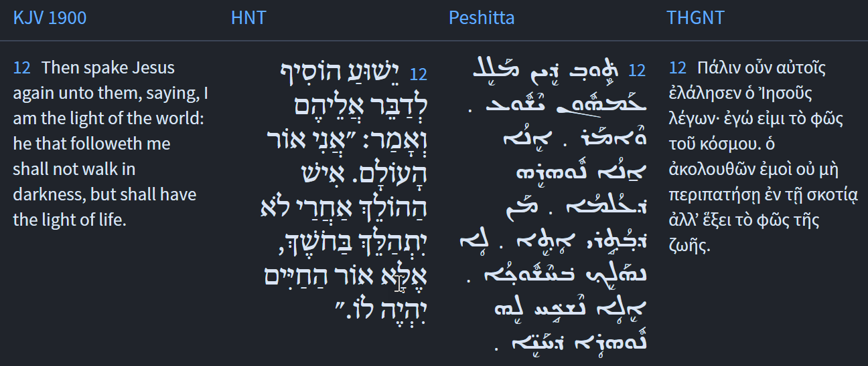
Isaiah / ישעיה
http://www.matsati.com

Slide 8
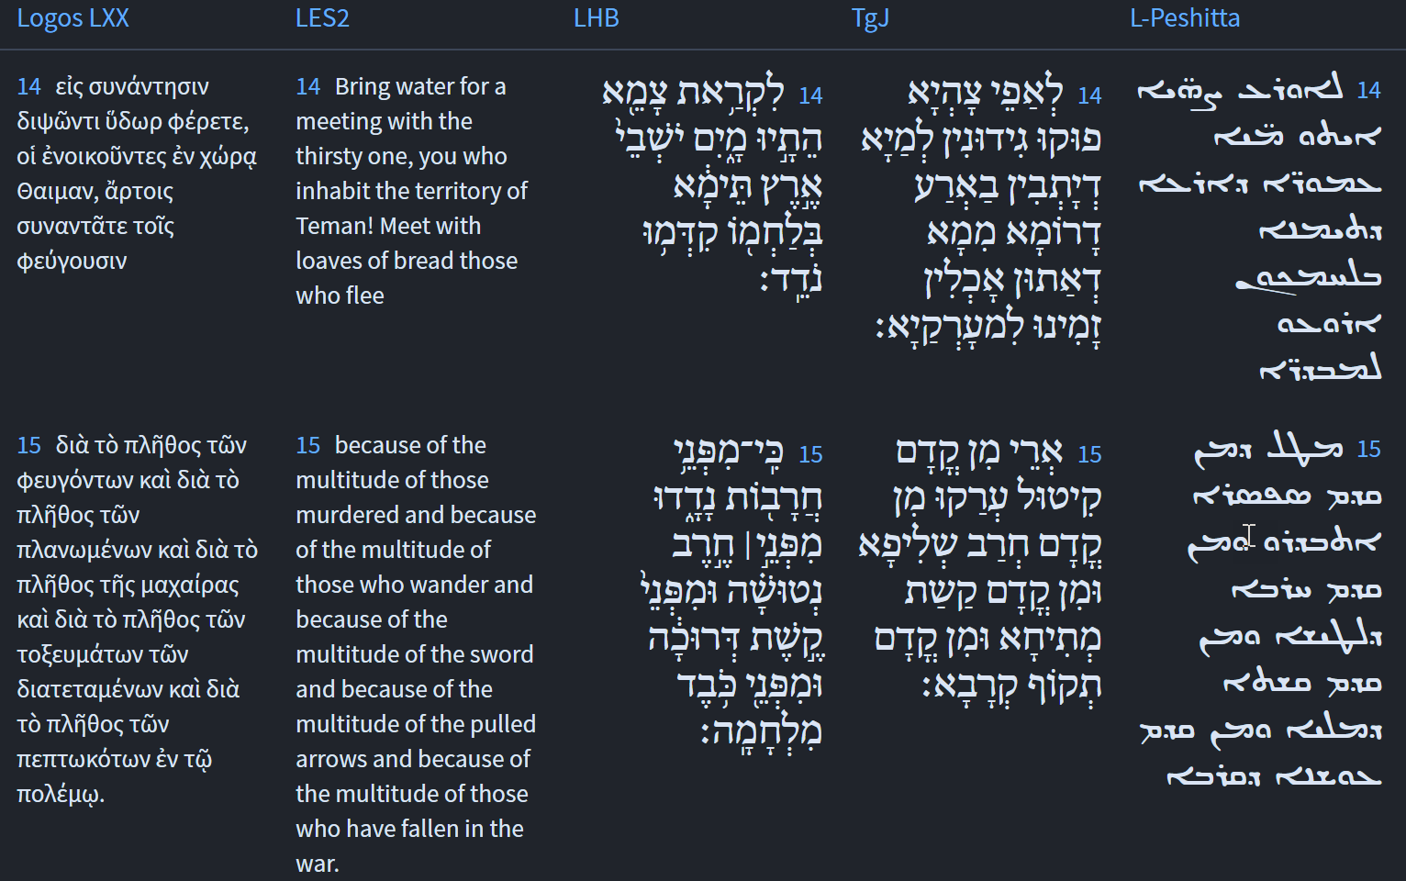
Isaiah / ישעיה
http://www.matsati.com

Slide 9
Rabbinic Literature
ספרות רבנית
Part 2
Isaiah / ישעיה
http://www.matsati.com

Slide 10
Targum Jonathan son of Uziel Isaiah 21:10-17
21:10 Kings, who are skilful to wage war, shall come against her to plunder her, like a husbandman who is skilful to thrash the floor. The prophet said, The voice of the WORD of the Lord of Hosts, the God of Israel, which I have heard, I have declared unto you. 21:11 THE BURDEN OF THE CUP OF CURSING TO GIVE DUMA TO DRINK. He thundered unto me from the heavens, Prophet! explain unto them the prophecy; prophet! explain unto them what shall hereafter come to pass. 21:12 The prophet said, there is a reward to the righteous, and there is punishment to the wicked: if ye will repent, repent ye, whilst ye are able to repent. 21:13 THE BURDEN OF THE CUP OF CURSING TO GIVE THE ARABIANS TO DRINK. In the forest, at even, the caravan of the sons of Dedan shall remain for the night. 21:14 Bring bottles of water before the thirsty, who dwell in land of the south; prepare for the fugitives the daily food which ye eat. 21:15 Because, on account of the slaughter they have fled: from the face of the drawn sword; and from the face of the bent bow; and from the face of the strength of the battle. 21:16 For thus hath the Lord said unto me: at the end of the years, as the years of an hireling, all the glory of the Arabians shall come to an end. 21:17 And the strength of the warriors, the mighty, the sons of the Arabians, shall be lessened, because by the WORD of the Lord, the God of Israel, it is thus decreed. (TgJ)
Isaiah / ישעיה
http://www.matsati.com

Slide 11
Midrash Tanchuma Buber, Bamidbar 22:3
[Another interpretation (of Is. 43:4): BECAUSE YOU ARE PRECIOUS IN MY EYES, YOU ARE HONORED.] The Holy One said: You are precious in my eyes, because to all the those nations I gave no numbering (minyan), but to you I did give a numbering. It is comparable to a king of flesh and blood who had a lot of granaries, but all of them were dirty and full of darnel; so he was not meticulous about numbering. <There was,> however, this granary <which had> beautiful wheat. I therefore want to be meticulous in numbering how many kors123One kor is equivalent to somewhat under 400 liters. there are, how many sacks there are in it, <and> how many measures there are in it. Similarly this king is the Supreme King of Kings, the Holy One; and this granary (goren) is Israel, since it is stated (in Is. 21:10): MY THRESHING, AND THE PRODUCT (literally: THE CHILD) OF MY THRESHING FLOOR (goren). It also says (in Jer. 2:3): ISRAEL IS THE LORD'S SANCTUARY, [THE BEGINNING OF HIS HARVEST]. The child of his house is Moses, as stated (in Numb. 12:7): NOT SO WITH MY SERVANT MOSES; [HE IS TRUSTED IN ALL MY HOUSE]. The Holy One said to him: The nations are comparable to thorns, as stated (in Is. 33:12): AND THE PEOPLES SHALL BECOME BURNINGS OF LIME, THORNS CUT DOWN <THAT ARE BURNED IN THE FIRE>. Therefore, you shall not be meticulous about numbering them, but Israel is righteous, as stated (in Is. 60:21): AND ALL OF YOUR PEOPLE ARE RIGHTEOUS. It also says (in Cant. 4:7): YOU ARE BEAUTIFUL ALL OVER, MY BELOVED, [AND THERE IS NO BLEMISH IN YOU]. Therefore, be meticulous in counting Israel. Moses did so. He numbered them <to determine> how many kors there were, as stated (in Numb. 1:2): TAKE A CENSUS….; how many sacks there were, as stated (in Numb. 2:4): HIS HOST AND THOSE OF THEM ENROLLED; and how many measures there were, as stated (in Numb. 3:40): ENROLL EVERY FIRST-BORN MALE.
Isaiah / ישעיה
http://www.matsati.com

Slide 12
Matthew 4:19
4:19 And he saith unto them, Follow me, and I will make you fishers of men. (KJV, ܘܶܐܡܰܪ ܠܗܽܘܢ ܝܶܫܽܘܥ ܂ ܬܱ݁ܘ ܒܴ݁ܬ݂ܱܪܝ ܆ ܘܶܐܥܒܷ݁ܕ݂ܟ݂ܽܘܢ ܕ݁ܬ݂ܷܗܘܽܘܢ ܨܱܝܴ̈ܕ݂ܶܐ ܕܱ݁ܒ݂ܢܱ̈ܝ ܐ̱ܢܴ̈ܫܳܐ ܂19, καὶ λέγει αὐτοῖς· δεῦτε ὀπίσω μου, καὶ ποιήσω ὑμᾶς ἁλεεῖς ἀνθρώπων.)
Mark 1:16-17
1:16 Now as he walked by the sea of Galilee, he saw Simon and Andrew his brother casting a net into the sea: for they were fishers. 1:17 And Jesus said unto them, Come ye after me, and I will make you to become fishers of men. (KJV, ܘܟ݂ܰܕ݂ ܡܗܰܠܷܟ݂ ܚܕ݂ܳܪܱ̈ܝ ܝܰܡܳܐ ܕܱ݁ܓ݂ܠܻܝܠܴܐ ܆ ܚܙܳܐ ܠܫܶܡܥܽܘܢ ܘܠܱܐܢܕ݁ܪܷܐܘܳܣ ܐܱܚܽܘܗ̄ܝ ܂ ܕ݁ܪܴܡܶܝܢ ܡܨܻܝ̈ܕ݂ܳܬ݂ܴܐ ܒ݁ܝܰܡܳܐ ܂ ܐܻܝܬ݂ܱܝܗܽܘܢ ܗ̄ܘܰܘ ܓܷ݁ܝܪ ܨܱܝܴ̈ܕ݂ܶܐ ܂ܘܶܐܡܰܪ ܠܗܽܘܢ ܝܶܫܽܘܥ ܂ ܬܱ݁ܘ ܒܴ݁ܬ݂ܱܪܝ ܂ ܘܶܐܥܒܷ݁ܕ݂ܟ݂ܽܘܢ ܂ ܨܱܝܴ̈ܕ݂ܶܐ ܕܱ݁ܒ݂ܢܱ̈ܝ ܐ̱ܢܴ̈ܫܳܐ ܂, Καὶ παράγων παρὰ τὴν θάλασσαν τῆς Γαλιλαίας εἶδεν Σίμωνα καὶ Ἀνδρέαν τὸν ἀδελφὸν Σίμωνος ἀμφιβάλλοντας ἐν τῇ θαλάσσῃ· ἦσαν γὰρ ἁλεεῖς. καὶ εἶπεν αὐτοῖς ὁ Ἰησοῦς· δεῦτε ὀπίσω μου, καὶ ποιήσω ὑμᾶς γενέσθαι ἁλεεῖς ἀνθρώπων.)
Isaiah / ישעיה
http://www.matsati.com

Slide 13
Matthew 9:37-10:1
9:37 Then saith he unto his disciples, The harvest truly is plenteous, but the labourers are few; 9:38 Pray ye therefore the Lord of the harvest, that he will send forth labourers into his harvest. 10:1 And when he had called unto him his twelve disciples, he gave them power against unclean spirits, to cast them out, and to heal all manner of sickness and all manner of disease. (KJV, ܘܶܐܡܰܪ ܠܬ݂ܱܠܡܺܝ̈ܕ݂ܰܘܗ̄ܝ ܆ ܚܨܴܕ݂ܳܐ ܣܰܓܻ݁ܝ ܂ ܘܦ݂ܳܥ̈ܠܷܐ ܙܥܽܘܪܻ̈ܝܢ ܂ܒ݁ܥܰܘ ܗܳܟ݂ܺܝܠ ܡܶܢ ܡܳܪܷܐ ܚܨܴܕ݂ܳܐ ܆ ܕ݁ܢܰܦܷ݁ܩ ܦܴ݁ܥ̈ܠܷܐ ܠܱܚܨܴܕ݂ܶܗ ܀ ܘܰܩܪܴܐ ܠܱܬ݂ܪܷ̈ܥܣܰܪ ܬܱ݁ܠܡܺܝ̈ܕ݂ܰܘܗ̄ܝ ܆ ܘܝܰܗ̄ܒ݂ ܠܗܽܘܢ ܫܽܘܠܛܴܢܳܐ ܥܰܠ ܪܾ̈ܘܚܶܐ ܛܱܢ̈ܦ݂ܳܬ݂ܴܐ ܕ݁ܢܰܦ݁ܩܽܘܢ ܆ ܘܰܠܡܰܐܣܳܝܽܘ ܟܾ݁ܠ ܟܻ݁ܐܒ݂ ܘܟ݂ܽܘܪܗܳܢ ܀, Τότε λέγει τοῖς μαθηταῖς αὐτοῦ· ὁ μὲν θερισμὸς πολύς, οἱ δὲ ἐργάται ὀλίγοι· δεήθητε οὖν τοῦ κυρίου τοῦ θερισμοῦ ὅπως ἐκβάλῃ ἐργάτας εἰς τὸν θερισμὸν αὐτοῦ. Καὶ προσκαλεσάμενος τοὺς δώδεκα μαθητὰς αὐτοῦ ἔδωκεν αὐτοῖς ἐξουσίαν πνευμάτων ἀκαθάρτων ὥστε ἐκβάλλειν αὐτὰ καὶ θεραπεύειν πᾶσαν νόσον καὶ πᾶσαν μαλακίαν.)
Isaiah / ישעיה
http://www.matsati.com

Slide 14
Talmud Bavli Sanhedrin 94a:8
On a similar note, Isaiah said: “The burden of Dumah. One calls to me out of Seir: Watchman, what of the night? Watchman, what of the night? The Watchman said: The morning comes and also the night; if you will inquire, inquire; return, come” (Isaiah 21:11–12). Rabbi Yoḥanan says: That angel, who is appointed over the spirits [seirim], his name is Dumah. All the spirits assembled near Dumah and said to him: “Watchman of the night, what of the night? Does God, Guardian of Israel, say that the time for redemption has arrived?” The angel answered: “The Watchman said: The morning comes and also the night; if you will inquire, inquire; return, come.” The Holy One, Blessed be He, said that the morning of redemption has come as well as the night of the exile. If you inquire and seek repentance, inquire and repent, and return to God and redemption will come.
Isaiah / ישעיה
http://www.matsati.com

Slide 15
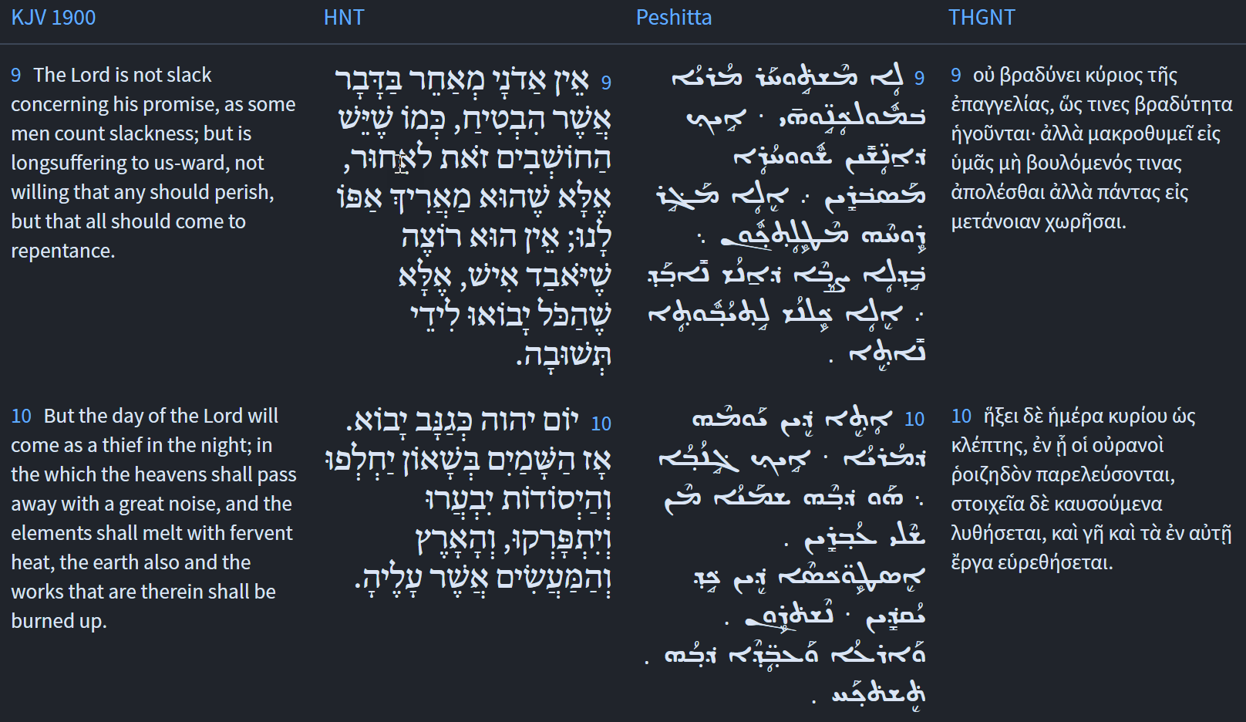
Isaiah / ישעיה
http://www.matsati.com

Slide 16
Rashi on Isaiah 21:14:1
לקראת צמא. דרך להביא מים ואתם יושבי ארץ תימא לא עשיתם כן אלא בלחמו קדמו נודד הביאו להם מיני מאכלים מלוחים ונודות נפוחים מלאי רוח והיה אוכל ומבקש לשתות ונותן פי הנוד לתוך פיו והרוח נכנס במעיו והוא מת, ד"א לקראת צמא התיו מים לא כן עשיתי לאביכם כשהיה צמא גליתי לו באר מים:
Toward the thirsty it is customary to bring water, but you, the inhabitants of the land of Tema, did not do so, but with his bread they came before the wanderer; they brought them sorts of salty foods and blown up flasks full of air, and he would eat and ask to drink, and he would put the opening of the flask into his mouth, and the air would go into his innards, and he would die. Another explanation of “Toward the thirsty they bring water,” is as follows: I did not do so to your forefather, Ishmael; when he was thirsty, I revealed to him a well of water
Isaiah / ישעיה
http://www.matsati.com

Slide 17
Talmud Bavli Taanit 7a:13
Rabbi Ḥanina bar Pappa raised a contradiction. In one verse it is written: “To him who is thirsty bring water” (Isaiah 21:14), which indicates that the one who has water must bring it to the thirsty person, and it is written elsewhere: “Ho, everyone who thirsts, come for water” (Isaiah 55:1), from which it may be inferred that the thirsty person must seek out water himself. Rabbi Ḥanina bar Pappa resolves this apparent contradiction by explaining that if he is a worthy student the teacher must seek him out, as in “to him who is thirsty bring water,” but if the student is not worthy, then “Ho, everyone who thirsts, come for water,” i.e., this student must seek out a teacher himself.
Isaiah / ישעיה
http://www.matsati.com

Slide 18
Rashi on Isaiah 21,15 Part 1-2
כי מפני חרבות נדדו. עמי: Since because of the swords they wandered (I.e.,) my people (wandered).
וחרב נטושה. פשוטה על פני הארץ כמו (שמואל א ל׳:ט״ז) והנם נטושים על פני כל הארץ (שם כה) וינטשו בעמק רפאים ד"א נטושה כמו לטושה כל אותיות אשר מוצאיהם קרובים להיות ממקום אחד מתחלפות זו בזו נו"ן בלמ"ד כענין שנא' (נחמיה י״ג:ז׳) לעשות לו נשכה כמו לשכה: the outstretched sword (נְטוּשָׁה), spread over the surface of the earth, as (I Sam. 30:16) “And behold, they were scattered (נְטוּשִׁים) over the entire landscape,” (II Sam. 5: 18) “And spread out (וַיִּנָּטְשׁוּ) in the Valley of Rephaim.” Another explanation is that נְטוּשָׁה is like לְטוּשָׁה, sharp. All letters whose sources are close to being from one place, (i.e., from one speech organ,) are interchangeable with one another, the ‘nun’ with the ‘lamed,’ as in the case stated (in Nehemiah 13:7): “To make him a chamber (נִשְׁכָּה),” like לִשְׁכָּה.
Isaiah / ישעיה
http://www.matsati.com

Slide 19
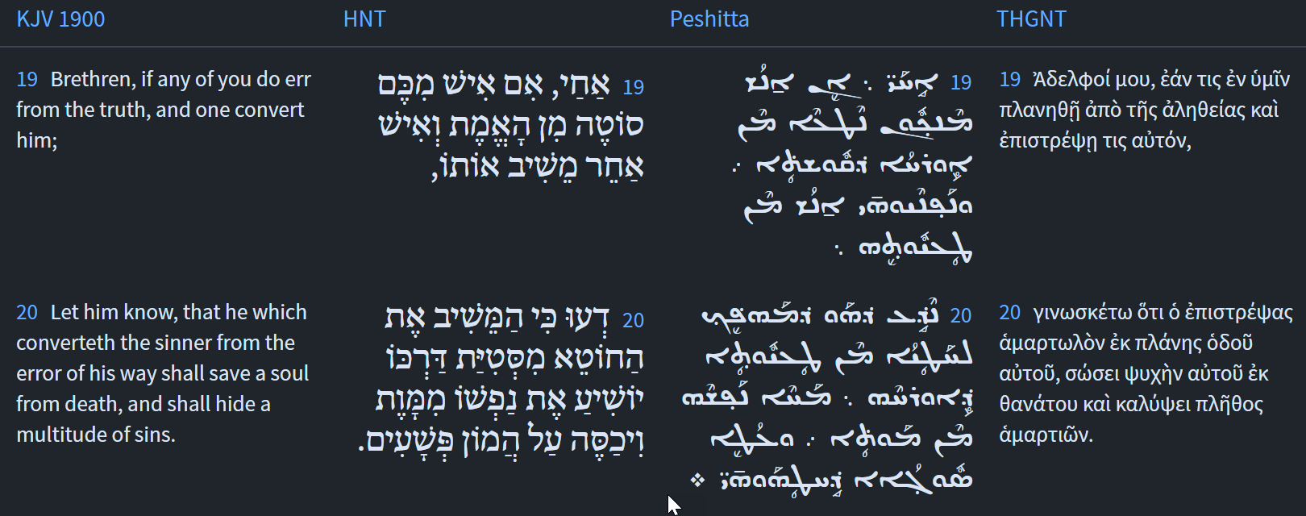
Isaiah / ישעיה
http://www.matsati.com

Slide 20
1 John 1:5-10
1:5 And this is the message we have heard from Him and announce to you, that God is light, and in Him there is no darkness at all. 1:6 If we say that we have fellowship with Him and yet walk in the darkness, we lie and do not practice the truth; 1:7 but if we walk in the light as He Himself is in the light, we have fellowship with one another, and the blood of Jesus His Son cleanses us from all sin. 1:8 If we say that we have no sin, we are deceiving ourselves, and the truth is not in us. 1:9 If we confess our sins, He is faithful and righteous to forgive us our sins and to cleanse us from all unrighteousness. 1:10 If we say that we have not sinned, we make Him a liar, and His word is not in us. (NASB, ܘܗܳܕ݂ܶܐ ܗ̄ܝ ܣܒ݂ܰܪܬ݂ܴܐ ܕܱ݁ܫܡܰܥܢ ܡܶܢܶܗ ܇ ܘܰܡܣܰܒ݁ܪܻܝܢܰܢ ܠܟ݂ܽܘܢ ܆ ܕܱ݁ܐܠܴܗܳܐ ܢܽܘܗܪܴܐ ܗ̄ܘ ܆ ܘܚܶܫܽܘܟ݂ܳܐ ܟܾ݁ܠ ܟܾ݁ܠܷܗ ܠܱܝܬ݁ ܒܷ݁ܗ ܂ܘܶܐܢ ܐܴܡܪܻܝܢܰܢ ܕ݁ܫܰܘܬܴ݁ܦ݂ܽܘܬ݂ܴܐ ܐܻܝܬ݂ ܠܱܢ ܥܰܡܶܗ ܘܰܡܗܰܠܟ݂ܺܝܢܰܢ ܒ݁ܚܶܫܽܘܟ݂ܳܐ ܆ ܕܱ݁ܓܴ̈݁ܠܷܐ ܚ̄ܢܰܢ ܘܠܱܘ ܒܱ݁ܫܪܴܪܴܐ ܪܴܕ݂ܶܝܢܰܢ ܂ ܐܷܢ ܕܷ݁ܝܢ ܒ݁ܢܽܘܗܪܴܐ ܡܗܰܠܟ݂ܺܝܢܰܢ ܐܱܝܟ݂ ܕ݁ܗܽܘ ܐܻܝܬ݂ܱܘܗ̄ܝ ܒ݁ܢܽܘܗܪܴܐ ܆ ܐܻܝܬ݂ ܠܱܢ ܫܰܘܬܴ݁ܦ݂ܽܘܬ݂ܴܐ ܥܰܡ ܚ̈ܕ݂ܳܕ݂ܶܐ ܇ ܘܰܕ݂ܡܳܐ ܕ݁ܝܶܫܽܘܥ ܒ݁ܪܷܗ ܡܕ݂ܰܟܷ݁ܐ ܠܱܢ ܡܶܢ ܟܾ݁ܠܗܽܘܢ ܚܛܴܗܰܝ̈ܢ ܂ ܘܶܐܢ ܢܺܐܡܰܪ ܕ݁ܠܱܝܬ݁ ܠܱܢ ܚܛܻܝܬ݂ܴܐ ܆ ܢܰܦ݂ܫܰܢ ܡܰܛܥܶܝܢܰܢ ܂ ܘܰܫܪܴܪܴܐ ܠܱܝܬ݁ ܒܱ݁ܢ ܂ ܐܷܢ ܕܷ݁ܝܢ ܡܰܘܕܷ݁ܝܢܰܢ ܒܱ݁ܚܛܴܗܰܝ̈ܢ ܆ ܡܗܰܝܡܰܢ ܗ̄ܽܘ ܘܙܰܕܻ݁ܝܩ ܁ ܕ݁ܢܶܫܒܾ݁ܘܩ ܠܱܢ ܚܛܴܗܰܝ̈ܢ ܇ ܘܰܢܕ݂ܰܟܷ݁ܝܢ ܡܶܢ ܟܾ݁ܠܷܗ ܥܰܘܠܱܢ ܂ ܘܶܐܢ ܐܴܡܪܻܝܢܰܢ ܕ݁ܠܴܐ ܚܛܱܝܢ ܆ ܥܳܒ݂ܕܻ݁ܝܢܰܢ ܠܷܗ ܕܱ݁ܓܴ݁ܠܴܐ ܂ ܘܡܶܠܬ݂ܷܗ ܠܱܝܬ݁ ܠܘܳܬ݂ܱܢ ܀ 5 καὶ ἔστιν αὕτη ἡ ἀγγελία ἣν ἀκηκόαμεν ἀπʼ αὐτοῦ καὶ ἀναγγέλλομεν ὑμῖν ὅτι ὁ θεὸς φῶς ἐστιν καὶ σκοτία ἐν αὐτῷ οὐκ ἔστιν οὐδεμία. 6 ἐὰν εἴπωμεν ὅτι κοινωνίαν ἔχομεν μετʼ αὐτοῦ καὶ ἐν τῷ σκότει περιπατῶμεν, ψευδόμεθα καὶ οὐ ποιοῦμεν τὴν ἀλήθειαν· 7 ἐὰν δὲ ἐν τῷ φωτὶ περιπατῶμεν ὡς αὐτός ἐστιν ἐν τῷ φωτί, κοινωνίαν ἔχομεν μετʼ ἀλλήλων καὶ τὸ αἷμα Ἰησοῦ τοῦ υἱοῦ αὐτοῦ καθαρίζει ἡμᾶς ἀπὸ πάσης ἁμαρτίας. 8 ἐὰν εἴπωμεν ὅτι ἁμαρτίαν οὐκ ἔχομεν, ἑαυτοὺς πλανῶμεν καὶ ἡ ἀλήθεια οὐκ ἔστιν ἐν ἡμῖν. 9 ἐὰν ὁμολογῶμεν τὰς ἁμαρτίας ἡμῶν, πιστός ἐστιν καὶ δίκαιος ἵνα ἀφῇ ἡμῖν τὰς ἁμαρτίας καὶ καθαρίσῃ ἡμᾶς ἀπὸ πάσης ἀδικίας. 10 ἐὰν εἴπωμεν ὅτι οὐχ ἡμαρτήκαμεν, ψεύστην ποιοῦμεν αὐτὸν καὶ ὁ λόγος αὐτοῦ οὐκ ἔστιν ἐν ἡμῖν.)
Isaiah / ישעיה
http://www.matsati.com

