Slide 1
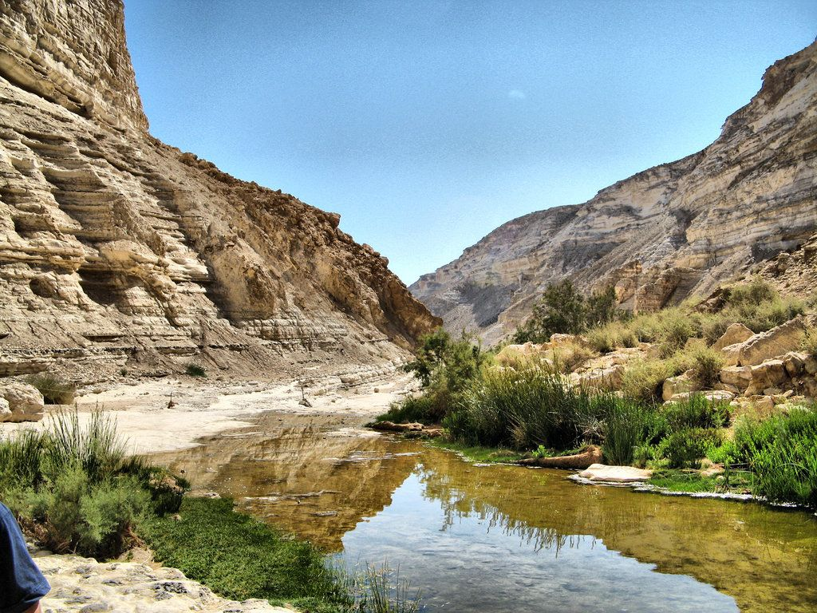

Isaiah 21:1-9
ישעיהו כא:א-ט
Isaiah / ישעיה
http://www.matsati.com

Slide 2



John Oswalt Commentary on Isaiah 21
“Verse 9 makes it appear that the entire address is to Babylon, but that is by no means clear, so that Penna and Kissane see vv. 1–5 as speaking about Judah. The strange title only compounds the difficulty. Also, it is not clear what destruction of Babylon is being spoken of. The reference to Elam and Media (v. 2) seems to point to the Persian overthrow in 539 B.C., as does v. 5 with its apparent allusion to Belshazzar’s feast (Dan. 5). As a result, given the rise of the Deutero-Isaiah hypothesis, many commentators assigned the oracle a date of about 540 (e.g., Delitzsch). Toward the end of the nineteenth century, however, such influential commentators as G. A. Smith and T. K. Cheyne reverted to the idea of Isaianic authorship on the grounds that the reference was to one of the defeats in 710, 702, or 689. More recently the move is back toward the 540 date or even later. The most recent treatment of the chapter concludes that both points of view are correct. A. A. Macintosh refers to the material as a palimpsest, by which he means that there was a sixth-century rewriting of an eighth-century document. This point of view seems to represent the most accurate observation of the data, for materials reflecting data from both centuries seem to be present (see below for further discussion).”
Isaiah / ישעיה
http://www.matsati.com

Slide 3

אִגֶּרֶת פֶּטְרוֹס הַשְּׁנִיָּה פרק ג:ט
ט אֵין אַדֹנָי מְאַחֵר בַּדָּבָר אֲשֶׁר הִבְטִיחַ, כְּמוֹ שֶׁיֵּשׁ הַחוֹשְׁבִים זֹאת לאִחוּר, אֶלָּא שֶׁהוּא מַאֲרִיךְ אַפּוֹ לָנוּ; אֵין הוּא רוֹצֶה שֶׁיֹּאבַד אִישׁ, אֶלָּא שֶׁהַכֹּל יָבוֹאוּ לִידֵי תְּשׁוּבָה.
2 Peter 3:9
3:9 The Lord is not slack concerning his promise, as some men count slackness; but is longsuffering to us-ward, not willing that any should perish, but that all should come to repentance. (KJV, ܠܴܐ ܡܶܫܬܱ݁ܘܚܰܪ ܡܳܪܝܳܐ ܒ݁ܡܽܘܠܟܴ݁ܢܱ̈ܘܗ̄ܝ ܁ ܐܱܝܟ݂ ܕ݁ܐ̱ܢܴ̈ܫܺܝܢ ܫܽܘܘܚܳܪܴܐ ܡܰܣܒ݁ܪܻܝܢ ܇ ܐܷܠܴܐ ܡܰܓܱ݁ܪ ܪܾܘܚܶܗ ܡܶܛܾܠܴܬ݂ܟ݂ܽܘܢ ܆ ܒܱ݁ܕ݂ܠܴܐ ܨܴܒ݂ܶܐ ܕ݁ܐ̱ܢܳܫ ܢܺܐܒ݂ܰܕ݂ ܇ ܐܷܠܴܐ ܟܾ݁ܠܢܳܫ ܠܱܬ݂ܝܳܒ݂ܽܘܬ݂ܴܐ ܢܺܐܬ݂ܷܐ ܂)
Isaiah / ישעיה
http://www.matsati.com

Slide 4
























﻿ספר ישעיה פרק כא
﻿א מַשָּׂא מִדְבַּר-יָם כְּסוּפוֹת בַּנֶּגֶב לַחֲלֹף מִמִּדְבָּר בָּא מֵאֶרֶץ נוֹרָאָה: ב חָזוּת קָשָׁה הֻגַּד-לִי הַבּוֹגֵד | בּוֹגֵד וְהַשּׁוֹדֵד | שׁוֹדֵד עֲלִי עֵילָם צוּרִי מָדַי כָּל-אַנְחָתָה הִשְׁבַּתִּי: ג עַל-כֵּן מָלְאוּ מָתְנַי חַלְחָלָה צִירִים אֲחָזוּנִי כְּצִירֵי יוֹלֵדָה נַעֲוֵיתִי מִשְּׁמֹעַ נִבְהַלְתִּי מֵרְאוֹת: ד תָּעָה לְבָבִי פַּלָּצוּת בִּעֲתָתְנִי אֵת נֶשֶׁף חִשְׁקִי שָֹם לִי לַחֲרָדָה: ה עָרֹךְ הַשֻּׁלְחָן צָפֹה הַצָּפִית אָכוֹל שָׁתֹה קוּמוּ הַשָּׂרִים מִשְׁחוּ מָגֵן: ו כִּי כֹה אָמַר אֵלַי אֲדֹנָי לֵךְ הַעֲמֵד הַמְצַפֶּה אֲשֶׁר יִרְאֶה יַגִּיד: ז וְרָאָה רֶכֶב צֶמֶד פָּרָשִׁים רֶכֶב חֲמוֹר רֶכֶב גָּמָל וְהִקְשִׁיב קֶשֶׁב רַב-קָשֶׁב: ח וַיִּקְרָא אַרְיֵה עַל-מִצְפֶּה | אֲדֹנָי אָנֹכִי עֹמֵד תָּמִיד יוֹמָם וְעַל-מִשְׁמַרְתִּי אָנֹכִי נִצָּב כָּל-הַלֵּילוֹת: ט וְהִנֵּה-זֶה בָא רֶכֶב אִישׁ צֶמֶד פָּרָשִׁים וַיַּעַן וַיֹּאמֶר נָפְלָה נָפְלָה בָּבֶל וְכָל-פְּסִילֵי אֱלֹהֶיהָ שִׁבַּר לָאָרֶץ:
Isaiah / ישעיה
http://www.matsati.com

Slide 5







ספר ירמיה פרק נ
לח חֹרֶב אֶל-מֵימֶיהָ וְיָבֵשׁוּ כִּי אֶרֶץ פְּסִלִים הִיא וּבָאֵימִים יִתְהֹלָלוּ:
Jeremiah 50:38
50:38 A drought is upon her waters; and they shall be dried up: for it is the land of graven images, and they are mad upon their idols. (KJV)
﻿ספר ירמיה פרק נא
﻿יג שֹׁכַנְתְּי [שֹׁכַנְתְּ] עַל-מַיִם רַבִּים רַבַּת אֹוצָרֹת בָּא קִצֵּךְ אַמַּת בִּצְעֵךְ:
Jeremiah 51:13
51:13 O thou that dwellest upon many waters, abundant in treasures, thine end is come, and the measure of thy covetousness. (KJV)
﻿ספר ירמיה פרק נא
﻿לו לָכֵן כֹּה אָמַר יְהֹוָה הִנְנִי-רָב אֶת-רִיבֵךְ וְנִקַּמְתִּי אֶת-נִקְמָתֵךְ וְהַחֲרַבְתִּי אֶת-יַמָּהּ וְהֹבַשְׁתִּי אֶת-מְקוֹרָהּ:
Jeremiah 51:36
51:36 Therefore thus saith the LORD; Behold, I will plead thy cause, and take vengeance for thee; and I will dry up her sea, and make her springs dry. (KJV)
Isaiah / ישעיה
http://www.matsati.com

Slide 6
Pseudepigrapha Of Solomon, To Victory
1* My ear heard distress and the sound of war,
the blast of the trumpet sounding slaughter and destruction.
2* The sound of many people as of a violent storm,
as a raging fire storm sweeping through the wilderness.
3 And I said to my heart, Where, then, will God judge it?
(James H. Charlesworth, The Old Testament Pseudepigrapha and the New Testament: Expansions of the “Old Testament” and Legends, Wisdom, and Philosophical Literature, Prayers, Psalms and Odes, Fragments of Lost Judeo-Hellenistic Works, vol. 2 (New Haven; London: Yale University Press, 1985), 658.)
Isaiah / ישעיה
http://www.matsati.com

Slide 7
הַבּוֹגֵד | בּוֹגֵד וְהַשּׁוֹדֵד | שׁוֹדֵד
Wilhelm Gesenius, drawing on Wickes, divided them into five:
as a divider between two words which end and begin with the same letters, e.g. שָׁלוֹם׀ מַ‎ (Shalom, ma)
between identical or very similar words, e.g. רַקדָן׀ רָקַד‎ (the dancer danced)
between words which are to a high degree contradictory, e.g. אֱלֹהִים׀ רֶשַׁע‎ (God, evil)
between words otherwise liable to be wrongly connected, e.g. כַּף׀ תּוֹר‎, which prevents the somewhat bizarre phrase כַּף‎ (kaf, spoon) תּוֹר‎ (tor, queue) from being wrongly read as כַּפְתּוֹר‎ (kaftor), meaning button.
"and lastly, between heterogeneous terms, as Eleazar the High Priest, and Joshua" (אֶלְעָזָ֣ר הַכֹּהֵ֣ן׀ וִיהוֹשֻׁ֪עַ‎—see context in Joshua 19:51)
Isaiah / ישעיה
http://www.matsati.com

Slide 8
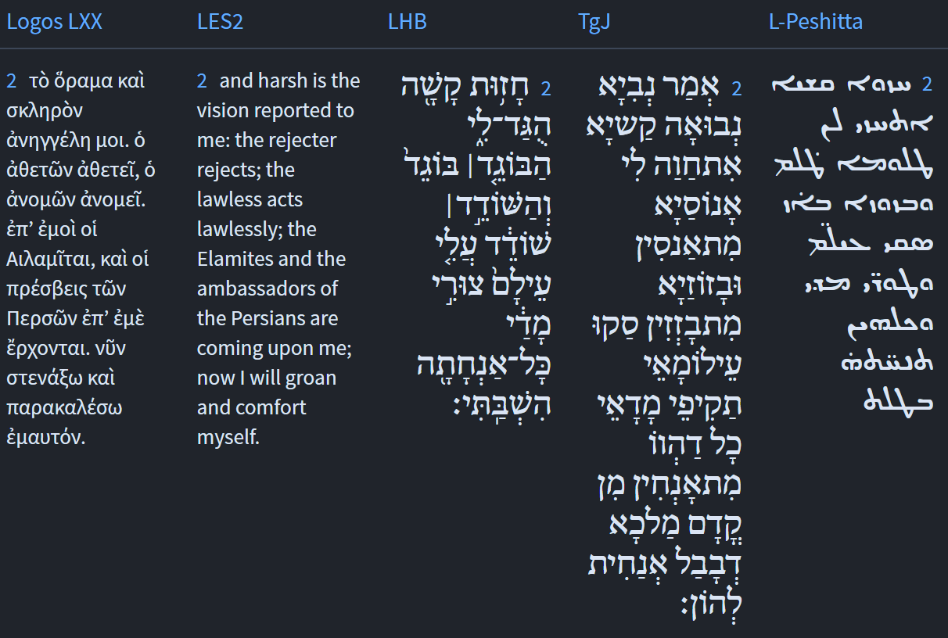
Isaiah / ישעיה
http://www.matsati.com

Slide 9

הַבּוֹגֵד | בּוֹגֵד וְהַשּׁוֹדֵד | שׁוֹדֵד
ὁ ἀθετῶν ἀθετεῖ, ὁ ἀνομῶν ἀνομεῖ.
Ἀθετῶν - verb, present, active, participle, singular, nominative, masculine
ἀθετεῖ - verb, present, active, indicative, third person, singular
ἀνομῶν - verb, present, active, participle, singular, nominative, masculine
Ἀνομεῖ - verb, present, active, indicative, third person, singular
Isaiah / ישעיה
http://www.matsati.com

Slide 10
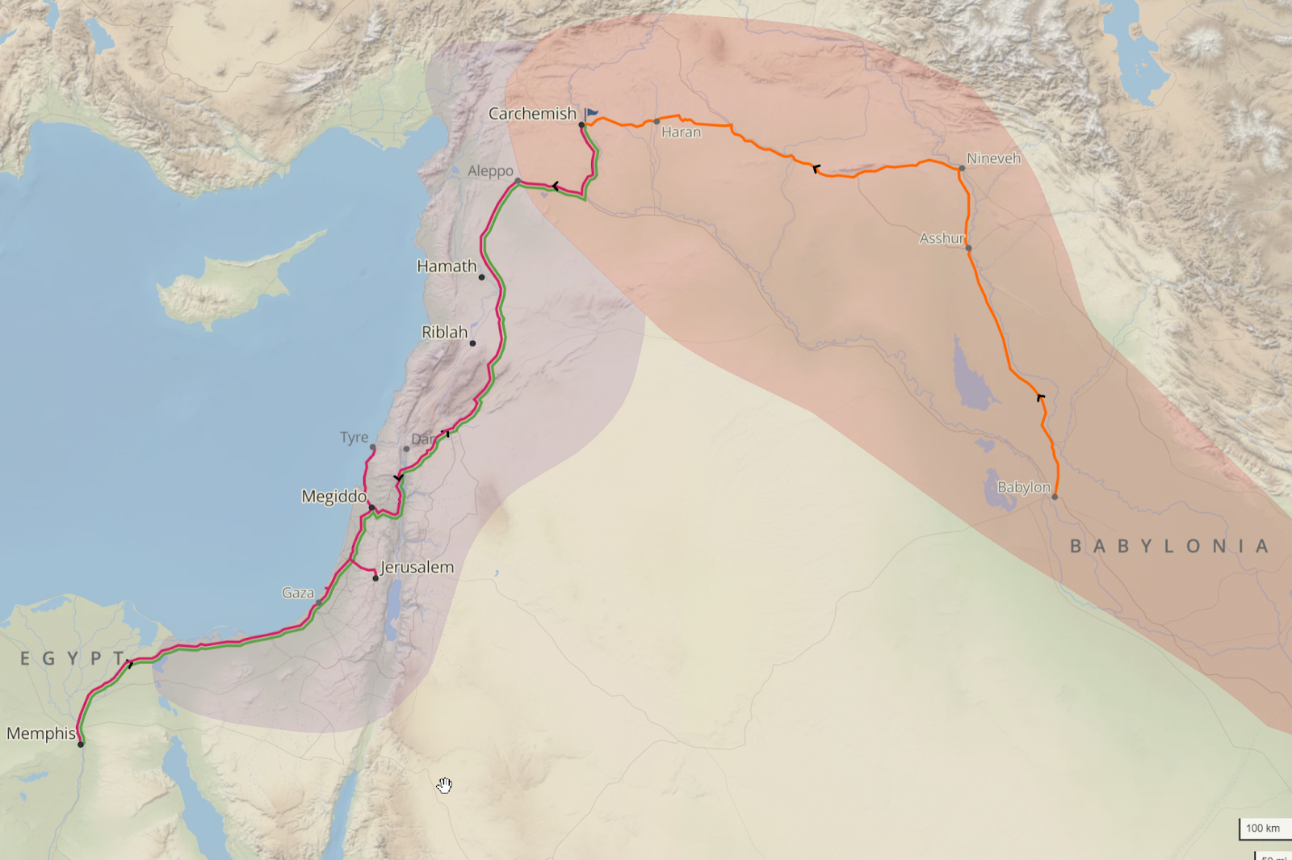






Isaiah / ישעיה
http://www.matsati.com

Slide 11
Mark 13:28-37
28 And, from the fig-tree, learn ye a simile. When its twigs are tender, and its leaves bud forth, ye know that summer approacheth. 29 So also, when ye shall see these occurrences, know ye, that it is near, at the door. 30 Verily I say to you, That this generation shall not pass away, until all these things occur. 31 Heaven and earth will pass away, but my words will not pass away.—32 But of that day and that hour, knoweth no man; nor the angels of heaven; neither the Son, but the Father. 33 Take heed, watch, and pray; for ye know not when the time is. 34 For it is as a man, who took a journey, and left his home; and he gave authority to his servants, and to each his service; and he commanded the porter to be watchful. 35 Watch ye, therefore; for ye know not when the lord of the house cometh; at evening, or at midnight, or at the cock-crowing, or in the morning: 36 lest he come suddenly, and find you sleeping. 37 And what I say to you, I say to you all: Be ye watchful. (JM, ܡܶܢ ܬܻ݁ܬܴ݁ܐ ܕܷ݁ܝܢ ܝܺܠܱܦ݂ܘ ܦܷ݁ܠܷܐܬ݂ܴܐ ܂ ܕ݁ܡܳܐ ܕ݁ܪܱܟ݂ ܣܰܘܟܷ݁ܝ̈ܗ ܁ ܘܰܦ݂ܪܱܥܘ ܛܱܪ̈ܦ݂ܶܝܗ ܆ ܝܳܕ݂ܥܺܝܢ ܐܢ̄ܬܾ݁ܘܢ ܂ ܕܱ݁ܡܛܴܐ ܩܰܝܛܴܐ ܂ܗܳܟ݂ܰܢܳܐ ܐܴܦ݂ ܐܱܢ̄ܬܾ݁ܘܢ ܡܳܐ ܕܱ݁ܚܙܰܝܬܾ݁ܘܢ ܗܳܠܷܝܢ ܕ݁ܗܳܘܝܴ̈ܢ ܆ ܕܱ݁ܥܘ ܁ ܕ݁ܩܰܪܻܝܒ݂ܳܐ ܗ̄ܝ ܥܰܠ ܬܱ݁ܪܥܳܐ ܂ ܐܱܡܺܝܢ ܐܴܡܰܪ ܐ̱ܢܳܐ ܠܟ݂ܽܘܢ ܆ ܕ݁ܠܴܐ ܬܷ݁ܥܒܱ݁ܪ ܫܰܪܒ݁ܬ݂ܴܐ ܗܳܕ݂ܶܐ ܇ ܥܕ݂ܰܡܳܐ ܕ݁ܗܳܠܷܝܢ ܟܾ݁ܠܗܶܝܢ ܢܶܗܘܝܴ̈ܢ ܂ ܫܡܰܝܳܐ ܘܰܐܪܥܳܐ ܢܶܥܒ݁ܪܾܘܢ ܆ ܘܡܶܠܱܝ̈ ܠܴܐ ܢܶܥܒ݁ܪܴ̈ܢ ܀ ܥܰܠ ܕܷ݁ܝܢ ܝܰܘܡܳܐ ܗܰܘ ܁ ܘܥܰܠ ܫܳܥܬ݂ܴܐ ܗܳܝ ܆ ܐ̱ܢܳܫ ܠܴܐ ܝܳܕ݂ܰܥ ܂ ܐܴܦ݂ܠܴܐ ܡܰܠܱܐܟ݂ܷ̈ܐ ܕܱ݁ܫܡܰܝܳܐ ܂ ܘܠܴܐ ܒ݁ܪܴܐ ܂ ܐܷܠܴܐ ܐܷܢ ܐܱܒ݂ܳܐ ܀ ܚܙܰܘ ܁ ܐܷܬ݁ܬ݁ܥܺܝܪܘ ܂ ܘܨܱܠܱܘ ܂ ܠܴܐ ܓܷ݁ܝܪ ܝܳܕ݂ܥܺܝܢ ܐܢ̄ܬܾ݁ܘܢ ܐܷܡܰܬ݂ܝ ܗ̄ܽܘ ܙܰܒ݂ܢܳܐ ܀ ܐܱܝܟ݂ ܓܱ݁ܒ݂ܪܴܐ ܗ̄ܘ ܓܷ݁ܝܪ ܕܱ݁ܚܙܰܩ ܂ ܘܰܫܒ݂ܰܩ ܒܱ݁ܝܬܷ݁ܗ ܆ ܘܝܰܗ̄ܒ݂ ܫܽܘܠܛܴܢܳܐ ܠܥܰܒ݂ܕܱ݁ܘܗ̄ܝ̈ ܂ ܘܰܠܐ̱ܢܳܫ ܐ̱ܢܳܫ ܥܒ݂ܳܕ݂ܶܗ ܂ ܘܰܠܬ݂ܴܪܥܳܐ ܦܱ݁ܩܶܕ݂ ܂ ܕ݁ܢܶܗܘܶܐ ܥܺܝܪ ܂ ܐܷܬ݁ܬ݁ܥܺܝܪܘ ܗܳܟ݂ܺܝܠ ܂ ܕ݁ܠܴܐ ܝܳܕ݂ܥܺܝܢ ܐܢ̄ܬܾ݁ܘܢ ܐܷܡܰܬ݂ܝ ܐܴܬ݂ܷܐ ܡܳܪܷܗ ܕ݁ܒ݂ܰܝܬܴ݁ܐ ܂ ܒ݁ܪܱܡܫܳܐ ܁ ܐܱܘ ܒ݁ܦ݂ܶܠܓܷ݁ܗ ܕ݁ܠܻܠܝܳܐ ܂ ܐܱܘ ܒ݁ܡܰܩܪܴܐ ܬܱ݁ܪܢܳܓ݂ܠܴܐ ܁ ܐܱܘ ܒ݁ܨܱܦ݂ܪܴܐ ܂ ܕܱ݁ܠܡܳܐ ܢܺܐܬ݂ܷܐ ܡܶܢ ܫܶܠܝܳܐ ܂ ܘܢܶܫܟܱ݁ܚܟ݂ܽܘܢ ܟܱ݁ܕ݂ ܕܱ݁ܡܟܻ݁ܝܢ ܐܢ̄ܬܾ݁ܘܢ ܂ ܡܶܕܷ݁ܡ ܕܱ݁ܠܟ݂ܽܘܢ ܕܷ݁ܝܢ ܐܴܡܰܪ ܐ̱ܢܳܐ ܂ ܠܟ݂ܽܠܟ݂ܽܘܢ ܗ̄ܽܘ ܐܴܡܰܪ ܐ̱ܢܳܐ ܆ ܗܘܰܝܬܾ݁ܘܢ ܥܺܝܪܻܝܢ ܀)
Isaiah / ישעיה
http://www.matsati.com

Slide 12

ספר תהילים פרק סח
יח רֶ֤כֶב אֱלֹהִ֗ים רִבֹּתַ֣יִם אַלְפֵ֣י שִׁנְאָ֑ן אֲדֹנָ֥י בָ֝֗ם סִינַ֥י בַּקֹּֽדֶשׁ׃ יט עָ֘לִ֤יתָ לַמָּר֨וֹם׀ שָׁ֘בִ֤יתָ שֶּׁ֗בִי לָקַ֣חְתָּ מַ֭תָּנוֹת בָּאָדָ֑ם וְאַ֥ף ס֝וֹרְרִ֗ים לִשְׁכֹּ֤ן׀ יָ֬הּ אֱלֹהִֽים׃
Tehillim / Psalm 68:17-18
68:17 The chariots of God are twenty thousand, even thousands of angels: the Lord is among them, as in Sinai, in the holy place. 68:18 Thou hast ascended on high, thou hast led captivity captive: thou hast received gifts for men; yea, for the rebellious also, that the Lord God might dwell among them. (KJV)
Isaiah / ישעיה
http://www.matsati.com

Slide 13
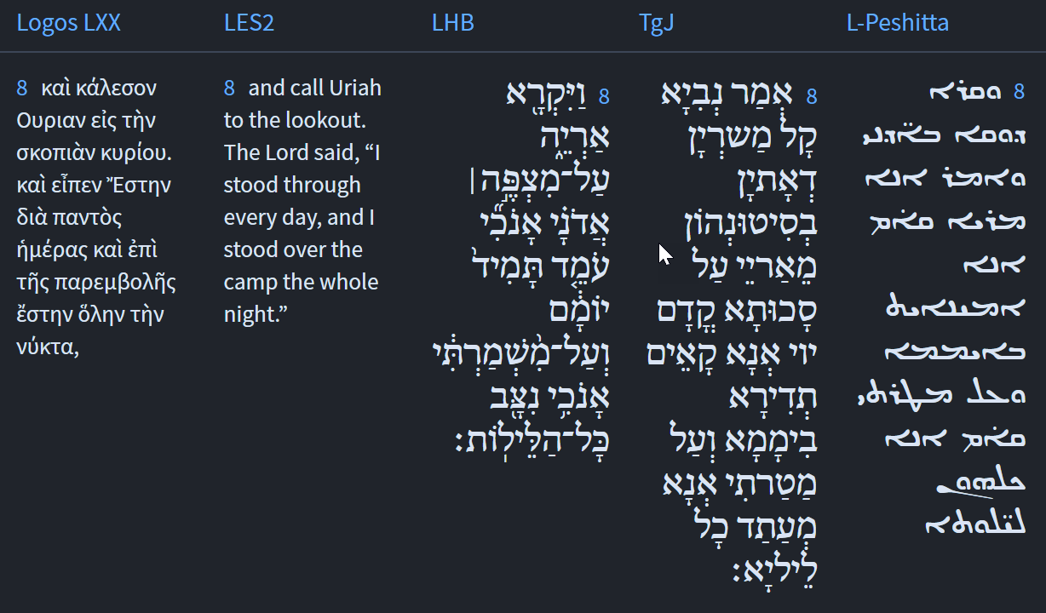






Isaiah / ישעיה
http://www.matsati.com

Slide 14







Matthew 26:41
26:41 Watch and pray, that ye enter not into temptation: the spirit indeed is willing, but the flesh is weak. (KJV, γρηγορεῖτε καὶ προσεύχεσθε ἵνα μὴ εἰσέλθητε εἰς πειρασμόν. τὸ μὲν πνεῦμα πρόθυμον ἡ δὲ σὰρξ ἀσθενής. ܐܷܬ݁ܬ݁ܥܺܝܪܘ ܁ ܘܨܱܠܱܘ ܂ ܕ݁ܠܴܐ ܬܷ݁ܥܠܾܘܢ ܠܢܶܣܝܽܘܢܳܐ ܂ ܪܾܘܚܳܐ ܂ ܡܛܱܝܒ݂ܳܐ ܂ ܦܱ݁ܓ݂ܪܴܐ ܕܷ݁ܝܢ ܟ݁ܪܻܝܗ ܀)
Mark 13:33
13:33 Take ye heed, watch and pray: for ye know not when the time is. (KJV, βλέπετε, ἀγρυπνεῖτε καὶ προσεύχεσθε· οὐκ οἴδατε γὰρ πότε ὁ καιρός ἐστιν. ܚܙܰܘ ܁ ܐܷܬ݁ܬ݁ܥܺܝܪܘ ܂ ܘܨܱܠܱܘ ܂ ܠܴܐ ܓܷ݁ܝܪ ܝܳܕ݂ܥܺܝܢ ܐܢ̄ܬܾ݁ܘܢ ܐܷܡܰܬ݂ܝ ܗ̄ܽܘ ܙܰܒ݂ܢܳܐ ܀)
Mark 14:38
14:38 Watch ye and pray, lest ye enter into temptation. The spirit truly is ready, but the flesh is weak. (KJV, γρηγορεῖτε καὶ προσεύχεσθε ἵνα μὴ ἔλθητε εἰς πειρασμόν. τὸ μὲν πνεῦμα πρόθυμον, ἡ δὲ σὰρξ ἀσθενής. ܐܷܬ݁ܬ݁ܥܺܝܪܘ ܘܨܱܠܱܘ ܂ ܕ݁ܠܴܐ ܬܷ݁ܥܠܾܘܢ ܠܢܶܣܝܽܘܢܳܐ ܂ ܪܾܘܚܳܐ ܨܴܒ݂ܝܳܐ ܂ ܘܰܡܛܱܝܒ݂ܳܐ ܂ ܐܷܠܴܐ ܦܱ݁ܓ݂ܪܴܐ ܟ݁ܪܻܝܗ ܀)
Isaiah / ישעיה
http://www.matsati.com

Slide 15

ספר ישעיה פרק כא
ז וְרָאָה רֶכֶב צֶמֶד פָּרָשִׁים רֶכֶב חֲמוֹר רֶכֶב גָּמָל וְהִקְשִׁיב קֶשֶׁב רַב-קָשֶׁב:
ספר ישעיה פרק כא
ט וְהִנֵּה-זֶה בָא רֶכֶב אִישׁ צֶמֶד פָּרָשִׁים וַיַּעַן וַיֹּאמֶר נָפְלָה נָפְלָה בָּבֶל וְכָל-פְּסִילֵי אֱלֹהֶיהָ שִׁבַּר לָאָרֶץ:
Isaiah / ישעיה
http://www.matsati.com

Slide 16
Rabbinic Literature
ספרות רבנית
Part 2
Isaiah / ישעיה
http://www.matsati.com

Slide 17
Targum Jonathan son of Uziel Isaiah 21:1-9
21:1 The burden of the armies which are coming from the wilderness, as the waters of the sea, rushing along as the tempests: yea, they are coming by the way of the south, hurrying along; ea, they are coming from the wilderness, from the land, in which terrible things are done. 21:2 The prophet said: a dreadful vision has been declared unto me. The violent deal violently, and the spoilers spoil. Come up, ye Elamites; encompass, ye Media! I will give rest to all who sigh on account of the king of Babylon. 21:3 Therefore their loins shall be full of terror: behold, fear shall seize them, like the pangs of a woman that travaileth. They are become foolish, so that they cannot hear; they have erred, so that they cannot see. 21:4 Their heart is bewildered; distress and terrors have seized them, because the place of their confidence hath become destruction unto them. 21:5 Prepare the table, place the watchmen, eat ye, drink ye; rise, ye princes, polish, and make bright the arms! 21:6 For thus hath the Lord said unto me: Go, set a watchman, let him report what he seeth. 21:7 And he saw a chariot, a man, and with him a couple of horsemen: a rider on an ass, a rider on a camel. The prophet said, I listened diligently, and, behold, I saw mighty armies! 21:8 The prophet said, the voice of armies, coming with coats of mail, is as a lion; and I stand continually upon the watchtower before the Lord in the day, and as a guard I stand all the night. 21:9 And, behold, this was coming: A chariot! a man! and with him a couple of horsemen. He answered, and said, She is fallen! Yea, it shall come to pass, that Babylon shall fall, and all the images of her idols shall be dashed to pieces to the ground. (TgJ)
Isaiah / ישעיה
http://www.matsati.com

Slide 18
Zohar 1:60a:5
Rabbi Elazar opened his discourse "Come, behold the works of Hashem, who has made desolations in the earth" (Tehilim 46:9). "Come, behold (Heb. חֲזוּ)": what is the meaning of "behold?" It is related to the verse, "a grievous vision (Heb. חָזוּת) has been declared to me (Yeshayah 21:2). Because by His deeds, the Holy One, blessed be He, reveals his prophecy to man. And when a prophecy is revealed by preceding grievous deeds, it is called 'a grievous vision.' "Who has made desolations (Heb. שַׁמּוֹת)" assuredly alludes to names (Heb. שֵׁמוֹת), for a name is the cause of everything that happens.
Isaiah / ישעיה
http://www.matsati.com

Slide 19




ספר ישעיה פרק נה
ז יוֹצֵ֥ר אוֹר֙ וּבוֹרֵ֣א חֹ֔שֶׁךְ עֹשֶׂ֥ה שָׁל֖וֹם וּב֣וֹרֵא רָ֑ע אֲנִ֥י יְהוָ֖ה עֹשֶׂ֥ה כָל־אֵֽלֶּה׃
Isaiah 45:7
45:7 I form the light, and create darkness: I make peace, and create evil: I the LORD do all these things. (KJV)
ספר עמוס פרק ג
ו אִם־יִתָּקַ֤ע שׁוֹפָר֙ בְּעִ֔יר וְעָ֖ם לֹ֣א יֶחֱרָ֑דוּ אִם־תִּהְיֶ֤ה רָעָה֙ בְּעִ֔יר וַיהוָ֖ה לֹ֥א עָשָֽׂה׃
Amos 3:6
3:6 Shall a trumpet be blown in the city, and the people not be afraid? shall there be evil in a city, and the LORD hath not done it? (KJV)
Isaiah / ישעיה
http://www.matsati.com

Slide 20
Rashi on Isaiah 21:7 Part 1-2
וראה רכב. וראה המצפה רכב צמד פרשים רכב שרוכבים עליו זוג פרשים:
And he shall see a chariot and I will show him there a sort of chariot with a pair of riders, one riding a donkey
וראה גם כן רכב חמור רכב גמל: והקשיב קשב רב קשב. יקשיב אם הם קרובים אם ישמע קול פרסותם, ויונתן תרגם ויחזי רתך אינש ועמיה זוג פרשים וגומר:
key and one riding a camel, and that is a sign of Persia and Media. and he shall listen attentively And there he shall hear in his prophecy a representation of the mighty rumbling and stirring of armies.
Ibn Ezra on Isaiah 21:7 Part 1
וראה וגו׳ When he sees, And he saw, And he hearkened. According to I. E. these sentences are not coordinated, but the former is subordinate, and the latter is the principal sentence.15A. V., And he saw, And he hearkened. According to I. E. these sentences are not coordinated, but the former is subordinate, and the latter is the principal sentence. a chariot with a couple of horsemen, a chariot of asses, or a chariot of camels, he will hearken diligently to learn what news they have to tell.
Isaiah / ישעיה
http://www.matsati.com

Slide 21

Ibn Ezra on Isaiah 21,8 Part 1
אריה A lion. According to the Midrash, Habakkukis meant, because חבקוק ═ אריה taking the arithmetical value of the letters. The arithmetical value of the letters of the word אריה, is 1 + 200 + 10 + 5 ═ 216, that of חבקוק, 8 + 2 + 100 + 6 + 100 ═ 216. Our attention is called to this arithmetical equation, as if Isaiah foreshadowed a prophecy of Habakkuk in similar terms. See Rashi ad locum. I think ב must be supplied; comp. אש אוכלה as a consuming fire A. V., A consuming fire. (Deut. 4:24). The watchman called with a loud voice like a lion.
Ibn Ezra on Isaiah 21,9 Part 3
Babylon is fallen, is fallen. The repetition indicates that no remnant has been left to her.
Isaiah / ישעיה
http://www.matsati.com

