Slide 1
Isaiah 20:1-6
ישעיהו כ:א-ו
Isaiah / ישעיה
http://www.matsati.com

Slide 2
﻿ספר ישעיה פרק כ
א בִּשְׁנַת בֹּא תַרְתָּן אַשְׁדּוֹדָה בִּשְׁלֹח אֹתוֹ סַרְגוֹן מֶלֶךְ אַשּׁוּר וַיִּלָּחֶם בְּאַשְׁדּוֹד וַיִּלְכְּדָהּ: ב בָּעֵת הַהִיא דִּבֶּר יְהֹוָה בְּיַד יְשַׁעְיָהוּ בֶן-אָמוֹץ לֵאמֹר לֵךְ וּפִתַּחְתָּ הַשַּׂק מֵעַל מָתְנֶיךָ וְנַעַלְךָ תַחֲלֹץ מֵעַל רַגְלֶיךָ וַיַּעַשֹ כֵּן הָלֹךְ עָרוֹם וְיָחֵף: ג וַיֹּאמֶר יְהֹוָה כַּאֲשֶׁר הָלַךְ עַבְדִּי יְשַׁעְיָהוּ עָרוֹם וְיָחֵף שָׁלשׁ שָׁנִים אוֹת וּמוֹפֵת עַל-מִצְרַיִם וְעַל-כּוּשׁ: ד כֵּן יִנְהַג מֶלֶךְ-אַשּׁוּר אֶת-שְׁבִי מִצְרַיִם וְאֶת-גָּלוּת כּוּשׁ נְעָרִים וּזְקֵנִים עָרוֹם וְיָחֵף וַחֲשֹוּפַי שֵׁת עֶרְוַת מִצְרָיִם: ה וְחַתּוּ וָבֹשׁוּ מִכּוּשׁ מַבָּטָם וּמִן-מִצְרַיִם תִּפְאַרְתָּם: ו וְאָמַר ישֵׁב הָאִי הַזֶּה בַּיּוֹם הַהוּא הִנֵּה-כֹה מַבָּטֵנוּ אֲשֶׁר-נַסְנוּ שָׁם לְעֶזְרָה לְהִנָּצֵל מִפְּנֵי מֶלֶךְ אַשּׁוּר וְאֵיךְ נִמָּלֵט אֲנָחְנוּ:
Isaiah / ישעיה
http://www.matsati.com

Slide 3
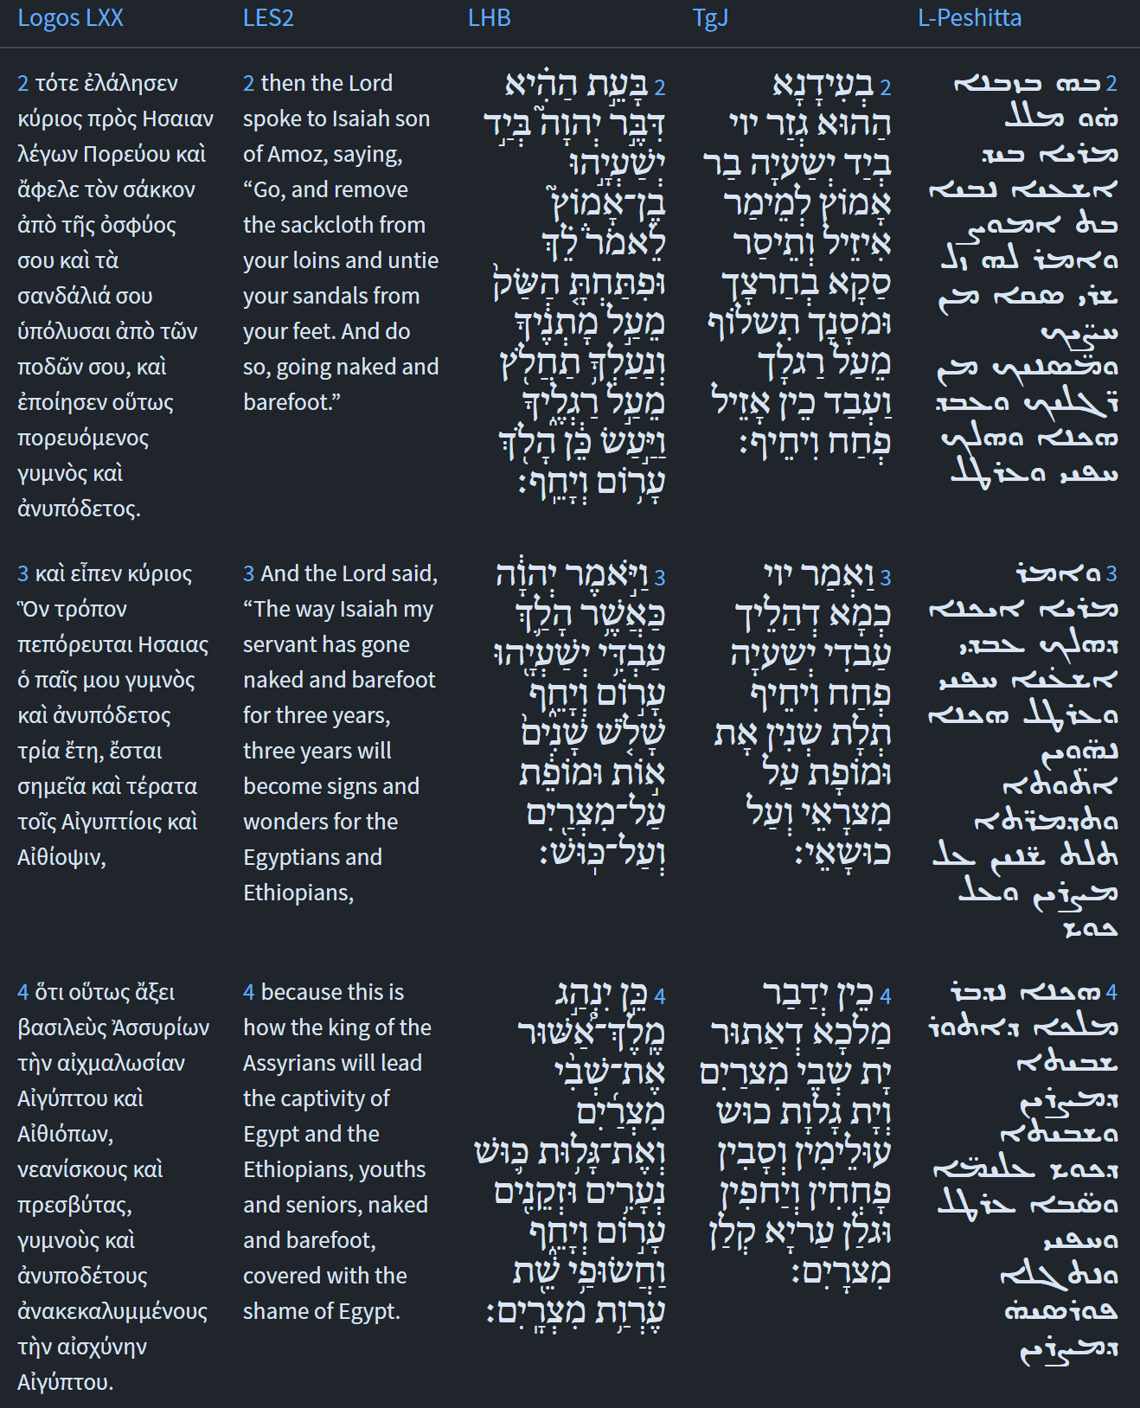
Isaiah / ישעיה
http://www.matsati.com

Slide 4
﻿ספר שמואל א פרק יט ﻿כד וַיִּפְשַׁט גַּם-הוּא בְּגָדָיו וַיִּתְנַבֵּא גַם-הוּא לִפְנֵי שְׁמוּאֵל וַיִּפֹּל עָרֹם כָּל-הַיּוֹם הַהוּא וְכָל-הַלָּיְלָה עַל-כֵּן יֹאמְרוּ הֲגַם שָׁאוּל בַּנְּבִיאִם:
1 Samuel 19:24
19:24 He stripped off his garments, and he too prophesied in Samuel's presence. He lay naked all that day and all that night. This is why people say, "Is Saul also among the prophets?"
Isaiah / ישעיה
http://www.matsati.com

Slide 5
DSS 4Q169: A Commentary on Nahum Frags. 3–4 ii:10-iii:2
DSSSE:EN | DSSSE:TR | DSS:NT
4Q169 Frags. 3–4 ii:10 10 will fall [due to the fero]city of their tongues. Blank Nah 3:5 See, I am against you!—oracle of YHWH of H[ost]s—You shall hoist | 4Q169 Frags. 3–4 ii:10 10 יפולו [מז]עם לשונם vacat הנני אליך נאם יהוה צ[באו]ת וגלית | 4Q169 Frags. 3–4 ii:10 10will perish through their [arrog]ant talk. According to Josephus, Jannaeus had to relinquish power over some of his Transjordanian conquests to buy the neutrality of the Arabians. The reference to “cities of the East” being “stripped” may be to this strategy. “See, I am against you, says the LORD of H[ost]s. You will strip off
4Q169 Frags. 3–4 ii:11 11 [your] skirts up to your face and show the nations [your] nudity and kings {…} your shame. Blank Its interpretation […] … | 4Q169 Frags. 3–4 ii:11 11 שולי[ך ]על פניך והרא[י]ת גוים מער[ך] וממלכות {…} קלונך vacat פשרו .[…]… | 4Q169 Frags. 3–4 ii:11 11your skirts over your face and show the Gentiles [your] nudity, the kingdoms your shame” (3:5). This refers to […]
4Q169 Frags. 3–4 ii:12 12 […] the cities of (the) East, because «the skirts» […] | 4Q169 Frags. 3–4 ii:12 12 […]ערי המזרח כי השול[י]ם[ …] | 4Q169 Frags. 3–4 ii:12 12[…] the cities of the East, for “the skirts” are […]
4Q169 Frags. 3–4 iii Frags. 3–4 Col. III | 4Q169 Frags. 3–4 iii Frags. 3–4 III | 4Q169 Frags. 3–4 iii Col. 3
4Q169 Frags. 3–4 iii:1 1 The nations with their uncleanness [and with] their detestable abominations. Nah 3:6 I will throw refuse on top of you, [af]front you and make you | 4Q169 Frags. 3–4 iii:1 1 הגוים בנדתם [ובש]קוצי תועבותיהם והשלכתי עליך שקוצים [ונ]בלתיך ושמתיך | 4Q169 Frags. 3–4 iii:1 1the Gentiles in their filth [and in] their abhorrent [i]dols. “I will throw your abominations at you, I will treat you with scorn, I will make you
4Q169 Frags. 3–4 iii:2 2 repulsive. Nah 3:7 And what will happen is that all those who see you will run away from you. Blank | 4Q169 Frags. 3–4 iii:2 2 כאורה והיה כול רואיך ידודו ממך vacat | 4Q169 Frags. 3–4 iii:2 2repulsive, so that everyone who sees you will avoid you” (3:6–7a).
Isaiah / ישעיה
http://www.matsati.com

Slide 6
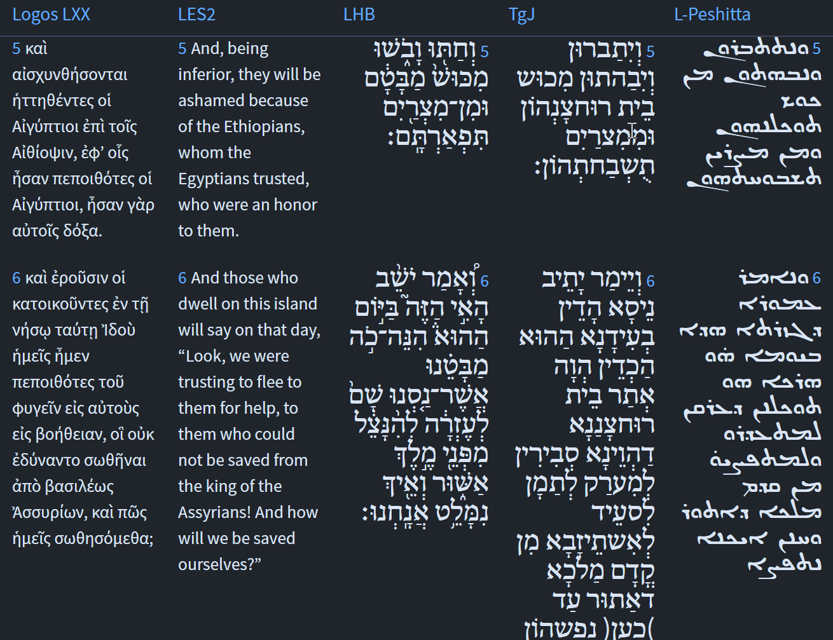
Isaiah / ישעיה
http://www.matsati.com

Slide 7
Rabbinic Literature
ספרות רבנית
Part 2
Isaiah / ישעיה
http://www.matsati.com

Slide 8
Targum Jonathan son of Uziel Isaiah 20:1-6
20:1 In the year that Tharthan marched to Ashdod, (when Sargon, the king of Assyria, sent him,) and he waged battle against Ashdod, and subdued it; 20:2 At that time the Lord decreed by Isaiah, the son of Amoz, saying, Go and remove the sackcloth which is on thy loins, and put off thy sandals from off thy feet: and he did so, walking naked and barefoot. 20:3 And the Lord said, Like as my servant Isaiah hath walked naked and barefoot three years for a sign and wonder upon Egypt and Cush: 20:4 So shall the king of Assyria lead the captives, and the captivity of Cush, the young and old, naked and barefoot, even with their shame uncovered, to the disgrace of Egypt. 20:5 And they shall be afraid and confounded because of Cush, the place of their confidence, and because of Egypt, their boasting. 20:6 At that time the inhabitant of this island shall say: Such is become the place of our trust, to which we were hoping to flee for help to be delivered from before the king of Assyria, if hitherto they could not deliver themselves, how shall we be delivered? (TgJ)
Isaiah / ישעיה
http://www.matsati.com

Slide 9
Rashi on Isaiah 20,2 Part 1-3
ופתחת השק מעל מתניך. ת"י ותיסר סקא בחרצך והדברים מוכיחים שהרי עד עכשיו לא ציוהו לחגור שק שהוא אומר לו להתירה ועוד שהוא אומר ונעלך תחלוץ והוא סימן לאבלות ופי' ופתחת כמו (שמו' לט) מפותחות פתוחי חותם לחגור שק בדוחק על בשרו כדי שתרא' חקוקה בבשרו: and you shall gird sackcloth over your loins (וּפִתַּחְתָּ) Jonathan renders: “And you shall gird the sackcloth over your loins.” And his interpretation is evidenced by the fact that until now, He had not commanded him to gird himself with sackcloth, that He should tell him to remove it. Moreover, when He tells him, “And you shall remove your shoes from upon your feet,” this is a sign of mourning. (It is, therefore, likely that He commanded him to gird himself with sackcloth, also a sign of mourning.) And the meaning of וּפִתַּחְתָּ is like: (Exodus 39:6) “Engraved like the engravings of a seal (מְפֻתָּחוֹת פִּתּוּחֵי חוֹתָם),” to gird himself with sackcloth tightly on his flesh, so that it appears to be engraved in his flesh.
מעל מתניך. למעלה ממתניך: over your loins above your loins.
ערום. ת"י פחיח בבגדים קרועים ובלואים ולא ערום ממש: naked (עָרוֹם). Jonathan renders: פְּחֵיחַ, with torn and worn out clothing, but not actually naked.
Isaiah / ישעיה
http://www.matsati.com

Slide 10
Pirkei Avot 6:1
שָׁנוּ חֲכָמִים בִּלְשׁוֹן הַמִּשְׁנָה, בָּרוּךְ שֶׁבָּחַר בָּהֶם וּבְמִשְׁנָתָם: רַבִּי מֵאִיר אוֹמֵר כָּל הָעוֹסֵק בַּתּוֹרָה לִשְׁמָהּ, זוֹכֶה לִדְבָרִים הַרְבֵּה. וְלֹא עוֹד אֶלָּא שֶׁכָּל הָעוֹלָם כֻּלּוֹ כְדַי הוּא לוֹ. נִקְרָא רֵעַ, אָהוּב, אוֹהֵב אֶת הַמָּקוֹם, אוֹהֵב אֶת הַבְּרִיּוֹת, מְשַׂמֵּחַ אֶת הַמָּקוֹם, מְשַׂמֵּחַ אֶת הַבְּרִיּוֹת. וּמַלְבַּשְׁתּוֹ עֲנָוָה וְיִרְאָה, וּמַכְשַׁרְתּוֹ לִהְיוֹת צַדִּיק וְחָסִיד וְיָשָׁר וְנֶאֱמָן, וּמְרַחַקְתּוֹ מִן הַחֵטְא, וּמְקָרַבְתּוֹ לִידֵי זְכוּת, וְנֶהֱנִין מִמֶּנּוּ עֵצָה וְתוּשִׁיָּה בִּינָה וּגְבוּרָה, שֶׁנֶּאֱמַר (משלי ח) לִי עֵצָה וְתוּשִׁיָּה אֲנִי בִינָה לִי גְבוּרָה. וְנוֹתֶנֶת לוֹ מַלְכוּת וּמֶמְשָׁלָה וְחִקּוּר דִּין, וּמְגַלִּין לוֹ רָזֵי תוֹרָה, וְנַעֲשֶׂה כְמַעְיָן הַמִּתְגַּבֵּר וּכְנָהָר שֶׁאֵינוֹ פוֹסֵק, וֶהֱוֵי צָנוּעַ וְאֶרֶךְ רוּחַ, וּמוֹחֵל עַל עֶלְבּוֹנוֹ, וּמְגַדַּלְתּוֹ וּמְרוֹמַמְתּוֹ עַל כָּל הַמַּעֲשִׂים:
The sages taught in the language of the mishnah. Blessed be He who chose them and their teaching. Rabbi Meir said: Whoever occupies himself with the Torah for its own sake, merits many things; not only that but he is worth the whole world.He is called beloved friend; one that loves God; one that loves humankind; one that gladdens God; one that gladdens humankind. And the Torah clothes him in humility and reverence, and equips him to be righteous, pious, upright and trustworthy; it keeps him far from sin, and brings him near to merit. And people benefit from his counsel, sound knowledge, understanding and strength, as it is said, “Counsel is mine and sound wisdom; I am understanding, strength is mine” (Proverbs 8:14). And it bestows upon him royalty, dominion, and acuteness in judgment. To him are revealed the secrets of the Torah, and he is made as an ever-flowing spring, and like a stream that never ceases. And he becomes modest, long-suffering and forgiving of insult. And it magnifies him and exalts him over everything.
Isaiah / ישעיה
http://www.matsati.com

Slide 11
Talmud Bavli Yoma 77a:12
אֶלָּא אָמַר רַב נַחְמָן בַּר יִצְחָק, מֵהָכָא: ״לֵךְ וּפִתַּחְתָּ הַשַּׂק מֵעַל מׇתְנֶיךָ וְנַעַלְךָ תַחֲלוֹץ מֵעַל רַגְלֶךָ״, וּכְתִיב: ״וַיַּעַשׂ כֵּן הָלוֹךְ עָרוֹם וְיָחֵף״. יָחֵף מִמַּאי — לָאו מִנְּעִילַת הַסַּנְדָּל? וְאֵימָא בְּמִנְעָלִים הַמְטוּלָּאִים? דְּאִי לָא תֵּימָא הָכִי, ״עָרוֹם״ — עָרוֹם מַמָּשׁ, אֶלָּא בִּבְגָדִים בְּלוּיִים, הָכָא נָמֵי בְּמִנְעָלִים הַמְטוּלָּאִים.
Rather, Rav Naḥman bar Yitzḥak said: We learn it from here, as it states: “Go and loose the sackcloth from your loins, and remove your shoe from your foot” (Isaiah 20:2). And it is written: “And he did so, walking naked and barefoot” (Isaiah 20:2). Barefoot implies a lack of what? Is it not a lack of wearing shoes? The Gemara challenges: And say that perhaps the meaning of barefoot is that Isaiah walked with patched shoes. Because if you do not say this, but you claim that the verse is to be understood literally, does “naked” mean actually naked? Rather, the meaning is that Isaiah walked in ragged garments. Here too, the meaning is that he walked in patched shoes
Isaiah / ישעיה
http://www.matsati.com

Slide 12
Rashi on Isaiah 20,6 Part 1-2
יושב האי הזה. ארץ ישראל שהיו נשענים על פרעה לעזרה:
the inhabitants of this isle The land of Israel, who relied on Pharaoh for aid. האי. לשון איי הים: isle like the islands of the sea.
Isaiah / ישעיה
http://www.matsati.com

