Slide 1
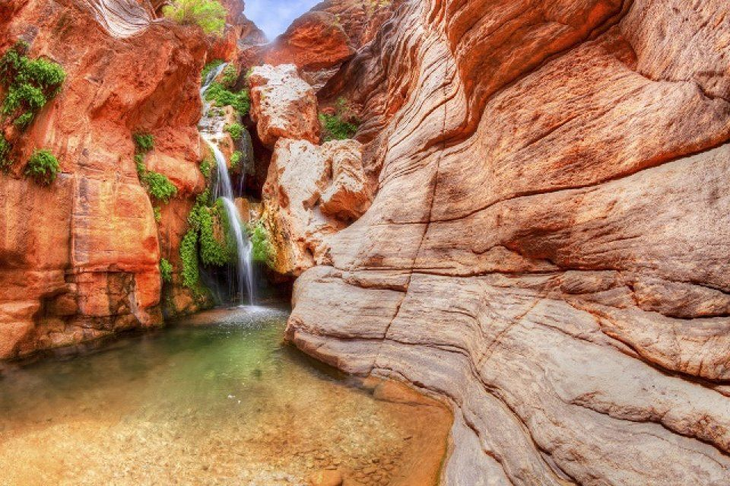
Isaiah 19:1-13
ישעיהו יט:א-יג
Isaiah / ישעיה
http://www.matsati.com

Slide 2
ספר ישעיה פרק מא
י אַל־תִּירָא֙ כִּ֣י עִמְּךָ־אָ֔נִי אַל־תִּשְׁתָּ֖ע כִּֽי־אֲנִ֣י אֱלֹהֶ֑יךָ אִמַּצְתִּ֙יךָ֙ אַף־עֲזַרְתִּ֔יךָ אַף־תְּמַכְתִּ֖יךָ בִּימִ֥ין צִדְקִֽי׃
Isaiah 41:10
41:10 Fear not, for I am with you; be not dismayed, for I am your God; I will strengthen you, I will help you, I will uphold you with my righteous right hand. (ESV)
Isaiah / ישעיה
http://www.matsati.com

Slide 3
﻿ספר ישעיה פרק יט
א מַשָּׂא מִצְרָיִם הִנֵּה יְהֹוָה רֹכֵב עַל-עָב קַל וּבָא מִצְרַיִם וְנָעוּ אֱלִילֵי מִצְרַיִם מִפָּנָיו וּלְבַב מִצְרַיִם יִמַּס בְּקִרְבּוֹ: ב וְסִכְסַכְתִּי מִצְרַיִם בְּמִצְרַיִם וְנִלְחֲמוּ אִישׁ-בְּאָחִיו וְאִישׁ בְּרֵעֵהוּ עִיר בְּעִיר מַמְלָכָה בְּמַמְלָכָה: ג וְנָבְקָה רוּחַ-מִצְרַיִם בְּקִרְבּוֹ וַעֲצָתוֹ אֲבַלֵּעַ וְדָרְשׁוּ אֶל-הָאֱלִילִים וְאֶל-הָאִטִּים וְאֶל-הָאֹבוֹת וְאֶל-הַיִּדְּעֹנִים: ד וְסִכַּרְתִּי אֶת-מִצְרַיִם בְּיַד אֲדֹנִים קָשֶׁה וּמֶלֶךְ עַז יִמְשָׁל-בָּם נְאֻם הָאָדוֹן יְהֹוָה צְבָאוֹת: ה וְנִשְּׁתוּ-מַיִם מֵהַיָּם וְנָהָר יֶחֱרַב וְיָבֵשׁ: ו וְהֶאֶזְנִיחוּ נְהָרוֹת דָּלְלוּ וְחָרְבוּ יְאֹרֵי מָצוֹר קָנֶה וָסוּף קָמֵלוּ: ז עָרוֹת עַל-יְאוֹר עַל-פִּי יְאוֹר וְכֹל מִזְרַע יְאוֹר יִיבַשׁ נִדַּף וְאֵינֶנּוּ: ח וְאָנוּ הַדַּיָּגִים וְאָבְלוּ כָּל-מַשְׁלִיכֵי בַיְאוֹר חַכָּה וּפֹרְשֵֹי מִכְמֹרֶת עַל-פְּנֵי-מַיִם אֻמְלָלוּ: ט וּבֹשׁוּ עֹבְדֵי פִשְׁתִּים שְֹרִיקוֹת וְאֹרְגִים חוֹרָי: י וְהָיוּ שָׁתֹתֶיהָ מְדֻכָּאִים כָּל-עֹשֵֹי שֶֹכֶר אַגְמֵי-נָפֶשׁ: יא אַךְ-אֱוִלִים שָֹרֵי צֹעַן חַכְמֵי יֹעֲצֵי פַרְעֹה עֵצָה נִבְעָרָה אֵיךְ תֹּאמְרוּ אֶל-פַּרְעֹה בֶּן-חֲכָמִים אֲנִי בֶּן-מַלְכֵי-קֶדֶם: יב אַיָּם אֵפוֹא חֲכָמֶיךָ וְיַגִּידוּ נָא לָךְ וְיֵדְעוּ מַה-יָּעַץ יְהֹוָה צְבָאוֹת עַל-מִצְרָיִם: יג נוֹאֲלוּ שָֹרֵי צֹעַן נִשְּׁאוּ שָֹרֵי נֹף הִתְעוּ אֶת-מִצְרַיִם פִּנַּת שְׁבָטֶיהָ:
Isaiah / ישעיה
http://www.matsati.com

Slide 4
3 Enoch 24:1-15
24:1* R. Ishmael said: The angel Meṭaṭron, Prince of the Divine Presence, the glory of highest heaven, said to me: How many chariots has the Holy One, blessed be he? He has the chariots of the cherubim, as it is written, “He mounted a cherub and flew.” 2* He has the chariots of wind, as it is written, “He soared on the wings of the wind.” 3* He has the chariots of swift cloud, as it is written, “See! the Lord comes, riding a swift cloud.” 4* He has the chariots of clouds, as it is written, “I am coming to you in a dense cloud.” 5* He has the chariots of the altar, as it is written, “I saw the Lord standing upon the altar.” 6* He has the chariots of twice ten thousand, as it is written, “The chariots of God are twice ten thousand, thousands of angels.” 7* He has the chariots of the tent, as it is written, “The Lord showed himself in the tent, in a pillar of cloud.” 8* He has the chariots of the tent of meeting, as it is written, “The Lord addressed Moses from the tent of meeting.” 9* He has the chariots of the mercy seat, as it is written, “He heard a voice that spoke to him from above the throne of mercy.” 10* He has the chariots of sapphire stone, as it is written, “Beneath his feet there was, it seemed, a sapphire pavement.” 11* He has the chariots of eagles, as it is written, “I carried you on eagles’ wings.” They are not eagles but fly like eagles. 12* He has the chariots of acclamation, as it is written, “God has gone up in acclamation.” 13* He has the chariots of ʿArabot, as it is written, “Extol him who rides in the ʿArabot.” 14* He has the chariots of clouds, as it is written, “He makes the clouds his chariots.” 15* He has the chariots of the creatures, as it is written, “The creatures ran and returned”—they run by permission and return by permission, for the Šekinah is above their heads. (James H. Charlesworth, The Old Testament Pseudepigrapha, vol. 1 (New York; London: Yale University Press, 1983), 308–309.)
Isaiah / ישעיה
http://www.matsati.com

Slide 5
DSSSE: | EnDSSSE: | TrDSS:NT
1Q33 Col. xiv:1 1 like the fire of his wrath against the idols of Egypt. Blank | 1Q33 Col. xiv:1 1 כאש עברתו באלילי מצרים vacat | 1Q33 Col. xiv:1 1like the fire of His fury against the idols of Egypt.”
1Q33 Col. xiv:2 2 And when they have departed from the slain in order to enter the camp, they shall all sing the hymn of return. In the morning they shall wash their clothes and cleanse themselves | 1Q33 Col. xiv:2 2 ואחר העלותם מעל החללים לבוא המחנה ירננו כולם את תהלת המשוב ובבוקר יכבסו בגדיהם ורחצו | 1Q33 Col. xiv:2 The blessings of the war recited by all the leaders in the morning before the battle. 2After they have withdrawn from the slain to return to the camp, all of them shall sing the hymn of return. In the morning they shall wash their clothes, cleanse themselves
1Q33 Col. xiv:3 3 of the blood of the guilty corpses. They shall go back to the site of their positions, where they arranged the battle line before the slain of the enemy fell. And there they shall all bless | 1Q33 Col. xiv:3 3 מדם פגרי האשמה ושבו אל מקום עומדם אשר סדרו שם המערכה לפני נפול חללי האויב וברכו שם | 1Q33 Col. xiv:3 3of the blood of the sinful bodies, and return to the place where they had stood, where they had formed the battle line before the slain of the enemy fell. There they shall all bless
1Q33 Col. xiv:4 4 the God of Israel and exalt his name in joyful chorus. They shall begin to speak and say: «Blessed be the God of Israel, the one who keeps mercy for his covenant and pledges of | 1Q33 Col. xiv:4 4 כולם את אל ישראל ורוממו שמו ביחד שמחה וענו ואמרו ברוך אל ישראל השומר חסד לבריתו ותעודות | 1Q33 Col. xiv:4 4the God of Israel and joyously exalt His name together. They shall say in response: “Blessed is the God of Israel, who guards loving-kindness for His covenant and the appointed times
1Q33 Col. xiv:5 5 deliverance for the people he has redeemed. He has called those who are tottering to wondrous [exploits], and has gathered the assembly of peoples for destruction with no remnant, in order to raise up in justice | 1Q33 Col. xiv:5 5 ישועה לעם פדותו ויקרא כושלים ל[גבורו]ת פלא וקהל גויים אסף לכלה אין שארית ולהריס במשפט | 1Q33 Col. xiv:5 5of salvation for the people He redeems. He has called those who stumble unto wondrous [accomplishment]s, and He has gathered a congregation of nations for annihilation without remnant in order to raise up in judgment
Isaiah / ישעיה
http://www.matsati.com

Slide 6
Pseudepigrapha, Testament of Judah 23.1-24:5
23:1 “My grief is great, my children, on account of the licentiousness and witchcraft and idolatry that you practice contrary to the kingship, following ventriloquists, omen dispensers, and demons of deceit. 2 You shall make your daughters into musicians and common women, and you will become involved in revolting gentile affairs. 3 In response to this the Lord will bring you famine and plague, death and the sword, punishment by a siege, scattering by enemies like dogs, the scorn of friends, destruction and putrefaction of your eyes, slaughter of infants, the plunder of your sustenance, the rape of your possessions, consumption of God’s sanctuary by fire, a desolate land, and yourselves enslaved by the gentiles. 4 And they shall s castrate some of you as eunuchs for their wives, 5 until you return to the Lord in integrity of heart, penitent and living according to all the Lord’s commands. Then the Lord will be concerned for you in mercy and will free you from captivity under your enemies. 24:1 “And after this there shall arise for you a Star from Jacob in peace: And a man shall arise from my posterity like the Sun of righteousness, walking with the sons of men in gentleness and righteousness, and in him will be found no sin. 2* And the heavens will be opened upon him to pour out the spirit as a blessing of the Holy Father. 3* And he will pour the spirit of grace on you. And you shall be sons in truth, and you will walk in his first and final decrees. 4 This is the Shoot of God Most High; this is the fountain for the life of all humanity. 5 Then he will illumine the scepter of my kingdom, 6 and from your root will arise the Shoot, and through it will arise the rod of righteousness for the nations, to judge and to save all that call on the Lord.
Isaiah / ישעיה
http://www.matsati.com

Slide 7
ספר דברים פרק לב
﻿טז יַקְנִאֻהוּ בְּזָרִים בְּתוֹעֵבֹת יַכְעִיסֻהוּ: יז יִזְבְּחוּ לַשֵּׁדִים לֹא אֱלֹהַּ אֱלֹהִים לֹא יְדָעוּם חֲדָשִׁים מִקָּרֹב בָּאוּ לֹא שְֹעָרוּם אֲבֹתֵיכֶם:
Devarim / Deuteronomy 32:16-17
32:16 They provoked him to jealousy with strange gods, with abominations provoked they him to anger. 32:17 They sacrificed unto devils, not to God; to gods whom they knew not, to new gods that came newly up, whom your fathers feared not. (KJV)
DSS 1QS Col. ix:10
10 in complete stubbornness of their heart, but instead shall be ruled by the first directives which the men of the Community began to be taught
DSS CD–B Col. xx:31
31 judgment[s] and his truthful stipulations; and they are instructed in the first ordinances
Isaiah / ישעיה
http://www.matsati.com

Slide 8
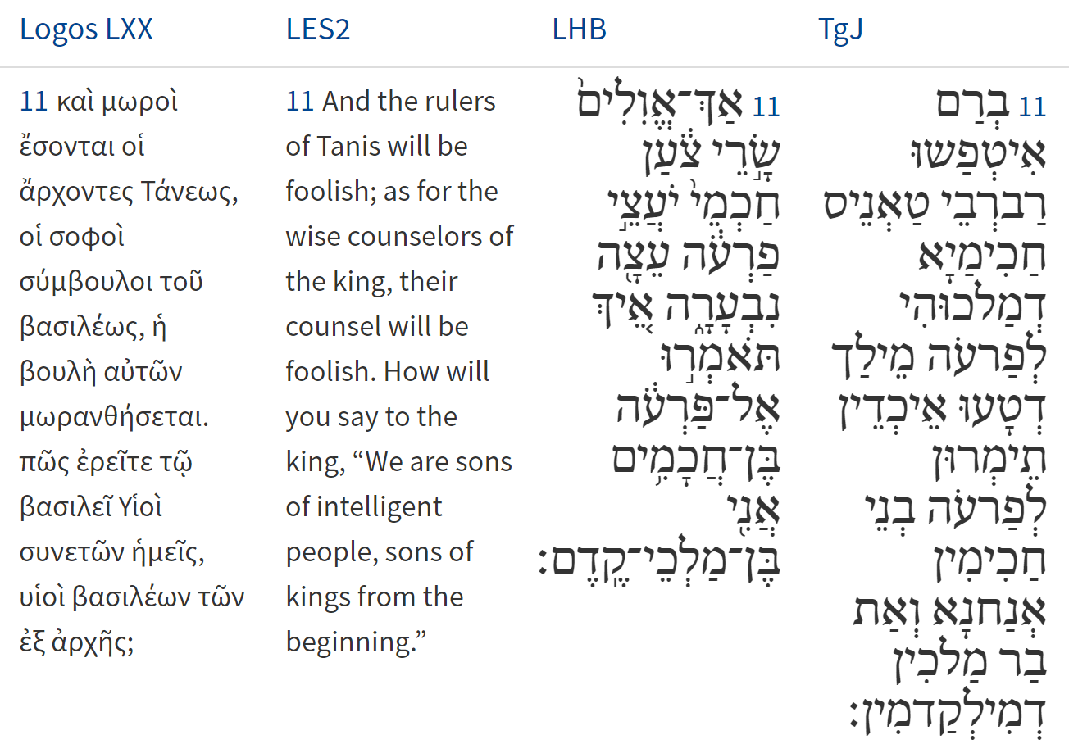
Isaiah / ישעיה
http://www.matsati.com

Slide 9
DSS 4Q163 Frag. 8-19 on Isaiah 19
4Q163 Frags. 8–10:8 8 [as it is writ]ten in the book of Zechariah: Zech 3:9 [See, I will] en[grave its inscription, oracle of YHWH] 4Q163 Frags. 8–10:9 9 [of Hosts.] Blank […] 4Q163 Frag. 11 ii:2 2 laborers knocked [down. How deranged the princes of Zoan; the wise advise] 4Q163 Frag. 11 ii:3 3 Pharaoh with [inane] advice. [How can you say to Pharaoh: We are sons of wise men,] 4Q163 Frag. 11 ii:4 4 we are sons of [ancient] kin[gs? Where are your wise men? Let them announce] 4Q163 Frag. 11 ii:5 5 you, [so that they know what YHWH of Hosts is planning against Egypt.] 4Q163 Frags. 15–16 Frags. 15–16 Isa 29:10–12 [For] 4Q163 Frags. 15–16:1 1 YHWH has poured [upon] you [a spirit of de]ep stupor and he has closed [your eyes—the prophets—and] 4Q163 Frags. 15–16:2 2 he has covered your [h]eads—the seers—. For you the vi[sion of this all] has become [like the words of a] 4Q163 Frags. 15–16:3 3 [sea]led [book,] which one [gives] to someone who can read, te[lling him: Please read this,] 4Q163 Frags. 15–16:4 4 [and he answers: I cannot be]cause [it is] se[aled;] and when one gives the boo[k to someone who cannot read] 4Q163 Frags. 18–19 Frags. 18–19 4Q163 Frags. 18–19:1 1 Isa 29:18–23 [words of a book;] without darkness or glo[om the eyes of the blind will see. The oppressed will rejoice even more in YHWH] | 4Q163 Frags. 8–10:8 8 [כאשר כת]וב בספר זכריה מפ[תח פתחה נאום יהוה] 4Q163 Frags. 8–10:9 9 [צבאות] vacat […] 4Q163 Frag. 11 ii:2 2 שכר אגמ[י נפש אך אולים שרי צוען חכמי יועצי] 4Q163 Frag. 11 ii:3 3 פרעוה עצ[ה נבערה איך תואמרו אל פרעוה בני חכמים] 4Q163 Frag. 11 ii:4 4 אנו בני מל[כי קדם אים אפוא חכמיכה ויגידו נא] 4Q163 Frag. 11 ii:5 5 לכה[ וידעו מה יעץ יהוה צבאות על מצרים] 4Q163 Frags. 15–16 Frags. 15–16 4Q163 Frags. 15–16:1 1 [עליכ]מה יהוה [רוח ת]רדמה ויעצם את[ עיניכמה את הנביאים] 4Q163 Frags. 15–16:2 2 [ואת ר]אשיכמה הה[וזים ]כסה ותהי לכמה ח[זות הכול כדברי] 4Q163 Frags. 15–16:3 3 [הספר הח]תום אשר [יתנו א]ותו אל יודע ספר לא[מור קרא נא זה] 4Q163 Frags. 15–16:4 4 [ואמר לוא אוכל כ]יא ח[תום הוא] ונתן הספ[ר על אשר לוא ידע ספר] 4Q163 Frags. 18–19 Frags. 18–19 4Q163 Frags. 18–19:1 1 [דברי ספר] ומאופל ומח[ושך עיני עורים תראינה ויספו ענוים ביהוה]
Isaiah / ישעיה
http://www.matsati.com

Slide 10
DSS 1QapGen ar Col. xx:19-23
19 for all the wise men [of] Egypt to be called, and all the wizards as well as all the healers of Egypt, (to see) whether they could heal him of that disease, (him) and the members
20 of his household. However, all the healers and wizards and all the wise men were unable to rise up to heal him. For the spirit attacked all of them
21 and they fled. Blank Then Hirqanos came to me and asked me to come and pray for
22 the king, and lay my hands upon him so that he would recover. For he had seen [me] in a [dr]eam. But Lot said to him: Abram, my uncle, cannot pray for
23 the king while Sarai, his wife, is with him. Go, now, and tell the king to send back his wife to her own husband and he will pray for him and he will recover.
(Florentino Garcı́a Martı́nez and Eibert J. C. Tigchelaar, “The Dead Sea Scrolls Study Edition (translations)” (Leiden; New York: Brill, 1997–1998), 43.)
ספר ישעיה פרק כח
טז לָכֵן כֹּה אָמַר אֲדֹנָי יְהֶוִֹה הִנְנִי יִסַּד בְּצִיּוֹן אָבֶן אֶבֶן בֹּחַן פִּנַּת יִקְרַת מוּסָד מוּסָּד הַמַּאֲמִין לֹא יָחִישׁ:
Isaiah 28:16
28:16 Therefore thus saith the Lord God, Behold, I lay in Zion for a foundation a stone, a tried stone, a precious cornerstone, a sure foundation: he that believeth shall not make haste. (KJV)
Isaiah / ישעיה
http://www.matsati.com

Slide 11
Rabbinic Literature
ספרות רבנית
Part 2
Isaiah / ישעיה
http://www.matsati.com

Slide 12
Targum Jonathan son of Uziel Isaiah 19:1-13
19:1 THE BURDEN OF THE CUP OF CURSING TO MAKE THE EGYPTIANS TO DRINK. Behold, the Lord is revealed in the cloud of His glory, to take vengeance of the Egyptians; and the idols of the Egyptians shall be broken before His face, and the heart of the Egyptians shall be melted within them. 19:2 And I will excite Egyptians against Egyptians, and they shall wage war, every man against his brother, and every man against his neighbor: city against city, kingdom against kingdom. 19:3 And the spirit of the Egyptians shall melt within them, and their wise men I will destroy: and they shall seek to the idols, and to the charmers, to the deceitful, and to the diviners. 19:4 And I will deliver the Egyptians into the hand of a cruel lord; and a fierce king shall rule over them, saith the Lord of the world, the Lord of hosts. 19:5 And the waters of the sea shall be laid desolate, and their river shall be wasted and dried up. 19:6 And their rivers shall be laid waste, and their deep streams shall be dried up and wasted: the reeds and flags shall not grow. 19:7 And the greatest part of the river shall wither, and that which is on its bank, and every sown place of their rivers shall wither, and shall be dried up, and nothing shall grow. 19:8 The fishermen shall be laid desolate, and all they that cast angle into the brook, and they that spread nets upon the faces of the waters shall be destroyed. 19:9 They shall be confounded which work combed flax, and weave nets of it. 19:10 And there shall be trodden under foot the well watered place, where they have been making pits, water pools each for himself. 19:11 Surely the princes of Tanes have become foolish; the wise, the counselors of Pharaoh have counseled an erroneous counsel; how will ye say to Pharaoh, We are the sons of the wise, and thou art the son of ancient kings. 19:12 Where are thy wise men? Let them tell thee now, and let them know what the Lord of hosts has counseled against Egypt. 19:13 The princes of Tanes have become foolish, the men of Memphis have erred; they caused the Egyptians, the lords of the provinces, to err. (TgJ)
Isaiah / ישעיה
http://www.matsati.com

Slide 13
Pirkei DeRabbi Eliezer 4:5
Over against them are the Ophanim (Wheels) and the Whirling Wheels of the Chariot, and when He looketh upon the earth His chariots are upon the Ophanim, and owing to the noise caused by the whirling wheels of the Chariot—lightnings and thunder go forth into the world. When He dwells in heaven He rideth upon a swift cloud. When He hastens He flies upon the wings of the wind, as it is said, "And he rode upon a cherub, and did fly; yea, he flew swiftly upon the wings of the wind" (Ps. 18:10).
Isaiah / ישעיה
http://www.matsati.com

Slide 14
Ezekiel 1:1-21
1:1 Now it came to pass in the thirtieth year, in the fourth month, in the fifth day of the month, as I was among the captives by the river of Chebar, that the heavens were opened, and I saw visions of God. 1:2 In the fifth day of the month, which was the fifth year of king Jehoiachin's captivity, 1:3 The word of the LORD came expressly unto Ezekiel the priest, the son of Buzi, in the land of the Chaldeans by the river Chebar; and the hand of the LORD was there upon him. 1:4 And I looked, and, behold, a whirlwind came out of the north, a great cloud, and a fire infolding itself, and a brightness was about it, and out of the midst thereof as the color of amber, out of the midst of the fire. 1:5 Also out of the midst thereof came the likeness of four living creatures. And this was their appearance; they had the likeness of a man. 1:6 And every one had four faces, and every one had four wings. 1:7 And their feet were straight feet; and the sole of their feet was like the sole of a calf's foot: and they sparkled like the color of burnished brass. 1:8 And they had the hands of a man under their wings on their four sides; and they four had their faces and their wings. 1:9 Their wings were joined one to another; they turned not when they went; they went every one straight forward. 1:10 As for the likeness of their faces, they four had the face of a man, and the face of a lion, on the right side: and they four had the face of an ox on the left side; they four also had the face of an eagle. 1:11 Thus were their faces: and their wings were stretched upward; two wings of every one were joined one to another, and two covered their bodies. 1:12 And they went every one straight forward: whither the spirit was to go, they went; and they turned not when they went. 1:13 As for the likeness of the living creatures, their appearance was like burning coals of fire, and like the appearance of lamps: it went up and down among the living creatures; and the fire was bright, and out of the fire went forth lightning. 1:14 And the living creatures ran and returned as the appearance of a flash of lightning. 1:15 Now as I beheld the living creatures, behold one wheel upon the earth by the living creatures, with his four faces. 1:16 The appearance of the wheels and their work was like unto the colour of a beryl: and they four had one likeness: and their appearance and their work was as it were a wheel in the middle of a wheel. 1:17 When they went, they went upon their four sides: and they turned not when they went. 1:18 As for their rings, they were so high that they were dreadful; and their rings were full of eyes round about them four. 1:19 And when the living creatures went, the wheels went by them: and when the living creatures were lifted up from the earth, the wheels were lifted up. 1:20 Whithersoever the spirit was to go, they went, thither was their spirit to go; and the wheels were lifted up over against them: for the spirit of the living creature was in the wheels. 1:21 When those went, these went; and when those stood, these stood; and when those were lifted up from the earth, the wheels were lifted up over against them: for the spirit of the living creature was in the wheels. (KJV)
Isaiah / ישעיה
http://www.matsati.com

Slide 15
Rashi on Isaiah 19,1 Part 1-2
רוכב על עב קל. מהרה לשלוח קל מהרה גזרת דברו ליפרע ממצרים:
is riding on a light cloud quickly to send easily and quickly the decree of His word to punish Egypt.
ונעו אלילי מצרים מפניו. לא יהיה להם כח להציל את עמם מיד שלוחיו של אשור וזה שאמר הנביא פורענות מצרים בלשון הזה מה שלא אמר בלשון הזה לשאר אומות מפני שהם למודים ללקות במדה הזאת ועברתי בארץ מצרים (שמות יב) ובכל אלהי מצרים (שם) ודרך ארץ מייראין את האדם במכה שכבר לקה בה:
and the idols of Egypt shall quake from before Him They will have no power to save their people from the messengers of the king of Assyria. The prophet presented the retribution of Egypt in this manner, unlike the way he presented it to other nations, because they are accustomed to being punished in this manner. (Exodus 12:12) “And I will pass through the land of Egypt...and upon all the gods of Egypt [will I execute punishment],” and it is customary to frighten a person with a misfortune from which he has already suffered.
Isaiah / ישעיה
http://www.matsati.com

Slide 16
Pirkei DeRabbi Eliezer 9:4
Rabbi Eliezer said: Not only concerning the water does the Scripture say that "the waters should bring forth abundantly" (Gen. 1:20), but also concerning the birds which are compared with water, as it is said, "And the uproar of many peoples, which roar like the roaring of the seas" (Isa. 17:12), and just as the waters brought forth abundantly on the fifth day, likewise in the future will the nations of the world swarm in the fifth world, and they will fight one another to destroy (one another), as it is said, "And they were broken in pieces, nation against nation, and city against city; for God did vex them with all adversity" (2 Chron. 15:6). What is written (immediately) afterwards? The Salvation of Israel (is mentioned), as it is said, "But be ye strong; and your hands shall not be slack" (2 Chron. 15:7).
Isaiah / ישעיה
http://www.matsati.com

Slide 17
ספר דברים פרק יא
יט וְלִמַּדְתֶּם אֹתָם אֶת-בְּנֵיכֶם לְדַבֵּר בָּם בְּשִׁבְתְּךָ בְּבֵיתֶךָ וּבְלֶכְתְּךָ בַדֶּרֶךְ וּבְשָׁכְבְּךָ וּבְקוּמֶךָ: כ וּכְתַבְתָּם עַל-מְזוּזוֹת בֵּיתֶךָ וּבִשְׁעָרֶיךָ:
Devarim / Deuteronomy 11:19-20
11:19 And ye shall teach them your children, speaking of them when thou sittest in thine house, and when thou walkest by the way, when thou liest down, and when thou risest up. 11:20 And thou shalt write them upon the doorposts of thine house, and upon thy gates: (KJV)
﻿ספר משלי פרק כב
ו חֲנֹךְ לַנַּעַר עַל-פִּי דַרְכּוֹ גַּם כִּי-יַזְקִין לֹא-יָסוּר מִמֶּנָּה:
Mishley / Proverbs 22:6
22:6 Train up a child in the way he should go: and when he is old, he will not depart from it. (KJV)
Isaiah / ישעיה
http://www.matsati.com

Slide 18
Guide for the Perplexed, Part 1 40:6
The meaning of "intention," "will," is likewise contained in the word ruaḥ. Comp. "A fool uttereth all his spirit" (ruaḥ) (Prov. 29:11), i.e., his intention and will; "And the spirit (ruaḥ) of Egypt shall fail in the midst thereof, and I will destroy the counsel thereof" (Isa. 19:3), i.e., her intentions will be frustrated, and her plans will be obscured; "Who has comprehended the spirit (ruaḥ) of the Lord, or who is familiar with his counsel that he may tell us?" (Isa. 40:13), i.e., Who knows the order fixed by His will, or perceives the system of His Providence in the existing world, that he may tell us? as we shall explain in the chapters in which we shall speak on Providence.
Rashi on Isaiah 19,3 Part 1-2
ונבקה רוח. תתרוקן חכמתו כמו (לקמן כד) בוקק הארץ:
And the spirit of Egypt shall empty out Heb. וְנָבְקָה. His wisdom shall be emptied out. Comp. (infra 24:1) “Empties out (בּוֹקֵק) the land.”
האטים. א' מן השמות של עו"ג:
sorcerers Heb. הָאִטִּים, one of the names of the idols.
Isaiah / ישעיה
http://www.matsati.com

Slide 19
Midrash Bamidbar Rabbah 1:3
...R’ Yehoshua be Levi said: If the nations of the world knew how good the Holy Temple was for them, they would surround it with fortifications in order to guard it. It was better for them than it was for Israel, just as Shlomo ordered his prayer “And also to the stranger, who is not of Your people Israel…” (Kings I 8:41 and it is written “…and do according to all that the stranger calls You for…” (Kings I 8:43) But when it comes to Israel, what is written? “…and give to each man according to his ways, whose heart You know…” (Chronicles II 6:30) If it was appropriate, He would give, and if not He would not. Don’t say that (they should value) the Holy Temple. Rather, if it were not for Israel the rain would not fall and the sun would not shine, because in their merit the Holy One brings plenty to His world. In the world to come the nations of the world will see how the Holy One is with Israel and they will come to cleave to them, as it says “In those days, when ten men of all the languages of the nations…” (Zechariah 8:23)
Isaiah / ישעיה
http://www.matsati.com

Slide 20
Ibn Ezra on Isaiah 19.12 Part 1
אים וגו'. אם הוא בן חכם היה גם מלך, שידע דברי העולם, למה לא ידעו מה יעץ השם עליהם:
Where are thy wise men, etc. If they in reality be the sons of wise men, of royal family, why do they not know what God has decided for Egypt.
Isaiah / ישעיה
http://www.matsati.com

