Slide 1
Isaiah 18:1-7
ישעיהו יח:א-ז
Isaiah / ישעיה
http://www.matsati.com

Slide 2
﻿ספר ישעיה פרק יח
﻿א הוֹי אֶרֶץ צִלְצַל כְּנָפָיִם אֲשֶׁר מֵעֵבֶר לְנַהֲרֵי-כוּשׁ: ב הַשֹּׁלֵחַ בַּיָּם צִירִים וּבִכְלֵי-גֹמֶא עַל-פְנֵי-מַיִם לְכוּ | מַלְאָכִים קַלִּים אֶל-גּוֹי מְמֻשָּׁךְ וּמוֹרָט אֶל-עַם נוֹרָא מִן-הוּא וָהָלְאָה גּוֹי קַו-קָו וּמְבוּסָה אֲשֶׁר-בָּזְאוּ נְהָרִים אַרְצוֹ: ג כָּל-יֹשְׁבֵי תֵבֵל וְשֹׁכְנֵי אָרֶץ כִּנְשֹֹא-נֵס הָרִים תִּרְאוּ וְכִתְקֹעַ שׁוֹפָר תִּשְׁמָעוּ: ד כִּי כֹה אָמַר יְהֹוָה אֵלַי אֶשְׁקֳוטָה [אֶשְׁקֳטָה] וְאַבִּיטָה בִמְכוֹנִי כְּחֹם צַח עֲלֵי-אוֹר כְּעָב טַל בְּחֹם קָצִיר: ה כִּי-לִפְנֵי קָצִיר כְּתָם-פֶּרַח וּבֹסֶר גֹּמֵל יִהְיֶה נִצָּה וְכָרַת הַזַּלְזַלִּים בַּמַּזְמֵרוֹת וְאֶת-הַנְּטִישׁוֹת הֵסִיר הֵתַז: ו יֵעָזְבוּ יַחְדָּו לְעֵיט הָרִים וּלְבֶהֱמַת הָאָרֶץ וְקָץ עָלָיו הָעַיִט וְכָל-בֶּהֱמַת הָאָרֶץ עָלָיו תֶּחֱרָף: ז בָּעֵת הַהִיא יוּבַל-שַׁי לַיהֹוָה צְבָאוֹת עַם מְמֻשָּׁךְ וּמוֹרָט וּמֵעַם נוָֹרא מִן-הוּא וָהָלְאָה גּוֹי | קַו-קָו וּמְבוּסָה אֲשֶׁר בָּזְאוּ נְהָרִים אַרְצוֹ אֶל-מְקוֹם שֵׁם-יְהֹוָה צְבָאוֹת הַר-צִיּוֹן:
Isaiah / ישעיה
http://www.matsati.com

Slide 3
ספר דברים פרק כח
מב כָּל-עֵצְךָ וּפְרִי אַדְמָתֶךָ יְיָרֵשׁ הַצְּלָצַל:
Devarim / Deuteronomy 28:42
28:42 All thy trees and fruit of thy land shall the locust consume.
Isaiah / ישעיה
http://www.matsati.com

Slide 4
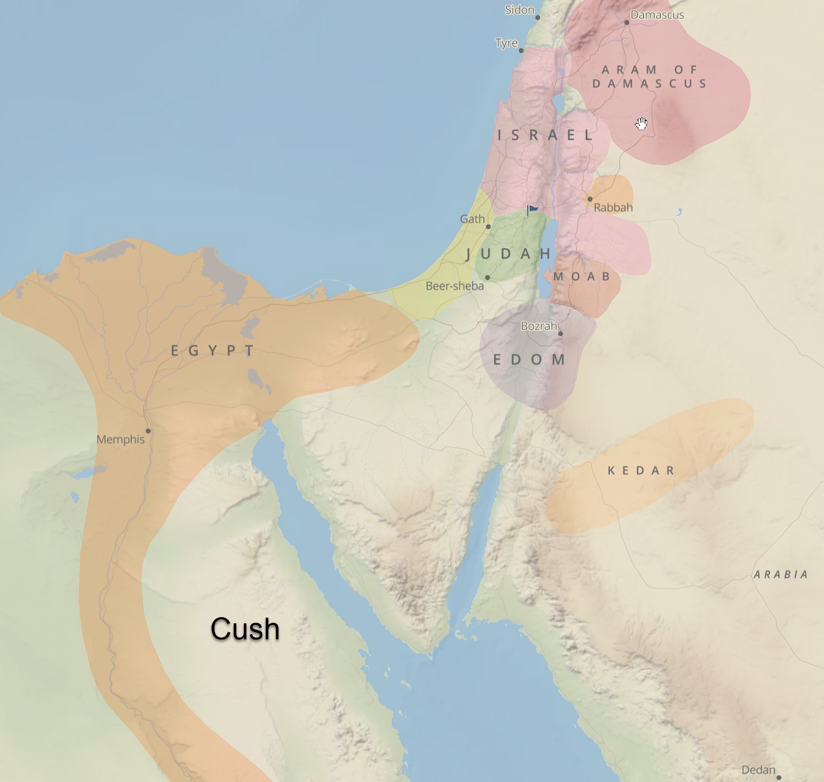
Isaiah / ישעיה
http://www.matsati.com

Slide 5
Isaiah / ישעיה
http://www.matsati.com

Slide 6
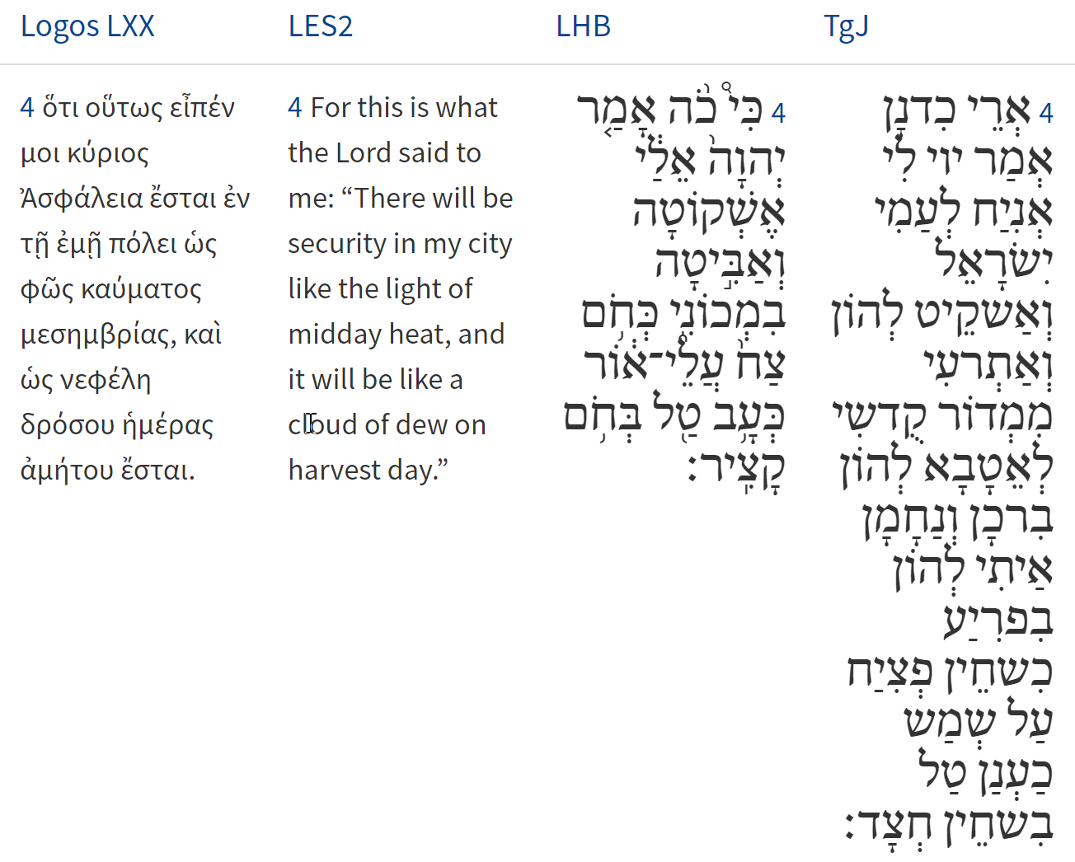
Isaiah / ישעיה
http://www.matsati.com

Slide 7
ספר יחזקאל פרק יח
א וַיְהִי דְבַר-יְהֹוָה אֵלַי לֵאמֹר: ב מַה-לָּכֶם אַתֶּם מֹשְׁלִים אֶת-הַמָּשָׁל הַזֶּה עַל-אַדְמַת יִשְֹרָאֵל לֵאמֹר אָבוֹת יֹאכְלוּ בֹסֶר וְשִׁנֵּי הַבָּנִים תִּקְהֶינָה: ג חַי-אָנִי נְאֻם אֲדֹנָי יְהֹוִה אִם-יִהְיֶה לָכֶם עוֹד מְשֹׁל הַמָּשָׁל הַזֶּה בְּיִשְֹרָאֵל: ד הֵן כָּל-הַנְּפָשׁוֹת לִי הֵנָּה כְּנֶפֶשׁ הָאָב וּכְנֶפֶשׁ הַבֵּן לִי-הֵנָּה הַנֶּפֶשׁ הַחֹטֵאת הִיא תָמוּת:
Ezekiel 18:1-4
18:1 The word of the LORD came unto me again, saying, 18:2 What mean ye, that ye use this proverb concerning the land of Israel, saying, The fathers have eaten sour grapes, and the children's teeth are set on edge? 18:3 As I live, saith the Lord GOD, ye shall not have occasion any more to use this proverb in Israel. 18:4 Behold, all souls are mine; as the soul of the father, so also the soul of the son is mine: the soul that sinneth, it shall die. (KJV)
Isaiah / ישעיה
http://www.matsati.com

Slide 8
ספר יחזקאל פרק לא:יא-טז
יא וְהָיָ֣ה בַיּ֣וֹם הַה֡וּא אֶתֵּ֣ן לְגוֹג֩׀ מְקֽוֹם־שָׁ֨ם קֶ֜בֶר בְּיִשְׂרָאֵ֗ל גֵּ֤י הָעֹֽבְרִים֙ קִדְמַ֣ת הַיָּ֔ם וְחֹסֶ֥מֶת הִ֖יא אֶת־הָעֹֽבְרִ֑ים וְקָ֣בְרוּ שָׁ֗ם אֶת־גּוֹג֙ וְאֶת־כָּל־הֲמוֹנֹ֔ה וְקָ֣רְא֔וּ גֵּ֖יא הֲמ֥וֹן גּֽוֹג׃ יב וּקְבָרוּם֙ בֵּ֣ית יִשְׂרָאֵ֔ל לְמַ֖עַן טַהֵ֣ר אֶת־הָאָ֑רֶץ שִׁבְעָ֖ה חֳדָשִֽׁים׃ יג וְקָֽבְרוּ֙ כָּל־עַ֣ם הָאָ֔רֶץ וְהָיָ֥ה לָהֶ֖ם לְשֵׁ֑ם י֚וֹם הִכָּ֣בְדִ֔י נְאֻ֖ם אֲדֹנָ֥י יְהוִֽה׃ יד וְאַנְשֵׁ֨י תָמִ֤יד יַבְדִּ֙ילוּ֙ עֹבְרִ֣ים בָּאָ֔רֶץ מְקַבְּרִ֣ים אֶת־הָעֹבְרִ֗ים אֶת־הַנּוֹתָרִ֛ים עַל־פְּנֵ֥י הָאָ֖רֶץ לְטַֽהֲרָ֑הּ מִקְצֵ֥ה שִׁבְעָֽה־חֳדָשִׁ֖ים יַחְקֹֽרוּ׃ טו וְעָבְר֤וּ הָעֹֽבְרִים֙ בָּאָ֔רֶץ וְרָאָה֙ עֶ֣צֶם אָדָ֔ם וּבָנָ֥ה אֶצְל֖וֹ צִיּ֑וּן עַ֣ד קָבְר֤וּ אֹתוֹ֙ הַֽמְקַבְּרִ֔ים אֶל־גֵּ֖יא הֲמ֥וֹן גּֽוֹג׃ טז וְגַ֥ם שֶׁם־עִ֛יר הֲמוֹנָ֖ה וְטִהֲר֥וּ הָאָֽרֶץ׃
Isaiah / ישעיה
http://www.matsati.com
Notes:
Ezekiel 39:11–16
39:11﻿ “And it will come about on that day that I shall give Gog a burial ground there in Israel, the valley of those who pass by east of the sea, and it will block off the passers-by. So they will bury Gog there with all his multitude, and they will call it the valley of Hamon-gog. ﻿39:12﻿ “For seven months the house of Israel will be burying them in order to cleanse the land. ﻿39:13﻿ “Even all the people of the land will bury them; and it will be to their renown on the day that I glorify Myself,” declares the Lord God. ﻿39:14﻿ “And they will set apart men who will constantly pass through the land, burying those who were passing through, even those left on the surface of the ground, in order to cleanse it. At the end of seven months they will make a search. ﻿39:15﻿ “And as those who pass through the land pass through and anyone sees a man’s bone, then he will set up a marker by it until the buriers have buried it in the valley of Hamon-gog. 39:﻿16﻿ “And even the name of the city will be Hamonah. So they will cleanse the land.”’ (NASB)

Slide 9
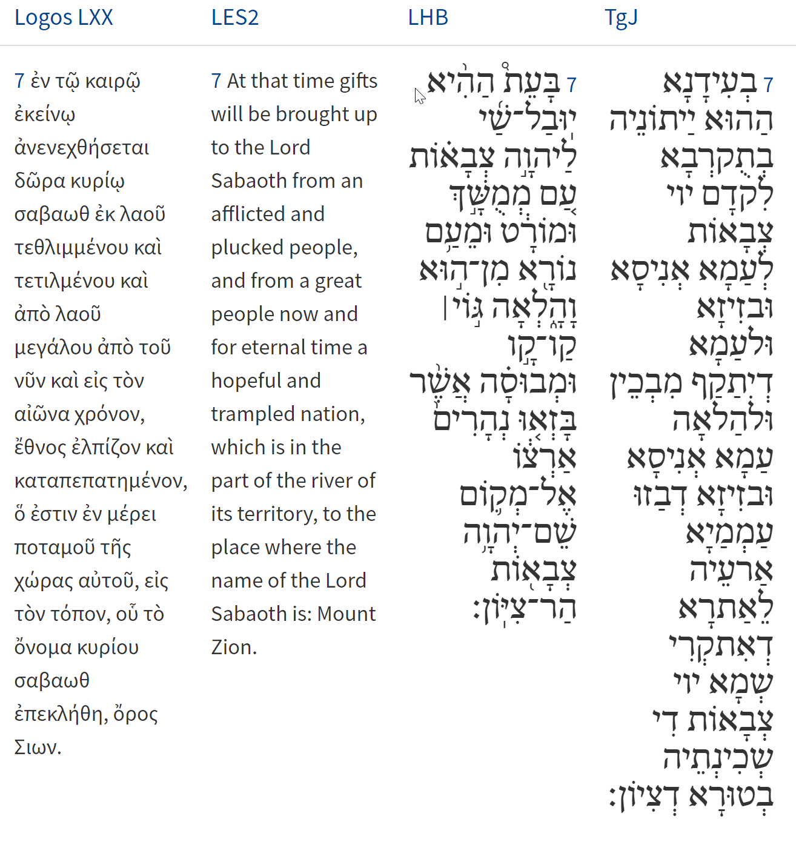
Isaiah / ישעיה
http://www.matsati.com

Slide 10
Isaiah / ישעיה
http://www.matsati.com

Slide 11
Rabbinic Literature
ספרות רבנית
Part 2
Isaiah / ישעיה
http://www.matsati.com

Slide 12
Targum Jonathan son of Uziel Isaiah 18:1-7
18:1 Ho! the land which is beyond the rivers of India, to which they come in ships from a far country, whose sails are spread as an eagle flieth with its wings. 18:2 That sendeth ambassadors by the sea, even in ships on the face of the waters, saying, Go, ye swift messengers, unto a people oppressed and plundered, unto a people that was mighty in times past, and shall be so in time to come: a people oppressed and robbed, whose land the nations have spoiled. 18:3 All ye inhabitants of the world, and ye dwellers on the earth, when the standard is lifted up on the mountains, ye shall see the standard, and the trumpet shall sound, ye shall hear of redemption. 18:4 For thus hath the Lord said unto me: I will give rest to my people, yea, I will make them to rest, and I will delight in my holy habitation to do them good: blessings and consolations I will bring upon them quickly, when the heat is intense through the heat of the sun, then I will be to them a cloud of dew as in the heat of harvest. 18:5 Before the time of harvest cometh the tree is ready to bud, and the unripe grape bursts forth into a flower: He shall slay the rulers of the nations with the sword, and their mighty ones He shall remove, and cause to pass away. 18:6 They shall be left together unto the fowl of the mountains, and to the beasts of the earth: all the fowls of the heavens shall dwell upon them in the summer, and all the beasts of the earth shall winter upon them. 18:7 At that time shall one bring an offering unto the Lord of hosts, to a people oppressed and spoiled, to a people that was mighty in times past, and shall be so in time to come, a people oppressed and robbed, whose land the nations have spoiled, unto the place which is called by the name of the Lord of hosts, whose Shekinah is in the mountain of Zion. (TgJ)
Isaiah / ישעיה
http://www.matsati.com

Slide 13
Rashi on Isaiah 18.1 Part 1
הוי ארץ צלצל כנפים. ת"י דאתן לה בספינון מארעא רחיקא וקלעיהון פריסן כנשרא דטאיס בכנפוהי, אני אומר לפי שהן שרוין במזרח והארץ חמה העופות נאספים שם והיא מצולצלת בכנפי עופות ונבואה זו על אוכלוסי גוג ומגוג כענין שנא' (ביחזקאל ל״ח:ה׳) פרס כוש ופוט אתם:
Woe to the land shaded by wings Jonathan renders: to which they come in ships from a distant land, and their sails are spread out like an eagle that flies with its wings. I say, however, that because they live in the east, and the land is hot, birds assemble there, and it is shaded by the birds’ wings. Now this prophecy concerns the armies of Gog and Magog, as the matter is stated in Ezekiel (38:5) “Persia, Cush, and Put with them.”
Isaiah / ישעיה
http://www.matsati.com

Slide 14
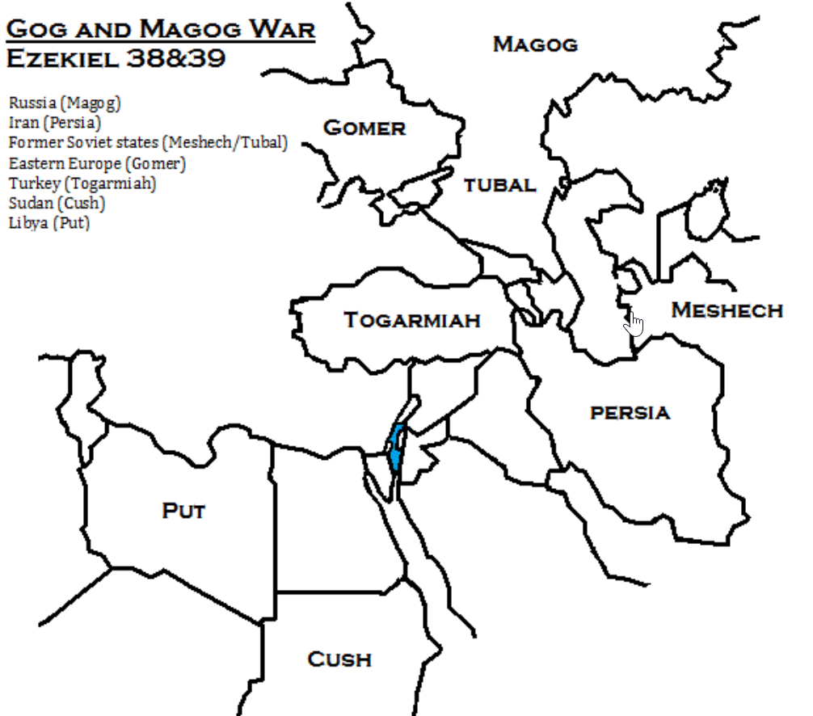
Isaiah / ישעיה
http://www.matsati.com

Slide 15
Talmud Bavli Berakhot 7b:11
And Rabbi Yoḥanan said other aggadic statements in the name of Rabbi Shimon ben Yoḥai: The existence of wayward children in a person’s home is more troublesome than the war of Gog and Magog, the ultimate...While concerning the war of Gog and Magog, which is alluded to in the second chapter of Psalms, it is written: “Why are the nations in an uproar? And why do the peoples speak for naught?...Yet in this chapter describing the war of Gog and Magog “how numerous are my enemies” is not written, as it is not as difficult as raising a wayward son like Absalom.
Radak on Psalms 2:12 Part 5
And there are some who interpret this Psalm of Gog and Magog, and the anointed one is King Messiah: and so our teachers of blessed memory have interpreted (Babli, Berakhoth 7b). And the Psalm can be explained in this way, but the better is that David uttered it concerning himself, as we have interpreted.
Mishnah Megillah 3:5
For we have a tradition that the resurrection will occur on Pesach and the war of Gog and Magog, on Succoth.]
Midrash Tanchuma, Shemot / Exodus 1:7
Degeneracy in a man’s house is considered far more grievous than the war between Gog and Magog. The final struggle preceding the Messianic age....For with reference to the war between Gog and Magog it is written: Why are the nations in an uproar? , but not: O Lord, how many are mine adversaries become.
Isaiah / ישעיה
http://www.matsati.com

Slide 16
Ibn Ezra on Isaiah 18.1 Part 2
צלצל כנפים. כפול מצל, שהיא ארץ רחבה:
צלצל Shadowing. Reduplication of צל shadow. A shady land is identical with a wide land.
Rashi on Isaiah 18.3 Part 1
כל יושבי תבל וגו'. אינכם צריכים לשלוח צירים על כך כי כנשוא נס הרים תראו בהקבץ הגליות וכתקוע שופר תשמעו:
All inhabitants of the world, etc. You need not send messengers for this, for when a standard of the mountains is raised, you shall see the ingathering of the exiles, and when a shofar is sounded you shall hear.
Isaiah / ישעיה
http://www.matsati.com

Slide 17
Shemot / Exodus 17:15
17:15 And Moses built an altar, and named it The LORD is My Banner; (NASB, וַיִּ֥בֶן מֹשֶׁ֖ה מִזְבֵּ֑חַ וַיִּקְרָ֥א שְׁמ֖וֹ יְהוָ֥ה׀ נִסִּֽי׃)
Bamidbar / Numbers 21:8-9
21:8 Then the LORD said to Moses, “Make a fiery serpent, and set it on a standard; and it shall come about, that everyone who is bitten, when he looks at it, he shall live.” 21:9 And Moses made a bronze serpent and set it on the standard; and it came about, that if a serpent bit any man, when he looked to the bronze serpent, he lived. (NASB, ח וַיֹּ֨אמֶר יְהוָ֜ה אֶל־מֹשֶׁ֗ה עֲשֵׂ֤ה לְךָ֙ שָׂרָ֔ף וְשִׂ֥ים אֹת֖וֹ עַל־נֵ֑ס וְהָיָה֙ כָּל־הַנָּשׁ֔וּךְ וְרָאָ֥ה אֹת֖וֹ וָחָֽי׃ ט וַיַּ֤עַשׂ מֹשֶׁה֙ נְחַ֣שׁ נְחֹ֔שֶׁת וַיְשִׂמֵ֖הוּ עַל־הַנֵּ֑ס וְהָיָ֗ה אִם־נָשַׁ֤ךְ הַנָּחָשׁ֙ אֶת־אִ֔ישׁ וְהִבִּ֛יט אֶל־נְחַ֥שׁ הַנְּחֹ֖שֶׁת וָחָֽי׃)
Isaiah / ישעיה
http://www.matsati.com

Slide 18
Article 1: Being guilty of Slander and the Fiery Serpent, בלק חקת פרשת, Parshiot Chukat and Balak, Bits of Torah Truths | MATSATI.COM Teaching Ministry,
Article 2: Why MUST the Messiah be Lifted Up? – A Torah-Based Perspective, פרשת חקת, Parashat Chukat, Bits of Torah Truths | MATSATI.COM Teaching Ministry
Shemot / Exodus 19:16
19:16 So it came about on the third day, when it was morning, that there were thunder and lightning flashes and a thick cloud upon the mountain and a very loud trumpet sound, so that all the people who were in the camp trembled. (NASB, וַיְהִי֩ בַיּ֨וֹם הַשְּׁלִישִׁ֜י בִּֽהְיֹ֣ת הַבֹּ֗קֶר וַיְהִי֩ קֹלֹ֨ת וּבְרָקִ֜ים וְעָנָ֤ן כָּבֵד֙ עַל־הָהָ֔ר וְקֹ֥ל שֹׁפָ֖ר חָזָ֣ק מְאֹ֑ד וַיֶּחֱרַ֥ד כָּל־הָעָ֖ם אֲשֶׁ֥ר בַּֽמַּחֲנֶֽה׃)
Isaiah / ישעיה
http://www.matsati.com

Slide 19
Shemot / Exodus 19:19
19:19 When the sound of the trumpet grew louder and louder, Moses spoke and God answered him with thunder. (NASB, וַיְהִי֙ ק֣וֹל הַשּׁוֹפָ֔ר הוֹלֵ֖ךְ וְחָזֵ֣ק מְאֹ֑ד מֹשֶׁ֣ה יְדַבֵּ֔ר וְהָאֱלֹהִ֖ים יַעֲנֶ֥נּוּ בְקֽוֹל׃)
Shemot / Exodus 20:18
20:18 And all the people perceived the thunder and the lightning flashes and the sound of the trumpet and the mountain smoking; and when the people saw it, they trembled and stood at a distance. (NASB, וְכָל־הָעָם֩ רֹאִ֨ים אֶת־הַקּוֹלֹ֜ת וְאֶת־הַלַּפִּידִ֗ם וְאֵת֙ ק֣וֹל הַשֹּׁפָ֔ר וְאֶת־הָהָ֖ר עָשֵׁ֑ן וַיַּ֤רְא הָעָם֙ וַיָּנֻ֔עוּ וַיַּֽעַמְד֖וּ מֵֽרָחֹֽק׃)
Isaiah / ישעיה
http://www.matsati.com

Slide 20
Ibn Ezra on Isaiah 18.4 Part 5
צח עלי אור. אחר הגשם כמו יפיץ ענן אורו (איוב ל"ז י"א), כי השמש הנקרא אור גם כן הירח, כי כן כתוב לעושה אורים גדולים (תהלים קל"ו ז'), הם סבת הגשם במאמר השם:
עלי אור After rain. Comp. ענן אורו the cloud of his rain (Job 37:11). The sun is also called אור, the moon too,—comp. אורים גדולים great luminaries (Ps. 136:7)—because they are the cause of the rain, but of course only at the will of the Almighty.
Isaiah / ישעיה
http://www.matsati.com

Slide 21
Hebrew
חֹרֶב n.m. dryness, drought, heat — 1. dryness. 2. drought. 3. parching heat (of sun); of fever.
בּוּשָׁה II n.f. dryness—הֶעֱטִיתָ עָלָיו בּוּשָׁה you covered him with dryness Ps 89:46.
DCH (V 7, p 113) Hebrew Alignment חֹ֫רֶב— dryness, drought; heat; devastation, waste (3): Jdg 6:37, 39, 40 יַבָּשָׁה— dry land; mainland (1): Esd B 19:11 יָבֵשׁ 1— dried, dry (1): Nah…
see צִיָּה dry land, dryness.
Greek
ξηρασία The Lexham Analytical Lexicon of the Septuagint (2×), xērasia, n.c., dryness. 6×
ξηρότης An Intermediate Greek-English Lexicon (2×) (p 539)
ξηρότης, ητος, ἡ, (ξηρός) dryness, Plat., Xen.: ἡξ. τῶν νεῶν the dryness, I. e. soundness, of their timbers, Thuc.
καύσων The Lexham Analytical Lexicon of the Septuagint (2×)
17; Eze 17:10; 19:12; Hos 12:1; 13:15; Jon 4:8 חֹ֫רֶב— dryness, drought; heat; devastation, waste (1): Ge 31:40 שָׁרָב— heat of the sun; dryness, aridness (1): Is 49:10 English Gloss burning heat…
Isaiah / ישעיה
http://www.matsati.com

Slide 22
Isaiah / ישעיה
http://www.matsati.com

Slide 23
Derashot HaRan 7.42
And our sages have yet another view in the Midrashim, namely, that this assurance materializes only after the coming of the redeemer, the assurance being that even though the kingdom may cease from his tribe for a certain period, after the Messiah comes it will never cease from his seed. "Until Shiloh shall come'' is understood, in this context, as "when Shiloh shall come." This is mentioned in Genesis Rabbah (99:10) and in Yelamdeinu, viz.: "'The staff shall not depart from Judah' — this is the throne of kingdom, as it is written (Psalms 45:7): 'Your throne, O G-d, is for ever and ever.' 'And the scepter from between his feet' — when there comes the one of whom it is written (Isaiah 28:3): 'The crown of pride of the drunkards of Ephraim shall be trodden under feet.' 'Until Shiloh shall come' — when there comes the one to whom the kingdom belongs. 'And his is the blunting of the peoples' — when there comes the one who blunts the teeth of all the nations of the world, as it is written (Micah 7:16): 'They shall lay their hands on their mouths, their ears shall be deaf.'' It is clear from their words that the assurance does not take effect until after the coming of the redeemer. And they expounded similarly (Genesis Rabbah 97): "'The staff shall not depart from Judah' — this is Messiah, the son of David, who is destined to subjugate the kingdoms, as it is written (Psalms 2:9): 'You shall break them with a rod of iron.' 'And the scepter from between his feet' — these are the inhabitants of Yavetz. 'Until Shiloh shall come' — all the peoples of the world are destined to bring a gift to Messiah, the son of David, as it is written (Isaiah 18:7): 'In that time a present shall be brought to the L-rd of hosts.'"
Isaiah / ישעיה
http://www.matsati.com

Slide 24
ספר ויקרא פרק כא
ו קְדֹשִׁ֤ים יִהְיוּ֙ לֵאלֹ֣הֵיהֶ֔ם וְלֹ֣א יְחַלְּל֔וּ שֵׁ֖ם אֱלֹהֵיהֶ֑ם כִּי֩ אֶת־אִשֵּׁ֨י יְהוָ֜ה לֶ֧חֶם אֱלֹהֵיהֶ֛ם הֵ֥ם מַקְרִיבִ֖ם וְהָ֥יוּ קֹֽדֶשׁ׃
Vayikra / Leviticus 21:6
21:6 ‘They shall be holy to their God and not profane the name of their God, for they present the offerings by fire to the LORD, the bread of their God; so they shall be holy. (NASB)
Isaiah / ישעיה
http://www.matsati.com

Slide 25
ספר תהילים פרק פו
ח אֵין-כָּמוֹךָ בָאֱלֹהִים | אֲדֹנָי וְאֵין כְּמַעֲשֶֹיךָ: ט כָּל-גּוֹיִם | אֲשֶׁר עָשִֹיתָ יָבוֹאוּ וְיִשְׁתַּחֲווּ לְפָנֶיךָ אֲדֹנָי וִיכַבְּדוּ לִשְׁמֶךָ: י כִּי-גָדוֹל אַתָּה וְעֹשֵֹה נִפְלָאוֹת אַתָּה אֱלֹהִים לְבַדֶּךָ: יא הוֹרֵנִי יְהֹוָה דַּרְכֶּךָ אֲהַלֵּךְ בַּאֲמִתֶּךָ יַחֵד לְבָבִי לְיִרְאָה שְׁמֶךָ: יב אוֹדְךָ | אֲדֹנָי אֱלֹהַי בְּכָל-לְבָבִי וַאֲכַבְּדָה שִׁמְךָ לְעוֹלָם:
Tehillim / Psalms 86:8-12
86:8 Among the gods there is none like unto thee, O Lord; neither are there any works like unto thy works. 86:9 All nations whom thou hast made shall come and worship before thee, O Lord; and shall glorify thy name. 86:10 For thou art great, and doest wondrous things: thou art God alone. 86:11 Teach me thy way, O LORD; I will walk in thy truth: unite my heart to fear thy name. 86:12 I will praise thee, O Lord my God, with all my heart: and I will glorify thy name for evermore. (KJV)
Isaiah / ישעיה
http://www.matsati.com

